Slide 1
Systems Approach:
Correction Of Respiratory, Phonatory, Resonatory, Articulatory And Prosodic Errors
Faculty: Ms. Sarita Rautara
Assistant Professor
Dept. of Audiology & Speech Language Pathology,
SVDU

Slide 2
Respiration (Speech Breathing)
If a patient has adequate loudness and demonstrates flexible and appropriate breath patterning during speech, respiration does not require attention.
Even in absence of significant respiratory compromise, some dysarthric speakers may have reduced words per breath group or less or greater than normal variability in breath group length, and they may occasionally take breaths at nonsyntactic boundaries.
In addition, poor speech breathing can affect other speech functions, especially phonation
Management efforts are primarily behavioral and prosthetic.

Slide 3
Increasing Respiratory Support
A steady subglottal air pressure of 5 to 10 cm of water can be sustained for 5 seconds should be normally present.
Work to increase support for speech breathing may be necessary or appropriate if 5 cm of water pressure on speech or speechlike tasks cannot be sustained for 5 seconds; respiratory pressure cannot support phonation; or more than one word per breath group cannot be produced during speech.
Respiratory exercises should be done during speech.
Nonspeech tasks that may improve respiratory support and subglottal air pressure include blowing into a water glass manometer with a goal of sustaining 5 cm of pressure for 5 seconds (“5 for 5” task).

Slide 4
A speechlike task is maximum vowel prolongation, with duration and loudness goals. Feedback can be provided by the clinician, a sound level meter, or a more sophisticated acoustic feedback device.
Practice exhaling at a steady rate for several seconds, sometimes with glottal frication and eventually with voicing, may help promote respiratory control. Steady vocal output for 5 seconds would be the goal of such activities, followed by the production of several syllables on a single exhalation.
Pushing, pulling, and bearing down during speech or nonspeech tasks may help increase respiratory drive for speech.
Controlled exhalation tasks, in which a uniform stream of air is exhaled slowly over time, may help increase respiratory capacity and enhance control of exhalation for speech

Slide 5
Inspiratory or expiratory muscle strength training (IMST, EMST)
Increase inspiratory muscle strength to a degree that permits larger, faster, or better sustained or repeated inspirations.
Employs a handheld device with a springloaded valve that requires the generation of a minimum inspiratory pressure for inspiration to continue. The threshold for inspiratory pressure is adjusted as strength builds during training.
EMST has been successful especially for individuals with Parkinson’s Disease.

Slide 6
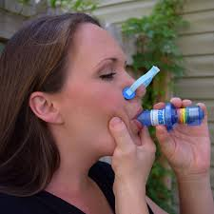
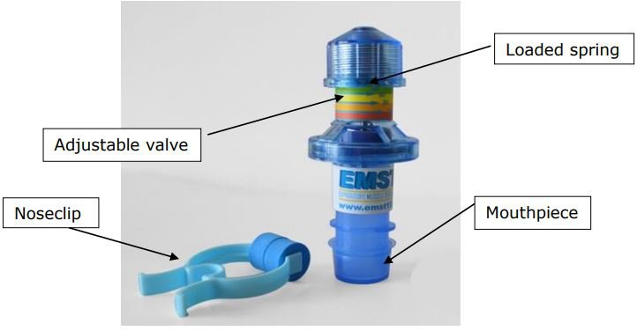
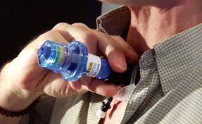

Slide 7
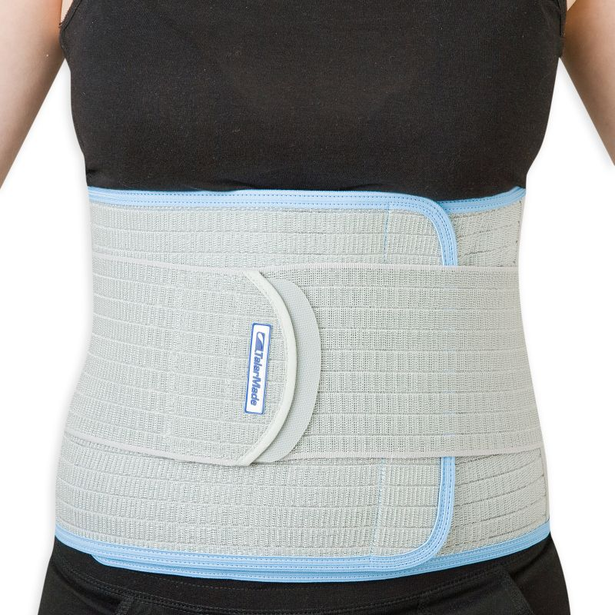
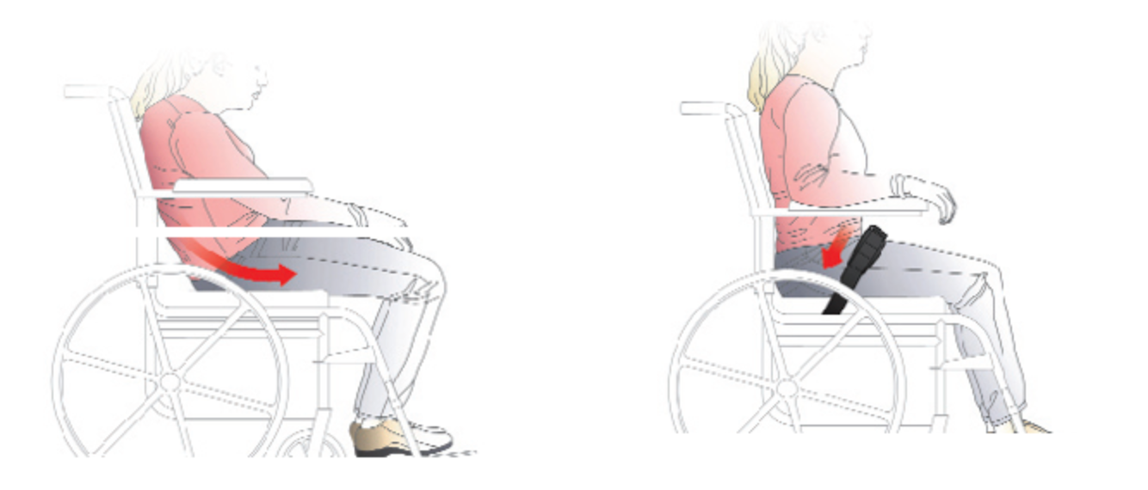
Prosthetic Management
Abdominal trussing (binders or corsets) can enhance posture, support weak abdominal muscles, and improve respiratory support and airflow, especially in people with spinal cord injuries who may have intact diaphragmatic function but weak expiratory muscles.
Medical approval and supervision is important when binding is used, because it can restrict inspiration and increase the risk of pneumonia.
Leaning into a flat surface during expiration or using an expiratory board or paddle mounted on a wheelchair and swung into position at the abdominal level may help increase respiratory force for speech.

Slide 8
Behavioral Management
Some patients simply need to practice inhaling more deeply or using more force when exhaling during speech.
Working to increase inspiratory range can be tied to attempts to sustain isolated sounds for 5 seconds while keeping intensity and quality constant.
Use inspiratory checking, which is the use of inspiratory muscles to “check” or control exhalatory forces to maintain steady subglottal pressure.
“Take a deep breath and let it out slowly when speaking.”
Optimal breath group: the number of syllables that can be produced comfortably on one breath.
Relevant for patients who initiate speech at variably inappropriate points in the speech breathing cycle and thus need to be more consistent in inspiratory control
Contextual speech tasks may include gradually increasing the length of phrases/sentences that can be uttered in a single breath without significant acceleration of rate or decreases in loudness.

Slide 9
A useful task for increasing breath group length and variability is to read paragraphs in which breath groups are marked, with subsequent progression to marked conversational scripts, and eventually to noncued conversation and narrative tasks.
There are two compensatory techniques for speech breathing that can be used by people with flaccid paralysis of the rib cage, diaphragm, and abdomen.
  neck breathing, in which the sternocleidomastoid, scaleni, and trapezius muscles of the neck are used to bring about to-and-fro displacement of the rib cage for inspiration
  glossopharyngeal breathing (or “frog breathing”), is a self-generated, positive-pressure strategy in which the larynx and upper airway structures are used to pump small volumes of air into the lungs in a stepwise fashion

Slide 10
Instrumental Biofeedback
Visual feedback about the movement, excursion, and coordination of the chest wall muscles during speech and nonspeech tasks, with and without simultaneous feedback about the onset, control, and offset of phonation.
Biofeedback about coordination between phonation and chest wall movements
Visual biofeedback about vital capacity

Slide 11
Phonation
Laryngeal Framework and Related Laryngeal Surgeries
Medialization laryngoplasty, or type I thyroplasty involves placing implant material between the thyroid cartilage and inner thyroid perichondrium at the level of the vocal fold on the involved side, in effect displacing the paralyzed fold medially and facilitating vocal fold approximation, particularly anterior approximation, during phonation.
It is a reversible procedure.
Arytenoid adduction surgery, repositions the paralyzed vocal fold by rotating the vocal process of the arytenoid medially.
Surgical anastomosis of the ansa cervicalis nerve (which innervates several infrahyoid muscles) to the recurrent laryngeal nerve to reinnervate a paralyzed vocal fold has resulted in significant voice and glottic closure improvements.

Slide 12
Recurrent laryngeal nerve resection induces unilateral vocal fold paralysis and, in effect, prevents hyperadduction and reduces laryngospasm in adductor SD (ADSD).
Symptoms often recur within 3 years, the procedure has been replaced by botulinum toxin injection.
Selective laryngeal adductor denervation-reinnervation, in which the recurrent laryngeal nerve is denervated bilaterally, with reinnervation of the nerve’s distal portions with branches of the ansa cervicalis nerve.
Thyroplasty procedure (type II) involving midline lateralization of the vocal folds in order to reduce their hyperadduction
Removal (myectomy) of thyroarytenoid and lateral cricoarytenoid muscle fibers and nerve terminals

Slide 13
Injectable Substances for Vocal Fold Paralysis
Placement of material into a paralyzed vocal fold, especially when it has persisted for a year.
Injected into the middle third of the fold
Narrows the glottis, and enhances vocal fold approximation for phonation
Substances currently include collagen, homologous collagen, autologous fat, micronized Alloderm (Cymetra), and calcium hydroxylapatite
Autologous fat, harvested by liposuction from the abdomen, has been used to augment vocal fold function for unilateral vocal fold paralysis.
Reduce aspiration and airflow, improve glottal efficiency, and improve the dysphonia associated with vocal fold paralysis and in some patients with hypophonia associated with PD.

Slide 14
Botulinum Toxin Injection
Unilateral or bilateral injection of botulinum toxin type A (Botox) into the thyroarytenoid muscle
Preferred method for treating neurogenic ADSD
The toxin blocks the release of acetylcholine (ACh) from presynaptic nerve endings, in effect denervating some of the thyroarytenoid muscle fibers
The effect occurs 24 to 72 hours after injection and lasts for about 3 months
Side effects include transient breathiness and mild dysphagia for fluids
Injection of Botox into the posterior cricoarytenoid muscles (and sometimes the thyroarytenoid muscles) can be beneficial for people with ABSD. Effectiveness is generally less than that for ADSD, and airway compromise is a possible side effect

Slide 15
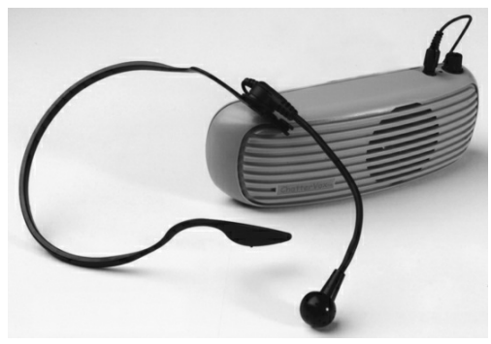
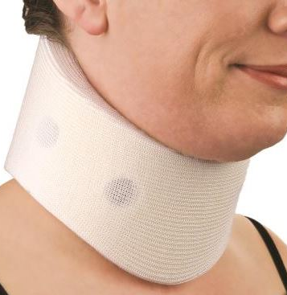
Prosthetic Management
Portable voice amplifier: a speaker is located on the body, chair, or bed or in which the voice is transmitted wirelessly to a distant speaker.
Gains in intelligibility and reduced activity limitation
Improves loudness
Patients who are aphonic, severely breathy, or lack sufficient respiratory support for speech but who have good articulation skills may benefit from the use of an artificial larynx
Patients with movement disorders or significant neck weakness may benefit from neck braces or cervical collars that stabilize the head and neck during speech

Slide 16
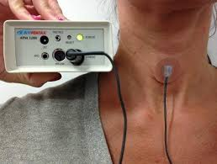
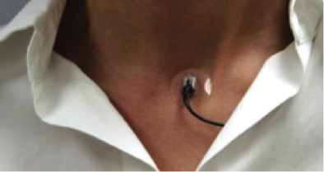
A vocal intensity controller can provide feedback about excessive or inadequate loudness. This can be accomplished with a loudness monitoring device that samples vocal intensity from a throat microphone and provides feedback if intensity is below (or above) a predetermined threshold.
Ambulatory Phonation Monitor, KayPENTAX
Simple feedback device is a sound level meter or the VU meter

Slide 17
Behavioral Management
Effort closure techniques including grunting and controlled coughing, pushing, lifting, pulling, and hard glottal attack; maximize vocal fold adduction & improve vocal fold strength
Learning to initiate phonation at the beginning of exhalation; reduces air wastage and fatigue and possibly increase loudness and phrase length
Turning the head to the left or right when speaking
Lateral digital manipulation of the thyroid cartilage
Behavioral treatment of strained voice quality associated with dysarthria often is not undertaken because it is so difficult to modify and may not contribute greatly to improving intelligibility.
Lee Silverman Voice Treatment (LSVT), involving vigorous vocal exercise for people with PD, is in many respects a voice-strengthening program

Slide 18
Resonance
Excessive nasal airflow can result in air wastage during speech and place sometimes unachievable added demands on respiratory and laryngeal functions; the result can be reduced breath groups and increased pauses for inhalation.
Can reduce loudness, and nasal emission may reduce the perceptual distinctiveness of consonants requiring intraoral pressure.
A crude but often effective way of determining the impact of velopharyngeal inadequacy on speech intelligibility, loudness, phrase length, and articulatory precision is to compare speech with the nares occluded (by fingers or a nose clip) and unoccluded or with the patient in the upright versus supine position (patients with marked palatal weakness may benefit from the effect of gravity on velar position in the supine position). Marked improvement under facilitated conditions may signal the need to focus on velopharyngeal function early in management.

Slide 19
Surgical Management
Superiorly based pharyngeal flap surgery or sphincter pharyngoplasty surgery are the preferred methods for managing velopharyngeal incompetence in people with repaired palatal clefts.
Injectable substances (e.g., hyaluronic acid [Restylane]) placed into the posterior or lateral pharyngeal walls has also been used to manage velopharyngeal inadequacy.
Pharyngeal flaps, pharyngeal implants, and Teflon injection) for velopharyngeal dysfunction in dysarthria

Slide 20
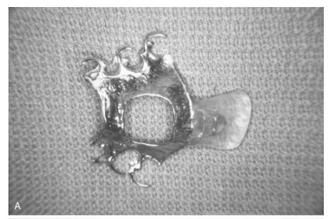
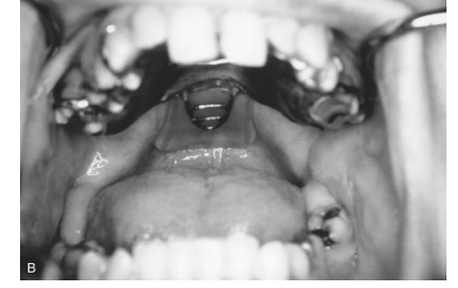
Prosthetic Management
Palatal lift prosthesis is the most frequently studied intervention for managing velopharyngeal dysfunction in dysarthria.
A palatal lift consists of a palatal portion that is attached to the teeth and a lift portion that extends posteriorly to lift the palate in the direction of velopharyngeal closure.

Slide 21
Candidates for palatal lift are those
with significant velopharyngeal weakness, usually associated with flaccid dysarthria, whose deficits at other levels of the speech system are minimal or would be minimized by more adequate velopharyngeal closure;
who have evidence of lateral pharyngeal wall movement during speech;
whose deficits are stable or not rapidly worsening;
who have sufficient supporting dentition;
who do not have significant spasticity or a hyperactive gag reflex;
who are motivated to improve speech and willing to tolerate the time to fit and adapt to the device; and
who are able to insert and remove the lift without assistance.

Slide 22
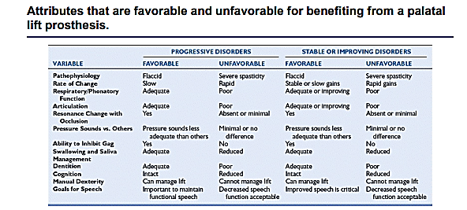
Problems encountered include
  inadequate retention of the lift because of poor dental support;
  hyperactive gag responses that are unresponsive to desensitization or appliance modification;
  a spastic or stiff palate that does not tolerate the lift; and
  lack of cooperation, lack of acceptance, or unrealistic expectation

Slide 23
The effectiveness of palatal lift prostheses, as reflected in increased intelligibility, decreased hypernasality, and improved articulation.
“Minor” prosthetic devices like wearing a nose clip (or simply manually occluding the nares during speech); although this may not be done on a constant basis, it can improve intelligibility when a statement has not been understood.
Nasal obturator or one-way nasal speaking valve that can be inserted into the nostrils for the purpose of occluding nasal airflow during speech.

Slide 24
Behavioral Management
It is generally felt that dysarthric people with severe and chronic velopharyngeal impairment do not benefit from behavioral intervention.
1. Modifying the pattern of speaking
Increase effort, reduce rate, or overarticulate; “speak more precisely.”
Exaggerated jaw movement to increase oral opening during speech; increasing loudness; and reducing the duration of stops, fricatives, and affricates to reduce demands for sustained intraoral pressure. Speaking in the supine position may facilitate velopharyngeal closure
2. Resistance training during speech.
Continuous positive airway pressure (CPAP), frequently used for people with obstructive sleep apnea, delivers positive airflow into the nasal cavities through a hose and nasal mask assembly
Involves challenging the velopharyngeal muscles during speech to overcome positive airway pressure to achieve velopharyngeal closure.

Slide 25
3. Feedback
Some speakers benefit from feedback from a mirror, nasal-flow transducer, nasoendoscope, or other simple or sophisticated devices that provide feedback during efforts to decrease hypernasality and nasal airflow during speech.
4. Techniques focused on nonspeech velopharyngeal movement
Nonspeech activities to improve speech are generally not beneficial
Existing evidence and expert opinion suggest that pushing exercise, nonspeech strengthening exercise (e.g., blowing, sucking), tasks to control and modify the breath stream (e.g., blowing bubbles, cotton balls, whistles), and inhibition or facilitation techniques (e.g., icing, stroking, brushing, pressure to muscle insertion points) are not effective for improving velopharyngeal function for speech.

Slide 26
Articulation
Historically been viewed as a major part of dysarthria treatment for many patients
It could be treated by focusing on other functions such as improving when the respiratory support or loudness/ prosodic enhancement.

Slide 27
Behavioral Management
Strength training The use of strength training to improve articulation is controversial due to limited efficacy data.
Two methods are commonly used.
Moving the articulators against the resistance is the most common method (e.g.,The jaw can be opened, closed, lateralized, and pushed forward against resistance)
Patients with marked weakness or limited movement may simply be asked to perform nonspeech movements without external resistance.
Nonspeech strengthening exercises for the articulators are probably appropriate for only a small percentage of dysarthric people. Rationale against its use
Low levels of force are used for speech: Tongue and lips use only 10% to 30% of their maximum forces for speech, and the jaw only 2%.
High intensity exercises to be limited on certain population (e.g., ALS) • Strength and articulatory rate not correlated (e.g., ALS) . Rationale for its use:
To improve endurance or speed of movement.
Speed training aimed at increasing the speed at which articulatory force can be Produced
Power can be increased by increasing rate without increasing force (supported by “fitness training” for the limbs in people with upper motor neuron and lower motor neuron diseases and extrapyramidal Diseases)

Slide 28
Stretching
Reduces stretch reflex and motion sensitive increases spasticity in limb muscles. Hence, limb motor literature have used slow, steady, continuous, prolonged, and directional, with avoidance of sudden changes in force or direction of stretches.
It is thought reduce muscle contractions and improve range of motion, particularly for limb muscles.
There is neither positive nor negative evidence regarding the effect of stretching exercise on speech muscles.
Because the lips and tongue do not exhibit the typical pattern of stretch reflexes, however, stretching them for the purpose of reducing spasticity may not be beneficial.

Slide 29
Relaxation
Some clinicians suggest that relaxation exercises may improve muscle tone in patients with spasticity or rigidity.
Focus on speech movements rather than relaxation of speech structures seems most appropriate for most patients

Slide 30
Instrumental biofeedback
Electropalatography has shown to improve intelligibility (tongue movement accuracy improved)
EMG biofeedback: reduced hemifacial spasm, tension and restored voluntary mandibular control in few spastic cases, reduction of drooling and improved intelligibility
Augmented visual feedback (AVF): using kinematic sensor to guide the tongue movement- Tongue movement amplitudes increased in PD patients and their tongue articulatory working space with no generalization or enhanced intelligibility. Research is worthy to explore more on this area.

Slide 31
Traditional Approaches
These include
integral stimulation (watch and listen imitation tasks);
phonetic placement (e.g., hands-on assistance in attaining targets and movements, pictured illustrations of articulatory targets); and
phonetic derivation (using an intact nonspeech gesture to establish a target, such as blowing to facilitate production of /u/). Work on minimal pair contrasts to increase the control over ‘consonant’ articulation.

Slide 32
Clear speech
Here articulatory movements are exaggerated to improve articulatory precision. Instructions could vary “speak clearly”, “use big speech movements”, “slow down”, “overenunciate”, “exaggerate movements of your mouth”, “speak as if you are in a noisy environment”, “speak as if your listener is hearing impaired”.

Slide 33
Intelligibility drills
This can be useful during work on articulation, rate, and prosody. They involve referential tasks in which the clinician-listener is naïve to the target produced by the patient. Stimuli can be randomized word lists, sentences, pictures to describe, and so on. The listener’s task is to tell the speaker what they heard. These drills are useful because they (1) promote discovery learning (the patient does not receive instruction but rather discovers how to make speech intelligible); and (2) focus on the primary goal, which is improved intelligibility

Slide 34
Medical Management
Botox injection, in addition to its use in treating SD, also can effectively treat spasmodic torticollis, oral mandibular dystonia, lingual protrusion dystonia, and jaw tremor. Oromandibular tremor or dystonia who have had injections into the genioglossus, styloglossus, pterygoid, masseter, temporalis, digastric, or risorius muscles;
Results of acoustic analyses: enhanced word and sentence duration, reduction of inappropriate silences, and reduction of tremor amplitude.

Slide 35
Prosthetic Management
A bite block is a small piece of material that is custom-fitted to be held between the lateral upper and lower teeth. A bite block may help patients with jaw opening dystonia by helping them to inhibit jaw opening by clenching the teeth or biting on an object during speech.
Contraindicated for flaccid dysarthria: As jaw movement may be necessary to compensate for weakness in other articulators. Could be used to promote independent movement of tongue and lips thereby reducing jaw compensation.

Slide 36
Speaking Rate
Rate may be the most powerful, behaviorally modifiable variable for improving intelligibility.
Why rate reduction? facilitates articulatory precision and intelligibility by allowing time for a full range of movement (i.e., it reduces articulatory undershooting), increased time for coordination, and improved linguistic phrasing, reduces spatiotemporal variability of speech movements in dysarthric speakers
Benefits: Most dysarthrias-spastic, ataxic, and hypokinetic dysarthria
Demerits: Perceptual integrity of consonants and vowels can deteriorate at extremely slow rates (e.g., mild ALS cases)

Slide 37
Non prosthetic rate reduction strategies
1. Hand or finger tapping in pace with syllable production. Careful on few dysarthrics such as parkinsonian patients who accelerate their hand tapping, and ataxic patients who may have uncoordinated tapping.
2. Rhythmic cueing, in which the clinician points to words in a written passage in a rhythmic fashion, giving more time to prominent words and pauses at syntactic boundaries. Computerized rate pacing has been shown to slow rate in dysarthric speakers.
3. Visual feedback from a screen display to pace rate. For example, reduced rate and increased intelligibility were achieved by an ataxic speaker who was asked to speak at a rate that would “fill the [oscilloscopic] screen” during reading tasks 5. “Backdoor” approaches: Activities such as increase loudness, alter pitch variability, alter word and sentence stress patterns, or alter phrasing or breath patterning.

Slide 38
Prosthetic based rate reduction strategies
Delayed auditory feedback (DAF)
is among the most useful prosthetic devices for reducing rapid rate in well-selected patients (mostly with hypokinetic dysarthria).
Used when other traditional methods fail. Effective delays generally range from 50 to 150 ms. Expected effects: slow speech rate and presumably increase articulation time and accuracy.
Reported effects: Marked reductions in speech rate, increased loudness, reduced phonetic errors, increased acoustic distinctiveness, increased amplitude of lip and jaw movements, and improved intelligibility; several reported cases have maintained functional and social benefits outside the clinical setting
Drawbacks: 1. Disrupt naturalness, is cosmetically unacceptable to some speakers, 2. Adaptation to its effects can occur. 3. Not effective in short conversations

Slide 39
Pacing devices
Patient to point sequentially to each slot on a board as each word or syllable is produced. This promotes rate reduction and a syllable-by-syllable approach to speaking.
Effective and evidence observed in PD, spastic-ataxic and TBI patients. 1. Alphabet supplementation can be used as an acute or chronic aid to control speaking rate. Speaker to point to the first letter of each spoken word on an alphabet board. User should have adequate cognitive, pragmatic and the motor ability to generate the cues
Advantages: 1. Increased intelligibility (from about 5% to 80%) over non supplemented speech, up to and faster rate of communication (than when the entire word is spelled out)
Disadvantages include slowed rate, reduced eye contact, reduced naturalness (e.g., disrupted breath groups), and possible eventual adaptation to the technique.

Slide 40
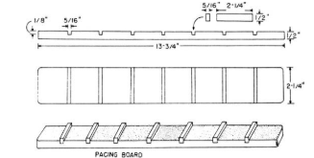
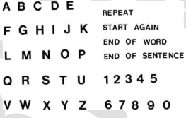

Slide 41
Prosody
Work on prosody can be appropriate at all severity levels (mild to severe) with potential benefits to intelligibility when impairment is severe∗ and benefits to naturalness when impairment is mild.
Working on prosody (stress) could also reduce speaking rate.
Teaching stress should be an early part of treatment Naturalness reflects the overall adequacy of prosody. Compromised Prosody: monotonous voice; inhalation does not occur at natural syntactic boundaries.
Pitch, loudness, and durational characteristics should be natural to signal the prosodic variations. Strategies to enhance prosody 1. Enhancing the breath group:
“Number of words spoken in one inhalation” -breath group • Breath group is the basic unit of prosody

Slide 42
Normals Vs Dysarthrics: Normals generally inhale during syntactic boundaries; Dysarthrics pause more frequently and inhale more frequently (95 % Vs 65% during pausing); Dysarthrics have short breath group and pausing/inhaling is less associated with syntactic boundaries Strategies • Improve speech breathing and phonatory control to extend the breath groups
Increase the frequency of pauses without inhaling in between.
Provide sentences and paragraphs where pausing and inhalations are marked; gradually fade the written cues.
Enhance Greater variability in words per breath group (reduces the perception of monotony). 2. Chunking Utterances Train to chunk utterances into natural syntactic units, within the limits of their physiologic capacity. If a person with dysarthric is capable of producing four to five words per breath group may learn to use pauses at logical syntactic boundaries within the limited breath group. 3. Contrastive stress tasks: Write the explanations given in the AOS treatment 4. Referential tasks

Slide 43
Patient reads randomized phrases or sentences containing prespecified stress targets that are unknown to a listener, • Client will learn (‘discovery learning’) ways to signal stress by himself (alter either pitch, duration or loudness)
Listener is made to identify the words which are stressed and also rates the specch production on an intelligibility scale. That is, if the listener can identify the targeted stressed word, the speaker has succeeded.
One of the easiest ways to evaluate the effectiveness of actively taught stress strategies.

Slide 44


