Slide 1
Bone CONDUCTION IMPLANTABLE DEVICES
Faculty:
Mr. Sanket Bhalerao
Assistant Professor
DASLP, SVDU

Slide 2
INTRODUCTION
Bone-conduction Implants are semi-implantable devices for the treatment of hearing losses in patients who either cannot wear or underperform with conventional hearing aids.
These devices must be surgically implanted, based on the principle of osseointegration, and work by enhancing natural bone conduction.
Since their first introduction in 1977, even the surgical technique has undergone several modifications.

Slide 3
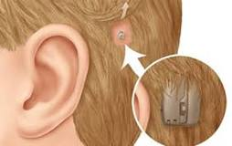
The Bone Anchored Hearing Aid (BAHA) is a surgically implanted device designed to help people with hearing loss.
Most of the conventional hearing aids transmit sound through the medium of air conduction. BAHA stimulates the cochlea by transmitting the sound waves through the bones in our skull, or bone conduction, thereby bypassing the outer and middle ear.
Once the cochlea receives the sound signals, the information is converted in to neural signals and transferred to the brain, where it is perceived as sound.

Slide 4
NEED

Slide 5
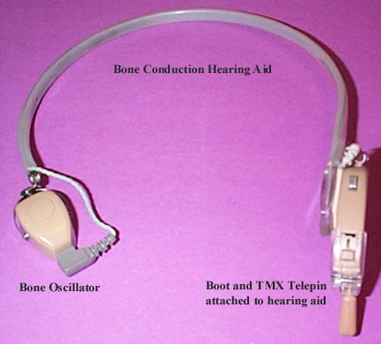
Hearing aids can be divided into two groups
Air Conduction (AC) hearing aids
Bone conduction (BC) hearing aids
BC hearing aids are useful to a relatively small population of hearing impaired people, but nevertheless for this group often are the only satisfactory solution.
The conventional bone conduction hearing aids use a steel spring headband to apply a vibration transducer against the skull to vibrate it.
They are not in common use because of several drawbacks.

Slide 6
 | BONE CONDUCTION HEARING AIDS | BONE ANCHORED HEARING AIDS
1. | There is pressure against the skin and the skull with a BC hearing aids | No such pressure present.
2. | Damping of signal present due to presence of skin, which affects the sound quality | better sound quality with a bone-anchored hearing, as there is no damping of the signal via the skin.
3. | This might cause embarassement as it can be seen and is worn as a steel headband. | Bone-anchored system is much more discreet.
4. | Not comfortable | It is more comfortable.
5. | Not so advanced technology used. | Today’s bone-anchored systems utilize the same advanced technology that is found in a premium hearing instrument. Eg: wireless accessories, directional microphones.

Slide 7
Conductive hearing loss is a common type of hearing loss which is not always amenable for surgical correction.
Those patients are usually fitted with either conventional air or sometimes bone conduction hearing aids.
However, difficulties arise when hearing loss is further complicated by chronic suppurative otitis media and/or otitis externa. In these situations, an ear mould is difficult or impossible to use.

Slide 8
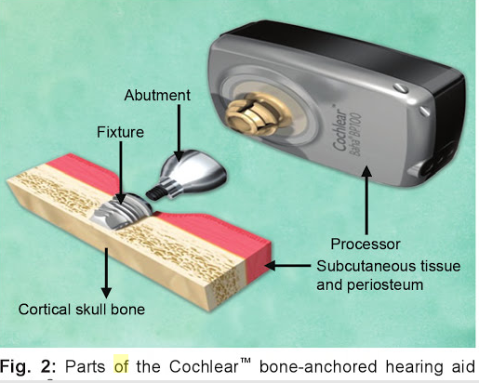
COMPONENTS
BAHA has 3 components. They are:
1. The sound processor: A detachable electronic hearing aid with a snap-fit coupling to the abutment. The user takes the sound processor on and off as required, for example for hair washing or swimming.

Slide 9
2. The abutment: A socket attached by an internal screw to the fixture.
The abutment penetrates the surface of the scalp and is shaped to hold the snap-fit coupling of the sound processor.
The abutment can be unscrewed from the fixture for maintenance or replacement by the specialist audiologist.

Slide 10
3. The fixture (or implant): A small titanium screw, four millimetres long, implanted into the bone behind the ear.
The fixture is permanent, it is not adjusted or removed.
The metal becomes firmly anchored to living bone by the process of osseointegration.

Slide 11
HOW DOES BAHA WORK
The principle for bone conduction hearing aids comes from the basis that when a sound source is placed directly on the bones of the skull, sound will travel through the skull using the bone itself as a medium, where it in turn causes fluids of the inner ear to move, leading to production of neural impulses and sound perception.
BAHA system works by taking the sound from the outside and transmitting it to the inner ear through the bone. This bypasses the ear canal and the middle ear.

Slide 12
In BAHA the titanium implant is placed during a short surgical procedure and over time osseointegrates with the skull bone.
For hearing, the sound processor transmits sound vibrations through the external abutment to the titanium implant.
The vibrating implant sets up vibrations within the skull and inner ear that finally stimulate the nerve fibres of the inner ear, allowing hearing.

Slide 13
baha video
https://youtu.be/RQrqhY3cLK0

Slide 14
Video osseointegration
https://youtu.be/kGOkIWooUc4

Slide 15
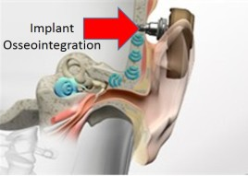
OSSEOINTEGRATION
Branemark defined osseointegration as a direct structural and functional connection between ordered living bone and the surface of a load-carrying implant.
Most materials fail to osseointegrate, and, instead, a foreign body reaction leads to formation of a fibrous capsule around the material. Titanium has proven to be the material of choice for osseointegration. Osseointegration is reliably achieved in the Baha system using commercially pure titanium (99.75 %), which is machined, then covered with an extremely biocompatible thin oxide layer.

Slide 16
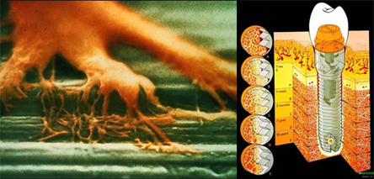
Osseointegration is dynamic process that develops gradually over 6-12 weeks following fixture implantation.
Many factors influence successful osseointegration, including
the material,
the macrostructure and microstructure of the implant,
the quality of bone at the site of implantation, and
surgical factors.

Slide 17
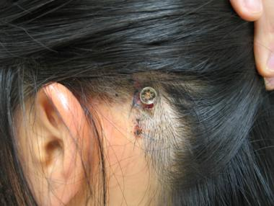
The implant must remain completely immobile during the initial period of osseointegration.
This is critical; otherwise, osseointegration fails, with the formation of a fibrous capsule around the implant instead of new bone formation. The initial stability of the implant is mechanically achieved via the use of a screw-shape implant that is secured to bone with precise torque parameters.

Slide 18
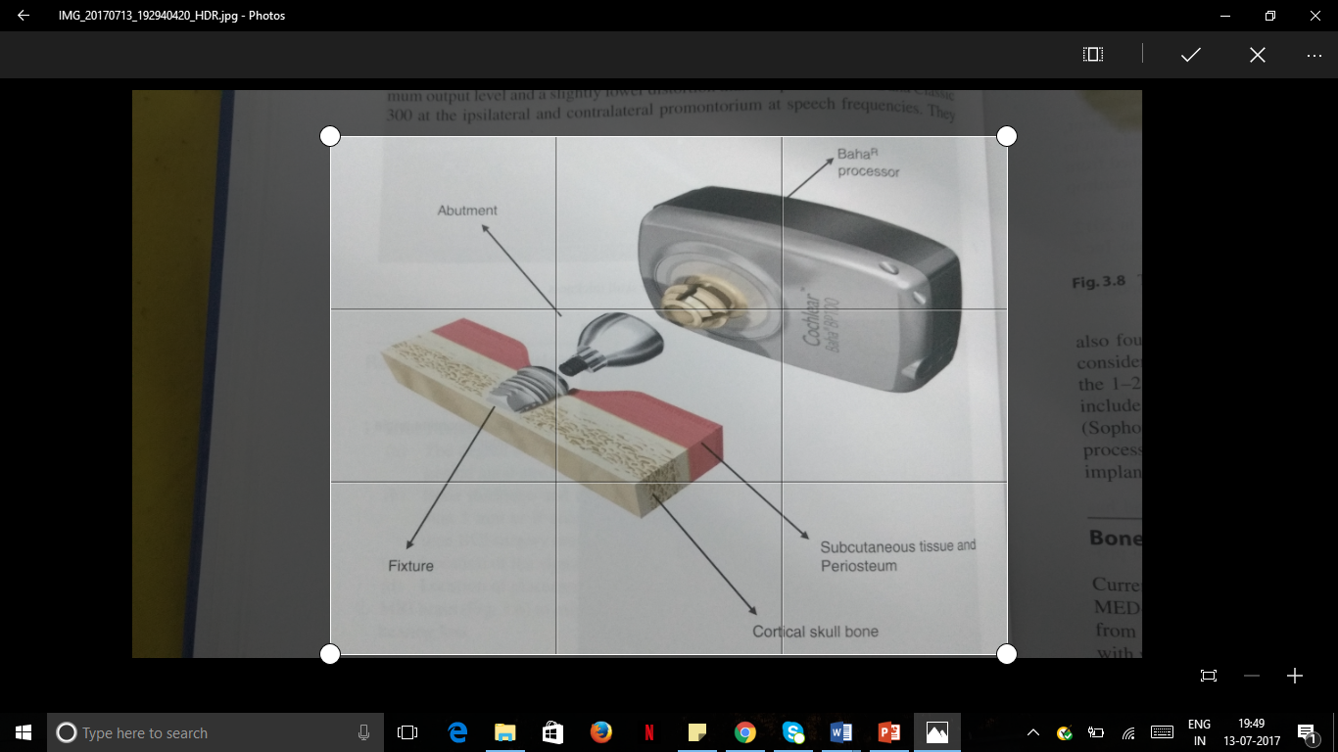
TYPES
1. Percutaneous: -
The BCI uses a percutaneous and bone anchored implant.
The percutaneous implant protrudes out of the skin and therefore, there is high risk of granulations and peri- implant infection. Additionally, the processor cannot be loaded until the fixture implant is osseointegrated.
Examples of currently available percutaneous devices are: Baha Classic 300 and Ponto and Ponto Plus.

Slide 19
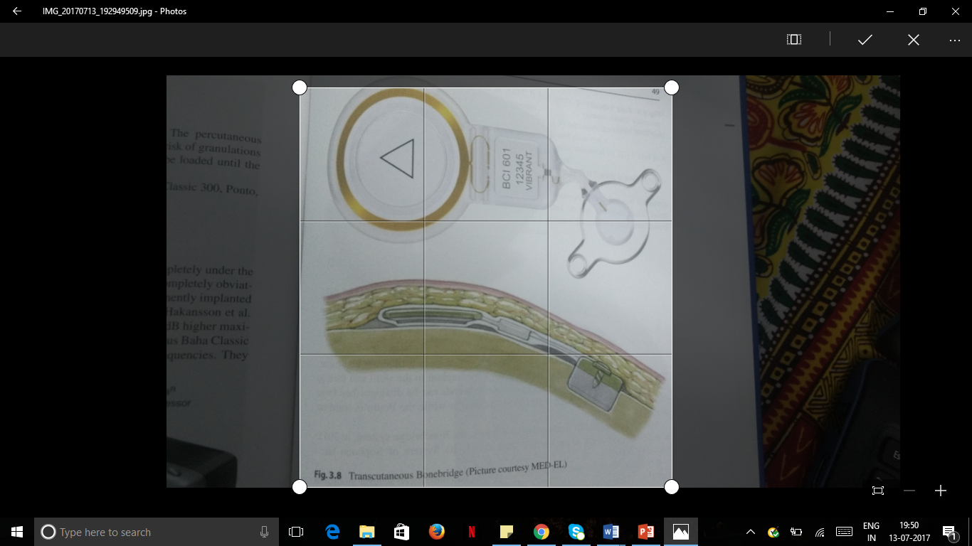
2. Transcutaneous: -
Here, the device lies completely under the skin, leaving the skin intact. So, the implant site closes and heals completely obviating the need for an abutment.
It transmits the signal to a permanently implanted transducer with an induction loop system through the intact skin.

Slide 20
CANDIDACY
The BAHA is used to rehabilitate people with conductive and mixed hearing impairment.
This includes people with:-
chronic infection of the ear canal,
absence of or a very narrow ear canal as a result of a congenital ear malformation, infection, or surgery, or
a single sided hearing loss as a result of surgery for a vestibular schwannoma.

Slide 21
Conductive hearing loss:
BAHA is frequently the ideal choice for conductive hearing loss.
Because conductive loss is often concomitant with various outer and middle ear abnormalities (e.g. atresia) or middle ear pathologies like continuously draining ear that prelude the wearing of conventional hearing aids. In cases, wherein the ear discharge fails to respond to treatment or recurs with the use of conventional hearing aid, BCI could be an option for rehabilitation.
Conventional hearing aids can aggrevate the ear discharge by obstruction of the canal and the resulting execessive humidity and lack of drainage. With BAHA, the conductive element of the hearing loss is bypassed by sending sound vibrations directly from the BAHA through the skull to the cochlea. BAHA often provides benefits over conventional hearing aids in large conductive losses due to their technical limitations of insufficient gain, saturation, feedback and necessity of wearing a tight ear mould.

Slide 22
Studies suggest that candidates with an air-bone gap of more than 30 dB (PTA) will experience significant advantages from the Baha System, compared to using an air conduction (AC) hearing aid.

Slide 23
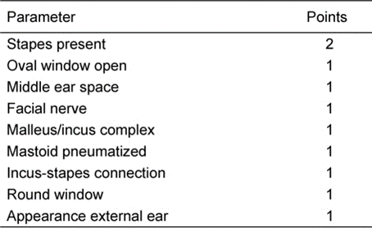
BAHA could be offered to patients with Jahrsdoerfer atresia scores less than 6, chronic ear discharge and otosclerosis.
In congenital aural atresia, surgery is performed to restore conducting mechanism of the ear. However, not all patients are candidates for surgery.
The Jahrsdoerfer grading scale, proposed in 1992 assigns anatomical score for atretic ear. The higher the score the better chance for normal or near normal hearing post implantation
JAHRDOERFER GRADING SCALE

Slide 24
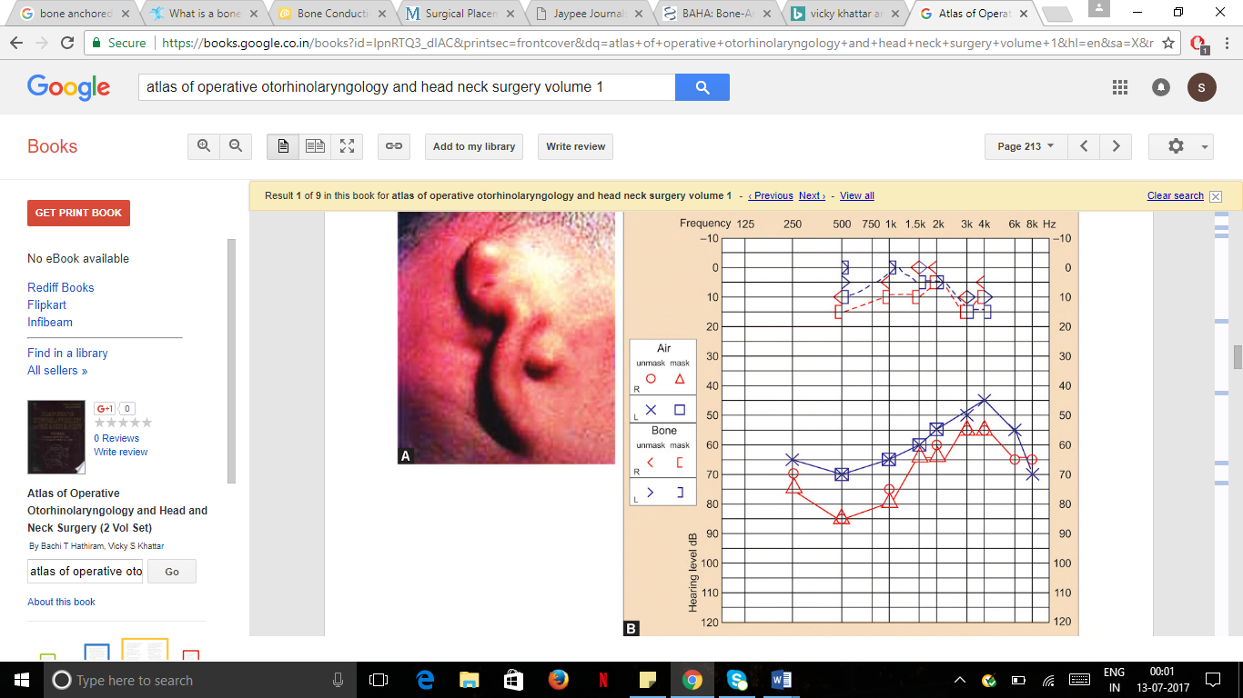

Slide 25
Mixed hearing loss:
BAHA provides two-fold solution to all such patients:
1. It closes the air-bone gap by bypassing the conductive element.
2. It compensates for the remaining degree of sensorineural hearing loss.
The overall amplification required for people with mixed hearing loss is less with BAHA than conventional hearing aids and it is recommended when conductive component of the mixed hearing loss is greater than 30dB.

Slide 26
For mixed hearing loss:
Degree of conductive hearing loss - the air-bone gap is a good indicator of suitability for a Baha System. The greater the air-bone gap, the more the candidate will benefit from implantable bone conduction system. Studies suggest that candidates with an air-bone gap of more than 30-35 dB (PTA) derive greater benefit from a Baha System than a hearing aid.
Extent of the sensorineural hearing loss – those with a mild-to-moderate sensorineural component in their hearing loss are suitable Baha candidates.. The most powerful Baha sound processor can compensate for a sensorineural element of up to 65 dB HL (measured at 0.5, 1, 2 and 3 kHz).

Slide 27
Single-sided sensorineural deafness (SSD):
SSD causes significant communication difficulties for the patient due to inability to localize sound, more so when noise is directed towards the good ear and the talker is near the deaf ear.
BAHA is worn on the deaf side and transfers the signal directly across the skull via bone conduction thus eliminating the head shadow effect.
But these patients must have normal hearing in the contra-lateral ear (20 dB HL air conduction pure tone averages). BAHA provides better directional 360-degree hearing in these patients. Studies have shown that patients with BAHA have better speech understanding than those with Contralateral Routing of Signal (CROS) hearing aids.

Slide 28
The level of hearing in the good ear should be assessed. Candidates with normal hearing in their good ear will benefit from a Baha. In cases where there is a more pronounced hearing loss in the good ear, a bone conduction implant may not be the best solution.

Slide 29
Contraindications:
• Physical and mental fitness of the patient. Ill health can cause considerable risk by application of anesthesia.
• Patients vulnerable to increased risk of infection.
• Patients having allergic reaction to the implant.
• Rejection of the device due to subjective factors like cosmetic appeal.
• Obliteration of the cochlea, auditory nerve, auditory cortex. This can be revealed by CT Scan, MRI etc. MRI is a better technique for finding ossified cochlea, nerve hypoplasia and CNS anomalies.
• Poor hygiene. Presence of any disease affecting the skin of the scalp is required for assessing a patient for BAHA device.
• If sufficient bone volume and bone density and quality is not present for the successful anchoring of the BAHA abutment within a patient’s skull.
The osseointegrated auditory implant (BAHA) is a system used for hearing rehabilitation through direct bone conduction. As such , the BAHA is an alternative to traditional bone, air conduction and contralateral routing of offside signal. (CROS) hearing devices.

Slide 30
COMPLICATIONS
Intraoperative
Intraoperative bleeding
cortical bone thickness
Perioperative
Infection
Bone overgrowth
Dural injury and CSF leak
Failure of osseointegration

Slide 31
complications
Intraoperative-
Ideally, surgery in children with cortical bone thickness less than 3 mm should be delayed until age of 4 or 5 years. These children can be provided rehabilitation with the processor worn on a soft band around their head.

Slide 32
PERIOPERATIVE
Infection: Local wound inflammation around the abutment is commonly classified according to the clinical scoring system of Holger’s and colleagues, as follows:
Grade 0: No irritation;
Grade 1: Slight redness;
Grade 2: Red and moist;
Grade 3: Same as 2, but also with granulation tissue formed;
Grade 4: Skin irritation of such a degree that the abutment must be removed.

Slide 33
Treatment of the skin reaction may vary, depending on its grade.
For Grade 1 reactions, local antibiotic ointment is recommended.
Reapplying the healing cap, and wrapping the area with antibiotic gauze for a period may treat Grade 2 reactions.
Grade 3 and4 reactions require revision surgery.
Inflammation around the abutment is, in general, more common in children than in adults. Persistent, chronic infections around the implant may be due to Staphylococcus aureus. More severe infections can also occur, ranging from osteomyelitis with loss of the fixture, to intracerebral abscess.

Slide 34
2. Failure of osseointegration: Symptoms and signs of osseointegration failure can vary.
In the most severe situation, the abutment-fixture complex may be so loose that it falls out.
At other times, a fibrous attachment is present; the fixture remains in place but the patient experiences little or no sound, or complains of sound distortion when the sound processor is fitted.
Several factors like age & craniofacial anatomy must be considered for adequate osseointegration. Proper surgical technique at the initial surgery is paramount. The thickness of the bone is also important. Patients with craniofacial syndromes often have thin bone in the area of planned implantation.
One reason for implant losses without any known trauma is idiopathic bone resorption at the bone metal interface.

Slide 35
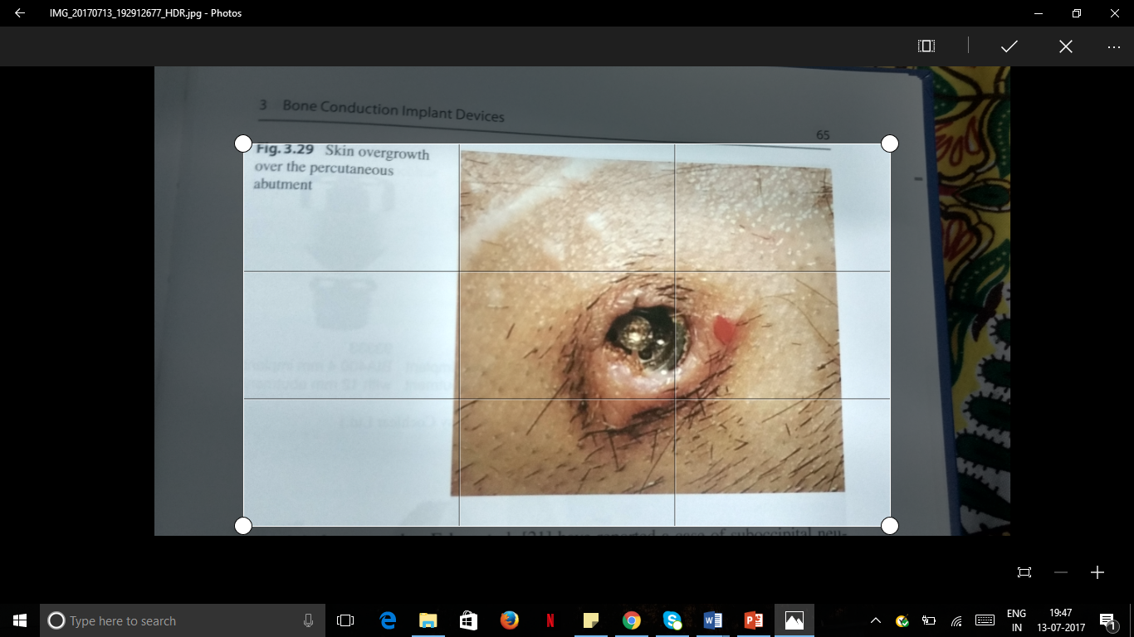
3. Bone overgrowth: The possibility of bone overgrowth should be considered when a loose abutment cannot be tightened. Bone overgrowth is found exclusively in children, especially between the ages of 5 and 11. Bone growth during this time period is significant, with the growth of the temporal and parietal bones being appositional.

Slide 36
REFERENCES
Cass, S. P., Meyers, A. D. (2016). Surgical Placement of Bone-Anchored Hearing Systems
Hagr, A. (2007). BAHA: Bone-Anchored Hearing Aid. International Journal of Health Sciences, 1 (2), 265-276
Hathiram, B. T. & Khattar, V. S. (2013). Atlas of Operative Otorhinolaryngology and Head and Neck Surgery (2 Vol Set). New Delhi: Jaypee Brothers Medical Publications.
Manenkar, G., Chitranshi, P. B., Kirtane, M. V. (2010). Hearing with Bone Anchored Hearing Aid (BAHA). Otorhinolaryngology Clinics: An International Journal, 2, 125-131.
http://www.cochlear.com/wps/wcm/connect/au/home/discover/baha-bone-conduction-implants
http://www.sophono.com
http://www.oticon.com
Lustig, L. R., Arts, H. A., Brackmann, D. E. Francis, H. F., Molony, T., Megerian, C. A., Moore, G. F., Moore, K. M., Morrow, T., Potsic, W., Rubenstein, J. T., Srireddy, S., Syms, C. A., Takahashi, G., Vernick, D., Wackym, P. A., Niparko, J. K. (2001). Hearing Rehabilitation Using the BAHA Bone-Anchored Hearing Aid: Results in 40 Patients. Journal of Otology and Neurology, 22(3), 328-334.

Slide 37
Macnamara, M., Phillips, D., Proops, D. W. (2007). The bone anchored hearing aid (BAHA) in chronic suppurative otitis media (CSOM). The Journal of Otology and Neurology, 110(21). https://doi.org/10.1017/S0022215100136254
Kitty T.M., Snik, F.M., Cor W.R.J. (1998). Audiometric results of bilateral bone-anchored hearing aid application in patients with bilateral congenital aural atresia. The Laryngoscope 108 (4), 548-553. 10.1097/00005537-199804000-00016.
Jovankovičováa, A., Staníkb, R., Kunzoa, S., Majákováa, L., Profantc, M. (2015). Surgery or implantable hearing devices in children with congenital aural atresia: 25 years of our experience congenital aural atresia. International Journal of Pediatric Otorhinolaryngology, 79(7), 975-979. https://doi.org/10.1016/j.ijporl.2015.03.031
Gerdes, T., Benedikt, S. R., Burkard, S., Thomas, L., Hannes, M. (2016). Comparison of Audiological Results Between a Transcutaneous and a Percutaneous Bone Conduction Instrument in Conductive Hearing Loss. Journal of Otology and Neurotology 37(6), 685-691. doi: 10.1097/MAO.0000000000001010.
Niparko, J. K., Cox, K. M., Lustig, L. R. (2003). Comparison of the Bone Anchored Hearing Aid Implantable Hearing Device with Contralateral Routing of Offside Signal Amplification in the Rehabilitation of Unilateral Deafness. Journal of Otology and Neurotology, 24(1), 73-78.

Slide 38
http://www.cochlear.com/wps/wcm/connect/intl/home/discover/baha-bone-conduction-implants/baha-5-sound-processor
http://www.audiologyonline.com/articles/evaluating-oticon-medical-ponto-plus-12616
https://www.medgadget.com/2013/12/oticon-medicals-new-ponto-plus.html
https://www.oticonmedical.com
http://connections.cochlearamericas.com/know-the-difference-baha-attract-vs-baha-connect/
http://www.medel.com/int/bci-the-implant

Slide 39
THANK YOU

