Slide 1
Augmentative and Alternative Communication (AAC) Program
Faculty:
Ms. Sheena
Assistant Professor
Dept. of Audiology and Speech Language Pathology,
SVDU

Slide 2
Topics of discussion
What is Augmentative and Alternative Communication (AAC)?
Who requires AAC to access the curriculum?
Types of AAC
How to access AAC
Communication functions for curriculum access
How to request an assessment

Slide 3
Speech and Language Program
School language and speech therapy supports the educational program of students who have a communication disorder that adversely affect their educational performance.

Slide 4
Language and Speech includes
Articulation/Phonology
Language
Fluency (Stuttering)
Voice

Slide 5
Augmentative and Alternative Communication
(Lewis, 1993)
AAC: A set of approaches that is used to improve the communication skills of a person who does not speak or whose speech is not intelligible.
Augmentative Communication Approaches are used to supplement, enhance or support the communication processes for persons who have some speaking skills.
Alternative Approaches replace speech as a means of communication.
Notes:
". As this definition states communication encompasses more than just spoken words it includes gestures, eye gaze, touch, body postures/movements, sign language, photographs, printed words, objects, picto ideographs, and Braille. Aid Refers to "a physical object or device used to transmit or receive messages (e.g. communication book, board, chart, mechanical or electronic device, computer)" (ASHA, 1991, p. 10).

Slide 6
What is AAC?
“The supplementation or replacement of natural speech and/or writing with a variety of symbols, strategies, and techniques” (Lloyd, Fuller & Arvidson, 1997).

Slide 7
Who is AAC for?
Students with complex communication needs who are/have:
  Physically involved but cognitively able
  Multiply involved with unknown cognitive abilities
  Physically able but motor speech or language delayed
  Pre-verbal or emergent-verbal
  On the autism spectrum
  Developmentally delayed
  Exhibiting behavior disorders related to inability to communicate effectively
  Severe speech sound production difficulties
AND who have difficulty accessing their curriculum in the absence of AAC support

Slide 8
AAC Terms
Aided - A term used to refer to communication symbols, strategies, or techniques that use something external to the body to represent, select, or transmit messages.
Aided Communication - Communication that uses aided symbols and some type of external aid or assistive communication device.
Alternative Input Devices - Devices that enable access to technology through alternatives to direct selection ( single or multiple switches, expanded keyboards).

Slide 9
AAC Terms
Assistive Technology (ATTO) - Any specialized device or service used by individuals with disabilities to increase their ability to participate in tasks of learning and daily living to function as independently as possible.
Dedicated Communication Device - A device specifically designed to be used for communication but that may also interface to a computer, printer, and an environmental control unit.
Non-dedicated AAC Systems - Devices not specifically designed for communication that can be adapted to function as AAC devices (computers).

Slide 10
AAC Terms
Nonoral (nonvocal) - Literally, without speech, voice, or oral production.
Nonverbal - Without language.
Speech Generating Device (SGD) is a term used by Medicare to identify a range of voice output AAC systems.
Spontaneous Novel Utterance Generation (SNUG) is based on access to individual words, collocations, and commonly used phrases of our language

Slide 11
AAC Terms
Unaided communication - communication using unaided symbols and only parts of the body without any aids or devices (e.g. , facial expression, gesture, manual sign, natural speech).
Voice Output Communication Aid (VOCA) - An assistive communication device that features electronically produced voice/speech.

Slide 12

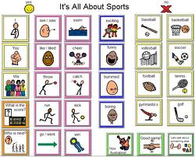
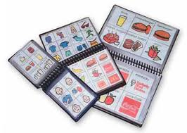

Types of AAC: No-Tech
Any AAC system that does not require a power source

Slide 13
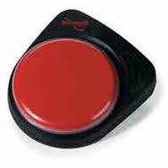
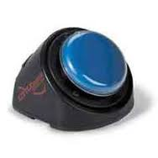
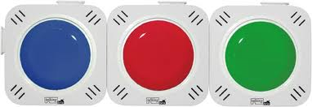
Types of AAC: Low-Tech
Requires a source of power; often used to encourage early communication skills

Slide 14

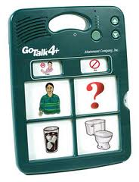
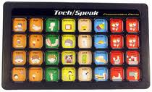
Types of AAC: Mid-Tech
Requires a source of power; has more vocabulary than low-tech systems

Slide 15
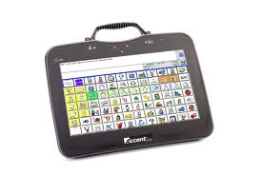
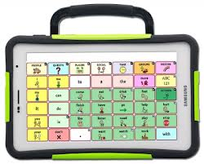
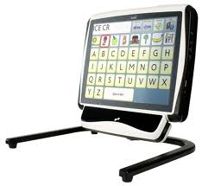
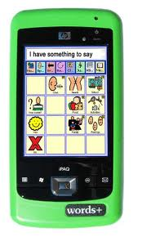
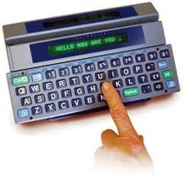
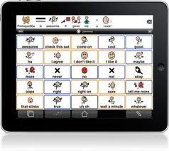
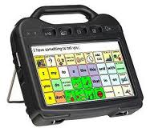
Types of AAC: High-Tech
Electronic devices that permit the storage and retrieval of messages.

Slide 16
AAC: Access
Direct selection
  Pointing with physical contact
    Finger
    Stylus
    Mouth stick
  Pointing without physical contact
    Eye gaze
    Light pointer
    Head mouse
  Symbol pickup and exchange
Indirect selection
  Scanning with single or dual switches
  Directed scanning
    joystick

Slide 17
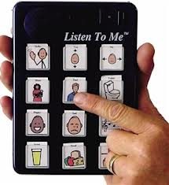
AAC: Access
Direct selection
  Pointing with physical contact
    Finger
    Stylus
    Mouthstick
  Pointing without physical contact
    Eyegaze
    Lightpointer
    Headmouse
  Symbol pickup and exchange
Indirect selection
  Scanning with single or dual switches
  Directed scanning
    joystick

Slide 18
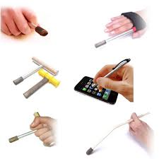
AAC: Access
Direct selection
  Pointing with physical contact
    Finger
    Stylus
    Mouthstick
  Pointing without physical contact
    Eyegaze
    Lightpointer
    Headmouse
  Symbol pickup and exchange
Indirect selection
  Scanning with single or dual switches
  Directed scanning
    joystick

Slide 19
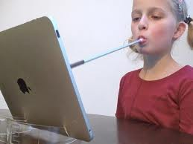
AAC: Access
Direct selection
  Pointing with physical contact
    Finger
    Stylus
    Mouthstick
  Pointing without physical contact
    Eyegaze
    Lightpointer
    Headmouse
  Symbol pickup and exchange
Indirect selection
  Scanning with single or dual switches
  Directed scanning
    joystick

Slide 20

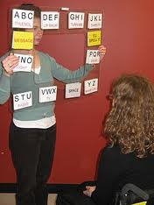
AAC: Access
Direct selection
  Pointing with physical contact
    Finger
    Stylus
    Mouthstick
  Pointing without physical contact
    Eyegaze
    Lightpointer
    Headmouse
  Symbol pickup and exchange
Indirect selection
  Scanning with single or dual switches
  Directed scanning
    joystick

Slide 21
AAC: Access
Direct selection
  Pointing with physical contact
    Finger
    Stylus
    Mouthstick
  Pointing without physical contact
    Eyegaze
    Lightpointer
    Headmouse
  Symbol pickup and exchange
Indirect selection
  Scanning with single or dual switches
  Directed scanning
    joystick

Slide 22
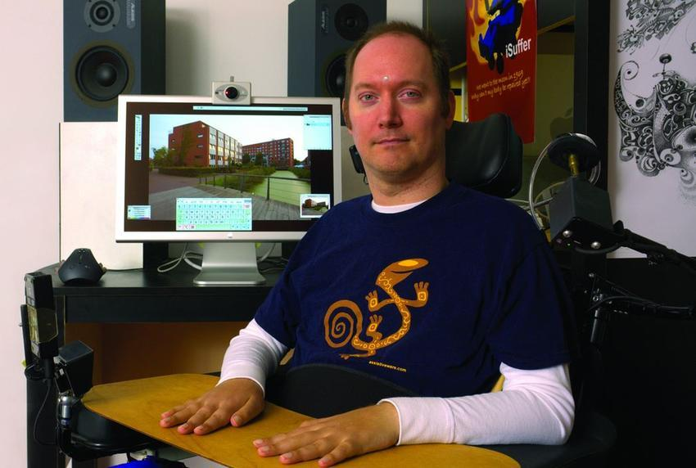
AAC: Access
Direct selection
  Pointing with physical contact
    Finger
    Stylus
    Mouthstick
  Pointing without physical contact
    Eyegaze
    Lightpointer
    Headmouse
  Symbol pickup and exchange
Indirect selection
  Scanning with single or dual switches
  Directed scanning
    joystick

Slide 23
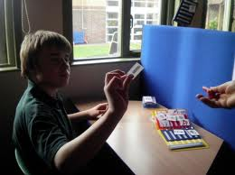
AAC: Access
Direct selection
  Pointing with physical contact
    Finger
    Stylus
    Mouthstick
  Pointing without physical contact
    Eyegaze
    Lightpointer
    Headmouse
  Symbol pickup and exchange
Indirect selection
  Scanning with single or dual switches
  Directed scanning
    joystick

Slide 24
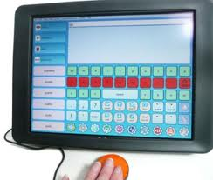
AAC: Access
Direct selection
  Pointing with physical contact
    Finger
    Stylus
    Mouthstick
  Pointing without physical contact
    Eyegaze
    Lightpointer
    Headmouse
  Symbol pickup and exchange
Indirect selection
  Scanning with single or dual switches
  Directed scanning
    joystick

Slide 25
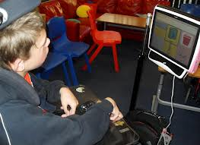
AAC: Access
Direct selection
  Pointing with physical contact
    Finger
    Stylus
    Mouthstick
  Pointing without physical contact
    Eyegaze
    Lightpointer
    Headmouse
  Symbol pickup and exchange
Indirect selection
  Scanning with single or dual switches
  Directed scanning
    joystick

Slide 26
What leads to successful AAC use?
Frequent, consistent use in a variety of settings (e.g., school, home, community) to discuss motivating topics.
Aided language stimulation (Goosens& Crain, 1986):
  Provide user with a model of the system in use
  Allow user to see AAC symbols in everyday situations
  Suggest to the user that the system is an acceptable means of communication

Slide 27
How to support the needs of your AAC user
Augmented communicators describe a ‘good’ communication partner as patient, motivated, interested, and comfortable with all methods of communication
Sometimes communication partners underrate their abilities, shout at them as though they are deaf, over enunciate, and/or talk to others instead of addressing them directly
Blackstone, 1999

Slide 28
How to request an AAC assessment
AAC support is the responsibility of the school site speech-language pathologist (SLP)
Request screening from SLP
If appropriate, assessment plan will be generated and sent home for signature
IEP will be held within 60 days to determine if student requires AAC to access his/her curriculum

