Slide 1
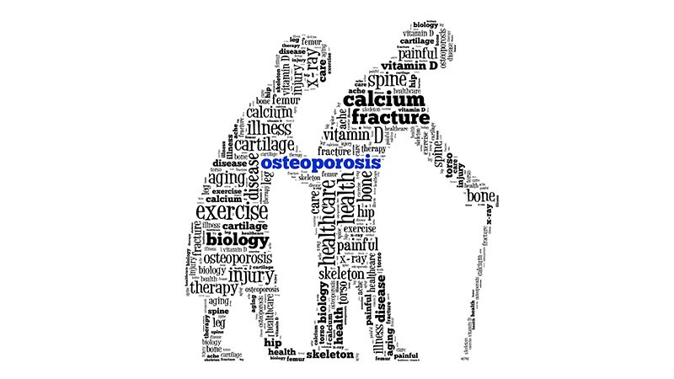
Dr Dharmik Patel
Assistant Professor
Department of Orthopaedics
DHIRAJ HOSPITAL
SBKS MIRC
SUMANDEEP VIDYAPEETH

Slide 2
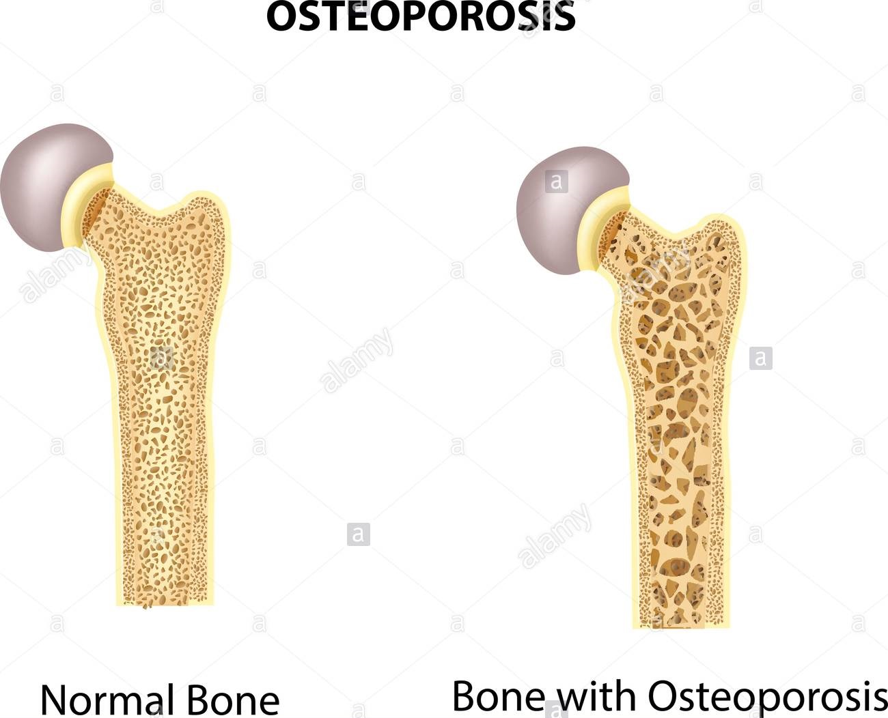
DEFINiTION

Slide 3
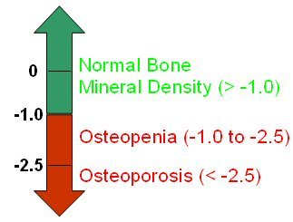
WHO DEFINITION OF OSTEOPOROSIS

Slide 4
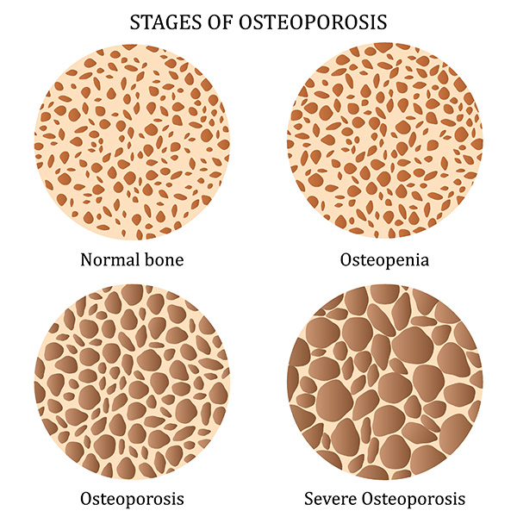

Slide 5
Bone Metabolism

Slide 6
Outline
Normal bone structure
Normal calcium/phosphate metabolism
Presentation and investigation of bone metabolism disorders
Common disorders of bone metabolism

Slide 7
Normal Bone Structure
What are the normal types of bone in the mature skeleton?
Lamellar
  Cortical
  Cancellous
Woven
  Immature
  Healing
  Pathological

Slide 8
What is the composition of bone?
The matrix
  40% organic
    Type 1 collagen (tensile strength)
    Proteoglycans (compressive strength)
    Osteocalcin/Osteonectin
    Growth factors/Cytokines/Osteoid
  60% inorganic
    Calcium hydroxyapatite
The cells
  osteo-clast/blast/cyte/progenitor

Slide 9
Bone structure
Structure of lamellar bone?
Structure of woven bone?

Slide 10
Bone turnover
How does normal bone grow……..
  In length?
  In width?
How does normal bone remodel?
How does bone heal?

Slide 11
Bone turnover
What happens to bone……….
  in youth?
  aged 20-40’s?
  aged 40+?
  aged over 70?

Slide 12
Calcium metabolism
What is the recommended daily intake?
1000mg
What is the plasma concentration?
2.2-2.6mmol/L
How is calcium excreted?
Kidneys - 2.5-10mmol/24 hrs
How are calcium levels regulated?
PTH and vitamin D (+others)

Slide 13
Phosphate metabolism
Normal plasma concentration?
0.9-1.3 mmol/L
Absorption and excretion?
Gut and kidneys
Regulation
Not as closely regulated as calcium but PTH most important

Slide 14
PTH
Physiological role
Production related to plasma calcium levels
Control of calcium levels
  target organs
    bone - increased Ca/PO4 release
    kidneys
      increased reabsorption of Ca
      increased excretion of PO4
    gut - indirect increase in calcium reabs by stimulting activation of vitamin D metabolism

Slide 15
Calcitonin
Physiological role
Levels increased when serum Ca >2.25mmol/L
Target organs
  Bone - suppresses resorption
  Kidney - increases excretion

Slide 16
Vitamin D (cholecalciferol)
Sources of vit D
Diet
u.v. light on precursors in skin
Normal daily requirement
400IU/day
Target organs
  bone - increased Ca release
  gut - increased Ca absorption

Slide 17
Normal metabolism
Vit D
25-HCC (Liver)
Ca/PTH
1,25-DHCC 24,25-DHCC
(Kidney) (Kidney)

Slide 18
Factors affecting bone turnover
Other hormones
Oestrogen
  gut - increased absorption
  bone - decreased re-absorption
Glucocorticoids
  gut - decrease absorption
  bone - increased re-absorption/decreased formation
Thyroxine
  stimulates formation/resorption
  net resorption

Slide 19
Factors affecting bone turnover
Local factors
I-LGF 1 (somatomedin C)
  increased osteoblast prolifn
TGF
  increased osteoblast activity
IL-1/OAF
  increased osteoclast activity (myeloma)
PG’s
  increased bone turnover (#’s/inflammn)
BMP
  bone formation

Slide 20
Factors affecting bone turnover
Other factors
Local stresses
Electrical stimuln
Environmental
  temp
  oxygen levels
  acid/base balance

Slide 21
Bone metabolic disorders
Presentation?
Skeletal abnormality
  osteopenia - osteomalacia/osteoporosis
  osteitis fibrosa cystica - replacement of bone with fibrous tissue usually due to PTH excess
Hypercalcaemia
Underlying hormonal disorder
When to investigate?
  Under 50
  repeated fractures or deformity
  systemic features or signs of hormonal disorder

Slide 22
Bone metabolic disorders
Assessment
History
  duration of sx
  drug rx
  causal associations
Examn
X-rays - plain and specialist (cort index/Singh index/DEXA)
Biochemical tests
Bone biopsy

Slide 23
Biochemical tests
Which investigations?
Ca/PO4 - plasma/excretion
Alkaline phosphatase/osteocalcin (o’blast activity)
PTH
vit D uptake
hydroxyproline excretion

Slide 24


EPIDEMIOLOGY

Slide 25



Slide 26
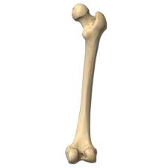


ETIOPATHOGENESIS
BONE FORMATION
BONE RESORPTION

Slide 27
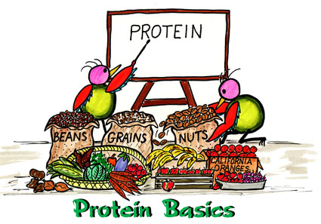


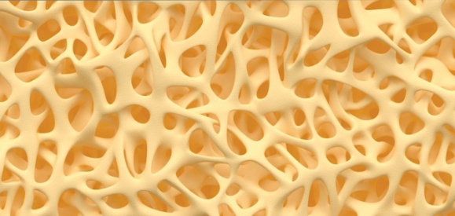
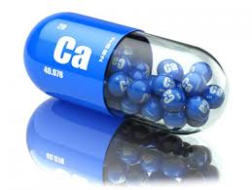

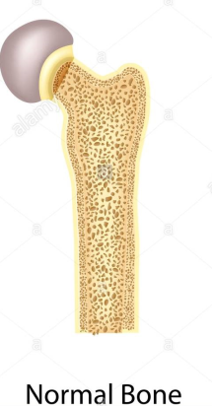
STRUCTURE OF BONE
CALCIUM
MATRIX

Slide 28

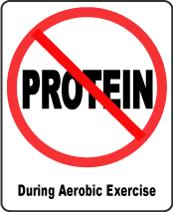

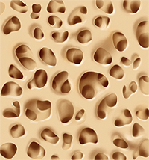

Slide 29
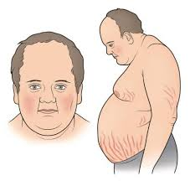
HYPERPLASIA OF ADRENAL CORTEX
INCREASE CONVERSION OF PROTEIN INTO GLYCOGEN
DECREASE PROTEIN CONTENT
DECREASE MATRIX FORMATION
OSTEOPOROSIS
CUSHING’S SYNDROME

Slide 30
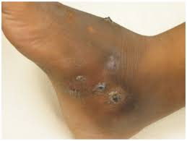
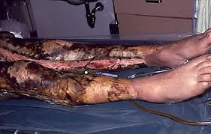
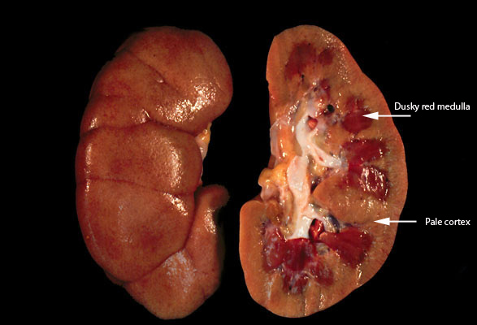
SINUSES
BURNS
NEPHROSIS
PROTEIN LOSS
REDUCE BONE FORMATION
OSTEOPOROSIS

Slide 31
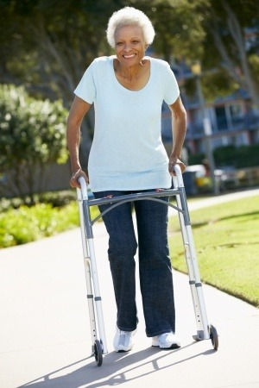
AGING
IMMOBILISATION
REDUCED PHYSICAL ACTIVITY
LOSS OF MECHANICAL STIMULATION OF OSTEOCYTES
DECREASE BONE FORMATION
OSTEOPOROSIS

Slide 32
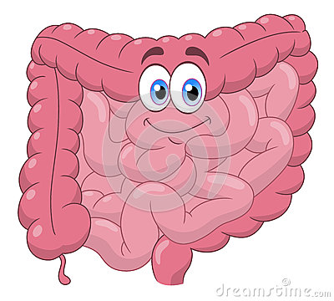
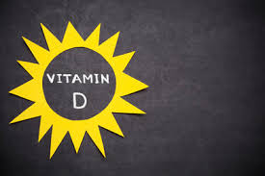
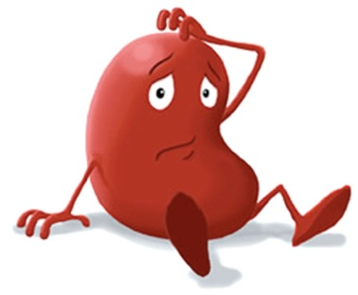
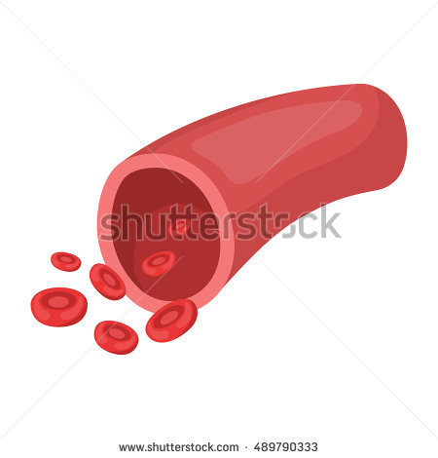
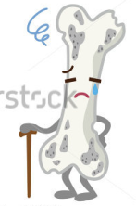



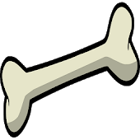
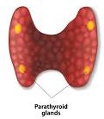
Ca2+
Ca2+
PTH
PTH

Slide 33
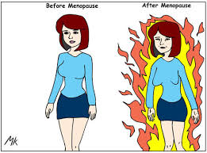
DECLINE IN LEVELS OF ESTROGEN
INCREASE OSTEOCLASTIC ACTIVITY
INCREASE BONE RESORPTION
OSTEOPOROSIS

Slide 34
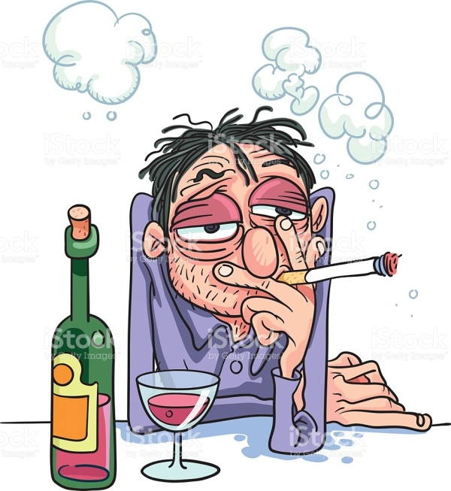
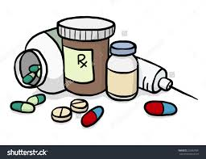
OTHER CAUSES
DRUGS
ALCOHOL AND CIGARETTE SMOKING
REFLEX SUDECK’S DYSTROPHY

Slide 35
Osteoporosis
Definition?
Decrease in bone mass per unit volume
Fragility (perfn of trabecular plates)
Primary (post-menopausal/senile) Secondary

Slide 36


Slide 37
NORDIN CLASSIFICATION
GENERALISED
LOCALISED

Slide 38
RIGGS AND MELTON
PRIMARY OSTEOPOROSIS
  TYPE 1- POST MENOPAUSAL OSTEOPOROSIS
  TYPE 2-SENILE/AGE RELATED OSTEOPOROSIS
SECONDARY OSTEOPOROSIS
  SECONDARY TO VARIOUS CAUSES

Slide 39
Primary osteoporosis
Post-menopausal
Aetiology?
Menopausal loss 3% vs 0.3% previously
Loss of oestrogen - incr osteoclastic activity
Risk factors?
Race
Heredity
Build
Early menopause/hysterectomy
Smoking/alcohol/drug abuse
?Calcium intake

Slide 40
Primary osteoporosis
Post-menopausal
Clinical features?
Prevention and treatment?
General health measures/diet
HRT
Bisphosphonates
Calcium
Vitamin D

Slide 41
Primary osteoporosis
Senile
Aetiology?
7-8th decade steady loss of 0.5%
physiological manifestation of aging
Risk factors?
Prolonged uncorrected post-menopausal loss
chronic illness
urinary insuff
muscle atrophy
diet def/lack of exposure to sun/mild osteomalacia

Slide 42
Primary osteoporosis
Senile
Clinical features?
as for post-menopausal
Treatment?
general health measures
treat fractures
as for post-menopausal (HRT not acceptable)

Slide 43
Secondary Osteoporosis
Aetiology?
Nutrition - scurvy, malnutr,malabs
Endocrine - Hyper PTH, Cush, Gonad, Thyroid
Drug induced - steroid, alcohol, smoking, phenytoin
Malignancy - ca’tosis, myeloma (o’clasts), leukaemia
Chronic disease - RA, AS, TB, CRF
Idiopathic - juvenile, post-climacteric
Genetic -OI
Clin features?
Investigation?
Treatment?

Slide 44


Slide 45
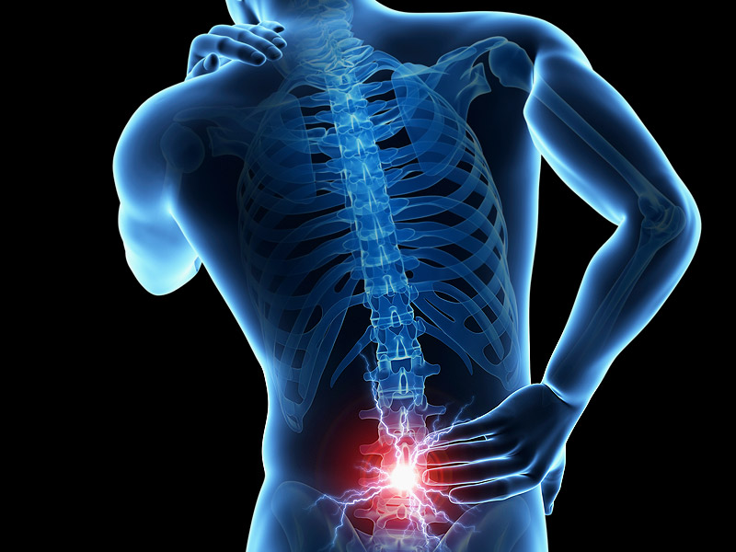
CLINICAL FEATURES
LOWER BACK PAIN

Slide 46
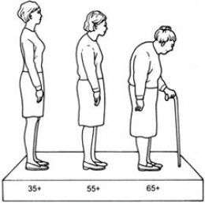
LOSS OF HEIGHT

Slide 47
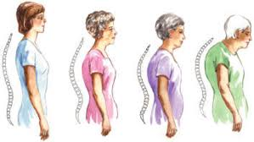
THORACIC KYPHOSIS

Slide 48
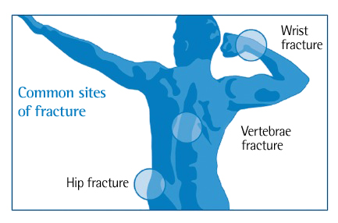
FRACTURES { VERTEBRAE>HIP>WRIST }

Slide 49
PHYSICAL EXAMINATION
MEASUREMENT OF HEIGHT.
DETECTION OF KYPHOSIS.
BLUE SCLERA , THIN SKIN.
HEPATO-SPLENOMEGALY.(SYSTEMIC DISEASE)
SKIN PIGMENTATION. (CUSHING SYNDROME)

Slide 50
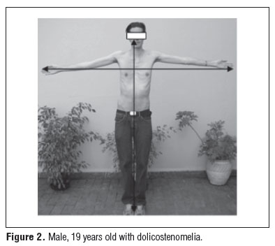
ARM SPAN-HEIGHT DIFFERENCE.

Slide 51
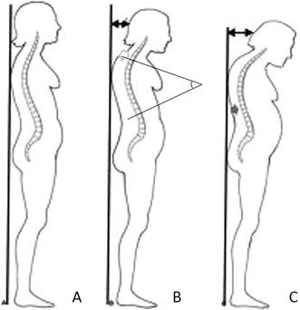
WALL-OCCIPUT DISTANCE.
  USUALLY 0cm , >0cms IS SIGNIFICANT

Slide 52
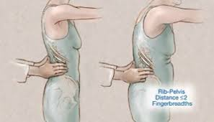
RIB PELVIS DISTANCE
  < or = 2 finger breadths is significant and suggestive of vertebral fracture.

Slide 53
DIFFERENTIAL DIAGNOSIS
HYPERPARATHYROIDISM.
PAGET’S DISEASE.
OSTEOMALACIA.
OSTEOGENESIS IMPERFECTA.
MULTIPLE MYELOMA.
SECONDARY TUMORS.

Slide 54
BLOOD INVESTIGATIONS
ROUTINE BLOOD INVESTIGATIONS
  CBC
  RBS
  S.CREAT
  BLOOD UREA
24hr URINE CALCIUM.
SERUM CALCIUM.
RFT
LFT
SERUM PTH LEVEL
VIT D3 LEVELS
TSH LEVELS
FREE CORTISOL/ FASTING SERUM CORTISOL.
SERUM ALBUMIN, CHOLESTEROL.

Slide 55
RADIOLOGICAL INVESTIGATIONS

Slide 56
CONVENTIONAL RADIOGRAPHY.

Slide 57
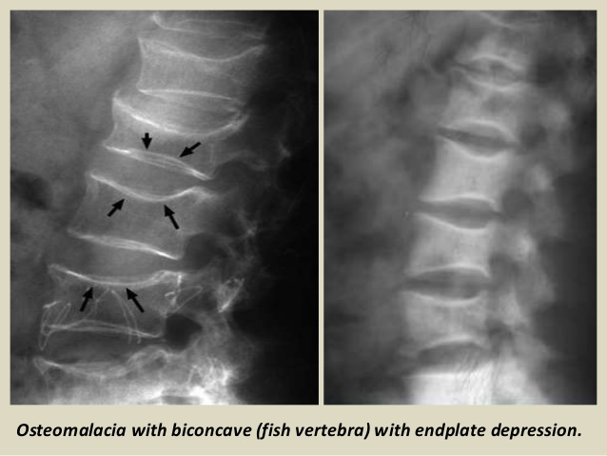
X-RAY SPINE

Slide 58
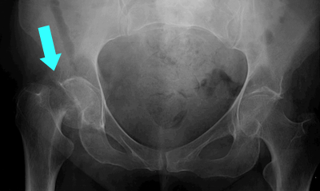
X-RAY PELVIS

Slide 59
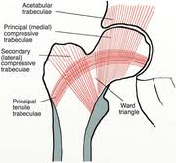
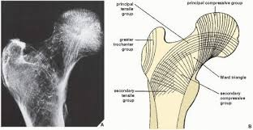
SINGH’S INDEX

Slide 60
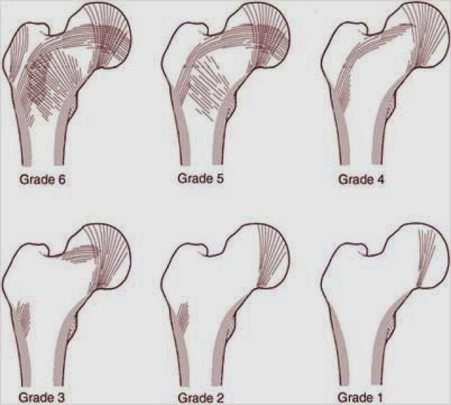
GRADES OF SINGH’S INDEX

Slide 61
QUANTITATIVE BONE DENSITOMETRY.
  BONE MINERAL DENSITY
  T-SCORE
  Z-SCORE
  RADIOGRAMETRY
  RADIOGRAPHIC PHOTO DENSITOMETRY
  NEUTRON ACTIVATION ANALAYSIS
  SINGLE/DUAL PHOTO ABSORBIOMETRY

Slide 62
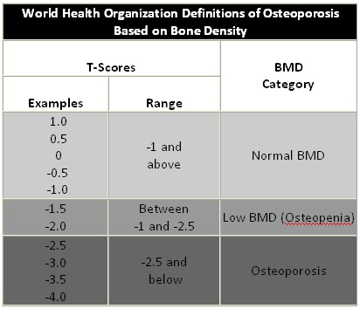

Slide 63
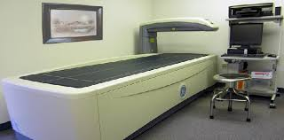
QUANTITATIVE BONE DENSITOMETRY.
  NEWER TECHNIQUES
  DEXA
  USG
  CT-SCAN
  MRI

Slide 64


Slide 65
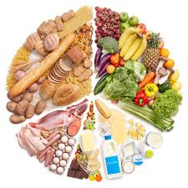
NON PHARMACOLOGICAL PREVENTION OF OSTEOPOROTIC FRACTURES
NUTRITION.

Slide 66
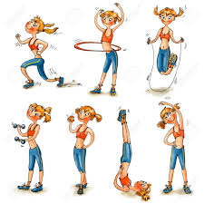
PHYSICAL ACTIVITY.

Slide 67

PREVENTION OF FALL.

Slide 68
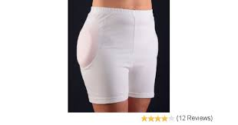
HIP PROTECTOR.

Slide 69
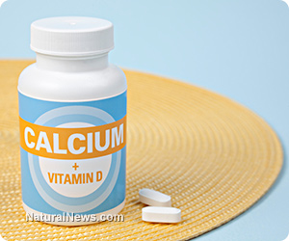
BASIC THERAPEUTIC MEASURES
VIT. D AND CALCIUM SUPPLEMENTS.
  SUPPLEMENTATION OF 1200mg OF CALCIUM AND 800 IU OF VIT. D.
  DECREASE FRACTURE RISK.

Slide 70
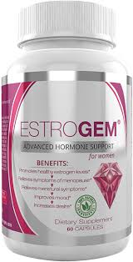
ESTROGEN AND HRT.
  MECHANISM OF ACTION
    DECREASE OSTEOCLASTIC ACTIVITY.
    PREVENT BONE LOSS.
  ADVERSE EFFECTS.
    INCREASE RISK OF CORONARY HEART DISEASE, STROKE, THROMBOEMBOLIC EVENTS, BREAST CANCER.

Slide 71
ANTI RESORPTIVE DRUGS
CALCITONIN.
  INHIBIT OSTEOCLASTIC ACTIVITY AND BONE RESORPTION.
  NASAL SPRAY OF CALCITONIN 200IU/DAY IS ADVICED.
  GIVEN IN ALTERNATE NOSTRILS.
  OTHERWISE IT CAUSE RIHINITS, EPISTAXIS, NASAL ULCERATION.
  VASODILATATION LEADS TO DIZZINESS AND VERTIGO

Slide 72
BISPHOSPHONATES.
THEY HAVE LOW BIOAVAILABILITY
MECHANISM OF ACTION
  ACCELARATES THE APOPTOSIS OF OSTEOCLAST
  1ST GENERATION-ETIDRONATE,TILUDRONATE
  2ND GENERATION-PAMIDRONATE(1000),ALENDRONATE(100-500),IBANDRONATE(500-1000)
  3RD GENERATION-RISEDRONATE(1000),ZOLEDRONATE(500)
ALENDRONATE 10mg OD.
RISEDRONATE 35mg PER WEEK.
TO BE TAKEN EMPTY STOMACH WITH PLAIN WATER AND NO ORAL INTAKE OF FOOD FOR ATLEAST NEXT 30 MINS.
ONE SHOULD REMAIN IN SITTING OR STANDING UPRIGHT POSITION AFTER TAKING DRUG AS THEY CAUSES OESOPHAGEAL IRRITATION.

Slide 73
SERM(SELECTIVE ESTROGEN RESPONSE MODULATOR)
RALOXIFENE 60mg PER DAY.
ESTROENIC AGENT.
NOT ASSOCIATED WITH INCREASED RISK OF UTERINE CANCER.
INCREASE THE OCCURANCE OF HOT FLUSHES,VAGINAL BLEEDS,DVT

Slide 74
DRUGS THAT STIMULATE BONE FORMATIONS.
PTH
  TERIPARATIDE, A RECOMBINATION OF HUMAN PTH.
  INJ. S.C ONCE DAILY 20-40 mcg.
  HIGH COST.
  MECHANISM OF ACTION
    IN LOW DOSE AND PULSATILE MANNER IT IS ANABOLIC AGENT
    PRIMARILY TARGETS OSTEOBLASTS.
  SIDE EFFECTS
    LEG CRAMPS
    DIZZINESS

Slide 75
STRONTIUM RONELATE
THIS DRUG HAVE DUAL ACTION ON BONE FORMATION AND BONE RESORPTION.
IT STIMULATES CALCIUM SENSING RECEPTORS AND LEADS TO DIFF.OF PREOSTEOBLASTS INTO OSTEOBLASTS WHICH INCREASES THE BONE FORMATION
AND ALSO STIMULATES OSTEOBLAST TO SECRETE OSTEOPROTEGERIN IN INHIBITING OSTEOCLASTS FORMED FROM PREOSTEOCLASTS .H

Slide 76
ORTHOPAEDIC MANAGEMENT IN OSTEOPOROSIS

Slide 77
PRINCIPLES
REDUCED BONE MASS, INCREASED BONE BRITTLENESS AND MEDULLARY EXPANSION TO BE TAKEN IN ACCOUNT WHILE DECIDING TYPE OF SURGERY.
THE MAJOR PROBLEM IN OSTEOPOROSIS TREATMENT IS FIXATION OF DEVICE TO BONE BECAUSE BONE FAILURE IS MORE COMMON THAN IMPLANT BREAKAGE.
IT IS IMPORTANT TO ACHIVE BONE CONTACT BETWEEN TWO FRAGMENTS EVEN IF IT RESULTS IN LIMB LENGTH SHORTNING DUE TO BONE LOSS.
BONE CEMENT TO BE USED WHEN NECESSARY.

Slide 78
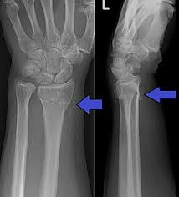
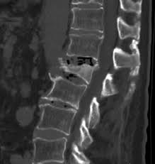
CONSERVATIVE MANAGEMENT

Slide 79
CALCIUM AND VIT. D TO BE STARTED BASICALLY.
IN DIAGNOSED CASES CALCITONIN, BISPHOSPHONATES TO BE STARTED.
CONTINOUS MOBILISATION OF THE PATIENT.
ORTHOSES CAN BE USED.

Slide 80
ORTHOPAEDIC SURGERY IN OSTEOPOROSIS.
ORTHOPAEDIC SURGERY SHOULD PROVIDE STABLE FIXATION TO ENABLE NORMAL FUNCTION IN CASE OF LOWER EXTRIMITIES.
INTERNAL FIXATION SHOULD BE SELECTED WITH A VIEW TO AVOID STRESS ON THE BONE AND FOR THIS REASON INTRAMEDULLARY NAIL ARE BEST SUITED FOR THIS CASES.
WHILE OPERATING OSTEOPOROTIC FRACTURES ONE SHOULD TAKE CARE THAT ANOTHER FRACTURE DOESNT OCCURS

Slide 81
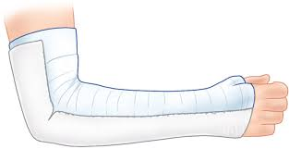
DISTAL END RADIUS
MOSTLY TREATED CONSERVATIVELY WITH PLASTER.
COMPLICATIONS OF EXTERNAL FIXATOR/ ORIF WITH PLATE AND SCREWS
  FINGER STIFFNESS.
  PIN LOOSENING.
  PIN TRACT INFECTION.

Slide 82
HIP FRACTURES
IN GARDEN TYPE 1 & TYPE 2 SCREW FIXATION.
IN GARDEN TYPE 3 & TYPE 4 HEMIARTHROPLASTY.
MOST COMMON PROBLEMS :
                PSEUDOARTHROSIS
                AVN OF FEMORAL HEAD
IT FRACTURES- DHS, SREWS WITH LARGE HEADS ARE AVAILABLE.
WASHERS WITH SCREWS AND SUPPORTING FIXATION WITH CIRCLAE WIRES CAN BE USED.

Slide 83
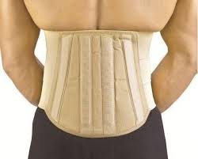
VERTEBRAL BODY FRACTURE
MOST COMMON SITE FOR COMPRESSION IN OSTEOPOROSIS ARE THORACIC AND THORACOLUMBER JUNCTION.
CONSERVATIVE TREATMENT
  BED REST
  LAXATIVES
  ANALGESICS
  STABILISE WITH BACK CORSET/BRACE.
CHRONIC BRACING IS ADVICED IN
  FLEXIBLE KYPHOTIC/SCOLIOTIC CURVES
  CHRONIC LUMBAR PAIN
  SPASM DUE TO IVDP

Slide 84
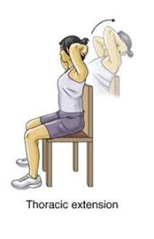

AFTER 3 WEEKS OF BED REST, PHYSICAL THERAPHY FOCUSSING ON THORACIC EXTENSION AND LUMBAR FLEXION EXERCISE.

Slide 85
INDICATIONS OF SURICAL DECOMPRESSION OF SPINAL CORD AND RECONSTRUCTION OF VERTEBRAL BODIES ARE NEUROLOGIC COMPLICATION:
  PARAPLEGIA
  PERSISTENT DESPITE TREATMENT.
MOST COMMON SITE FOR CORD COMPRESSION IS LOWER THORACIC REGION.
SURICAL PROCEDURES DONE ARE:
  VERTEBROPLASTY
  KYPHOPLASTY
PMMA CEMENT IS INJECTED TO FRACTURED VERTEBRAL BODY.

Slide 86


