Slide 1
Proximal humerus fracture
Dr Vraj Patel
Assistant Professor
Dept of Orthopaedics, Dhiraj Hospital
SBKS MIRC, Sumandeep Vidyapeeth
Vadodara

Slide 2
Definition
• Fractures of the metaphyses
• May involve the articular surface
• Include the humeral head, greater and lesser tuberosities, bicipital groove and proximal humeral shaft
• Anatomical vs surgical neck

Slide 3
Aetiology
• Fall onto outstretched hand (foosh) • Often low energy
• May be part of polytrauma • Excessive rotation with abduction • Direct blow
• Convulsion/shock • Metastatic

Slide 4
Classification
• Neer: 2 part, 3 part, 4 part, articular
• Muller AO: modified Neer system with emphasis on vascularity

Slide 5
Neer: (1970)
• Anatomy and biomechanics • Accurate I.D. of 4 major fragments • > 1cm or >45 degrees = displacement • Impression or head-split fractures

Slide 6
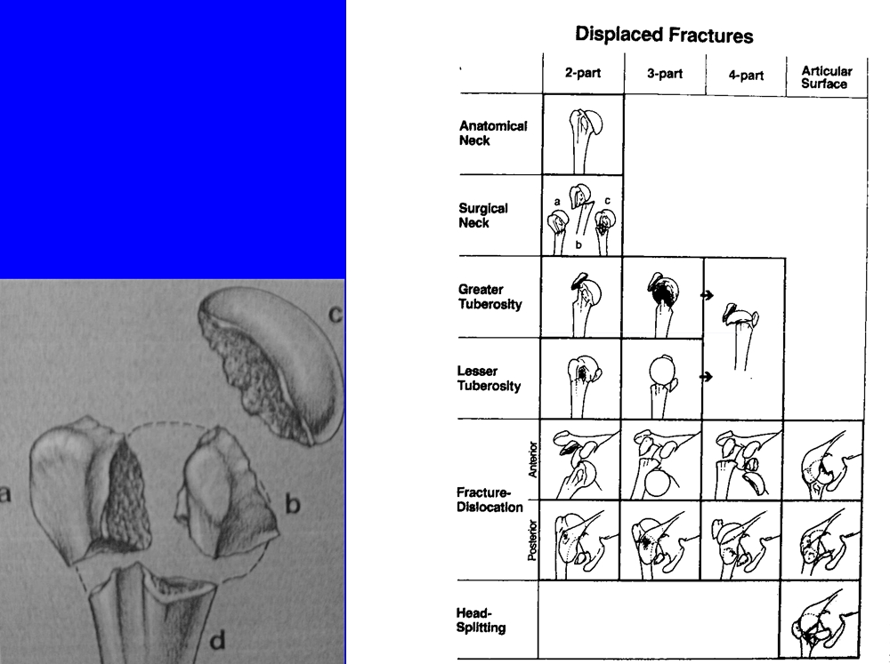
Neer 4-part
Classification (1970)
Codman

Slide 7
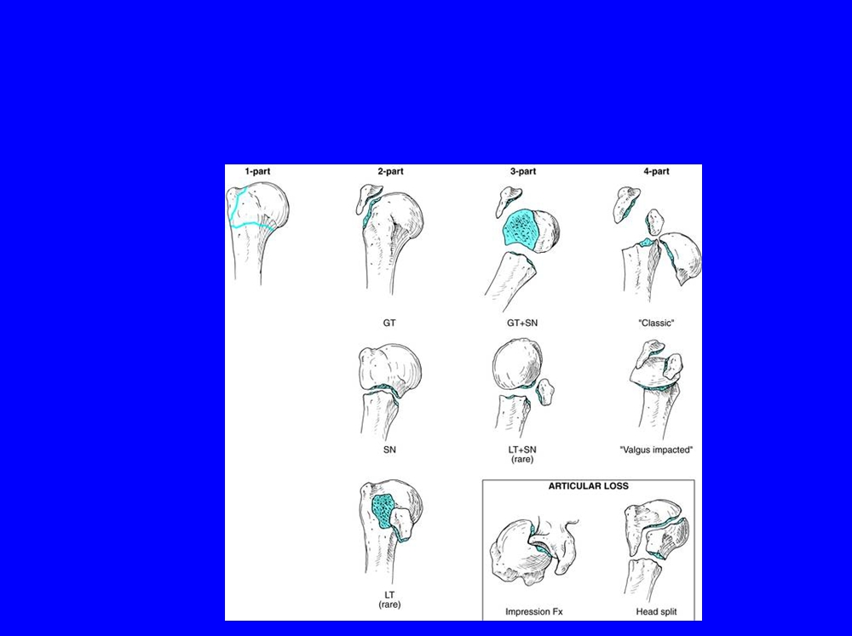
Classification
• Neer

Slide 8
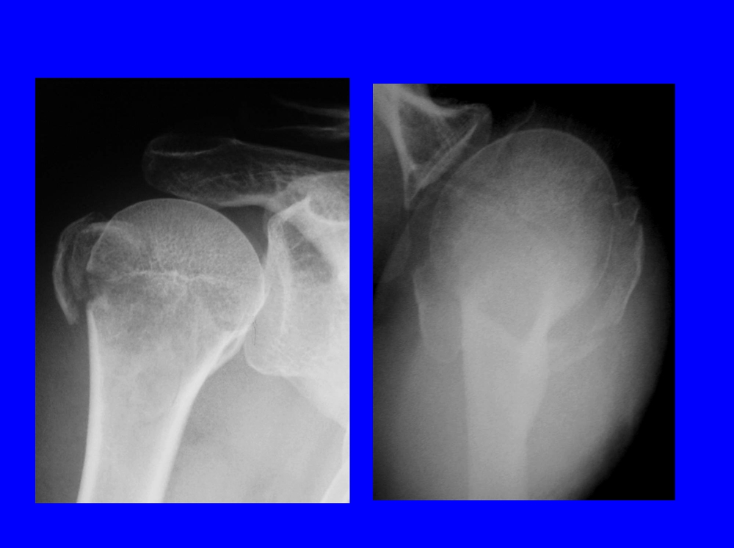
Neer 2 part: greater tuberosity

Slide 9
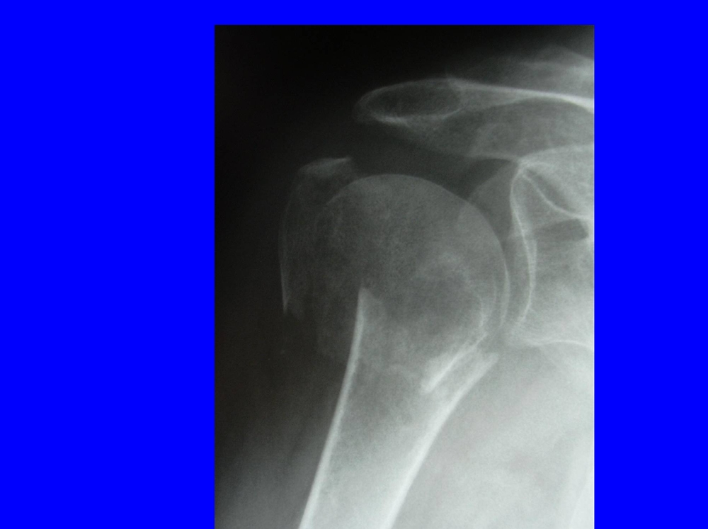
• Neer 3 part #

Slide 10
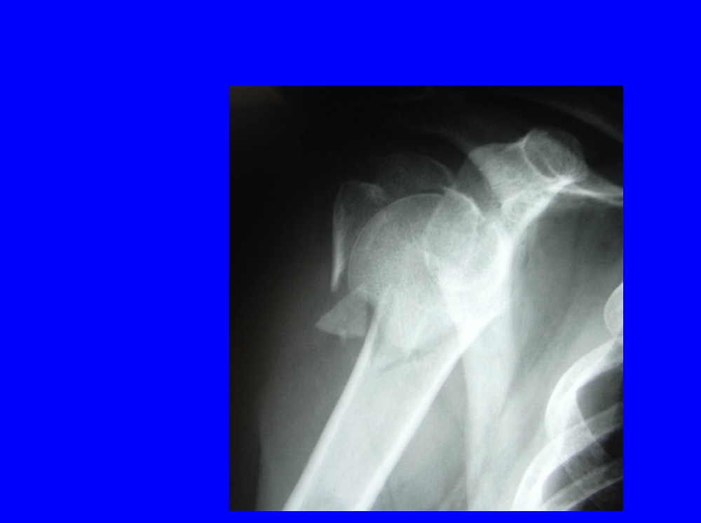
• Neer 4-part

Slide 11
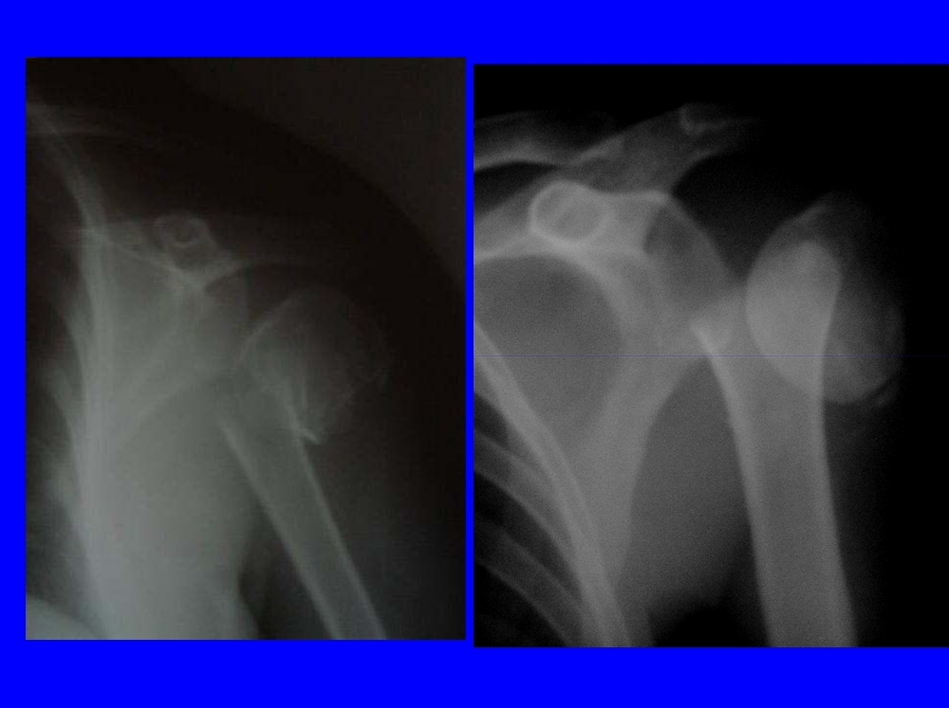
Fracture dislocation

Slide 12
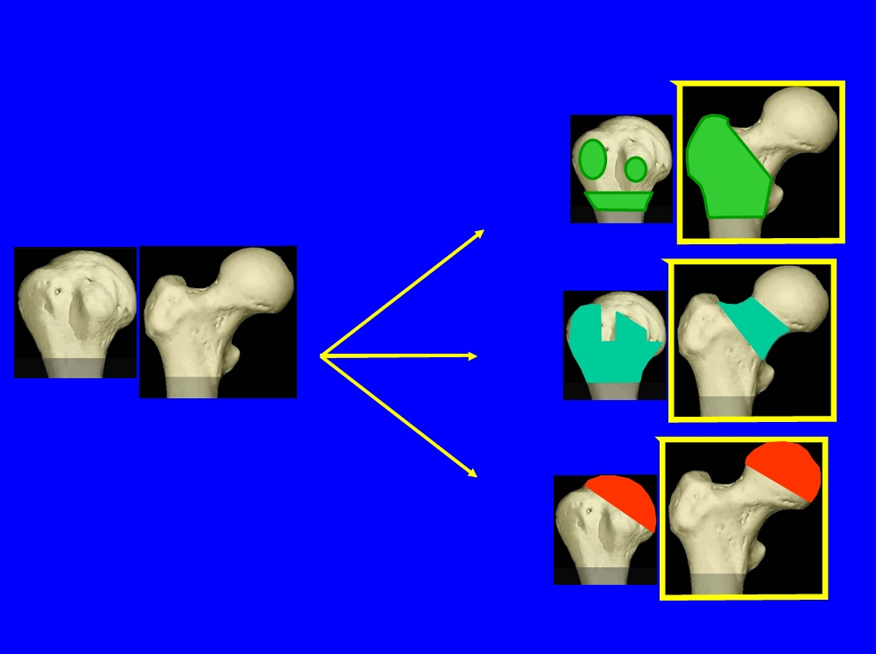
A.O. (Jacob et al. 1984
Proximal humerus 11-
A = extraarticular unifocal
B = extraarticular bifocal
A
C = articular fracture
B
11-
31-
Proximal femur 31-
A = trochanteric area
B = neck fracture C = head fracture
C

Slide 13
Incidence
• ~ 100 per 100 000 person years • 70% of the proximal femur rate • Increased incidence with age
• Not uncommon!

Slide 14
Anatomy
• Complex anatomy of shoulder • Almost global range of motion • Glenoid is shallow (1/4 size of head) • Capsule is loose (2 x size of head) • Anatomical neck # rare (poor prognosis) • Surgical neck # common (vasc. good)

Slide 15
Anatomy
• Lesser tuberosity
(subscapularis,anterior-inferior)
• Bicipital groove
(between tuberosities)
• Greater tuberosity
(supraspinatus,infraspinatus,teres minor, postero-superior)

Slide 16
Anatomy
• Acromion
• Rotator cuff
• Other muscles • Blood supply
• Nerve supply
Must all be considered!

Slide 17
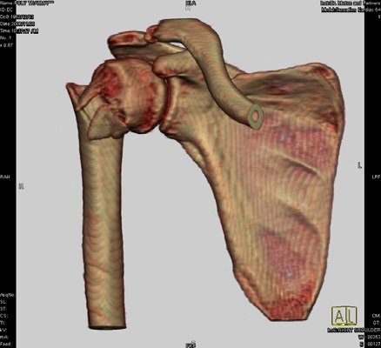
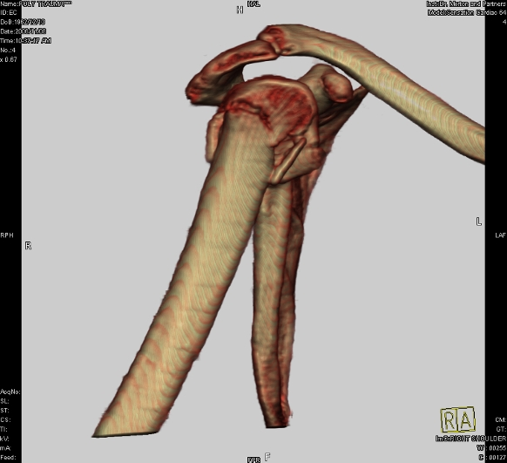
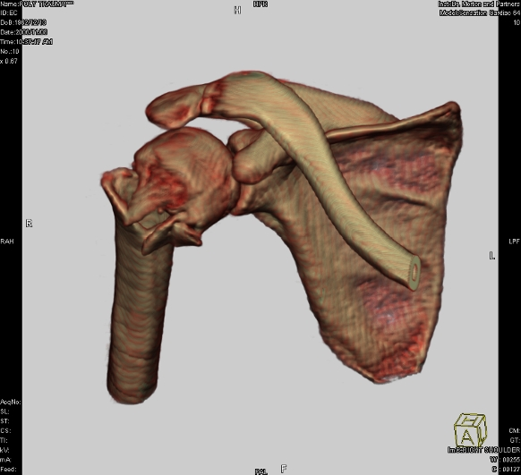
Radiology
• Radiographs • Special views
• C.T. Scan ( + 3D recon) • M.R.I.

Slide 18
Trauma series x ray
• Anteroposterior and lateral
• Axillary view (if possible)
• Velpeau (modified) axillary view

Slide 19
Associated injuries
• Neurological
• Vascular
• Musculotendonous • Chest

Slide 20
Management
• Classification / severity • Articular
• Extra-articular • Age
• Functional demand • Co-morbidities

Slide 21
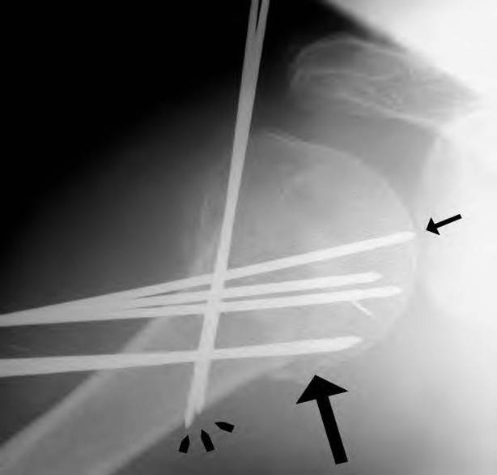
• Review of fixation methods • Pinning

Slide 22
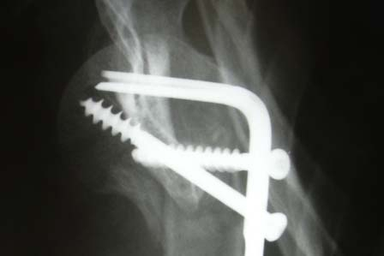
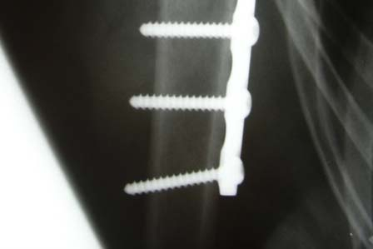
• Review of fixation methods • Pinning
• Blade plates

Slide 23
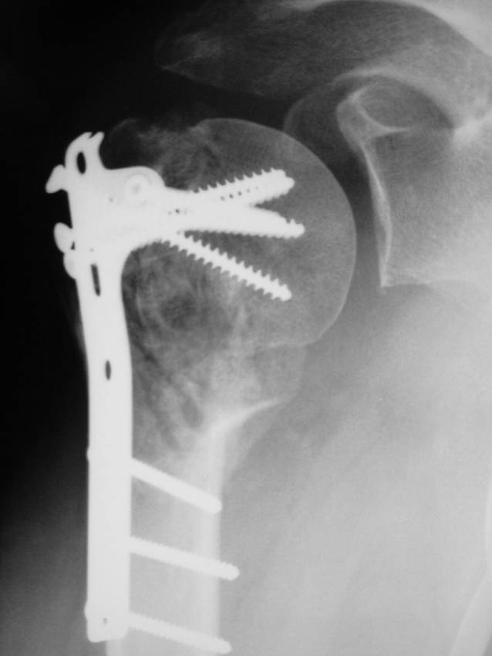
• Review of fixation methods • Pinning
• Blade plates • Clover plates

Slide 24
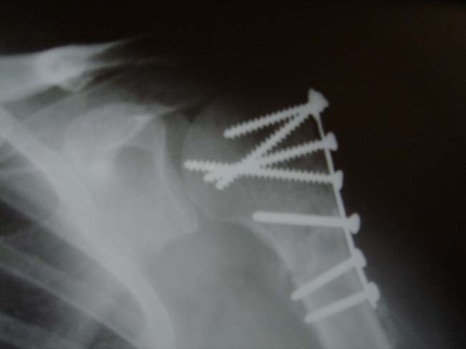
• Review of fixation methods • Pinning
• Blade plates • Clover plates • AO plates

Slide 25

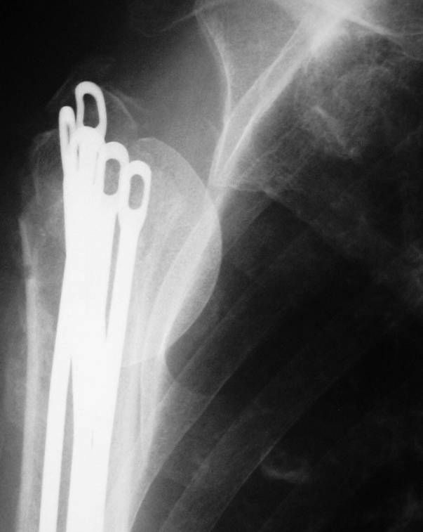
• Review of fixation methods • Pinning
• Blade plates • Clover plates • AO plates • Nails

Slide 26
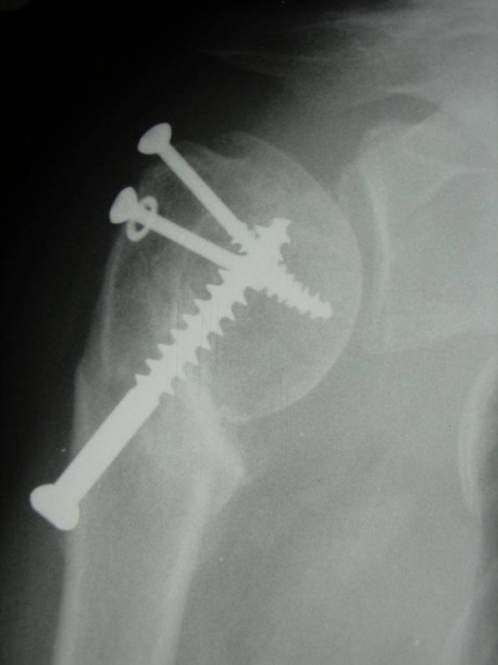
• Review of fixation methods • Pinning
• Blade plates • Clover plates • AO plates • Nails
• Screws

Slide 27
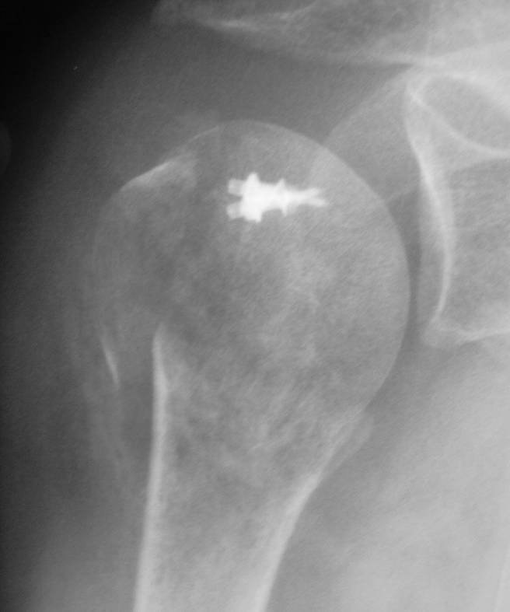
• Review of fixation methods • Pinning
• Blade plates • Clover plates • AO plates • Nails
• Screws • Sutures

Slide 28
• Internal fixation complications
• Nonunion
• Malunion
• Hardware complications • AVN
• Neurovascular injury • Subacromial impingement • Frozen shoulder
• Infection
• Heterotopic ossification • Subluxation

Slide 29
• Complications >50%
• Non-union
• Plate pull-out • Loss of fixation
• Mayo Clinic experience ASES 2006 (n=82, 57% complications)

Slide 30
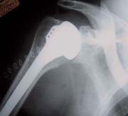
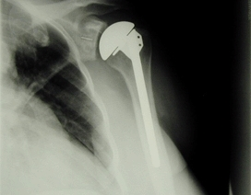
Treatment Methods
• Arthroplasty
• Only 50 % good or excellent outcomes • Tuberosity malposition
• Tuberosity nonunion

Slide 31
• Indications for Arthroplasty
• Preexisting GHJ OA
• Fractures where internal fixation is technically impossible

Slide 32
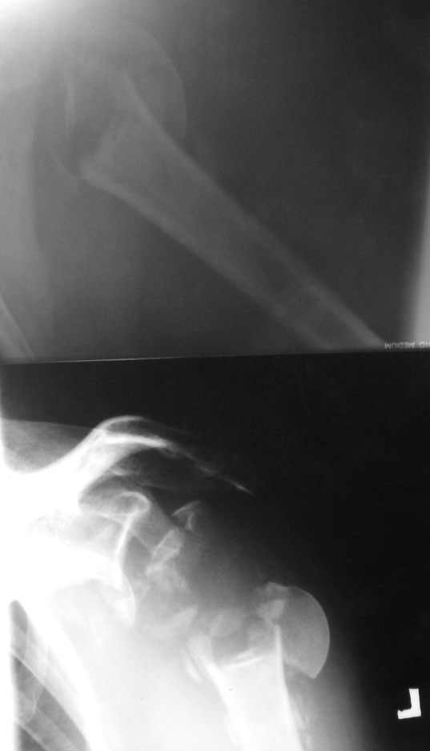
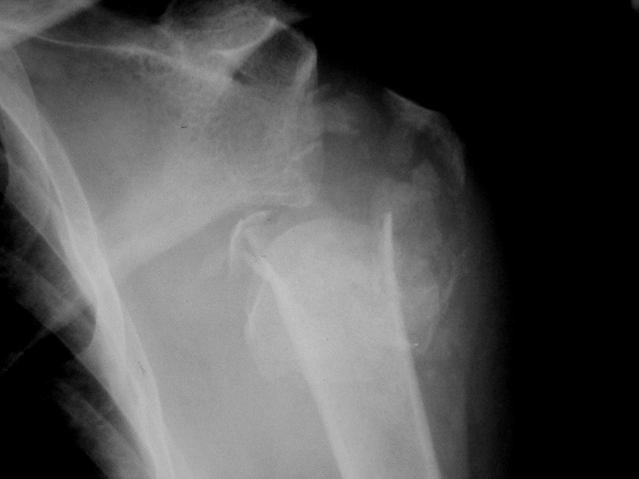
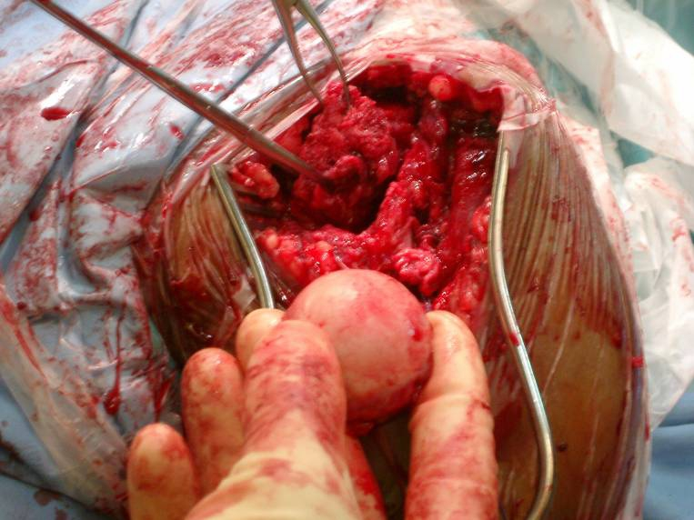
• Indications for Arthroplasty

Slide 33
Non-operative
• Small avulsion fractures and impacted surgical neck fractures.
• Low functional demand • Poor surgical risk
• Shoulder immobiliser and pendulum therapy at 3/52

Slide 34
2 part fractures
• 8/10 proximal humeral fractures • 1cm / 45 degree figure arbitrary, not fixed • Only allow motion once “sticky”
• Transitory subluxation occurs

Slide 35
2 part articular fracture
• Anatomic neck
• Rare
• AVN common
• Manage conservatively • Late prosthetic replacement?

Slide 36
2 part shaft displacement
Surgical neck. All ages. Pec major deforms
• Impacted: (11-A2) disimpact if > 45 degrees
• Unimpacted: (11-A3) pec major displaces shaft & may risk axillary artery / brachial plexus.
- closed reduction - ?stable. May need pin or ORIF to address interposition!
• Comminuted: Spica in flexion possible, but ORIF or percutaneous pins preferable

Slide 37
2 part greater tuberosity (11-A1)
• Anterior dislocation
• Tuberosity often fragmented • C.T. helpful to assess
• ORIF & cuff repair if articular component • Impingement may result (if >5mm proud) • Percutaneous cannulated screw or tension band technique

Slide 38
2 part lesser tuberosity
• Seizures
• Axillary view & C.T. help
• Block to internal rotation (? articular) may mandate ORIF & repair
subscapularis tendon

Slide 39
3 part (11 - B1,2,3)
• 1 tuberosity always attached & surgical neck always displaced
• Gr tuberosity # = internal rotation • Lesser tuberosity # = ext rotation • Modified axillary view & C.T. help
• ORIF favoured
• Prosthesis if poor soft tissue attachment or elderly patient

Slide 40
4 part (11-C3)
• Valgus impacted vs. true 4-part # • Non operative for minor displacement • Prosthesis for true 4 part fractures
• Explore intermediate lesions and ORIF if soft tissue allows

Slide 41
Fracture - dislocations
• 2 part - closed or open reduction and stabilise fracture on its merits
• 3 part - ORIF (or prosthesis ) • 4 part - prosthesis

Slide 42
Articular surface defects
Impression fractures:
• Common with posterior dislocation • Axillary view and C.T. helpful
• Management depends on size

Slide 43
Articular surface defects
Head splitting fractures:
• Central impact
• Prosthetic replacement usually required

Slide 44
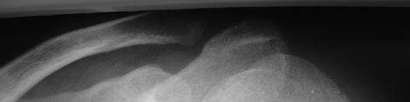
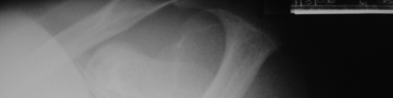
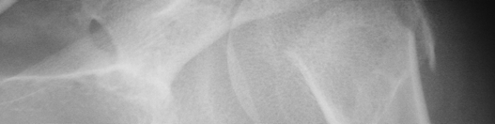

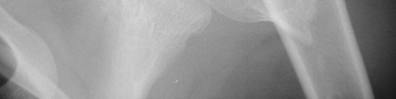

2-part fracture in healthy young man How will you treat?
1. Non operatively in a sling
2. Manipulation plus k-wire if unstable 3. Open reduction and internal fixation 4. Prosthetic replacement

Slide 45
Pre - operative plan
• Imaging is vital
• Expertise
• Implant availability
• Resources for perioperative care

Slide 46
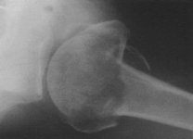
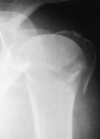
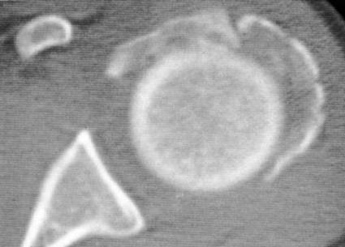
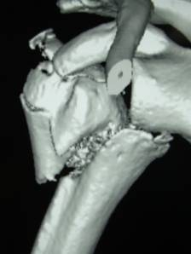
Management Tips
• Pre-surgery
• Sling + body-bandage
• Imaging: X-rays +/- CT
• Anaesthetic workup + optimisation

Slide 47
Implant choice
• K-wires
• Cannulated screws
• Tension band wire / suture • I.M.nail (retrograde or antegrade) • PHN
• Proximal humeral locking plate • Hemiarthroplasty
Combination may be required

Slide 48
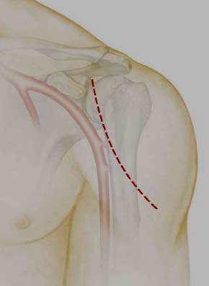
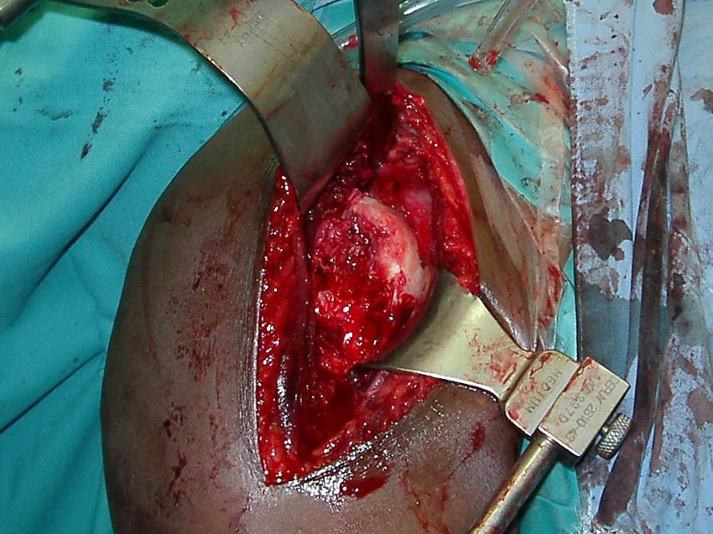
Surgical approach
- Deltopectoral approach
- Deltoid split

Slide 49
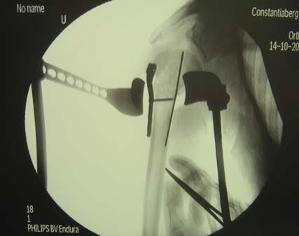
Surgery
Reduce fracture & provisionally fix

Slide 50
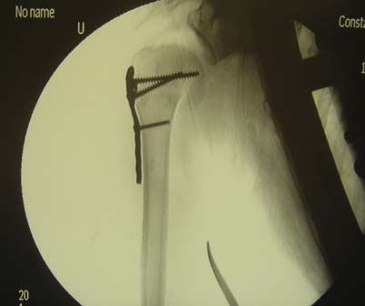
Surgery
• Locking screws into proximal segment

Slide 51
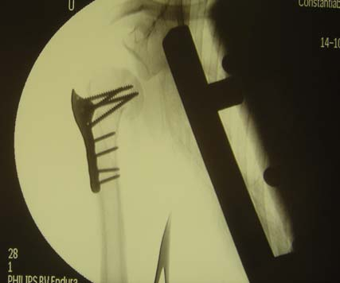
Surgery
• Complete fixation

Slide 52
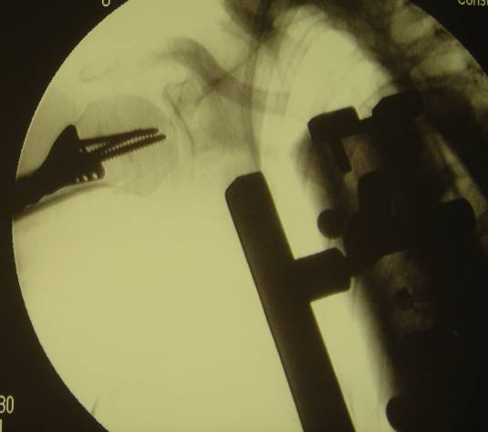
Surgery
• Ensure screw placement o.k.

Slide 53
Post operative care
• Consider ability & patient expectation • Consider stability & quality of repair • Passive - protected active - active • Supervision!

Slide 54
Complications
• Implant position • Malunion
• Non-union
• Avascular necrosis
• Nerve - axillary / brachial plexus • Infection

Slide 55
Summary
• Identify and classify # • Neurovascular assessment • Patient protoplasm and demand • Surgical experience and resources • Plan management accordingly • Choose implant carefully • Supervise rehabilitation

Slide 56
THANK YOU

