Slide 1
Right Cardiac Torsion
Dr. Parthiv Brahmbhatt
Professor
Radiology Department

Slide 2
Clinical History
Right mesothelioma treated by pleuro-pneumectomy and pericardiectomy. 12 hours after surgery, the patient presented an ill defined dizziness with global insufficiency cardiac signs.

Slide 3
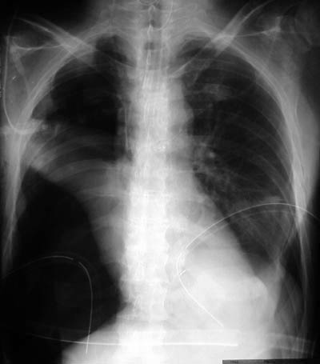
Imaging Findings
First control after pleuro-pneumectomy for right mesothelioma. The right upper opacity corresponds to the thoracoplasty. Normal cardiac contour.

Slide 4
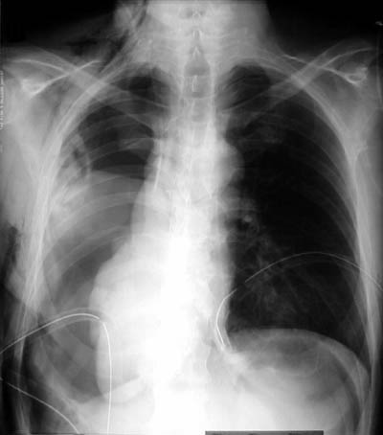
Chest radiograph obtained after sudden ill defined dizziness without perturbation of vital signs. Displacement and rotation of the heart in the right thoracic cavity.

Slide 5
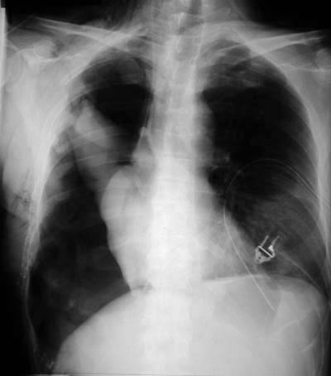
Control after surgical reduction of the cardiac torsion through a postoperative pericardial defect.

Slide 6
Discussion
Cardiac herniation with subsequent torsion is a rare life threatening complication after pneumectomy that requires an urgent surgical reduction. This clinical situation must be rapidly recognized, to allow prompt adequate treatmentdue to its high mortality rate. Etiology: Cardiac torsion can be seen in three conditions. After radical pneumectomy, in congenital pericardial anomaly and in post-traumatic conditions after rupture of the pericardium. The most common cause of cardiac torsion is due to pericardialectomy during pneumectomy without closure of the defect.

Slide 7
author | Study design | Level | conclusion
David sutton, 7th edition , volume 1 | metaanalytical | 1a | Computed tomography is probably more accurate than ultrasonography for right cardiac torsion in adults and adolescents. Prospective studies that apply gold standard diagnostic testing to all study participants would more reliably estimate the true diagnostic accuracy of these tests.

Slide 8
THANK YOU

