Slide 1
Sarcoidosis
Dr. Tushar Vaishnav
Professor
Radiology Department

Slide 2
What Is It ?
Idiopathic multisystemic chronic inflammatory disease
Characterized by presence of non-caseating granulomas
Commonly affects lungs, liver, skin, eyes

Slide 3
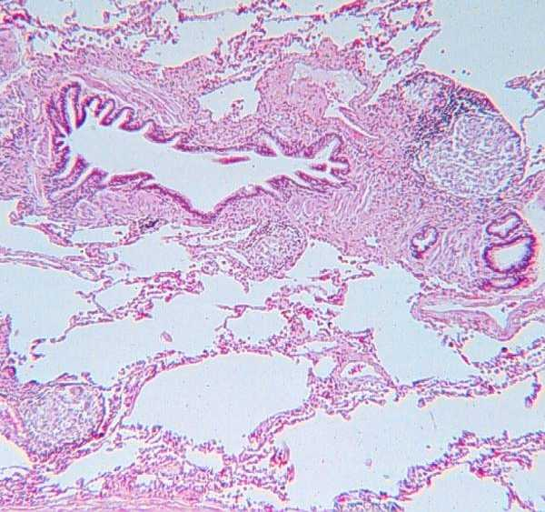

Slide 4
Who Does It Affect ?
Worldwide – Irish and Nordic populations especially Swedes
US – African American females
Age – typically young healthy adults, unusual before 18 yoa, smaller second peak around 60 yoa
Mostly sporadic
Incidence – 20-60/100,000
Notes:
Maybe more detected in AA because of worse and more chronic disease

Slide 5


Slide 6


Slide 7


Slide 8
Diagnosis
CXR – bilateral adenopathy
CT – more specific but not commonly used, shows peribronchial thickening and reticular nodular changes
BAL – increased lymphocytes, rule out other stuff
Mediastinoscopy
Bx – non-caseating granulomas
Supportive tests – ACE level, Ca²⁺ level
Notes:
EKG, Echo, eye exams, imaging to look for involvement in viscera and bones, PFTs

Slide 9
Signs and Symptoms
Asymptomatic to organ failure and death
Cough and SOB – most common
Non-specific skin lesions
Ocular symptoms – uveitis and optic neuritis
Constitutional – fever, night sweats, weight loss, fatigue
Notes:
erythema nodosum and lupus pernio

Slide 10
CXR
Initial test and most commonly used
Scoring system – Scadding in 1961
1 – hilar adenopathy, especially R paratracheal
2 – adenopathy and pulmonary infiltrates
3 – pulmonary infiltrates
4 – fibrosis, predominantly upper lobes
Notes:
increased stage correlates to lesser likelihood of spontaneous remission

Slide 11
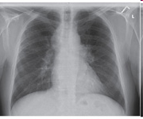
Stage 1

Slide 12
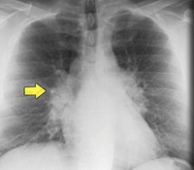
Stage 1
1-2-3 sign

Slide 13
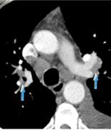
Stage 1
paratracheal adenopathy

Slide 14
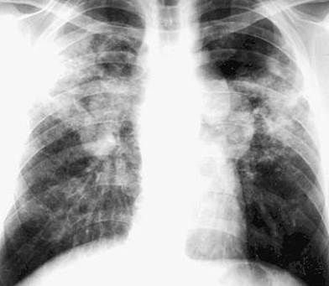
Stage 2

Slide 15
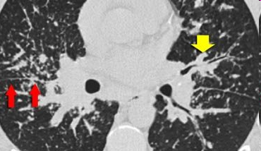
Stage 2
nodules along fissures and bronchovascular bundles

Slide 16
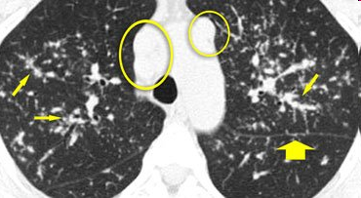
Stage 2

Slide 17
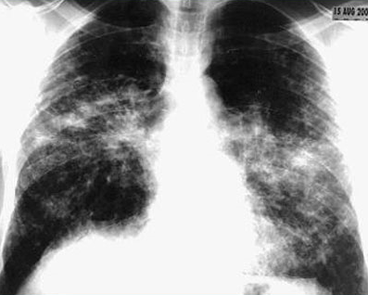
Stage 3

Slide 18
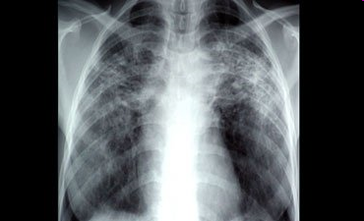
Stage 4

Slide 19
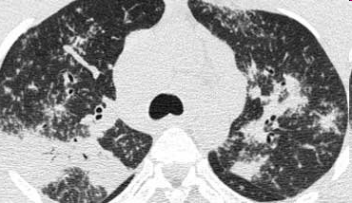
Stage 4

Slide 20
Prognosis
For most, disease is usually self-limiting and resolves within 3-5 years
Patients who present with pulmonary fibrosis, skin lesions other than erythema nodosum, bone lesions, cardiac disease, neurologic disease, or renal disease are at increased risk for chronic disease

Slide 21
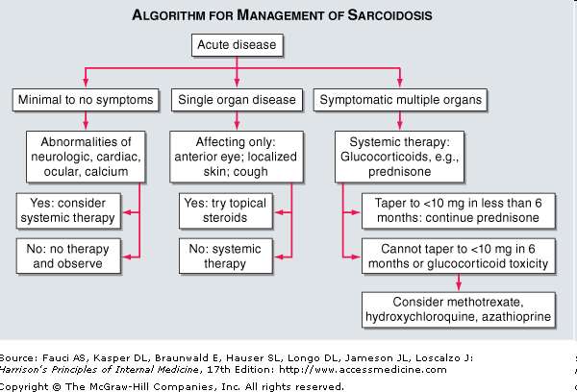
Treatment

Slide 22
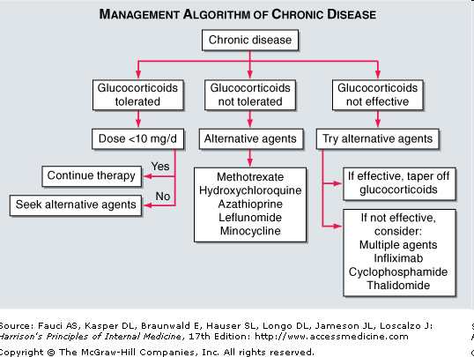
Treatment

Slide 23
The End

Slide 24
Sources
Harrison’s online
Radiology Department of the Rijnland Hospital, Leiderdorp and the Academical Medical Centre, Amsterdam, the Netherlands
Medscape
Current Diagnosis and Treatment in Pulmonary Medicine

Slide 25
Author/Year | Study Design | Level | Result | Outcome
Jack L. Westcott, M.D., and , Arthur C. DeGraff, Jr., M.D. September 1973 Volume 108, Issue 3 | Case series | 4 | Pulmonary vascular involvement in sarcoidosis is usually limited to the small and medium sized vessels. An unusual form of pulmonary artery involvement in a 29-year-old woman is described | Pressure from enlarged adjacent hilar nodes caused marked narrowing of the right upper lobe pulmonary artery and resulted in a large right upper lobe defect on the perfusion lung scan.

Slide 26
Author/Year | Study Design | Level | Result | Outcome
S Otake, , T Banno, , S Ohba, , M Noda, and , M Yamamoto | Case series | 4 | Twelve patients with muscular sarcoidosis were evaluated with magnetic resonance (MR) imaging: Nine patients had the nodular type and three had the myopathic type of muscular sarcoidosis. The nodular type showed a characteristic appearance on MR images. In each patient with the nodular type, both T1- and T2-weighted axial spin-echo images showed an oval nodule consisting of a star-shaped area of low signal intensity surrounded by an area of high signal intensity. | In each patient with the myopathic type of muscularsarcoidosis, MR images failed to show any abnormality; the authors hypothesize that this failure correlated with the sparse distribution of epithelioid cell granulomas. Identification of the star-shaped area of low signal intensity may help in the diagnosis of muscular sarcoidosisand the differentiation of lesions associated with sarcoidosis from other soft-tissue masses.

Slide 27
Thank You

