Slide 1

CERVICAL SPINE TUBERCULOSIS
Dr. Kunal G Solanki
PROFESSOR
RADIOLOGY DEPARTMENT

Slide 2
CASE REPORT
A 15yr old boy presented with complaints of dysphagia, neck pain and upper limb tingling and numbness since 2 months.
On physical examination the patient was sub-febrile , neck pain with restriction of neck movements.
Neurological motor weakness was noted in the right upper limb.
Routine Laboratory investigations were unremarkable apart from raised ESR.

Slide 3
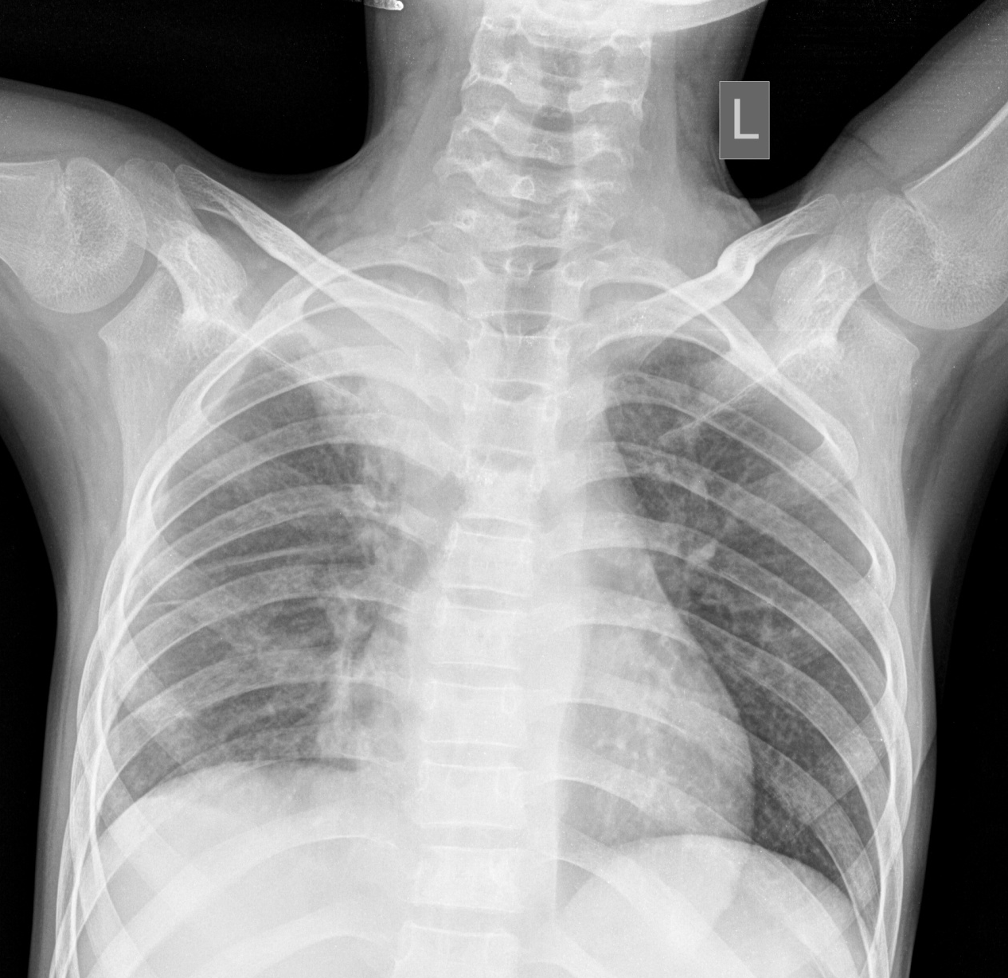
RADIOLOGICAL INVESTIGATIONS
CHEST XRAY
Fibrocavitatory lesion seen in the right upper lobe with erosion of the C6 and C7 vertebral body with a para-spinal soft tissue shadow on the right side.

Slide 4
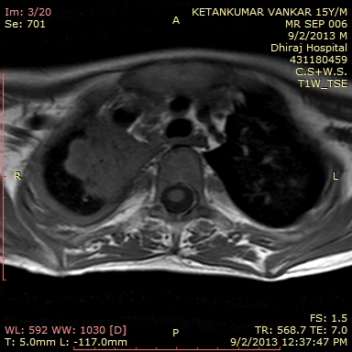
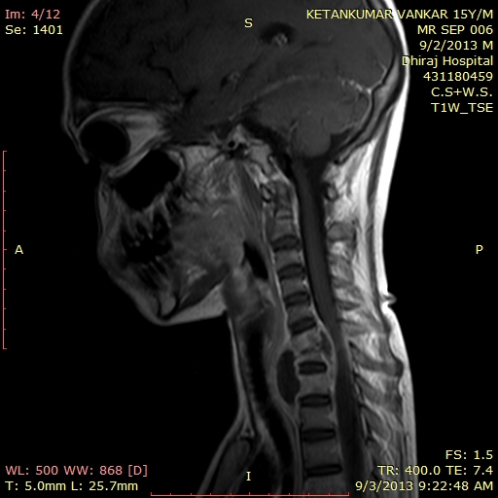
MRI CERVICAL SPINE – T1 WEIGHTED IMAGES
Soft tissue mass lesion seen in the right upper lobe.
Anterior wedge collapse of C7 vertebral body with pre and para vertebral collection extending posteriorly in the epidural space - Hypointense.

Slide 5
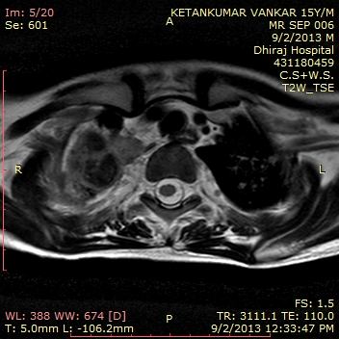
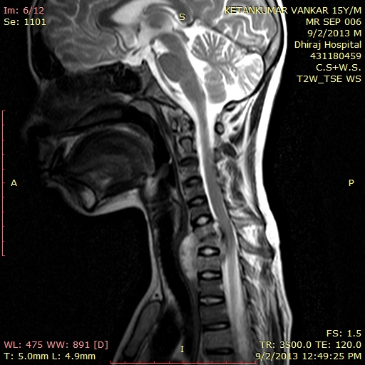
T2 WEIGHTED IMAGES
Anterior wedge collapse of C7 vertebral body with pre and para vertebral collection extending posteriorly in the epidural space - Hypointense.

Slide 6
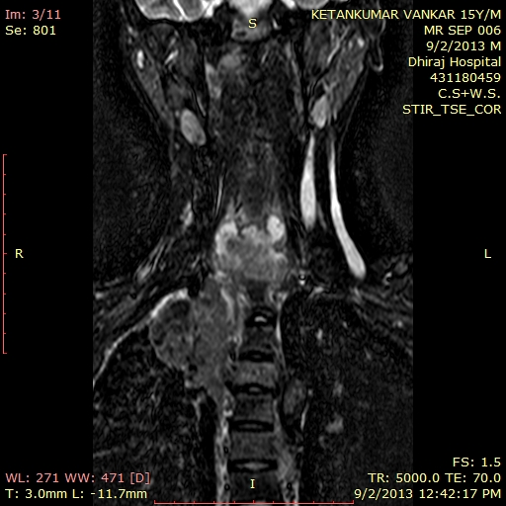
SHORT TIME INVERSION RECOVERY SEQUENCE
The collection does not show any suppression on STIR images.

Slide 7
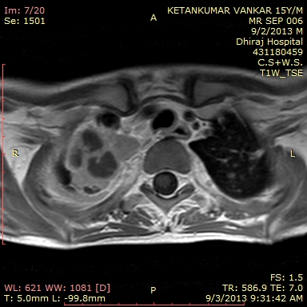
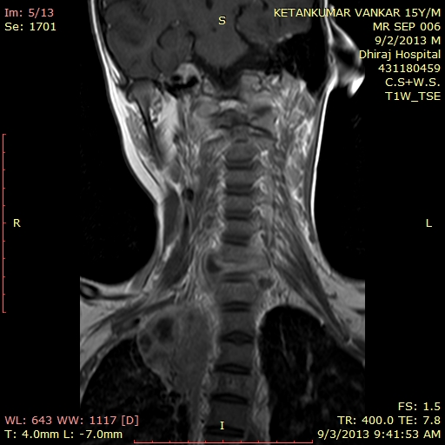
POST CONTRAST T1 WEIGHTED IMAGES
The associated collection shows peripheral enhancing wall on post contrast study.
Soft tissue lesion in the lung appears heterogeneously enhancing with multiple central hypo-intense lesions suggestive of necrosis.

Slide 8
FINAL DIAGNOSIS
MR findings reveal anterior wedge collapse with decreased height of C7 vertebra along with pre & para vertebral and epidural peripherally enhancing abscess causing anterior thecal sac indentation, spinal cord compression and spinal cord narrowing with rest of findings as mentioned in text.
Large heterogeneously enhancing soft tissue lesions in right upper lobe with central areas of necrosis.
Significantly enlarged conglomerated peripherally enhancing cervical necrotic lymph nodes.
Above findings are likely suggestive of infective aetiology likely Koch's .

Slide 9
DISCUSSION
Tuberculosis is a major global health problem. Every year eight million new cases are detected and about three million people die from this disease worldwide.
Spinal tuberculosis is a rare variant of TB, comprising less than 3% of cases. Lumbar and thoracic regions are often in­volved, whereas TB occurrence in the cervical spine is uncommon.
In spinal TB, onset of symptoms is usually insidious and disease progression slow.

Slide 10
Other conditions, which should be differentiated from TB of the spine include pyogenic and fungal osteomyelitis, multiple myeloma and eosinophilic granuloma.
The best diagnostic modality for spinal TB is MRI. MRI is more sensitive than radiography and more specific than CT in the diagnosis of spinal TB. MRI can also provide the diagnosis of TB of the spine 4-6 months earlier than conventional methods, offering the benefits of earlier detection and treatment.

Slide 11
author | Study design | Level | conclusion
David sutton, 7th edition , volume 1 | metaanalytical | 1a | Computed tomography is probably more accurate than ultrasonography for diagnosing cervial spine tb in adults and adolescents. Prospective studies that apply gold standard diagnostic testing to all study participants would more reliably estimate the true diagnostic accuracy of these tests.

Slide 12
THANK YOU

