Slide 1
Preoperative Assessment & Preparation
Dr. Sara Mary Thomas
Professor & Head
Dept. of Anaesthesia
SBKSMIRC

Slide 2
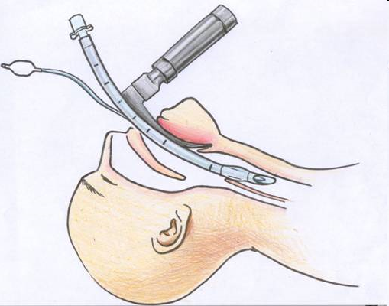
What is Anaesthesia ?
Reversible controlled loss of consciousness
Analgesia
Areflexia
Muscle relaxation

Slide 3
Preoperative Evaluation
Anesthetic drugs and techniques have profound effects on human physiology. Hence, a focused review of all major organ systems should be completed prior to surgery.
Goals of the preoperative evaluation is to ensure that the patient is in the best (or optimal) condition.
Vacanti cj et al Anaesth Analg:1970:19:564-6
Patients with unstable symptoms should be postponed for optimization prior to elective surgery.

Slide 4
The following primary goals of preoperative evaluation and preparation have been identified:
Documentation of the condition(s) for which surgery is needed.
Assessment of the patient’s overall health status.
Uncovering of hidden conditions that could cause problems both during and after surgery.
Perioperative risk determination.
Optimization of the patient’s medical condition in order to reduce the patient’s surgical and anesthetic perioperative morbidity or mortality.
Development of an appropriate perioperative care plan.
Education of the patient about surgery, anesthesia, intraoperative care and postoperative pain treatments in the hope of reducing anxiety and facilitating recovery.
Reduction of costs, shortening of hospital stay, reduction of cancellations and increase of patient satisfaction.
Hippokratia. 2007 Jan-Mar; 11(1): 13–21.
PMCID: PMC2464262
Preoperative evaluation and preparation for anesthesia and surgery

Slide 5
Steps of the preoperative visit :
Problem Identification
Risk Assessment
Preoperative Preparation
Plan of Anesthetic Technique

Slide 6
I. Problem Identification
Cardiovascular : hypertension ; ischemic , valvular or congenital heart disease; CHF or cardiomyopathy, , arrhythmias
Respiratory : smoking; COPD; restrictive lung disease; altered control of breathing (obstructive sleep apnea, CNS disorders, etc.)
Neuromuscular : raised ICP ; TIA's or CVA's; seizures; spinal cord Injury; disorders of NM junction e.g myasthenia gravis, muscular dystrophies ,MH
Endocrlne : DM; thyroid disease; pheochromocytoma; steroid therapy
GI - Hepatic : hepatic disease; gastresophageal reflux

Slide 7
Renal : renal failure
Hematologic : anemias; coagulopathies
Elderly , Children, Pregnancy
Medications and Allergies
Prior Anesthetics
Related to Surgery : significant blood loss; respiratory compromise; positioning

Slide 8
I. Problem Identification
Through :
History (including a review of the patient's chart)
Physical examination
Laboratory investigationS

Slide 9
Physical Examination:
General & Local examination
Should focus on evaluation of :
    Upper airway
    Respiratory system
    Cardiovascular system
    Other systems’ problems identified from the history

Slide 11
Predictors of difficult intubation ( 4 M )
Mallampati
Measurements 3-3-2-1 or 1-2-3-3 Patient ‘s fingers
Movement of the Neck
Malformations of the Skull
Teeth
Obstruction
Pathology
( Yamamoto k e tal Anaesthesiology 1997;86.316-21)

Slide 12



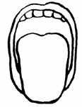
Mallampati
Class I = visualize the soft palate, fauces, uvula, anterior and posterior pillars.
Class II = visualize the soft palate, fauces and uvula.
Class III = visualize the soft palate and the base
of the uvula.
Class IV = soft palate is not visible at all
Used alone, the Mallampati tests have limited accuracy for predicting the difficult airway and thus are not useful screening tests*.
*Lee Anna et al Anesthesia & Analgesia:
June 2006 - Volume 102 - Issue 6 - pp 1867-1878

Slide 13
The modified Mallampati classification (MMP) is widely used for pre-operative assessment of airway, ^{[1]} and Mallampati scores of III and IV have been reported to be valuable in predicting difficult laryngoscopy in acromegalic patients as well. ^{[2]}
As it is known that MMP not only assesses pharyngeal structures but also head and neck mobility. It has been suggested that craniocervical extension relates to mouth opening and limited head and neck mobility can result in poor MMP. ^{[3],[4]}
Mashour and Sandberg found that application of craniocervical extension improves the specificity and positive predictive value while retaining the sensitivity of the traditional MMP examination in a group of normal patients. The addition of craniocervical extension to the MMP was referred as the extended Mallampati score (EMS).
J Anaesthesiol Clin Pharmacol. 2013 Apr-Jun; 29(2): 187–190
Predicting difficult laryngoscopy in acromegalic patients undergoing surgery for excision of pituitary tumors: A comparison of extended Mallampati score with modified Mallampati classification
Ashish Bindra, Hemanshu Prabhakar, Parmod K Bithal, Gyaninder Pal Singh, Tumul Chowdhury

Slide 14


Measurements 3-3-2-1
3 Fingers Mouth Opening
3 Fingers Hypomental Distance. (3 Fingers between the tip
of the jaw and the beginning of the neck (under the chin)
2 Fingers between the thyroid notch and the floor of the mandible (top of the neck)
1 Finger Lower Jaw Anterior sublaxation

Slide 15
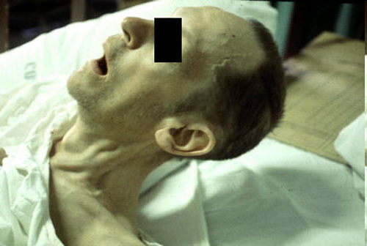
Movement of the Neck

Slide 16
Malformation
Skull (Hydro and Microcephalus)
Teeth (Buck, protruded, & loose teeth. Macro and Micro mandibles)
Obstruction (obesity, short Bull Neck & swellings around the head and neck)
Pathology (Craniofacial abnormalities & Syndromes e.g. Treacher Collins, Goldenhar's, Pierre Robin syndromes)
“Patients with an abnormal airway (including Class III or IV airway) should be considered at higher risk “.
.

Slide 17
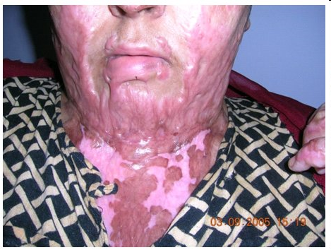
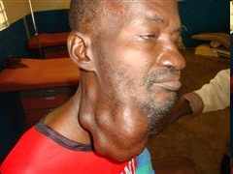
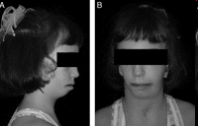
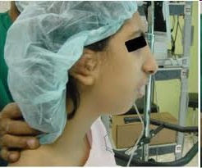

Slide 18
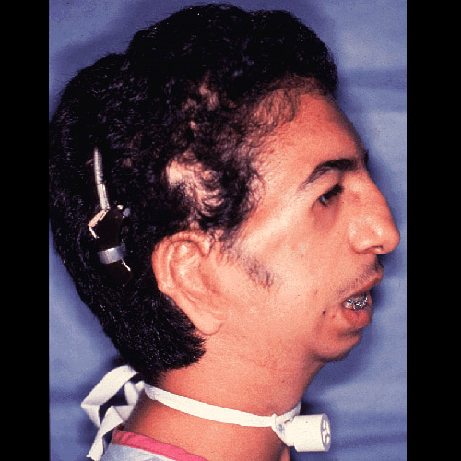
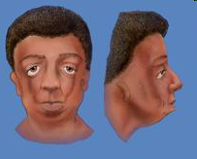
Treacher Collins
(mandibulofacial dysostosis)

Slide 19
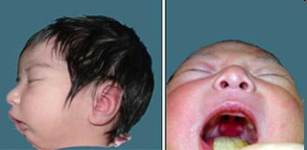
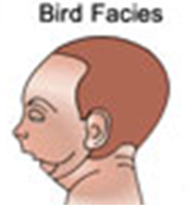
Pierre Robin
( hypertelorism; and external and middle ear deformities)

Slide 20
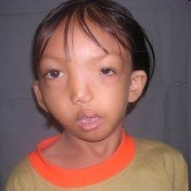
Goldenhar's
(oculoauriculovertebral dysplasia)

Slide 21
Preoperative testing is overused in patients undergoing low-risk, ambulatory surgery. Neither testing nor abnormal results were associated with postoperative outcomes. On the basis of high rates of testing in healthy patients, physician and/or facility preference and not only patient condition currently dictate use. Involvement from surgical societies is necessary to establish guidelines for preoperative testing.
Preoperative laboratory testing in patients undergoing elective, low-risk ambulatory surgery.
Benarroch-Gampel J, Sheffield KM, Duncan CB, Brown KM, Han Y, Townsend CM Jr, Riall TS.
Source
Department of Surgery, University of Texas Medical Branch, Galveston, TX 77555, USA.

Slide 22
Preoperative Laboratory Testing:
only if indicated from the preoperative history and physical examination.
"Routine or standing" pre operative tests should be discouraged
-CBC anticipated significant blood loss, suspected hematological disorder (eg.anemia, thalassemia, SCD), or recent chemotherapy.
-Electrolytes diuretics, chemotherapy, renal or adrenal disorders
-ECG age >50 yrs ,history of cardiac disease, hypertension, peripheral vascular disease, DM, renal, thyroid or metabolic disease.
-Chest X-rays prior cardiothoracic procedures ,COPD, asthma, a change in respiratory symptoms in the past six months.
-Urine analysis DM, renal disease or recent UTI.
-tests for different systems according to history and examination

Slide 23
II. Risk Assessment
Components for evaluating perioperative risk:
  patient's medical condition preoperatively
  extent of the surgical procedure
  risk from the anesthetic
“Most of the work, however, addresses the operative risk
according to the patient's preoperative medical status”

Slide 24
ASA Physical Status Classification System
 | medical status | mortality
ASA I | normal healthy patient without organic, biochemical, or psychiatric disease | 0.06-0.08%
ASA II | mild systemic disease with no significant impact on daily activity e.g. mild diabetes, controlled hypertension, obesity . | Unlikely to have an impact 0.27-0.4%
ASA III | severe systemic disease that limits activity e.g. angina, COPD, prior myocardial infarction | Probable impact 1.8-4.3%
ASA IV | an incapacitating disease that is a constant threat to life e.g. CHF, unstable angina, renal failure ,acute MI, respiratory failure requiring mechanical ventilation | Major impact 7.8-23%
ASA V | moribund patient not expected to survive 24 hours e.g. ruptured aneurysm | 9.4-51%
ASA VI | brain-dead patient whose organs are being harvested
For emergent operations, you have to add the letter ‘E’ after the classification.

Slide 25
III. Preoperative Preparation
Anesthetic indications:
-Anxiolysis, sedation and amnesia. e.g. benzodiazepine(diazepam ,lorazepam)
-Analgesia e.g narcotics
-Drying of airway secretions e.g atropine,glycopyrrolate,scopolamine
-Reduction of anesthetic requirements ,Facilitation of smooth induction
-Patients at risk for GE reflux :ranitidine ,metoclopramide , sodium citrate
Surgical indications:
-Antibiotic prophylaxis for infective endocarditis.
-Prophylaxis against DVT for high risk patients : low-dose heparin or aspirin
intermittent calf compression, or warfarin.
Co-existing Disease indications:
Some medications should be continued on the day of surgery e,g B blockers, thyroxine. Others are stopped e.g oral hypoglycemics and antidepressants .
Steroids within the last six months may require supplemental steroids

Slide 26
Common Preoperative Medications, Doses, and Administration Routes (adult)
MEDICATION | ADMINISTRATION ROUTE | DOSE (mg)
Lorazepam | Oral, IV | 0.5–4
Midazolam | IV | Titration of 1.0–2.5-mg doses
Fentanyl | IV | Titration of 25–100–µg doses
Morphine | IV | Titration of 1.0–2.5-mg doses
Meperidine | IV | Titration of 10–25-mg doses
Cimetidine | Oral, IV | 150–300
Ranitidine | Oral | 50–200
Metoclopramide | IV | 5–10
Atropine | IV | 0.3–0.4
Glycopyrrolate | IV | 0.1–0.2
Scopolamine | IV | 0.1–0.4

Slide 27
Fasting Recommendations
INGESTED MATERIAL | MINIMUM FASTING PERIOD, APPLIED TO ALL AGES (hr)
Clear liquids | 2
Breast milk | 4
Infant formula | 6
Nonhuman milk | 6
Light meal (toast and clear liquids) | 6

Slide 28
IV. Plan of Anesthetic Technique
Is the patient's condition optimal?
Are there any problems which require consultation or special tests? “Please assess and advise “
3. Is there an alternative procedure which may be more appropriate?
4. What are the plans for postoperative management of the patient?
5. What premedication if any is appropriate?

Slide 29
Finally, we plan our anesthetic technique :
Local or Regional anesthesia with 'standby‘ monitoring with or without sedation.
2. General anesthesia; with or without intubation. Spontaneous or controlled ventilation is used.
3. Combined regional with general anesthesia.

Slide 30
Author | Title | Journal details | Abstract | Level of evidence | Conclusion
Lee, Anna et al | A Systematic Review (Meta-Analysis) of the Accuracy of the Mallampati Tests to Predict the Difficult Airway | Anesthesia & Analgesia: June 2006 - Volume 102 - Issue 6 - pp 1867-1878 | For predicting difficult laryngoscopy, both versions of the Mallampati test had good accuracy For predicting difficult intubation, the modified Mallampati test had good accuracy whereas the original Mallampati test was poor . The Mallampati tests were poor at identifying difficult mask ventilation. | 1A | Used alone, the Mallampati tests have limited accuracy for predicting the difficult airway and thus are not useful screening tests

Slide 31
Q1. How many grades of mpg are there ?
1 3
2 6
3 4
4 8
Q2. Normal Breathe holding time ?
1 >10sec
2 15-20 sec
3 >25 sec
4 > 30 sec
Q3. How many grades does ASA has?
1 3
2 4
3 6
42
Q4. Which of the following is used to asses the airway?
1 mpg
2 spg
3 dsg
4 tsg
Q5. Normal fasting blood sugar?
1 116mg/dl
2 220mg/dl
3 126mg/dl
4 180mg/dl

