Slide 1

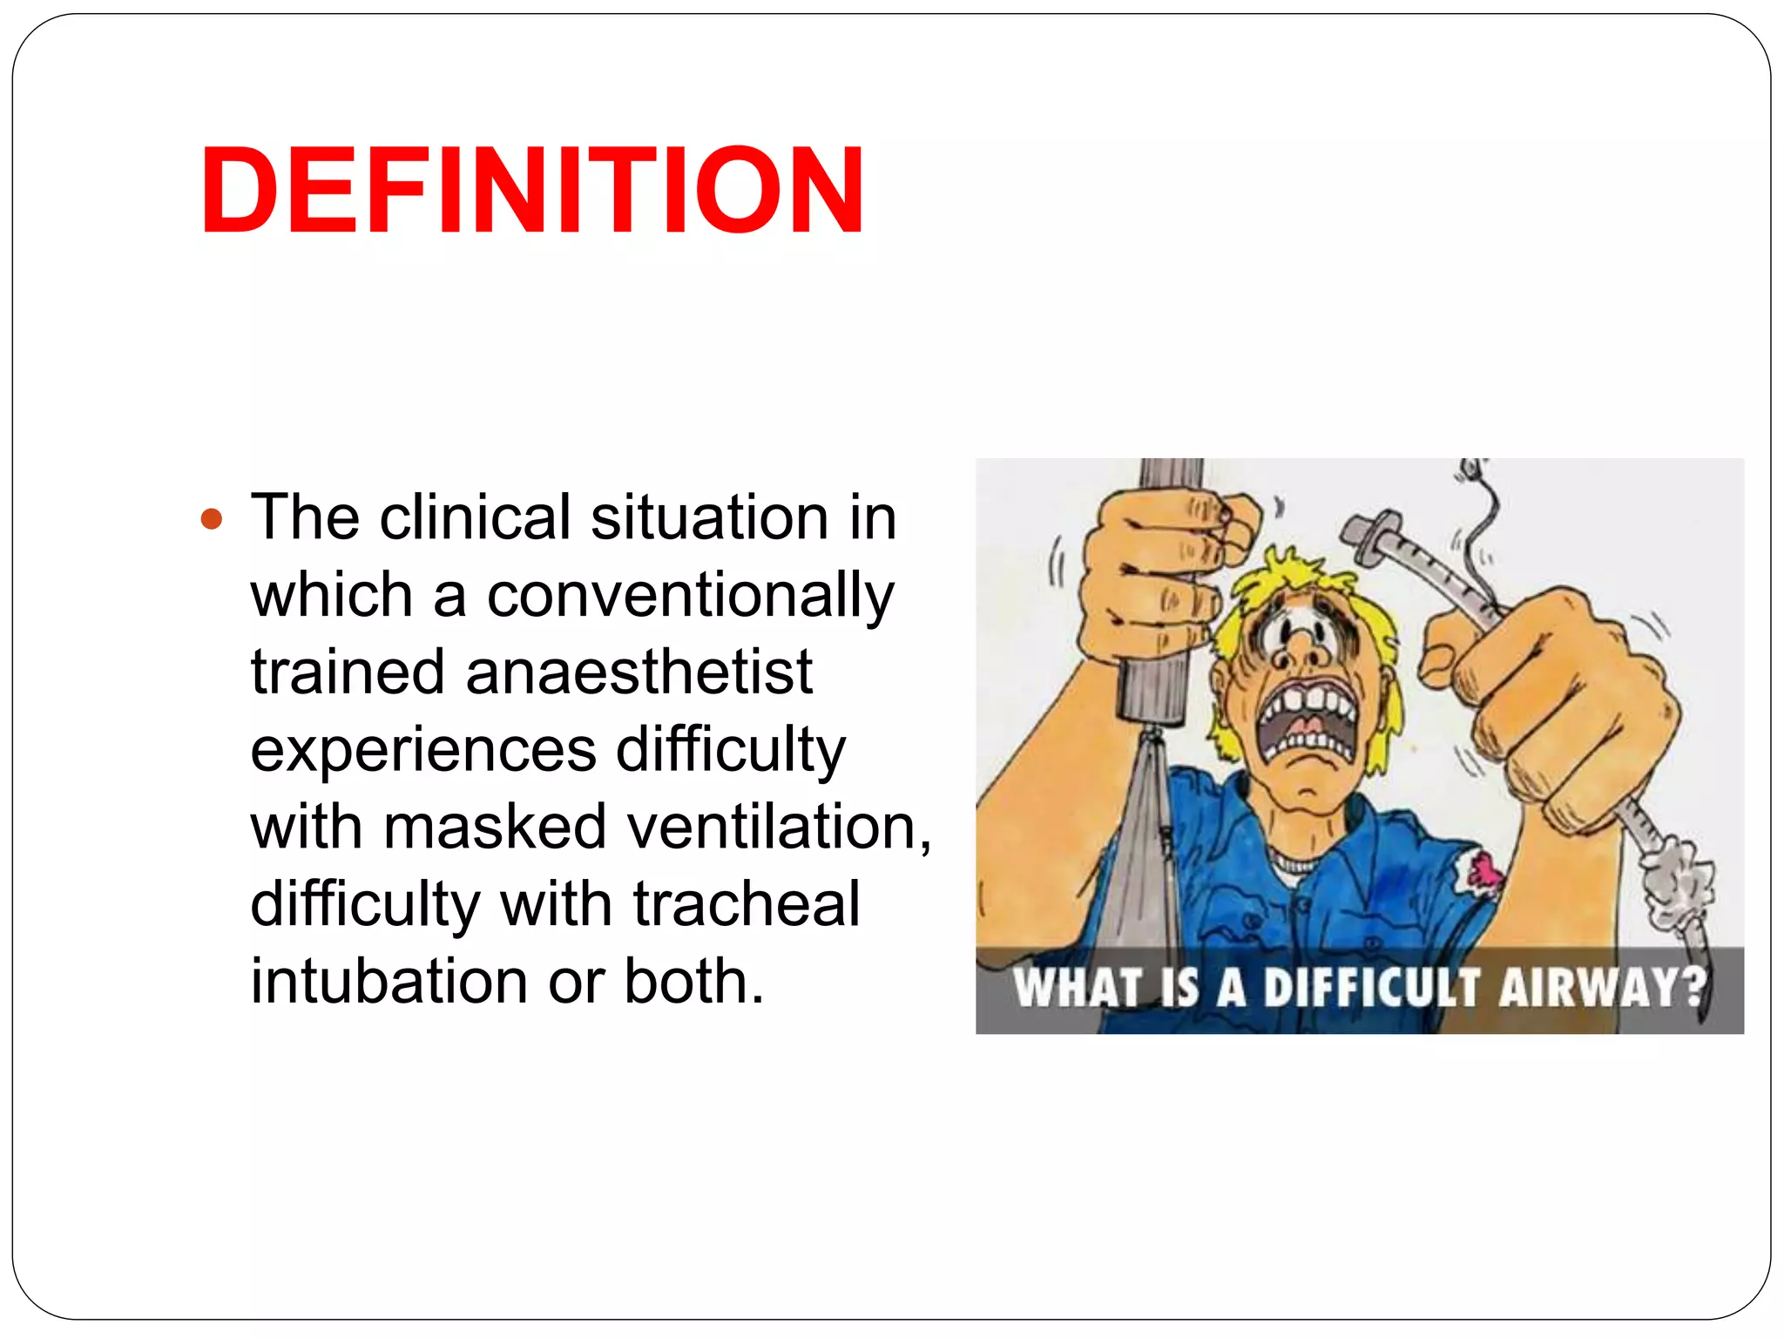
AIRWAY ASSESSMENT
Dr. Jatin Patel
Professor
Dept. of Anaesthesia
SBKSMIRC

Slide 2
Definition
AIRWAY: The passage through which the air passes during respiration.
DIFFICULT AIRWAY : According to ASA it is defined as the clinical situation in which a conventionally trained anaesthesiologist is unable to maintain the oxygen saturation above 90 % by using face-mask ventilation ( cannot ventilate – cannot intubate )

Slide 3
CAUSES OF DIFFICULT AIRWAY
1) FACIAL ANOMALIES - Maxillary hypoplasia (Apert syndrome, Crouzon ds)
Mandibular hypoplasia (Gierre Robin syndrome,
Treacher Collins syndrome, Goldenhar syndrome)
Mandibular hyperplasia (acromegaly)
2)TMJ PATHOLOGY - Ankylosis or reduced movement
3)MOUTH & TONGUE ANOMALY - Microstomia (burns, trauma), tumor of mouth & tongue macroglossia (down's syndrome, hypothyroidism)
4)TEETH PROBLEMS - Missing left upper incisors, protruding upper incisors
5)NOSE PATHOLOGY - Hypertrophied turbinate, polyps, gliomas, foreign bodies, DNS
6) PALATE PATHOLOGY - Narrow arched palate, large cleft palate
7) PHARYNX PATHOLOGY - Hypertrophied tonsils & adenoid, tumors, abscess
(retropharyngeal / parapharyngeal abscess)

Slide 4
8) LARYNX PATHOLOGY - Epiglotitis, laryngomalacia, foreign body, papillomas, congenital stenosis, edema
9) TRACHEAL PATHOLOGY - Tracheitis, tracheoesophageal fistula, tracheal stenosis & webbing, foreign body, tracheomalacia
10) BROCHIAL TREE PATHOLOGY - Mediastinal mass, foreign body aspiration, bronchial tumors
11)NECK-Large goiter, skin contracture, ankylosing spondylitis
12)SPINE- Limitation of movement( congenital Klippel-Feil syndrome, Acquired - surgical fusion, fracture of cervical vertebrae); cervical spine instability (down's syndrome

Slide 5
GROUP INDICES
Difficult Bag Mask Ventilation: BONES
B: Bearded individual
o: obesity ( BMI> 26 kg/m2 )
N: No teeth
E: Elderly ( age > 55 yrs )
S: Snorer
Patients having 2 or more of these are likely to have difficult mask ventilation
• MOANS
This is identicle to BONES except 'M'.
-Mask seal difficult due to receding mandible, syndromes with facial abnormalities,burn stricture etc.
-Obesity, upper airway Obstruction
-Advanced age
-No teeth
-Snorer

Slide 6
Predictors of difficult laryngoscopy and intubation
Individual indices
-Physical examination indices
-radiological indices
-advanced indices
Group indices
- Wilson's score
- Benumof's analysis
- Saghei & safavi test
- Lemon assessment
- Arne's simplified score
- Magboul's 4 M's

Slide 7
Physical examination indices
DIRECT ASSESSMENT :
Atlanto-occipital movement
The patient is asked to hold head erect, facing directly to the front, then he is asked to extend the head maximally and the examiner estimates the angle traversed by the occlusal surface of upper teeth.
GRADE | REDUCTION OF A.O. EXTENSION
1 | NONE
2 | One third
3 | Two third
4 | complete

Slide 8
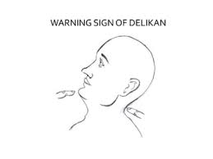
Warning sign of DELIKAN
Place the index finger of left hand, one underneath the chin and index finger of right hand under the inferior occipital prominence with the head in neutral position. The patient is asked to fully extend the head on neck. If the finger under the chin is seen to be higher than the other, there would appear to be no difficulty with intubation. If level of both fingers remains same or the chin finger remains lower than the other, increased difficulty is predicted.

Slide 9
INDIRECT ASSESSMENT :
Approx 1/3rd juvenile diabetics patiens present with laryngoscopic difficulties due to “stiff joint syndrome”. Patients with this syndrome have diffivulty in approximating palms and cannot bend their fingers backwards “prayer sign”
ASSESSMENT OF TMJ FUNCTION
TM joint exhibits 2 function.
1. Rotation of the condyle in the s.cavity.
2. Forward displacement of the condyle.
First movement is responsible for 2-3cm mouth opening & the second is responsible for further 2-3cm mouth opening.

Slide 10
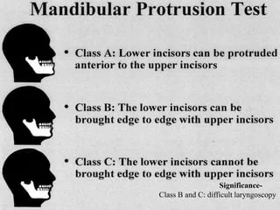
SUBLUXATION OF THE MANDIBLE
Index finger is placed in front of the tragus & the thumb is placed in front of the the lower part of the mastoid process. patient is asked to open his mouth as wide as possible. Index finger in front of the tragus can be intented in its space and the thumb can feel the sliding movement of the condyle as the condyle of the mandible slides forward

Slide 11
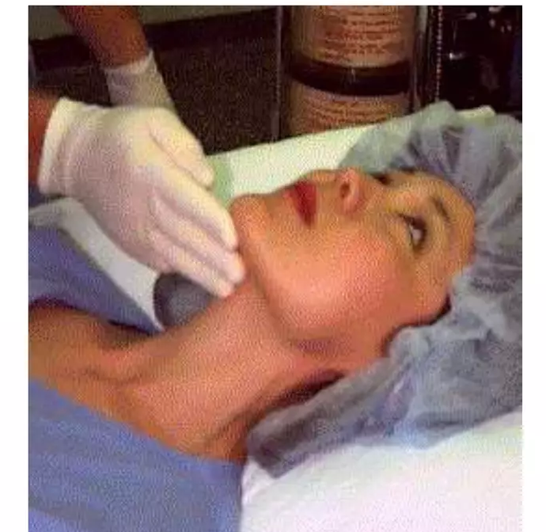
CALDER TEST : Patient is asked to protrude mandible as far as possible . The lower incisors will lie either anterior to , aligned with or posterior to upper incisors. The later two suggest reduced view at laryngoscope.
ASSESSMENT OF MANDIBULAR SPACE
1. Thyromental distance / PATIL’S TEST: Distance b/w thyroid notch and mental symphysis when neck is fully extended.
>6.5 cm : no problem with laryngoscopy and intubation
6-6.5 cm : without other concomitant anatomical problems , laryngoscopy and intubation are difficult but possible.
<6 cm : laryngcopy may be impossible .

Slide 12
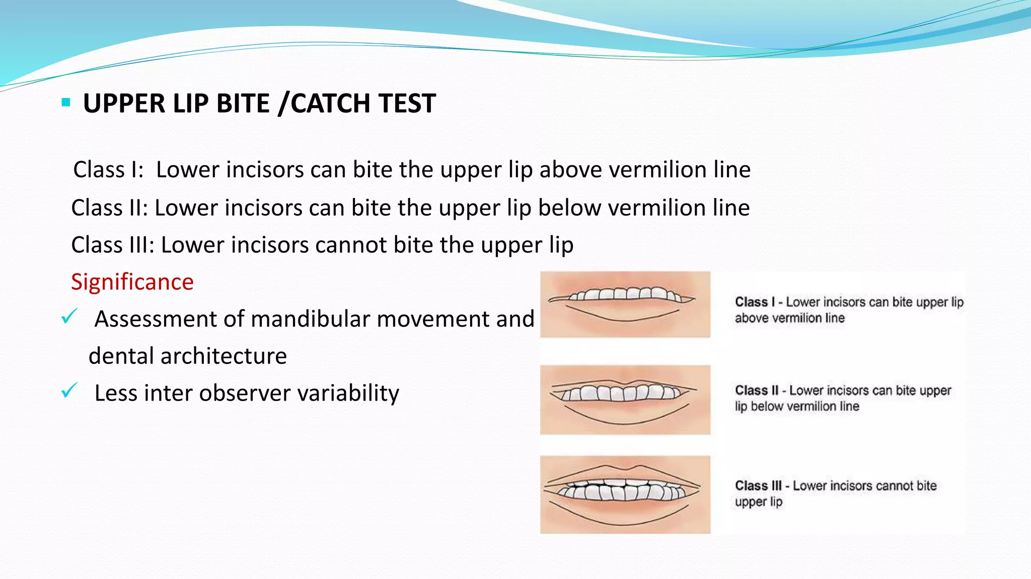
UPPER LIP BITE /CATCH TEST
Class I: Lower incisors can bite the upper lip above vermilion line
Class II: Lower incisors can bite the upper lip below vermilion line
Class III: Lower incisors cannot bite the upper lip
Significance
✓ Assessment of mandibular movement and dental architecture
✓ Less inter observer variability

Slide 13
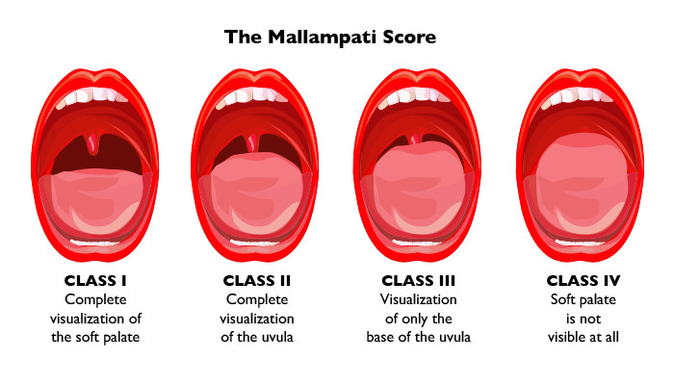
HYOMENTAL DISTANCE : distance b/w mentum and hyoid bone .
Grade I: > 6cm
Grade II: 4 - 6cm
Grade III: <4cm - Impossible laryngoscopy & Intubation.
TESTS FOR ASSESSING THE ADEQUACY OF OROPHARYNX FOR LARYNGOSCOPY AND INTUBATION
MALLAMPATI GRADING:

Slide 14
INTER-INCISOR GAP
- Inter-incisor distance with maximal mouth opening - Normal value >5cm/ admits 3 fingers.
Significance:
Positive results: Easy insertion of a 3 cm deep flange of the laryngoscope blade
<3cm: Difficult laryngoscopy
<2cm: Difficult LMA insertion
Affected by TMJ and upper cervical spine mobility
STERNOMENTAL DISTANCE (SAVVA TEST)
- Distance from the upper border of the manubrium to the tip of mentum, neck fully - extended,mouth closed
- Minimal acceptable value - 12.5cm
- Single best predictor of difficult laryngoscopy and intubation (Has high sensitivity & specificity)

Slide 15
NARROWNESS OF THE PALATE : Evaluate the narrowness of palate while performing Mallampati grading . A narrow , high arched palate offers very little space for laryngoscopy and simultaneous endotracheal intubation .
ASSESSMENT FOR QUALITY OF GLOTTIC VIEWING DURING LARYNGOSCOPY :
1. INDIRECT MIRROR LARYNGOSCOPIC VIEW :
1. Complete vocal cords visible
2. Posterior commissure visible .
3. Epiglottis visible .
4. No glottic structures visibl
2. DIRECT LARYNGOSCOPY “ AWAKE LOOK ”

Slide 16
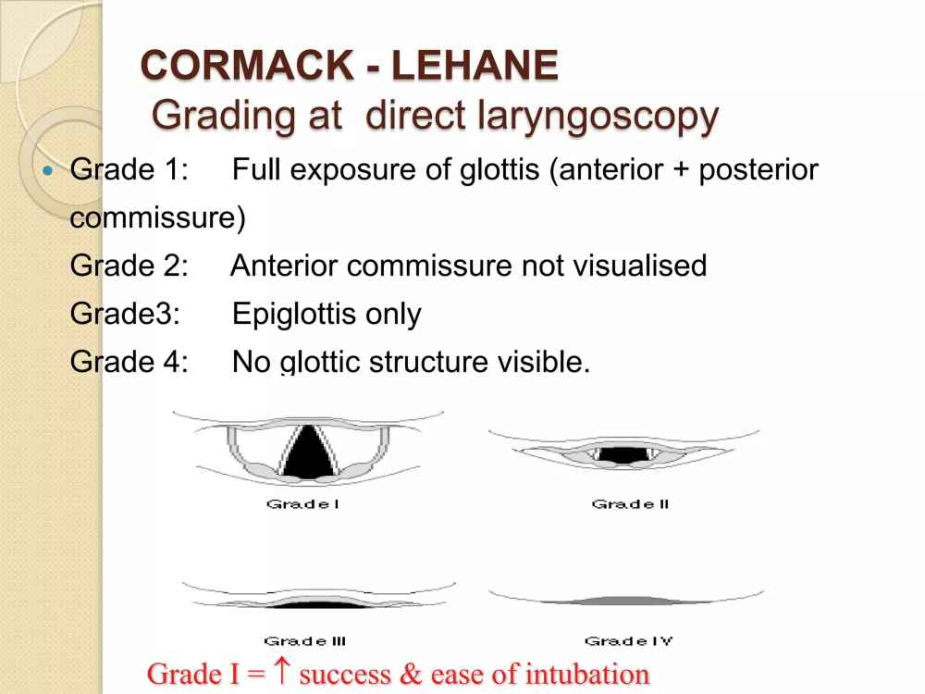

Slide 17
GRADING EASE OF INTUBATION :
Grade 1: no extrinsic manipulation of larynx is required .
Grade 2 : external manipulation of the larynx is necessary to intubate .
Grade 3 : intubation possible only when aided by a stylet .
Grade 4 : failed intubation .
RATIO OF PATIENT HEIGHT TO THYROMENTAL DISTANCE :
. If ratio pf patient height to thyromental distance is lesser than 23.5 , easy laryngoscopy may be anticipated

Slide 18
POGO SCORING
Percentage of glottic opening during direct laryngoscopy
100%- entire glottis structures visible
33%- only lower third of vocal cord & arytenoid visible
0% - no glottic structure visible
USEFUL WHEN NEW INTUBATING DEVICE TO RECORD EXACT % OF GLOTTIC OPENING
THAT CAN BE VISUALISED BY THIS DEVICE

Slide 19
STERNOMENTAL DISTNACE :
A distance of < 12.5cm predicts difficult laryngoscopic intubation .
GROUP INDICES
WILSON’S SCORING SYSTEM :
 | 0 | 1 | 2
Weight ( kg ) | < 90 | 90-110 | >110
Head and neck movement | >90 degree | 90 degree | <90 degree
Jaw movement ( inter incisor gap | > 5 cm | 5 cm | < 5 cm
Sliding mandibular beyond maxillary incisors | >0 | 0 | <0
Receding mandible | none | moderate | severe
Buck teeth | none | moderate | severe

Slide 20
Patients scoring 5 or less have easy laryngoscopy
6-7 moderate difficulty
8-10 have severe difficulty
BELLHOUSE’S CRITERIA :
Restricted atlanto – occipital joint extension
Reduced mandibular space
Enlarged tongue ( versus pharyngeal ) size
BENUMOF’S 11 PARAMETER ANALYSIS:

Slide 21
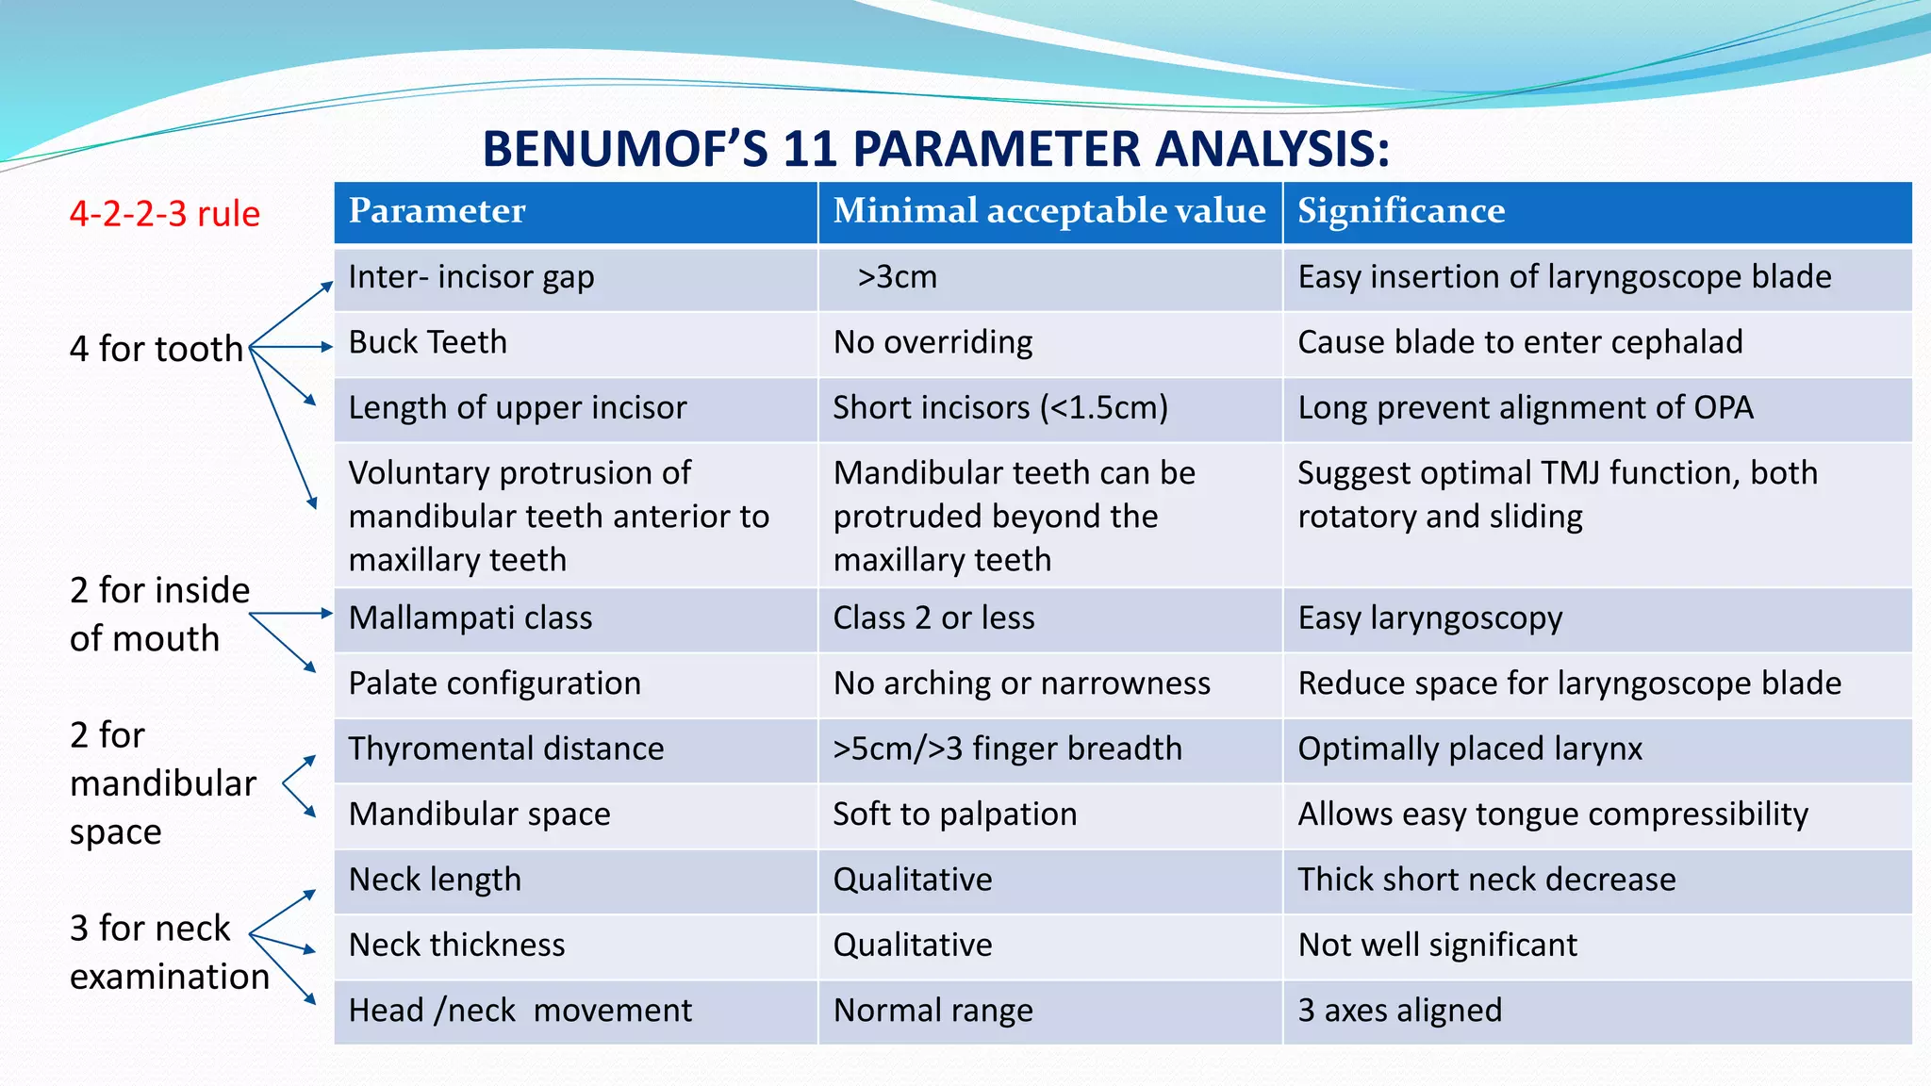

Slide 22
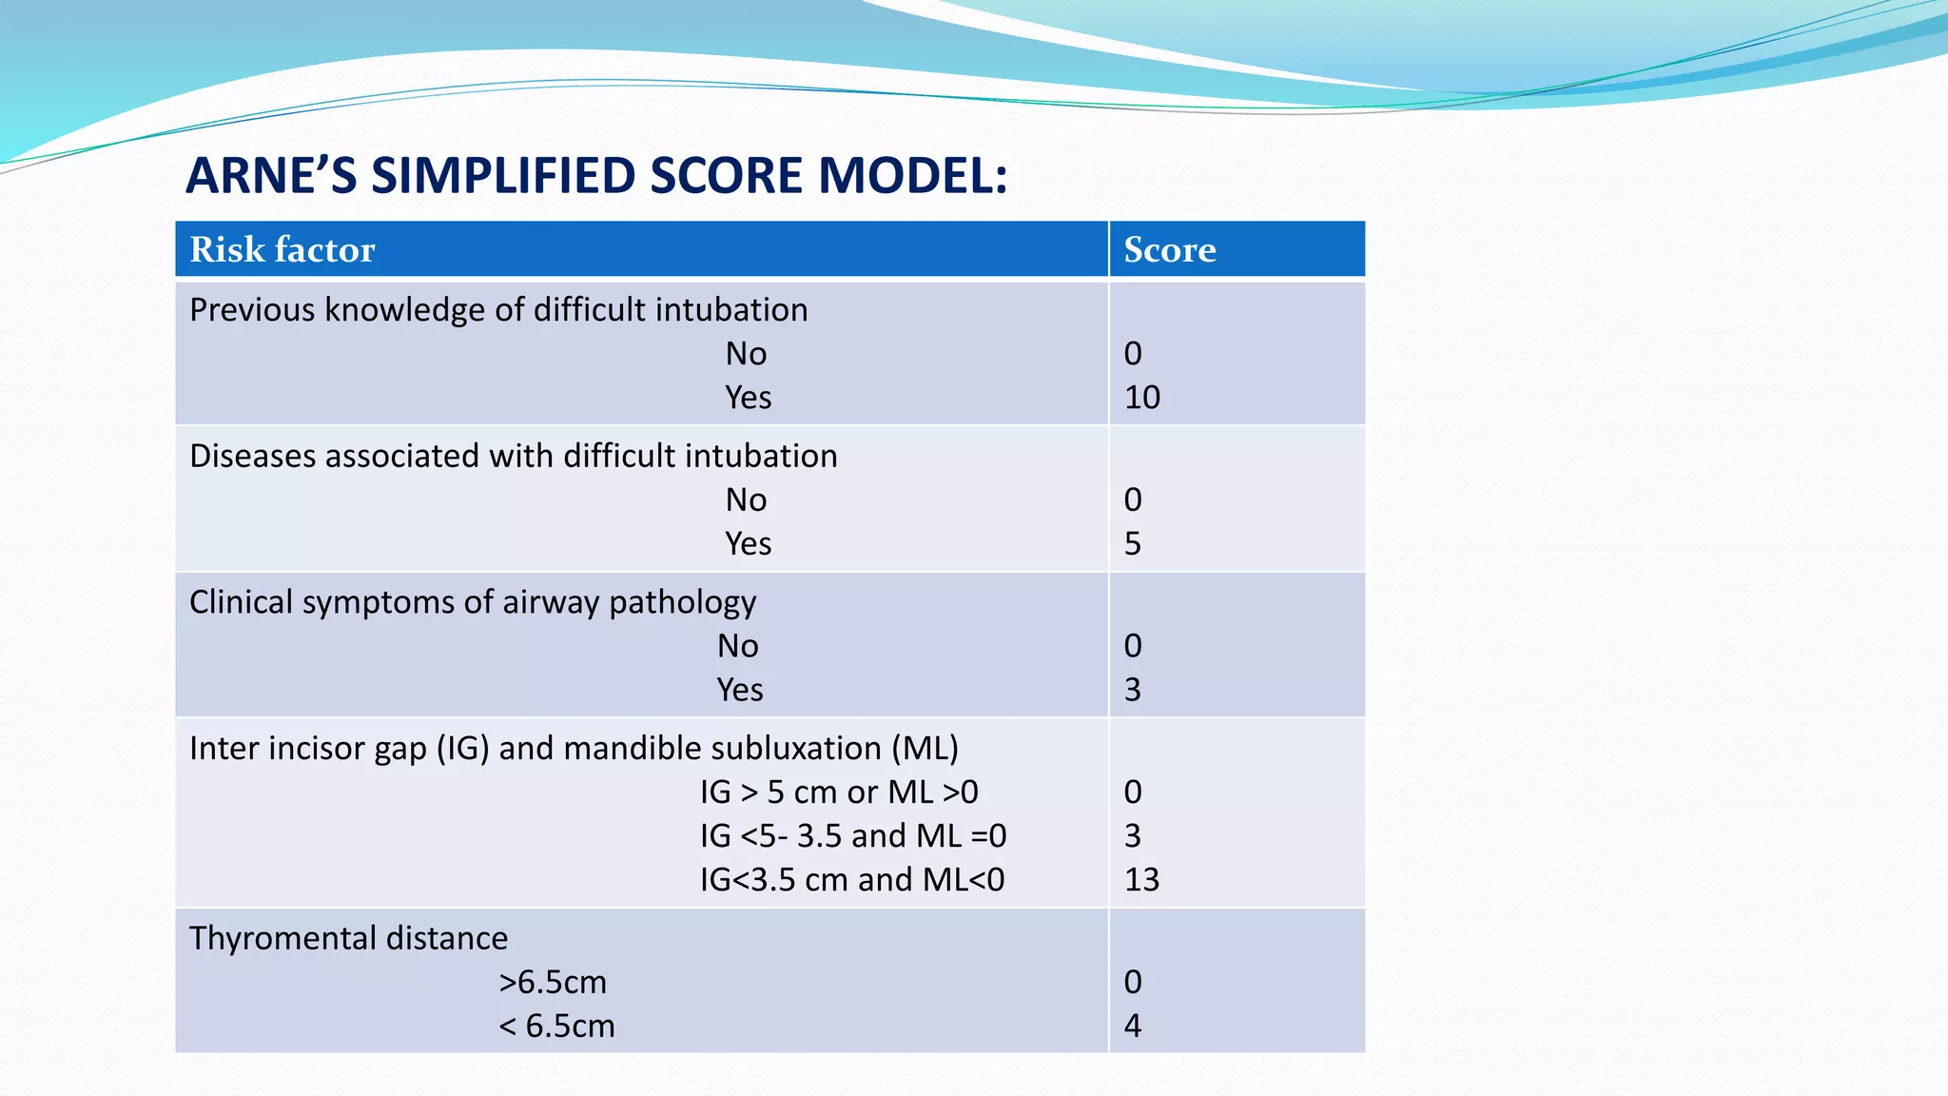
ARNE’S SIMPLIFIED SCORE MODEL

Slide 23
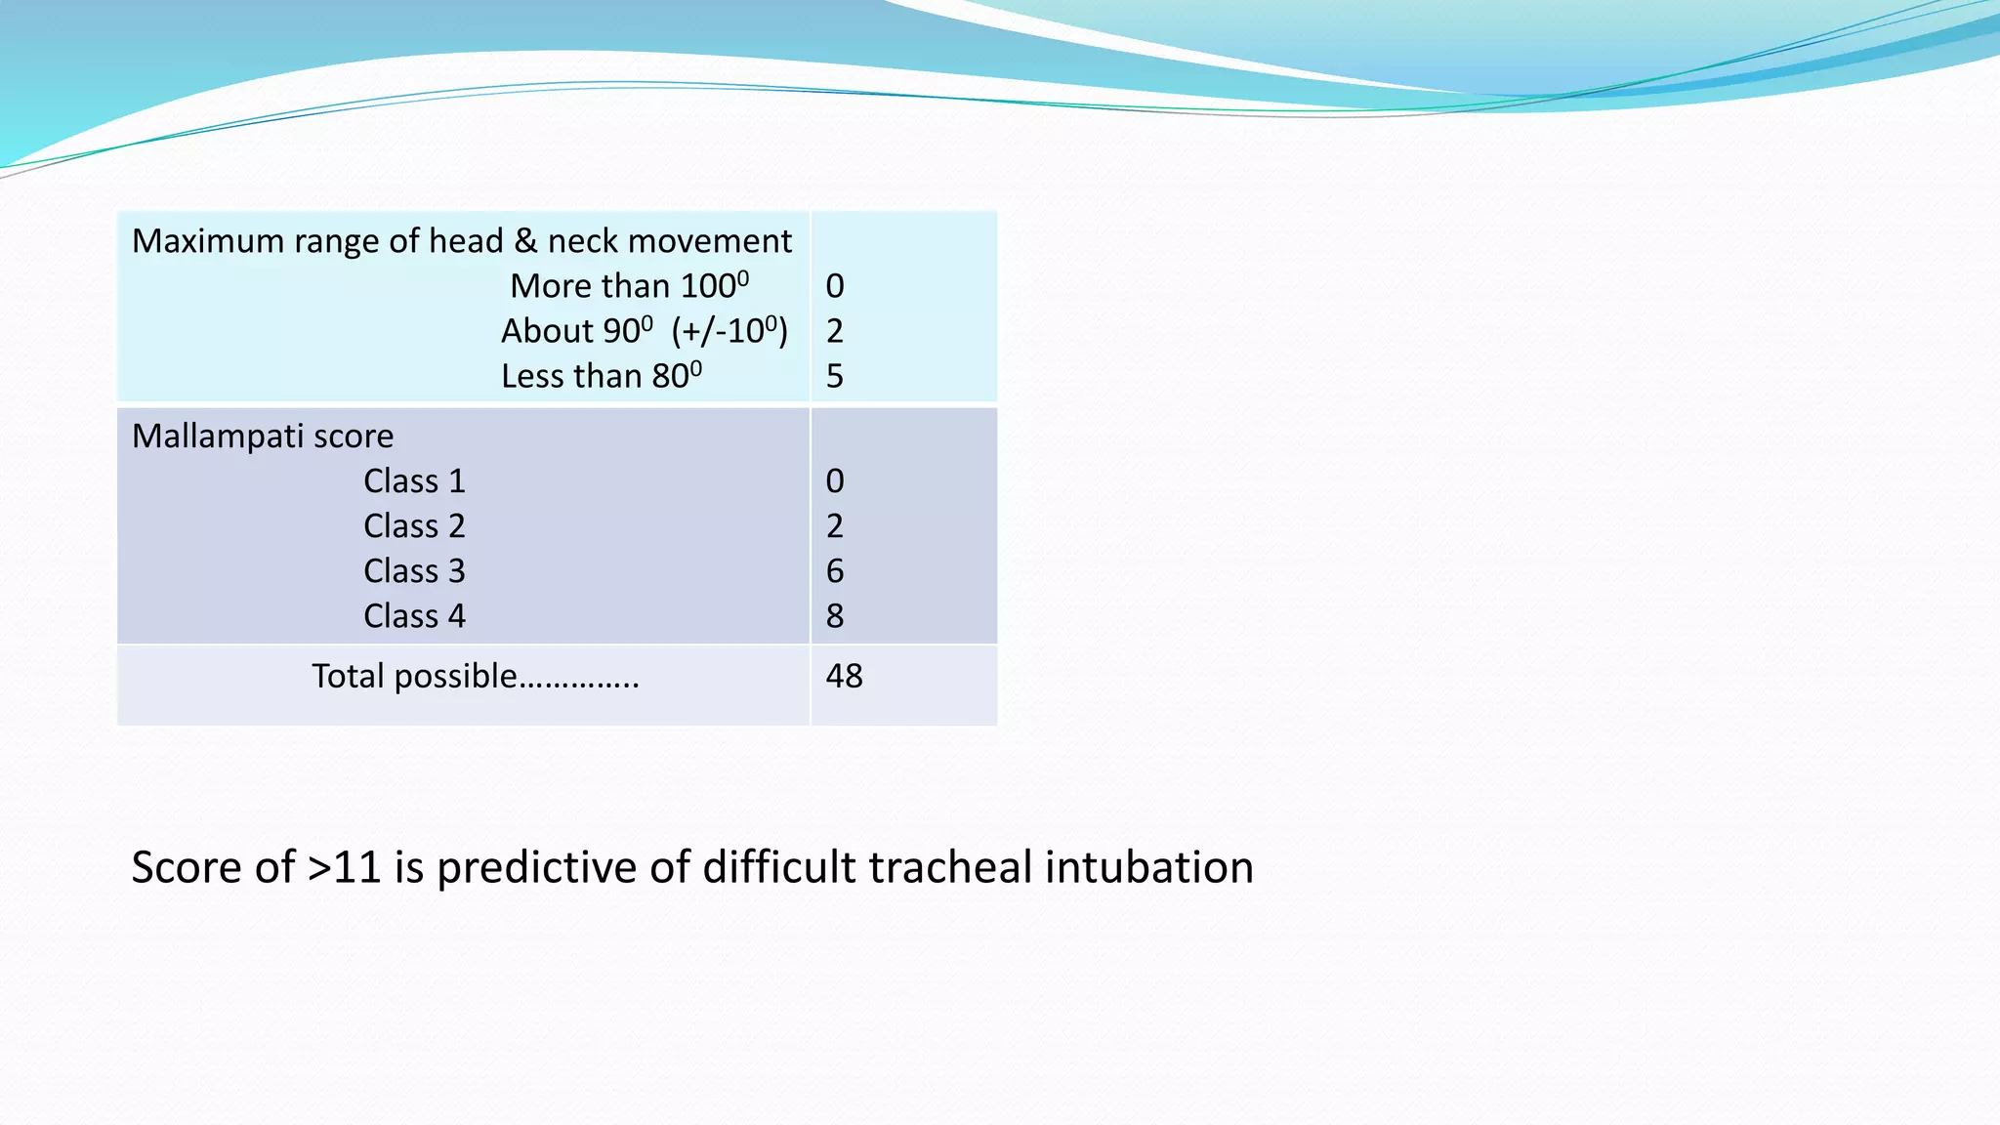

Slide 24
LEMON LAW
Represents 5 simple rapid assessment methods on uncooperative & cooperative patient
Look (for anatomic feature)
Facial trauma
Large incisors
Beard , High arched palate
Large tongue
Facial hairs
Facial/oral swelling
Short neck , Obese
Edentulous patient
Examination (of airway anatomy)
3-3-2
*Inter incisor gap - mouth opens at least 3 fingers breadth.
*Hyomental distance - 3 fingers breadth
*Thyroid to floor of mouth distance
- 2 finger breadth

Slide 25
Mallampati grading
Obstruction
Laryngoscopy or intubation may be more difficult in the presence of an obstruction
-LOCATION OF OBSTRUCTION
-FIXITY ( FIXED OR MOBILE )
-PROGRESSION OF OBSTRUCTION
Neck mobility
Normal
Neck extension >80-85 degree
Flexion > 25-30 degree
Rotation>70-75 degree
Assess All 3 ANGLES

Slide 26
ALI MAGBOUL’s 4 M’s
For Intubation remember the 4(M & M's) with (STOP) sign
Mallampati
Measurement
Movement
Malformation & STOP
M=Malformation of the skull, teeth, obstruction, & Pathology (the Macros and Micros).
We can memorize them with the word (STOP)
S= Skull (Hydro and Microcephalus)
T= Teeth (Buck, protruded, & loose teeth, macro and micro mandibles)
O= Obstruction (due to obesity, short Bull Neck and swellings around the head and neck)
P= Pathology (Craniofacial abnormalities & Syndromes: Treacher Collins, Goldenhar's, Pierre Robin, Waardenburg syndromes )

Slide 27
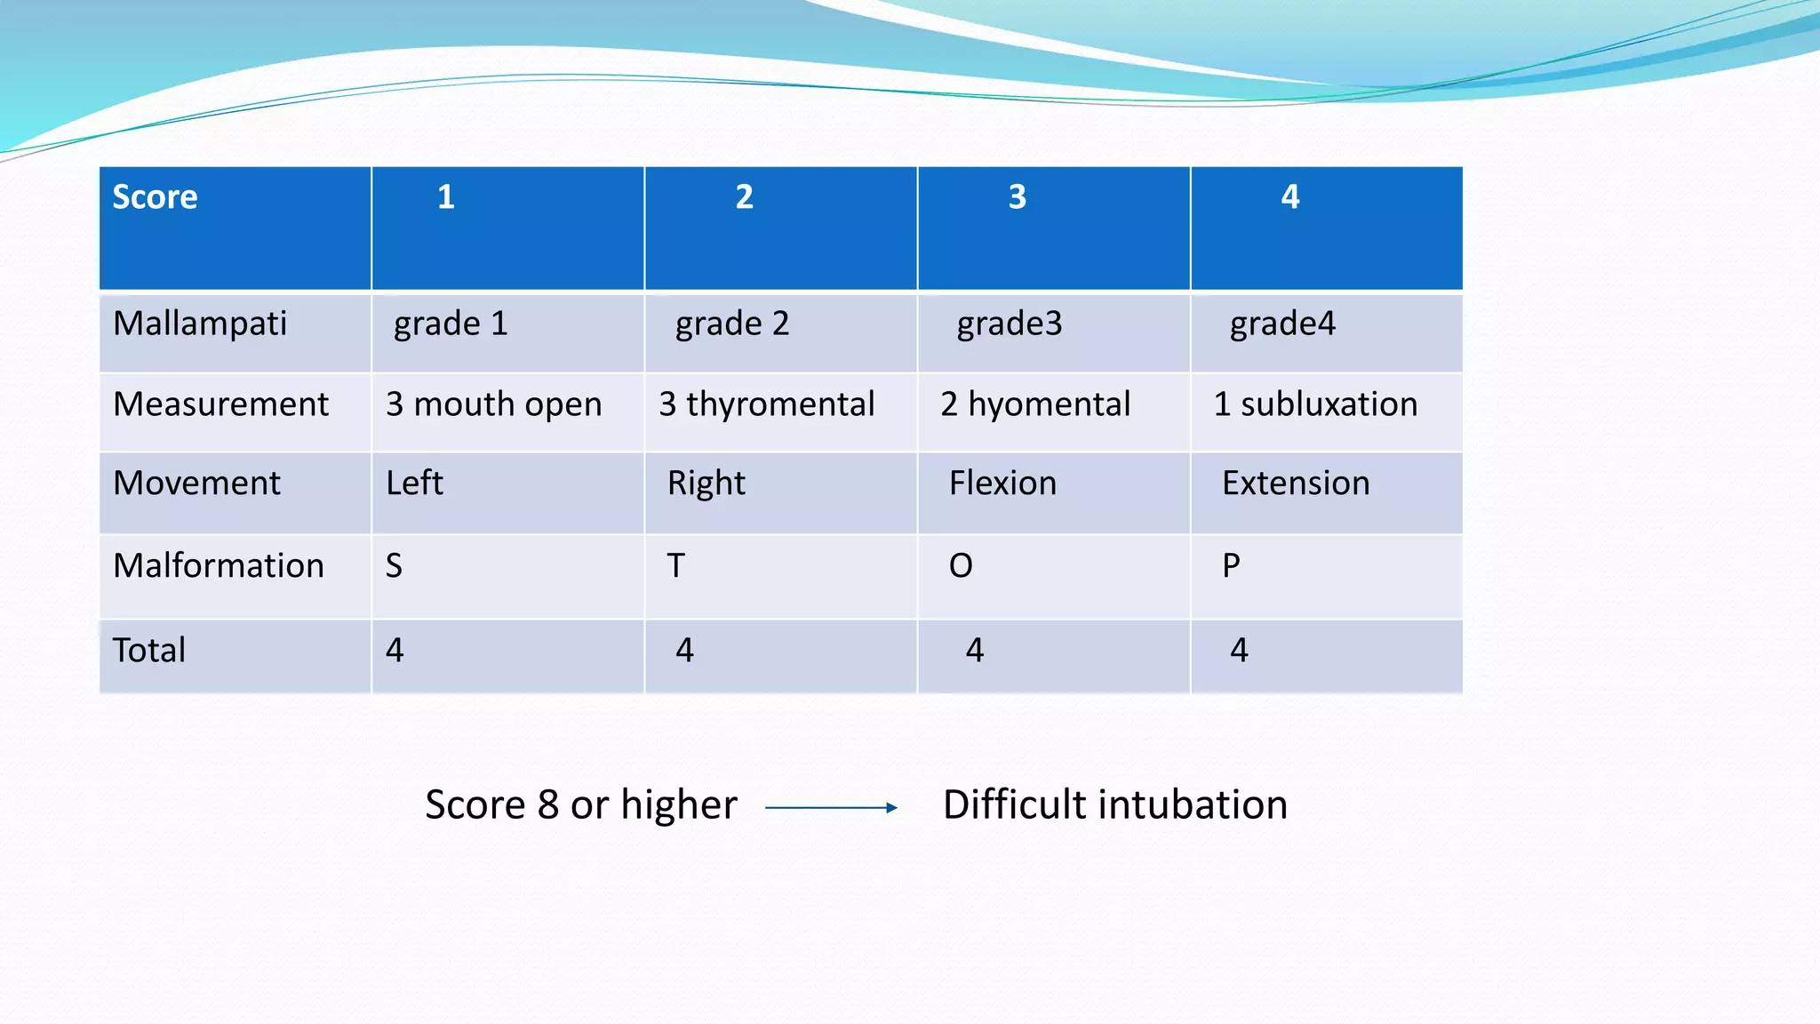

Slide 28
FOUR D's:
The following Four D's also suggest a difficult airway:
Dentition (prominent upper incisors, receding chin)
Distortion (oedema, blood, vomits, tumor, infection)
Disproportion (short chin-to-larynx distance, bull neck, large tongue, small mouth)
Dysmobility (TMJ and cervical spine)

Slide 29
How to predict difficult placement of supraglottic devices (RODS)
Restricted mouth opening
Obstruction of the upper airway
Distrupted upper airway as following trauma,burn,caustic ingestion.
Stiff lung (poor lung or thoracic compliance)
Suggested by Hung and Murphy

Slide 30
How to predict difficulty in creating surgical airway (BANG)
Bleeding tendency
Agitated patient
Neck scarring
Growth or vascular abnormality in region of surgical airway.

Slide 31
THANK YOU

