Slide 1
General Anesthetics
Dr. Nilesh Shah
Professor
Dept. of Anaesthesia
SBKSMIRC

Slide 2
General Anesthetics
  Introduction
  Mechanism of Action
  Stages of Anesthesia
  Inhaled Anesthetics
    MAC
    Equilibrium dynamics
    Elimination
    Organ system effects
    Toxicity
  Intravenous Anesthetics
  Adjuvant drugs
  Balanced anesthesia
  Drug Pictures

Slide 3
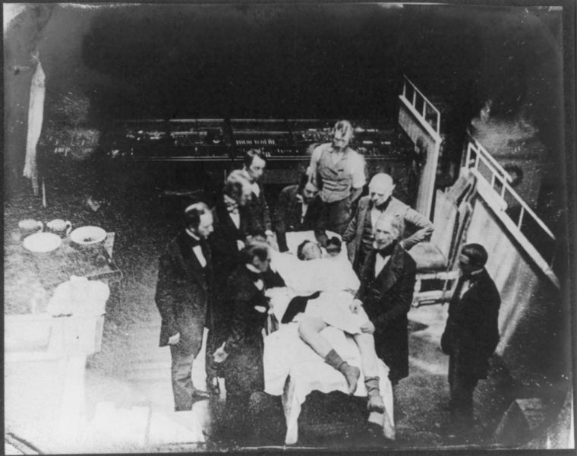
Ether Operation 1846

Slide 4
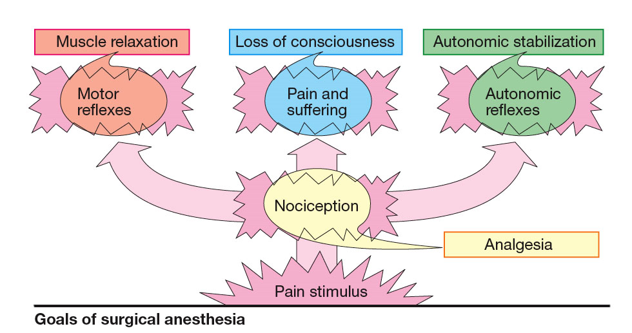

Slide 5
Introduction
General anesthesia includes:
  Analgesia
  Amnesia
  Loss of consciousness
  Inhibition of sensory and autonomic reflexes
  Skeletal muscle relaxation.

Slide 6
Mechanism of Action
Anesthetics depress activity of neurons in many regions of the brain.
A primary target of many anesthetics is the GABA_{A} receptor channel
Anesthetics directly activate GABA_{A} receptors, but can also facilitate the action of GABA.

Slide 7
Mechanism of Action Cont’d
Ketamine does not affect GABA_{A} it antagonizes glutamic acid on NMDA receptor.
Inhaled anesthetics also cause membrane hyperpolarization via activation of potassium channels.

Slide 8
Stages of Anesthesia
Analgesia: first analgesia, later analgesia and amnesia.
Excitement: delirium, excitement, irregular respiration, vomiting & incontinency.
Surgical Anesthesia: the recurrence of regular respiration.
The most reliable indication is loss of the eyelash reflex and regular respiratory pattern.
Medullary Depression: severe depression of the vasomotor and respiratory center.

Slide 9
Inhaled Anesthetics
Consist of:
  Nitrous oxide
  Chloroform
  Ether
  Halothane
  Enflurane
  Methoxyflurane
  Isoflurane
  Desflurane
  Sevoflurane

Slide 10
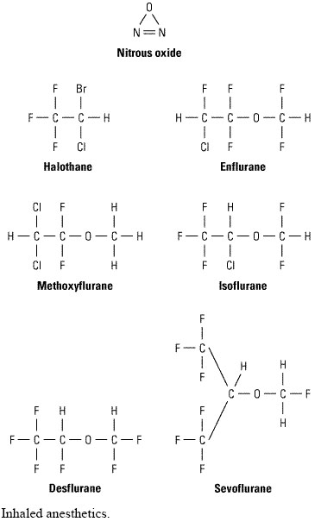

Slide 11
MAC
MAC stands for: Minimum Alveolar Anesthetic Concentration
In steady state, the partial pressure of an inhaled anesthetic in the brain equals that in the lung
MAC is the concentration that results in immobility in 50% of patients when exposed to a noxious stimulus (eg, surgical incision).

Slide 12
MAC Cont’d
MAC values decrease in elderly patients and with hypothermia, but are not affected by sex, height, and weight.
Presence of adjuvant drugs can reduce MAC dramatically.
Nitrous oxide can be used as a "carrier" gas at 40% of its MAC, decreasing the anesthetic requirement of other inhaled anesthetics to 70% of their MAC

Slide 13
Equilibrium Dynamics
The rate at which a given concentration of anesthetic in the brain is reached depends on:
  Solubility properties
  Concentration in the inspired air
  Pulmonary ventilation
  Pulmonary blood flow
  Arteriovenous concentration gradient

Slide 14
Solubility Properties
Blood:gas partition coefficient defines the relative affinity of an anesthetic for the blood compared to air.
The partition coefficients for poorly soluble gases are < 0.5 and for very soluble gases can be more than 10

Slide 15
Solubility Properties Cont’d
If blood solubility is low, few molecules raise the arterial tension quickly and vice versa
Compounds that are not very soluble in blood, rapidly equilibrate with the brain and have fast onset of action.

Slide 16
Concentration in Air
It is directly proportionate to the rate of induction of anesthesia by increasing the rate of transfer into the blood.

Slide 17
Pulmonary Ventilation
The rise of gas tension in arterial blood is directly dependent on both the rate and depth of ventilation.
Increase in ventilation has a slight effect for gases with low blood solubility but significantly increases tension of agents with moderate or high blood solubility.

Slide 18
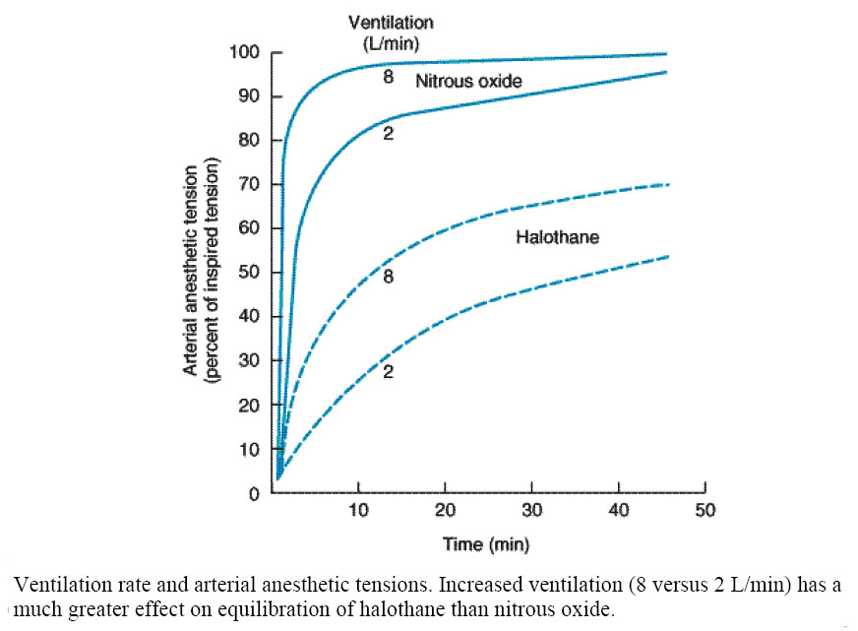

Slide 19
Pulmonary Blood Flow
Increase in pulmonary blood flow (increased cardiac output) slows the rate of rise in arterial tension.

Slide 20
Arteriovenous Concentration Gradient
Pulmonary veins contain less anesthetic than arteries. The greater this difference, the more has been taken up by the body and achievement of equilibrium with the brain is more delayed.

Slide 21
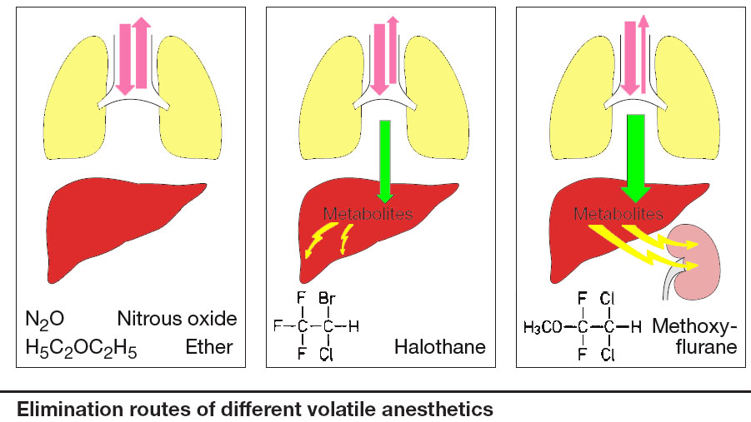

Slide 22
Elimination
One of the most important factors governing rate of recovery is the blood:gas partition coefficient
Elimination by hyperventilation is limited since the concentration in the lungs cannot be reduced below zero.

Slide 23
Elimination Cont’d
Gases that are relatively insoluble in blood and brain are eliminated faster.
The duration of exposure to the anesthetic have a marked effect on the time of recovery, especially for more soluble gases.

Slide 24
Elimination Cont’d
Despite their solubilities, the elimination of halothane is more rapid than enflurane because 40% of halothane versus 10% of enflurane is metabolized.
Sevoflurane is degraded by contact with the carbon dioxide absorbent in anesthesia machines, yielding "compound A" that causes renal damage if high concentrations are absorbed.

Slide 25
Elimination Cont’d
In terms of the extent of metabolism of inhaled anesthetics, the rank order is:
Methoxyflurane > Halothane > Enflurane > Sevoflurane > Isoflurane > Desflurane > Nitrous Oxide

Slide 26
Cardiovascular System
All gases decrease arterial pressure in direct proportion to their alveolar concentration.
Halothane and enflurane reduce cardiac output
Isoflurane, desflurane, and sevoflurane decrease systemic vascular resistance
Bradycardia is often seen with halothane (vagal stimulation).

Slide 27
Cardiovascular System Cont’d
Nitrous oxide in combination with potent gases produces sympathetic stimulation that minimizes cardiac depressant effects.
Halothane & isoflurane sensitize the myocardium to catecholamines. Arrhythmias may occur in patients with cardiac disease who are given sympathomimetics or are anxious.

Slide 28
Respiratory System
All gases are respiratory depressants but it is lessened by surgical stimulation.
Isoflurane and enflurane are the most depressant.
Inhaled anesthetics decrease the ventilatory response to hypoxia.
Concentrations that still exist during recovery depress the increase in ventilation during hypoxia.

Slide 29
Respiratory System Cont’d
Inhaled anesthetics are bronchodilators*.
Halothane and sevoflurane* the anesthetics of choice in patients with airway problems.
The pungency of enflurane may elicit breath holding, which can decrease the speed of induction.
* Goff MJ et al ; Anesthesiology [2000, 93(2):404-408]

Slide 30
Nervous System
Most volatile agents decrease cerebral vascular resistance, increase cerebral blood flow and ICP.
It is prudent not to use enflurane in patients with a history of seizure.
Nitrous oxide has analgesic and amnesic actions which in combination with other agents is useful in general and dental anesthesia.

Slide 31
Other Systems
Kidney
  All gases decrease GFR and renal plasma flow in spite of well-maintained or even increased perfusion pressures
Liver
  All gases decrease hepatic blood flow from 15% to 45%.
Uterine smooth muscle
  The halogenated gases are potent uterine muscle relaxants. (Useful for intrauterine fetal manipulation or manual extraction of a retained placenta).

Slide 32
Toxicity
Hepatotoxicity
  Hepatotoxicity due to halothane is one in 20,000–35,000. Obese patients having several exposures to halothane are more susceptible.
Nephrotoxicity
  Metabolism of methoxyflurane releases nephrotoxic inorganic fluoride so it is obsolete for most purposes.

Slide 33
Toxicity Cont’d
Malignant hyperthermia
  It is an autosomal dominant genetic disorder of skeletal muscle occurs by inhaled agents and muscle relaxants (eg,succinylcholine).
  Consists of: the rapid onset of tachycardia, hypertension, severe muscle rigidity, hyperthermia, hyperkalemia and acidosis
  Treatment consists of correction of metabolic disturbances and administration of dantrolene.

Slide 34
Toxicity Cont’d
Reproduction
  Female operating room personnel have a higher than expected incidence of miscarriages but the evidence is not strong.
Hematotoxicity
  Prolonged exposure to nitrous oxide causes megaloblastic anemia especially in poorly ventilated dental operating suites.

Slide 35
Intravenous Anesthetics
Intravenous anesthetics have an onset of action faster than the fastest of the gaseous agents so they are used for induction of anesthesia.
Consist of:
  Barbiturates (thiopental, methohexital)
  Propofol
  Etomidate
  Ketamine

Slide 36
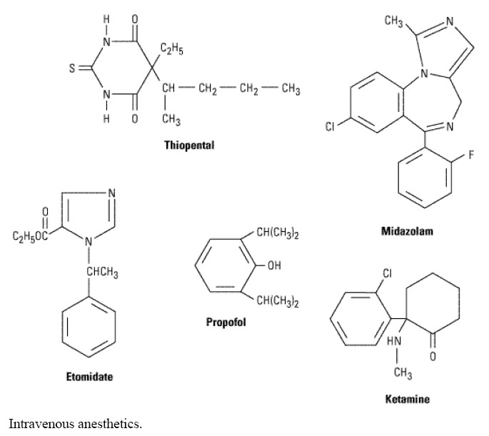

Slide 37
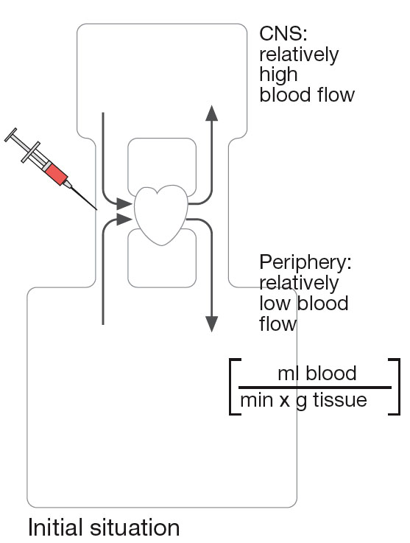

Slide 38
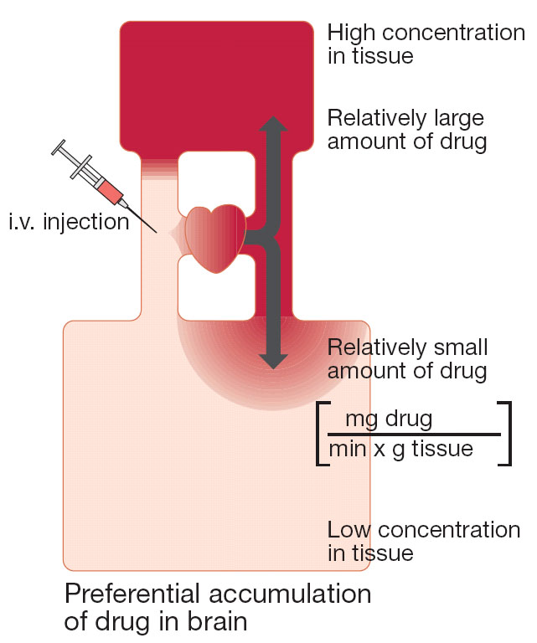

Slide 39
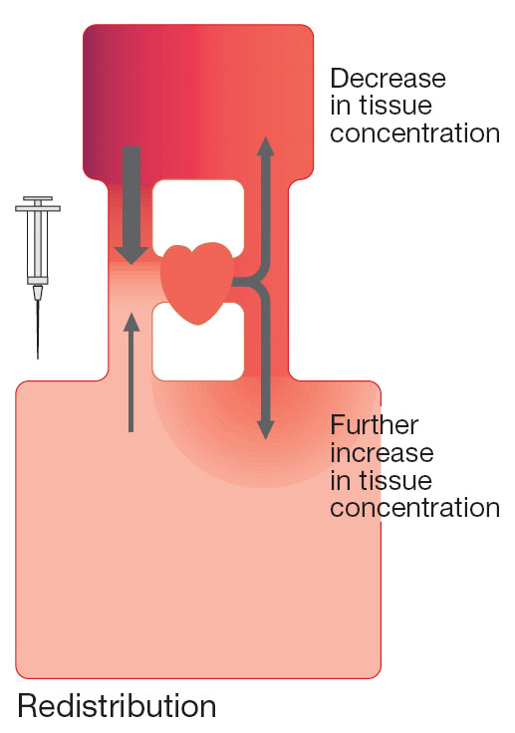

Slide 40
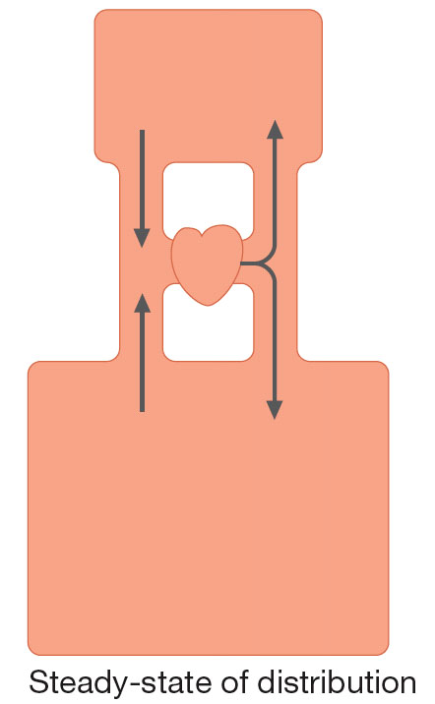

Slide 41
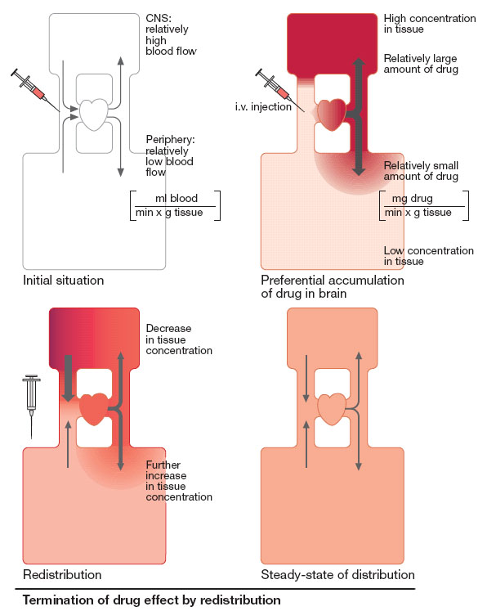

Slide 42
Thiopental
Thiopental can produce loss of consciousness (hypnosis) in one circulation time.
Because of its rapid removal from brain tissue a single dose of thiopental is so short-acting.
Large doses of thiopental decreases blood pressure and cardiac output and depresses respiration
Cerebral blood flow is decreased. (A desirable drug for patients with head trauma or brain tumors)

Slide 43
Propofol
Its onset of action is similar to thiopental but recovery is more rapid (similar to the shortest-acting inhaled anesthetics).
Postoperative nausea and vomiting is less common because propofol has antiemetic actions.
Because of strong negative inotropic effects, propofol causes a marked decrease in blood pressure and is a respiratory depressant.

Slide 44
Etomidate
Etomidate causes minimal cardiovascular and respiratory depression.
Etomidate produces a rapid loss of consciousness and rapid recovery (< 5 minutes).
Etomidate causes a high incidence of pain on injection, myoclonus, and postoperative nausea and vomiting.
Etomidate may cause adrenocortical suppression and decrease in hydrocortisone after a single dose.

Slide 45
Ketamine
Ketamine produces dissociative anesthesia, characterized by: catatonia, amnesia, and analgesia, with or without loss of consciousness.
Ketamine is the only intravenous anesthetic that possesses analgesic properties and produces cardiovascular stimulation.
Ketamine markedly increases cerebral blood flow and intracranial pressure.

Slide 46
Ketamine Cont’d
Ketamine may produce postoperative sensory and perceptual illusions, disorientation and vivid dreams (emergence phenomena).
It is considered useful for poor-risk geriatric patients and in cardiogenic or septic shock.
It is also used in children undergoing painful procedures (eg, dressing changes for burns).

Slide 47
Adjuvant Drugs
Remifentanil (opioid) has an extremely short duration of action
Fentanyl and droperidol together produce analgesia and amnesia and are used with nitrous oxide to provide neuroleptanesthesia.
Midazolam is frequently given intravenously before induction of general anesthesia because it causes amnesia (> 50%)

Slide 48
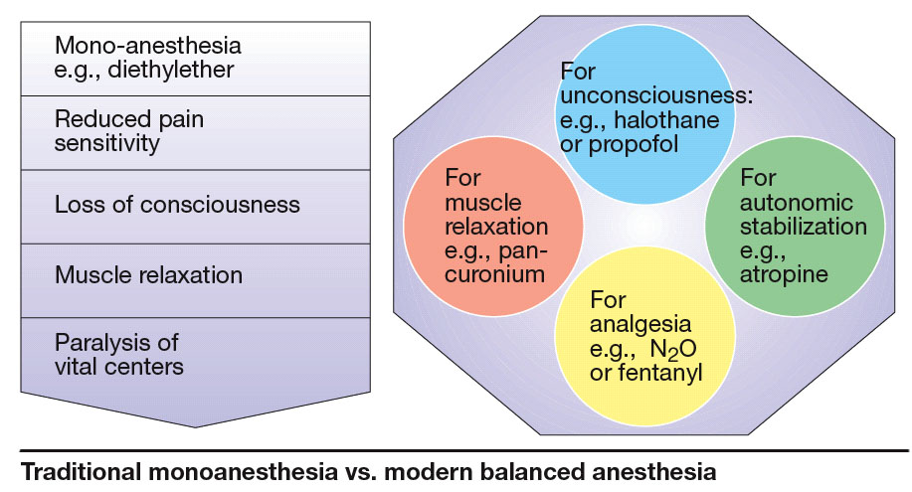

Slide 49
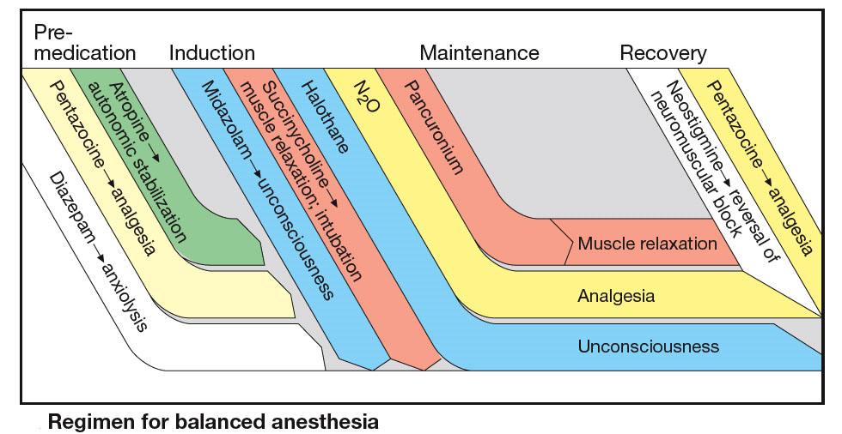

Slide 50
Author | Title | Journal details | Abstract | Level of evidence | Conclusion
Mitchell J. Goff et al | Absence of Bronchodilation during Desflurane Anesthesia: A Comparison to Sevoflurane and Thiopental | Anesthesiology 8 2000, Vol.93, 404-408 | Sevoflurane as an alternative to halothane for the management and/or prevention of bronchospasm has the added advantage of low blood solubility and, therefore, anesthetic depth can be rapidly adjusted. The disadvantage of desflurane might be its extreme pungency. | 1B | sevoflurane is an effective bronchodilating inhalation anesthetic Desflurane cause bronchoconstriction in patients with a positive history of smoking.

Slide 51
Q1.Which of the following is an inducing agent?
1 glycopyrolate
2 atrophine
3 midazolam
4 thiopentone
Q2. Which of the following is not used to secure airway?
1 I-gel
2 Ryle’s tube
3 Endotracheal tube
4 Gudell airway
Q3. Which of the following is volatile agent?
1 atracurium
2 propafol
3 isoflurane
4 ondeansetron
Q4. Which of the following drug is Egg-Lecitin based?
1 atracurium
2 propafol
3 isoflurane
4 ondeansetron
Q5. Which agent is used as a reversal agent in general anesthesia?
1 Neostigmine
2 propafol
3 isoflurane
4 ondeansetron

