Slide 1
Local anaesthetics
Dr. Tejash Sharma
Professor
Dept. of Anaesthesia
SBKSMIRC

Slide 2
LOCAL ANAESTHETIC DRUGS
Local Anaesthetic drugs block pain sensation (nociception) from specific area of body by reversibly blocking impulse conduction along nerve axons & other excitable membrane that utilize Na⁺ channels for Action Potential generation.

Slide 3
LOCAL ANAESTHETHIC DRUGS
HISTORY :
Cocaine (1860)
Procaine (1904)
Dibucaine and Tetracaine (1930s)
Lidocaine (Lofgren & Lundqvist 1943)
Mepivacaine,Prilocaine & Bupivacaine (Late 1950s)
Ropivacaine & Levobupivacaine

Slide 4
IDEAL LOCAL ANAESTHETIC AGENT :
Rapid/ faster onset,
Long Duration of Action,
Reversible & selective blockade of sensory nerves without motor blockade,
Minimal local tissue irritation &
No systemic toxicities

Slide 5
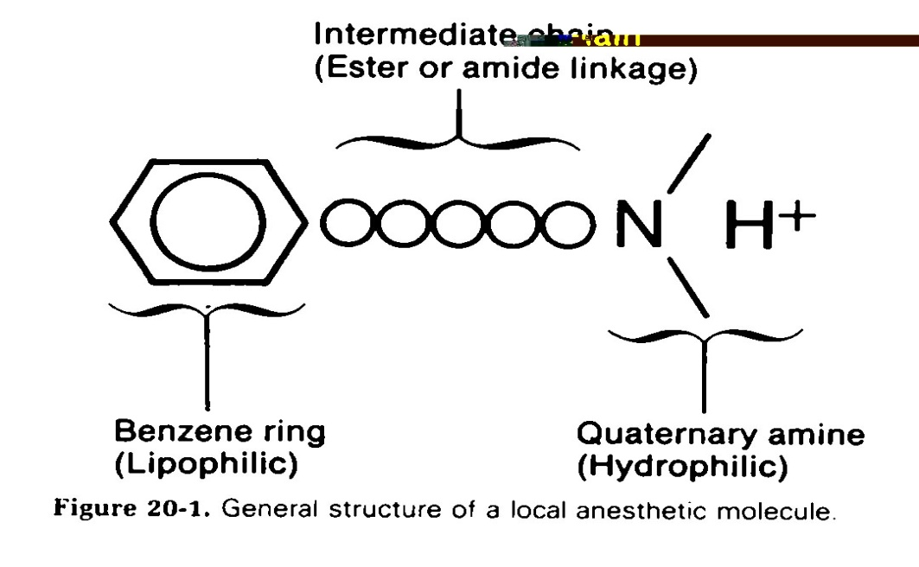
Chemistry of LA
Weak base & available as salts to increase solubility & stability

Slide 6
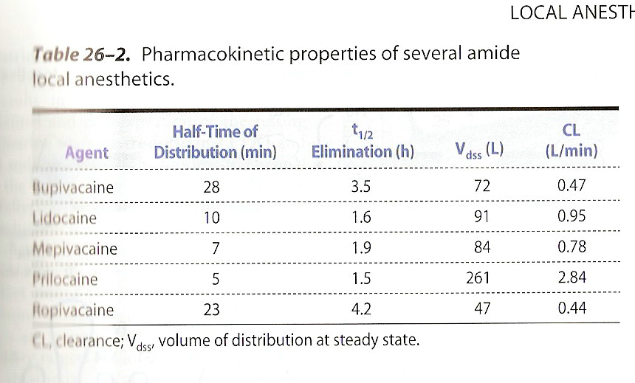

Slide 7
Absorption
Systemic absorption of injected LA
Depends on---
Dosage,
Site of injection (Vascularity): IV > tracheal > intercostals > paracervical > epidural > brachial plexus > sciatic > SC
Drug-tissue binding,
Local blood flow,
Use of Vasoconstrictors (epinephrine/ phenylephrine) reduce systemic absorption of LA from inj site by decreasing blood flow (upto 30%) & cause higher local tissue concentration of drug & prolong conduction blockade.
Physiochemical property of drug.

Slide 8
Distribution
Amide LAs are widely distributed after IV bolus injection.
Initial rapid phase into highly perfused organs (brain,
kidney, liver & heart), followed by a slower phase to
moderately perfused organs (Muscle, GIT).

Slide 9
Metabolism & Excretion
Ester-type: hydrolyzed rapidly in blood (by pseudo-choline-sterase) to inactive metabolites; short plasma t_{1/2} (< 1 min).
! amide linkage : hydrolyzed by liver cytochrome P₄₅₀ with different rates order (prilocaine (fastest) > Lidocaine > Bupivacaine (slowest).
All ester & amide Las are converted in to more water-soluble metabolites & excreted in urine.

Slide 10
Mechanism Of Action
Blocks initiation & propagation of action potential (AP) by preventing voltage-gated Na⁺ channels.
Activity is PH-dependent, increased at alkaline PH. Its penetration to Na⁺ channels is very poor at acid PH. Inflamed tissues (acidic): resistance to LA.
Elevated extracellular Ca²⁺ antagonizes action of LA by Ca²⁺ which increase surface potential on membrane.

Slide 11
Structure- Activity Characteristics of LA:
Smaller & more lipophilic LA : Faster rate of interaction with Na⁺ channels.
Potency is +vely correlated with lipid solubility.
Lidocaine, Procaine, & Mepivacaine are more water-soluble than Tetracaine, Bupivacaine, & Ropivacaine that are more potent & have longer duration of action
Long acting (Bupivacaine ) also bind more extensively to plasma proteins & can be displaced by other protein-bound drugs.
Reference-Stoelting book of pharmacology

Slide 12
1- Effect on fiber diameter:
LA block conduction in small-diameter nerve fibers more readily than in large fibers.
Pain sensation is blocked more readily than other sensory modalities.
LAs block conduction in following order:
small myelinated (pain impulses),
non- myelinated (C-fibers),
large myelinated axons.

Slide 13
2- Effect on firing frequency
Blockade by LA is more at higher frequencies of depolarization.
Sensory (esp pain) fibers have High firing rate & long action potential duration. While motor fibers fire at a slower rate & have shorter action potential duration.
Refn- Oxford journal of anaesthesia

Slide 14
Lid | Rapid | M | 2 hr | As procaine but < tendency to CNS | Widely used + IV in ventricular arrhythmia. Mepivacaine is similar
Amethoc- (tetrac | V. Slow | Long | 1 hr | As Lid | spinal & corneal anesthesia.
Bupivac- | Slow | Long | 2 hr | As Lid but > CVS | Widely used (long DOA). Ropivacine is similar, with less cardioTox.
Priloc- | M | M | 2 hr | No VD MetHgemia | Widely used, not for obstetric (neonatal metHgemia.

Slide 15
Methods of administration:
Six Placement Sites
Surface/topical anesthesia
Local infiltration
Peripheral nerve block
Bier block (IV regional anesthesia)
Epidural anesthesia
Spinal anesthesia (subarachnoid)

Slide 16
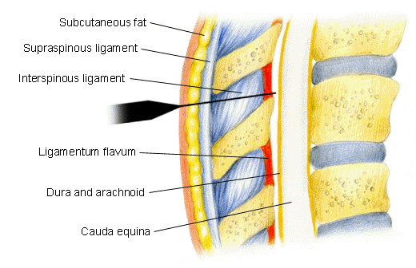
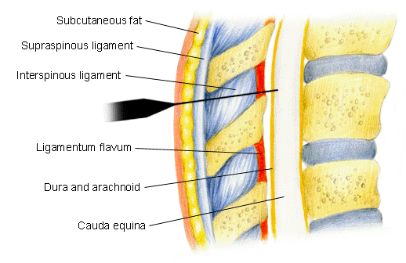
Epidural
Spinal

Slide 17
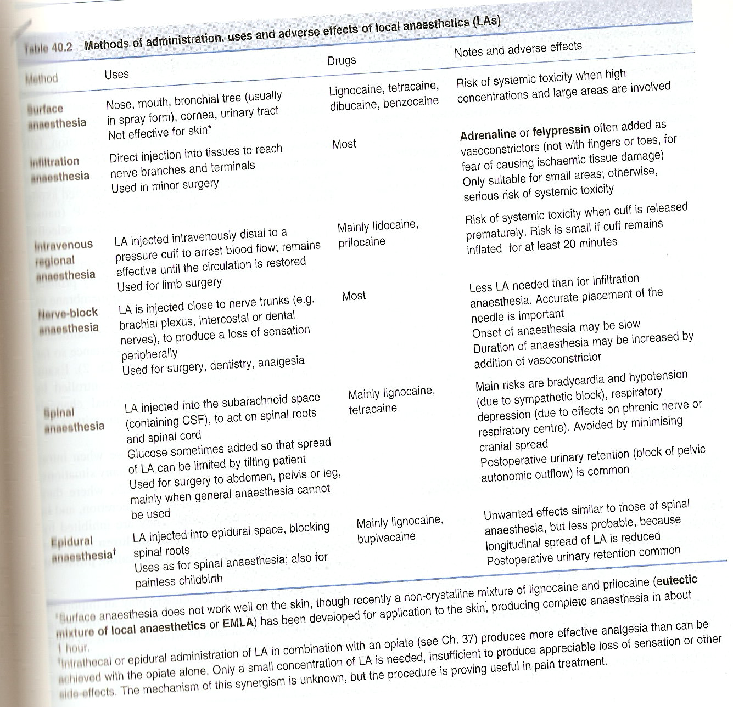

Slide 18
Duration of Action
Short: Procaine & Chloroprocaine
Intermediate*: Lidocaine, Mepivacine & Prilo- caine
Long-acting: Tetracaine, Bupivacaine, & Ropiva- caine,Levobupivacaine
*Duration can be prolonged by increasing adding vasoconstrictor agents.

Slide 19
To increase speed of onset of LA:
Add Na-bicarbonate to LA soln; LA become > lipid soluble.
Repeated inj of LA: Tachyphylaxis (extracellular acidosis)
Pregnancy increase LA toxicity
Topical LA:
( Eye, ENT & for cosmetic surgery).
Properties:
- rapid penetration across skin/ mucosa &
- low tendency to diffuse away from site of application.
Cocaine bec of excellent penetration & local VC used for (ENT) procedures. Has irritating effect so NOT used in ophthalmic procedure.
Other topical: Lidocaine

Slide 20
Toxicity
A- CNS:
At low plasma concentration:
sleepiness, light headiness, visual & auditory disturbances & restlessness.
Early symptoms: tongue numbness + metallic taste.
Rare but at high plasma conc.:
nystagmus & muscular twitching, then tonic-clonic convulsions followed by generalized CNS depression (apnea).

Slide 21
B- Neuro toxicity:
Direct neuronal toxicity.
Chloroprocaine & Lid are more neurotoxic than others in spinal anesthesia.( transient irritation leading to neuropathic symptoms).

Slide 22
C- CVS:
Direct effect on heart & smooth muscle &
Indirect effect through Autonomic Nervous System.
Depress strength of cardiac contraction & cause arteriolar dilatation leading to hypotension.
Bupivacaine is more cardiotoxic than other long-acting LA.*
Ropivacaine: lesser than Bupivacaine.
*Sukhminder Jit Singh Bajwa et al:JOACP 2013;29 (4):530-39

Slide 23
D- Hematologic effects:
Large dose of prilocaine: accumulation of Oxidizing Agent (o- toluidine) that convert Hg to metHg.;; cyanosis & chocolate-colored. Not recommended in infants. (Benzocaine can also cause metHg).
Rx: IV methylene blue/ ascorbic acid.
E- Allergic rxs: (Not with amides)
Ester-type LAs are metabolized to P-ABA derivatives; allergic rxs.
Reference-stoltings book of pharmacology

Slide 24
Author | Title | Journal details | Abstract | Level of evidence | Conclusion
*SukhminderJit Singh Bajwa et al | Clinical profile of levobupivacaine in regional anesthesia: A systematic review | Journal of Anaesthesiology Clinical Pharmacology:2013;29 (4)530-39 | .Levobupivacaine has been found to be equally efficacious as bupivacaine, but with a superior pharmacokinetic profile. | 1A | Levobupivacaine is a long-acting local anesthetic with a clinical profile similar to that of bupivacaine. I The better safety profile of levobupivacaine confers an advantage over its racemic parent, bupivacaine.

Slide 25
Q1. Drug of choice in local anesthesia?
1 lignocaine
2 procaine
3 bupivacaine
4 ropivacaine
Q2. First local anesthetic agent used?
1 cocaine
2 procaine
3 bupivacaine
4 ropivacaine
Q3. Which of the following is long duration local anesthetic?
1 lignocaine
2 mapivacaine
3 prilocaine
4 bupivacaine
Q4. Shortest duration of action as local agent?
1 chloroprocaine
2 mapivacaine
3 prilocaine
4 bupivacaine
Q5. Concentration of lignocaine in gelly form?
1 3%
2 6%
3 2%
4 8%

