Slide 1
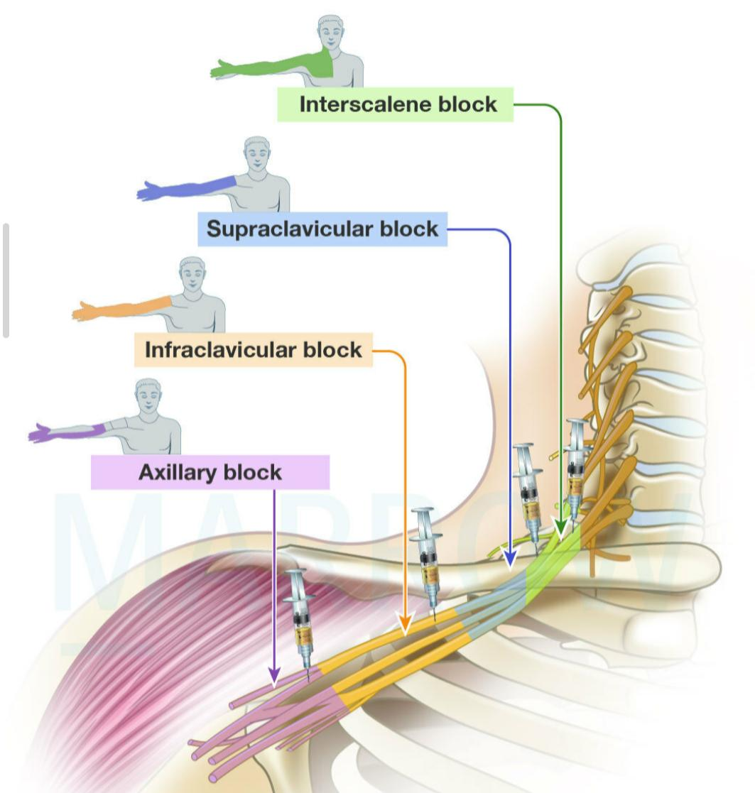
Brachial Plexus Block
Dr. Pooja Shah
Professor
Dept. of Anaesthesia
SBKSMIRC

Slide 2
ANATOMY
The brachial plexus is an arrangement of nerve fibres,
running from the spine, formed by the ventral rami of the lower cervical and upper thoracic nerve roots
it includes –
from above the fifth cervical vertebra to underneath the first thoracic vertebra(C5-T1).
It proceeds through the neck, the axilla and into the arm.
The brachial plexus is responsible for cutaneous and
muscular innervation of the entire upper limb.

Slide 3
The trunks pass laterally and lies around the subclavian
artery while passing over the first rib to enter the axilla,
between the clavicle and the scapula.
Behind the clavicle, each trunk splits into anterior and
posterior divisions. These recombine to form the
posterior , lateral and medial cords around the axillary
artery.
The upper roots (C5–7) tend to stay lateral, the lower
roots (C8,T1) tend to stay medial and All roots
contribute to the posterior cord, and therefore also to
the radial nerve.

Slide 4
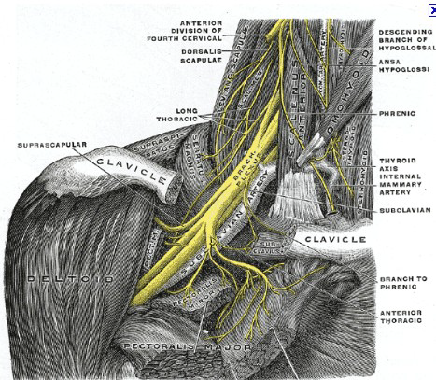
RELATIONS
In the neck, the brachial plexus lies in the posterior triangle, being covered by the skin, Platysma, and deep fascia; where it is crossed by the supraclavicular nerves, the inferior belly of the Omohyoideus, the external jugular vein, and the transverse cervical artery.
When It emerges between the Scaleni anterior and medius; its upper part lies above the third part of the subclavian artery, while the trunk formed by the union of the eighth cervical and first thoracic is placed behind the artery.

Slide 5
RELATIONS
the plexus next passes behind the clavicle, the Subclavius, and the transverse scapular vessels, and lies upon the first digitation of the Serratus anterior, and the
Subscapularis.
In the axilla it is placed lateral to
the first portion of the axillary
artery; it surrounds the second
part of the artery, one cord lying
medial to it, one lateral to it, and
one behind it; at the lower part of
the axilla it gives off its terminal
branches to the upper limb.

Slide 6
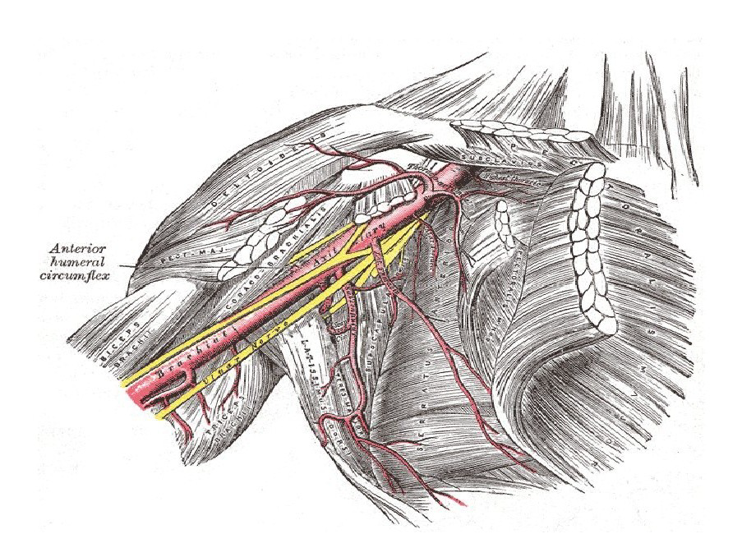

Slide 7
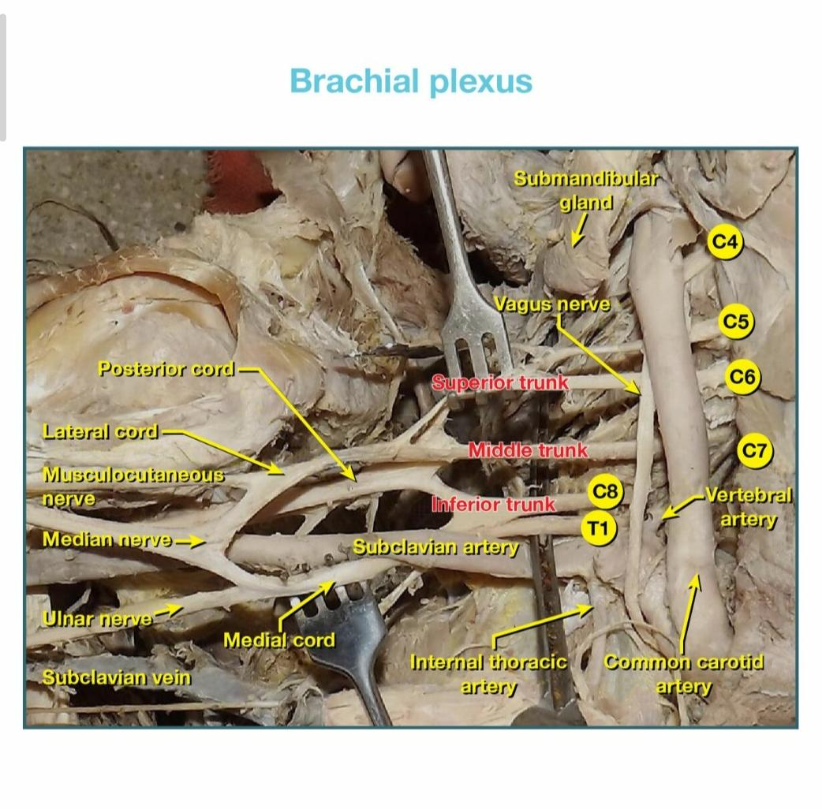

Slide 8
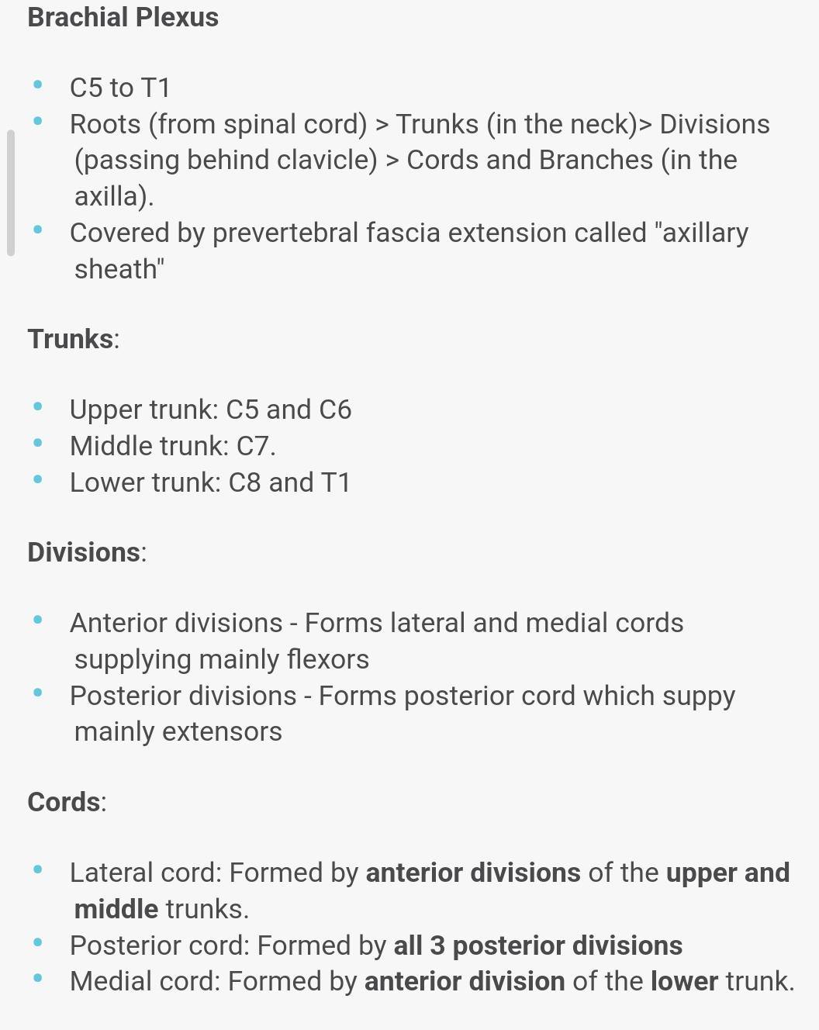
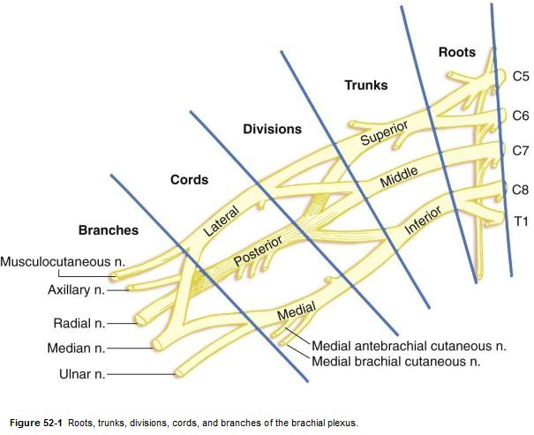
FORMATION OF THE
BRACHIAL PLEXUS

Slide 9
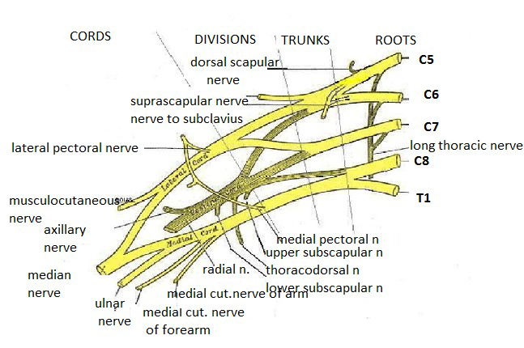
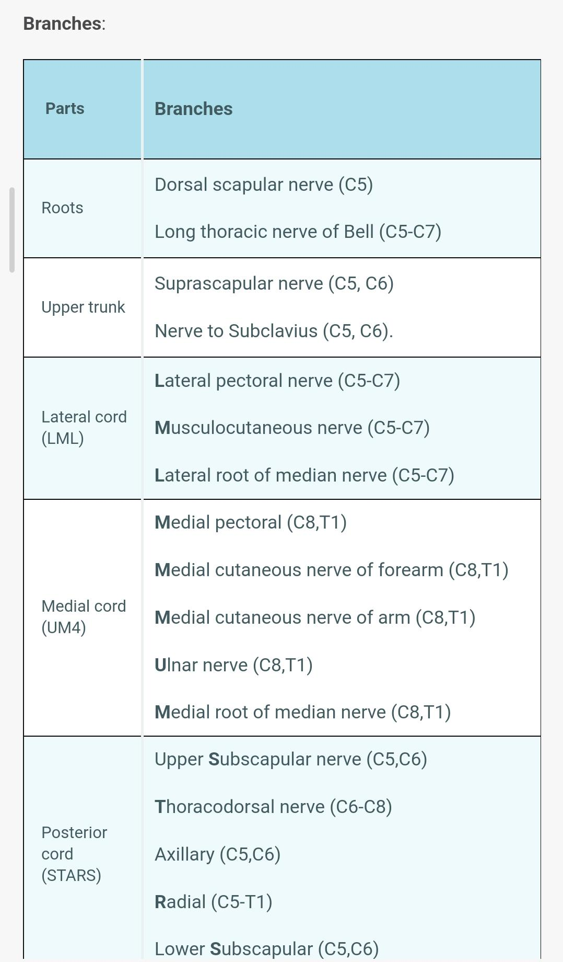

Slide 10
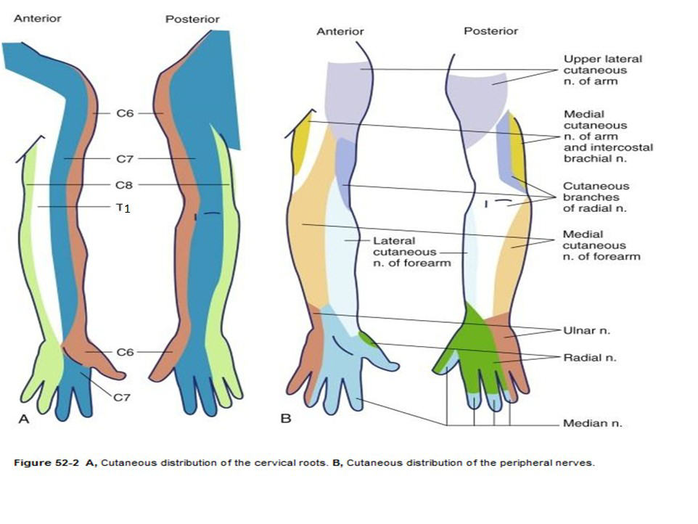
CUTANEOUS DISTRIBUTION

Slide 11
ANATOMIC VARIATION
The plexus may include anterior rami from C4 or T2 and these are designated as
Pre fixed- C4 added
Post fixed- T2 added.
The connective tissue sheath that invests the plexus especially in the axillary region has a convoluted and septated structure that can lead to non uniform distribution of local anaesthetics .

Slide 12
The musculocutaneous nerve may fuse to or have
communications with the median nerve , which can
result in its absence from within the coracobrachialis
muscle.
Communication between median and ulnar nerves is common in the forearm with the median nerve
replacing the innervations to various muscles normally
supplied by the ulnar nerve.
Variations with respect to vessels within the arm may
be present like double axillary veins , high origin of
radial artery and double brachial arteries.

Slide 13
The interscalene groove may have variations in the
relationship between the plexus roots and trunks and
the muscles.
For eg.- the C5 or C6 roots may traverse through or
anterior to the anterior scalene muscles.
In many specimens no inferior trunk exists , a single
cord or a pair of cords may develop. In some cases no
discrete posterior cord forms , with the posterior divisions diverging to form terminal branches

Slide 14
ANAESTHETIC IMPLICATION
BRACHIAL PLEXUS BLOCK-
Techniques-
Interscalene Brachial Plexus Block
Lower interscalene block
Parascalene block
Supraclavicular(Subclavian)Brachial Plexus Block
Infraclavicular Brachial Plexus Block
Axillary Brachial Plexus Block

Slide 15
INTERSCLALANE BLOCK
Described by winnie in 1970.
Indications-
Surgery in shoulder ,upper arm and forearm.
Post operative analgesia for total shoulder arthroplasty
Blockade occurs at the level of the upper and middle trunks.

Slide 16
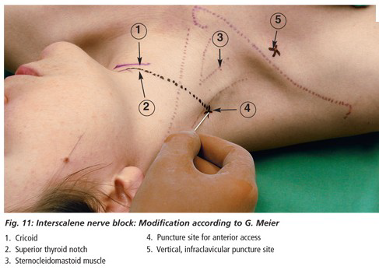

Slide 17
Positioning- supine position with the head turned away
from the side to be blocked.
The posterior border of the sternocleidomastoid
muscle is palpated by having the patient briefly lift the
head.
The interscalene groove can be palpated by rolling the
fingers posterolaterally from this border over the belly
of the anterior scalene muscle into the groove.
A line extended laterally from the cricoid cartilage and
intersecting the interscalene groove indicates the level
of the transverse process of C6.
The external jugular vein often overlies this point of
intersection.

Slide 18
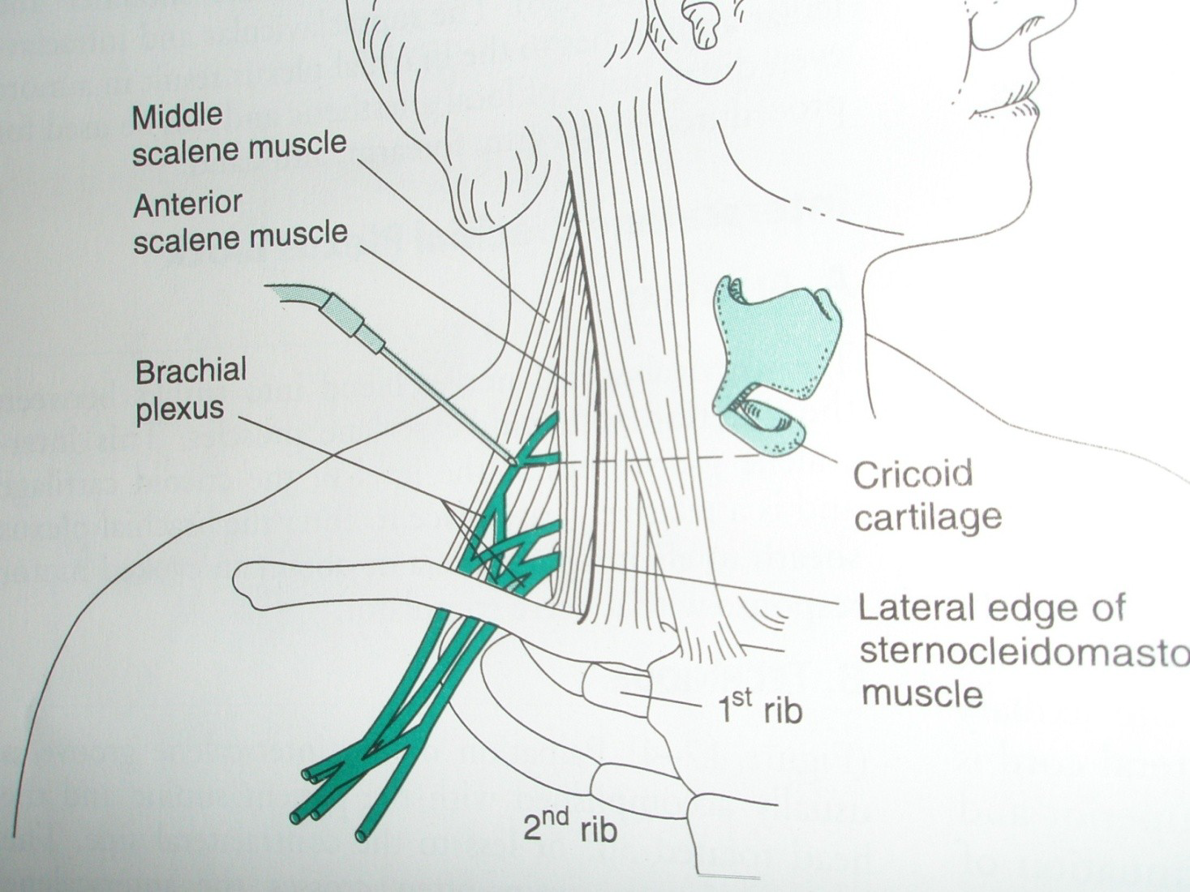

Slide 19
TECHNIQUE-
Under sterile precautions and development of a skin wheal, a 22- to 25-gauge, 4-cm needle is inserted perpendicular to the skin at a 45-degree caudad and slightly posterior angle. The needle is advanced until paresthesia is elicited.
If bone is encountered within 2 cm of the skin, it is likely to be a transverse process, and the needle may be “walked” across this structure to locate the nerve.

Slide 20
After negative aspiration, 10 to 40 mL of solution is injected incrementally, depending on the desired extent of blockade.
Contraction of the diaphragm indicates phrenic nerve stimulation and anterior needle placement; the needle should be redirected posteriorly to locate the brachial plexus.

Slide 21
COMPLICATIONS
Ipsilateral diaphragmatic paresis
Severe hypotension and bradycardia (i.e., the Bezold-
Jarisch reflex)
Inadvertent epidural or spinal block
Nerve damage or neuritis
Intravascular injection with Seizure activity
Horner’s syndrome with dyspnea and hoarseness of
voice.
Puncture of the pleura may cause Pneumothorax.
Hemothorax.
Hematoma and Infection.

Slide 22
TREATMENT OF COMPLICATIONS
Horners syndrome: Do investigate through MRI or CT scan. Wait uptill 6 months to 12 months for resolution but may persist with ptosis.
Hematoma formation are prevented by use of anticagulants( like enoxaparin)
Neuritis and nerve damage prevented by use of appropiate needle.
LAST(local anaesthesia systemic toxicity):
Includes mild symptoms(Auditory changes, numbness, aggitation) to CNS symptoms(seizure, coma, respiratory arrest) and cardio vascular events. Rx,
Airway management
Seizure supression
ACLS/ BLS
Bezold- Jarisch reflex: Treated with atropine and ephedrine

Slide 23
SCANNING TECHNIQUE
The operator stands on the side of the patient to be blocked. The US machine should be at a comfortable ergonomic position on the opposite side of the patient.
Distal to proximal or ‘Traceback’ approach
The supraclavicular fossa is scanned first to identify the subclavian artery as it passes over the first rib.
This may be achieved by placing the probe against the clavicle and scanning in a caudad direction.
The vascular anatomy may be confirmed using the colour Doppler mode.
The brachial plexus is easily identified in this region. It resembles a “bunch of grapes” usually lying supero-lateral to the artery.
The nerves in this position appear hypo-echoic (black) surrounded by more echogenic (white) connective tissue.
The plexus can be followed medially and cephalad along it course by keeping the nerves in the centre of the screen till the roots/trunks are seen as hypoechoic round or oval structures in the interscalene groove.

Slide 24
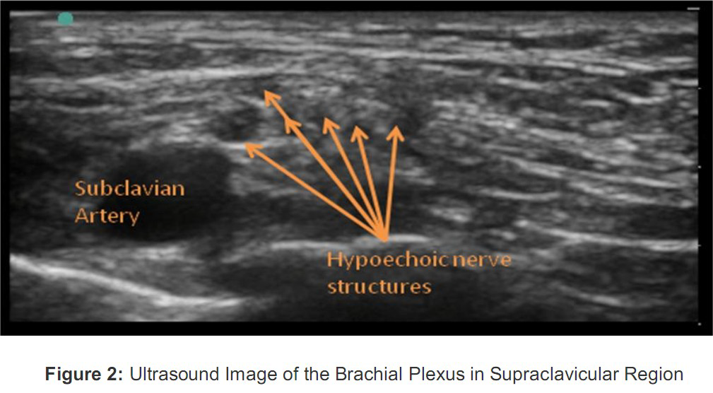

Slide 25
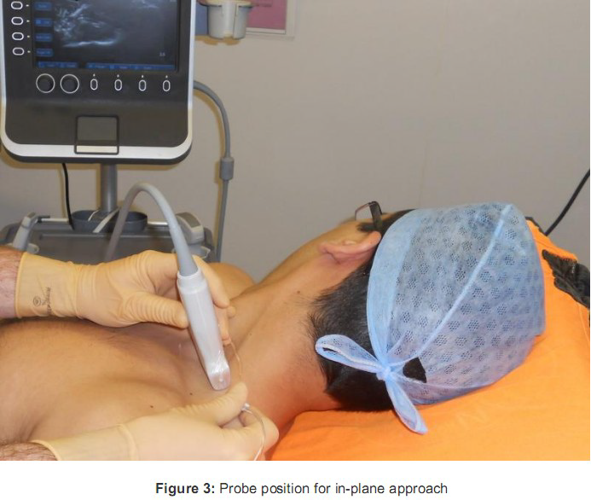

Slide 26
MEDIAL TO LATERAL APPROACH
The probe is initially placed near the midline at the
level of cricoid cartilage and scanned laterally to
identify the carotid artery and internal jugular vein.
The sternocleidomastoid muscle overlies these
structures. By moving the probe laterally, the anterior
scalene muscle is seen below the lateral edge of the
sternocleidomastoid.
A groove containing the hypo-echoic nerve structures
can usually be identified but may require fine
adjustments of the probe in a rotational or tilting
motion.

Slide 27
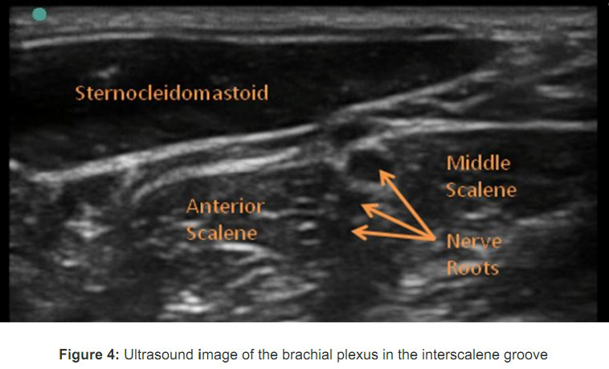

Slide 28
OUT OF PLAIN APPROACH
The needle is inserted cranial to the probe similar to techniques
for internal jugular cannulation.
The needle may be seen as a bright dot on the screen as it
crosses the ultrasound beam.
It may initially be difficult to be sure which part of the needle you
are seeing as the “dot” may represent a cross-section of the
shaft and not the needle tip.
By tilting the probe, the tip is identified as the point where further
tilting leads to the bright dot no longer being visualised onscreen.
The movement of the surrounding tissues in response to rapid
small movements of the needle may also aid its identification.
This method is preferred by the authors only for catheter
insertion.

Slide 29
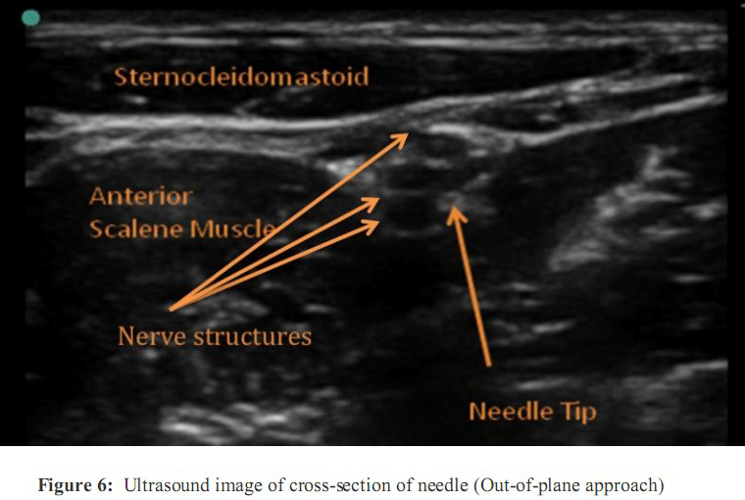

Slide 30
END POINT OF INJECTION
A small amount of local anaesthetic is injected to hydro-dissect
and open up the fascial plane.
This allows clearer visualization of the nerve structures.
Local anaesthetic should ideally spread anterior and
posterior to the nerve structures and surround the nerves as a
doughnut shaped hypoechoic area
Avoid intramuscular injection which is indicated by an increase in
echogenicity (increasing black space) within the muscle bulk.
It is usually more difficult to inject into the muscle.
Adjust the needle position during injection to optimize local
anaesthetic spread if necessary. Scan proximally and distally
along the course of the nerves to assess the extent of local
anaesthetic spread.

Slide 31
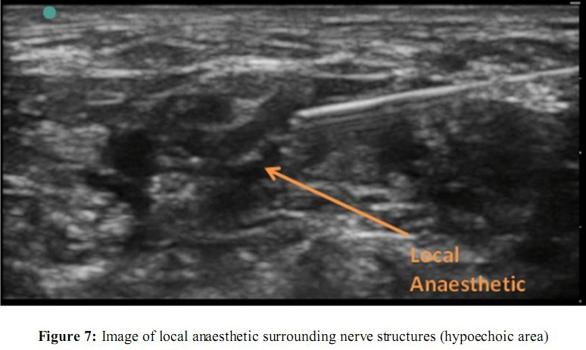

Slide 32
CHECKING OF BLOCK ADEQUANCY
It may be possible to demonstrate adequate surgical
anaesthesia after 5-10 minutes, however, some blocks
may take significantly longer to establish (up to 40
minutes).
Three components for the block should be tested.
Motor- by asking the patient to abduct and flex the arm
Sensory- by checking loss of cold sensation over the
area of surgery
Proprioception- by demonstrating loss of sense of
joint position and motion

Slide 33
CHECKING OF BLOCK ADEQUANCY
It may be possible to demonstrate adequate surgical
anaesthesia after 5-10 minutes, however, some
blocks may take significantly longer to establish (up to
40 minutes).
Three components for the block should be tested.
Motor- by asking the patient to abduct and flex the arm
Sensory- by checking loss of cold sensation over the
area of surgery
Proprioception- by demonstrating loss of sense of
joint position and motion

Slide 34
CATHETER INSERTION
Continuous interscalene block (CISB) may also be
performed for procedures with anticipated ongoing pain.
The in-plane or out-of-plane approach may be used for
siting CISB.
Injection of 0.5-1ml of local anaesthetic or 5% dextrose
solution (if nerve stimulation is being used) through the
needle to distend the interscalene groove is
recommended to facilitate the ease of catheter
advancement.
Local anaesthetic spread can be observed in real time
during catheter injection to help confirm correct
positioning.

Slide 35
LOWER INTERSCALENE BLOCK(LISB)
Indications
Operations on the shoulder, upperarm and elbow.
Location
Approach is same as ISB but block is given more caudad.
Middle and index finger placed at posterior border of clavicular head of SCM so as middle or index finger should touch clavicle depending on left or right side to be blocked
After palpating interscalene groove needle is advanced perpendicular to skin plane and on slight caudal direction, needle is advanced till stimulation was obtained.

Slide 36
PARASCALENE BLOCK
Patient supine with a role under the shoulder, arm by the side and head turned to opposite side.
The injection site is junction of upper 2/3 eith lower 1/3 of line joining the mid point of clavicle and transverse process of 6th vertebra.
Less complication.

Slide 37
SUPRACLAVICULAR BLOCK
Indications
Operations on the elbow, forearm, and hand. Blockade occurs at the distal trunk–proximal division level.
Location-
The three trunks are clustered vertically over the first rib cephaloposterior to the subclavian artery.
The neurovascular bundle lies inferior to the clavicle at about its midpoint.

Slide 38
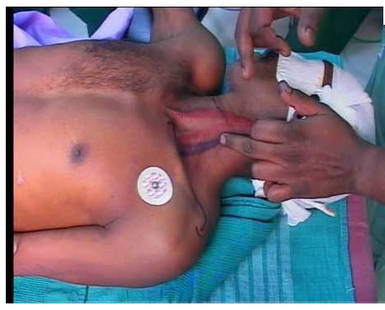

Slide 39
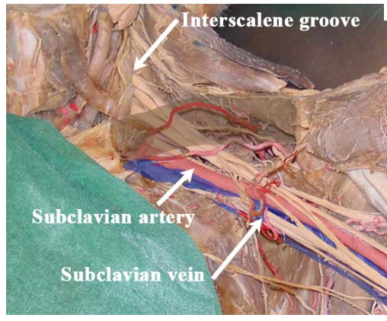

Slide 40
SUPRACLAVICULAR BLOCK
Technique-
In supine position with the head turned away from the
side to be blocked.
The arm to be anesthetized is adducted, and the hand
should be extended along the side toward the ipsilateral
knee as far as possible.
In the classic technique, the midpoint of the clavicle is
identified . The posterior border of the
sternocleidomastoid is felt. The palpating fingers can
then roll over the belly of the anterior scalene muscle
into the interscalene groove, where a mark should be
made approximately 1.5 to 2.0 cm posterior to the
midpoint of the clavicle. Palpation of the subclavian
artery at this site confirms the landmark.

Slide 41
After appropriate preparation and development of a skin
wheal, the anesthesiologist stands at the side of the patient
facing the patient's head.
A 22-gauge, 4-cm needle is directed in a caudad, slightly
medial, and posterior direction until a paresthesia is elicited
or the first rib is encountered.
If a syringe is attached, this orientation causes the needle
shaft and syringe to lie almost parallel to a line joining the
skin entry site and the patient's ear.
If the first rib is encountered without elicitation of a
paresthesia, the needle can be systematically walked
anteriorly and posteriorly along the rib until the plexus or the
subclavian artery is located .

Slide 42
Location of the artery provides a useful landmark; the needle can be withdrawn and reinserted in a more posterolateral direction, which generally results in a paresthesia or motor response.
On localization of the brachial plexus, aspiration for blood should be performed before incremental injections of a total volume of 20 to 30 mL of solution.
Complications
Pneumothorax
phrenic nerve block (40% to 60%),
Horner's syndrome and
neuropathy.

Slide 43
SUPRACLAVICULAR BLOCK
Landmarks
There is no proper landmark, besides the clavicle,
which in most patients is easily felt.
The subclavian pulse might be palpated above
the clavicle, but that is not indispensable.
The ultrasound probe is positioned in the
supraclavicular fossa, pointing caudad, and
moved laterally and medially, as well as in a
rocking fashion, in order to locate the subclavian
artery

Slide 44
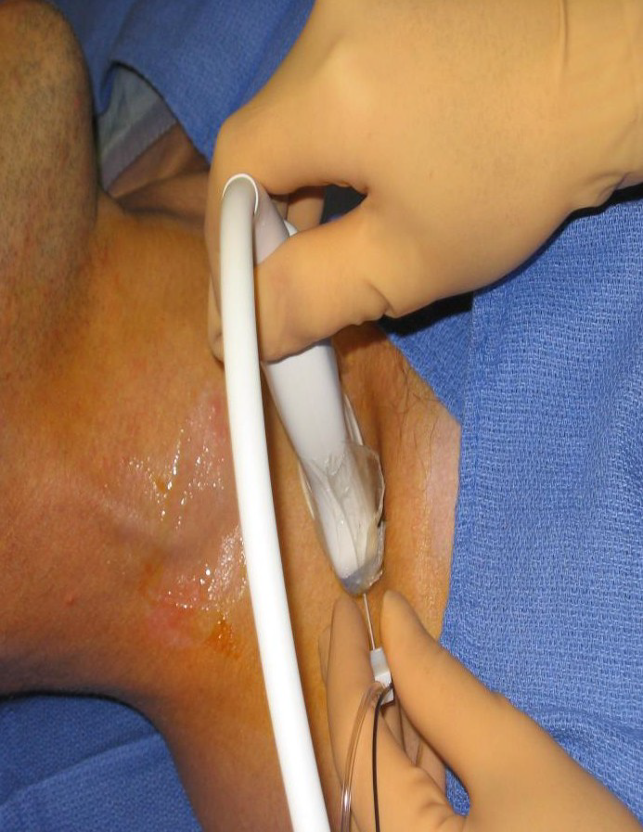
POSITION OF PROBE AND NEEDLE
Landmarks
There is no proper landmark, besides the clavicle, which in most patients is easily felt.
The subclavian pulse might be palpated above the clavicle, but that is not indispensable.
The ultrasound probe is positioned in the supraclavicular fossa, pointing caudad, and moved laterally and medially, as well as in a
rocking fashion, in order to locate the subclavian
artery

Slide 45
TECHNIQUE
Once the subclavian artery is visualized, the
area lateral and superficial to it is explored until
the plexus is seen, with a characteristic
“honeycomb” appearance.
Multiple nerves can be seen, or as few as two,
depending on the level and the patient (Figure1).
A caudad-cephalad rocking motion is then used to find the plane where the nerves are best seen.

Slide 46
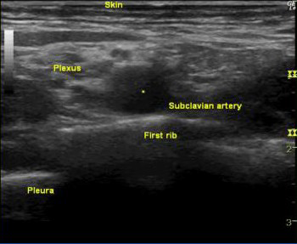
Figure 1: Left subclavian artery and nerves of the brachial plexus.
The subclavian artery is seen beating at the center of the field.
Underlying it is the first rib, with a bright cortical bone and a posterior shadow.
The pleura are seen on each side of the rib, somewhat deeper, and moving with the patient’s respiration.
The nerves of the brachial plexus can be seen lateral and a little superficial to the artery.
The distribution is variable, with as little as two or as

Slide 47
INFRACLAVICULAR BLOCK
Indications- Hand, wrist, elbow and distal arm surgery
Blockade occurs at the level of the cords of the
musculocutaneous and axillary nerves.
Anatomical landmarks: The boundaries of the infraclavicular fossa are
- pectoralis minor and major muscles anteriorly,
- ribs medially ,
- clavicle and the coracoid process superiorly,
- humerus laterally.

Slide 48
TECHNIQUE
Classic approach
The needle is inserted 2 cm below the midpoint of the inferior clavicular border, advanced laterally and directed toward the axillary artery
A coracoid technique consisting of insertion of the needle 2 cm medial and 2 cm caudal to the coracoid process has also been described

Slide 49
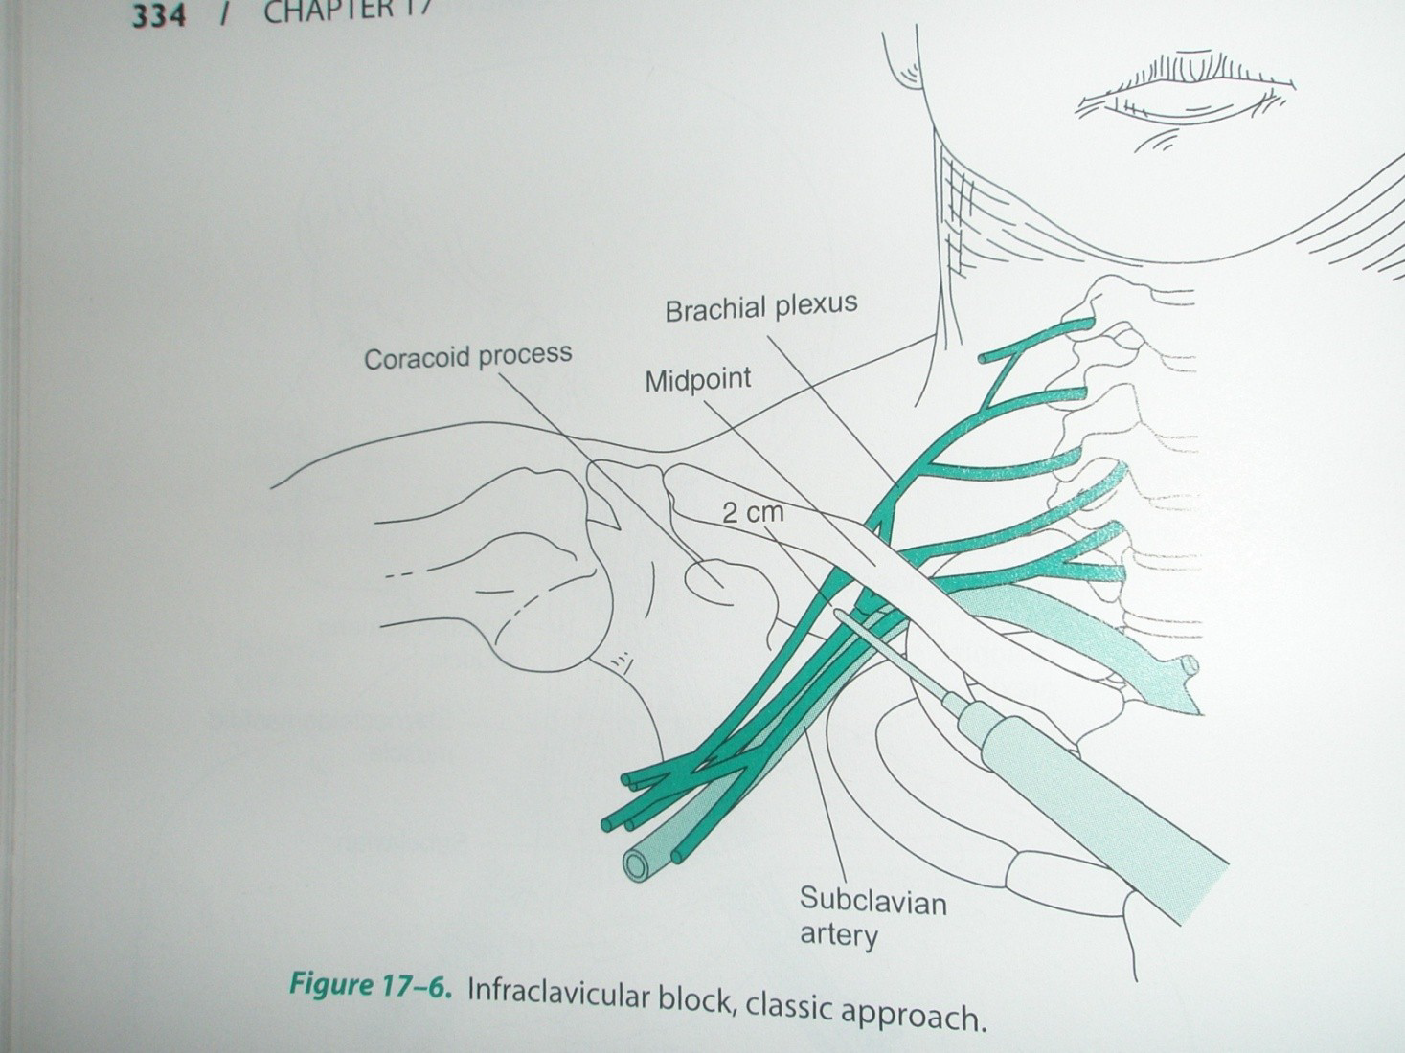
INFRACLAVICULAR APPROACH

Slide 50
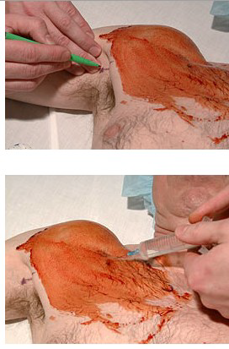

Slide 51
AXILLARY APPROACH
Indications –
Include surgery on the forearm and hand. Elbow
procedures are also successfully performed with the axillary approach.
Blockade occurs at the level of the terminal nerves.
Blockade of the musculocutaneous nerve is not always produced with this approach.

Slide 52
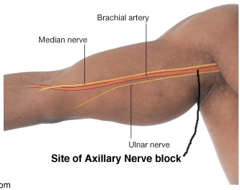
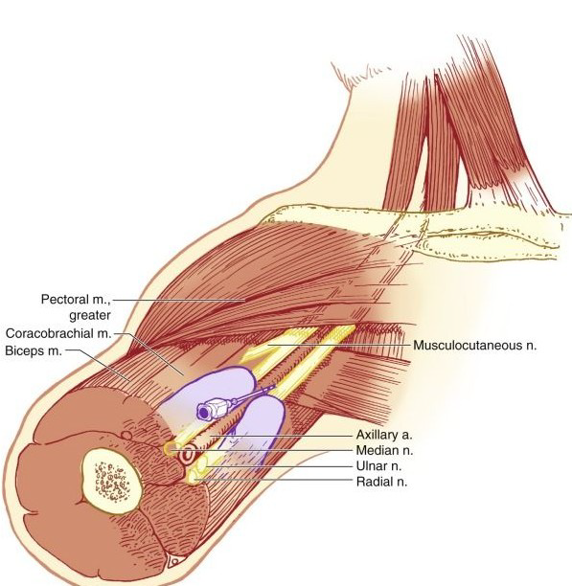
AXILLARY BLOCK

Slide 53
Landmark-
The axillary artery is the most important landmark; the
nerves maintain a predictable orientation to the artery.
The median nerve is found superior to the artery, the
ulnar nerve is inferior, and the radial nerve is posterior
and somewhat lateral
At this level, the musculocutaneous nerve has already
left the sheath and lies in the substance of the
coracobrachialis muscle.

Slide 54
TECHNIQUE
The patient should be in the supine position with the
arm to be blocked placed at a right angle to the body
and the elbow flexed to 90 degrees.
A transarterial technique can be used whereby the
needle pierces the artery and 40 to 50 mL of solution is
injected posterior to the artery; alternatively, half of the
solution can be injected posterior and half injected
anterior to the artery.
Field block of the brachial plexus with a fanlike
injection of 10 to 15 mL of local anesthetic solution on
each side of the artery is a variation of the sheath technique.

Slide 55
COMPLICATIONS
Nerve injury and systemic toxicity
Intravascular injection
Hematoma and infection are rare complications.

Slide 56
LOCAL ANAESTHETIC DRUG
Its concentration used depend upon the requirement of the
block in terms of surgical anaesthesia or analgesia, onset
time, duration and motor sparing effects.
Bupivacaine (0.25-0.5%) and Ropivacaine (0.2-0.75%) are
commonly used .
The volume required is 20-40 ml for nerve stimulator or
paraesthesia guided blockade.
However, the advent of ultrasound allows lower volumes (10-15ml) to be used effectively.

Slide 57
ADJUVANTS
Clonidine (1mcg/kg) is sometimes used as an adjunct as it can prolong the duration of the block.
Alkalization (8.4% soda bicarbonate) will improve drug penetration and induce sfaster onset. For Lignocaine 1cc for 10cc, Bupivacaine 0.1 cc for 10cc
Compounding (mixing two local anaesthe \tic drugs)
Hyaluronidase (3.75 IU/ml)
Dextran
Potassium
Other drugs used are dexem, opiods, dexona etc.

Slide 58
EQUIPMENTS AND DRUGS
Fully prepare the equipment and patient, including consent. Ensure intravenous access,monitoring and full resuscitation facilities.
“Peripheral nerve blocks - Getting started”. Appropriate aseptic precautions should be taken.
A linear ultrasound probe (Frequency 10-15 MHz) is used with the depth setting of 2-4 cm. A 50mm length insulated nerve stimulator needle is used to perform the block. Peripheral nerve stimulation
(PNS) is desirable as an additional way of confirming nerve location but not essential.
If PNS used, initial settings should be 0.5 mA for current , frequency of 2Hz and pulse width of 0.1 msec.
Higher currents may result in muscle contractions which cause the arm to move and make it difficult to maintain a stable ultrasound image.
If a PNS is used, the usual precautions of a threshold potential > 0.3mA, immediate twitch
ablation on injection and painless easy injection should be observed. It is not a requirement to seek out specific
nerve stimulator twitches if the relevant anatomy is clearly identified.

Slide 59
THANK YOU

