Slide 1
EPIDURAL ANAESTHESIA
Dr. Priya Kishnani
Associate Professor
Dept. of Anaesthesia
SBKSMIRC

Slide 2
Definitions
Neuraxial anaesthesia:
The term neuraxial anaesthesia is placement of local
anaesthetic in and around the CNS
Epidural anaesthesia:
It is type if neuraxial anaesthesia in which drug
deposited in outside the dura matter
Spinal anaesthesia:
It is type of neuraxial anaesthesia in which drug
is deposited inside dura matter or intrathecal space

Slide 3
Epidural anaesthesia | Spinal Anaesthesia
Drug can be given in extra dural space Onset is delay Dose of drug depending upon segment Plain drug can be given Needles:quinke,sprotte,whitcare | Drug can be given in subarachnoid space Onset is immediate Minimal amount of drug can be given Hyperbaric/heavy drug can be given Touhy needle

Slide 4
Epidural anaesthesia | Spinal Anaesthesia
More expertise/more failure. Segmental block practice For intraoperative anaesthesia and post operative analgesia Less hemodynamic imbalance Duration can prolong | Easy /fail less Intraoperative anaesthesia only More hemodynamic imbalance Fixed duration

Slide 5
INTRODUCTION
epidural anaesthesia is a neuraxial technique offering a range of applications wider than single-dose spinal anaesthesia.
Can be performed at the lumbar, thoracic, or cervical level.
Widely used for surgical anesthesia, obstetric analgesia , postoperative pain control, and chronic pain management.
Epidurals can be used as a single shot technique or with a catheter that allows intermittent, boluses or continuous infusion, or both.
The motor block can range from none to complete .It basically depends on drug ,doses , concentration and level of injection

Slide 6
Anatomy of epidural space:
The epidural space is between the dura matter the anteriorly and posteriorly ligamentum flavum.
The superior limit of the epidural space is the fusion of the dura to the foramen magnum.
The inferior limit is the sacrococcygeal membrane.
The epidural space is made of fat, veins, arteries, and lymphatic and connective tissue.

Slide 7
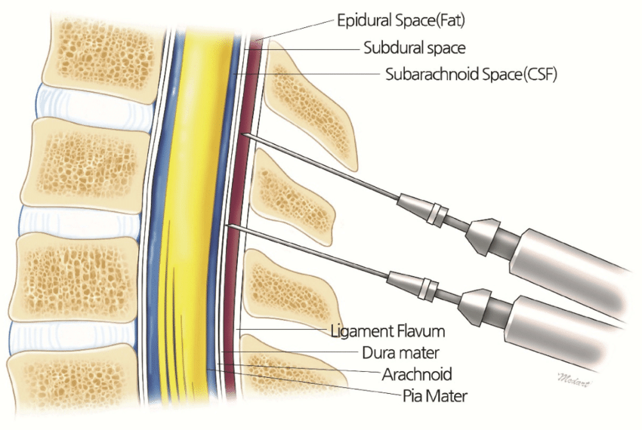

Slide 8
MECHANISM OF ACTION
For epidural anaesthesia, drug uptake is more complex.
Some of the injected local anaesthetic will move from the epidural space through the meninges into the CSF to exert its neural blocking effect
Some will be lost through vascular absorption through the capillary vessels into the systemic circulation and some into epidural fat

Slide 9
Drug penetration and uptake is directly proportionate to
The drug mass
Contact surface area
lipid content (high in spinal cord and myelinated nerves)
local tissue vascular supply
Inversely related to
nerve root size.

Slide 10
Drug distribution
(1) crossing the dura mater into the subarachnoid space
(2) rostral and caudal (longitudinal) spread within the epidural space
(3) circumferential spread within the epidural space
(4) exit of the epidural space through the intervertebral foramina
(5) binding to epidural fat

Slide 11
DRUG ELIMINATION
The rate of elimination
Dependent on the distribution of local anaesthetic , greater spread will expose the drug to a larger area for vascular absorption and thus a shorter duration of action.
Lipid-soluble local anaesthetics (e.g., bupivacaine) bind to epidural fat to form a depot that can slow vascular absorption

Slide 12
Epidural Needles
The standard epidural needle is typically 17 to 18 gauge and 3.5 inches long
Types –tuohy,hustead,crawford,weiss
The Tuohy needle is most commonly used
Tuohy needle is blunt bevel with a gentle curve of 15° to 30° at the tip.

Slide 13
The blunt, curved tip theoretically helps to push away the dura after passing through the ligamentum flavum instead of penetrating it.
Crawford needles Straight needles without a curved tip may have a greater incidence of dural puncture.
Needle modifications include winged tips and introducer devices set into the hub designed for guiding catheter placement

Slide 14
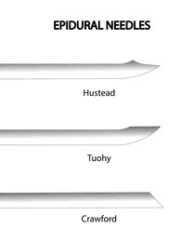

Slide 15
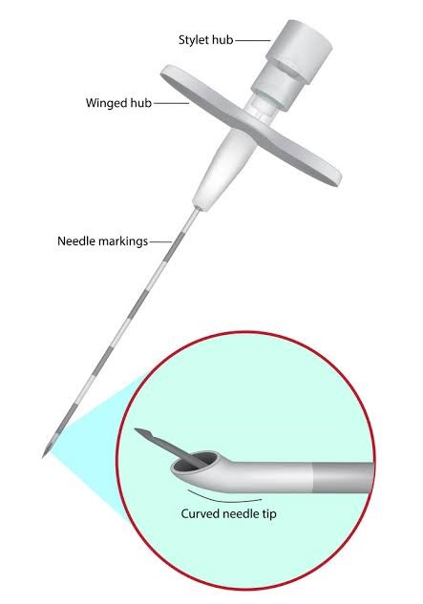
TUOHY NEEDLE

Slide 16
Epidural Catheters
Epidural catheters are useful for intraoperative epidural anesthesia and postoperative analgesia
19- or 20-gauge catheter is introduced through a 17- or 18-gauge epidural needle.
The shorter the distance the catheter , the more likely it is to become dislodged.
Conversely, the further the catheter is advanced, the greater the chance of a unilateral block.

Slide 17
After advancing the catheter the desired depth, the needle is removed, leaving the catheter in place
The catheter can be taped or otherwise secured along the back.
Catheters that will remain in place for prolonged times (eg, >1 week) may be tunneled under the skin.
Catheters have either a single port at the distal end or multiple side ports close to a closed tip.

Slide 18
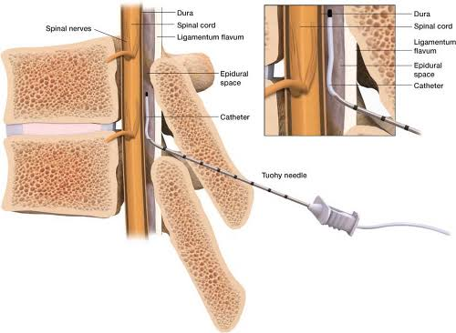

Slide 19
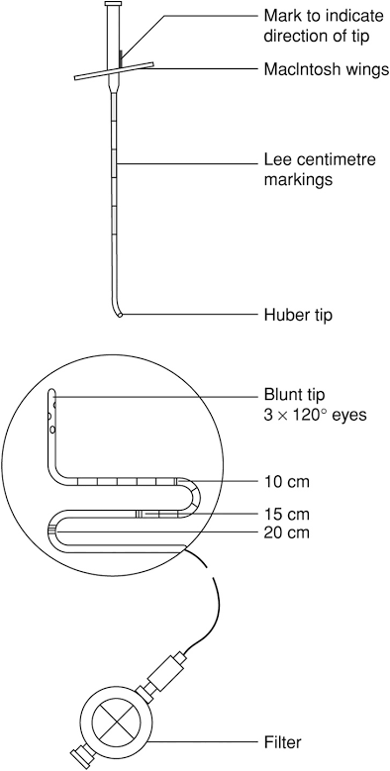

Slide 20
Preparation
Emergency equipment available before procedure
Secure iv line ,preloading with fluid and medication if needed ,standard ASA monitors applied before procedure
Position of patient is sitting or lateral decubitus with proper arching of back for proper exposure

Slide 21
Techniques for Epidural Anaesthesia
The epidural needle must pass through skin and ligamentum flavum , the needle must stop short of piercing the dura.
Two techniques make it possible to determine when the tip of the needle has entered the potential (epidural) space:
1. Loss of resistance techniques.
2. Hanging drop techniques.

Slide 22
The loss of resistance technique
The needle is advanced through the subcutaneous tissues with the stylet in place until the interspinous ligament is entered, as noted by an increase in tissue resistance.
The stylet or introducer is removed, and a glass syringe filled with saline or air is attached to the hub of the needle.

Slide 23
If the tip of the needle is within the ligament, gentle attempts at injection are met with resistance, and injection is not possible.
The needle is then slowly advanced, millimeter by millimeter, with either continuous or rapidly repeating attempts at injection.
As the tip of the needle just enters the epidural space, there is a sudden loss of resistance, and injection is easy

Slide 24
Hanging drop technique
Once the interspinous ligament has been entered and the stylet has been removed, the hanging drop technique requires that the hub of the needle be filled with solution so that a drop hangs from its outside opening.
The needle is then slowly advanced deeper. As long as the tip of the needle remains within the ligamentous structures, the drop remains “hanging.”

Slide 25
However, as the tip of the needle enters the epidural space, it creates negative pressure, and the drop of fluid is sucked into the needle.
If the needle becomes plugged, the drop will not be drawn into the hub of the needle.

Slide 26
Complication
Complications related to adverse or exaggerated physiological response
1. Pain on injection
2. High block (Hypotension & Bradycardia)
3. Total spinal anaesthesia
4. Horner’s Syndrome
5. Urinary Retention
6. Vasovagal Shock

Slide 27
Complications related to needle or catheter placement
A. Trauma:
Backache
Dural Puncture- PDPH
Neural Injury
Vascular injury(Spinal or Epidural hematoma)
B. Misplacement:
Intravascular or intraosseus injection.
Subdural or subarachnoid block C.

Slide 28
C. Inflammation:
Infection
Arachnoiditis
Meningitis
Epidural Abscess

Slide 29
Contraindications:
Absolute:
Refusal
Bacteremia
Local infection
Hemorrhagic diasthesis
Increase intracranial pressure
Relative:
Anatomical spine deformity
Aortic stenosis
Pulmonary hypertension

Slide 30
Thank You

