Slide 1
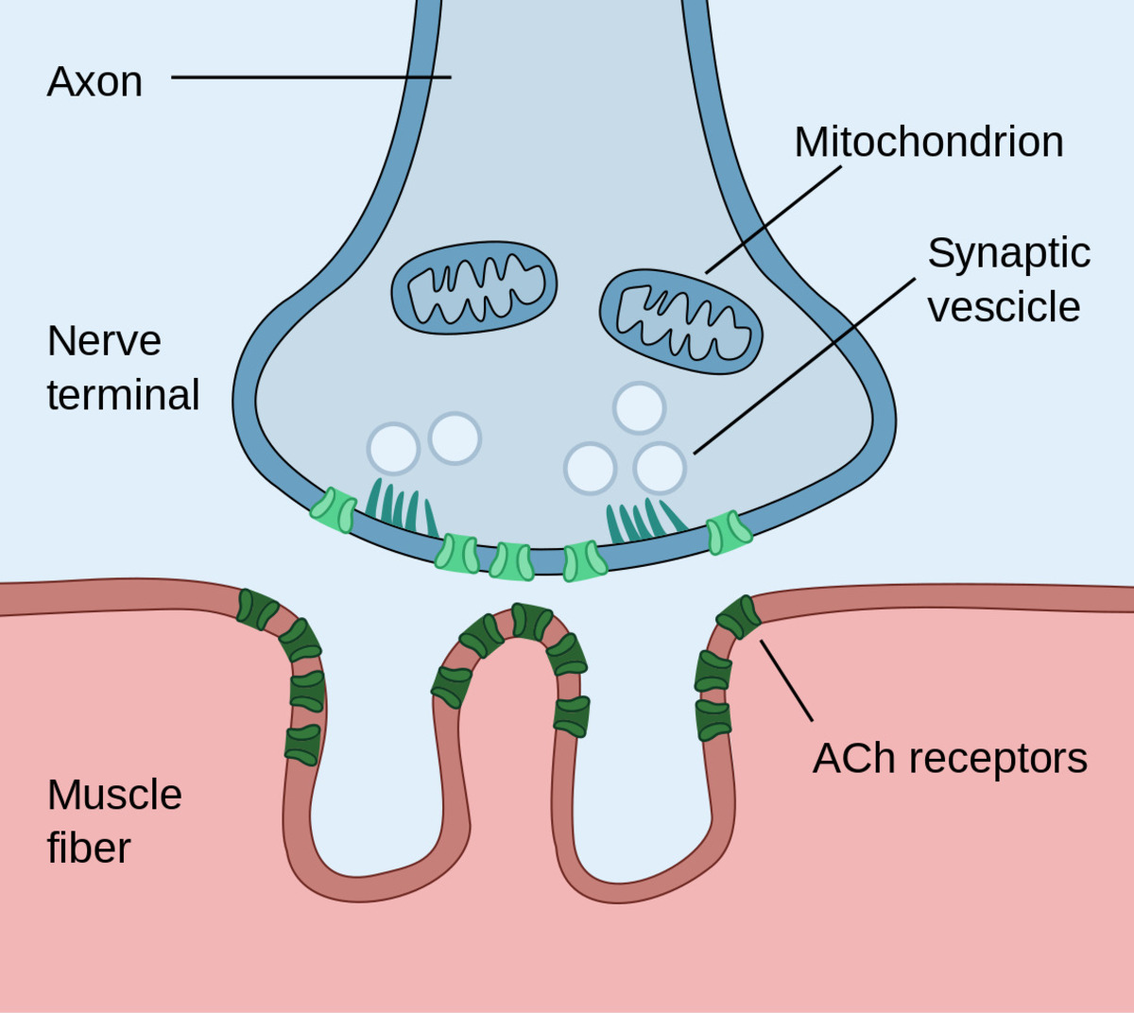
anatomy and physiology of neuromuscular junction
Dr. Jigisha Mehta
Associate Professor
Dept. of Anaesthesia
SBKSMIRC

Slide 2
NEUROMUSCULAR JUNCTION
Neuromuscular junction (NMJ) is a synapse that develops between a motor neuron and a muscle fiber.
It is composed of the following:
Presynaptic nerve terminal : motor neuron
Synaptic cleft / junctional cleft
Post synaptic muscle membrane

Slide 3
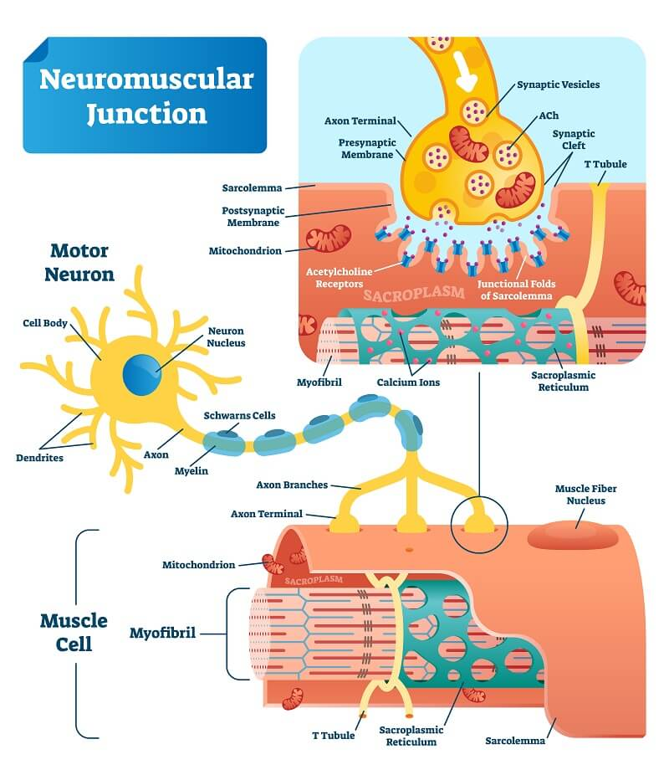

Slide 4
Motor neuron travels from ventral horn of spinal cord to NMJ as myelinated axon.
As it approaches the muscle, neuron branches to many muscle cells and converts them into a functional unit called motor unit.
As the nerve terminals reaches muscle fibres, it looses its myelin and is covered by schwann cells.
Nerve and muscle are separated by a gap called synaptic cleft, aka junctional cleft. It measures approx. 50nm.

Slide 5
Presynaptic nerve terminal
Each nerve terminal is expanded to form a knob like structure known as synaptic knob ( terminal boutton)
Synaptic knob lies in the groove in the surface of muscle fibres (synaptic trough).
They contain synaptic vesicles which are syntesized in the nerve body in the endoplasmic reticulum and transported to nerve terminal.
Synaptic vesicles size: 40 to 50nm
About 300000 vesicles collect in the nerve terminals of single skeletal muscle end plate.

Slide 6
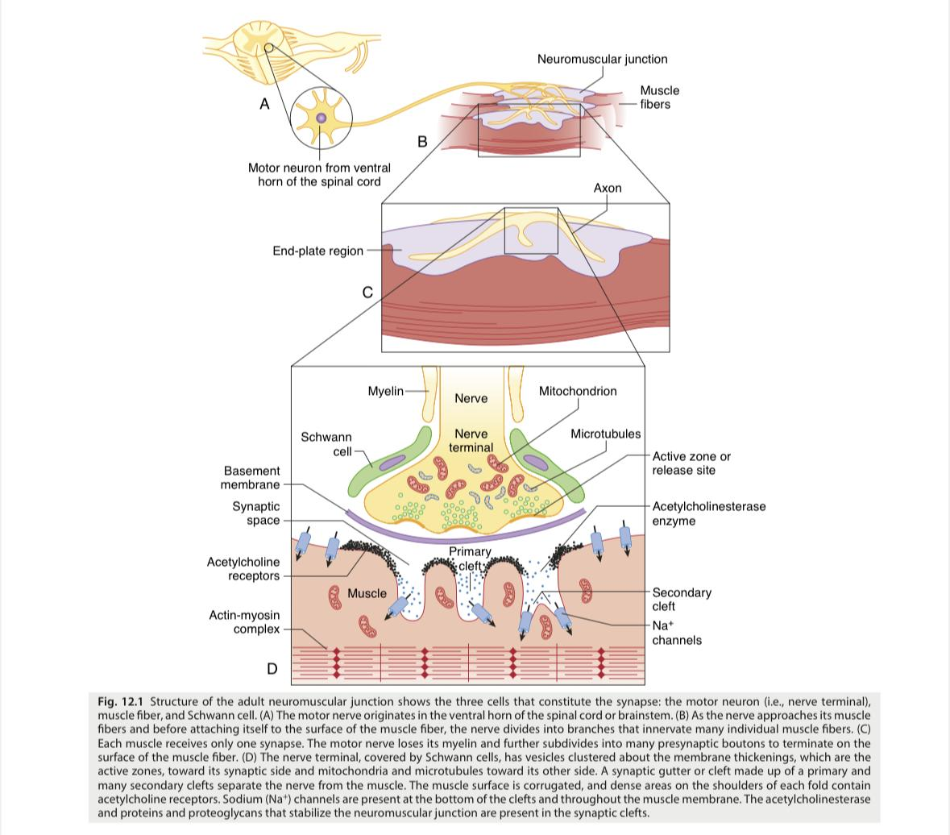

Slide 7
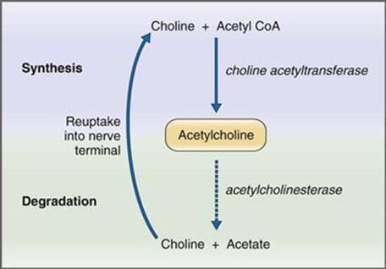
Acetylcholine

Slide 8
Acetylcholine receptors are located at pre and post junctional sites.
Neuromuscular transmission is initiated by stimulation of nerve which causes calcium influx.
Synaptic vesicles migrate to the surface of muscle and release Ach into the clefts between nerve and muscle.
Ach attaches to Ach receptors present at end plate of muscle -> influx of sodium which causes depolarization of muscle which leads to muscle contraction.

Slide 9
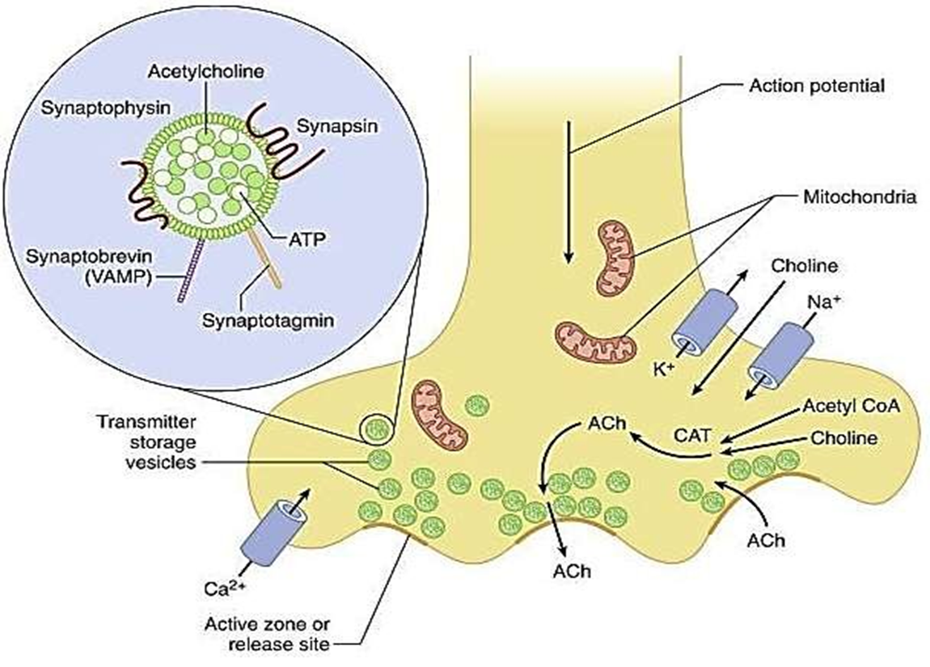
Magnified view of synaptic vesicle
Quanta of Ach, together with ATP (adenosine triphosphate) are stored in vesicle and covered by membrane protein.
Synaptophysin is a glycoprotein component of the vesicle membrane.
Synaptogmin is vesicle’s calcium sensor.
Phosphorylation of synapsin (another membrane protein) fascilitates vesicular trafficking to the release site.
Synaptobrevin ( vesicle asso. membrane protein[vamp]) is a SNARE protein involved in attaching the vesicle to the release site protiens at the nerve terminal.

Slide 10
Different pools of acetylcholine in the nerve terminal have variable availability for release.
The immediately releasable stores, VP2: responsible for maintainence of transmitter release under conditions of low nerve activity, 1% vesicles.
The reserve pool, VP1: released in response to nerve impulse, 80% vesicles.
The stationary store : the remainder of vesicles.
Each vesicle contains approx. of 12000 molecules of Ach, which are loaded into the vesicles by an active transport process in the vesicle membrane involving a magnesium dependent H+ pump ATPase.
Release of Ach may be spontaneous or in response to a nerve impulse.
When a nerve impulse invades the nerve terminal, calcium channels in the nerve terminal membrane are opened up.
Calcium enters the nerve terminal and there is calcium dependent synchronous release of the contents from 50-100 vesicles.

Slide 11
the number of quanta released by each nerve impulse is very sensitive to extracellular ionized calcium concentrations. Increased calcium conc results in increased quanta released.
to enable this, vesicle must be docked at special release sites in the part of the terminal where axonal membrane faces the post junctional Ach receptors.
These are vesicle from the immediately releasable stores.
Once the contents have been discharged, they are rapidly refilled from the reserve stores.
The reserve vesicles are anchored to actin fibrils in the cytoskeleton, by vesicular proteins called synapsins.

Slide 12
Some calcium that enters the axoplasm, on arrival of nerve impulse binds to calmodulin, which activates protein kinase 2 which phosphorylates synapsins, which in turn dissociates the vesicle from the actin fibrils allowing it to move forward to the release site.
Docking of the vesicle and subsequent discharge of Ach by exocytosis involves several other proteins.
Membrane protein called SNAREs (Soluble N- ethylmatrimide sensitive attachment proteins) are involved in fusion, docking and release of Ach at the active sites.
SNARE includes: synaptic vesicle protein synaptobrevin, synaptaxin and SNAP-25.

Slide 13
The released Ach diffuses to the muscle type nicotinic Ach receptors which are concentrated at the tops of junctional folds of membrane of motor end plate.
Binding of Ach to these receptors increases Na and K conductance of membrane and resultant influx of Na+ produces depolarizing potential, end plate potential.
The current created by the local potential depolarize the adjacent muscle membrane to firing level.
Ach is then removed by acetylcholinesterase from synaptic cleft, which is present in high concentrations at NMJ.
Action potential generated on either side of end plate and are conducted away from end plate in both directions along muscle fiber.
The muscle action potential in turn initiates muscle contraction.

Slide 14
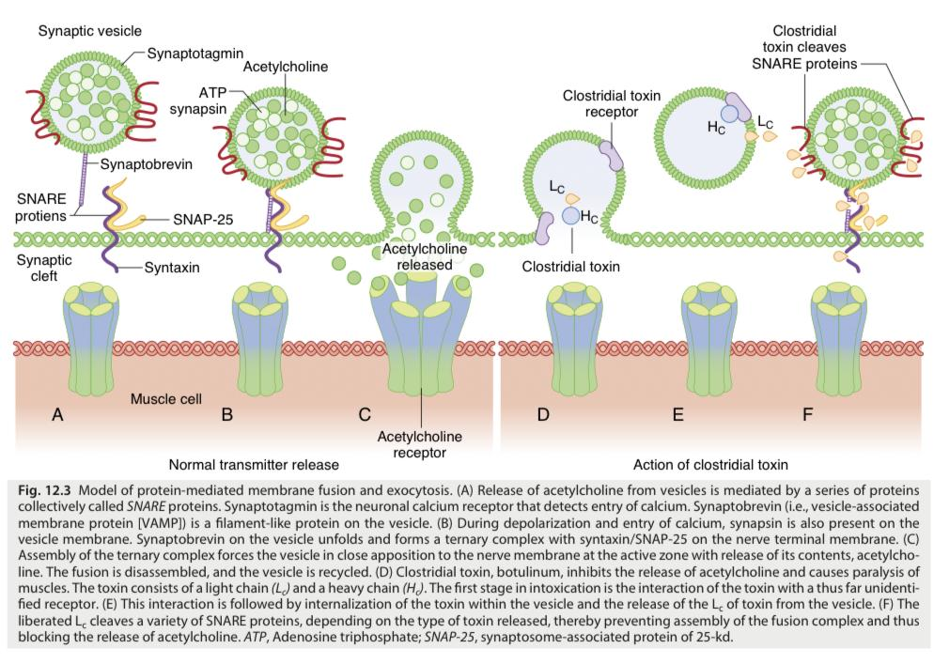

Slide 15
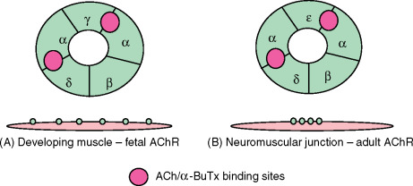
Ach Receptors
They are nicotinic and are of following types:
Junctional or mature receptors
Extrajunctional or immature receptors
Acetylcholine receptors, aka post junctional receptors are present in post junctional membrane of the motor end plate. They exist in pairs.
They are made up of protein subunits as alpha, beta, delta, and epsilon.
In fetus gamma is relaced by epsilon.
The receptor has 2 gates: voltage dependent and time dependent.
The immature, extrajunctional, or fetal form consists of two α1-subunits and one each of β1-, δ-, and γ-subunits.
The mature or junctional receptor consists of two α1-subunits and one each of β1-, δ-, and ε-subunits.

Slide 16
When Ach receptors bind to the complex, they cause a confirmational change in the proteins which open the channel and occurs only if it binds to both alpha binding sites.
Cations flow through the open channel, sodium and calcium goes in and potassium comes out, thus generating end plate potential.
Na ions attach to inside of the cell which induces depolarisation.

Slide 17
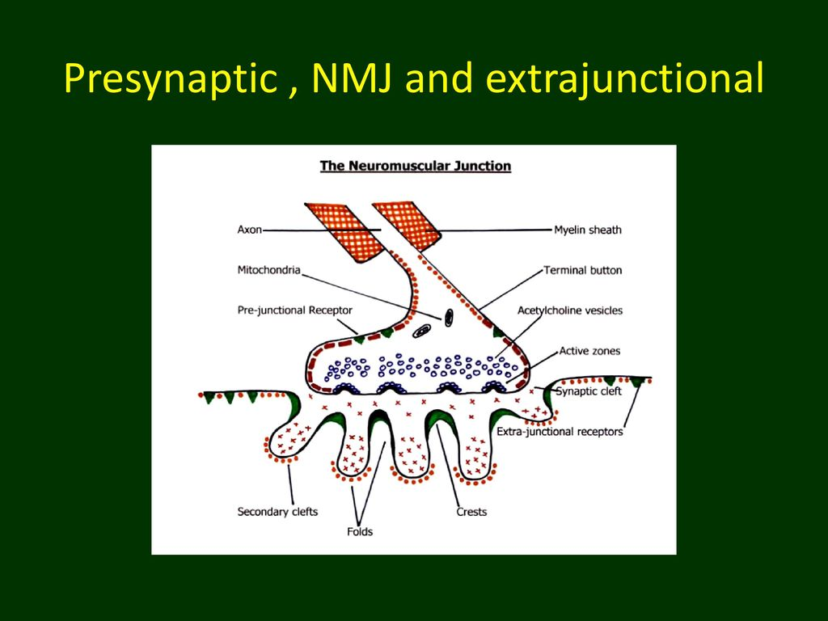
PREJUNCTIONAL RECEPTORS
These are nicotinic receptors that control ion channel specific for calcium which is required for synthesis and mobilization of Ach.
They are blocked by non depolarizing muscle relaxants.

Slide 18
EXTRA JUNCTIONAL RECEPTORS
They are not found in normal active muscle but appear very rapidly after injury or when muscle activity has ended.
They can appear within 18hrs of injury and an altered response to neuromuscular blocking drugs can be detected in 24hrs of the insult.
When a large number of extra-junctional receptors are present, resistance to non-depolarising muscle relaxants develops, yet there is an increased sensitivity to depolarising muscle relaxants.
In most extreme cases, increased sensitivity to succinylcholine results in lethal hyperkalemic receptors with an exaggerated efflux of intracellular potassium.
The longer opening time of the ion channel on the extra-junctional receptor also results in larger efflux.

Slide 19
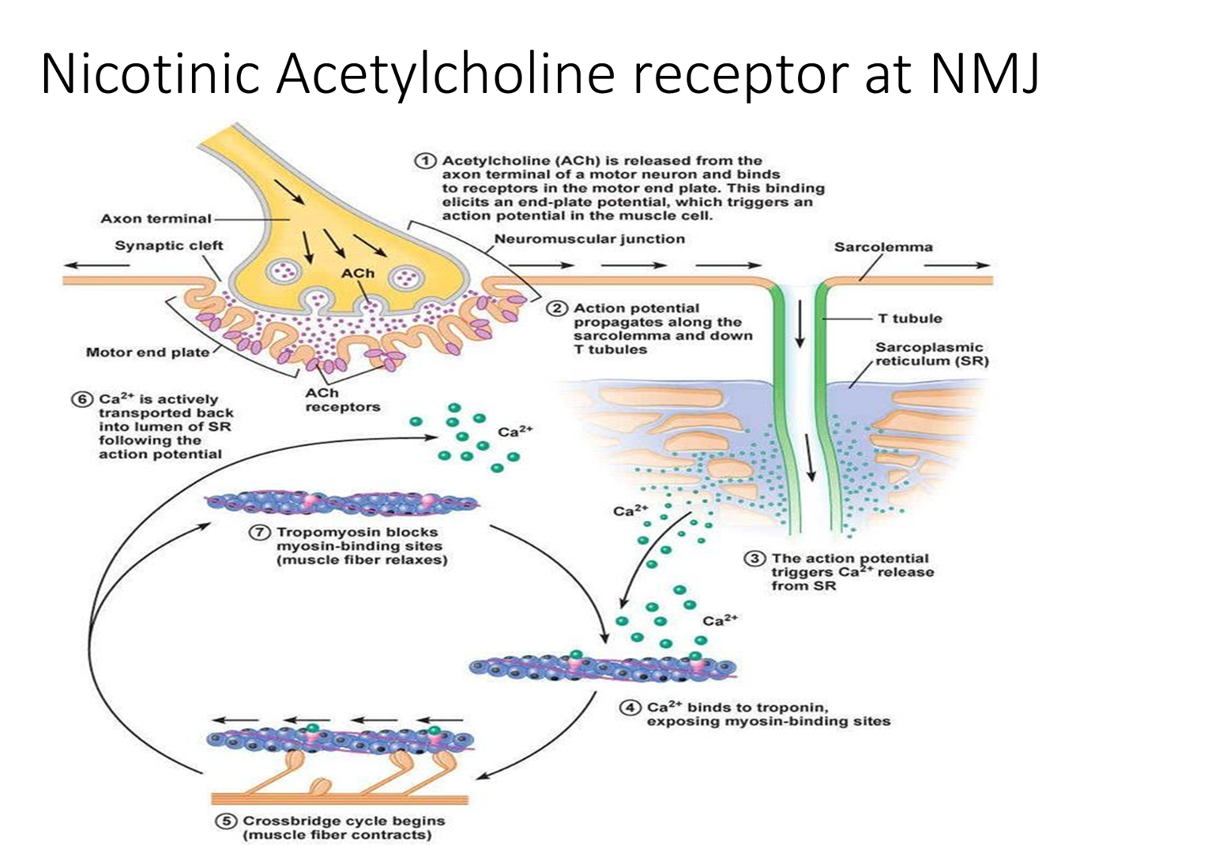

Slide 20
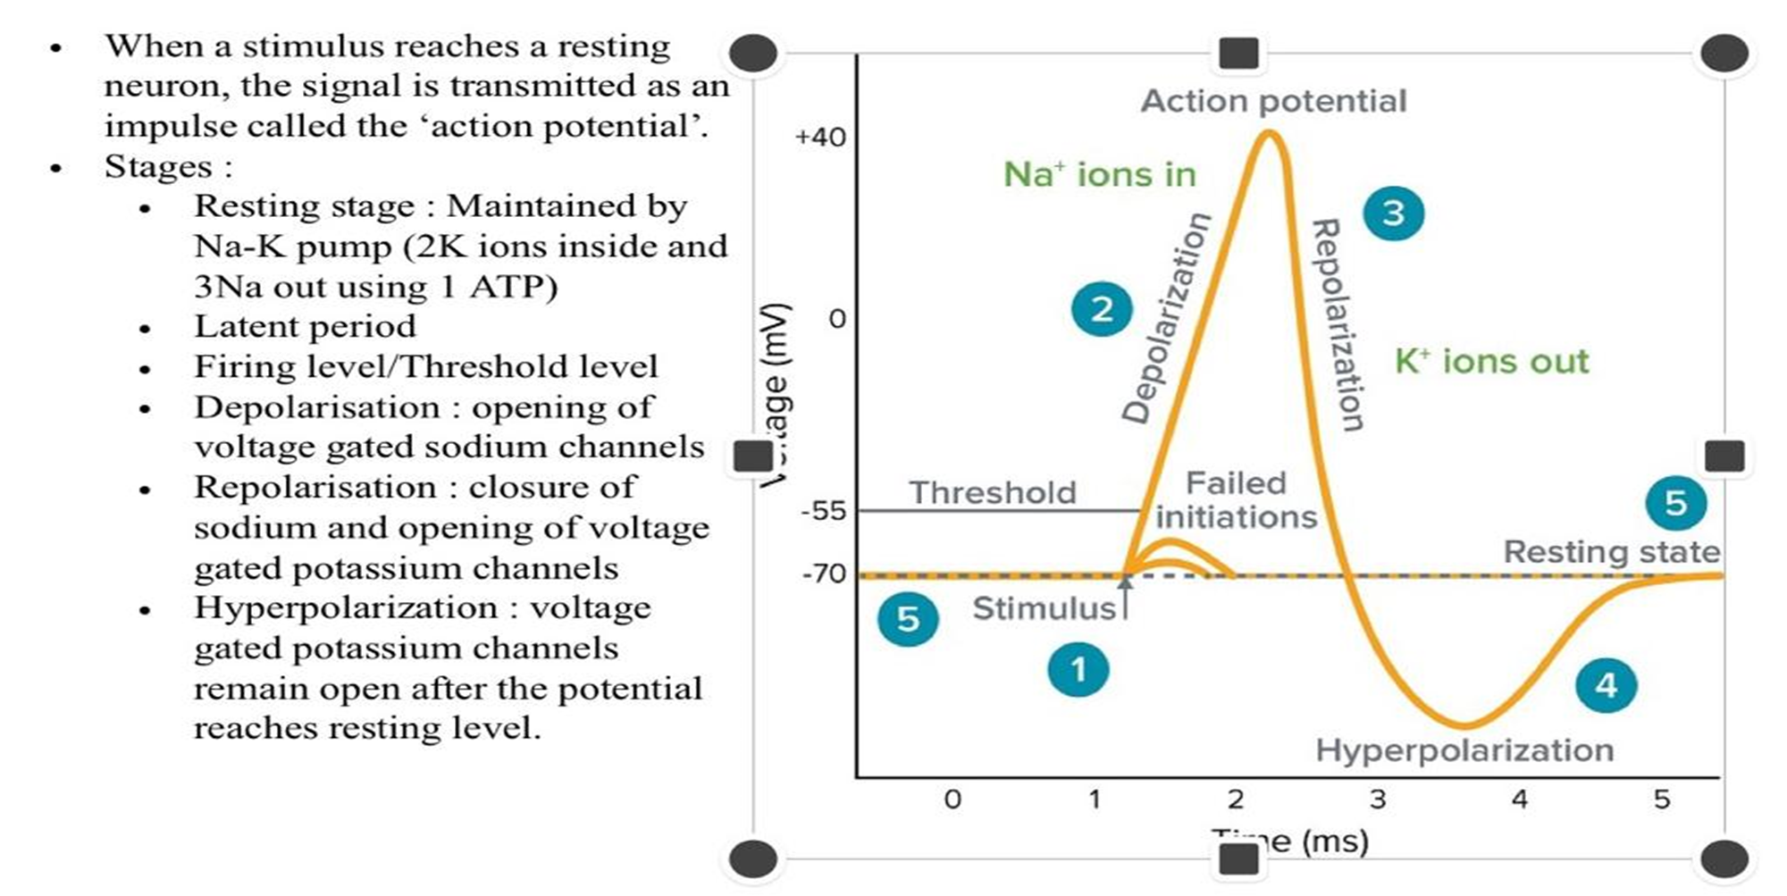
ACTION POTENTIAL

Slide 21
NEUROMUSCULAR TRANSMISSION AND EXCITATION CONTRACTION COUPLING
• Depolarization of motor nerve that open voltage gated Calcium channels that triggers both mobilization of synaptic vesicles and fusion in nerve terminal to release acetylcholine.
• The released acetylcholine binds to alpha subunits of nicotinic acetylcholine receptors and causing a conformational shift.
• When channel opens, sodium ions flow down their electrochemical gradient and depolarize muscle membrane at NMJ and potassium simultaneously exits.
• This depolarization activate sodium channels which mediate the initiation and propagation of action potentials resulting in upstroke of AP.

Slide 22
MECHANISM OF SMOOTH MUSCLE CONTRACTION
Contain both actin & myosin but lacks troponin.
• Calcium that causes contraction enters from ECF at the time of action potential & pump is slow compared to sarcoplasmic reticulum.
• Contraction of smooth muscle is in seconds & skeletal muscle is in milliseconds.
• Two neurotransmitters: acetylcholine & norepinephrine are secreted by the ANS that innervate smooth muscles.
• Ach is an excitatory neurotransmitter for smooth muscle at some sites & inhibitory for other sites.
• Norepinephrine exerts reverse effects of Ach.

Slide 23
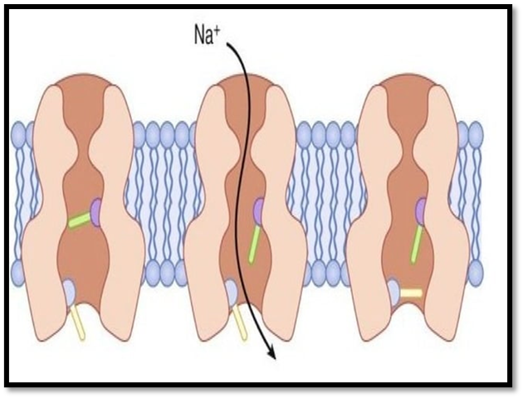
SODIUM CHANNEL
Cylindrical, membrane protein.
Has 2 gates: voltage gated and time dependent
Voltage dependent gate is closed in resting state and opens only if there is depolarizing voltage, remains open as long as the voltage persists.

Slide 24
The time dependent gate is normally open at rest closing a few milliseconds after the voltage gate opens and remains closed as long as the voltage gate is open.
It reopens after the voltage gate closes.
The channel is patent, allowing sodium ions only when the gates are open.

Slide 25
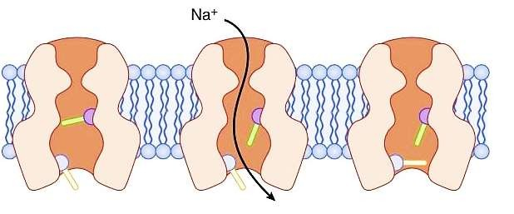


Voltage dependent
Time dependent

Slide 26
Na+ channel configuration
Resting state
Depolarization
Voltage gate closed.
Time gate open.
Channel closed.
Voltage gate open.
Time gate open.
Channel open

Slide 27
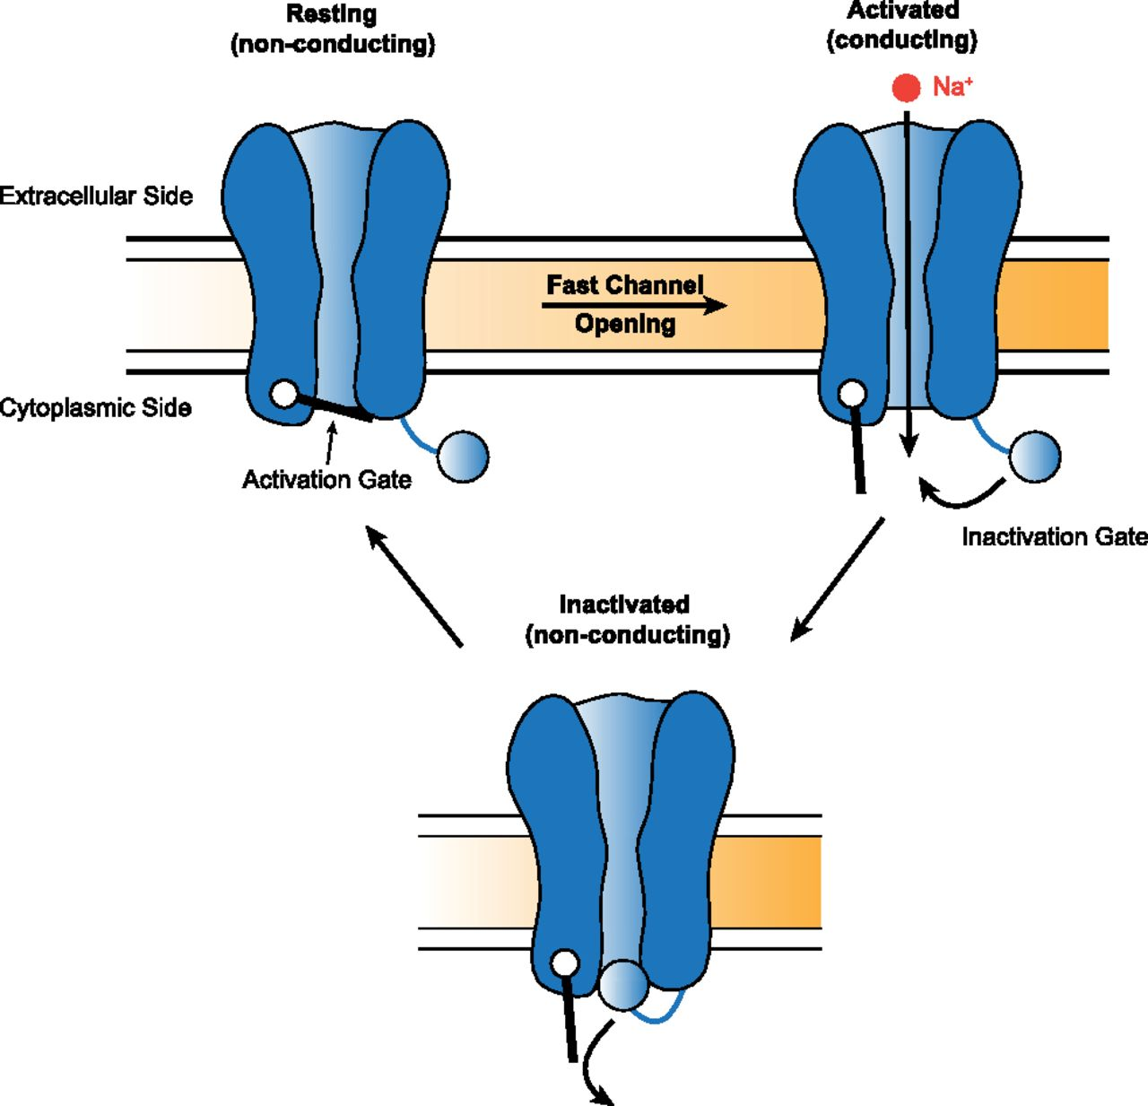

Slide 28
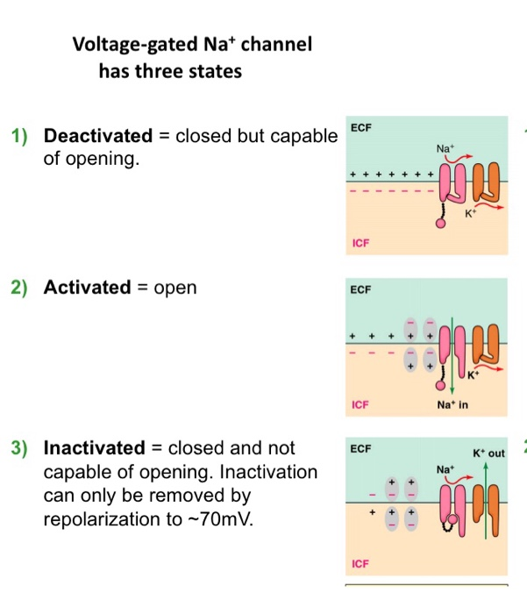

Slide 29
ACETYLCHOLINESTERASE
• This protein enzyme is secreted from the muscle, but remain attached to it by thin stalks of collagen, attached to the basement membrane.
• Acetylcholine molecules that don't interact with receptors are released from the binding site & are destroyed almost immediately by acetylcholinesterase, in <1 ms, after its release into the junctional cleft.

Slide 30
THANKYOU

