Slide 1
Intravenous Induction Agents
Dr. Kalpesh Patil
Associate Professor
Dept. of Anaesthesia
SBKSMIRC

Slide 2
What are IV induction drugs ?
• These are drugs that, when given intravenously in an appropriate dose, cause a rapid loss of consciousness.
One arm-brain circulation time ( Usually < 1 min )

Slide 3
PROPERTIES OF AN IDEAL INDUCTION AGENT
Pharmaceutical
Needs no mixing or diluting
Long shelf-life without refrigeration
pH close to plasma
No preservatives needed
Pharmacodynamic
Affects only CNS
No excitatory phenomena
No unwanted effects, particularly respiratory or cardiovascular
Good correlation between plasma concentration and clinical effects
High therapeutic index
Analgesic
No important drug interactions
No pain on injection
No histamine release or anphy lactic reactions
(Lee’s synopsis page no 156)

Slide 4
Pharmacokinetic
No organ-based metabolism
Rapid onset and offset of action
No active metabolites
Physicochemical
High lipid solubility
High proportion unionized at plasma pH
Economic
Cheap to produce
Sustainable supply at low cost

Slide 5
CLASSIFICATION BASED ON CHEMICAL STRUCTURE
BARBITURATES
Thiopental
Methohexital
PHENOLS
Propofol
IMIDAZOLES
Etomidate
PHENCYCLIDINES
Ketamine
BENZODIAZEPINES
Midazolam

Slide 6
CLASSIFICATION BASED ON ACTION
1. y-Aminobutyric acid (GABA) receptors - barbiturates, benzodiazepines, etomidate and propofol
2. N-methyl-D-aspartate (NMDA) receptor - ketamine

Slide 7
MOST COMMONLY USED ONES
Thiopental
Propofol
Ketamine
Etomidate

Slide 8
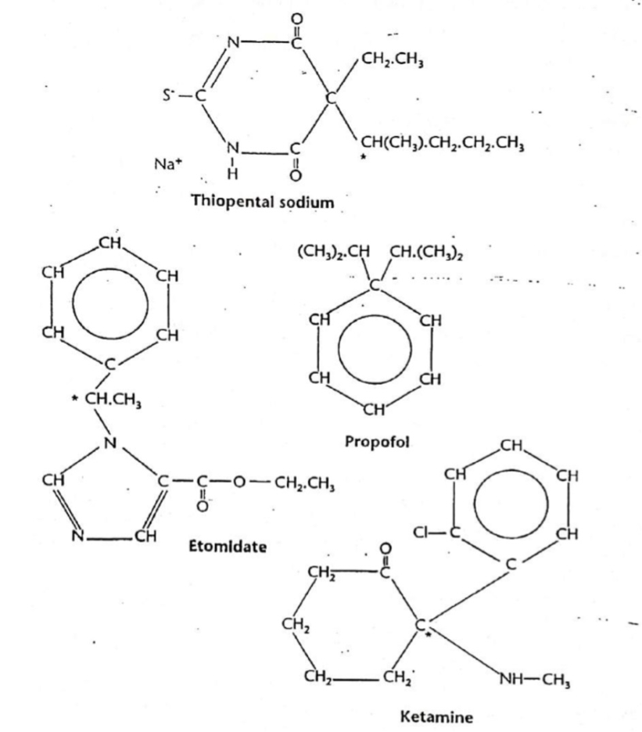

Slide 9
THIOPENTAL
HISTORY
Barbiturates : first intravenous induction agents to be used in clinical anaesthesia.
Hexobarbital : first rapidly acting agent but was soon superseded by thiopental.
Methohexital : ultra- short-acting barbiturate, was popular because of its more rapid recovery than thiopental, but has largely been replaced by propofol.

Slide 10
introduced in 1934
sodium 5-ethyl-5'-(1-methylbutyl)-2-thiobarbiturate
A yellow powder containing 6% anhydrous Na carbonate
Prepared and stored under nitrogen, which prevents release of free thiobarbituric acid in the presence of atmospheric Co2.
Dissolved in water for injection and usually diluted to give a 2.5% (25 mg/mL) alkaline solution, pH 11.
Injection into a vein may cause precipitation because the lower pH of blood increases proportion in unionized form.
Once in the blood, thiopental is highly protein bound.

Slide 11
Dose of Thiopental
-5 to 7mg/kg, with an effective plasma concen. of 15 ug/mL.
-Rectally, using a 5% or 10% solution at a dose of 50 mg/kg.
Mechanism of Action
-Potentiaition of inhibitory effects of GABA-A receptor & hyperpolarisation of pre-& post-synaptic membranes
-They cause increased channel opening time for chloride.
-Enantiomers, S- more potent than R-thiopental, suggests specific binding sites.
-Other inhibitory activity : central sodium and calcium channels, particularly neuronal nicotinic receptors.
(Stoelting page no 183)

Slide 12
Pharmacokinetics
Absorption : Rapid due to high lipid solubility
Distribution : Initially into highly vascularised organs & then into the lean tissue
Clearance : Metabolism & elimination mainly by liver.
Hepatic extraction ratio is less than 20% & clearance during elimination phase is 250ml/ min.

Slide 13
CNS :
-Sedation, anaesthesia, respiratory depression, anticonvulsant action, retrograde amnesia and depression of the vasomotor centre.
-No analgesic action and may be antanalgesic in low dose.
-Cerebral vasoconstrictor, causing a reduction in cerebral blood flow and ICP and depression of cerebral metabolism (neuro- protection)
CVS :
-Myocardial contractility depressed (dose-dependent )
-PVR falls, leading to reduced preload and cardiac output.
-hypotension and tachycardia.
Respiratory System :
-Centrally mediated respiratory depression and reduced sensitivity to raised CO2. (dependent on dose and rate of injection)
-Transient apnea
-In Asthmatics : Coughing, laryngeal spasm and mild bronchoconstriction.

Slide 14
USES :
-Induction ot anaesthesia
- Treatment of increased ICP and ischemic injury.
-In status epilepticus which is refractory to BZDs & specialised anti-convulsant drugs.
Adverse effects :
-Histamine release
-Pain on injection into small veins,thrombophlebitis
-SC inj.-Pain & tissue necrosis
-Arterial inj.-Painful arterial spasm & chemical arteritis, irreversible thrombosis
-Involuntary excitatory movements,hypertonus, coughing & hiccups

Slide 15
Contraindications :
-Porphyria
-Status asthmatics
-Severe shock
-Pericardial temponade
-Uncompensated myocardial disease

Slide 16
PROPOFOL
History
First synthesized in 1973, by John B. Glen, a British veterinary anesthesiologist working for Imperial Chemical Industries.
In 1986 propofol was introduced for therapeutic use as a lipid emulsion in the United Kingdom and New Zealand.
Propofol (Diprivan) received FDA approval in October 1989.

Slide 17
-2,6-di-isopropyl-phenol
-Highly lipid soluble but water insoluble
-Presents as 1 to 2% emulsion in 10% soybean oil with 1.2% egg phosphatide as an emulsifying agent.
Dose of Propofol
-1-2.5 mg/kg for induction with effective blood concen. of
3.4 mcg/ml.
-0.2 mg/kg for sedation with effective blood concen. of
1.5 mcg/ml.
(Stoelting page no 160)

Slide 18
Mechanism of action
-Potentiaition of inhibitory effects of GABA-A receptor & hyperpolarisation of pre-& post-synaptic membranes.
Pharmacokinetics
Absorption
Rapid due to high lipid solubility
Distribution
Initial vol. Of distribution is 20-40 L &
initial distribution half-life is 1-8 mins.
Clearance
CL=1.5 - 2.2 L/min
Metabolised by liver to inactive, water soluble glucuronide & sulfate compounds & excreted by kidney

Slide 19
Context-Sensitive Half-Time (CSHT)
-The time required for blood or plasma concentrations of a drug to decrease by 50% after discontinuation of drug administration.
-It explains the duration of action of a drug given by
infusion after stopping the infusion.
-any drug is infused into the body most of the drug will deposit in the body's tissues ,the longer the duration of infusion (context) until the body's tissues are completely saturated. Once the drug infusion is stopped this stored drug will then redistribute back into the blood and maintain its effects.

Slide 20
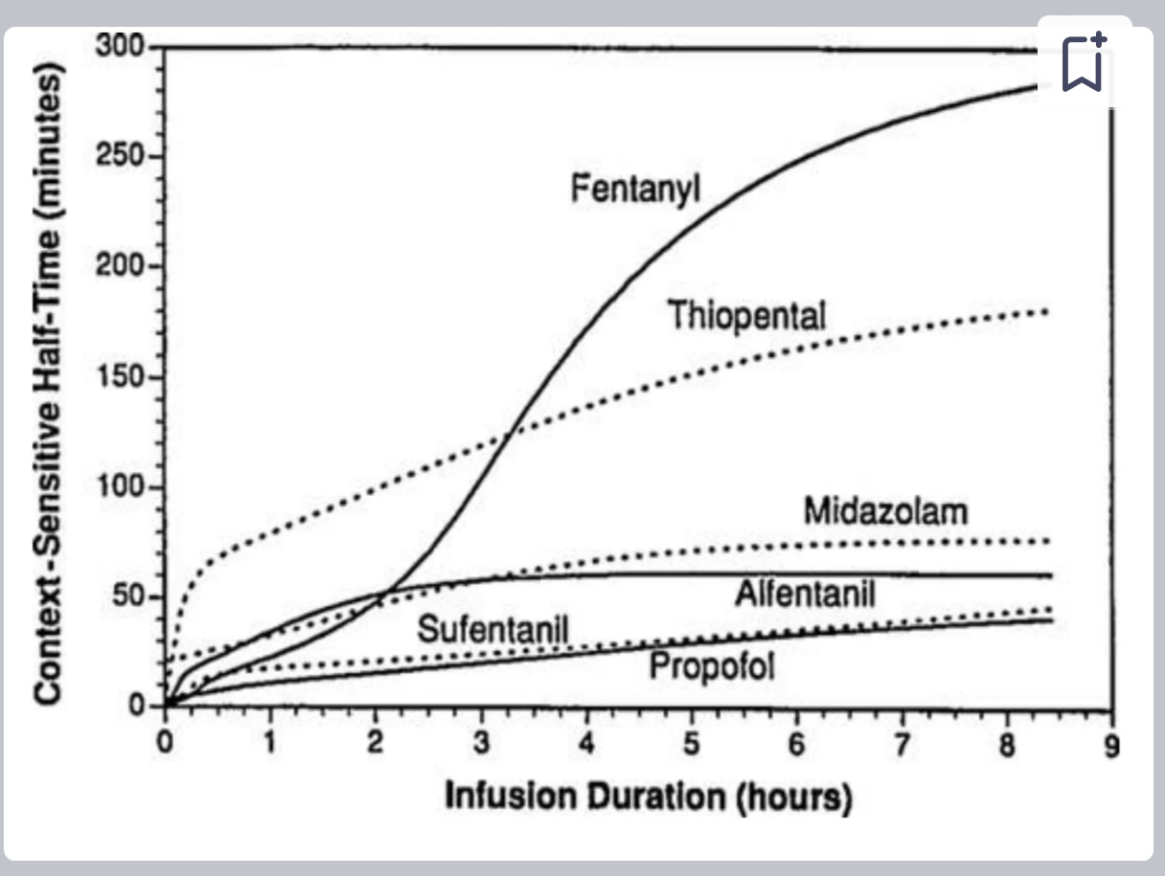

Slide 21
For Propofol ,
-Elimination half life : 0.5-1.5 hours
-Context sensitive half life : 40 mins ( for infusions < 8 hours )
: 1-3 days ( for infusions ~ 10 days)
The context-sensitive half-time of propofol is only minimally influenced by the duration of the infusion at times relevant for surgery because of slow return of the drug from tissue storage sites to the circulation.
(Stoelting page no 161)

Slide 22
CVS
-Myocardial depression dose dependent and seen more commonly ni ischaemic heart disease.
-SVR reduced by up to 30% without compensatory tachycardia.
-Centrally mediated bradycardia can lead to heart block. -low-dose induction maintains cardiac output in hypertrophic obstructive cardiomyopathy.
Respiratory System
-Central respiratory depression occurs
-Laryngeal tone is reduced so it’s easier to insert a laryngeal mask.
-less risk of coughing and laryngospasm than with Thio.

Slide 23
USES
-Most common intravenous agent used for induction and maintenance of Anaesthesia.
-Preferred drug in Day care surgeries.
-Also used for sedation in intubated and mechanically ventilated patients in ICU.
-The best choice in TIVA
-Anaesthesia during radiographic procedures, endoscopy

Slide 24
Non-Anaesthetic Uses
- Anti-emetic- 10-20 mg IV ,can be repeated every 5-10 min or start infusion of 10 ug/kg/min.
-Anti-pruritic- 10 mg IV is effective in the treatment of pruritis associated withneuraxial opoids and cholelithiasis.
-Attenuation of bronchospasm- Hence,useful in asthamatics.
-Antioxidant- beneficial in acute lung injury.

Slide 25
Adverse effects :
Airway
* ﻿Copious secretions
* ﻿Laryngospasm
Respiratory
* ﻿﻿Apnea, respiratory depression
* ﻿﻿Hiccough
* ﻿﻿Bronchospasm
* ﻿﻿Hypotension
* ﻿﻿Dysrhythmias, bradycardia or tachycardia
Central Nervous System
* ﻿﻿Headache
* ﻿﻿Dizziness, euphoria, confusion
* ﻿﻿Clonic/ myoclonic movements
* ﻿﻿Seizures, disinhibition

Slide 26
Other
* Pain or burning at the injection site is common especially when the IV is in a small peripheral vein
* Green urine
* Transient local pain: larger veins; prior injection of IV lidocaine (1 ml of a 1% solution), not exceeding 20 mg lidocaine/200mg propofol. Post operative unconsciousness.
Pediatric patients
* no vagolytic activity
* Reports of bradycardia, asystole, and rarely, cardiac arrest have been associated with propofol (particularly when fentanyl is given)

Slide 27
Absolute contraindications:
1. Known hypersensitvity to propofol or any of its components.
2. Allergies to egg, egg products, soyabeans or soy products.
3. Disorders of fat metabolism.
Relative contraindications:
1.Untreated hypertensive, hypovolemia and compromised left ventricular function.
2. Paediatric patients <3 yrs.
3. Pregnant or lactating mother.
4. Known case of epilepsy.
5. Patients undergoing neurosurgery such as pallidotomy as it temporary abolishes tremors in patients of parkinsonism.

Slide 28
KETAMINE
History
Ketamine was synthesized in an attempt to find a safer anesthetic alternative to PCP, which was more likely to cause hallucinations and seizures.
First synthesized by the Belgian chemist C.L. Stevens in 1962/1963, and patented by Parke Davis in 1966,
Ketamine was approved by the FDA in February of 1970

Slide 29
-2- (2-chlorophenyl)-2-methylaminocyclohexanone hydrochloride)
-phencyclidine derivative
-racemic mixture of -R and S-ketamine.
-S-enantiomer is three times more potent and is associated with fewer unwanted effects.
Dose of Ketamine
-1-2 mg/kg intravenously for induction. (intramuscular (4-6 mg/kg) or rectal (8-10 mg/kg) )
-infusion 25-100 g/kg/min used for maintenance of anaesthesia.
(Stoelting page no 186)

Slide 30
Mechanism of Action
-Non-competitive inhibitor at the N-methyl-D-aspartate (NMDA) receptor.
-Also a ligand at opioid receptors, both μ and k, where S-ketamine is more potent than R-ketamine.
Absorption
-Very rapid absorption & penetration of blood-brain barrier
Distribution
-Rapid early redistribution t1/2=11-16mins.,
Initial vol. of distribution 20-100L, & SSVD is 100-400L
CLEARANCE
-Metabolized primarily by liver CL=1.4 L/min

Slide 31
Central Nervous System
-Increases cerebral blood flow and metabolism and intracranial pressure ( unsuitable for neuroanaesthesia)
-Produces “dissociative anaesthesia” ,
Muscle tone is maintained,spontaneous respiration is preserved,
there is profound analgesia and amnesia.
Patients appear to keep their eyes open and involuntary movement is common.
Cardiovascular System
-Heart rate, blood pressure, cardiac output and myocardial oxygen consumption increase.
Respiratory System
-Minimal respiratory depression & Powerful bronchodilator

Slide 32
USES
Anaesthesia for patients with severe shock or who are cardiovascularly Compromised, asthmatic patients.
Adverse effects
Raises ICP, IOP, emergence reactions post-op such as vivid dreams, surreal experiences and illusions.

Slide 33
ETOMIDATE
History
• Etomidate discovered by Janssen (J & J ) Pharmaceuticals in 1964 at Belgium.
• First introduced as Anti-Fungal agent ( carboxylated imidazole )
• Introduced as IV Anesthetic agent ( due to potent sedative properties)
- In Europe 1972
- In India 2013
• Brand name in India -Troymidate, Lipuro & Etomid

Slide 34
-R-1-(methylbenzyl)-imidazole-5-ethylcarboxylate sulphate)
-water soluble and is presented as a 0.2% solution with pH 7 in 35% propylene glycol.
-single chiral carbon; the R- and S-isomers have very different potencies ( clinical preparation is just the R-enantiomer)
Dose of Etomidate
-0.3 mg/kg.
May cause pain on injection.
Does not release histamine.
(Lee’s synopsis page no 163)

Slide 35
Mechanism of Action
Acts on the GABA-A receptor & potentiates its inhibitory effect
Pharmacokinetics
Absorption
Rapidly absorbed & crosses the blood brain barrier, producing peak effect site concs. within 1 min of administration
Distribution
Moderate initial & steady state vols. of distribution.
Redistribution half-li CD fe is 2.7 mins
Clearance
Rapidly metabolized in liver primarily by ester hydrolysis to
inactive carboxylic acid derivative
Elimination half-life is 2.9-5.3 hrs,hepatic extraction ratio is high 0.5-0.9

Slide 36
CNS
-Reduces CBF, cerebral 02 consumption
-ICP & IOP reduced
-High incidence of myoclonus
CVS
No effect on mean blood pressure, cardiac output or coronary perfusion.
RS
Minimal respiratory depression

Slide 37
USES
-Suitable for patients compromised by trauma, serious illness, shock or cardiovascularcomorbidity
Adverse effects
-Pain on inj, thrombophlebitis,
-Myoclonus
- PONV
-Transient Adrenocortical Suppression
A synthesis of both mineralo- and glucocorticoids is inhibited in the adrenal cortex following continuous infusion of etomidate, leading ot higher than predicted mortality in the critically ill.
-Nausea and Vomiting

Slide 38
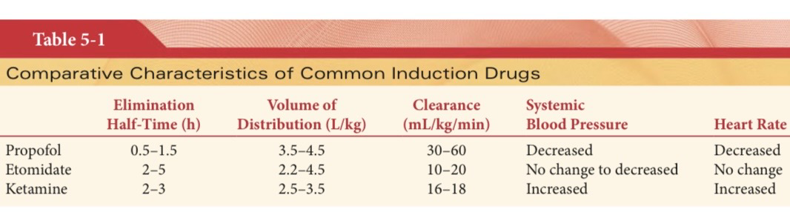

Slide 39
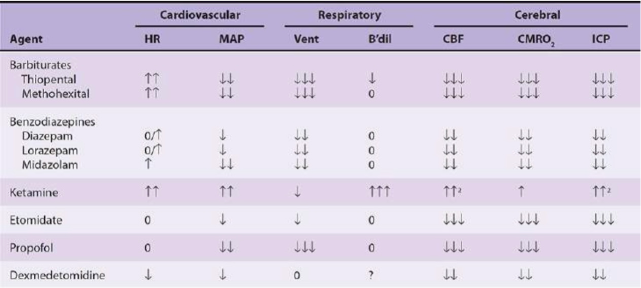

Slide 40
THANK YOU

