Slide 1
Respiratory Distress in Newborn
DR. MANISH RASANIA
DEPARTMENT OF PAEDIATRICS

Slide 2
Respiratory Distress in Newborn
Incidence – 4 to 6% of live births
Associated with significant morbidity & mortality
Early recognition, timely referral & appropriate treatment is essential

Slide 3
Respiratory Distress
  RR > 60/min
  Retractions
  Grunting
  ± Cyanosis

Slide 4
Causes
Pulmonary – RDS, TTN, MAS, PPHN, Pneumonia (congenital, aspiration, community acquired, nasocomial), Pneumothorax
Cardiac – Congenital Heart Diseases
CNS – Birth Asphyxia, ICH
Metabolic – metabolic acidosis
Surgical – TOF, Diaphragmatic Hernia, Pierre Robin Syndrome, Choanal atresia

Slide 5
Causes of Respiratory Distress on Day 1 of life?
Hyaline Membrane Disease (HMD)
Transient Tachypnea of Newborn (TTN)
Meconium Aspiration Syndrome (MAS)
Persistent Pulmonary Hypertension of Newborn (PPHN)
Early onset sepsis with pneumonia
Birth Asphyxia
Pneumothorax
Congenital anomalies – diaphragmatic hernia, TOF

Slide 6
How do you assess respiratory distress in newborn?

Slide 7
Assessment of Respiratory Distress in Full Term Neonates
Downe’s Scoring System for Assessment of Respiratory Distress in Term Neonates
Score | 0 | 1 | 2
Respiratory Rate | < 60/min | 60 – 80 /min | >80/min
Cyanosis (SpO2 < 80%) | None in room air | No cyanosis in 40% Oxygen | Requiring more than 40% FiO2
Retractions | None | Mild | Moderate to severe
Grunting | None | Audible with stethoscope | Audible without stethoscope
Air entry | Good | Decreased | Barely audible
Downe’s score of 7 or more is suggestive of impending respiratory failure

Slide 8
Assessment of Respiratory Distress in Preterm Neonates
Silverman Anderson Retraction Score for Preterms
Score | 0 | 1 | 2
Upper Chest Retraction | Sync | Lag on Inspiration | See – saw
Lower Chest Retraction | None | Just visible | Marked
Xiphoid Retraction | None | Just visible | Marked
Nasal Flare | None | Minimal | Marked
Grunt | None | Steth only | Naked ear
Score of 7 or more is indicative of impending respiratory failure.

Slide 9
Differential Diagnosis (clinical features) of various conditions causing respiratory distress on day 1 of life

Slide 10
Hyaline Membrane Disease
It occurs due to deficiency of surfactant.
Surfactant lines alveolar lining, it decreases surface tension, and thus prevents collapse of alveoli at the end of expiration.
It is produced by type II alveolar cells. Its production starts at 20 to 24 weeks of gestation. Adequate amount of surfactant is available by 35 weeks of gestation.
In the deficiency of surfactant – alveoli collapse, results in respiratory distress, V/P mismatch, hypoxia and hypercarbia.
Premature birth is the most common etiological factor for RDS.
Notes:
Maternal diabetes, birth asphyxia (damages type II alveolar cells), elective cesarean section are other risk factors. (infants delivered before labor starts do not benefit from adrenergic and steroid hormones released during labor, which increase surfactant production and release)

Slide 11
Incidence and severity of RDS is inversely proportionate to the gestational age. Risk of RDS is 80% in those who are < 28 weeker, 50% in those who are < 30 weeker, 10% at 34 weeks.
Maternal diabetes, birth asphyxia are other risk factors for the RDS.
Common presenting features
Premature neonate
Respiratory distress starts soon after birth (within 4-6 hours of birth)- tachypnea, retractions, grunting.
Distress increases till 72 hours of age unless condition is managed early and adequately with surfactant administration and CPAP or ventilatory support.
Chest X-ray is diagnostic.

Slide 12
Radiological Grading of Severity of RDS
Grade | Characteristics
Grade 1 | Very fine granularity Air bronchograms within heart borders
Grade 2 | Generalized reticulogranular mottling Air bronchograms projected beyond heart borders
Grade 3 | More confluent densities More extensive air bronchograms - Extending to second and third bronchial divisions Heart borders still visible
Grade 4 | Complete opacification of lung fields Absence of air bronchograms Heart borders no longer visible ‘White-out’ appearance

Slide 13
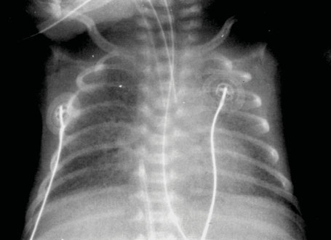
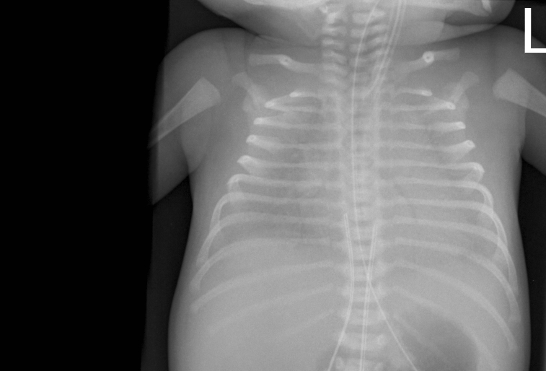
HMD (Hyaline Membrane Disease)
Changes of mild RDS
(grade 1)
Changes of severeRDS ‘white-out’ (grade 4)
Notes:
Chest radiograph showing changes of mild RDS (grade 1)
Chest radiograph showing changes of severeRDS equivalent to ‘white-out’ (grade 4)

Slide 14
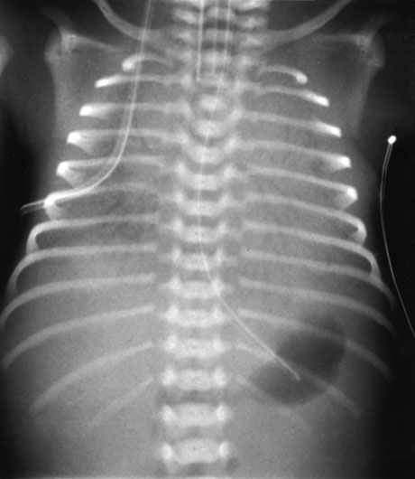
Changes of RDS (grade 3)

Slide 15
Management of RDS
Monitor SpO2 – maintain between 90 – 93%
Oxygen therapy – with O2 Hood or Nasal prongs
Respiratory support – CPAP/Ventilator
Early CPAP and Early Surfactant therapy is most helpful.
Surfactant should be used only where facilities for ventilation/CPAP is available.
Cost – 10 to 20000 Rs
Dose – 100 mg/kg phospholipid
Supportive management – iv fluid, continuous monitoring, prevention of hypothermia, prevention of hypoglycemia, aseptic precautions to prevent infections

Slide 16
Prevention of RDS – Antenatal Steroids
Preterm labour – 24 to 34 weeks of gestation, irrespective of PROM, Hypertension, Diabetes
Betamethasone – 12 mg IM every 24 hours × 2 doses
Dexamethasone – 6 mg every 12 hourly × 4 doses

Slide 17
Study | Journal, Authors | Level of Evid | Results | Conclusions
Avoidance of mechanical ventilation by surfactant treatment of spontaneously breathing preterm infants (AMV): an open-label, randomised, controlled trial. | Lancet. 2011 Nov 5;378(9803):1627-34. doi: 10.1016/S0140-6736(11)60986-0. Epub 2011 Sep 29. Göpel W¹, Kribs A, Ziegler A, Laux R, Hoehn T, Wieg C, Siegel J, Avenarius S, | 2 | 108 infants were assigned to the intervention group and 112 infants to the standard treatment group. All infants were analysed. On day 2 or 3 after birth, 30 (28%) infants in the intervention group were mechanically ventilated versus 51 (46%) in the standard treatment group (number needed to treat 6, 95% CI 3-20, absolute risk reduction 0·18, 95% CI 0·30-0·05, p=0·008). 36 (33%) infants in the intervention group were mechanically ventilated during their stay in the hospital compared with 82 (73%) in the standard treatment group (number needed to treat: 3, 95% CI 2-4, p<0·0001). The intervention group had significantly fewer median days on mechanical ventilation, (0 days. IQR 0-3 vs 2 days, 0-5) and a lower need for oxygen therapy at 28 days (30 infants [30%] vs 49 infants [45%], p=0·032) compared with the standard treatment group. We recorded no differences between groups for mortality (seven deaths in the intervention group vs five in the standard treatment group) and serious adverse events (21 vs 28). | The application of surfactant via a thin catheter to spontaneously breathing preterm infants receiving continuous positive airway pressure reduces the need for mechanical ventilation.

Slide 18
Transient Tachypnea of Newborn (TTN)
It is a condition which arises whenever there is delayed clearance of fetal lung fluid.
Fetal lungs are filled with amniotic fluid. Immediately after birth - Fluid present in lungs is replaced by gas by following mechanisms.
During labor – adrenergic hormones are released which inhibit secretion of fluid by alveolar epithelium.
During vaginal birth chest is compressed while passage through birth canal which squeezes out lung fluid.
Good breathing efforts result in enhanced reabsorption of lung fluid in pulmonary arterioles.

Slide 19
Postnatal clearance of lung fluid is much slower after CS delivery, precipitate labor and in premature deliveries.
TTN is more common in neonates who are late preterm or term born.
Onset of respiratory distress is within first 6 hours of life.
Respiratory distress is usually of mild to moderate severity.
Usually they do not require supplemental oxygen with FiO2 > 40%. Respiratory failure and need for mechanical ventilation are rare.
Respiratory distress gradually improves with time, and usually persist for 12 to 24 hours in mild cases and up to 72 hours of life in severe cases.
CXR is having characteristic appearance.

Slide 20
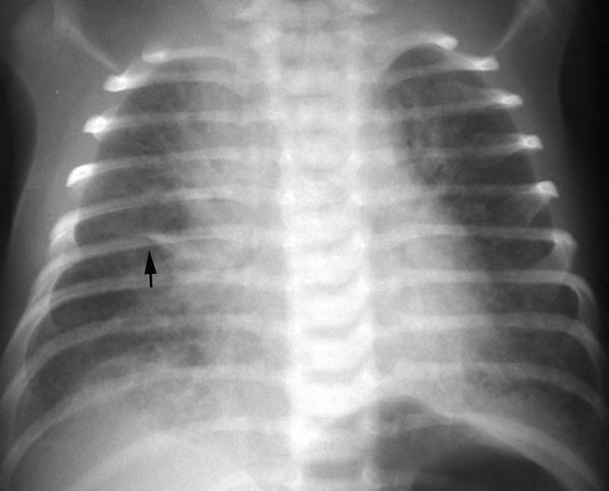
Transient Tachypnea of Newborn (TTN)
Diffuse perihilar strandlike opacities (of retained pulmonary fluid)
Fluid in the minor fissure (arrow).
The lungs are well expanded.

Slide 21
Meconium Aspiration Syndrome (MAS)
Normally passage of meconium occurs after birth.
In utero passage of meconium occurs when
Acute or chronic fetal hypoxia with vagal stimulation.
Postmature fetus with rising motilin levels leading to increased GI motility.
Breech presentation because of pressure on abdomen.
In utero passage of meconium is unlikely in premature neonates of < 34 weeks of gestation.
It is more common in IUGR neonates, post term and term neonates.

Slide 22
In utero passage of meconium occurs in 10 to 20% of all deliveries.
Out of which 10% of neonates develop meconium aspiration syndrome.
Meconium produces chemical pneumonitis.
It mechanically obstructs airways – complete obstruction causes atelectasis and partial obstruction produces ball valve effect with resultant air trapping and possible air leak.
Meconium leads to release of various chemical mediators (leukotrienes, PGE2, etc.), which results in pulmonary vasospasm and pulmonary hypertension (in 1/3rd cases).
Notes:
Gasping type of breathing (in presence of fetal distress) results in aspiration of meconium, which can occur before, during or immediately following delivery.

Slide 23
Meconium also inhibits surfactant function.
Onset of respiratory distress is within 12 hours of birth.
Course is progressive during initial 48-72 hours of life and may be complicated by PPHN leading to intractable hypoxemia.
About 50% of neonates with MAS require mechanical ventilation.
Chest of neonate may be barrel shaped because of air trapping.
CXR is characteristic.

Slide 24
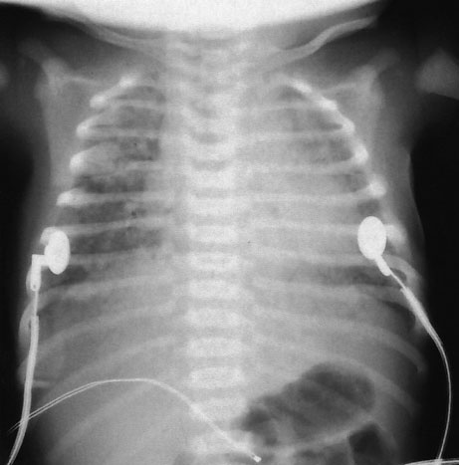
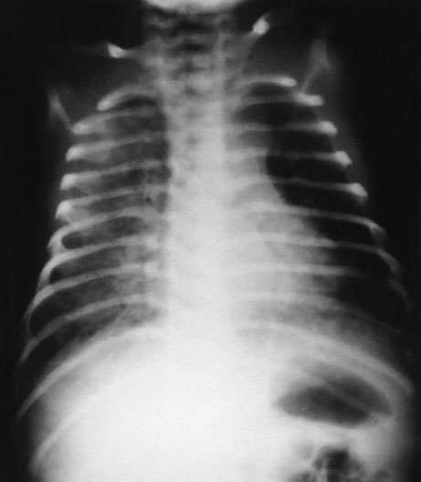
Meconium Aspiration Syndrome
Bilateral hyperexpansion of the lung fields due to air trapping
Diffuse patchy bilateral infiltrates
Notes:
Chest radiograph of an infant with MAS. There are diffuse, patchy infiltrates bilaterally.

Slide 25
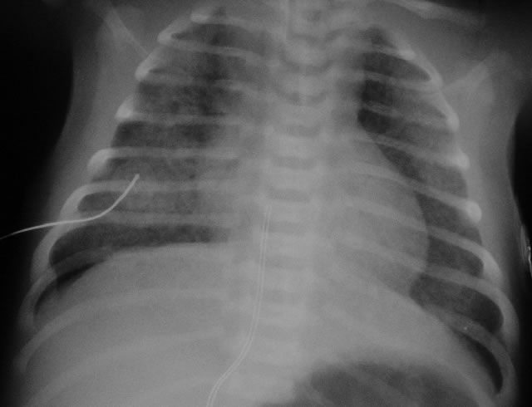
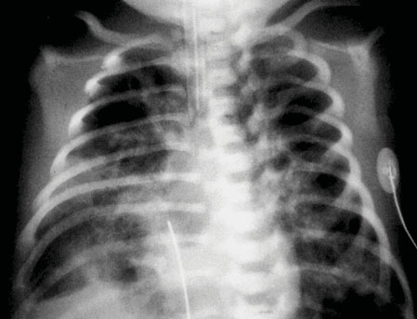
Meconium Aspiration Syndrome (MAS)
Notes:
Meconium aspiration syndrome – areas of hazziness and hyperinflation (mixed)

Slide 26
Study | Journal, Authors | Level of Evid | Results | Conclusions
Oropharyngeal and nasopharyngeal suctioning of meconium-stained neonates before delivery of their shoulders: multicentre, randomised controlled trial | The Lancet, Volume 364, Issue 9434, 14–20 August 2004, Pages 597–602 Nestor E Vain, MD^{a, ,} , Edgardo G Szyld, MD^{b}, Luis M Prudent, MD^{c}, Thomas E Wiswell, MD^{d} | 2 | 18 infants in the suction group and 15 in the no suction group did not meet entry criteria after random assignment. 87 in the suction group were not suctioned, and 26 in the no suction group were suctioned. No significant difference between treatment groups was seen in the incidence of MAS (52 [4%] suction vs 47 [4%] no suction; relative risk 0·9, 95% CI 0·6–1·3), need for mechanical ventilation for MAS (24 [2%] vs 18 [1%]; 0·8, 0·4–1·4), mortality (9 [1%] vs 4 [0·3%]; 0·4, 0·1–1·5), or in the duration of ventilation, oxygen treatment, and hospital care. | Routine intrapartum oropharyngeal and nasopharyngeal suctioning of term-gestation infants born through MSAF does not prevent MAS. Consideration should be given to revision of present recommendations.

Slide 27
Early Onset Sepsis with Pneumonia
Here pneumonia is as a part of early onset sepsis, and develops due to aspiration of infected amniotic fluid.
Risk factors for early onset sepsis are present – like – PROM > 24 hours - maternal chorioamnionitis (foul smelling liquor, intrapartum maternal fever, uterine tenderness)
Present with respiratory distress at birth or soon after birth.
If neonate is premature – it is very difficult to differentiate from RDS.
Additional features of early onset sepsis – lethargy, apnea, poor feeding, temperature instability, poor perfusion and shock.
CXR – patchy non homogenous opacities involving one or both lungs.

Slide 28
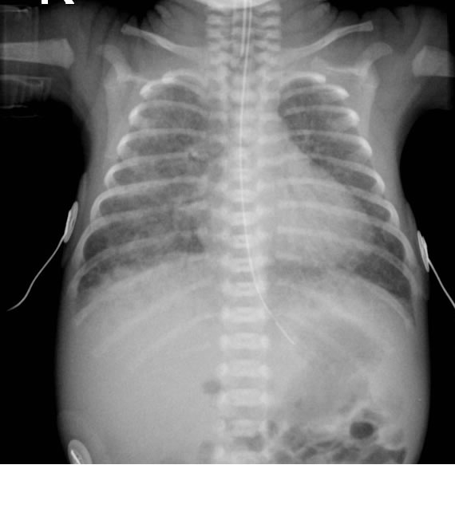
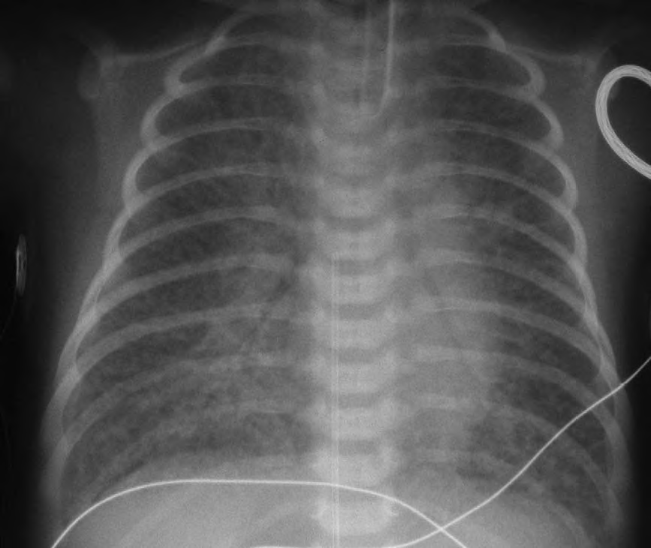
Early Onset Sepsis with Pneumonia
Notes:
CXR 1 - GBS pneumonia indistinguishable from RDS.
CXR 2 - Diffuse reticulonodular airspace disease throughout both lungs suggest RDS. However, in this term baby (presence of humeral ossification
center dates this baby as at least 36 weeks) the findings suggest another etiology—beta streptococcal pneumonia.

Slide 29
Persistent Pulmonary Hypertension of Newborn (PPHN)
In PPHN – there is sustained elevation in pulmonary vascular resistance (PVR), which results in right to left shunt through foramen ovale or ductus arteriosus.
Primary Idiopathic PPHN – in which there is excessive muscularization of pulmonary arterial system, results in elevated PVR.
Secondary PPHN occurs in conditions like
Intrauterine asphyxia
Meconium Aspiration Syndrome
Septicemia
Notes:
It can be primary idiopathic, wherein excessive muscularization of pulmonary arterial system occurs leading to elevated PVR.
Secondary PPHN occurs in conditions like
intrauterine asphyxia (hypoxia and acidosis results in pulmonary vasocontriction)
meconium aspiration syndrome (aspirated meconium leads to release of various chemical mediators in alveoli, which results in pulmonary vasospasm)
septicemia (suppression of endogenous NO production, pulmonary vasoconstriction associated with the release of thromboxanes)
pulmonary hypoplasia due to diaphragmatic hernia and oligohydramnios (wherein lung as well as pulmonary arteriolar development is affected due to compression effect)

Slide 30
Clinically – full term or post term neonate
Background history of birth asphyxia or meconium aspiration may be present
Presentation - within first 18 hours of life
Marked cyanosis which is out of proportion to the underlying lung disease. It must be distinguished from cyanotic heart disease.
SpO2 - Labile/fluctuating
If ductus arteriosus is present, then right to left shunting through ductus results in gradient of 10% or more in oxygen saturation/PaO2 between preductal (right upper extremity) and postductal (lower extremity) arterial blood.
Notes:
Cyanosis/degree of hypoxemia is more compared to severity of respiratory distress.

Slide 31
On cardiac auscultation, P2 is loud, murmur of TR may be heard.
Echocardiographic study should be performed in all neonates with suspected PPHN – to confirm the diagnosis of PPHN and to rule out cyanotic CHD.
Chest X-ray may be normal or shows finding of associated pulmonary disease. Cardiac silhoutte is normal. Pulmonary blood flow is normal or diminished.

Slide 32
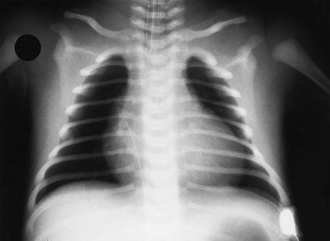
Persistent Pulmonary Hypertension of Newborn
Idiopathic PPHN - normal lung volumes and features of pulmonary vasoconstriction and oligemia
Notes:
Chest radiograph of an infant with PPHN characterized by normal lung volumes and features of pulmonary vasoconstriction and oligemia

Slide 33
Birth Asphyxia
Reasons of respiratory distress in birth asphyxia –
Increased pulmonary vascular resistance leading to PPHN
Pulmonary hemorrhage
Pulmonary edema due to cardiac dysfunction
Damage to type II alveolar cells, leading to decreased surfactant production
Decreased clearance of fetal lung fluid
Metabolic acidosis
Reperfusion injury and cerebral edema resulting in central hyperventilation

Slide 34
Pneumothorax
Pneumothorax commonly occurs in
Newborns treated with mechanical ventilation
RDS – after treatment of surfactant esply if ventilatory pressures are not reduced
MAS
Aggressive IPPV during resuscitation
Spontaneous pneumothorax occurs in 0.07% of otherwise healthy newborns.
Neonates can be preterm or full term depending up on underlying primary clinical situation
Small pneumothoraces may be asymptomatic.
Notes:
Spontaneous pneumothorax – due to high trans pulmonary pressure swings during the first breaths.

Slide 35
With large penomothorax - rapid deterioration in condition
Chest asymmetry with expansion of the affected side
Diminished or absent breath sounds on affected side
Shift of apex beat, shock in case of tension pneumothorax
Transillumination –is positive in case of pneumothorax.
Needle aspiration is diagnostic as well as therapeutic.
CXR is diagnostic
Notes:
Transillumination – high intensity fiberoptic light source when applied to chest – transillumination is positive in case of pneumothorax.
In rapidly deteriorating condition - Needle aspiration may confirm the diagnosis and is therapeutic also.

Slide 36
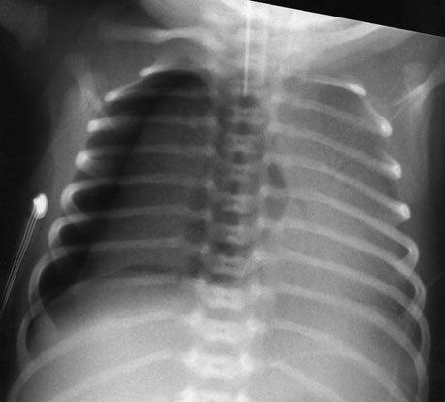
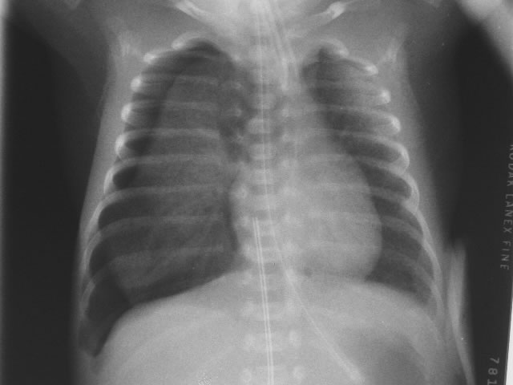
Pneumothorax
Notes:
CXR 2 - Right-sided tension pneumothorax with mediastinal shift. Both lungs demonstrate opacification of alveolar collapse.

Slide 37
Diaphragmatic Hernia
Most common site – left hemithorax, posterior defect (foramen of Bochdalek)
Infants with large DHs present at birth with cyanosis, respiratory distress, scaphoid abdomen, decreased or absent breath sounds on the side of hernia, heart sounds displaced to the side opposite the hernia.
DHs often occur after routine 16 week USG, so many of these cases are not diagnosed until postnatally. Development of polyhydramnios can prompt a later fetal ultrasonography that will detect DH.
CXR is diagnostic.
Notes:
Incidence 1 in 4000 live births
50% cases are associated with other malformations

Slide 38
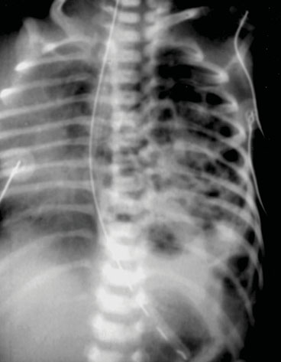
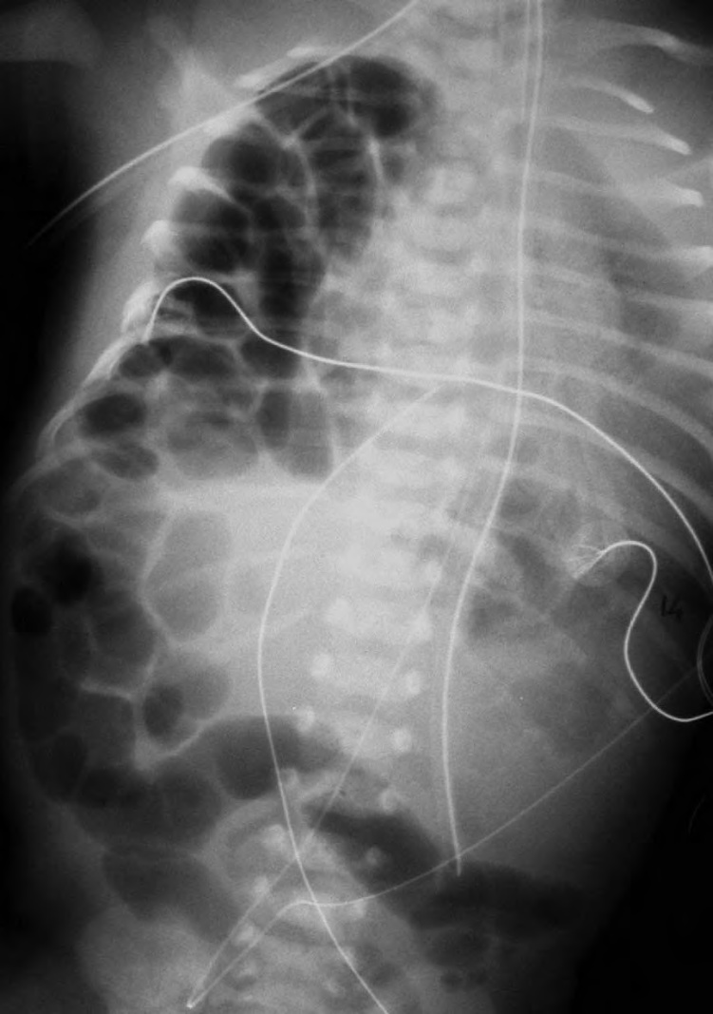
Diaphragmatic Hernia
Notes:
CXR 1 – Classical left diaphragmatic hernia with characteristic intrathoracic mediastinal shift.
CXR 2 - Radiograph of the chest and abdomen demonstrates air-fi lled bowel loops herniating into the right hemithorax. The heart and mediastinum have shifted to the left. The lungs are poorly aerated secondary to passive atelectasis.

Slide 39
Esophageal Atresia with TOF
Most common form is esophgeal atresia with distal tracheoesophageal fistula, occurs in 85% cases.
Excessive salivation and vomiting soon after feeding
Respiratory distress may develop due to aspiration of secretions/feed and reflux of gastric contents up the distal esophagus into the lungs through the fistula
Polyhydramnios is present in 1/3rd of cases.
CXR with feeding tube is diagnostic.
Notes:
Incidence is 1 in 3000 to 4000 live births
In presence of distal fistula – in crying newborn distension of stomach with air occurs, which compresses lungs

Slide 40
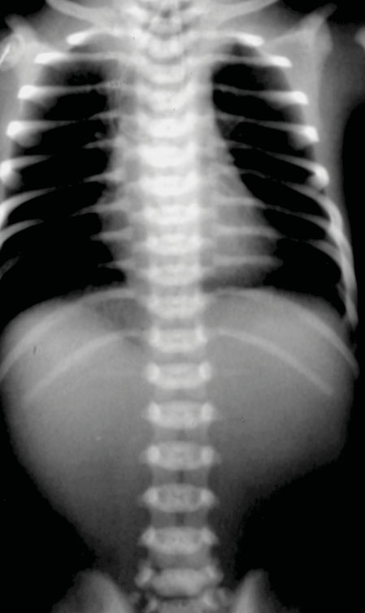
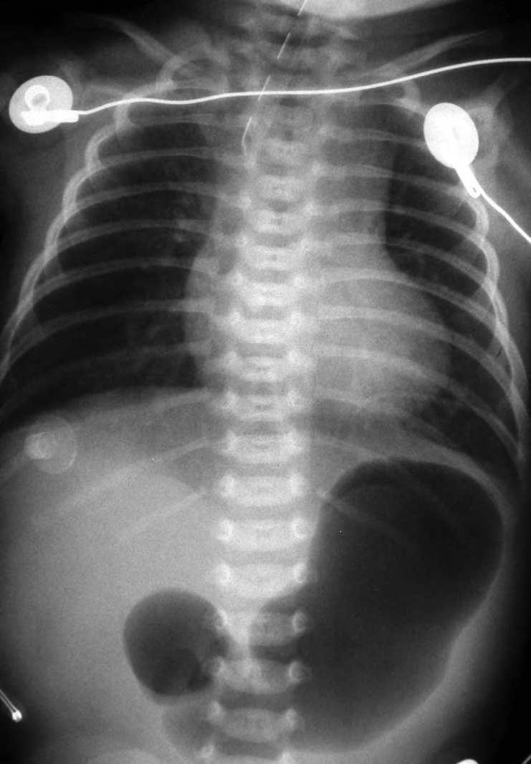
Esophageal Atresis with Tracheo-esophageal Fistula
Notes:
CXR 1 - Oesophageal atresia. A coiled feeding tube can be seen in the distended proximal oesophageal pouch. The gasless abdomen indicates the absence of a tracheo-oesophageal fifistula
CXR 2 - The clinicians were unable to pass a nasogastric (NG) tube. The radiograph demonstrates the NG tube ending in the proximal atretic esophagus (blind pouch). Air in the stomach suggests a tracheoesophageal fistula. In addition, a double-bubble sign of duodenal atresia is present.

Slide 41
MCQ. 1
Newborn is considered tachypneic if RR is
> 40/min
>50/min
> 60/min
> 30/min

Slide 42
MCQ. 2
Following statements are true for RDS (HMD) except
It is due to deficiency of surfactant
It is common in term neonates
Respiratory distress starts soon after birth
Early CPAP and surfactant therapy is most helpful

Slide 43
MCQ. 3
Following statements are true for TTN except
It is common in late preterm
Respiratory distress starts soon after birth
Ventilator support is usually required
Respiratory distress gradually improves with time and persists for 24 to 72 hours

Slide 44
MCQ. 4
Following statements are true for meconium aspiration syndrome except
It is common in IUGR and post term neonates
Respiratory distress starts after 24 hours of life
About 50% of neonates require mechanical ventilation
PPHN is a common complication

Slide 45
MCQ. 5
Following statements are true for early onset sepsis with pneumonia except
Risk factors for sepsis are usually present
It is more common in preterm
Respiratory distress starts within 24 hours of life
Lethargy, poor feeding, hypothermia, poor perfusion, shock are common

