Slide 1
SHOCK
DR. VISHRUTI GANDHI
DEPARTMENT OF PAEDIATRICS

Slide 2
Shock
Definition:
Shock is the clinical state of inadequate perfusion to meet the body’s metabolic needs. Delivery of oxygen and important substrates (glucose) is impaired.

Slide 3
Physiology -
Decreased blood volume.
Decreased cardiac activity.
Poor oxygen carrying capacity.
Maldistribution.

Slide 4
Cont….
Stroke volume depends on preload, contractility and after-load.
Stroke volume x Heart rate = CO.
CO xO2 content = O2 delivery.

Slide 5
Compensatory mechanisms -
Tachycardia.
Vasoconstriction.
Increased contractility of heart.
Increased venous tone.

Slide 6
Severity -
Compensated.
Uncompensated.
Progressive.
Irreversible.

Slide 7
Shock- an accelerating process.
        Compensated shock
        ↓ within hours
        Hypotension shock
        Cardiac Arrest
Within minutes

Slide 8
Types -
Hypovolemic – (Haemorragic /Non-haemorrhagic)
Cardiogenic.
Distributive.
Septic.
Neurogenic.

Slide 9
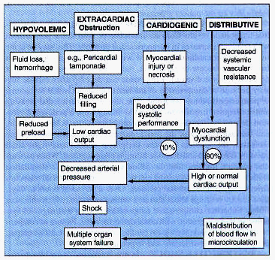

Slide 10
Hypovolemic Shock
Pathology: Decreased preload secondary to internal or external losses.
Reduced circulating blood volume with secondary decreased cardiac output

Slide 11
Hypovolemic Shock
Non-hemorrhagic
  Vomiting
  Diarrhea
  Bowel obstruction, pancreatitis
  Burns
  Neglect, environmental (dehydration)
  Dengue.
Hemorrhagic
  GI bleed
  Trauma
  Massive hemoptysis
  Vascular rupture
  Ectopic pregnancy, post-partum bleeding

Slide 12
Distributive Shock
Pathology:
Abnormalities of vasomotor tone.
Loss of venous capcitance decreases preload.
Loss of arterial capcitance decreases afterload or systemic blood pressure.
Peripheral Vasodilation secondary to disruption of cellular metabolism by the effects of inflammatory mediators.
Gram negative or other overwhelming infection.
Results in decreased Peripheral Vascular Resistance.

Slide 13
Septic Shock- Definitions
Infection:
Suspected or proven (by positive culture, tissue stain, or polymerase chain reaction test) infection caused by any pathogen OR a clinical syndrome associated with a high probability of infection. Evidence of infection includes positive findings on clinical exam, imaging, or laboratory tests.

Slide 14
Definitions – SIRS(Any 2)
Fever /Hypothermia.
Tachycardia.
Fast breathing.
Leucocytosis/Leucopenia.

Slide 15
Definitions
Systemic inflammatory response syndrome:
The presence of at least 2 of the following 4 criteria, 1 of which must be abnormal temperature or leukocyte count:
1. Core-temperature of >38.5°C or <36°C
2. Tachycardia, defined as a mean heart rate >2 SD above normal for age in the absence of external stimulus, long-term drug use or painful stimuli; or otherwise unexplained persistent elevation over a 0.5- to 4-hr period
OR
for children <1 yr old: bradycardia, defined as a mean heart rate <10th percentile for age in the absence of external vagal stimulus, β-blocker drugs, or congenital heart disease; or otherwise unexplained persistent depression over a 0.5-hr period
3. Mean respiratory rate >2 SD above normal for age or mechanical ventilation for an acute process not related to underlying neuromuscular disease or the receipt of general anesthesia
4. Leukocyte count elevated or depressed for age (not secondary to chemotherapy-induced leukopenia) or >10% immature neutrophils.

Slide 17
Definitions
Septic shock
Sepsis and cardiovascular organ dysfunction.

Slide 18
New definitions. (2016)
Sepsis – Life threatening organ dysfunction caused by dysregulated host response to infection.
Septic Shock – Sepsis with circulatory and cellular/ metabolic dysfunction associated with a higher risk of mortality.
Severe sepsis term deleted.
For Adults. In due course will be adopted in pediatrics also.

Slide 19
Criteria for Organ Dysfunction
CARDIOVASCULAR DYSFUNCTION
Despite administration of isotonic intravenous fluid bolus ≥40 mL/kg in 1 hr
Decrease in BP (hypotension) <5th percentile for age or systolic BP <2 SD below normal for age
OR
Need for vasoactive drug to maintain BP in normal range (dopamine >5 g/kg/min or dobutamine, epinephrine, or norepinephrine at any dose)
OR
Two of the following:
Unexplained metabolic acidosis: base deficit >5.0 mEq/L
Increased arterial lactate >2 × upper limit of normal
Oliguria:urine output <0.5 mL/kg/hr
Prolonged capillary refill: >5 sec
Core to peripheral temperature gap >3° C

Slide 20
RESPIRATORY[*]
Pao₂/Fio₂ <300 in absence of cyanotic heart disease or pre-existing lung disease
OR
PaCO₂ >65 torr or 20 mm Hg over baseline PaCO₂
OR
Proven need[†] or >50% Fio₂ to maintain saturation ≥92%
OR
Need for nonelective invasive or noninvasive mechanical ventilation[‡]
NEUROLOGIC
Glasgow Coma score ≤11
OR
Acute change in mental status with a decrease in Glasgow Coma score ≥3 points from abnormal baseline

Slide 21
HEMATOLOGIC
Platelet count <80,000/mm³ or a decline of 50% in the platelet count from the highest value recorded over the last 3 days (for patients with chronic hematologic or oncologic disorders)
OR
International normalized ratio >2
RENAL
Serum creatinine ≥2 × upper limit of normal for age or 2-fold increase in baseline creatinine
HEPATIC
Total bilirubin ≥4 mg/dL (not applicable for newborn)
Alanine transaminase level 2 × upper limit of normal for age

Slide 22
Septic Shock
Septic shock has features of :
  Hypovolemic shock
  Cardiac shock
  Distributive shock
Clinical Manifestations.:
Inflammatory triad-
  Fever
  Tachycardia
  flushed skin Warm
  Shock
Hypoperfusion
  Altered sensorium
  Decreased Urine output
  >CFT
  Wide pulse pressure.......bounding pulses

Slide 23
Clinical Manifestations.
Hypotension
  Cold and clammy skin
  Mottling
  Tachycardia Cold shock
  Cyanosis
  Narrow pulse pressure
  Hypoxemia
  Acidosis.

Slide 24
Clinical Manifestations.
Staging of Septic Shock:
I. Compensated / Preshock / Hyperdynamic
II.Decompensated / Organ hypoperfusion
III. End organ failure / Irreversible

Slide 25
Signs of decreased perfusion
ORGAN SYSTEM | ↓PERFUSION | ↓↓PERFUSION | ↓↓↓PERFUSION
Central nervous system | — | Restless, apathetic, anxious | Agitated/confused, stuporous, coma
Respiration | — | ↑Ventilation | ↑↑Ventilation
Metabolism | — | Compensated metabolic acidemia | Uncompensated metabolic acidemia
Gut | — | ↓Motility | Ileus
Kidney | ↓Urine volume | Oliguria (<0.5 mL/kg/hr) | Oliguria/anuria
 | ↑Urinary specific gravity
Skin | Delayed capillary refill | Cool extremities | Mottled, cyanotic, cold extremities
Cardiovascular system | ↑Heart rate | ↑↑Heart rate | ↑↑Heart rate, ↓blood pressure, central pulses only
 |  | ↓Peripheral pulses

Slide 26
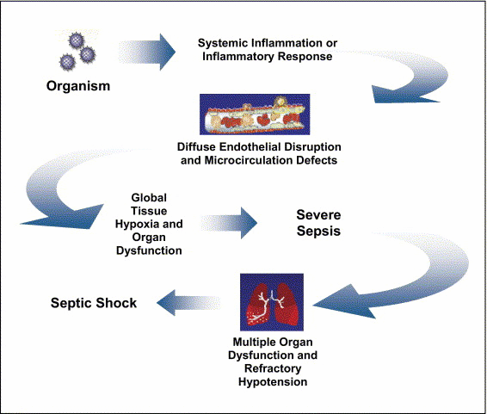
Pathogenesis of Sepsis
Nguyen H et al. Severe Sepsis and Septic-Shock: Review of the Literature and Emergency Department Management Guidelines. Ann Emerg Med. 2006;42:28-54.

Slide 27
Septic Shock
Clinical signs:
  Hyperthermia or hypothermia
  Tachycardia
  Wide pulse pressure
  Low blood pressure (SBP<90)
  Mental status changes
Beware of compensated shock!
  Blood pressure may be “normal”

Slide 28
Cardiogenic Shock, intracardiac
Pathology: Cardiac pump failure secondary to poor myocardial function
Myocardial Injury or Obstruction to Flow
  Arrythymias
  valvular lesions
  Severe CHF
  VSD
  Hypertrophic Cardiomyopathy

Slide 29
Cardiogenic Shock, extracardiac
(Obstructive)
Pulmonary Embolism
Cardiac Tamponade
Tension Pneumothorax

Slide 30
Etiologies
What are some causes of cardiogenic shock?
  Sepsis
  Myocarditis
  Myocardial contusion
  Aortic or mitral stenosis, HCM
  Acute aortic insufficiency
  Acute MI

Slide 31
Cardiogenic shock -
Signs of shock are present.
In addition signs of the underlying cardiac disease and CCF may also be present.
For example extreme tachycardia, pulmonary congestion, pneumothorax, pericardial effusion, gallop rhythm, H/O cardiac surgery etc.
JVP will be raised, basal crepts and SG catheter shows increased pulmonary wedge pressure (more than 18 mmHg).

Slide 32
Anaphylactic Shock
Anaphylaxis – a severe systemic hypersensitivity reaction characterized by multisystem involvement
  IgE mediated

Slide 33
Anaphylactic Shock
What are some symptoms of anaphylaxis?
  First- Pruritus, flushing, urticaria appear
  Next- Throat fullness, anxiety, chest tightness, shortness of breath and lightheadedness
  Finally- Altered mental status, respiratory distress and circulatory collapse

Slide 34
Anaphylactic Shock
Risk factors for fatal anaphylaxis
  Poorly controlled asthma
  Previous anaphylaxis
Most common causes
  Antibiotics
  Insects
  Food

Slide 35
Anaphylactic Shock
Mild, localized urticaria can progress to full anaphylaxis.
Symptoms usually begin within 60 minutes of exposure.
Faster the onset of symptoms = more severe reaction
Biphasic phenomenon occurs in up to 20% of patients.
Symptoms return 3-4 hours after initial reaction has cleared.
A “lump in my throat” and “hoarseness” heralds life-threatening laryngeal edema

Slide 36
Anaphylactic Shock- Diagnosis
Clinical diagnosis
  Defined by airway compromise, hypotension, or involvement of cutaneous, respiratory, or GI systems.
Look for exposure to drug, food, or insect.
Labs have no role.

Slide 37
Neurogenic Shock
Occurs after acute spinal cord injury.
Sympathetic outflow is disrupted leaving unopposed vagal tone.
Results in hypotension and bradycardia.
Spinal shock- temporary loss of spinal reflex activity below a total or near total spinal cord injury (not the same as neurogenic shock, the terms are not interchangeable)

Slide 38
Neurogenic Shock
Loss of sympathetic tone results in warm and dry skin.
Shock usually lasts from 1 to 3 weeks.
Any injury above T1 can disrupt the entire sympathetic system.
Higher injuries = worse paralysis

Slide 39
Approach to the Patient in Shock
History
  Recent illness
  Fever
  Chest pain, increased work of breathing.
  Abdominal pain
  Comorbidities
  Medications
  Toxins/Ingestions
  Recent hospitalization or surgery
  Baseline mental status
Physical examination
  Vital Signs
  CNS – mental status
  Skin – color, temp, rashes, sores
  CVS – JVP, heart sounds
  RS – lung sounds, RR, oxygen sat, ABG
  GI – abdominal pain, rigidity, guarding, rebound tenderness.
  Renal – urine output

Slide 40
Is This Patient in Shock?
Altered mental status
Patient looks ill
Skin cool and mottled or hot and flushed
Weak or absent peripheral pulses
SBP <100
Tachycardia
Yes!
These are all signs and symptoms of shock

Slide 41
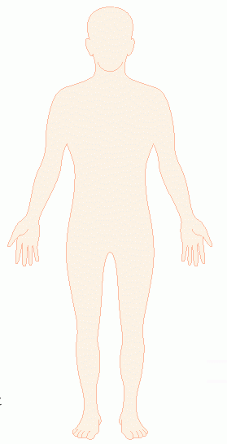
Shock
Do you remember how to quickly estimate blood pressure by pulse?
60
If you palpate a pulse,
you know SBP is at
least this number
70
80
90

Slide 42
Goals of Treatment
CABDE
  Optimize Circulation
  Airway
  Control work of Breathing
  Assure adequate oxygen Delivery
  Achieve End points of resuscitation

Slide 43
Airway
Position and clear the airway.
Determine need for intubation but remember: intubation can worsen hypotension
  Sedatives can lower blood pressure
  Positive pressure ventilation decreases preload
May need volume resuscitation prior to intubation to avoid hemodynamic collapse.

Slide 44
Control Work of Breathing
Respiratory muscles consume a significant amount of oxygen.
Increased work of breathing can contribute to lactic acidosis.
Mechanical ventilation and sedation decrease work of breathing and improves survival

Slide 45
Optimizing Circulation
Isotonic crystalloids
Titrated to:
  CVP 8-12 mm Hg
  Urine output 0.5 ml/kg/hr (30 ml/hr)
  Improving heart rate
May require 4-6 L of fluids
No outcome benefit from colloids in comparison to cystalloids.

Slide 46
Maintaining Oxygen Delivery
Decrease oxygen demands
  Provide analgesia and anxiolytics to relax muscles and avoid shivering.
Maintain arterial oxygen saturation/content
  Give supplemental oxygen
  Maintain Hemoglobin > 10 g/dL
Serial lactate levels or central venous oxygen saturations to assess tissue oxygen extraction.
Notes:
SmvO2 – mixed venous oxygen saturation from a PAC
ScvO2 – central venous oxygen saturation from central line

Slide 47
End Points of Resuscitation
Goal of resuscitation is to maximize survival and minimize morbidity.
Use objective hemodynamic and physiologic values to guide therapy.
Goal directed approach
  Urine output > 0.5 mL/kg/hr
  CVP 8-12 mmHg
  MAP 65 to 90 mmHg
  Central venous oxygen concentration > 70%

Slide 48
Persistent Hypotension
Inadequate volume resuscitation
Pneumothorax
Cardiac tamponade
Hidden bleeding
Adrenal insufficiency
Medication allergy

Slide 49
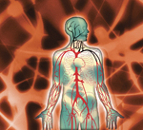
Hypovolemic Shock

Slide 50
Hypovolemic Shock
CABs.
Establish 2 large bore IVs or a central line or intra-osseous line.
Crystalloids
  Normal Saline or Lactate Ringers
PRBCs
  O negative or cross matched
Control any bleeding
Arrange definitive treatment

Slide 51
Evaluation of Hypovolemic Shock
CBC
ABG/lactate
Electrolytes
BUN, Creatinine
Coagulation studies
Type and cross-match
  Radiological investigations as indicated.

Slide 52
Septic Shock

Slide 53
Baseline investigations
CBC, PC, coagulation profile, LFTs, lipase.
ABG with lactate.
Blood culture x 2, urine culture.
CXR.
Cardiac monitor.
Pulse oximetry.

Slide 54
Treatment of Septic Shock
2 large bore IVs
  NS IV bolus
Supplemental oxygen
Empiric antibiotics, based on suspected source, as soon as possible.

Slide 55
Treatment of Sepsis
Antibiotics- Survival correlates with how quickly the correct drug was given.
Cover gram positive and gram negative bacteria.
Add additional coverage as indicated
  Pseudomonas- ceftazidime.
  MRSA- Vancomycin.
  Intra-abdominal or head/neck anaerobic infections- Clindamycin or Metronidazole.
  Asplenic- Ceftriaxone for N. meningitidis, H. infuenzae
  Neutropenic – Cefepime or Imipenem

Slide 56
Persistent Hypotension
If no response after fluid resuscitation, start a vasopressor (norepinephrine, dopamine…) and titrate to effect.
Goal: MAP > 60.
Consider adrenal insufficiency: hydrocortisone 2mg/kg (max 100 mg) IV.

Slide 57
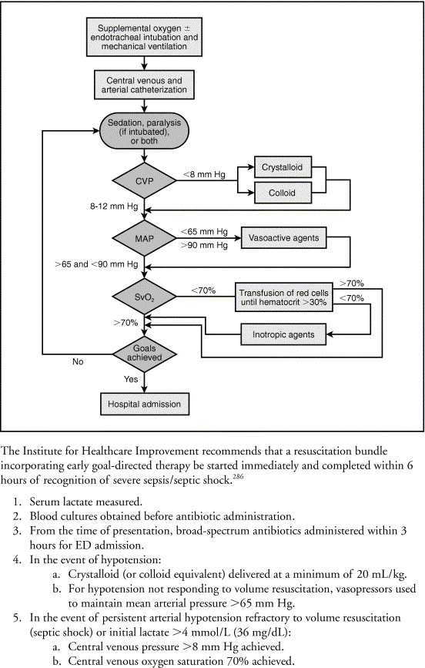
Treatment Algorithm
Rivers E et al. Early goal-directed therapy in the treatment of severe sepsis and septic shock N Engl J Med. 2001:345:1368-1377.

Slide 58

Cardiogenic Shock

Slide 59
Baseline investigations
CBC, cardiac enzymes, coagulation studies.
ECG.
CXR.
Echocardiogram.

Slide 60
Treatment of Cardiogenic Shock
Goals- Airway stability and improving myocardial pump function.
Cardiac monitor, pulse oximetry.
Supplemental oxygen, IV access.
Intubation will decrease preload and result in hypotension.
Be prepared to give fluid bolus.

Slide 61

Anaphalactic Shock

Slide 62
Anaphylactic Shock- Treatment
ABC’s
  Angioedema and respiratory compromise require immediate intubation.
IV, cardiac monitor, pulse oximetry.
IVFs, oxygen.
Epinephrine.
Second line
  Corticosteriods
  H1 and H2 blockers
Notes:
Epi – the single most important step in treatment

Slide 63
Anaphylactic Shock- Treatment
Epinephrine
  Repeat every 5-10 min as needed
  Caution with patients taking beta blockers- can cause severe hypertension due to unopposed alpha stimulation
  If refractory, start IV drip
Corticosteroids
  Hydrocortisone
  Prednisone
Antihistamines
Bronchodilators
Glucagon

Slide 64
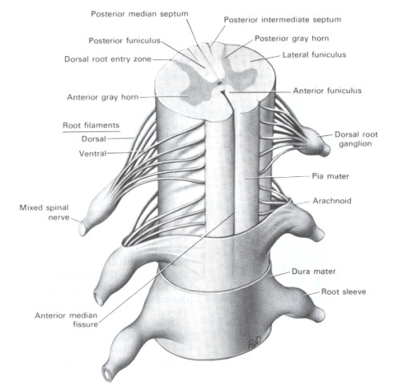
Neurogenic Shock

Slide 65
Neurogenic Shock- Treatment
A,B,Cs
  Remember c-spine precautions.
Fluid resuscitation
  Keep MAP at 85-90 mm Hg for first 7 days.
  Thought to minimize secondary cord injury.
  If crystalloid is insufficient use vasopressors.
Search for other causes of hypotension.
For bradycardia
  Atropine
  Pacemaker

Slide 66
Neurogenic Shock- Treatment
Methylprednisolone
  Used only for blunt spinal cord injury.
  High dose therapy for 2-3 hours.
  Must be started within 8 hours.
  Controversial- Risk for infection, GI bleed.

Slide 67
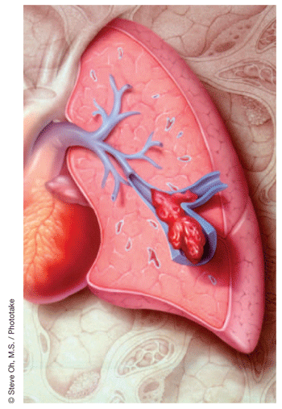
Obstructive Shock

Slide 68
Obstructive Shock
Tension pneumothorax
  Air trapped in pleural space with 1 way valve, air/pressure builds up
  Mediastinum shifted impeding venous return
  Chest pain, work of breathing, decreased breath sounds
  No tests needed!
  Rx: Needle decompression, chest tube

Slide 69
Obstructive Shock
Cardiac tamponade
  Blood in pericardial sac prevents venous return to and contraction of heart
  Related to trauma, pericarditis, MI
  Beck’s triad: hypotension, muffled heart sounds, JVP
  Diagnosis: large heart CXR, echo
  Rx: Pericardiocentisis

Slide 70
Obstructive Shock
Pulmonary embolism
  Virscow triad: hypercoaguable, venous injury, venostasis.
  Signs: Tachypnea, tachycardia, hypoxia.
  D-dimer, CT chest or VQ scan.
  Rx: Heparin, consider thrombolytics

Slide 71
Obstructive Shock
Aortic stenosis
  Resistance to systolic ejection causes decreased cardiac function
  Chest pain with syncope
  Systolic ejection murmur
  Diagnosed with echo
  Vasodilators (NTG) will drop pressure!
  Rx: Valve surgery

Slide 72
Recognise altered mental status and perfusion.
Give O₂ and support ventilation and establish vascular access and begin resuscitation. Do appropriate investigations.
First hour: push repeated 20ml/kg boluses 3-4 times or more based on patient response.
Correct hypoglycemia and hypocalcemia.
Administer antibiotic dose STAT.
Consider ordering STAT vasopressor drip and hydrocortisone***.
Fluid responsive shock (normalisation od blood pressure and/or perfusion)
Yes
No
Consider ICU monitoring.

Slide 73
Begin vasoacive drug therapy and titrate to correct hypotensive/ poor perfusion; consider establishing arterial and central venous access.
Normotensive : begin dopamine.
Hypotensive vasodilated shock (warm): begin norepinephrine.
Hypotensive vasoconstricted shock (cold): begin epinephrine.
Evaluate Scvo₂; goal Scvo₂ > 70%
Scvo2 > 70%, low BP; “warm shock”
Scvo2<70%, normal BP/ poor perfusion
Scvo2< 70%, low BP/ poor perfusion;
“cold shock”
Additional fluid boluses ± norepinephrine± vasopressin.
Transfuse to Hb > 10g/dl; optimise arterial oxygen stration; Additional fluid boluses ± milrinone or nitroprusside± dopamine.
Transfuse to Hb > 10g/dl; optimise arterial oxygen stration; Additional fluid boluses ± epinephrine or dobutamine + norepinephrine.

Slide 74
Fluid refractory and dopamine or nor epinephrine dependent shock defines patient at risk for adrenal insufficiency.
Draw base line cortisol; consider ACTH stimulation test if unsure of need for steroids.
If adrenal insufficiency is suspected, give hydrocortisone, 2mg/kg bolus IV; maximum 100 mg.

Slide 75
Drugs used in management of shock
Drug | Strength | Indication in shock
Salbutamol | 5mg/ml or 1mg/ml respules. | Severe anaphylaxis.
Dextrose | D10% | Hypoglycemia
Diphenhydramine | 10, 50mg/ml | Anaphylactic shock
Dobutamine | 50mg/ml | Cardiogenic shock
Dopamine | 40mg/ml | Distributive shick
Epinephrine | 1mg/ml | Anaphylaxis, shock.
Hydrocortisone | 100mg | Adrenal insufficiency

Slide 76
Drugs used in management of shock
Drug | Strength | Indication in shock
Milrinone | 1mg/ml | Cardiogenic shock
Norepinephrine | 1mg/ml | Hypotensive shock
Normal saline | Na⁺- 150mEq/L Cl—150mEq/L | Hypovolemic and septic shock.
Methyl prednisolone | 125mg | Anaphylactic and neurogenic shock

Slide 77
Author | Study design | Level | Result | outcome
Kusum Menon ¹ , Dayre McNally, Katharine O'Hearn, Anand Acharya, Hector R Wong, Margaret Lawson, Tim Ramsay, Lauralyn McIntyre, Elaine Gilfoyle, Marisa Tucci, David Wensley, Ronald Gottesman, Gavin Morrison, Karen Choong, Canadian Critical Care Trials Group | A Randomized Controlled Trial of Corticosteroids in Pediatric Septic Shock: A Pilot Feasibility Study | 1 | Six of 49 randomized patients (12.2%) received open-label steroids, three in each of the hydrocortisone and placebo groups. Time on vasopressors, days on mechanical ventilation, PICU and hospital length of stay, and the rate of adverse events were not statistically different between the two groups. | This study suggests that a large randomized controlled trial on early use of corticosteroids in pediatric septic shock is potentially feasible

Slide 78
Thank You.

