Slide 1
NEONATAL SEPSIS
DR. POOJA PATEL
DEPARTMENT OF PAEDIATRICS

Slide 2
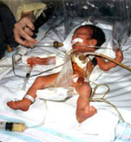
Definition
Presence of bacteria in blood (bacteremia) along with systemic signs and symptoms of infection in the first 4 weeks of life.

Slide 3
Importance
Neonatal sepsis accounts for about half of the neonatal deaths.
If diagnosed early and treated aggressively with antibiotics and good supportive care, it is possible to save most cases of neonatal sepsis.

Slide 4
Early Onset Neonatal Sepsis
Early onset sepsis – onset < 72 hours of birth
Causative organisms - organisms prevalent in the maternal genital tract or in the delivery area. Common Organisms - E.coli, GBS in US. H.influenzae, Klebsiella.
Risk factors - low birth weight, prolonged rupture of membranes > 24 hours, foul smelling liquor, multiple per vaginum examinations, intrapartum maternal fever, difficult or prolonged labour and aspiration of meconium.
Early onset sepsis manifests frequently as pneumonia. Onset within hours, most become symptomatic within 24 hours. Meningitis is rare. PPHN, poor perfusion and shock are also common. Course – fulminant.
Mortality – 15 – 50%

Slide 5
Late Onset Neonatal Sepsis
Late onset sepsis – onset > 72 hours
Causative organisms - organisms present in the home or in the hospital.
Common organisms - E.coli, Staph aureus for community acquired infections. Klebsiella, CONS, Pseudomonas, Candida for hospital acquired infections.
Risk factors – LBW, lack of breastfeeding/mismanaged feeding, superficial infections, aspiration of feeds, multiple needle pricks, unnecessary use of intravenous fluids, invasive procedures, delayed starting of enteral feeds.
Presentation is of septicemia (lethargy, apneas, feed intolerance, increase in ventilatory support), along with pneumonia or meningitis. Meningitis – common. Course – slowly progressive/fulminant depending upon organisms.
Mortality – 10 – 20%
Notes:
These factors enhance the chances of entry of organisms into the blood stream of the neonates whose immune defences are poor as compared to older children and adults.

Slide 6
Clinical Manifestations
Usually vague presentation, so a high index of suspicion is required for early diagnosis.
Most common presentation is lethargy and poor feeding in late onset sepsis and respiratory distress in early onset sepsis.
Notes:
The baby, who had been active and sucking well, gradually or suddenly, becomes lethargic, inactive or unresponsive and refuses to suckle.

Slide 7
Clinical Manifestations
Lethargy, coma
Poor feeding
Poor cry
Hypothermia
Poor perfusion
Abdominal distension
Diarrhea
Vomiting
Sclerema
Poor weight gain
Shock
Bleeding
Renal failure
Tachypnea*
Chest retractions*
Grunt*
Apnea/gasping*
Cyanosis*
Fever⁺
Seizures⁺
Blank look⁺
High pitched cry⁺
Excessive crying/irritability⁺
Neck retraction⁺
Bulging fontanel⁺
* Particularly s/o pneumonia
⁺ Particularly s/o meningitis
Notes:
Hypothermia is a common manifestation of sepsis, whilst fever is infrequent. Diarrhea, vomiting and abdominal distension may occur.
Episodes of apneic spells or gasping may be the only manifestation of septicemia. In sick neonates, the skin may become tight giving a hide-bound feel (sclerema) and the perfusion becomes poor (capillary refill time of over 3 seconds). Cyanosis may appear.
A critical neonate may develop shock, bleeding and renal failure.
The additional features of pneumonia or meningitis may be present depending upon the localization of infection.
The evidence of pneumonia includes tachypnea, chest retractions, grunting, early cyanosis and apneic spells in addition to inactivity and poor feeding. Cough is unusual. Findings on auscultation of the chest are non-specific and non- contributory.
Meningitis is often silent, the clinical picture being dominated by manifestations of associated septicemia. However, the appearance of excessive or high-pitched crying, fever, seizures, blank look, neck retraction or bulging anterior fontanel are highly suggestive of meningitis.

Slide 8
Diagnosis – Direct method - Culture
Isolation of microorganisms from blood, CSF, urine is the diagnostic.
Disadvantages – may not be available at all places. Positivity is low – esp.ly if prior antibiotics are given or bacteria are present in low number or less amount of blood is collected in culture bottle or inappropriate methods are used for culturing.
Send blood culture prior to starting antibiotics.

Slide 9
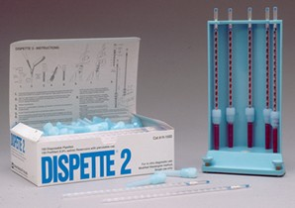
Diagnosis – Indirect – Septic Screen
Leukopenia (TLC <5000/cmm)
Neutropenia (ANC <1800/cmm)
Immature N to total N (I/T) ratio (> 0.2)
Micro ESR (> 15mm 1st hour)
CRP +ve (> 10 mg/L)
If at least 2 out of above five tests are positive -sepsis should strongly be suspected.
Notes:
Neutropenia is more predictive of neonatal sepsis than neutrophilia. Neutrophilia may be present in case of maternal fever, birth asphyxia, acute hemolysis, meconium aspiration. Neutropenia may be present in case of maternal PIH, pre eclampsia, as also thrombocytopenia.
Other acute phase reactants – interleukin 6, procalcitonin. More early increase in their values in response to sepsis, and early fall starts in response to treatment – as compared to CRP.
Immature neutrophils (Band cells + myelocytes + metamyelocytes) to total neutrophils ratio (l/T) > 0.20 means that immature neutrophils are over 20 percent of the total neutrophils because bone marrow pushes even the premature cells into circulation, to fight infection.
A negative CRP is reassuring. Raised CRP is not specific, it can occur in conditions - asphyxia, meconium aspiration syndrome, RDS, etc.
Perform septic screen at 24 hours of life is more sensitive than done earlier.
2 antenatal risk factors present or single risk factor in form of foul smelling liquor or Clinical features suggestive of sepsis – then one should take immediate blood culture at birth, and septic screen at 24 hours of life.
Quantitative CRP assayed by nephelometry is superior to CRP by ELISA and semiquantitative CRP by a latex agglutination kit. Cut-off value for quantitative assay is10 mg/L.
ITR: Value above 27% in term babies is considered positive. For preterms, it is considered to be 20%. ITR is defined as Immature neutrophils (band forms, metamyelocytes, myelocytes) / Mature + immature neutrophils
ANC: It must be read off Manroe’s charts or Mouzinho’s chart, depending on whether it is a term baby or a preterm baby respectively
Among the various tests, quantitative CRP is the best, followed by qualitative CRP and immature to total neutrophil ratio.

Slide 10
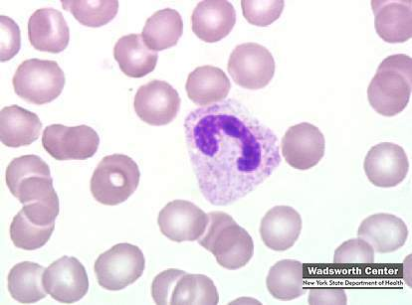
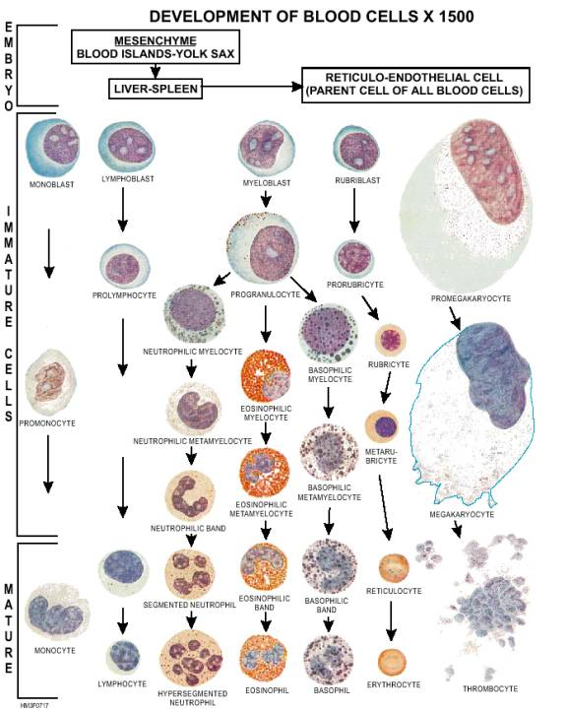
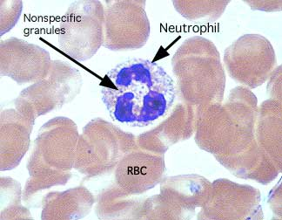
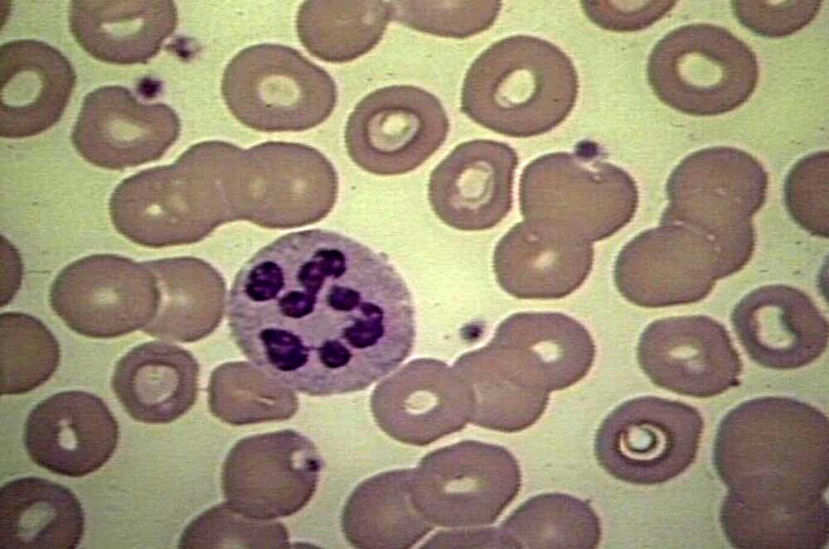

Slide 11
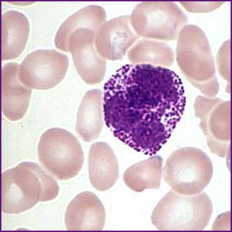
Other Indirect Evidences
Platelet < 100,000/cmm
Toxic granules on peripheral smear
Gastric aspirate smears showing >5 leucocytes/HPF

Slide 12
CSF Examination
CSF examination is a must in all neonates with late onset sepsis to rule out meningitis.
Proper interpretation of CSF examination report is important.
CSF is considered abnormal if
WBCs >30/hpf, > 60% of polymorphs
Glucose < 50% of blood glucose,
Protein >150 mg/dL in term babies
Protein >180 mg/dL in preterm babies

Slide 13
Study | Journal, Authors | Level of Evid | Results | Conclusions
Role of sepsis screen in the diagnosis of neonatal sepsis | Medical Journal of Dr. D Y Patil University Year : 2013 | Volume : 6 | Issue : 3 | Page : 254-257Rabindra N Misra, Savita V Jadhav, Purbasha Ghosh, Nageswari Gandham, | 4 | In this study, out of 115 cases of clinical neonatal sepsis 75 (65.2%) were culture positive. Among isolates, number of gram negative bacilli were 39 (52%) was more than gram positive cocci 36 (34.8%). However, Staphylococcus aureus 24 (32%) was most predominant. Forty (34.8%) were culture negative out of which 15(13%) neonates were positive for two or more sepsis screen tests.Conclusion | Blood culture and sepsis screen should be carried out in neonates suspected of sepsis; however, an immediate institution of empirical antibiotic therapy should be considered as culture positive and sepsis screen may not be positive in all the clinical sepsis cases to save lives.

Slide 14
Study | Journal, Authors | Level of Evid | Results | Conclusions
Morbidities of preterm VLBW neonates and the bacteriological profile of sepsis cases | Bangladesh Journals Online , Junuary 2010, volume 4, M M Hoque , A S M N U Ahmed , S K Halder , M F H Khan , M A K A Chowdhury | 4 | A total of 738 neonates were admitted during the study period. 92 wer the preterm VLBW and were enrolled in the cohort. 52 (56.5%) were male. 40 (43.5%) were female. Mean gestational age was 30.8 ± 2.8 weeks. Mean birth weight was 1320 ± 133 gms. 8 (8.7%) cases had features of septicemia on admission, 49 (53.2 %) developed nasocomial infections. Other morbidities were jaundice (34.8%), RDS (8.7%), NEC (4.3%), TTN (3.3%), IVH (2.2%), PDA (1.1%). Blood culture was positive among 29.8% among 57 suspected cases of sepsis. Acenatobacter (41.2%) was the commonest organism, followed by Klebsiella (23.5%), E. Coli (23.5%), and Pseudomonas (11.8%). Sixty (62.5%) preterm VLBW neonated improved and discharged. 3 (3.3%) discharged on risk bond. 29 (31.5%) died. | Preterm VLBW neonates are at increased risk of morbidity and mortality. Septicemia is the most common and devastating morbidity, most infections are hospital acquired. Therefore strict protocol for asepsis in neonatal units must be adhered to when handling these high risk infants.

Slide 15
Study | Journal, Authors | Level of Evidence | Results | Conclusions
Antibiotic sensitivity pattern of causative organisms of neonatal septicemia in an urban hospital of Bangladesh | Indian Journal of Medical Sciences, Year : 2010 | Volume : 64 | Issue : 6 | Page : 265-271Forhad Monjur¹, Farhana Rizwan², Muhammad Asaduzzaman³, Nishat Nasrin², | 4 | Among the patients, 633 (63.3%) were males and 367 (36.7%) were females. Blood cultures were found positive in 194 (19.4%) neonates. The organisms isolated were Pseudomonas spp. (31.4%), Klebsiella pneumoniae (23.2%), Staphylococcus aureus (12.4%), Escherichia coli (7.2%), Acinatobactor (5.7%), Gram-negative Bacilli (4.1%), Flavobacterium spp. (3.6%), Serratia spp. (5.7%), Citrobacter fruendi (3.1%), Streptococcus species (2.6%), and Enterobacter spp. (1.0%). A majority of the bacterial isolates in neonatal sepsis were found sensitive to imipenem (91.8%) and ciprofloxacin (57.2%) and resistant to commonly used antibiotics, eg. ampicillin (96.4%) and cephalexin (89.2%). | The problem can be mitigated by careful selection and prudent use of available antibiotics.

Slide 16
Study | Journal, Author | Level of Evid | Results | Conclusions
Randomized controlled trial of 7-Day vs. 14-Day antibiotics for neonatal sepsis. | J Trop Pediatr. 2006 Dec;52(6):427-32. Epub 2006 Oct 9. Chowdhary G¹, Dutta S, Narang A. | 2 | We compared the effectiveness of a 7-day intravenous antibiotic regimen with the standard 14-day regime in blood-culture-proven sepsis in neonates. This was a controlled, blinded, randomized trial with stratification (for birth weight). Blood-culture-positive septic babies > or =32 weeks and/or > or =1500 g were enrolled if meningitis and other deep-seated focal infections were ruled out. Parental consent was obtained. Randomization to either 7-day or 14-day therapy was done on day 7 of antibiotics if the baby had clinically remitted by day 5. Blood culture was repeated 24 h after antibiotic completion. Subjects were observed in the hospital for at least 72 h, and followed-up for 28 days by weekly visits and telephonic contacts. The primary outcome was treatment failure within 28 days defined as a positive blood culture, or clinical signs accompanied by either positive CRP or adjudicated to be a relapse by an expert committee. A total of 120 babies were eligible, 51 were excluded (no consent: 12; non-remission: 39), and 69 were randomized to receive either a 7-day course (n = 34) or a 14-day course (n = 35) of antibiotics. Baselines variables were comparable in the two groups. Primary outcome assessment could be done in 33 cases in either group. There was a trend to greater treatment failures in the 7-day group compared with 14-day group (5 vs. 1, respectively; P = 0.19). On subgroup analysis of subjects with Staphylococcus aureus infection, those who received 7-day therapy (n = 7) had significantly more treatment failure than 14-day therapy (n = 7) (four and zero, respectively; P = 0.022), whereas on sub-group analysis of babies with non-S. aureus infections, treatment failure rates were identical (3.8% in both groups). On comparing the organisms isolated in the group of subjects which was not randomized by virtue of being symptomatic (n = 39) vs. the group which was randomized (n = 69), it was found that S. aureus infections were significantly commoner in the former group (61.5 vs. 21.3%, respectively; P < 0.001). | Neonates > or =32 weeks and/or > or =1500 g with S. aureus sepsis require 14 days of antibiotics. S. aureus infection is also associated with failure to achieve clinical remission by the 5th day of antibiotic therapy. Larger trials are required to confirm whether neonates with non-S. aureus sepsis, whose symptoms remit by 5 days, can be treated with 7 days of antibiotics.

Slide 17
Management
In a clinically suspected case - do not delay the treatment till reports arrive.
Supportive care and antibiotics are two equally important components of the treatment.
Antibiotics take at least 24 hours to show any effect and it is the supportive care that makes the difference between life and death early in the hospital course.

Slide 18
Supportive Care of a Septic Neonate
Provide warmth, ensure consistently normal temp.
Start intravenous line.
Infuse NS 10 ml/kg over 5-10 minutes, if perfusion is poor (CRT > 3 seconds). If perfusion remains poor - repeat the same dose 1-2 times over the next 30-45 minutes.
Consider dopamine infusion if perfusion is persistently poor.
Infuse 10% glucose 2 ml/kg stat.
Give Vitamin K 1 mg intramuscularly.
Notes:
The purpose of supportive care is to normalize the temperature, stabilize the cardiopulmonary status, correct hypoglycemia and prevent bleeding tendency.

Slide 19
Supportive Care of a Septic Neonate
Start Oxygen - if retractions, cyanosis or grunting.
Provide gentle physical stimulation, if apneic.
Provide bag and mask ventilation with oxygen if apneic/gasping.
Avoid enteral feed if very sick or having abdominal distension, give maintenance fluids intravenously.
Give FFP/Platelets in a bleeding neonate.
Consider exchange transfusion if there is sclerema.

Slide 20
Empirical Antibiotics
As the profile of organisms is similar for EOS and LOS, the antibiotic policies remain the same for both EOS & LOS.
Policy for community acquired sepsis/EOS
• Ampicillin + Gentamicin/Amikacin
• If evidence of staphylococcus : Cloxacillin + Gentamycin/Amikacin
• If evidence of meningitis: Add Cefotaxime

Slide 21
Policy for Nosocomial Sepsis
Organisms responsible for nasocomial sepsis and their sensitivity pattern must be known for a particular NICU. Antibiotics should be started accordingly.
As most nasocomial infections are due to resistant organisms, preferably use Piperacilline – tazobactum plus an Aminoglycoside combination.
For suspected staphylococcal infection – start Cloxacillin. For suspected fungal sepsis – start antifungal.
Use of Cephalosporins rapidly induce the production of extended spectrum β-lactamases (ESBL) - cephalosporinases and fungal colonization.
Notes:
Usually staphylococci and Gram negative bacilli (Pseudomonas, Klebsiella) should be covered using aminoglycoside (gentamicin or amikacin) and a third generation cephalosporin (cefotaxime). For resistant staphylococcal infection, vancomycin should be used.

Slide 22
Up gradation of Empirical Antibiotics
If there is no clinical improvement within 48 – 72 hours of starting antibiotics
On confirmation of sensitivity pattern, appropriate antibiotics are used singly or in combination.
3rd line – Meropenam/Imipenam, Linezolid/Vancomycin
4th line – Polymyxin, Colistin, Teicoplanin

Slide 23
Duration of Antibiotics
When antibiotics were started on low suspicion of sepsis, can be stopped after 3 days, if baby is clinically well and the culture is negative.
Clinical sepsis, Culture & Sepsis Screen negative – 5 – 7 days
Clinical sepsis, Culture neg, Sepsis Screen positiv – 7 – 10days
Pneumonia or soft tissue infections – 7 – 10 days
Septicemia (Culture positive) – 10 – 14 days
Meningitis – 3 weeks
Osteomyelitis/Septic Arthritis, Ventriculitis - 6 weeks.

Slide 24
Risk Factors Associated with EOS
Low birth weight (<2500 grams) or prematurity
Febrile illness in the mother within 2 weeks prior to delivery.
Foul smelling and/or meconium stained liquor.
Rupture of membranes >24 hours.
Single unclean or > 3 sterile vaginal examination(s) during labor
Prolonged labor (sum of 1st and 2nd stage of labor > 24 hrs)
Perinatal asphyxia (Apgar score <4 at 1 minute)

Slide 25
Indications of Antibiotics in Neonates at Risk of EOS
Foul smelling liquor
≥3 risk factors for early onset sepsis
≤2 antenatal risk factor(s) – take blood culture at birth, do septic screen at 24 hours – start antibiotics only if a positive septic screen/culture or clinical features suggestive of sepsis develops
Strong clinical suspicion of sepsis

Slide 26
Prevention of Infections
Good & adequate antenatal care
Tetanus immunization of all pregnant mothers
Early diagnosis and vigorous treatment of infections in pregnant mothers
Early & exclusive breast feeding up to 6 month of age. No prelacteal feeds
Keep cord clean and dry
Early detection and appropriate management of superficial infections
Avoid unnecessary interventions

Slide 27
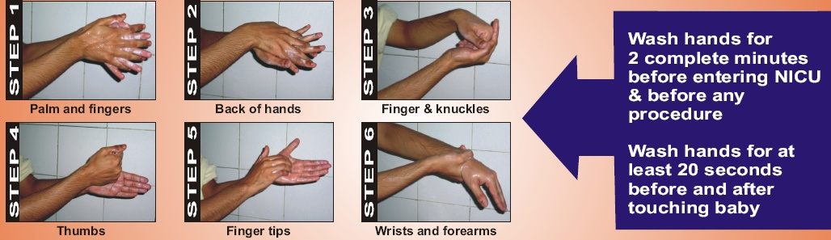
HAND WASHING – SIMPLEST AND MOST EFFECTIVE
METHOD FOR PREVENTION OF NOSOCOMIAL SEPSIS

Slide 28
Prevention of Infections in the Hospital
Keep nursery environment clean and dry
Adequate ventilation and lighting in nursery
Avoid overcrowding
Perform all the procedures should be performed under strict asepstic precautions.
Avoid unnecessary invasive interventions even as small as needle pricks and i.v infusions.
Use ample of disposables.
Keep separate thermometer and stethoscope for each neonate.
Strict house-keeping routines - mopping floors and walls, washing cleaning & disinfection of various equipments.
Strict safe waste disposal practices.
Avoid use of prophylactic antibiotics for prevention of nosocomial infections. They are not only useless but also dangerous because of the potential risk of emergence of resistant strains of bacteria.

Slide 29
Conclusions
Manifestations of neonatal sepsis are non-specific.
As morality is very high – early diagnosis with high index of clinical suspicion with or without lab evidences of infection is very important.
Prompt institution of antibiotic therapy and supportive care can save most of the cases of neonatal sepsis.

Slide 30

Thank You!

