Slide 1
      THALASSEMIA
Dr.PRADHYUMN PAMECHA
Department Of Pediatrics

Slide 2
Hemolytic Anemia

Slide 3
Introduction
Genetically Determined hematological disorders.
Mediated through all the 3 modes of inheritance e.g.
    Autosomal Recessive - Thalassemia Major, Sickle Cell Anemia- Commonest condition.
    Autosomal Dominant - Hereditary Spherocytosis.
    X-Link Recessive - G 6 PD Deficiency

Slide 4
Classification
Extrinsic Deficit
  Isoimmune
    Rh incompatibility
  Heteroimmune
    ABO incompatibility
  Autoimmune
  Infections & Toxins

Slide 5
Classification
Intrinsic Defects
  Membrane Defect
    Hereditary Spherocytosis
  Hb Defects
    Thalassemia
    Sickle cell anemia
  Enzyme Defects
    G 6 PD Deficiency
    Among all hemolytic Anemia's Thalassemia Major is the commonest condition

Slide 6
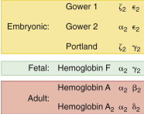
Types Of Hemoglobin at Various Stages

Slide 7
After 8 wk of fetal life the embryonic hemoglobins, Gower-1 (ζ₂ϵ₂), Gower-2 (α₂ϵ₂), and Portland (ζ₂γ₂), are formed.
At 9 wk of fetal life, the major hemoglobin is Hb F (α₂γ₂).
Hb A (α₂β₂) appears at ~1 mo of fetal life
It is the dominant hemoglobin after birth, when Hb F levels start to decline.

Slide 8
Hb A₂ (α₂δ₂) is a minor hemoglobin that appears shortly before birth and remains at a low level after birth.
The final hemoglobin distribution pattern is achieved after at least 6 mo of age and sometimes later.
The normal hemoglobin pattern is
  ≥95% - Hb A,
  ≤3.5 % - Hb A₂, and
  <2.5% - Hb F

Slide 9
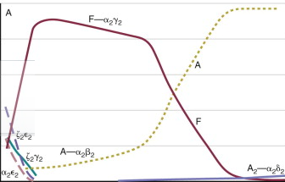
Switch Over Of Fetal Hb To Normal Adult Hb.(α2 β2 )

Slide 10
Types Of Hemoglobin
TYPES OF HEMOGLOBIN |  | COMPOSITION
Normal Adult hemoglobin | HbA | α2 β2 chains
Fetal hemoglobin | HbF | α2 ϒ2 chains
Sickle cell hemoglobin | HbS | α2 S2 chains
Minor adult hemoglobin | HbA2 | α2 δ2 chains

Slide 11
      THALASSEMIA

Slide 12
Autosomal Recessive Single Gene disorder
Defect in globin chain synthesis of Hb
Types
  α Thalassemia
    α chain is defective: incompatible with life
  β Thalassemia
    β˚ Thalassemia if β chain is absent
    β Thalassemia trait if β chain is partially produced

Slide 13
Classification
α – Thalassemia | β- Thalassemia
Silent carrier | Silent carrier
α- Thalassemia trait | Thalassemia trait
Hb.H disease | Thalassemia intermedia
Hydrops fetalis | Thalassemia Major

Slide 14
Common Communities Affected In India
Punjabis, Sindhis
Migrants from Pakistan – Khatris, Khukrajas
Bihar – Orrias
Gujratis – Lohanas, Baniyas, Bhanushalis, Kathiawadis
Maharashtrian – Kolies, Kunbis, Agris
Karnataka – Goudas, Saraswats, Lingayats, Koorgs
Goans – Goud – Saraswats

Slide 15
Pathophysiology
Hb. Consist of two pairs of amino acid chains α & β
Imbalance in the production of these peptide chains of globin leads to hemoglobinopathies
Unpaired peptide chains is precipitated on RBC membrane
Premature destruction of RBC in bone-marrow and in peripheral circulation particularly in R-E system of spleen (Ineffective erythropoiesis)
ɤ chain synthesis persist after fetal life (postnatal) also

Slide 16
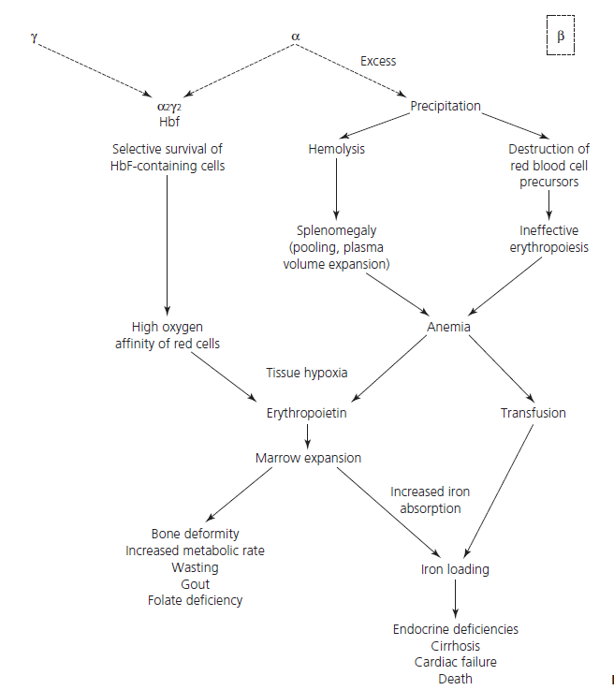

Slide 17
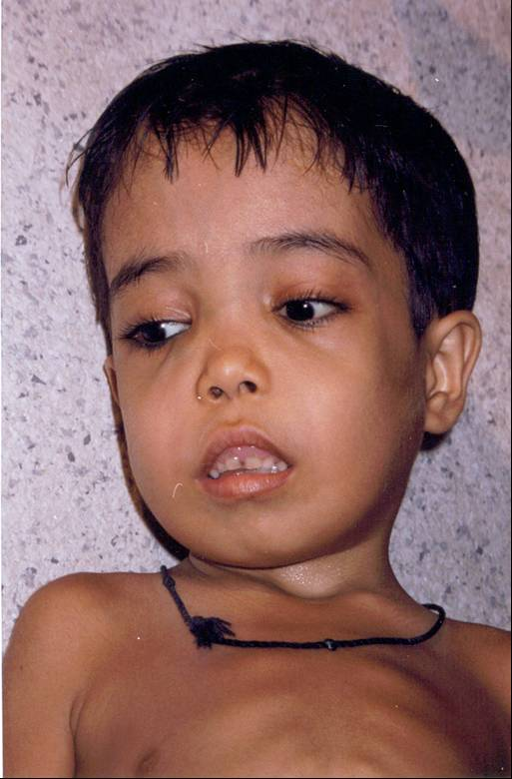
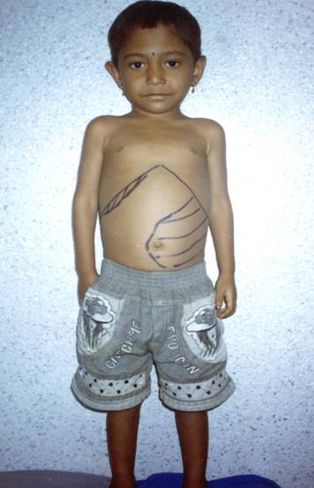
Clinical Profile of Thalassemia Major (Homozygous)

Slide 18
Clinical Features
Age of onset – From 6months onwards.
Thalassemic Facies (Maxillary hypoplasia, flat nasal bridge, frontal bossing)
Hepatosplenomegaly
Greenish Brown Complexion (Due to pallor, hemosiderosis & Jaundice)
Severe degree of persistent and progressive microcytic and hypochromic Anemia

Slide 19
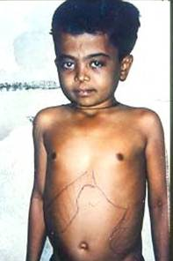
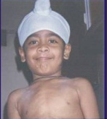
Other Types of Thalassemia
Thalassemia Intermedia (Double-heterozygotes)
Thalassemia Minor
(Heterozygous)

Slide 20
Clinical Features
Thalassemia Intermedia
  Later age of onset – > 2yrs.
  Mild degree of Anemia
  Hepatosplenomegaly
Thalassemia Minor
  Almost normal
  Only under stress situation manifest mild degree of Anemia

Slide 21
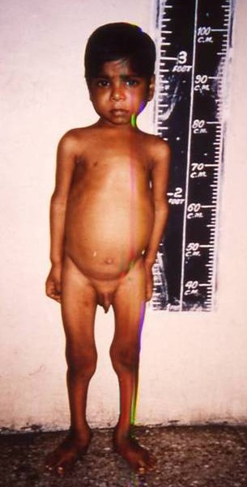
Complications - Thalassemia major
Growth & Development
Endocrine complications
SMR is delayed and does not reach final stages
Growth Hormone is reduced results in Short stature
Vulnerable for Hypothyroidism, Impaired Glucose Tolerance (3-4%)
Hypocalcaemia (6.6%)

Slide 22
Laboratory Studies
The CBC and peripheral blood film examination results are usually sufficient to suspect the diagnosis.
In the severe forms of Thalassemia, the Hb level ranges from 2-8 g/dL.
(MCV)
(MCH) are significantly
Thalassemia major is associated with a markedly elevated RDW, reflecting the extreme anisocytosis.

Slide 23
The WBC count is usually elevated in β Thalassemia major; this is due to miscounting nucleated RBCs as leukocytes.
Leukocytosis is usually present, even after excluding the nucleated RBCs.
A shift to the left is also encountered, reflecting the hemolytic process.
Platelet count is usually normal

Slide 24
Peripheral blood film examination reveals
  Marked hypochromasia and microcytosis,
  Polychromatophilic cells,
  Nucleated RBCs,
  Basophilic stippling, and
  Occasional immature leukocytes,
MENTZER INDEX
  MCV/TRBC <13 suggestive of Thalessemia

Slide 25
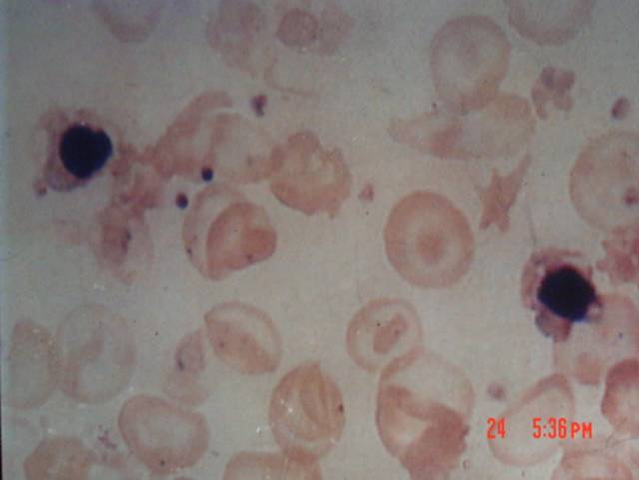
Peripheral blood smear of Thalassemia major

Slide 26
Hb electrophoresis usually reveals an
  ↑ Hb F fraction - β Thalassemia,
  Hb H (β ₄)disease, and
  Hb Bart(γ₄) in newborns with α Thalassemia trait.
In β° Thalassemia, Hb A is usually absent; only Hb A₂ and Hb F are found.

Slide 27
Iron studies:
  Serum iron level is elevated
  Serum ferritin level is elevated
  Serum iron saturation reaching as high as 80%.
Complete RBC phenotype,
Hepatitis screen,
Folic acid level, and
Human leukocyte antigen (HLA) typing are recommended before initiation of blood transfusion therapy.

Slide 28
Imaging Studies
Skeletal survey –
  “hair on end” appearance of the skull
  Thinning of the cortex
Osteoporosis and osteopenia may cause fractures
Maxillary overgrowth
Prominence of the upper incisors and separation of the orbit.
These changes contribute to the classic “chipmunk facies” observed in patients with Thalassemia major

Slide 29
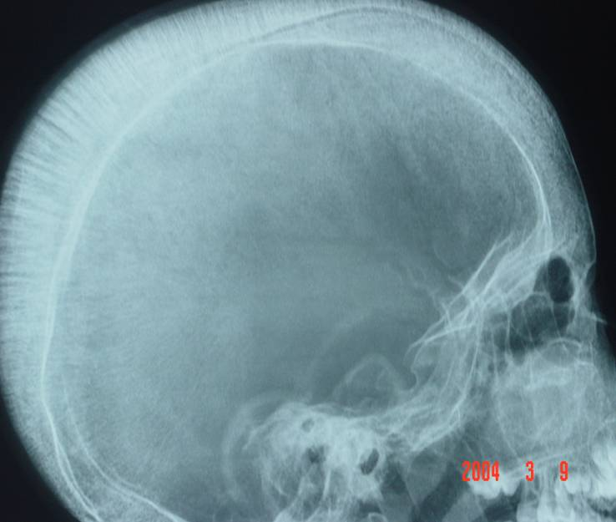
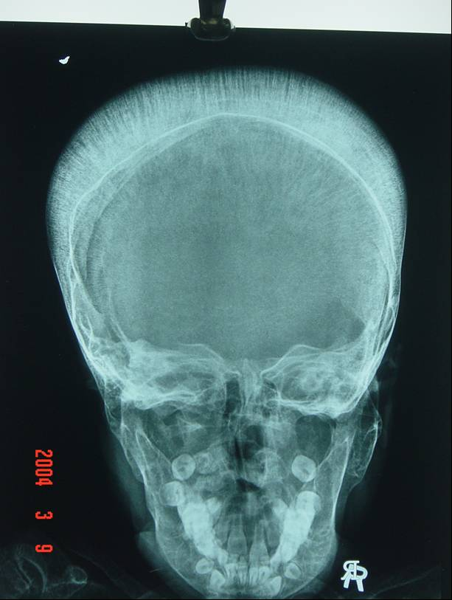
THALASSAEMIA MAJOR : X – RAY SKULL
Showing Hair end on appearance due to increased diploic space in the skull bones

Slide 30
Plain radiographs of the long bones may reveal a lacy trabecular pattern.
MRI and CT scans - Compression fractures and paravertebral expansion of extramedullary masses, more frequently occur during the second decade of life
Chest radiography is used to evaluate cardiac size and shape.

Slide 31
MRI and CT scan -noninvasive means to evaluate the amount of iron in the liver
Cardiac magnetic resonance (CMR)-shown decreased values in cardiac T2 due to iron deposit in the heart.

Slide 32
Hepatic Iron Concentration should be measured annually if possible in all patients
Normal HIC values are < 1.8 mg Fe/g dry weight levels,
HIC Levels of > 15 mg/gm dry weight is consistent with significant iron deposition and is associated with progression to liver fibrosis.

Slide 33
Other Tests
The following tests may be indicated:
ECG and echocardiography to monitor cardiac function.
HLA typing is performed if bone marrow transplantation is considered.
Eye examinations, hearing tests, renal function tests, and frequent blood counts are required to monitor the effects of iron chelators therapy and the administration of other chelating agents

Slide 34
Procedures
Bone marrow aspiration is needed in certain patients to exclude other conditions that may manifest as Thalassemia major.
Liver biopsy is used to assess iron deposition and the degree of hemochromatosis.
Measurement of urinary excretion of iron after a challenge test of DFO is used to evaluate the need to initiate chelation therapy and reflects the amount of iron overload.

Slide 35
Histologic Findings
All severe forms of Thalassemia exhibit hyperactive marrow with erythroid hyperplasia and increased iron stores in marrow, liver, and other organs.
Extramedullary hematopoiesis in unusual anatomic sites is one of the known complications.
Increased iron deposition is usually present in marrow, liver, heart, and other tissues.

Slide 36
Staging
Staging system based on the cumulative numbers of blood transfusions
  To grade cardiac-related symptoms and
  Determine when to start chelation therapy
Stage I disease <100 units of packed RBCs (PRBCs)
Stage II patients- 100-400 units of blood and may report slight fatigue.
Stage III patients - >400 units of blood, with signs and symptoms of palpitation to congestive heart failure.
  The ECG reveals atrial and ventricular premature beats, often in pairs or in runs.

Slide 37
Lucarelli classification
Done for patients with severe disease & are for Hematopoetic Stem Cell Transplantation.
Assesses risk factors to predict outcome and prognosis and has 3 elements:
  Degree of hepatomegaly,
  Presence of portal fibrosis in liver biopsy sample, and
  Effectiveness of chelation therapy prior to transplantation.
If one of these elements is unfavorable prior to HSCT, the chance of event-free survival is significantly poorer .
The event-free survival rate after allogeneic HSCT for class 1 patients is 90%, compared with 56% for those with class 3.

Slide 38
Management Of Thalassemia Major
Packed Red Cell Transfusions
Chelation Therapy
Preventative Monitoring
  Cardiac
  Endocrine
  Psychosocial Support.

Slide 39
When to start the transfusion?
As soon as diagnosis is firmly established
(Except in children > 18 months of age)
If age > 18 months, a period of observation to rule out Thalassemia intermedia
If Hb drops < 7 gms%, regular transfusion regimen is started.

Slide 40
Transfusion Regimens In Thalassemia
Palliative Transfusion Regimen - ↑Hb to 8.5 gm%
Moderate Transfusion - ↑Hb to 9-10.5 gm%
Hyper-transfusion Regimen - ↑ Hb to 12 gm%
Neocyte Transfusion – To make requirement of transfusion interval longer.

Slide 41
Rate And Frequency Of Transfusions
10 to 15 ml/kg of packed red cells every 3 to 4 weeks
Rate not > 5 ml/kg/hr
In patients with cardiac dysfunction not >2-3ml / kg / hr
Shorter intervals of 2 to 3 weeks are more physiological

Slide 42
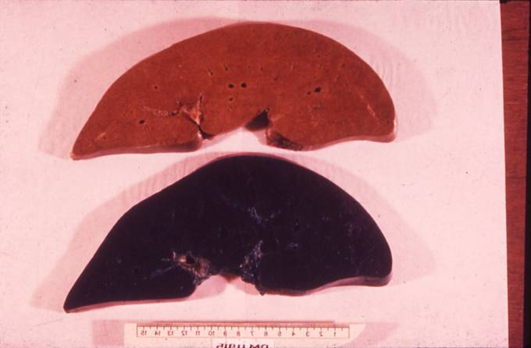
Chelation Therapy
Iron Overload
  Excess GI absorption
  Lack of excretory mechanism for excess iron in the body
  Chronic red cell transfusions
Deferoxamine- Parenteral
Deferiprone – Oral
Deferasirox - Oral
Hoffbrand AV, Taher A, Cappellini MD. How I treat transfusional iron overload. Blood. Nov 1 2012;120(18):3657-69. [Medline].

Slide 43
Pharmacologic And Clinical Characteristics Of Iron Chelators
Deferoxamine
Deferiprone
Mol.wt.
560
139
Iron : chelator
1 : 1
3 : 1
Plasma clearance
20 min
53 to 66 min
Oral Abs
Negligible
Peak 45 min
Iron excretion
Urine + Fecal
Urine
Therapeutic dose
40 mg/kg
75 mg/kg
Route
Parenteral
Oral
Clinical Experience
40 yrs.
26 yrs.
Side Effects
Ototoxicity
Arthropathy,
Retinal toxicity
agranulocytosis
growth failure
GI disturbance

Slide 44
 | Deferoxamine | Deferasirox | Deferiprone
Iron chelation | 1:1 | 1:2 | 1:3
Route & dose | S/c or IV, 5-7 day/ week as continuous infusion. 20- 60 mg/kg/day | PO as suspension, 20- 40 mg/kg/day | PO as tablet, 75mg/kg/day in 3 divided doses
½ life | Short(20- 30 min) | Long(10-11 hrs.) | Interm(2-3hrs)
Advantages | Safe, highly effective in iron balance | Oral, well tolerated, keep non transferrin bound iron low | Oral, best long term cardiac outcome
Disdvantages | Parenteral, compliance local skin reaction | GI symptoms, ability to reduce cardiac iron load | GI & joint symptom, agranulocytosis
Severe & dangerous side effects | Local skin reactions, SNHL, bone problems | Peptic ulcers, liver failure, renal dysfunction, cytopenia | Agranulocytosis

Slide 45
Author | Type of study | LOE | Result | Conclusion
Dudley J. Pennell, | A 1-year RCT of deferasirox vs deferoxamine for myocardial iron removal in β-thalassemia major (CORDELIA) Blood. 2014 Mar 6; 123(10): 1447–1454. | I | prospective, randomized comparison of deferasirox (target dose 40 mg/kg /day) vs S/C deferoxamine (50-60 mg/kg /day for 5-7 days/week) for myocardial iron removal in 197 patients with myocardial siderosis (T2* 6-20 milliseconds) and no signs of cardiac dysfunction (mean age, 19.8 years). Primary objective was to demonstrate noninferiority of deferasirox for myocardial iron removal, assessed by changes in myocardial T2* after 1 year . Geometric mean (Gmean) myocardial T2* improved with deferasirox from 11.2 milliseconds at baseline to 12.6 milliseconds at 1 year (Gmeans ratio, 1.12) and with deferoxamine (11.6 milliseconds to 12.3 milliseconds; Gmeans ratio, 1.07). The between-arm Gmeans ratio was 1.056 (95% confidence interval [CI], 0.998, 1.133). The lower 95% CI boundary was greater than the prespecified margin of 0.9, establishing noninferiority of deferasirox vs deferoxamine (P = .057 for superiority of deferasirox). Left ventricular ejection fraction remained stable in both arms. Frequency of adverse events was comparable . | CORDELIA demonstrated the noninferiority of deferasirox compared with deferoxamine for myocardial iron removal

Slide 46
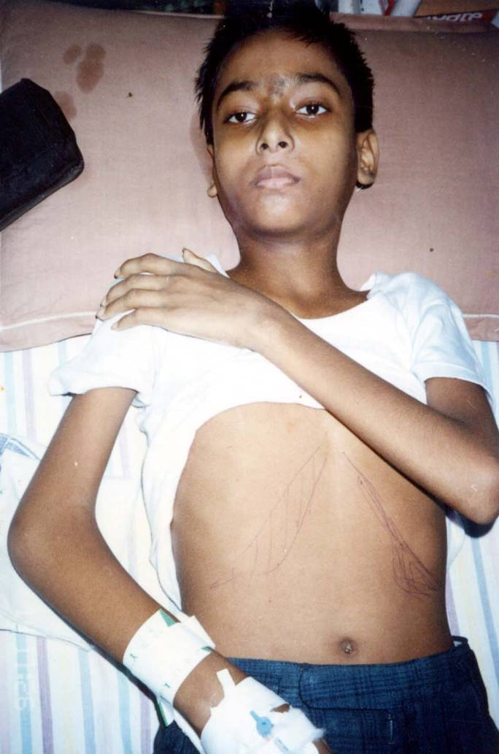
Cardiac Complications
Left Ventricular Ejection Fraction is Decreased
Cardiac failure and arrhythmias - cause of mortality
Holter monitoring, 2D-Echo, Stress test assist in qualitative cardiac function evaluation,
T2 Cardiac MRI - only method of assessing severity of cardiac iron overloading

Slide 47
Hypersplenism & Splenectomy
Causes
  Inadequate transfusions
  Alloimmunization
  Chronic liver disease
Indication
  May be beneficial in patients who require more than 200-250 mL/kg of PRBC per year to maintain an Hb level of 10 g/dL.
  Splenectomy after 5 yrs of age
  Pneumococcal & Hib vaccines
  Life long post- Splenectomy penicillin prophylaxis

Slide 48
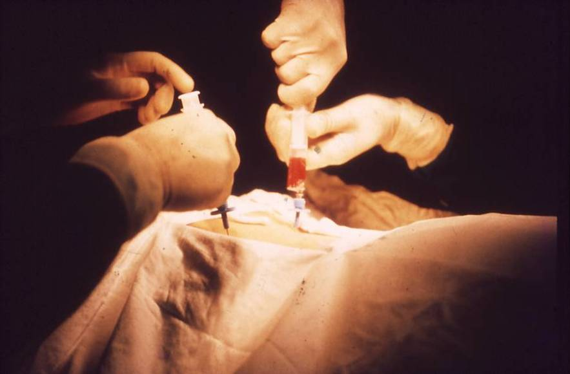
Stem Cell Transplant
Curative Treatment
  Stem Cell Transplant
    Sources
      Bone Marrow
      Peripheral Blood
      Cord Blood
Gene Therapy

Slide 49
Diet
A normal diet is recommended, with emphasis on the following supplements:
  folic acid,
  small doses of ascorbic acid (vitamin C), and
  alpha-tocopherol (vitamin E).
Do not give Iron, and iron rich foods should be avoided.
Drinking coffee or tea help decreased absorption of iron.
Green tea as antioxidant was shown to inhibit or delay the deposition of hepatic iron

Slide 50
Activity
Patients with well-controlled disease are usually fully active.
Patients with anemia, heart failure, or massive Hepatosplenomegaly are usually restricted according to their tolerances.

Slide 51
Vaccines
Pneumococcal vaccines
Haemophilus influenzae B
Meningitis group A C Y and W-135 vaccine

Slide 52
Antineoplastic Agent
Hydroxyurea
Some patients may respond to Hydroxyurea
  Decrease transfusion requirements.
  Improvement of pulmonary hypertension has been observed

Slide 53
Growth Hormone
It may be effective in increasing growth rate in all Thalassemic patient particularly the ones with growth hormone deficiency

Slide 54
Screening And Prevention
In persons with β Thalassemia trait,
  Genetic counseling
  If both parents are carriers, a detailed discussion with the couple should include all possible outcomes.
  These include the 1 in 4 chance of having a severely affected or completely healthy child
  1 in 2 chance of having a child with heterozygous Thalassemia.

Slide 55
Prenatal DNA Testing
Genetic counseling by professionals that addresses the genetic risks and the testing risks involved .

Slide 56
New Methods For Neonatal Screening
Pyrosequencing - The test is a good choice for rapid and cost-effective prenatal diagnosis of Thalassemia and sickle cell disease.
Next-generation sequencing (NGS) of single-nucleotide polymorphism (SNPs) is a noninvasive prenatal diagnostic method.
"targeted sequencing" based on detection of paternally inherited fetal alleles in maternal plasma is used.

Slide 57
Prevention
Premarital screening programs, genetic counseling
Screening of children, pregnant women, and individuals visiting public health facilities
A simple CBC count, with emphasis on the RBC counts and indices, including the MCV, MCH, and RDW, is the main component of such screening processes.
Persons suspected to be positive for Thalassemia are checked for elevated levels of Hb A₂, Hb F, or both for confirmation.

Slide 58
Prenatal diagnosis
Globin chain synthesis used on fetal cells obtained by fetoscopy to screen the fetus.
The DNA material is obtained by chorionic villus sampling (CVS),
Identifying mutations that cause α and β Thalassemia ,
Capillary electrophoresis on fetal cells has proved to be reliable

Slide 59
MCQS

Slide 60
1) The normal hemoglobin found in children and adults is all except
  ≥95% - Hb A,
  ≤3.5 % - Hb A₂, and
  <2.5% - Hb F
  1-2% - Hb Gower

Slide 61
2) In patients with Thalessemia imaging studies reveals all except
  “hair on end” appearance of the skull
  Osteopetrosis
  Maxilla may overgrow
  "chipmunk facies”

Slide 62
3) What is not done in management of Thalessemia major
  Palliative Transfusion Regimen
  Moderate Transfusion
  Hyper-transfusion Regimen
  Neonatal Transfusion

Slide 63
4) Complete blood count in a case of Thalessemia major reveals all except
  Hb 2-8 gm /dl
  Leukocytosis
  Normal platelets
  Normal RDW

Slide 64
5) Complications of Thalessemia major include all except
  Short stature
  Cirrhosis of liver
  Diabetes mellitus
  Leukemia

Slide 65
Answer

Slide 66
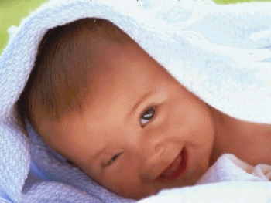
Thank you

