Slide 1
Migraine In A Clinic
Dr Sanjay Prakash
Professor and Head
Department of Neurology
Smt. B. K. Shah Medical Institute & Research Centre.
Vadodara, Gujarat

Slide 2
Facts about diagnosis of Migraine
Only 38-48 % diagnosed as migraine
Only 16 % diagnosed as migraine in first yr.
Mean Diagnostic delay for Migraine- 7 yrs (range up to 40 years)
Surgical (mis) intervention in migraine- 26%

Slide 3
Migraine misdiagnosis
Headache 2007;47:355-363)

Slide 4
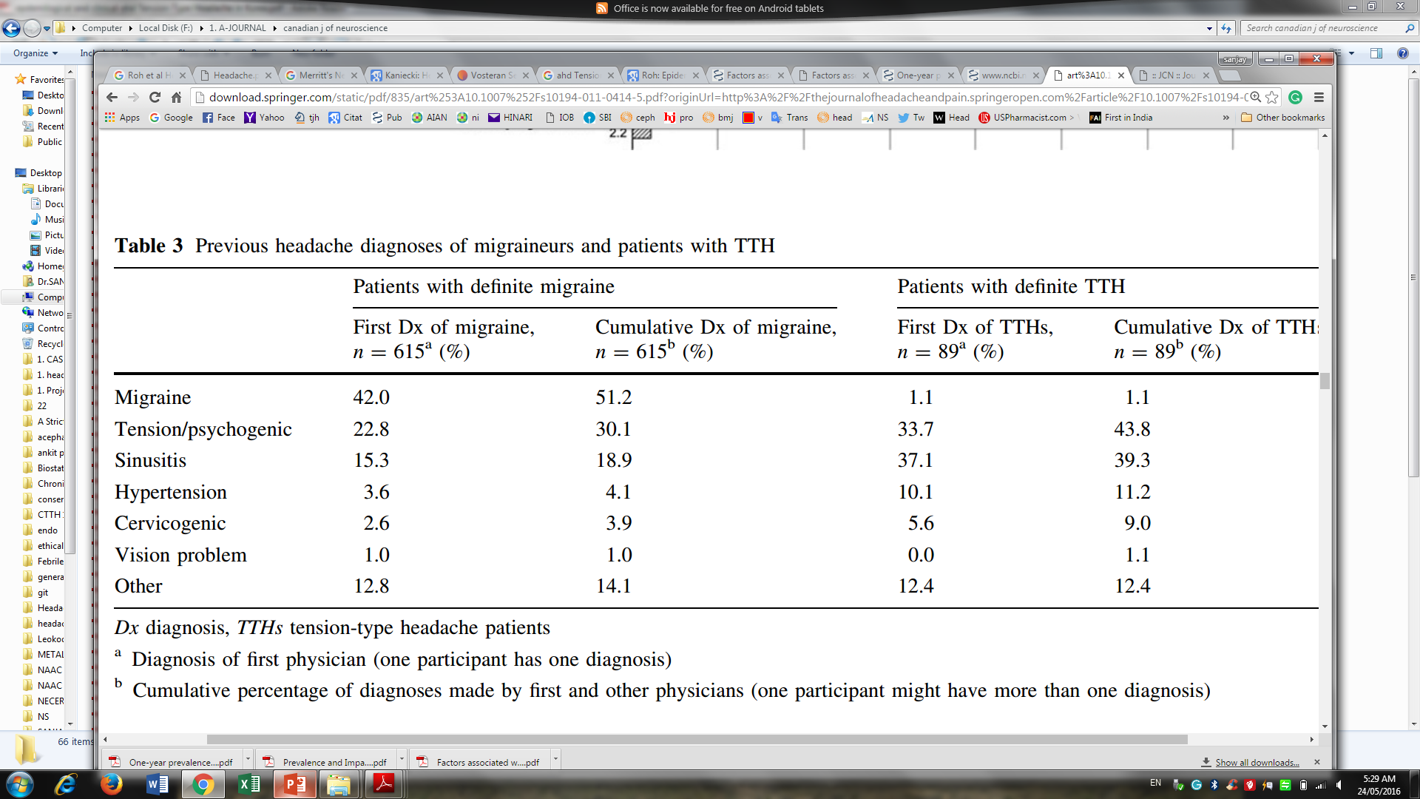
Migraine misdiagnoses
Ertas et al. J Headache Pain (2012) 13:147–157

Slide 5
Misdiagnosed Migraine
Spectrum Study
71 % patients initially diagnosed with TTH were later diagnosed as Migraine (Lipton et al Headache 2000; 40(10):783-791.)
Self reported Tension headache : 84 % patients had Migraine
          (Kaniecki et al Curr Med Res Opin 2006;22(8):1535Y1544.)
Migraine vs Sinus Headache
82 % patients initially diagnosed as sinus headache (Al-Hashel, et al J Headache Pain. 2013; 14(1): 97.)

Slide 6
Migraine as a misdiagnosed condition
Most common misdiagnosis for CH- Migraine
(Buture et al Neurol Sci. 2019 Jan;40(1):25-39)
Most common misdiagnosis for HC- Migraine
(Prakash et al J Pain Research 2017:10 1493
Most common misdiagnosis for NDPH- Migraine
(Prakash et al J Headache Pain (2012) 13:477–485
Spontaneous CSF Hypotension: as migraine ( 33%)
(Schievink et al2003)
Various secondary headaches : initially diagnosed as Migraine

Slide 7
Migraine: Misdiagnosis vs Over diagnosis
Migraine
Other Headaches
Migraine : Misdiagnosed as other headache
Other Headaches: Misdiagnosed as Migraine

Slide 8
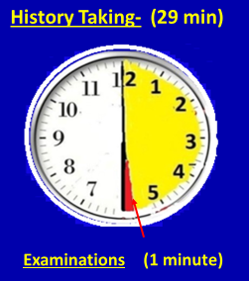
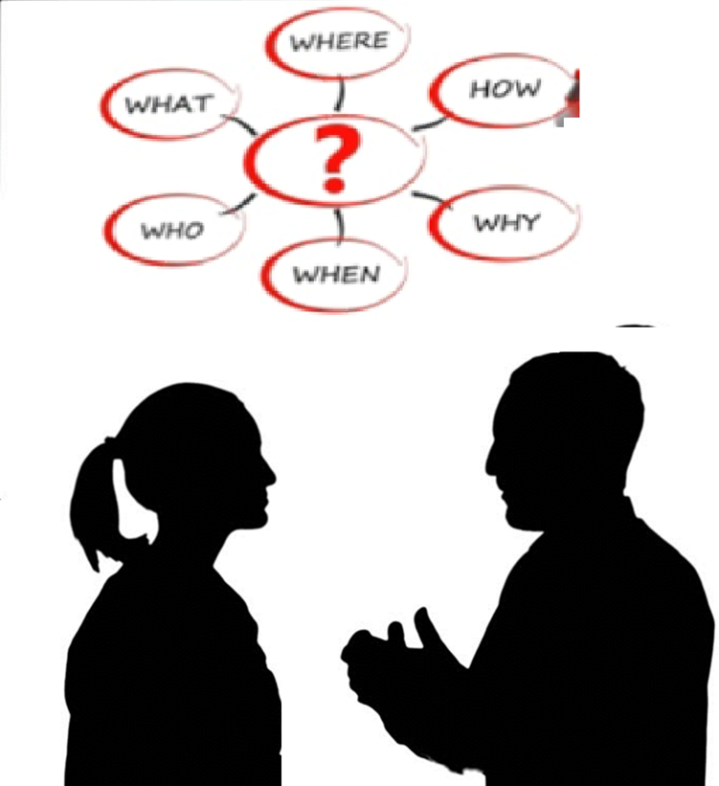
History Taking in Headache patients
What to ask?
How to ask?

Slide 9


Recall bias by patients

Slide 10
Points in Migraine
Migraine (ICHD-3)
A. 5 Headache Attacks
Pattern of attacks
B. 4- 72 hours
Durations of attacks
C. 2 out of 4
Unilateral
Pulsating
Moderate or severe
Aggravated by walking stairs
or
similar routine physical activity
Headache characteristics
D. One of these
Migrainous features
Nausea & /or Vomiting
Phonophobia & photophobia
E. Exclusion pf others

Slide 11
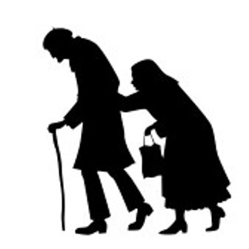

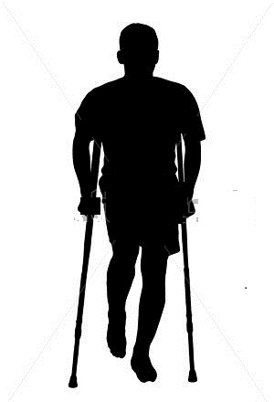
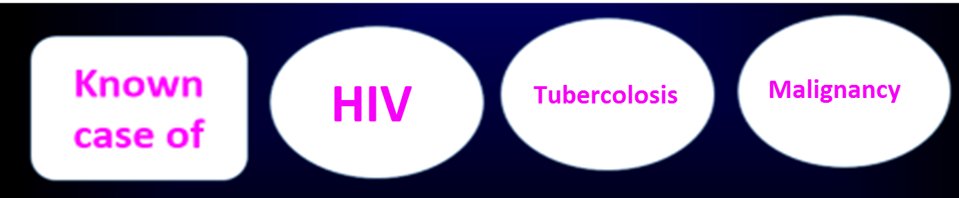
Patients characteristics
Female : pregnancy, Post-partum state, oral pill use
History of Trauma
Elderly patients (> 50 yrs.)
Temporal Arteritis, Malignancy, Glaucoma
Cortical Venous Thrombosis
Post traumatic Headache

Slide 12
Points in Migraine
Migraine (ICHD-3)
A. 5 Headache Attacks
Pattern of attacks
B. 4- 72 hours
C. 2 out of 4
Unilateral
Pulsating
Moderate or severe
Aggravated by walking stairs
or
similar routine physical activity
D. One of these
Nausea & /or Vomiting
Phonophobia & photophobia
E. Exclusion pf others

Slide 13
Pattern of headaches
Number or Pattern of attacks
First attack/New onset
Recurrent attacks
Continuous Headaches
Change in headache pattern
√
Reconfirm it before proceeding

Slide 14
Number of attacks
If patients say it is the first attack
Don’t Believe in straight way.
Confirm
Reconfirm it
First headache attack- No migraine/ any Primary Headache

Slide 15
How to extract Number of attacks
Tough job to get exact frequency
(Patients might not volunteer real number.)
Did you have such/similar attack in the past?
Did you have any type of headache in the past.
Giving option may work
  1-2 attacks / week
  5-10 attacks / month
  >15 attacks / month
  20- 25 attacks / month
  30 attacks / month (daily)

Slide 16


Pattern of headaches
Duration of attacks
$$√$$
Migraine
TTH
CH
PH
SUNCT/SUNA
Cough H
Exercise
Sexual
Thunderclap H
Hypnic H
Stabbing
External pressure
Cold stimulus
> 4 hrs.
4- 72 hrs
30 min – 7 days
15 min- 3 hrs.
2 min- 30 min
< 10 minutes
1 sec - < 2 hrs
< 4 hrs.
1 min- < 72 hrs
> 5 min.
Within 30 min of removal
> 15 min-< 4 hrs
Few seconds
Within 60 min of removal
$$√$$

Slide 17
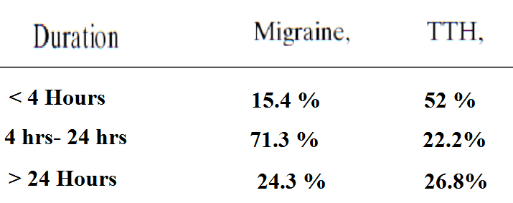
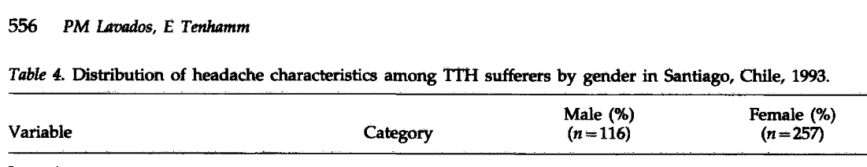
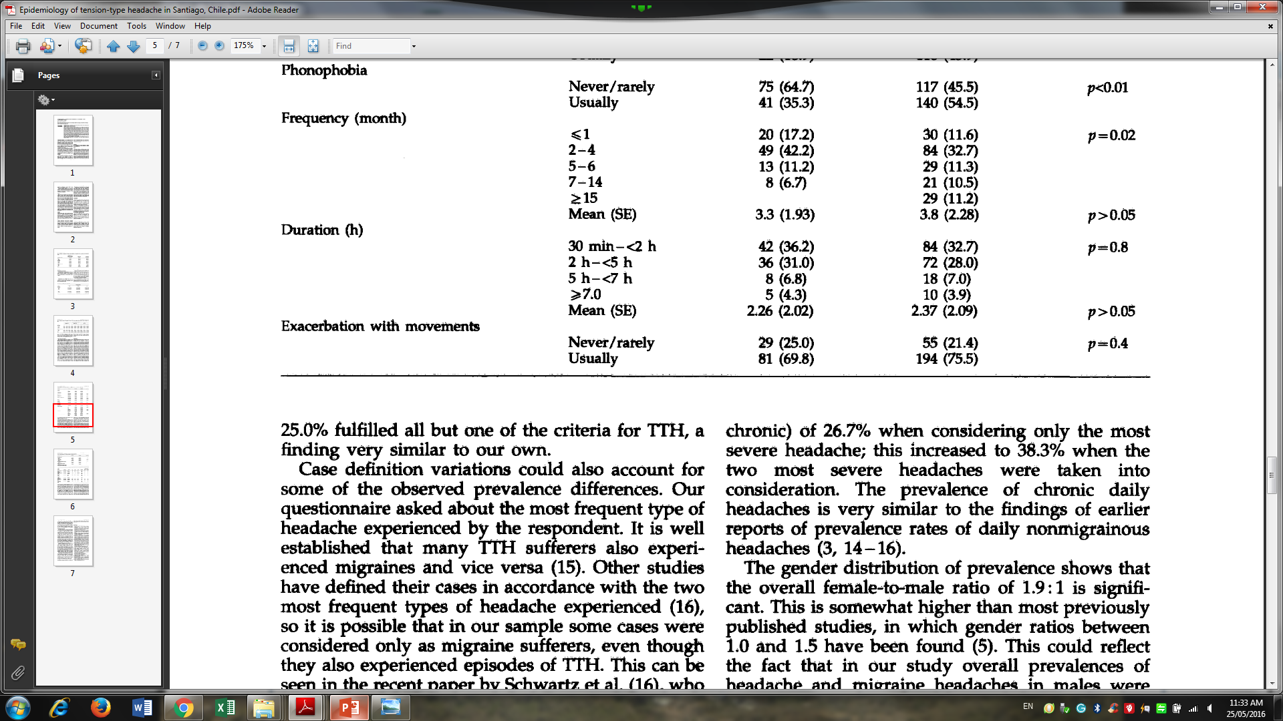
Headache duration migraine vs TTH
(Köseoglu et al Cephalalgia 2003; 23:381)
(Mean duration: 2. 4 hours)
(Lavados et al. Cephalalgia (1998) 18:552)

Slide 18
ICHD-3-Duration of TTH / Migraine attacks
TTH ( 30 minutes – 7 days)
Migraine ( 4- 72 hours)
Don’t get confused with 7 days
Most attacks are of the attacks < hours
> 4 hours
TTH
4 hours
Migraine
0 hr 4 h 24 h 72 hrs
No migraine if patient never had any attacks of more than 4 hours

Slide 19
Duration of attacks
Tough job to get exact duration
Patients might not give you exact duration
Got relieved by sleeping / vomiting
I take tablet whenever have pain
Overestimate / underestimate the duration
Do you have headache for all day along.
If yes: Gives idea of > 4 hrs

Slide 20
Points in Migraine
Migraine (ICHD-3)
A. 5 Headache Attacks
B. 4- 72 hours
C. 2 out of 4
Headache characteristics
Unilateral
Pulsating
Moderate or severe
Aggravated by walking stairs
or
similar routine physical activity
D. One of these
Nausea & /or Vomiting
Phonophobia & photophobia
E. Exclusion pf others

Slide 21
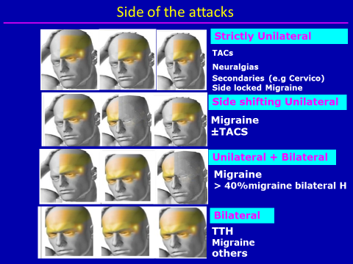
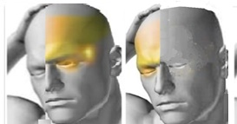
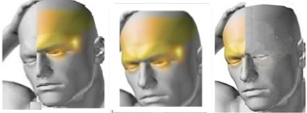
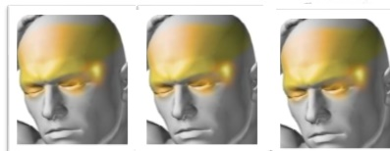
Side of the attacks
Strictly Unilateral
10-26% ( ¼th )
Strictly side locked
Side shifting Unilateral
All pattern possible
Unilateral + Bilateral
40- 61% Bilateral
(exclusive bilateral or
mixed with unilateral pain)
Bilateral
(Turkdogan et al Headache 2006,461)

Slide 22
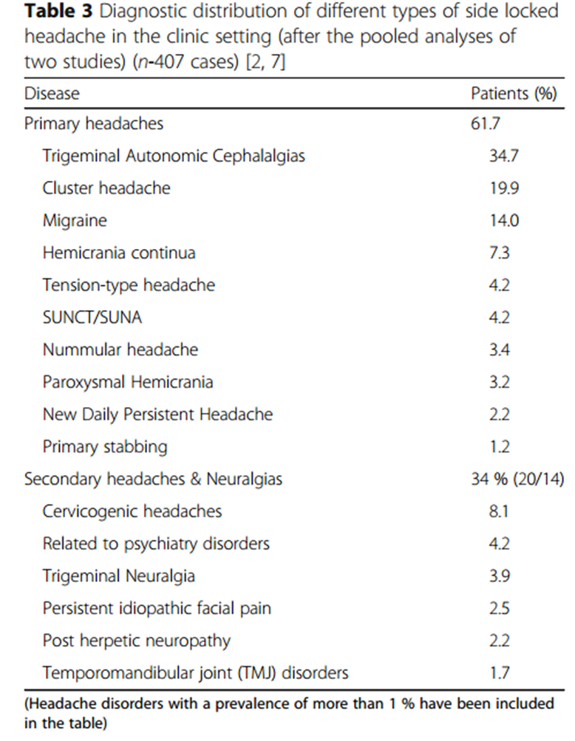
Side locked headache : clinical significance
20% headache patients: side-locked headache
14% - Migraine
(Prakash and Rathore TJHAP (2016) 17:95)
Strictly unilateral headache
Not synonymous with migraine
look for other causes

Slide 23
Side of the attacks
REMEMBER
Up to 61% migraineurs may have Bilateral Headaches
Unilaterality: a little bit Favours migraine
Bilateral Headaches: not rule out Migraine
(Turkdogan et al Headache 2006,461)

Slide 24

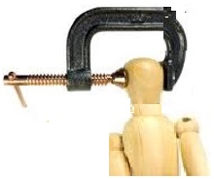
Character
Throbbing
Non throbbing
Hammering
Constricting/Pressing

Slide 25
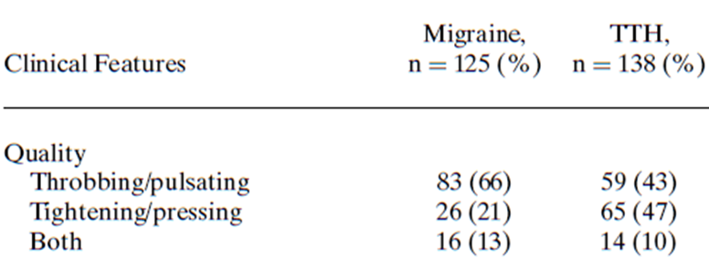
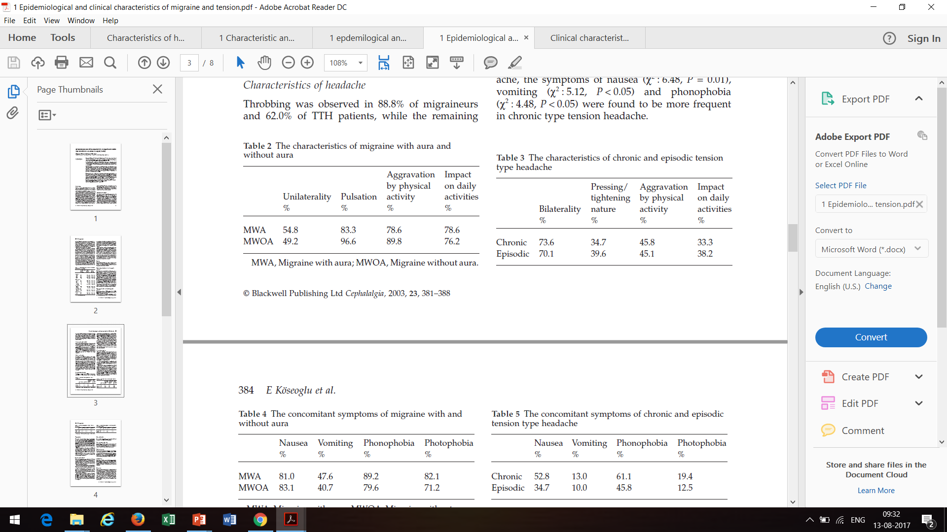
Migraine headache character
Tension type headache
65%
(Headache 2006;46:461-468)
Cephalalgia,2003,381–388
Up to 65% TTH may have Throbbing pain
Up to 50 % migraineur may have constricting pain

Slide 26
Character
Throbbing : not synonymous with Migraine
Throbbing pain in both TTH and Migraine
Headache character may not be much helpful in differentiating

Slide 27
INTENSITY
 | Rasmussen, Cephalalgia 1991;11:129 | Roh et al, Headache 1998, 365 | Turkdogan et al Headache 2006,461
Migraine
Mild | 1 | 30 | 6
Moderate | 15 | 51 | 55
Severe | 84 | 19 | 39
TTH
Mild | 41 | 48 | 28
Moderate | 58 | 44 | 59
Severe | 1 | 8 | 13
No migraine if patient never had severe attacks

Slide 28

INTENSITY
Restriction in any activity
1. Not hamper any activities Mild
2. Hamper some activities Moderate
3. Hamper routine activities Severe

Slide 29
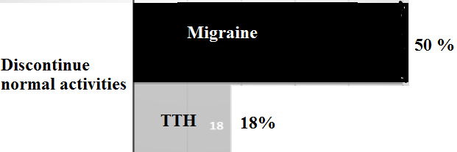
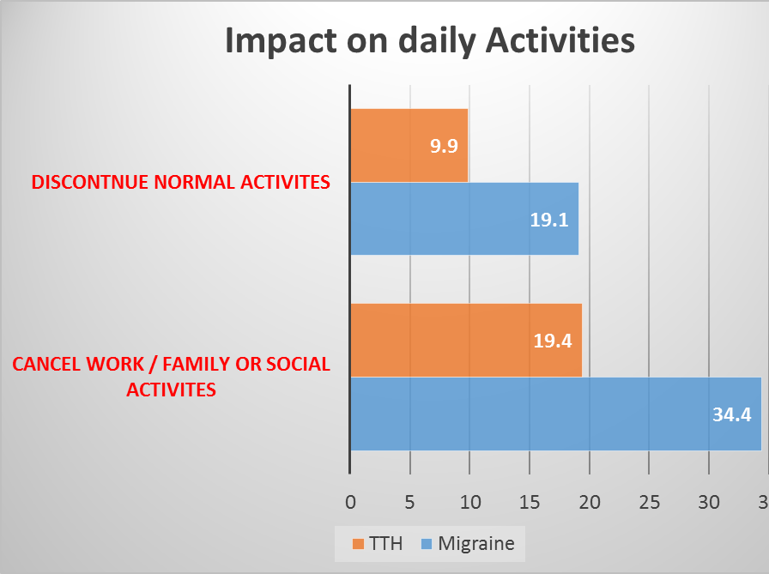
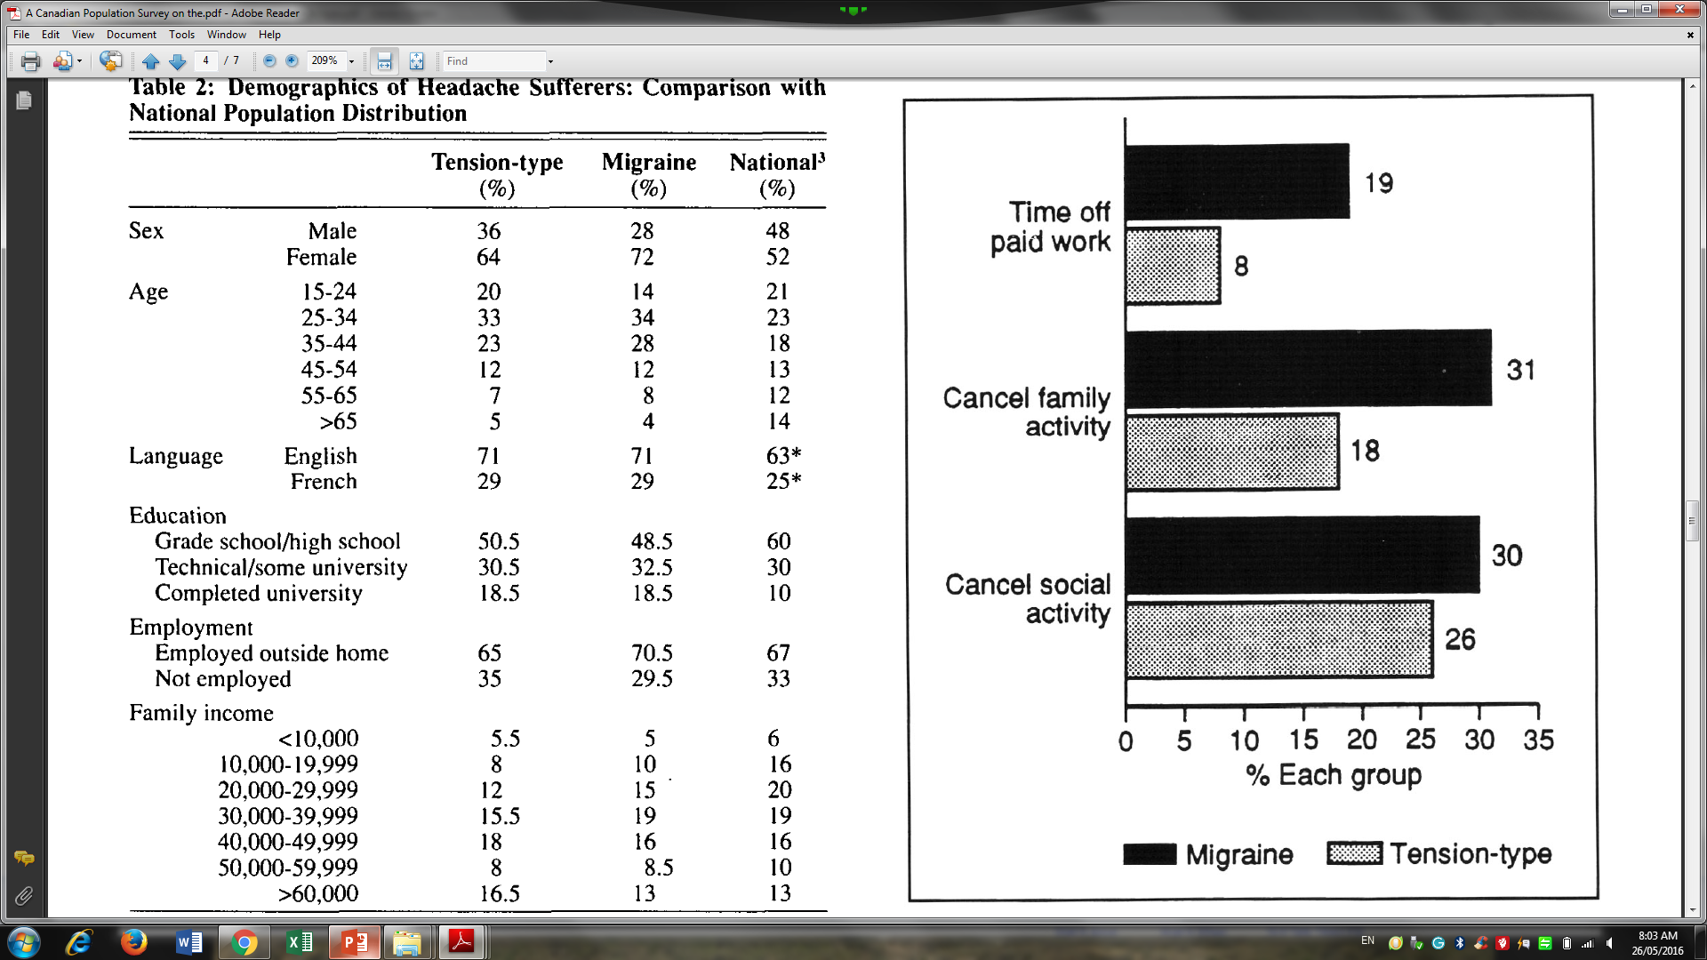
Effects on daily activities
( Pryse Phillips et al Can J Neurol. Scie 1992:19:333-39)
Roh et al Headache 1998: 38; 356-65

Slide 30
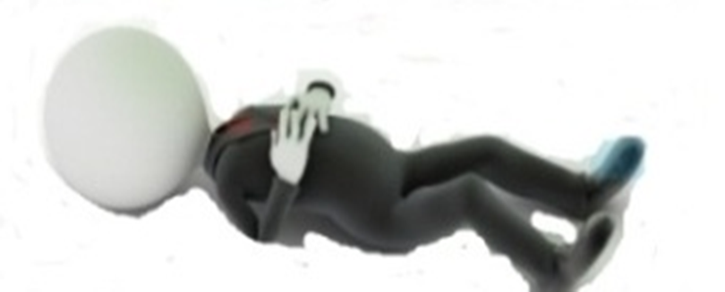
Headache patients requiring Bed rest
Migraine
TTH
30% (Can J Neurol. Scie 1992:19:333-39)
7 % (Can J Neurol. Scie 1992:19:333-39)
58 %
(Hu et al Arch Inter Medicine 1999, 813-17)
Length of bed rest :
much less than migraine
Average Length of Bed Rest 4-6 hrs.
(Hu et al Arch Inter Medicine 1999, 813-17)
Taking bed rest is more important that canceling some activities
Taking Bed rest is more likely with migraine

Slide 31
Relation to Physical Activity
Headache
Activity
Headache restricts activity
Activity increases headache
Can continue / start work?
If YES- No aggravation by activity
IF NO- Aggravation by activity
 | Migraine | TTH
Turkdogan et al Headache 2006, 461 | 66% | 31%
Köseoglu et al cephalgia | 78% | 45%

Slide 32
Associated features
Migrainous features
Systemic features
  Fever
  Weight loss
  Recurrent cough
  Nausea / Vomiting
  Photophobia
  Phonophobia
Neurological features
  Visual symptoms
  Cranial autonomic symptoms
  Vestibular symptoms

Slide 33
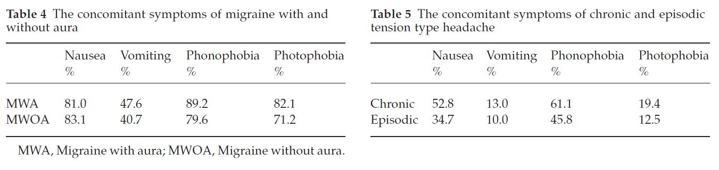
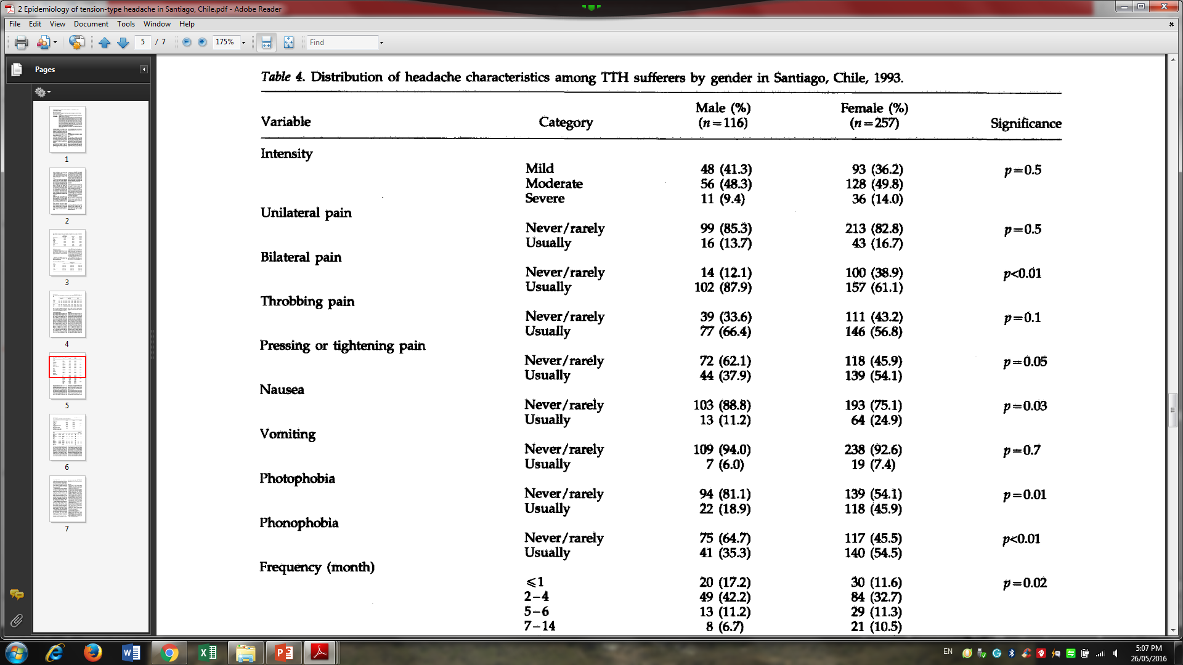
Migrainous features
(Köseoglu et al Cephalalgia 2003; 23:381)
Roh et al Headache 1998: 38; 356-65

Slide 34
Nausea in headaches, other than migraine
Headaches | Nausea / vomiting (%)
TTH | Up to 30
Cluster Headache | > 30
Paroxysmal Hemicrania | > 30
SUNCT/SUNA | > 20
Hemicrania Continua | > 50 %
NDPH | > 50 %
Hypnic headache | > 20 %

Slide 35
Migrainous features
  Interpretation of migrainous features
  Presence of migrainous features doN’t exclude other diagnosis
  Absence of migrainous features are highly against migraine
Meaning of PHOTOPHOBIA is important
Not discomfort by SUNLIGHT
Discomfort by light sources within the home
(Bulb light / Tube light / TV-Monitor-Screen light.)

Slide 36
Physical examinations
Red flag Signs
  Approach like any Neurological disorder
No Red flag Signs
  Bare minimum
    BP
    Fundus
    Meningeal signs

Slide 37
Points in Migraine
Migraine (ICHD-3)
Migraine likely
Doubt Migraine ?
A. 5 Headache Attacks
Recurrent attacks
New onset/first attack
B. 4- 72 hours
> 4 hours
Less than 4 hours
C. 2 out of 4
?
Side locked headache
Unilateral
Pulsating
Moderate or severe
Aggravated by walking stairs
or
similar routine physical activity
??
?
Severe
Never Severe
Bed rest
No restriction of activities
D. One of these
No Nausea
Nausea & /or Vomiting
Phonophobia & photophobia
N/V
?
No Photo/phono

Slide 38
Mnemonic for Migraine
Pulsatile
One day attack
Unilateral
Nausea
Disabled
P
Disabled headaches
One day headaches
Nausea or vomiting
O
D
O
U
N
N
D
Notes:
Mnemonics for migraine

Slide 39
Summary
Most common headache in the clinic settings
Migraine is highly misdiagnosed
No symptoms exclusive belong to migraine
No symptoms rule out migraine
Group of symptoms help in identifying migraine and others
  POND/ DON mnemonic may be helpful

Slide 40

Primary vs secondary

