Slide 1
Thiamine and Neurology
Dr Sanjay Prakash
Professor and Head
Department of Neurology
Smt. B. K. Shah Medical Institute & Research Centre.
Vadodara, Gujarat.

Slide 2
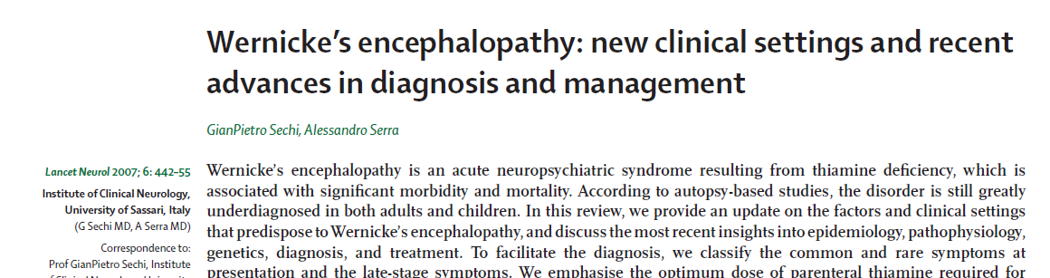
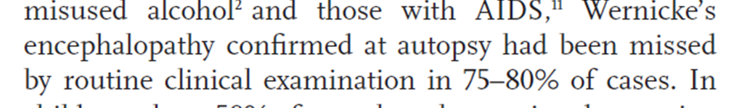
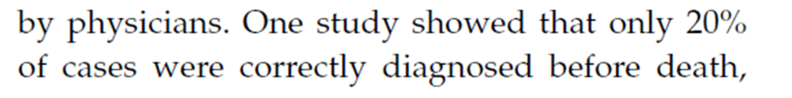
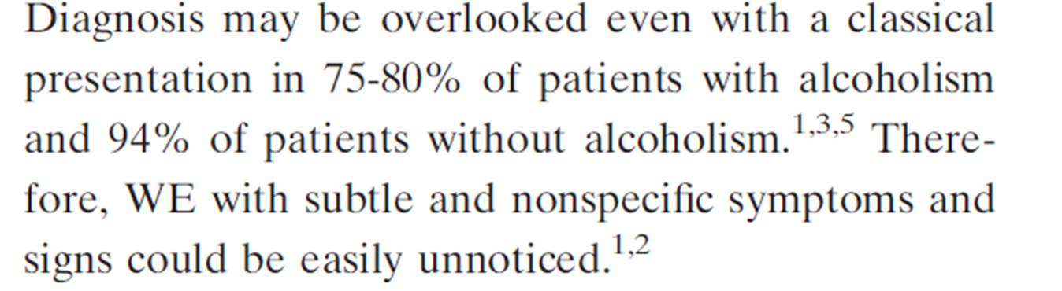
Thiamine
Notes:
I read one article in 2007 published in The lancet Neurology.
After reading this article I became obsessed or biased for thiamine supplementation. Almost more than 90% of my patients receive thiamine.

Slide 3
Thiamine
Other clinical features
Dry beriberi
Wet beriberi
Gastrointestinal beriberi
Notes:
I read one article in 2007 published in The lancet Neurology.
After reading this article I became obsessed or biased for thiamine supplementation. Almost more than 90% of my patients receive thiamine.

Slide 4
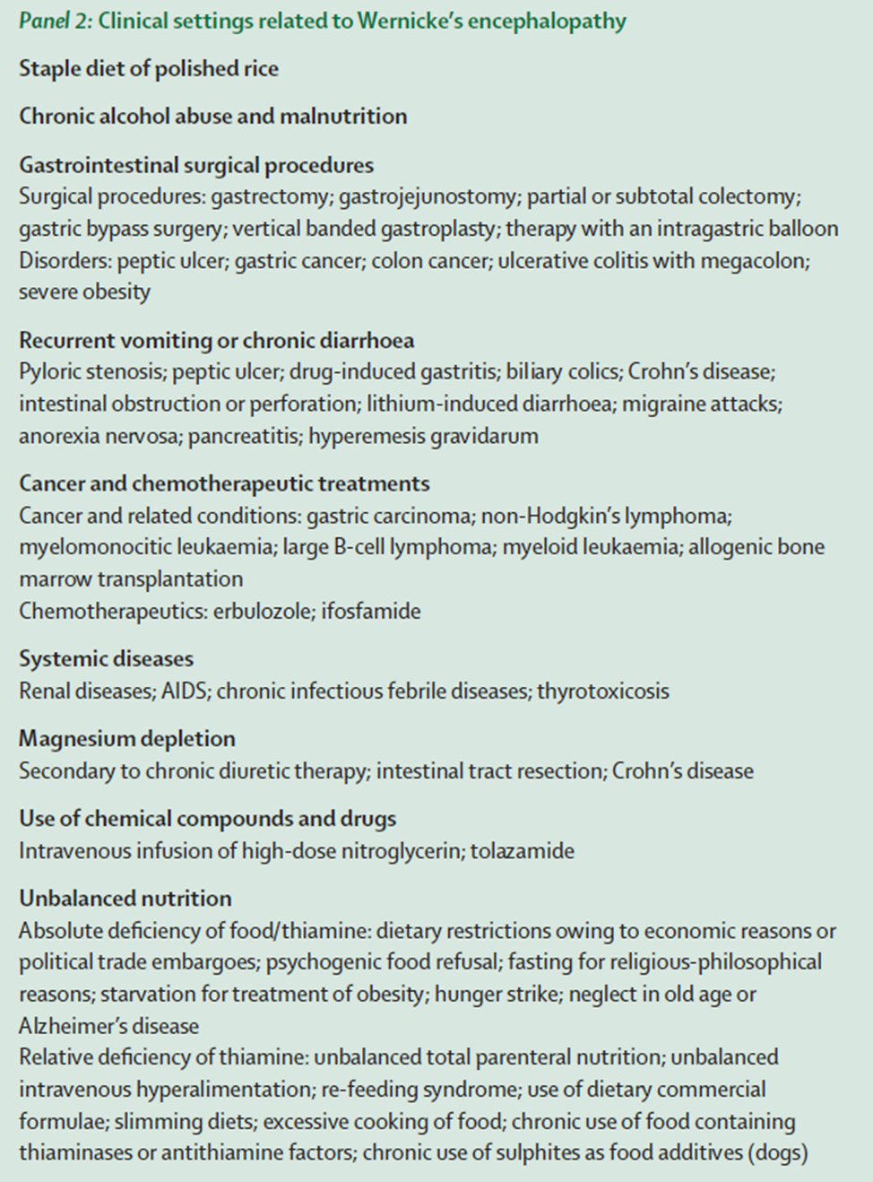
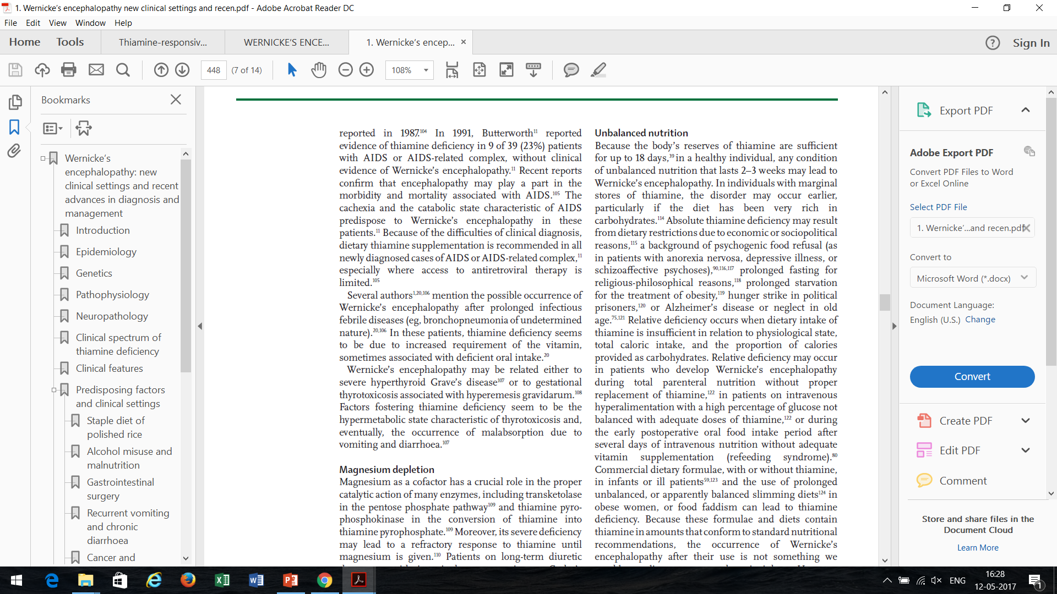
Clinical setting of thiamine deficinecy
Lancet Neurol 2007; 6: 442–55

Slide 5
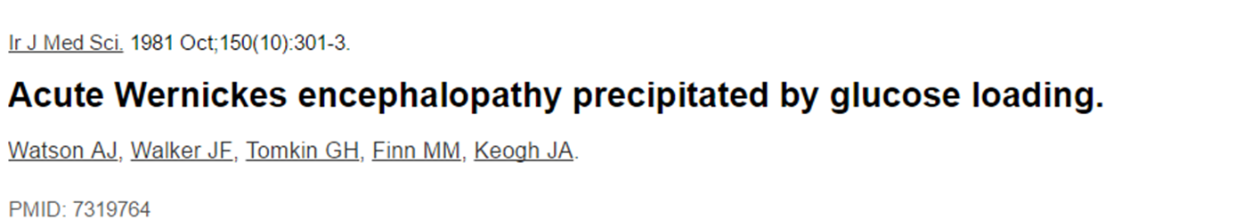
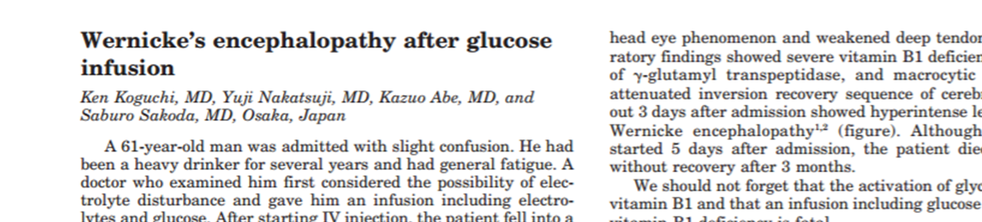
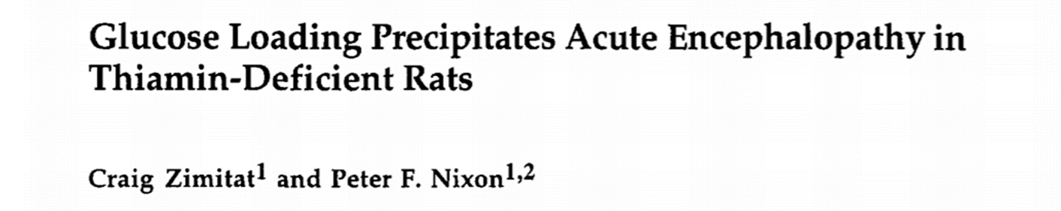
Wernicke’s encephalopathy
Notes:
What we know about WE or thiamine. WE all know this facts. The facts that WE can be precipitated by glucose infusion. Do we know more than that? Some may have heard about berry-dry or wet berry… Anything else…
I will let you know more than this… An will discuss neurological and non-neurological aspects of thiamine deficiency..
The current going decade is in the name of vitamin D. Before that, it was the decade of B12… And I guess next decade will belong to Thiamine… as far as nutrional l supplements are concerned

Slide 6

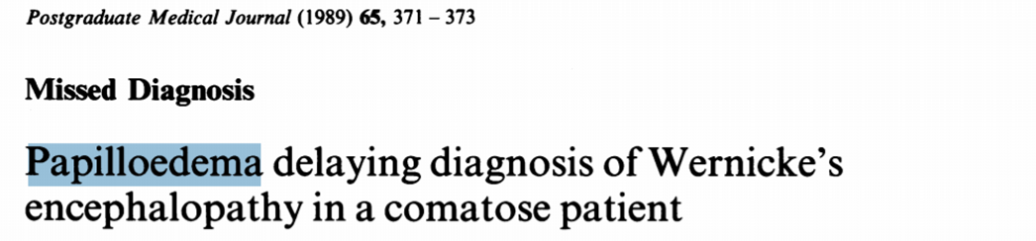
Coma
Notes:
We classically present as a triad of ….
However , WE may present as coma…
Over that comma may have papilledema, without any evidence of raised ICP.

Slide 7
Thiamine- Delirium

Slide 8
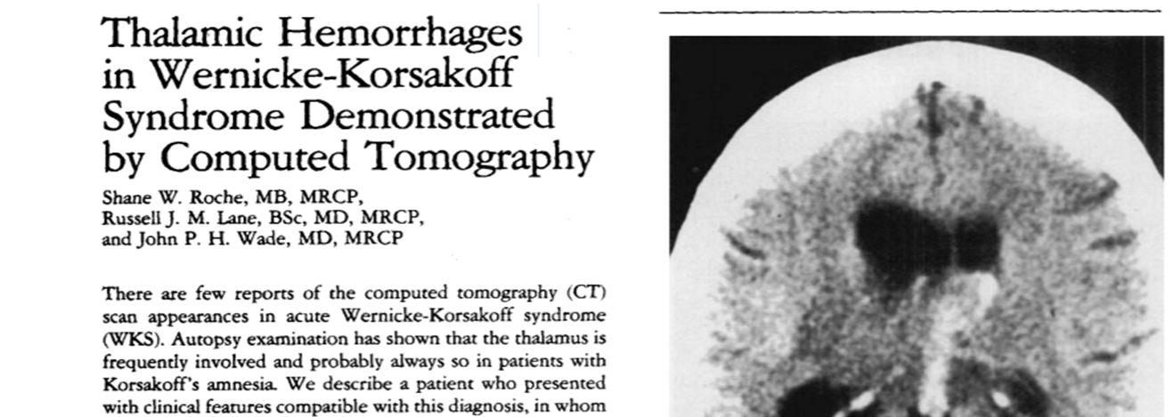
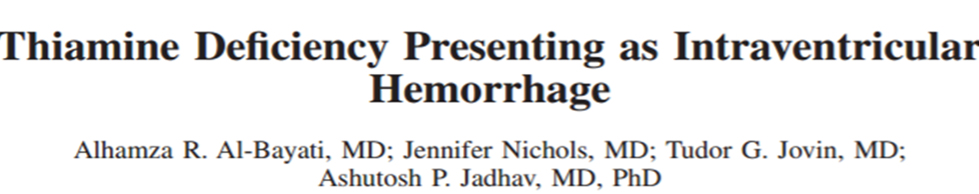
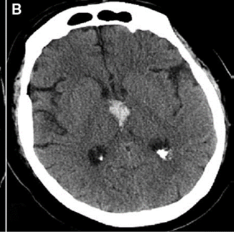
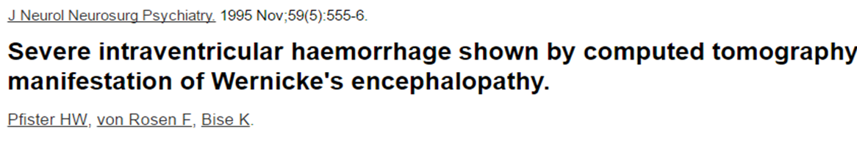
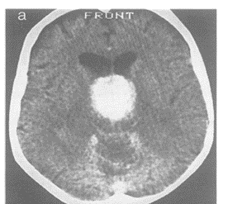
Thiamine- Intracerebral Hemorrhage
Ann Neurol 1988;23:312
Notes:
There may be true intracerebral hemorrhage….

Slide 9
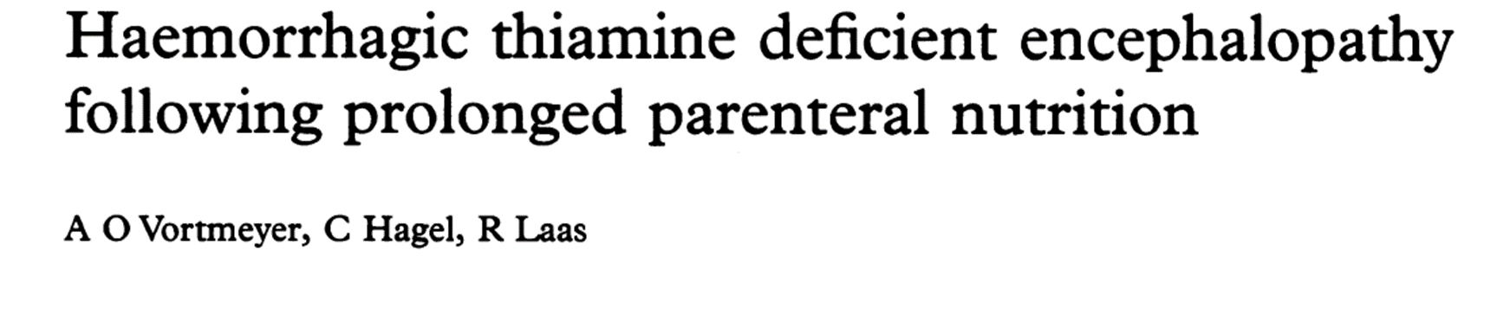
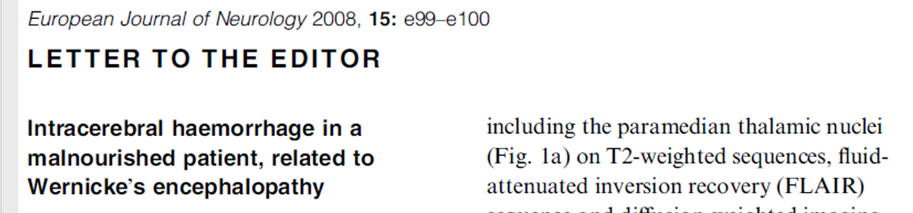
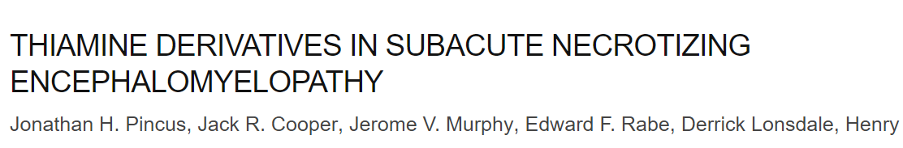
Thiamine- Intracerebral Hemorrhage
Notes:
WE patients may have hemorrhage in brain parenchyma….there may be necrotizing brain parenchyma..

Slide 10
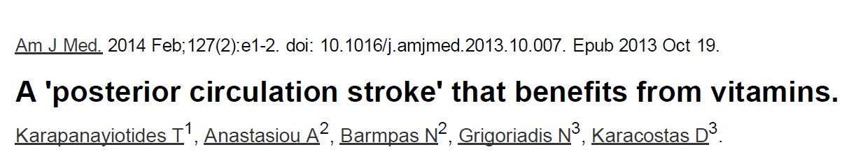
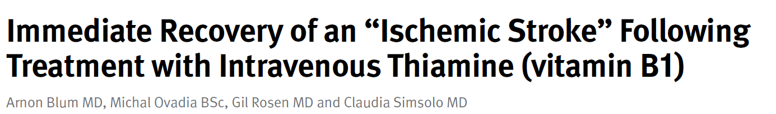
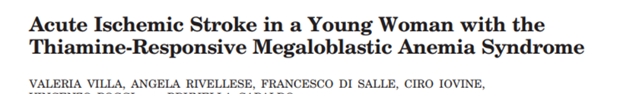
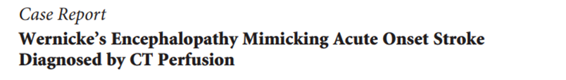
Thiamine- ischemic strokes
Notes:
Now ischemic stroke..

Slide 11
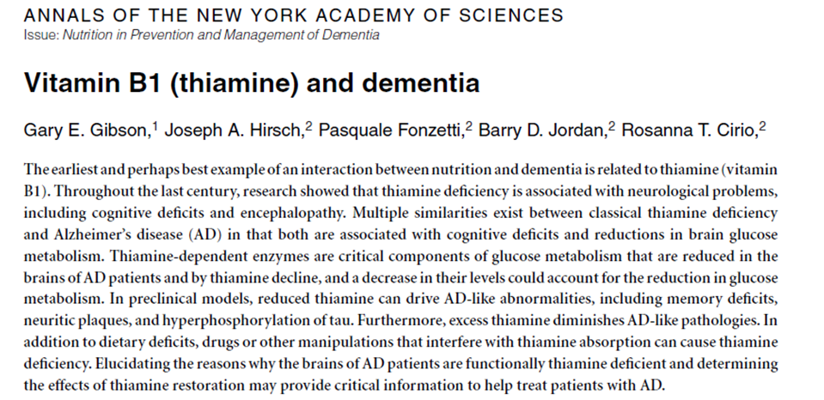
Thiamine - Dementia
Ann N Y Acad Sci.2016 Mar;1367(1):21-30

Slide 12
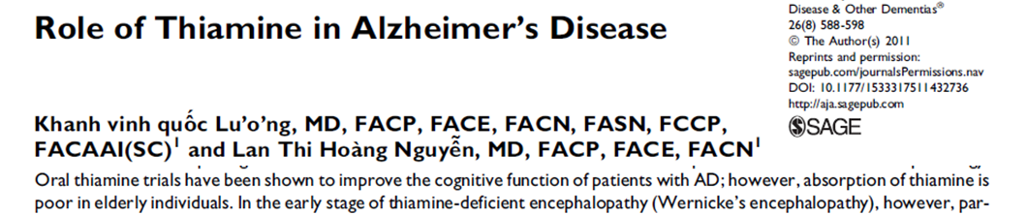
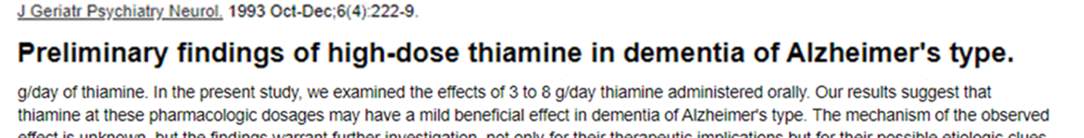

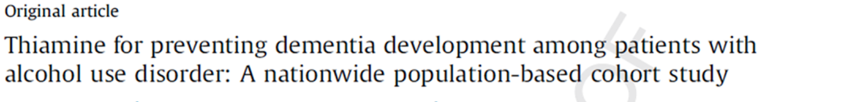
Thiamine - Dementia

Slide 13
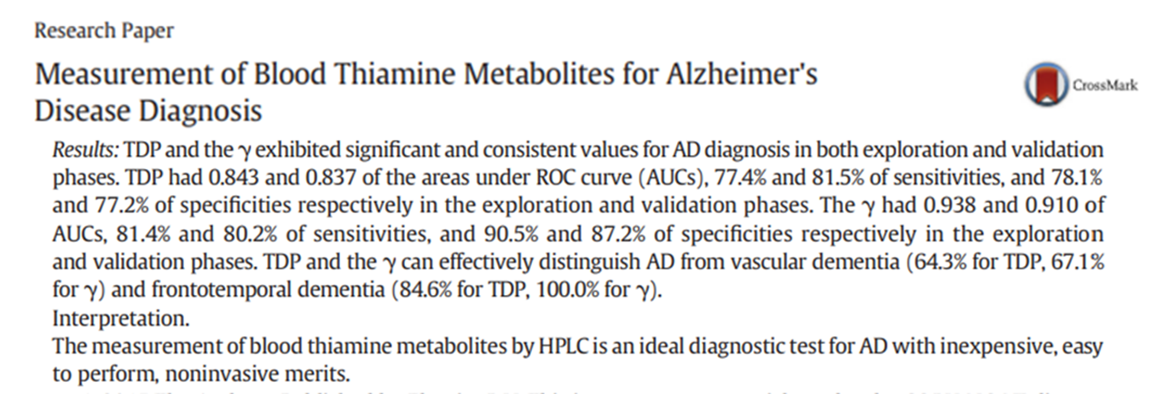
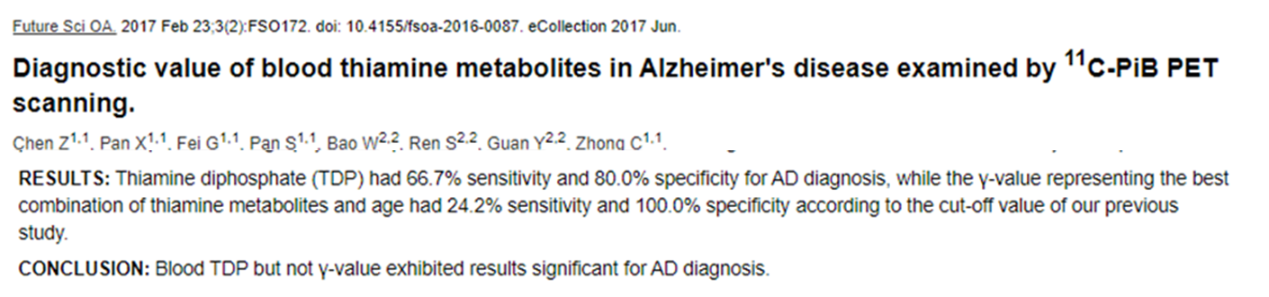
Thiamine - Dementia
EBioMedicine 3 (2016) 155–162

Slide 14
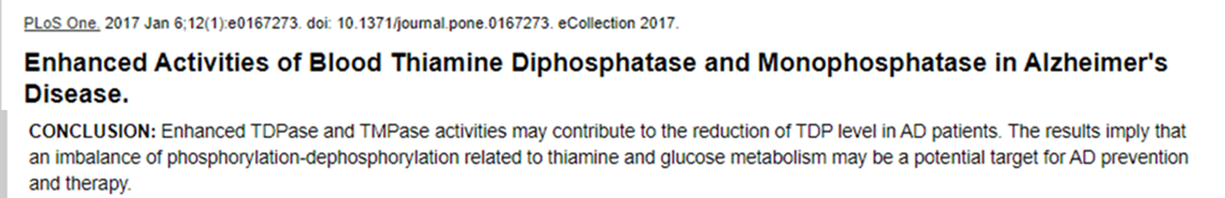
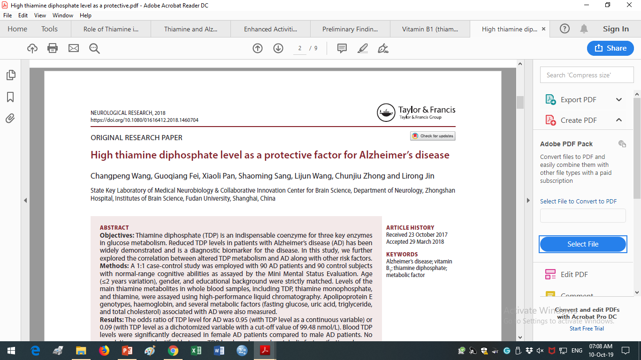
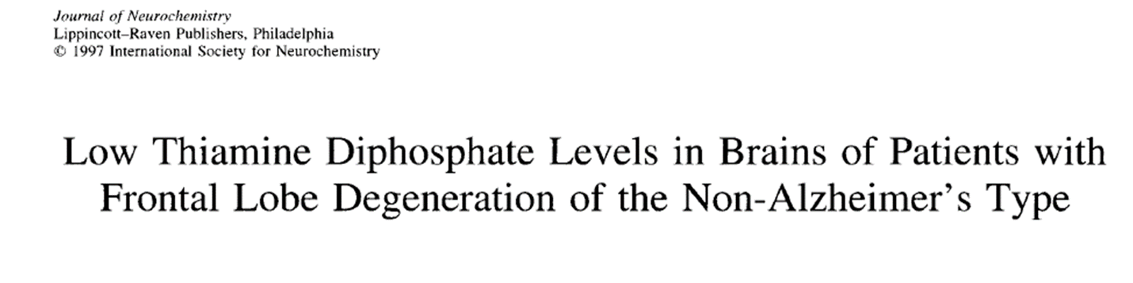
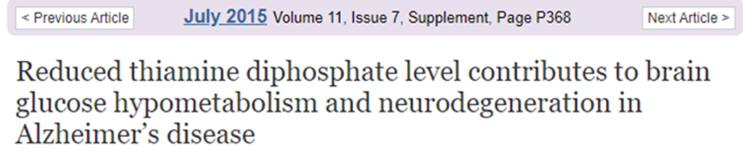
Thiamine - Dementia

Slide 15
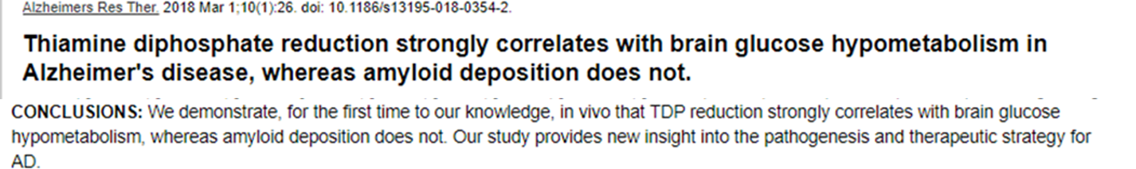
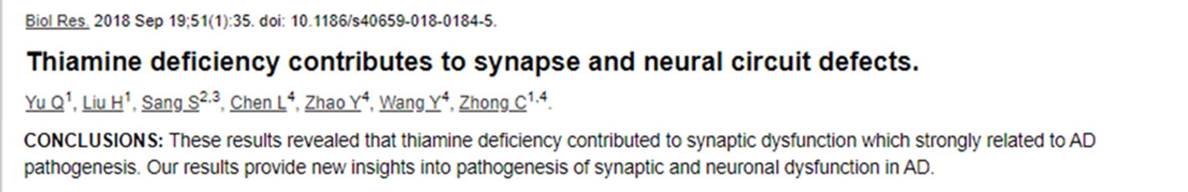
Thiamine - Dementia

Slide 16
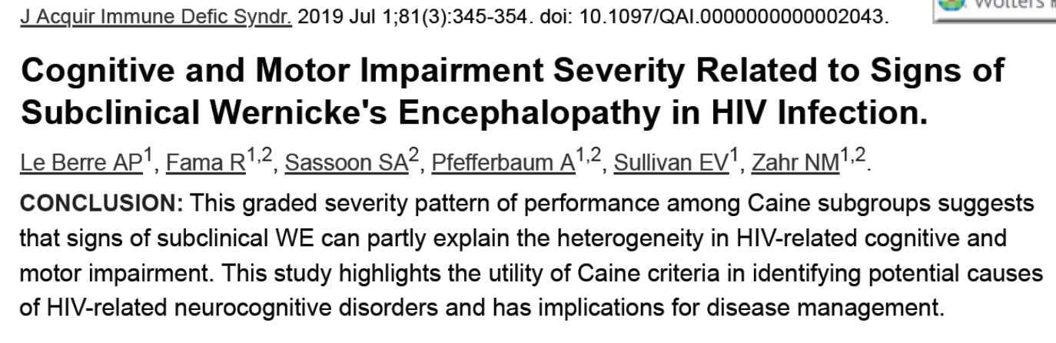
Thiamine – dementia encephalopathy

Slide 17
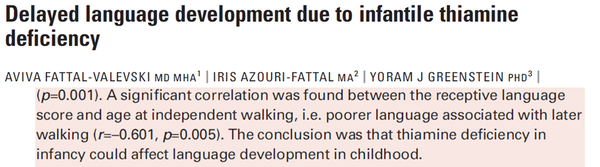
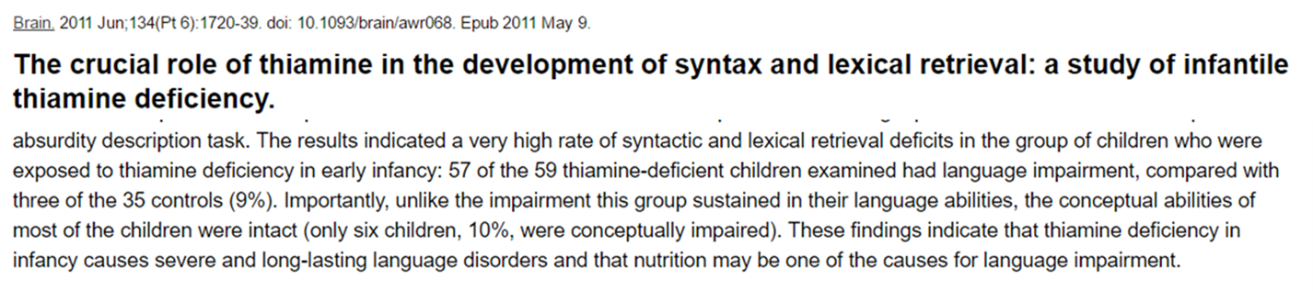
Thiamine – language development

Slide 18
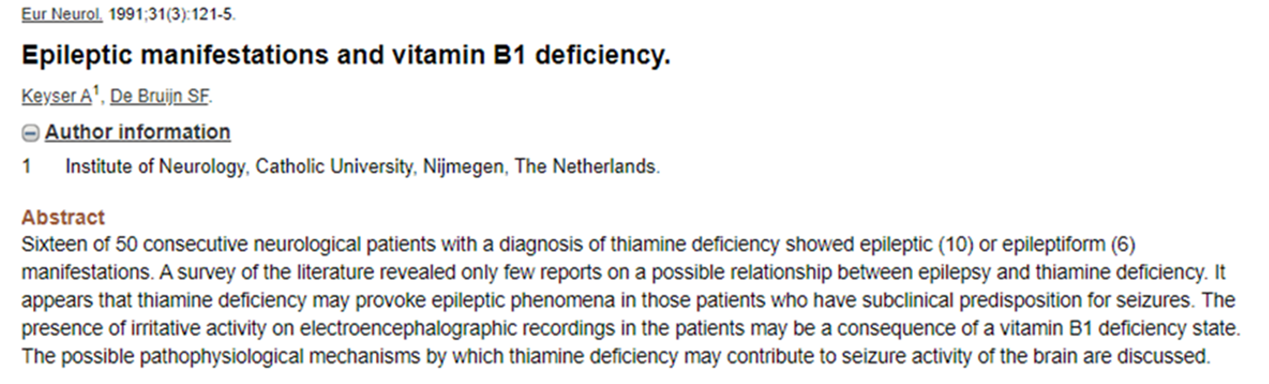
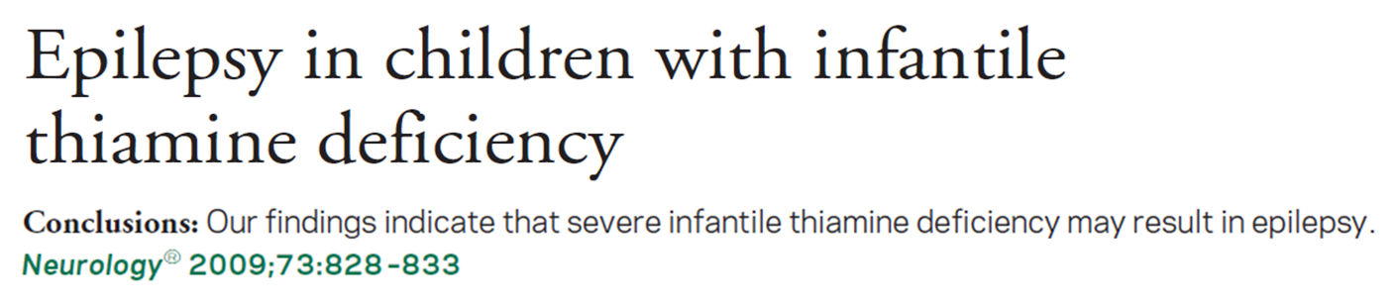
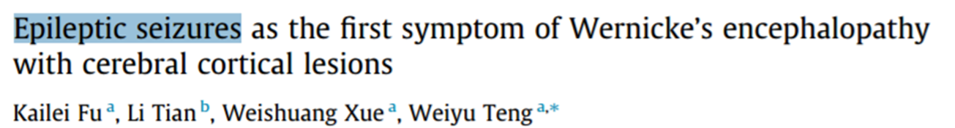
Thiamine - Epilepsy

Slide 19
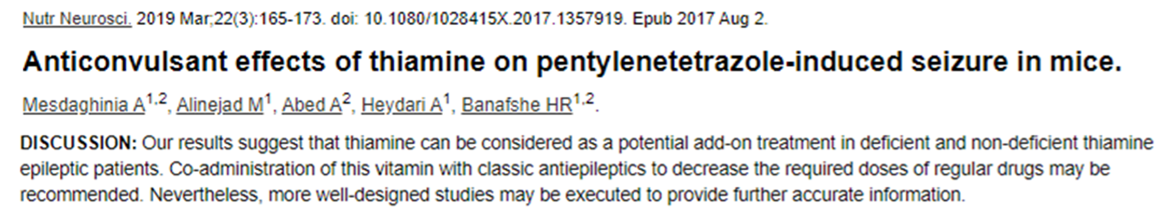
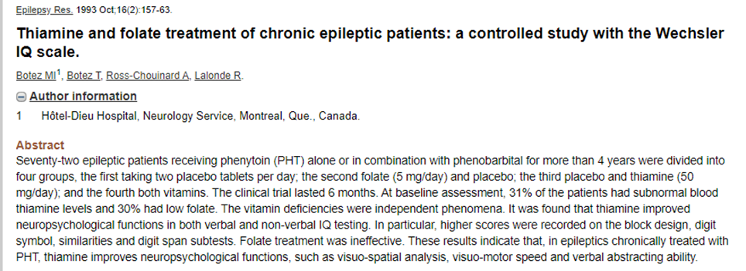
Thiamine - Epilepsy

Slide 20
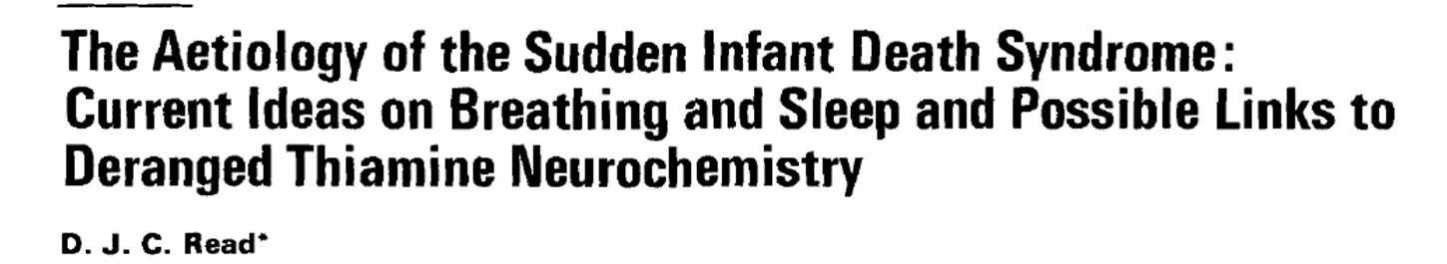
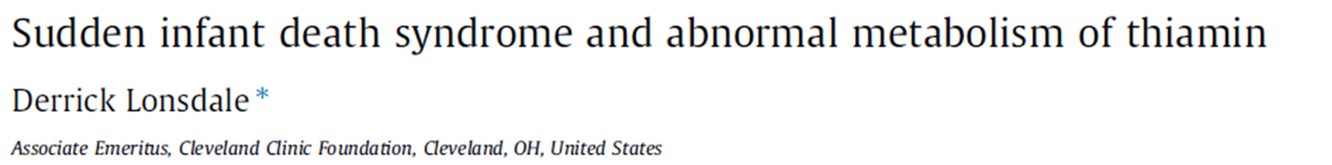
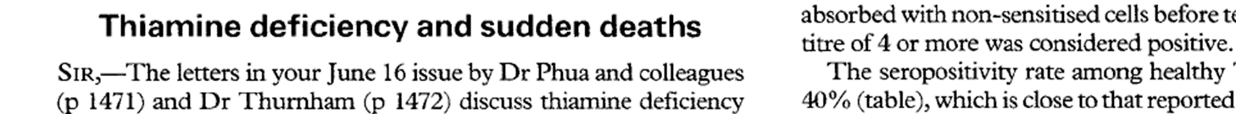
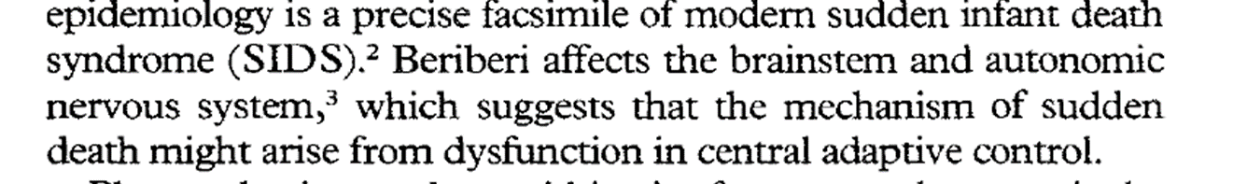
Sudden Infant Death syndrome

Slide 21
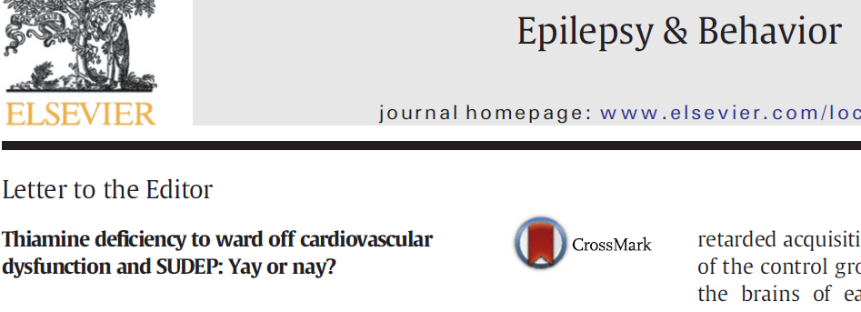
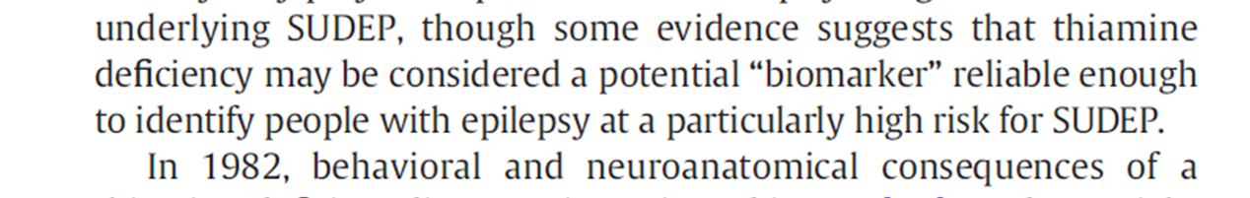
SUDEP - Epilepsy

Slide 22
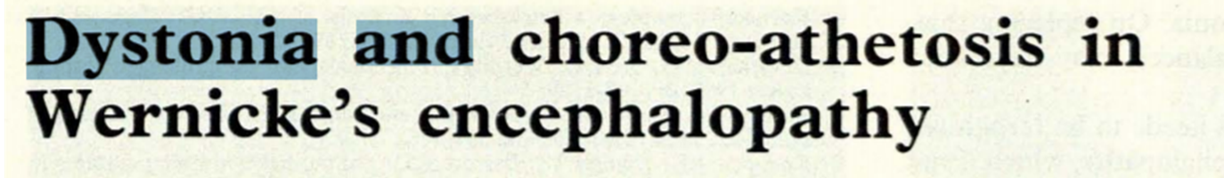
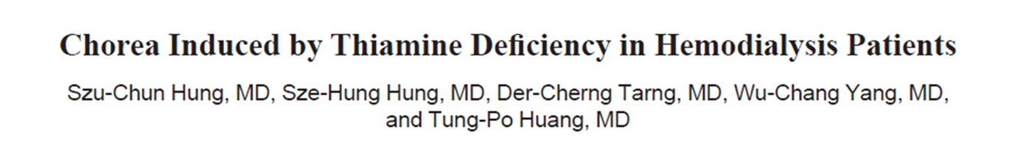

Thiamine Basal Ganglia Disorder

Slide 23


Thiamine Basal Ganglia Disorder

Slide 24



Friedreich’s Ataxia

Slide 25


Thiamine- Ataxia
Notes:
Hemicrania continua just like CH, PH SUNCT/SUNA is another TACs. Initially it was put under the heading of other primary headache disorders. But in the recent calcification system. It is classification with CH, PH, SUNCT, SUNA

Slide 26


Thiamine- Parkinson’s disease
Notes:
Hemicrania continua just like CH, PH SUNCT/SUNA is another TACs. Initially it was put under the heading of other primary headache disorders. But in the recent calcification system. It is classification with CH, PH, SUNCT, SUNA

Slide 27

Thiamin movement disorder

Slide 28



Thiamin movement disorder

Slide 29


Thiamin movement disorder

Slide 30




Thiamin neurodegeneration

Slide 31


Thiamine- neuroprotective

Slide 32
Thiamine- neuroprotective

Slide 33



Thiamine- Psychiatry

Slide 34


Thiamine- depression

Slide 35

Thiamine- depression

Slide 36
Thiamine- depression

Slide 37

Thiamine- Autism

Slide 38


Thiamine – Vision / eye

Slide 39



Thiamine – Vision / eye

Slide 40



Thiamine – Vision / eye

Slide 41


Thiamine – Vision / eye

Slide 42

Thiamine – Vision / eye

Slide 43


Thiamine-

Slide 44


Thiamine- eye

Slide 45


Thiamine- Ear

Slide 46

Thiamine- Ear

Slide 47
Thiamine- Ear

Slide 48


Hearing

Slide 49
Thiamine- Ear
Neurology india 2017;65(6):1406-1407

Slide 50
Thiamine- Ear

Slide 51


Vertigo- Thiamine

Slide 52

Vertigo- Thiamine

Slide 53


Thiamine- motor function

Slide 54

Thiamine- motor function

Slide 55

Thiamine -Neuropathy

Slide 56




Thiamine -Neuropathy

Slide 57



Thiamine -Neuropathy

Slide 58

Thiamine -Neuropathy

Slide 59


Thiamine- NMJ
Pediatrics.2014 Nov;134(5):e1436-40.

Slide 60



Thiamine- Muscle disease

Slide 61

Thiamine- Muscle disease

Slide 62

Thiamine- Neural axis
Cortex
Basal ganglia
Cerebellar
Vestibular
Eye
Ear
Spinal cord
Nerves
NMJ
Muscle
Thiamine

Slide 63

Thiamine always

Slide 64


