Slide 1
STROKE SYNDROMES
DEPT OF NEUROLOGY

Slide 2
SCHEME OF PRESENTATION
Introduction
Stroke syndrome classification
Anatomy of vascular tree
Stroke symptom localization by arterial territory
Water shed infarcts
Lacunar infarcts
ICH syndromes

Slide 3
A stroke, or cerebrovascular accident, is defined by abrupt onset of a neurologic deficit that is attributable to a focal vascular cause.
The clinical manifestations of stroke are highly variable because of the complex anatomy of the brain and its vasculature.
The clinical picture that results from an occlusion of any one artery differs in minor ways from one patient to another.

Slide 4
There is sufficient uniformity to justify the assignment of a typical syndrome to each of the major arteries and their branches.
Stroke syndrome classification helps in:
1. Anatomical localization of lesion
2. Determining the etiology of stroke
3. Helps in better clinico-anatomical correlate with a better understanding of brain functioning

Slide 5
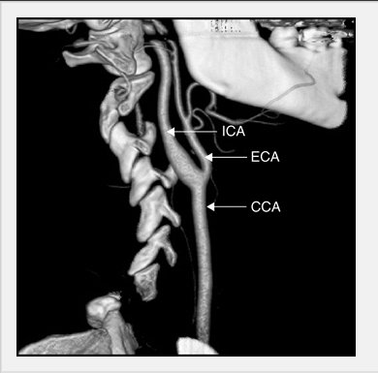
ANTERIOR CIRCULATION
The carotid system consists of three major arteries the common carotid, internal carotid and external carotid.
The common carotids ascend in the neck to the C4 level, just below the angle of the jaw, where each divides into external and internal branches .
Course of ICA :
Cervical
Petrosal
Cavernous

Slide 6
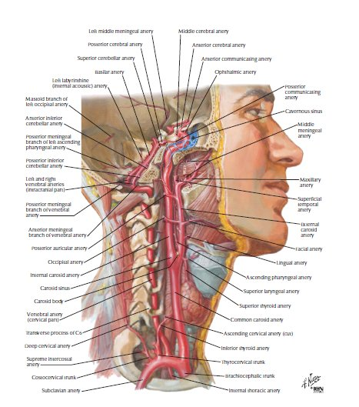
ICA branches
Ophthalmic artery
Posterior communicating artery
Anterior choroidal artery
Terminal branches -
ACA
MCA

Slide 7
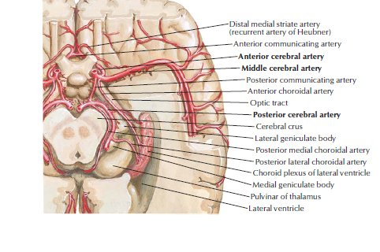
Anterior cerebral artery (ACA)
The ACA supplies the medial surface of the cerebrum and the upper border of the frontal and parietal lobes
It gives origin to (a) medial lenticulostriate branches, (b) pericallosal branches to the corpus callosum, and (c) hemispheric branches.

Slide 8
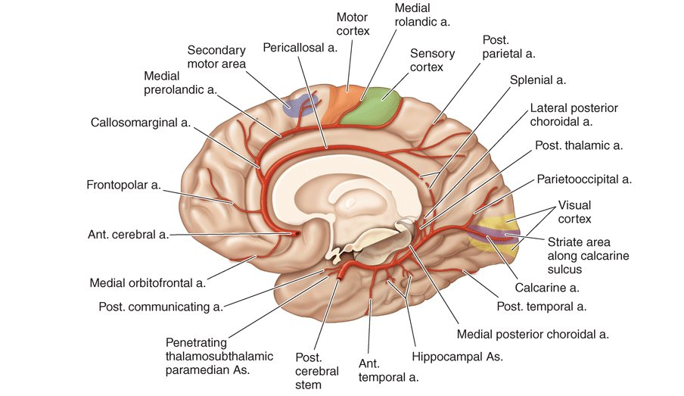
ACA

Slide 9
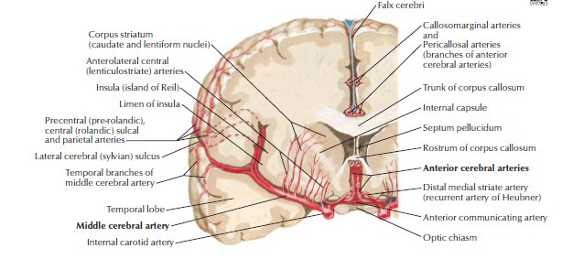
MCA
MCA
Three segments of the MCA :
Proximal
Sylvian
Distal.

Slide 10
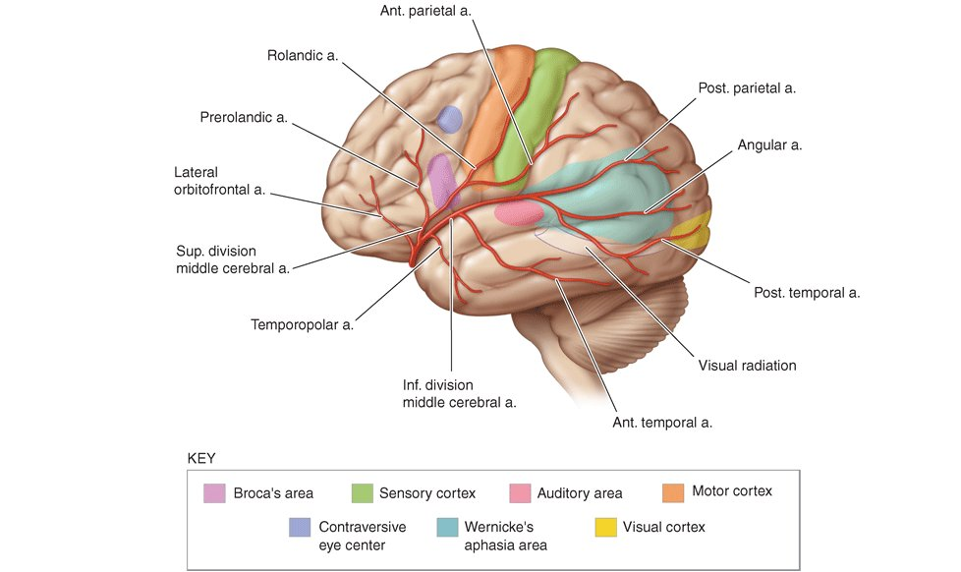
MCA

Slide 11
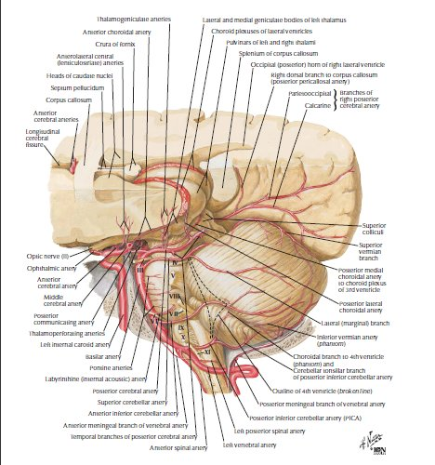
POSTERIOR CIRCULATION
The PCA are the terminal branches of the basilar artery
The branches of the PCA have been divided into three groups
(a) the penetrating arteries to the brainstem, thalamus, and other deep structures,
(b) the dorsal callosal artery
(c) the cortical branches..

Slide 12
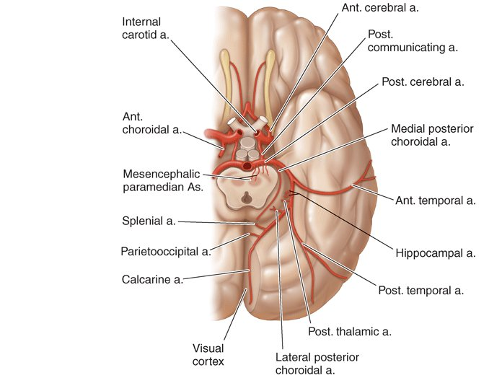
Mesencephalic branches include the interpeduncular perforators and the short and long circumferential arteries.
The arterial supply to the thalamus arises from the posterior communicating arteries and the perimesencephalic segment of the PCA.
The dorsal callosal artery or splenial branch anastomoses with distal branches of the ACA.
The PCA has four main cortical branches: the anterior temporal, posterior temporal, parieto-occipital, and calcarine arteries. The calcarine artery supplies the visual cortex

Slide 13
The terminal or cortical branches of the posterior cerebral artery supply the inferomedial part of the temporal lobe and the medial occipital lobe
Occlusion of the posterior cerebral artery produces a greater variety of clinical effects than occlusion of any other artery because both the upper brainstem, which is crowded with important structures, and the inferomedial parts of the temporal and occipital lobes lie within its domain.

Slide 14
VERTEBRAL ARTERY
The vertebral arteries are the chief arteries of the medulla; each supplies the lower three-fourths of the pyramid, the medial lemniscus, all or nearly all of the retro-olivary (lateral medullary) region, the restiform body, and the posteroinferior part of the cerebellar hemisphere.
The relative sizes of the vertebral arteries vary considerably, and in approximately 10 percent of cases, one vessel is so small that the other is essentially the only artery of supply to the brainstem.

Slide 15
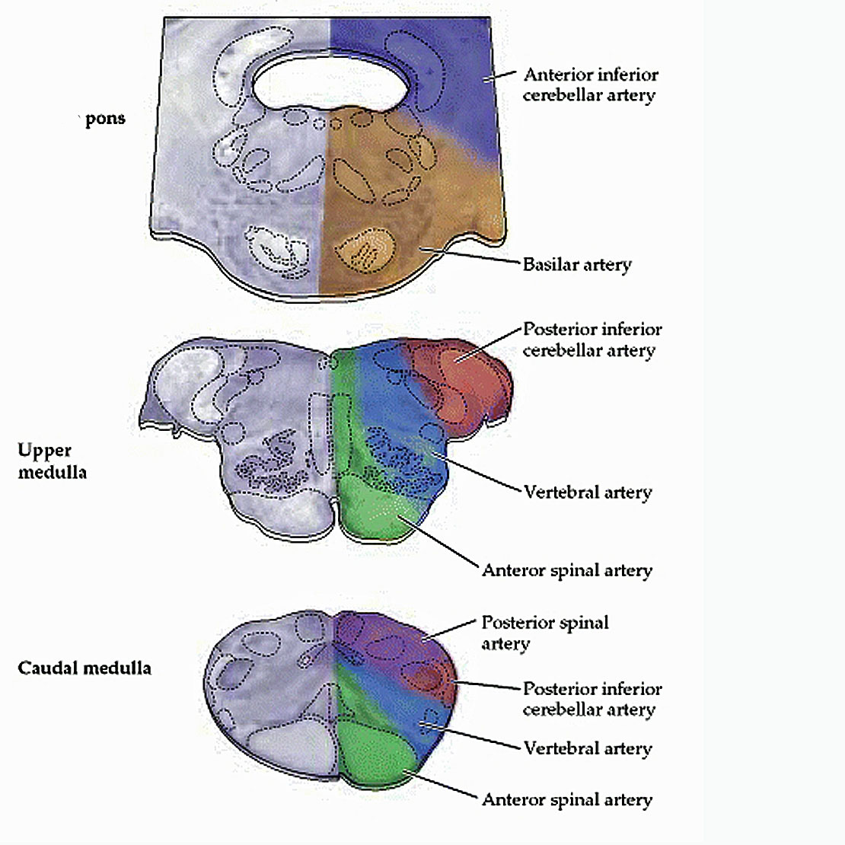
The posteroinferior cerebellar artery (PICA) is usually a branch of the vertebral artery but can have a common origin with the AICA .

Slide 16
BASILAR ARTERY
The branches of the basilar artery may be instructively grouped as follows:
(1) paramedian, 7 to 10 in number, supplying a wedge of pons on either side of the midline;
(2) short circumferential, 5 to 7 in number, supplying the lateral two-thirds of the pons and the middle and superior cerebellar peduncles;
(3) long circumferential, 2 on each side (the superior and anterior inferior cerebellar arteries), which run laterally around the pons to reach the cerebellar hemispheres
(4) several paramedian (interpeduncular) branches at the bifurcation of the basilar artery and origins of the posterior cerebral arteries supplying the high midbrain and medial subthalamic regions.

Slide 17
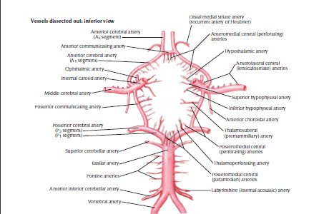
CIRCLE OF WILLIS

Slide 18
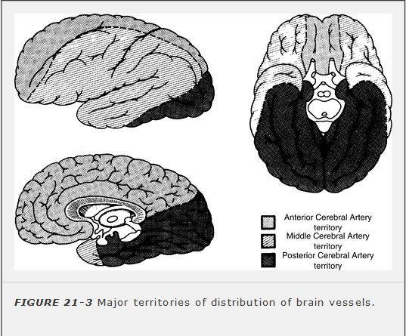
ARTERIAL TERRITORIES

Slide 19
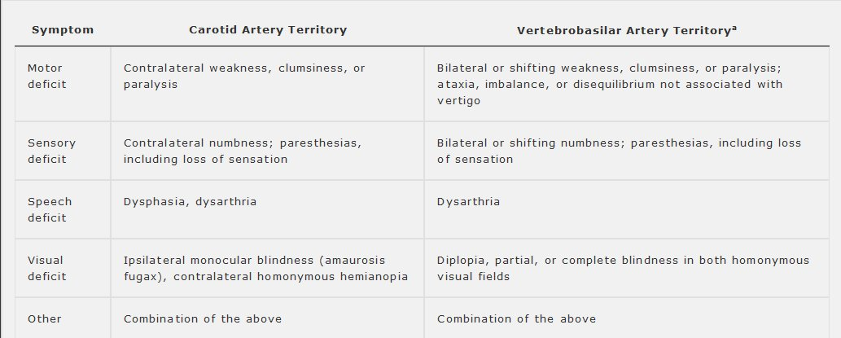
ARTERIAL TERRITORY LOCALIZATION TIA

Slide 20
ARTERIAL TERRITORY LOCALIZATION
MIDDLE CEREBRAL ARTERY SYNDROME
The MCA territory is the most common site of ischemic stroke. The clinical picture of MCA territory infarction varies according to the site of occlusion (e.g., stem, superior division, inferior division, lenticulostriate branches) and the available collaterals.
Contralateral weakness affecting the face, the arm, and, to a lesser extent, the leg is a common manifestation of MCA territory infarction.
Contralateral hemisensory loss involving the face, the arm, and, to a lesser extent, the leg is also frequent.

Slide 21
The middle cerebral artery may be occluded in its stem, the portion that is distal to its origin at the distal internal carotid and proximal to its bifurcation.
An occlusion here blocks the flow in the small deep penetrating vessels as well as in superficial cortical branches
An occlusion at the distal end of the stem blocks the orifices of the divisions of the artery in the sylvian sulcus but leaves unaffected the more proximal deep penetrating vessels.

Slide 22
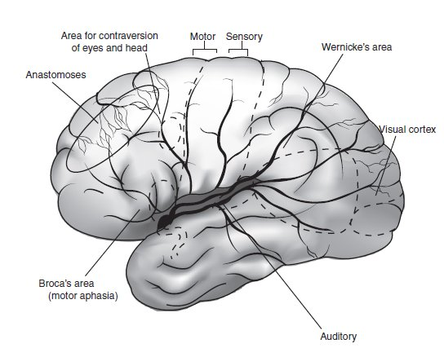
CLINICO ANATOMICAL CORELATE

Slide 23
Total occlusion of the stem manifests as contralateral hemiplegia (face, arm, and leg), hemianesthesia, and homonymous hemianopia with deviation of the head and eyes toward the side of the lesion.
In addition, there is a variable but usually global aphasia with left hemispheric lesions and anosognosia and amorphosynthesis with right-sided ones.

Slide 24
MCA SYNDROME CONTD…….
An embolus entering the middle cerebral artery most often lodges in one of its two main branches, the superior division or the inferior division
Major infarction in the territory of the superior division causes a dense sensorimotor deficit in the contralateral face, arm, and, to a lesser extent, leg as well as ipsilateral deviation of the head and eyes.

Slide 25
With left-sided lesions there is initially a global aphasia, which changes gradually to a predominantly motor (Broca) aphasia, with improvement in comprehension of spoken and written words and the emergence of an effortful, hesitant, grammatically simplified, and dysmelodic speech or there could be a Broca aphasia from the outset

Slide 26
Occlusion of the inferior division of the middle cerebral artery is slightly less frequent than occlusion of the superior one, but again is nearly always due to Embolism.
The usual result in left-sided lesions is a Wernicke aphasia, which generally remains static for days or weeks, or a month or two, after which some improvement can be expected

Slide 27
THE CAROTID ARTERY SYNDROME
Unilateral loss of vision in bright light may occur in patients with high-grade stenosis or occlusion of the ipsilateral carotid artery.
Episodic bilateral vision impairment related exclusively to light exposure may occur with bilateral high-grade stenosis or occlusion of the ICA.
Atherothrombotic disease of the carotid system has a predilection for the bifurcation of the common carotid artery and the proximal ICA

Slide 28
Patients with carotid artery occlusive disease may present with recurrent TIAs, an apoplectic or stepwise onset, or a slowly progressive neurologic deficit (pseudotumoral form).
Occlusion of the ICA in the neck may be totally asymptomatic in the presence of adequate collateral circulation, particularly if the occlusion develops slowly.
Infarction of the homolateral hemisphere may occur when the collateral circulation is inadequate.

Slide 29
The neurovascular examination may disclose a well-localized bruit in the mid- or upper cervical area.
Severe stenosis or occlusion of the ICA may cause progressive or episodic weakness of one lower extremity, often aggravated or precipitated by standing or walking .
A cluster of TIAs (capsular warning syndrome) causing weakness of the contralateral hemibody and reflecting ischemia of a single lenticulostriate artery may occur hours to days before a stroke.

Slide 30
ANTERIOR CHOROIDAL ARTERY
Infarction in the AChA territory typically results in hemiparesis due to involvement of the pyramidal tract in the posterior limb of the internal capsule
Hemisensory loss due to involvement of the superior thalamic radiations situated in the thalamolenticular portion of the posterior limb of the internal capsule
Homonymous hemianopia sparing the horizontal meridian

Slide 31
Clinical syndromes with AChA infarction include a pure motor syndrome, a sensorimotor syndrome, and ataxic hemiparesis.
Bilateral AChA infarction may result in bilateral capsular infarction, causing acute pseudobulbar mutism accompanied by varying degrees of facial diplegia, hemiparesis, hemisensory loss, lethargy, neglect, and affect changes

Slide 32

ANTERIOR CEREBRAL ARTERY
Infarction in the ACA territory causes damage primarily to the medial frontal area.
The clinical picture of an ACA territory infarction varies according to the site of occlusion and the available collaterals.
Contralateral weakness involving primarily the lower extremity and, to a lesser extent, the arm
Patients may display lack of initiative or abulia.

Slide 33
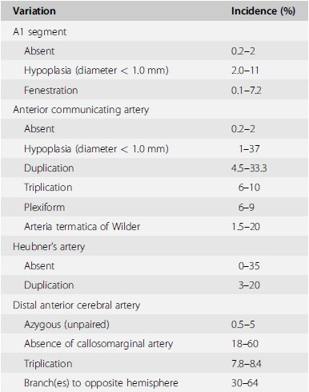
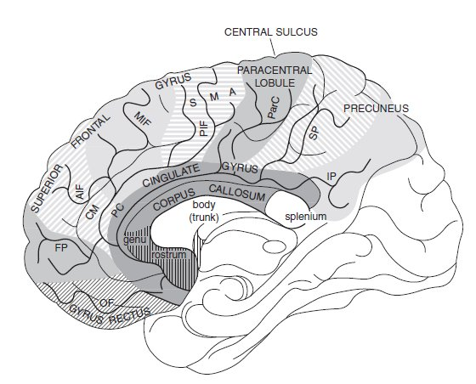

Slide 34
Lesions involving, in addition to the precentral gyrus, the premotor cortex and the supplementary motor area cause leg weakness, predominantly distal, and less severe proximal weakness of the arm.
Lesions affecting the medial part of the premotor cortex and the supplementary motor area, while sparing the precentral gyrus, cause a contralateral hemiparesis, more pronounced in the leg, and predominating proximally in both leg and arm.
Lesions of the internal capsule or brainstem cause proportional leg weakness.

Slide 35
With bilateral damage to the mesiofrontal region, patients may exhibit akinetic mutism, paraplegia, incontinence, and amnesia with apathy
Dominant medial frontal damage that includes the supplementary motor cortex may cause a disturbance of upper extremity control, including impaired bimanual coordination, the alien hand sign.
Large right ACA infarctions may cause a hemiplegia with the arm and leg affected more than the face, marked sensory neglect, impaired copying and micrographia.

Slide 36
The syndrome of homolateral ataxia and crural paresis, with hemiparesis that predominates in the leg and homolateral ataxia in the arm, can occur with superficial ACA infarcts in the paracentral area
Infarction in the territory of the medial lenticulostriate artery (artery of Heubner) results in contralateral weakness of the face and arm without accompanying sensory loss
Distal occlusion of the ACA may cause infarction localized to the caudate nucleus (occasionally extending to involve the anterior limb of the internal capsule and anterior putamen), resulting in slight, transient hemiparesis, dysarthria, behavioral and cognitive deficits.

Slide 37
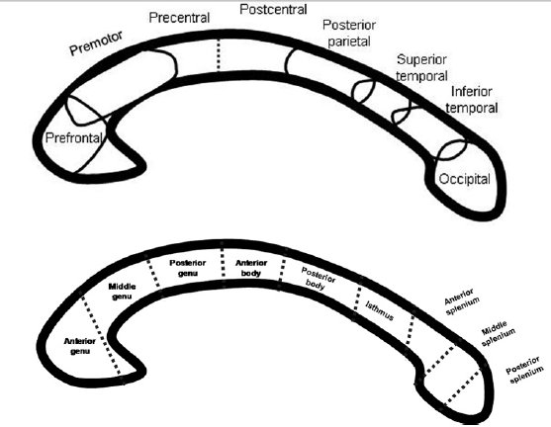
CALLOSAL DISCONNECTION SYNDROMES
Verbal disconnection syndrome
Motor disconnection syndrome

Slide 38
POSTERIOR CEREBRAL ARTERY SYNDROME
The clinical picture of PCA territory infarction varies according to the site of occlusion and the availability of collaterals.
Occlusion of the precommunal P1 segment causes midbrain, thalamic, and hemispheric infarction.

Slide 39
For convenience of exposition, it is helpful to divide the posterior cerebral artery syndromes into three groups:
(1) anterior and proximal (involving interpeduncular, thalamic perforant, and thalamogeniculate branches),
(2) cortical (inferior temporal and medial occipital)
(3) bilateral.

Slide 40
THALAMIC SYNDROMES
The main thalamic blood supply originates from the posterior communicating arteries and the perimesencephalic segment of the PCA.
Thalamic infarctions typically involve one of the four major vascular regions : posterolateral, anterior, paramedian, and dorsal .
Posterolateral thalamic infarctions result from occlusion of the thalamogeniculate branches arising from the P2 segment of the PCA.
Three common clinical syndromes may occur: pure sensory stroke, sensorimotor stroke, and the thalamic syndrome of Dejerine-Roussy.

Slide 41
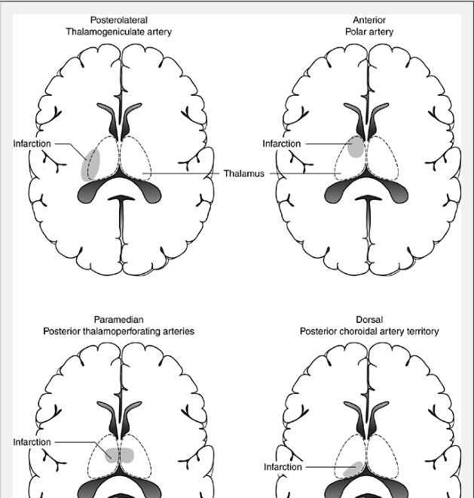

Slide 42
In the latter syndrome, the patient has contralateral sensory loss to all modalities, severe dysesthesias of the involved side
(thalamic pain), vasomotor disturbances, transient contralateral hemiparesis, and choreoathetoid or ballistic movements.
Anterior thalamic infarction results form occlusion of the polar or tuberothalamic artery.
The main clinical manifestations consist of neuropsychological disturbances such as abulia, apathy, disorientation, lack of insight and personality changes, contralateral emotional-facial paresis, occasional hemiparesis, and visual field deficits.

Slide 43
Left-sided infarcts are associated with dysphasia; selective impairment in semantic memory may be seen, whereas hemineglect and alien hand syndrome may be seen primarily in patients with right-sided lesions.
Paramedian thalamic infarctions result from occlusion of the paramedian or thalamic and subthalamic arteries (thalamoperforating pedicle). The main clinical manifestations include somnolence or transient loss of consciousness, memory loss or mood disturbances, and vertical gaze abnormalities.

Slide 44
Paramedian thalamic infarcts may also produce abnormal sleep and body core temperature abnormalities ; and bilateral eyelid tremor on voluntary eyelid closure.
Paramedian thalamic infarcts may be unilateral or bilateral, and often result from an embolic occlusion of the basilar apex, causing a disconnection between the thalamus and the frontal lobes.

Slide 45
Dorsal thalamic infarctions result from occlusion of the posterior choroidal arteries. These infarctions are characterized by the presence of homonymous quadrantanopia or homonymous horizontal sectoranopias.
There may also be an asymmetric optokinetic response and hemibody (face and arm) hypesthesia. Involvement of the pulvinar may account for thalamic aphasia.

Slide 46
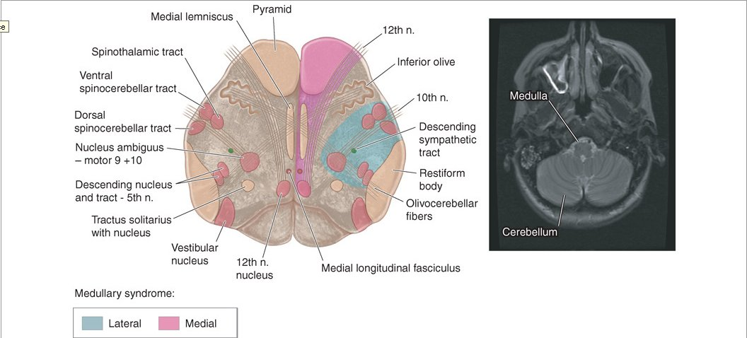
BRAINSTEM SYNDROMES : MEDULLA

Slide 47
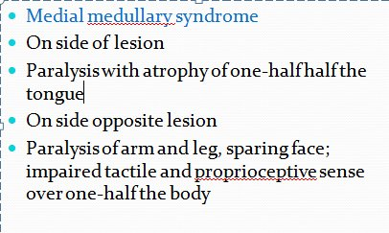
Lateral medullary syndrome
On side of lesion
Pain, numbness, impaired sensation over one-half the face
Ataxia of limbs, falling to side of lesion:
Nystagmus, diplopia, oscillopsia, vertigo, nausea, vomiting
Horner's syndrome
Dysphagia, hoarseness, paral
Loss of taste
Numbness of ipsilateral arm, trunk, or leg
Weakness of lower face
On side opposite lesion
Impaired pain and thermal sense over half the body, sometimes face

Slide 48
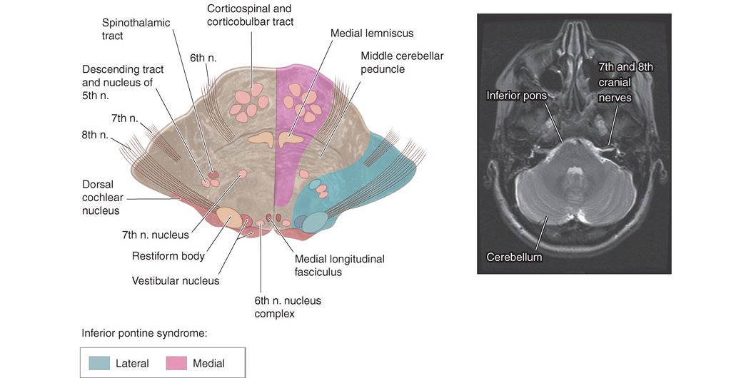
INFERIOR PONTINE
MEDIAL : On side of lesion
Paralysis of conjugate gaze to side of lesion
Nystagmus Ataxia of limbs and gait
Diplopia on lateral gaze
On side opposite lesion
Paralysis of face, arm, and leg:
Impaired tactile and proprioceptive sense over one-half of the body
LATERAL :
On side of lesion
Horizontal and vertical nystagmus, vertigo, nausea, vomiting, oscillopsia,Facial paralysis
Paralysis of conjugate gaze to side of lesion
Deafness, tinnitus
Ataxia
Impaired sensation over face
On side opposite lesion
Impaired pain and thermal sense over one-half the body (may include face)

Slide 49
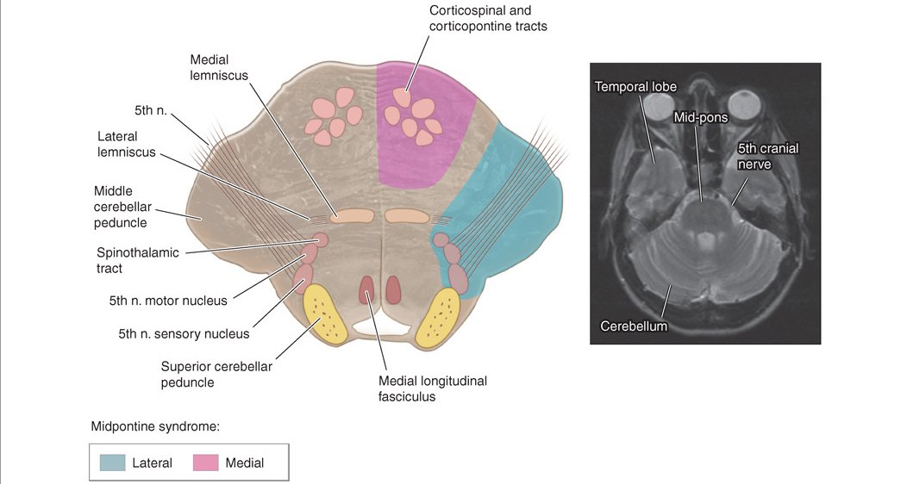
MID PONTINE
Medial : On side of lesion
Ataxia of limbs and gait
On side opposite lesion
Paralysis of face, arm, and leg
Variable impaired touch and proprioception when lesion extends posteriorly
Lateral : On side of lesion
Ataxia of limbs
Paralysis of muscles of mastication
Impaired sensation over side of face
On side opposite lesion
Impaired pain and thermal sense on limbs and trunk

Slide 50
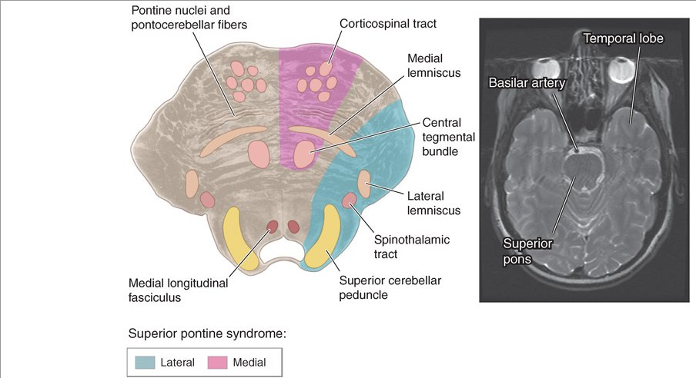
SUPERIOR PONTINE
Medial On side of lesion
Cerebellar ataxia
Internuclear ophthalmoplegia
Myoclonic syndrome
On side opposite lesion
Paralysis of face, arm, and leg
Rarely touch, vibration, and position are affected
Lateral On side of lesion
Ataxia of limbs and gait
Dizziness, nausea, vomiting; horizontal nystagmus
Paresis of conjugate gaze (ipsilateral)
Skew deviation,tremor
Miosis, ptosis, decreased sweating over face
On side opposite lesion
Impaired pain and thermal sense on face, limbs, and trunk:
Impaired touch, vibration, and position sense, more in leg than arm

Slide 51
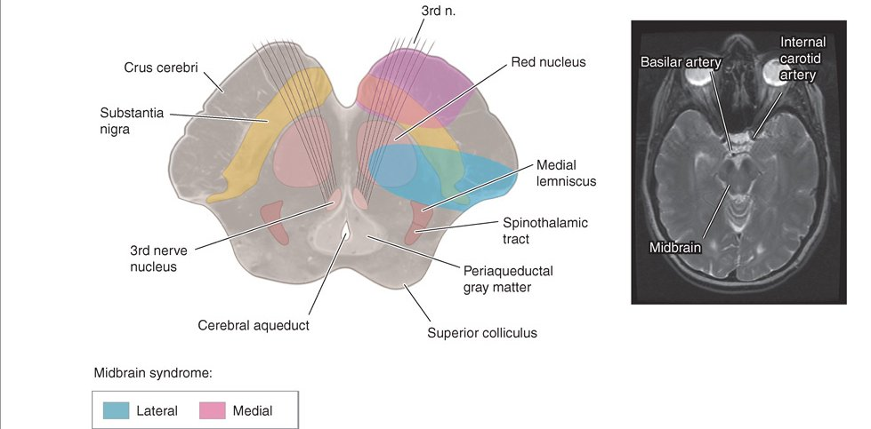
MID BRAIN
Medial On side of lesion
Eye "down and out" secondary to unopposed action of fourth and sixth cranial nerves, with dilated and unresponsive pupil: Third nerve fibers
On side opposite lesion
Paralysis of face, arm, and leg: Corticobulbar and corticospinal tract descending in crus cerebri
Lateral midbrain syndrome
On side of lesion
Eye "down and out" secondary to unopposed action of fourth and sixth cranial nerves, with dilated and unresponsive pupil: Third nerve fibers and/or third nerve nucleus
On side opposite lesion
Hemiataxia, hyperkinesias, tremor: Red nucleus, dentatorubrothalamic pathway

Slide 52
BASILAR BRANCH OCCLUSION
The main signs of occlusion of the superior cerebellar artery are ipsilateral cerebellar ataxia of the limbs
nausea and vomiting; slurred speech;
and loss of pain and thermal sensation over the opposite side of the body (spinothalamic tract).
Partial deafness, static tremor of the ipsilateral upper extremity, an ipsilateral Horner syndrome, and palatal myoclonus have also been reported.

Slide 53
The main signs of AICA occlusion are vertigo, vomiting, nystagmus, tinnitus and sometimes unilateral deafness; facial weakness;
Ipsilateral cerebellar ataxia
An ipsilateral Horner syndrome and paresis of conjugate lateral gaze; and contralateral loss of pain and temperature sense of the arm, trunk, and leg (lateral spinothalamic tract).

Slide 54
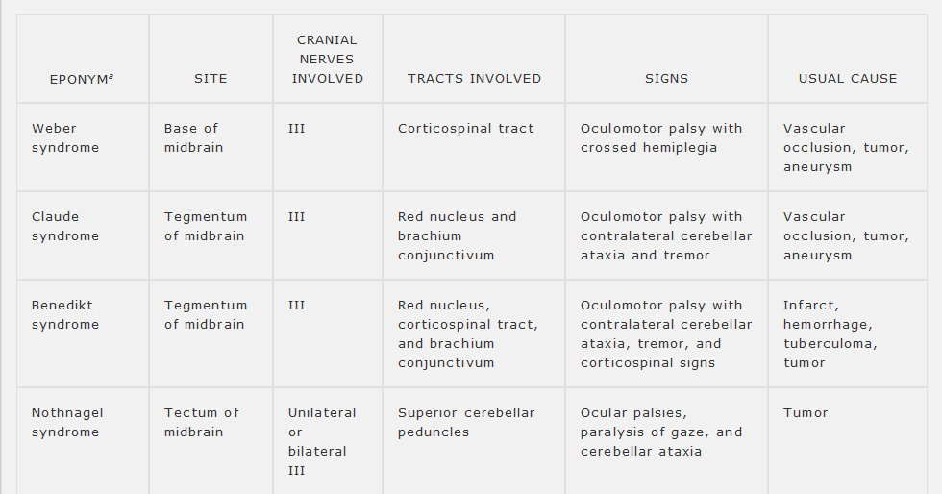
NAMED STROKE SYNDROMES

Slide 55
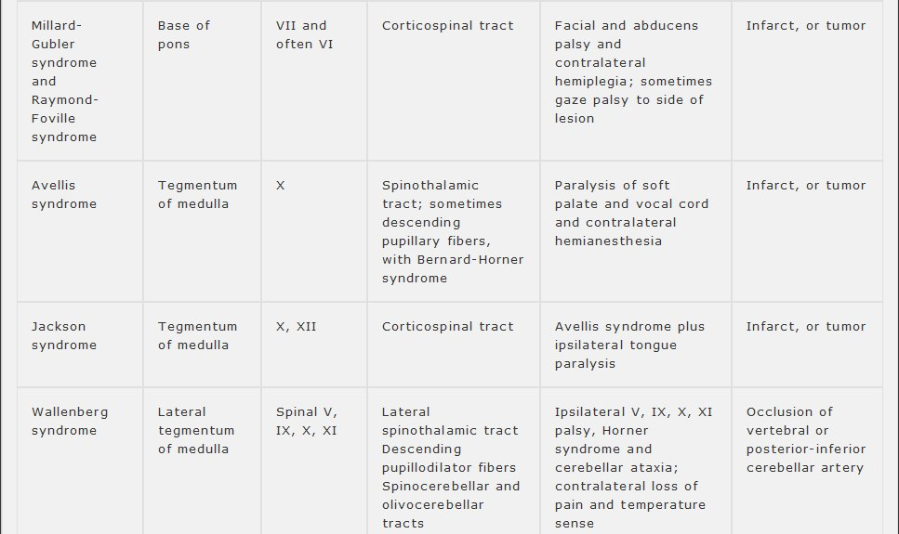

Slide 56

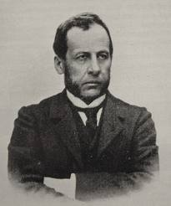
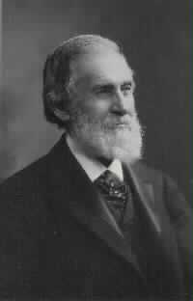
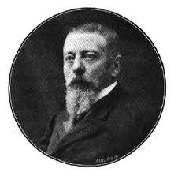
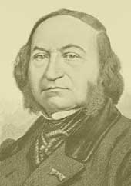
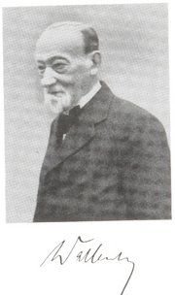
NEUROLOGISTS WITH NAMED SYNROMES

Slide 57
CORTICAL SYNDROMES
Posterior cortical infarcts of the dominant hemisphere cause alexia (with or without agraphia), anomia, a variety of visual agnosias, and rarely some degree of impaired memory.
The anomias are most severe for colors, but the naming of other visually presented material such as pictures, musical notes, mathematical symbols, and manipulable objects may also be impaired.
The defect in retentive memory is of varying severity and may or may not improve with the passage of time.

Slide 58
BILATERAL CORTICAL
These occur as a result of successive infarctions or from a single Embolic or thrombotic occlusion of the upper basilar artery, especially if the posterior communicating arteries are unusually small.
Bilateral lesions of the occipital lobes, if extensive, cause total cortical blindness sometimes accompanied by unformed visual hallucinations.
The pupillary reflexes are preserved, and the optic discs appear normal. (Anton syndrome)

Slide 59
The Balint syndrome is another effect of bilateral occipitoparietal border-zone lesions.
In bilateral lesions confined to the occipital poles, there may be a loss of central vision only (homonymous central scotomas).
With more anteriorly placed lesions of the occipital pole, there may be homonymous paracentral scotomas, or the occipital poles may be spared, leaving the patient with only central vision.

Slide 60
BORDER ZONE SYNDROMES
During or after cardiac surgery or after an episode of severe hypotension, ischemia may occur in the border zone or watershed areas between the major circulations.
Border zone ischemia is often explained by the combination of two frequently interrelated processes: hypoperfusion and embolization
Border zone ischemia may result in several characteristic syndromes

Slide 61
1.
Ischemia in the border zone territory of all three major arterial systems (anterior, middle, and PCA) may result in bilateral parieto-occipital lesions.
Patients develop bilateral lower altitudinal visual field defects; difficulty in judging size, distance, and movement; and disorders of smooth ocular pursuit. cortical blindness may also occur.
2. Ischemia between the anterior and middle cerebral arteries (bilateral) may result in bibrachial cortical sensorimotor impairment, initially affecting whole limbs but later confined to the hands and forearms. Also, there may be a disturbance of volitional saccadic eye movements due to frontal eye field involvement.

Slide 62
3. Ischemia of the border zone territory between the middle and PCA may result in bilateral parietotemporal lesions. Initially, there is cortical blindness that rapidly improves but leaves a marked dyslexia, dyscalculia, dysgraphia, and memory defect for verbal and nonverbal material.

Slide 63
U/L WATER SHED INFARCTS
Unilateral watershed infarcts may occur during episodes of systemic hypotension when there is preexisting ipsilateral vascular disease causing focal hypoperfusion in the most distal territory .
Syncope at onset and focal limb shaking are frequent and suggest acutely lowered cerebral perfusion.
Most patients have ICA occlusion or tight stenosis with a hemodynamically significant cardiopathy, increased hematocrit, or acute hypotension.
In a review of 51 patients with symptomatic unilateral watershed infarcts ,three types were noted:

Slide 64
Watershed infarcts in the border zone between the superficial territories of the middle and anterior cerebral arteries (anterior watershed infarct) were seen in 22 patients
Watershed infarcts in the border zone between the superficial territories of the middle and the PCA (posterior WS infarcts) were noted in 20 patients.
Watershed infarcts in the border zone between the superficial and deep territories of the MCA (subcortical watershed infarcts) occurred in nine patients.

Slide 65
LACUNAR INFARCTS
Fisher and Adams state that lacunes are always due to occlusion of small arteries, 50 to 200 mm in diameter
Fisher has delineated the more frequent symptomatic forms:
Pure motor hemiplegia
Pure sensory stroke
Clumsy hand dysarthria
Ipsilateral hemiparesis ataxia

Slide 66
PURE MOTOR SYNDROME
Pure motor hemiparesis or pure motor stroke is often due to an internal capsule, corona radiata, or basis pontis lacune and is characterized by a unilateral motor deficit (hemiparesis or hemiplegia) involving the face, arm, and, to a lesser extent, the leg, accompanied by mild dysarthria, particularly at the onset of stroke.
Patients may have a series of preceding TIAs (capsular warning syndrome).

Slide 67
Pure sensory stroke, also known as pure paresthetic stroke or pure hemisensory stroke, is often due to a lacune involving the ventroposterolateral nucleus of the thalamus. It is characterized by numbness, paresthesias, and a unilateral hemisensory deficit involving the face, arm, trunk, and leg.
Ataxic hemiparesis is often due to a lacune affecting either the contralateral posterior limb of the internal capsule or the contralateral basis pontis

Slide 68
This syndrome has also been described with contralateral thalamocapsular lesions, lesions of the contralateral red nucleus, lesions of the corona radiata, lentiform nucleus, with superior cerebellar artery territory infarcts, and with superficial ACA territory infarcts in the paracentral area.
Dysarthria clumsy hand syndrome is often due to a lacune involving the depth of the basis pontis between its upper third and lower two-thirds and is characterized by supranuclear facial weakness, deviation of the protruded tongue, dysarthria, dysphagia, loss of fine motor control of the hand, and an extensor plantar response.

Slide 69
ICH SYNDROMES
Putaminal
Lobar
Thalamic
Cerebellar
Pontine

Slide 70
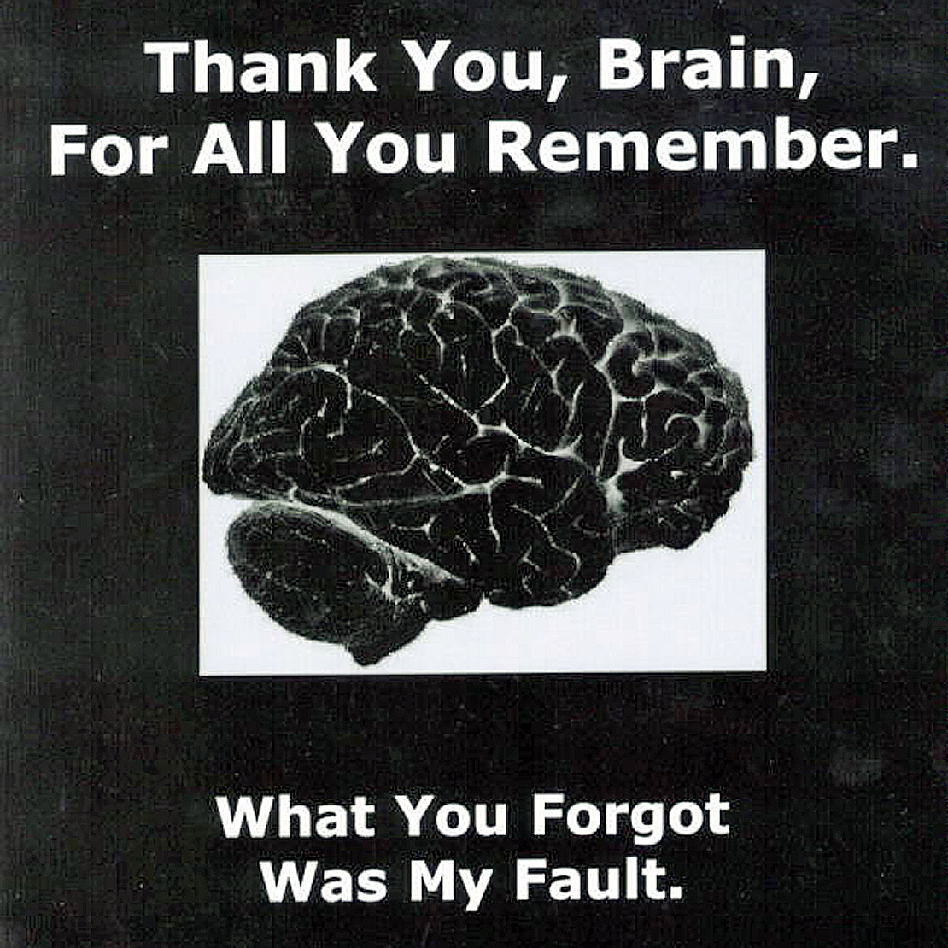

Slide 71
MCQ’S
1.Oculolmotor palsy with cerebellar ataxia with corticospinal involvement :
A) Benedikt’s
B) Claude
C) Parinaud
D) Weber

Slide 72
2. Motor alien hand syndrome pertains to strokes involving:
A)Thalamus
B)Corpus callosum
C)Centrum semi ovale
D)Brain stem

Slide 73
3. Splenium of corpus callosum is supplied by
A) Anterior choroidal artery
B) ACA
C) MCA
D) PCA

