Slide 1
Tremor

Slide 2
Definition: Tremor
  Movement of a body part
  Involuntary (even PMD)
  Rhythmical
    Regularly recurrent
  Oscillatory
    Around central plane

Slide 3
TREMOR
Arise during voluntary contraction of skeletal muscle
Action
Kinetic
-intention
Postural
Rest
Parkinsonian
Drug induced
Limb fully relaxed

Slide 4
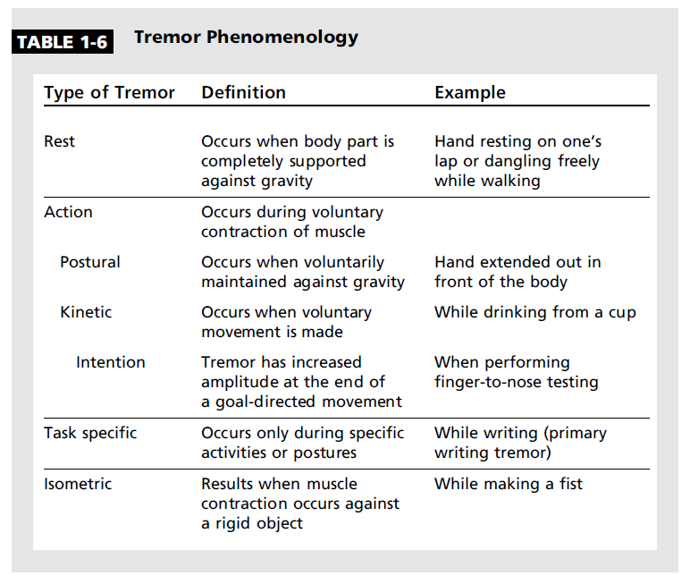
Continuum 2010 Movement Disorders

Slide 5
Action
Most Common:
  Essential tremor
  Enhanced physiological tremor
  Drug-Induced action tremor
  Dystonic
Less Common:
  Orthostatic
  Cerebellar
  Psychogenic
  Wilsonian
  FXTAS
  Peripheral neuropathy-related
  Midbrain or rubral

Slide 6
Essential Tremor
Most common adult-onset movement disorder
5% general population
Genetics: AD, variable penetrance, no gene found (polygenic)
Central generator: thought to represent cerebellar-thalamo-cortical outflow pathology
Kinetic and postural, mainly arms; 4-12Hz
Progressive
  Arms→head (“yes-yes” vs. “no-no”)
  Voice / vocal cord, chin, tongue
Unilateral → bilateral
Rare in LE’s
No parkinsonian or dystonic features.

Slide 7
Diagnostic Criteria
Core
  Bilateral action tremor of the hand and forearms
  Absence of other neurologic signs
    Caveat: cogwheeling*
  May have isolated head tremor with no signs of dystonia
Secondary / Supportive
  Long duration (3 yrs)
  + family Hx
  Beneficial response to ETOH
    50-90% of cases, but careful for rebound phenomenon
Notes:
* See next slide

Slide 8
Treatment of ET
General principals
  Treat only if bothersome
  The longer the tremor has been there the more difficult Tx will be
  Limb tremor responds much better than head/neck to oral Rx
Non-pharmacologic
  Biofeedback
  Weighted objects (e.g., utensils)
  Only dampens it temporarily, not viable long term treatment option
Pharmacologic
  2 P’s ; alone or in combo. Is there concurrent HTN?
    Primidone, propranolol (Inderal)
  Others: benzodiazepenes, gapapentin anecdotal use but not class A evidence (see table in appendix)
  Botox
    Voice, head
DBS (not lesional)
    ViM of VL of thalamus in refractory cases
Notes:
90% improvement with ventralis intermedius stimulation
a/e to surgery <1% in expert centers

Slide 9
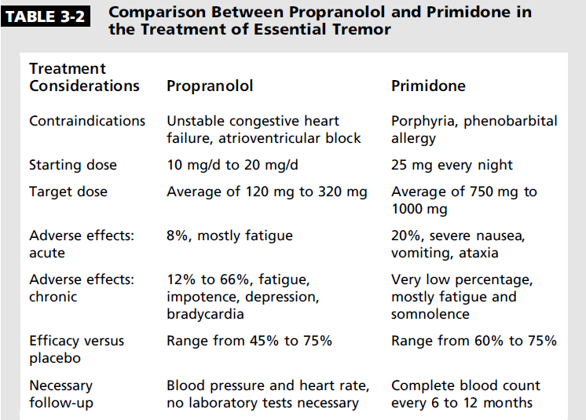
2 P’s
*
Notes:
Caution for hypotension, bradycardia in elderly → falls
A/E → impotence, drowsiness, confusion, h/a. Exercise intolerence
= be careful in COPD / ASTHMA and DB on oral hypoglycemics → BB can mask hypoglycemic episodes!
patients don’t develop tolerence to BB
Primidone→ patient’s eventually habituate to the s/e

Slide 10
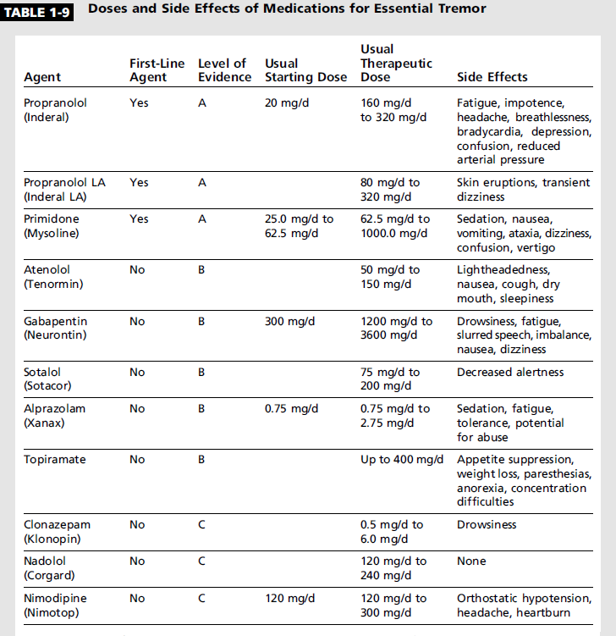

Slide 11
Enhanced Physiologic Tremor (EPT)
Appears to be peripherally generated (not central like ET)
  Based on inertial loading electrophysiological analysis
Faster postural and kinetic tremor than ET (7-12Hz); very low amplitude.
Very easily visible
15-35 yo
Anxious phenotype
Mainly voice and limb
  No head
  May have some cogwheeling, no frank rigidity
Endogenous & exogenous (see next slide) causes
Tx
  Reversible
  Reassurance
  Low dose beta-blockers, bzdp
Notes:
Endogenous = hyperT4, hypoglycemia

Slide 12
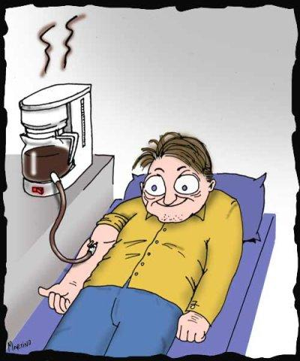
Drug Induced Action Tremor (EPT)
Based on history
  Temporal onset
  Sympathomimetics++ (ß-adrenergic bronchodilators)
    caffeine, nicotene
    SSRI, Li, valproate, roids!
  Withdrawal relieves symptoms
  Limb, never head
Treatment
  Remove causative agent
  Bb or bzdp can dampen tremor if causative Rx absolutely necessary
Notes:
neuroleptics, lithium, corticosteroids, calcium channel blockers, ethanol, beta adrenergic agonists, valproic acid, theophylline, thyroid hormones, cardiac antiarrhythmics, nicotine, and tricyclic antidepressants

Slide 13
Dystonic Tremor
Tremulous muscle activity in patients with dystonia
Pulling or pain sensation in region affected (e.g., neck)
Limbs (UE>LE), head (neck) or both (limb precedes neck)
Voice: strangled speech, voice break
Postural or kinetic
Not rythmic, nor oscillatory, not around 1 axis
Exam may reveal tonic muscle activity in tremoulous or conta-tremulous limb
  Tremulousness is directional
  Spooning of hands, fatiguing, thumb flexion or other dystonic postures
  May have scarf hiding hypertrophied muscle (eg neck with toriticollis)
  Dystonic tremor may be reduced by antagonistic gestures geste antagonistique
Commonly misdiagnosed as ET
Pharma treatment: anti-dystonic agents (baclofen, artane), bzdp, bb, botox (torticollis, voice)
Surgical (refractory): selective denervation, DBS
Notes:
Dystonic tremor may be reduced by antagonistic gestures geste antagonistique),

Slide 14
Orthostatic Tremor
Rare
‘Unsteadiness’ when standing
  Avoid situations when have to stand still (at movies)
o/e
  Rapid 13-18hz, low amplitude tremor/rippling in calves only on standing
    Visible and palpable
  pseudodystonic
  Confirmed with EMG
Rx:
  Nothing evidence based
  Most common =Clonazepam, sinemet
Notes:
Tried inderal, primidone, gabapentin, phenytoin, cbz, ethosux, baclofen, diamox
Subtype of ET actually by some catagorization schemes

Slide 15
Cerebellar Tremor
Central cerebellar disorders (e.g.,SCA)
Kinetic with terminal worsening = intentional
May have postural component, but rest absent
In multiple planes
Slow, 3-5 hz
Presence of overshooting
  Other cerebellar signs (hypermetric saccades, dysarthria, scanning speech, ataxic gait, head titubation, dyssynergia)
Treatment
  DBS
http://www.youtube.com/watch?v=5eBwn22Bnio&feature=related
Notes:
thalamic

Slide 16

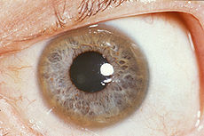
Wilson’s Disease associated Tremor
Can be action (rest, combination)
  Postural (possibly wing-beating)
  Kinetic (like ET)
Young (<40 yo)
Exam reveals multifocal and multisystemic disorder (long-tract, cognitive, neuro-psychiatric)
  Trivia: what are the genetics? Mode of transmission? On what layer of the cornea would you look to find KF rings?
Tx
  Chelation
    Penicillamine controversial
    Trientene
  Tetrathiomolybate
  Zinc once levels normalize
  Bb for action tremor
Notes:
AR
Gene = ATP7B gene on chromosome 13q
Layer of cornea = Descemet..
Striatal and generalized neuronal loss. Diffuse gliosis with Alzheimer’s types I and II astrocytes and Opalski’s cells (of microglial origin)
Tx:
Penicillamine-D; can cause drug induced lupus, myasthenic-like picture, subacute worsening prompting cessation...
Zinc
Less toxic = Trientin, ammonium tetrathiomolybdate
Liver translplant

Slide 17
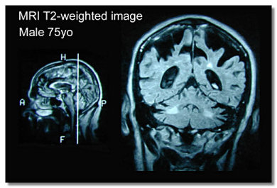
FXTAS (fragile X tremor ataxia syndrome)
Multiple complaints in addition to tremor
  Cerebellar or parkinsonian
  Cognition, dysexectuive function
Male family members (grandchildren) have MR
MR brain
  Classic picture
Tx: bb for action tremor
Notes:
intention tremor and/or ataxia, with peripheral neuropathy, autonomic dysfunction, and gradual cognitive decline beginning with memory and executive function deficits. Psychiatric features are often present, and may include anxiety, dysinhibition, depression, and apathy. MRI features of FXTAS include global brain atrophy, white matter disease in the subcortical, middle cerebellar peduncles (MCP) and periventricular regions

Slide 18
Peripheral neuropathy-related tremor
PN by history of same limb with tremor
  Intertial loading leads to suppression of tremor proving peripheral generator
  More common with demyelinating PN’s, also seen in HMSN1 (Levy-Roussy) and IgM dysgammaglobulinemic neuropathies
Temporal linkage
o/e
  Peripheral neuropathy readily apparent on tremulous limb
    Sensory impairment, weakness 4/5 MRC, altered DTR
  Tremor present when muscle strength allows limb to maintain certain postures
  Vanishes if weakness too severe or if limb power returns to normal
Tx:
  Underlying neuropathy
  BB for AT
  What do you think about DBS?
Notes:
By and large, they are relatively uncommon and generally consist of irregular postural or kinetic tremors of variable frequency from 4 to 11 Hz. Not all peripheral neuropathies have been identified with tremor, and most of them have been demyelinating and specifically dysgammaglobulinemic neuropathies (especially IgM disorders). Tremors have also been reported in type 1 hereditary motor and sensory neuropathies (Roussy-Levy syndrome). Tremors have also been reported with chronic inflammatory demyelinating polyneuropathies in the recovering phase of Guillain-Barré syndrome (Said et al 1982; Elbe 1983; Smith et al 1984; 1995).

Slide 19
Midbrain / Rubral / Holmes
Lesion based, central generator
Sudden onset focal neurological insult
  Progressive forms can occur (tumor or expanding vascular lesion)..some say this is typical even for stroke.
Strikingly unilat, HB or monomelic
Non-rythmic, <4.5 Hz, high amplitude
Rest, action (postural and kinetic)
  Severity: kinetic > postural > rest
Severe and disabling, limb entirely handicapped
Imaging confirms pontine-midbrain lesion affecting cerebellar outflow tracts and dopaminergic nigrostriatal fibers
Rx:
  AT primidone, bb
  Rest Levodopa, DA, Anti-chol
DBS (refratory)
YouTube:
rubral tremor.wmv
Notes:
Aka thalamic tremor, myorhythmia
A delay of up to 2 years between the lesion and tremor onset is typical

Slide 20
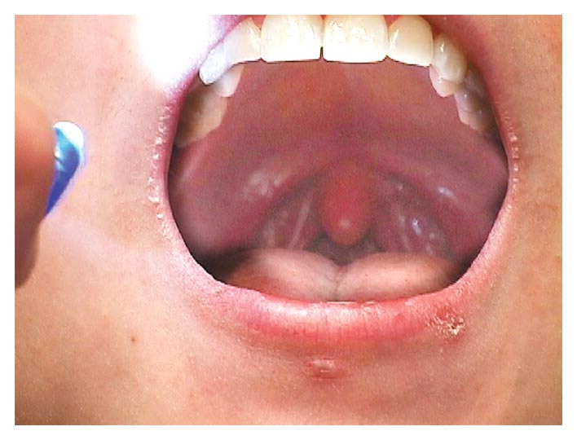
Palatal “myoclonus” – actually tremor
Essential vs. symptomatic
See Chenjie’s presentation, great comparative table
Notes:
Although it resembles a tremor, the movement is repetitive rather than oscillatory and involves contraction of agonist muscles only. The cause of the auditory ear click is unknown, but it occurs more commonly in essential palatal myoclonus, which is idiopathic, than in symptomatic palatal myoclonus that is secondary to a structural lesion in the brain stem.

Slide 21
Rest Tremor(s)
Most Common:
  Parkinsonian
  Drug-induced rest tremor
  ET (with rest component; rare…15-20%)
Less Common:
  Wilsonian
  Midbrain

Slide 22
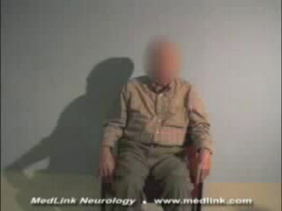
Critical Elements from Hx & Exam
History
  Rx?
  Change in arm swing, gait, facial expression?
  Previous CVA, dementia?
Exam
  Arms at rest (whole interview and dynamic exam)
  ‘pill-rolling’ quality
  Symmetry
  Limb or hemi-body
  Arm extension test
    Not true postural, rather emergent (with crescendo after several seconds)

Slide 23

Parkinsonian Tremor
Classically @ rest; 3-5 Hz
Often HB
If arm
  Pron-sup rather than flx-ext
  Check for limb “posturing” flexion/fist formation hand, thumb flexion
Re-emergent tremor during arm extension or during tasks (pouring water) causes considerable misdiagnosis with ET
  May be more disabling than rest tremor
Other hallmark-cardinal features
  Motor: asymmetric rigidity, bradykinesia, postural instability, fatiguing
  Non-motor: RBD, hyposmia, constipation, mood, sebborhea, ANS dysfunction (orthostasis, ED, etc.), excessive daytime sleepiness, RLS, body pain .......
  Aversion to caffeine...?
http://www.youtube.com/watch?v=gboQaXv9CuM&feature=related

Slide 24
PD tremor
DA 1st line
Levodopa
Anticholinergics (rare)
  Cogentin, artane, amantadine
Consider bzdp
Refractory DBS

Slide 25
Drug Induced
Temporal link with Rx
  Antipsychotics (typical>atypical), Li
Can look practically identical to Parkinsonian tremor
Removal of medication should result in complete resolution
Tx:
  Remove or diminish offending agent
  Levodopa (even if on Da blocking agents) or anticholinergics can be tried

Slide 26
Psychogenic Tremor (PMD)
History
Exam
Sudden, abrupt onset
  Link with psychological stressor
Maximal tremor at onset, rather than slowly progressive
Static course
Spontaneous remissions/cures
Psychiatric comorbidities
Somatisation
Entrainment, co-activation, distractibility and suggestibility (I will trigger your tremor..., or use magic tuning fork)
Give-way weakness
Non-physiological or unusual features
  Variable frequency or direction
  Unusual combined rest, postural, kinetic
  Changes speeds throughout exam
Fatigues with prolonged exam
Little response to pharmacotherapy
Intertial loading leads to tremor worsening
“la belle indifference”
Perceived disability out of proportion to exam findings
Notes:
Coactivation sign. This is observed when testing a trembling limb for rigidity and there is resistance to the passive movement. Two additional features should be present: 1) the tremor is dependent on there being an increase in tone (i.e. the examiner feels the patient “fighting” against him or her); and 2) the tremor disappears when the voluntary increase in tone disappears.

Slide 27
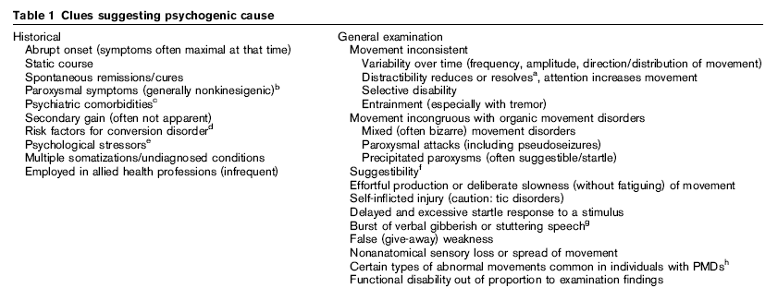
Psychogenic Movement Disorders (PMD)
  Gupta A, Lang AE. Psychogenic movement disorders. Curr Opin Neurol. 2009 Aug;22(4):430-6.

Slide 28
PMD
Not a diagnosis of exclusion
Enough qualifiers to be included on Ddx early on
Should be recognized and treated rapidly to avoid stigmatization, ‘crazy’ label
  CBT, neurologist (a movement disorder induced by internal stress), psychiatrist (somatization)

Slide 29
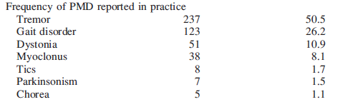
Frequency of PMD in clinical practice
%

Slide 30
Thanks!

