Slide 1
CARTILAGE
Dr. Hetal Vaishnani
Professor
Dept. of Anatomy
S.B.K.S.M.I. & R.C.

Slide 2
AN 71.2- Identify cartilage under the microscope & describe various types and structure- function correlation of the same

Slide 3
SPECIFIC LEARNING OBJECTIVES
Identify microscopic structure of different types of cartilage in prepared slide of histology (with H & E stain) under compound light microscope correctly.
Describe microscopic structure of different type of cartilage with diagram and examples.

Slide 4
General features
It is a specialized connective tissue
It is differ from all CT by presence of substances in the intercellular matrix that give firmness to it
Translucent, firm, and elastic
It can be compressible

Slide 5
General features
It consist of all 3 components of connective tissue
Ground substance
Fibers
Cells

Slide 6
Characteristic
Not supplied with blood vessels and nerves
Surround by a membrane called as perichondrium, which is rich in blood vessels.
Perichondrium absent in fibrous cartilage.

Slide 7
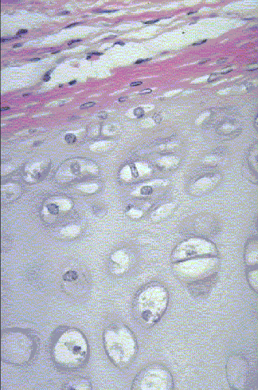
PERICHONDRIUM
Unsheathes the cartilage
Dense irregularly arranged connective tissue, outer layer(type I collagen)
Inner layer- cellular
Houses the blood vessels that nourish chondrocytes

Slide 8
CHONDROBLAST
Progenitor of chondrocytes
Lines border between perichondrium and matrix
Secretes type II collagen and other ECM components
Chondroblasts build

Slide 9
CHONDROCYTE
Mature cartilage cell
Reside in a space called the lacuna
Clear areas = Golgi and lipid droplets

Slide 10
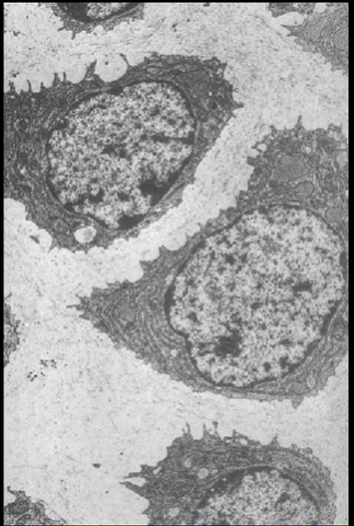
CHONDROCYTE
Chondrocytes completely fill their lacunae
RER and euchromatic nuclei
Synthetically active, secrete matrix
N
RER
Cartilage matrix
Notes:
?

Slide 11
MATRIX
Provides the rigidity, elasticity, & resilience
FIBERS
  Collagenous and elastic
Notes:
Territorial matrix surrounds lacuna (space in which chondrocyte lives)

Slide 12
MATRIX
GROUND SUBSTANCE
  Glycosaminoglycans (chondroitin sulfates, keratin sulfate, hyaluronic acid)
  Proteoglycans
  Water
Territorial matrix – newly formed matrix without fibers and is more basophilic
Interterritorial matrix- old matrix and is less basophilic
Notes:
Territorial matrix surrounds lacuna (space in which chondrocyte lives)

Slide 13
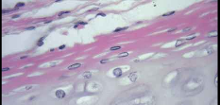
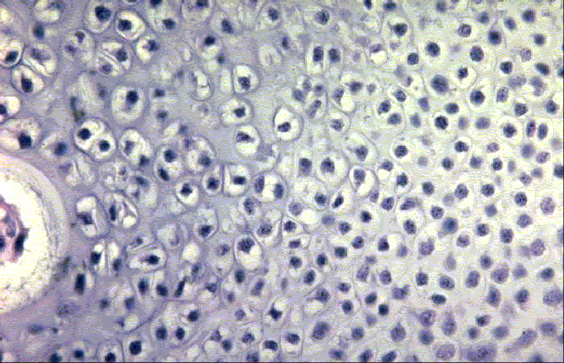
CARTILAGE GROWTH
Appositional
  Increasing in WIDTH; chondroblasts deposit matrix on surface of pre-existing cartilage
Interstitial
  Increasing in LENGTH; chondrocytes divide and secrete matrix from w/in lacunae

Slide 14
TYPES OF CARTILAGE
HYALINE
ELASTIC
FIBROUS

Slide 15
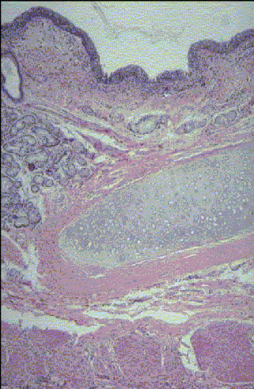
HYALINE CARTILAGE
Appearance White, resilient and glossy
FUNCTION
  Support tissue and organs
  Model for bone development
Notes:
Trachea

Slide 16
HYALINE CARTILAGE
Covered with perichondrium
MATRIX
  Type II collagen (thin fibrils)
  Chondroitin sulfate, keratin sulfate, hyaluronic acid
  Water
Notes:
Trachea

Slide 17
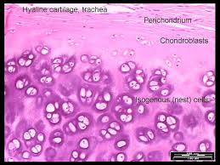
HYALINE CARTILAGE
Cells
Large, rounded encapsulated arranged in groups
Group of the cells are known as cell nests
Responsible for the synthesis of collagen fibers and ground substance

Slide 18
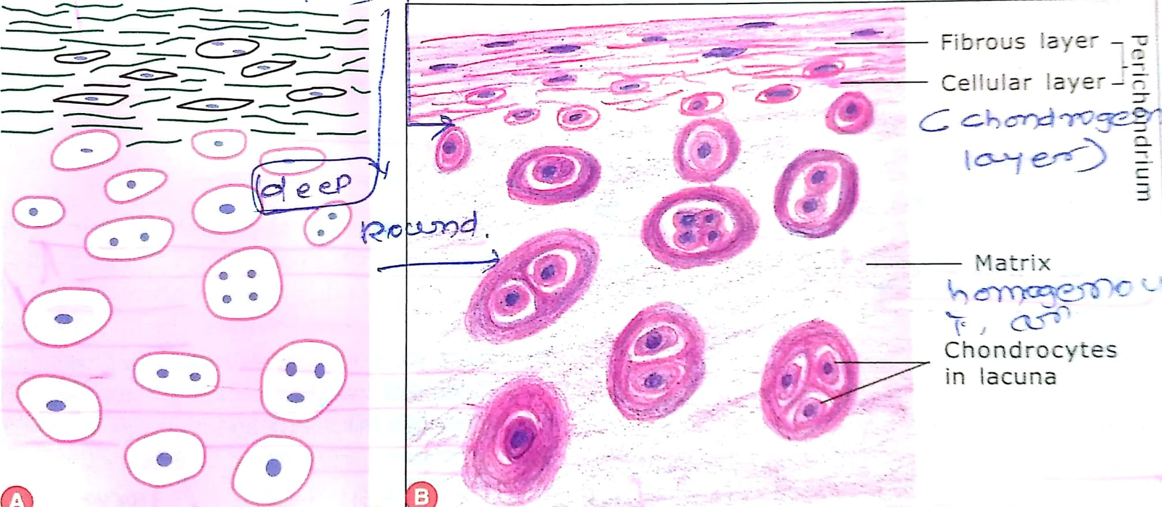

Slide 19
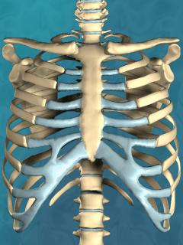
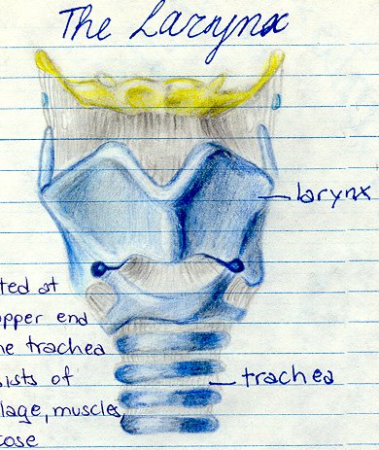
HYALINE CARTILAGE
Location
- Fetal skeleton
- Articular cartilage
- Costal cartilage
- Epiphyseal cartilage
- Cartilage of nose
- Trachea & Bronchi
- Larynx
* IN CAPABLE OF REPAIR
* FILLED WITH FIBROUS TISSUE

Slide 20
Hyaline cartilage

Slide 21
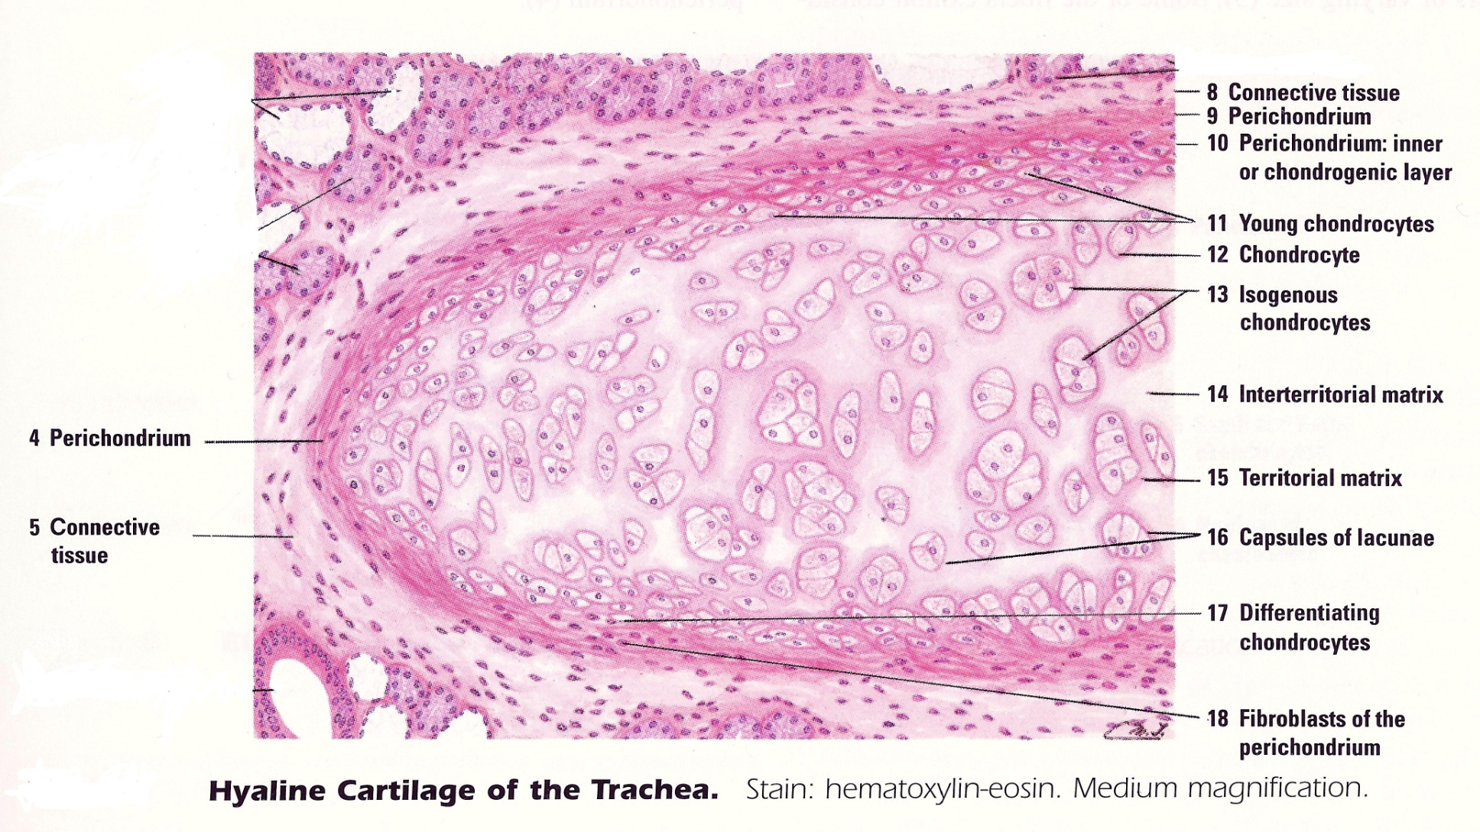
H

Slide 22
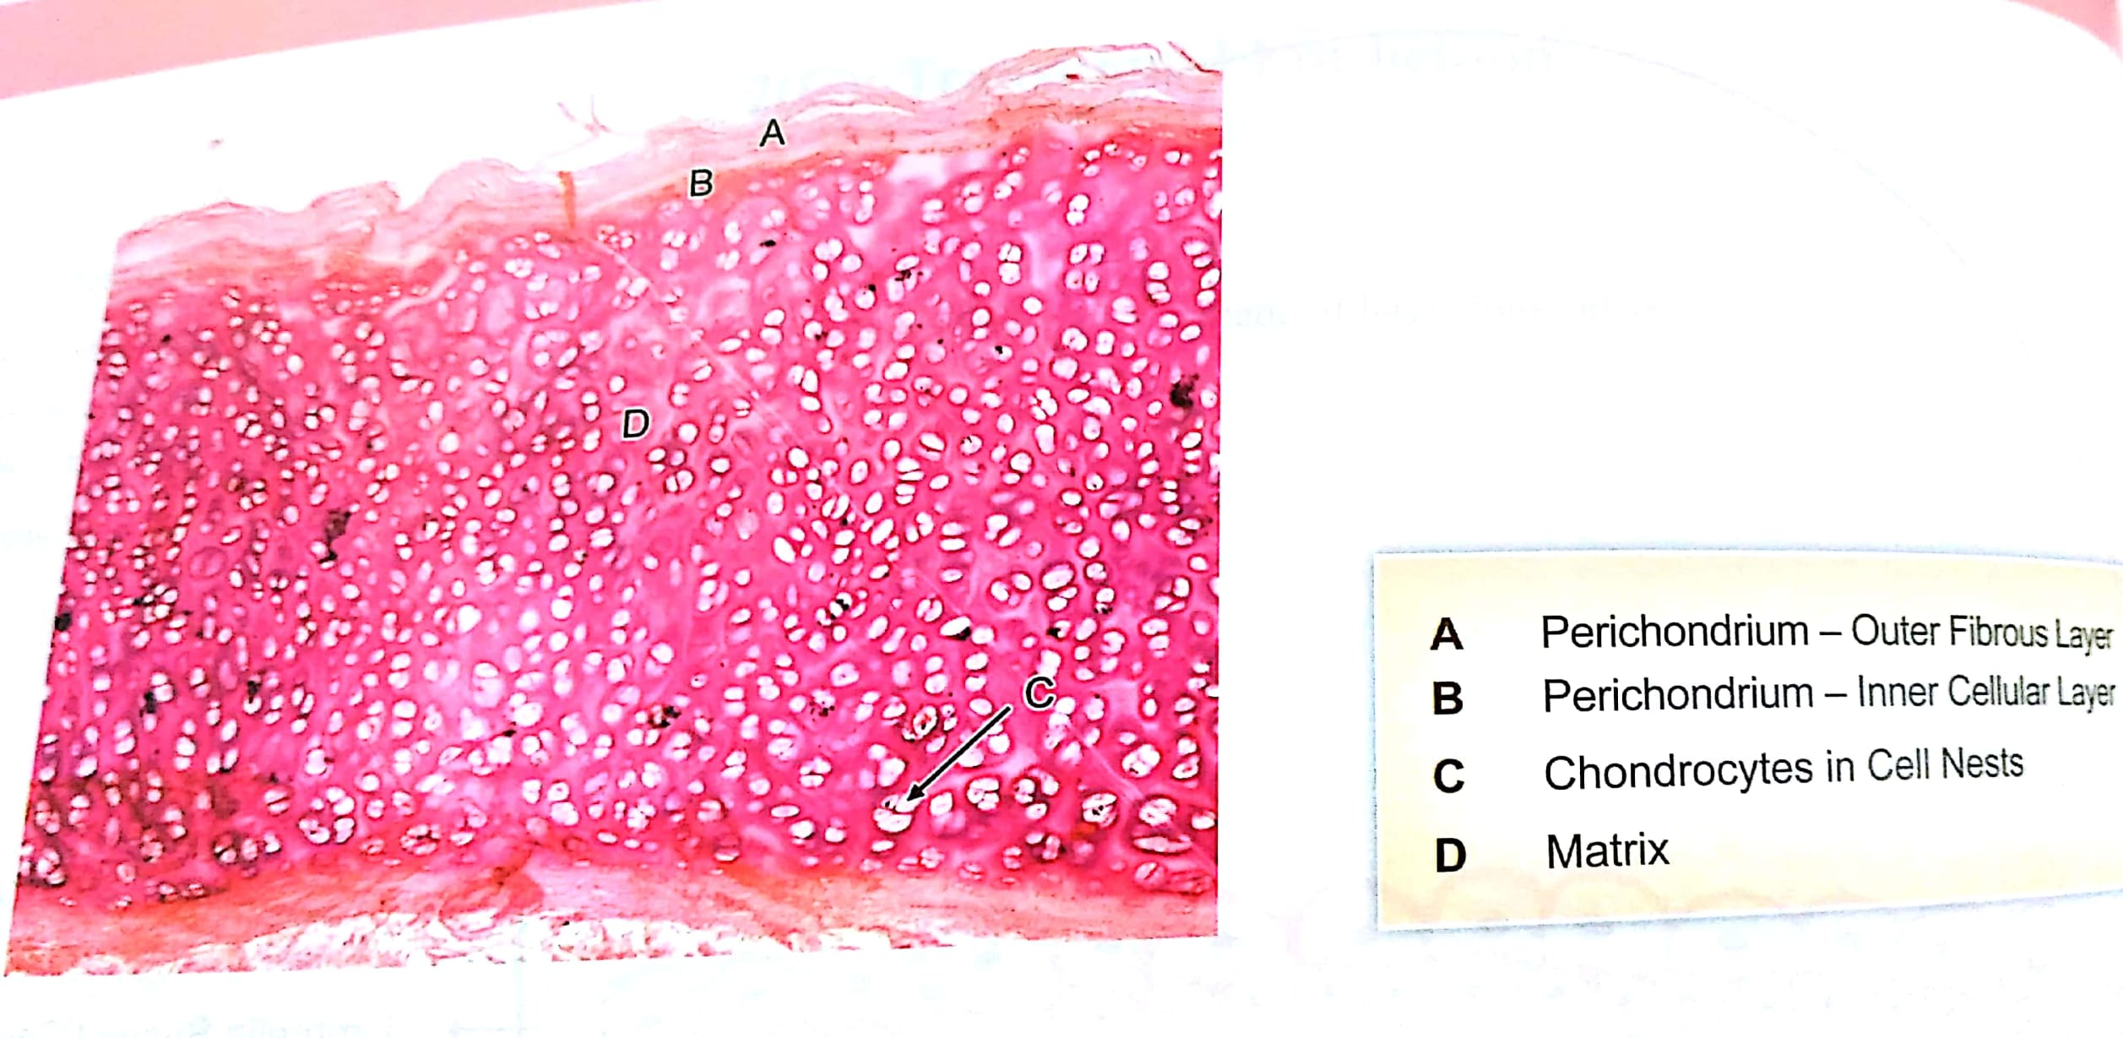

Slide 23
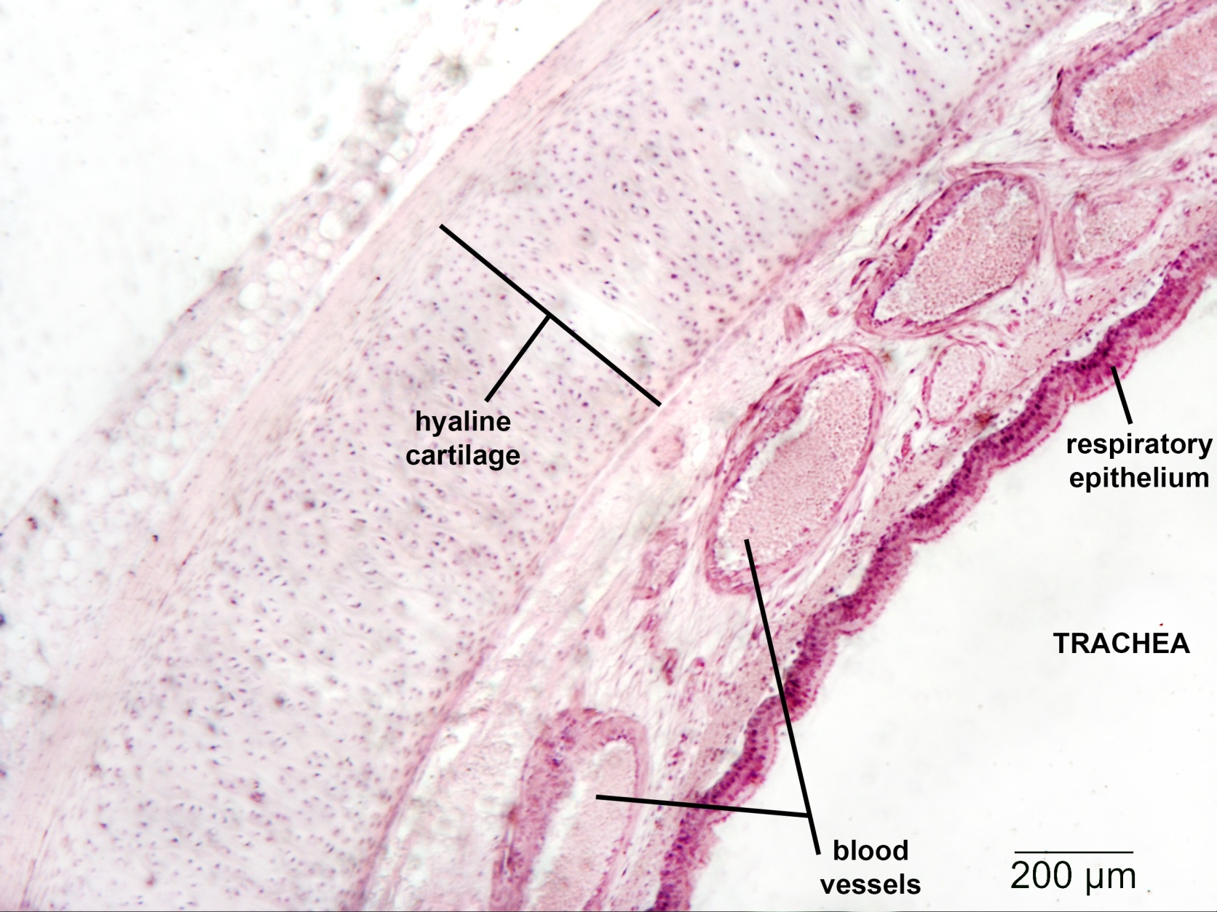

Slide 24
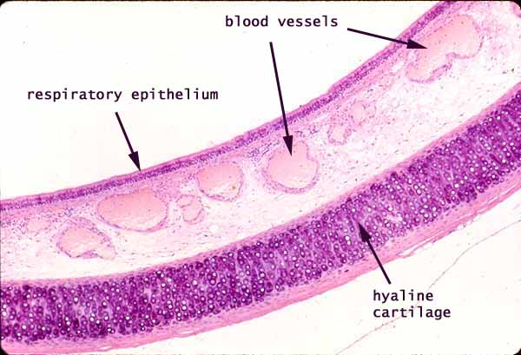

Slide 25
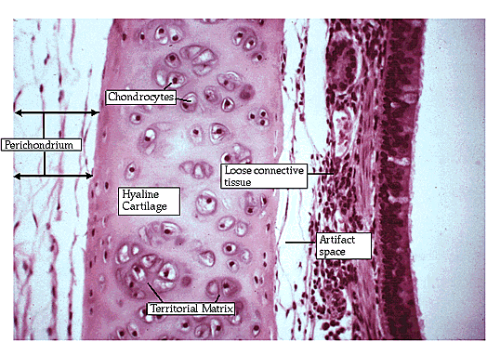

Slide 26
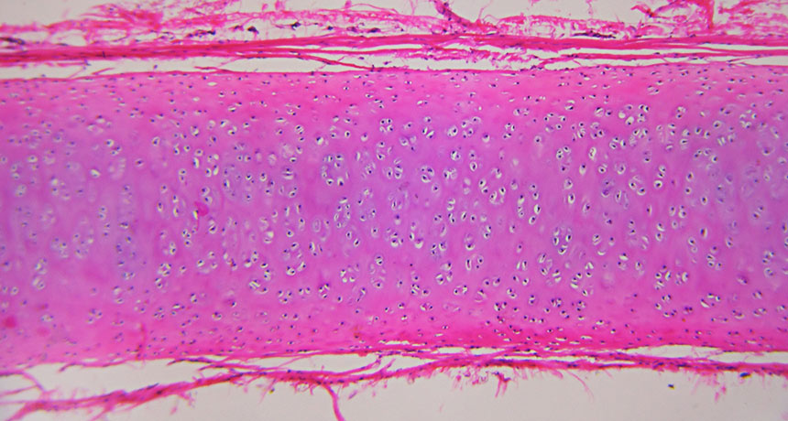

Slide 27
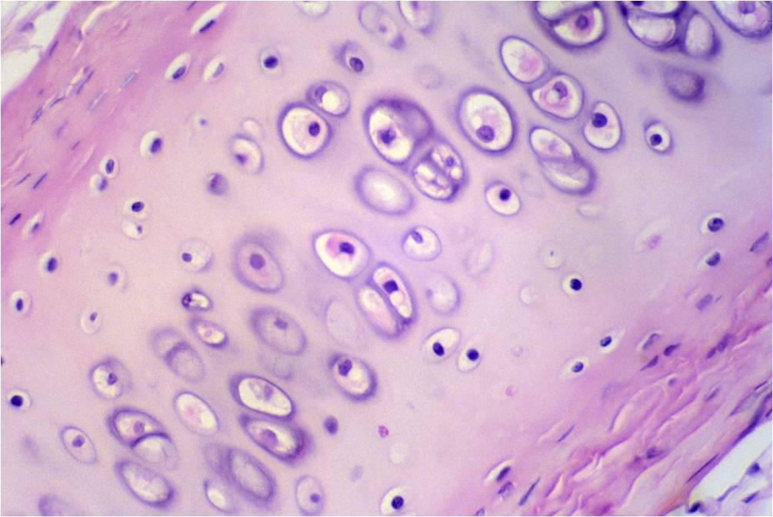

Slide 28
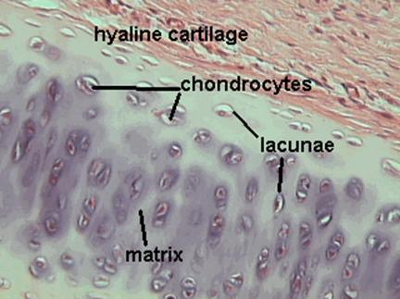

Slide 29
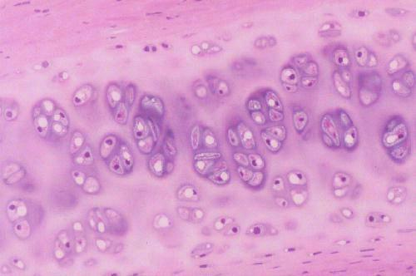

Slide 30
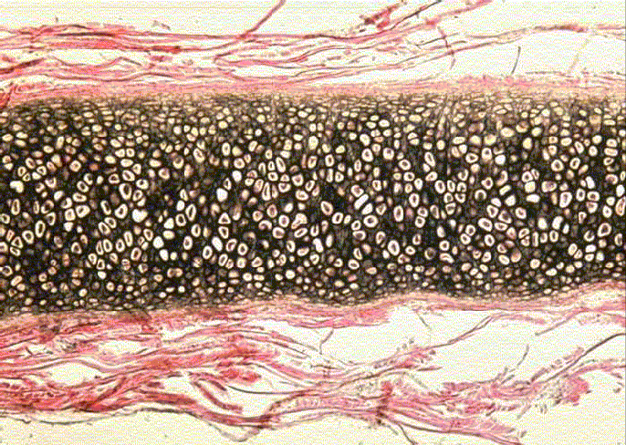
ELASTIC CARTILAGE
FUNCTION
  Provide shape and support to the organ with elasticity
MATRIX
  Contains a branching and anatomizing elastic fibers
  More in center than near to the perichondrium
  Also contain collagen type-II
perichondrium
Notes:
Ear

Slide 31
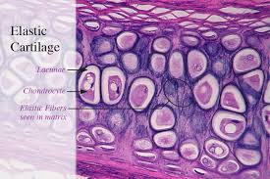
ELASTIC CARTILAGE
Cells
large
Present in lacuna
Present singly or in group of two
Closely packed
Intercellular ground substance is much less than in hyaline cartilage
perichondrium
Notes:
Ear

Slide 32
ELASTIC CARTILAGE
Location
Pinna of the ear
Epiglottis
External auditory meatus
Auditory tube
Tip of arytenoid
Cornuculate
Cuneiform
Notes:
Ear

Slide 33
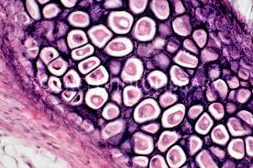
Elastic fibers

Slide 34
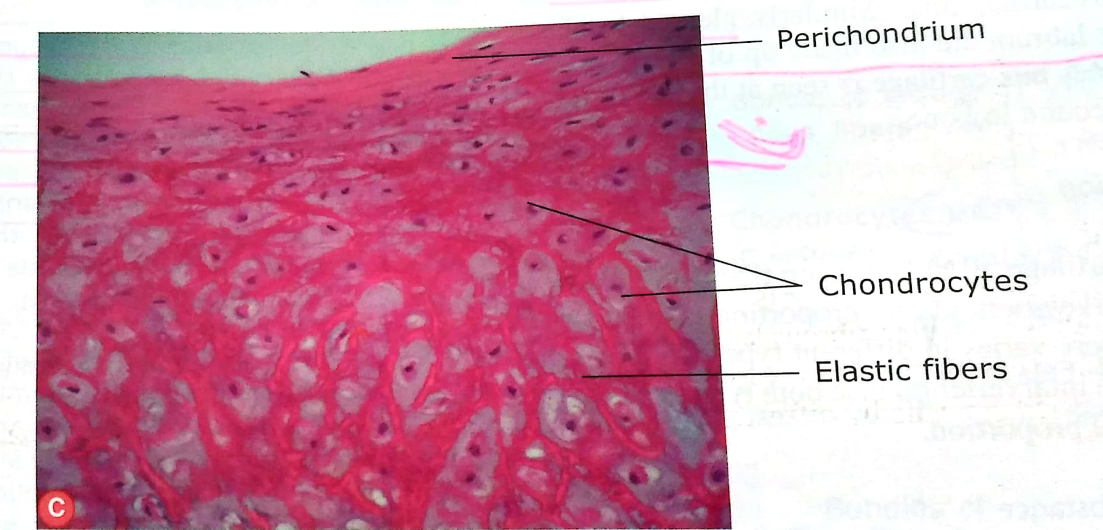

Slide 35
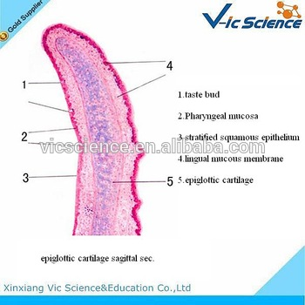

Slide 36
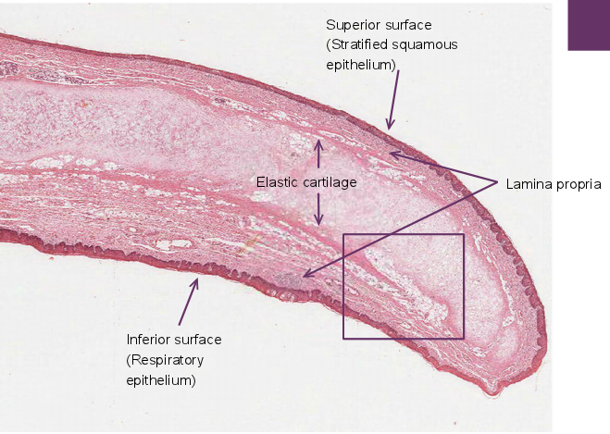

Slide 37
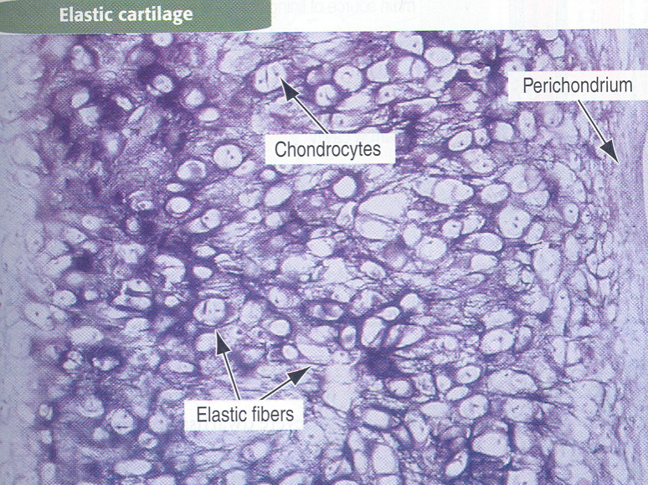

Slide 38
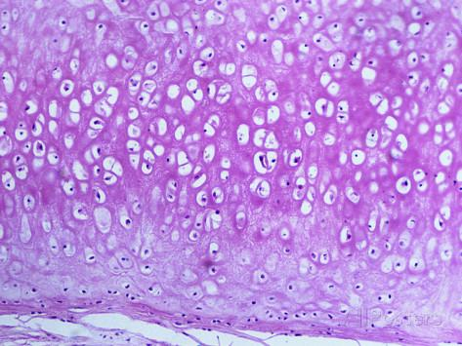

Slide 39


Slide 40
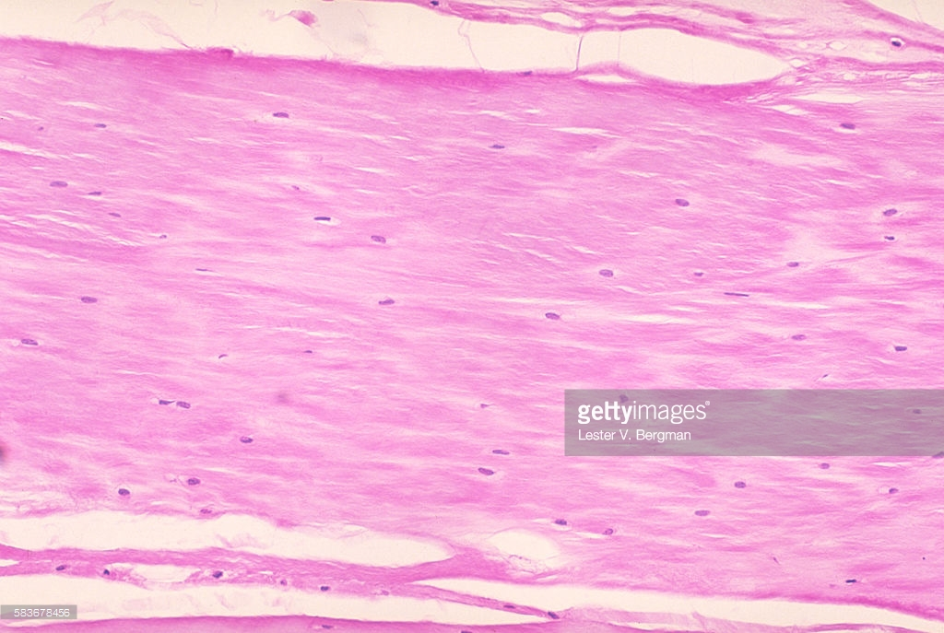
FIBROCARTILAGE
Perichondrium is absent
FUNCTION
  Support with great tensile strength
MATRIX
  Type I collagen
  Minimal amount of ground substance

Slide 41
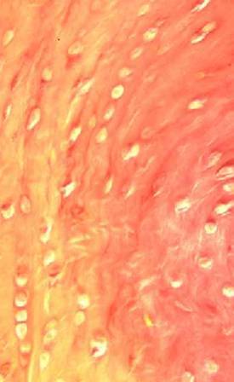
FIBROCARTILAGE
Cells
Chondrocytes align between collagen fibers
Collagen fibers lie parallel to lines of stress

Slide 42
FIBROCARTILAGE
Location
Intervertebral disc
Pubic symphysis
Menisci of knee
Articular disc
Glenoidal labrum
Acetabular labrum

Slide 43
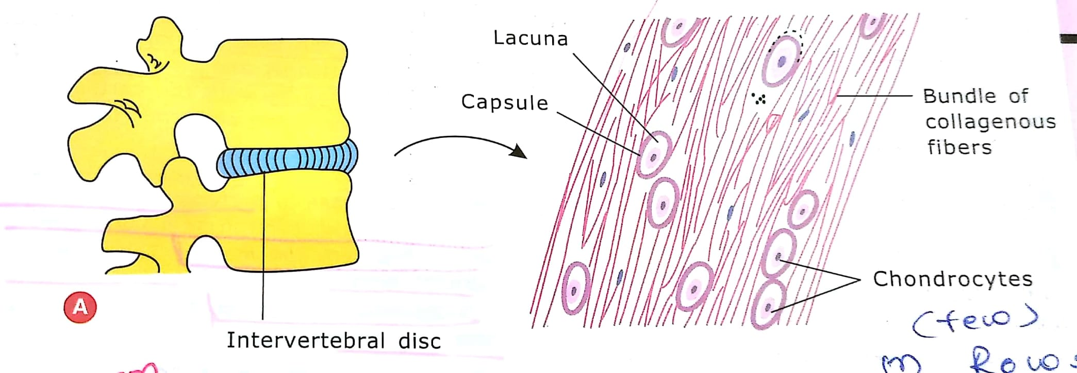

Slide 44
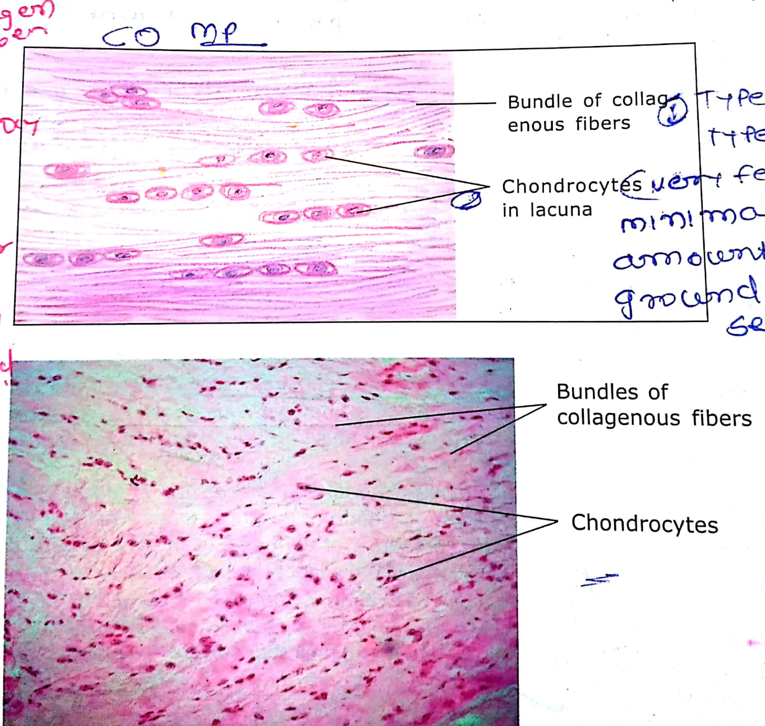

Slide 45
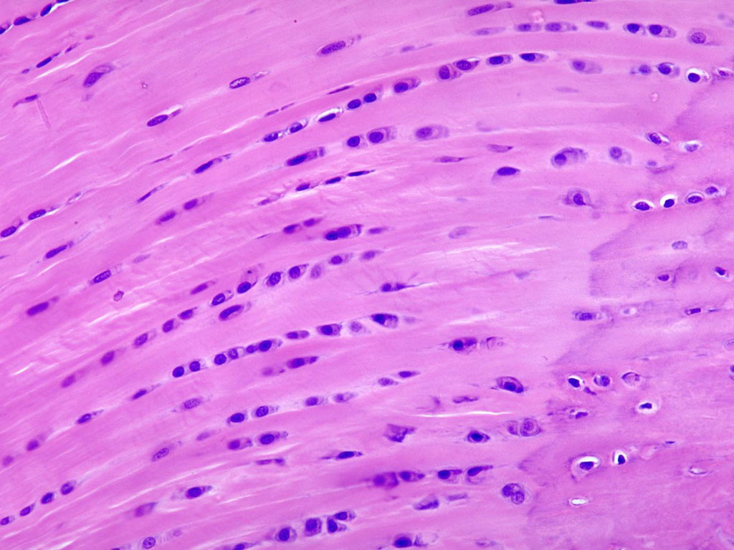

Slide 46
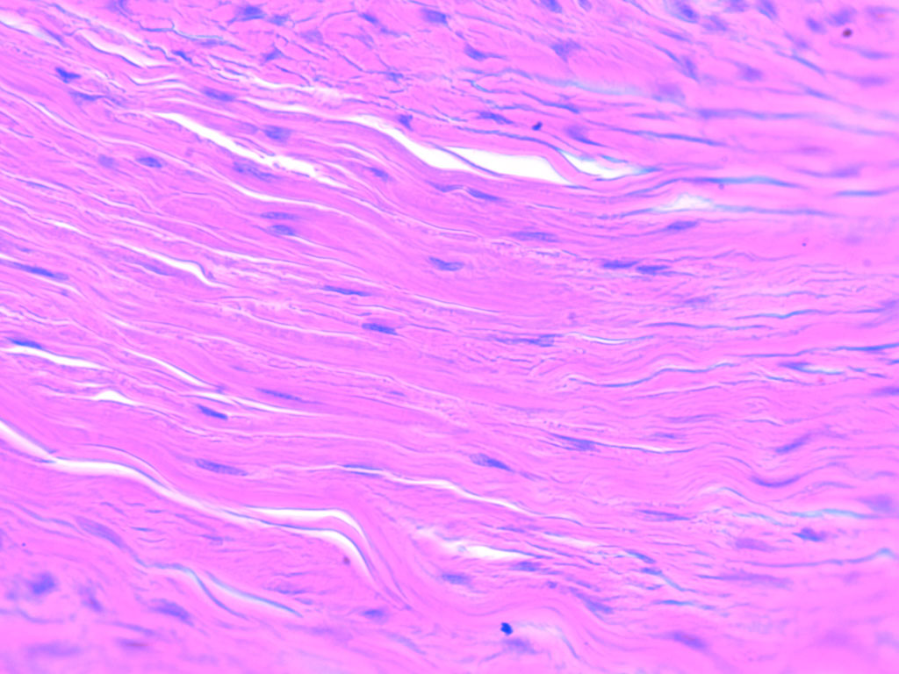

Slide 47
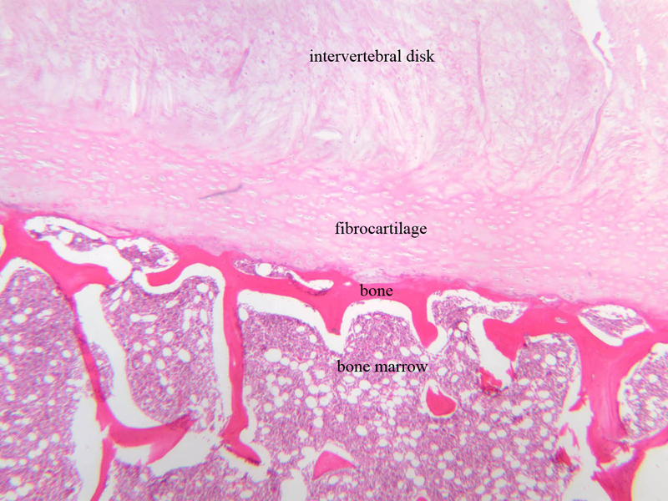

Slide 48
For practical in next week
Draw the hyaline and elastic cartilage in front of page no. 20
Draw the fibrocartilage in front of page no. 21

Slide 49
THANK YOU

Slide 50
In which cartilage cell nest is present?
Hyaline cartilage
Elastic cartilage
Fibrocartilage
None

Slide 51
2. Which cartilage is devoid of perichondrium?
Hyaline cartilage
Elastic cartilage
Fibrocartilage
None

Slide 52
3. Elastic cartilage is present in
Tracheal ring
Costal cartilage
Epiglottis
Menisci

Slide 53
4. Chondrocytes are
Derived from monocytes
Involved in phagocytosis
Polyhedral in shape
Found in lacunae

Slide 54
5. Identify
Hyaline cartilage
Elastic cartilage
Fibrocartilage
None

