Slide 1
Projection fibers
Dr. Kinjal Jethva
Professor
Department of anatomy
S.B.K.S.M.I. & R.C.

Slide 2
COMPETENCY
AN62.3 Describe Projection fibers and the white matter of cerebrum

Slide 3
PROJECTION FIBRES
They are ipsilateral
They are both corticofugal and corticopetal fibres
They are collectively called Corona Radiata and
intersect commissural fibres
When the fibres pass between diencephalon
and basal ganglia they are called Internal Capsule

Slide 4
CEREBRAL CORTEX
CORONA RADIATA
INTERNAL CAPSULE
CRUS CEREBRI
CORTICOPONTINE
CORTICOBULBAR
CORTICOSPINAL

Slide 5
INTERNAL CAPSULE
PARTS:
1. ANTERIOR LIMB
2. GENU
3. POSTERIOR LIMB
4. RETRO LENTIFORM
5. SUB LENTIFORM

Slide 6
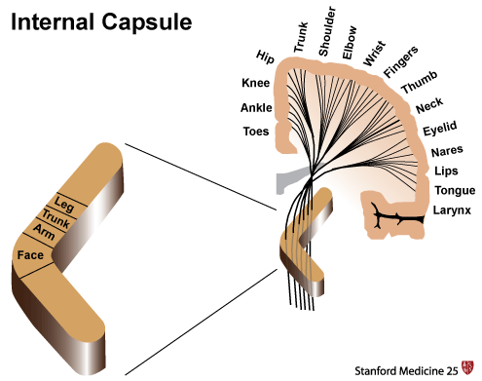

Slide 7
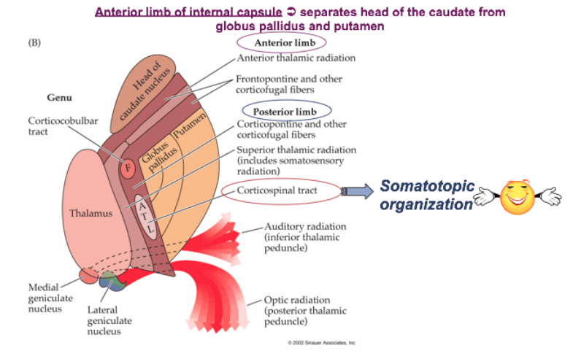

Slide 8
Anterior limb:
1. Frontopontine
2. Anterior thalamic radiation
Genu:
1. Corticonuclear fibres for head and neck
2. Anterior fibres superior thalamic radiation

Slide 9
Posterior limb:
1. Corticospinal
2. Frontopontine from area 4,6
3. Corticorubral
4. Superior thalamic radiation

Slide 10
Retro lentiform:
1. Parieto-pontine
2. Occipito-pontine
3. Occipito-collicular
4. Occipitotectal
5. Posterior thalamic radiation including
optic radiation area 17,18,19

Slide 11
Sub lentiform:
1. Temporo-pontine
2. Parieto-pontine
3. Inferior thalamic radiation including
acoustic radiation area 41,42.

Slide 12
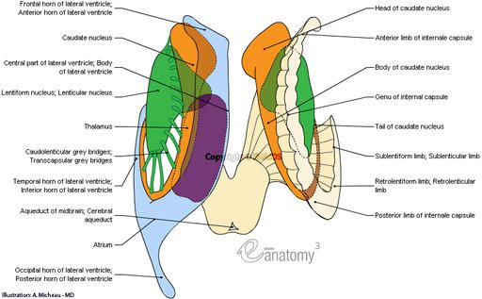

Slide 13
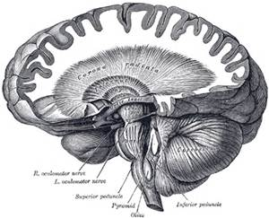

Slide 14
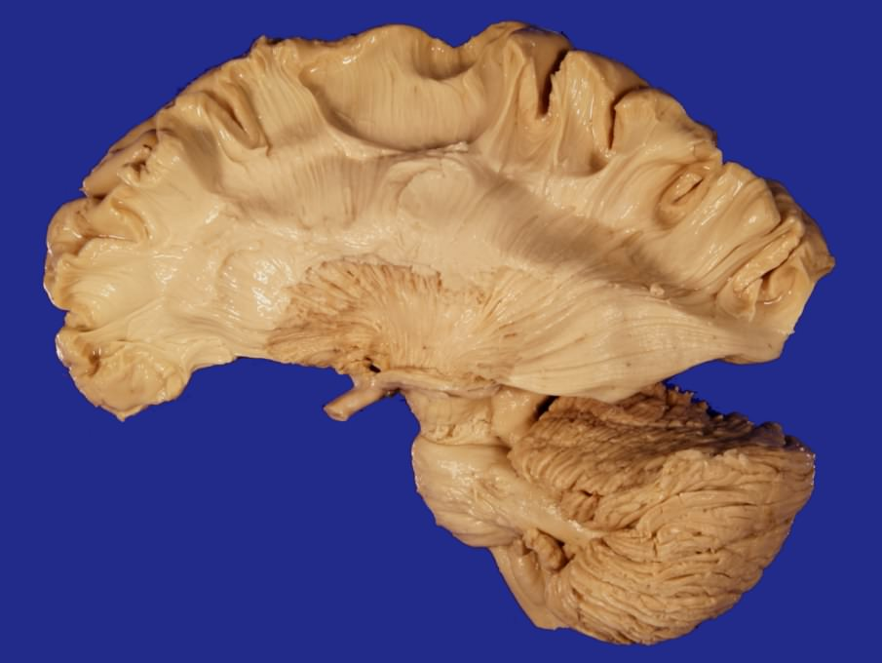

Slide 15
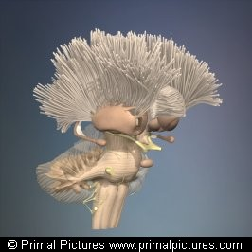

Slide 16
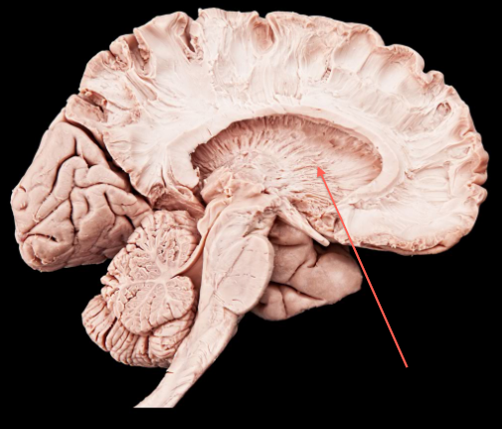

Slide 17
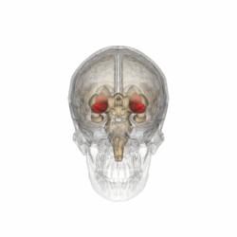

Slide 18
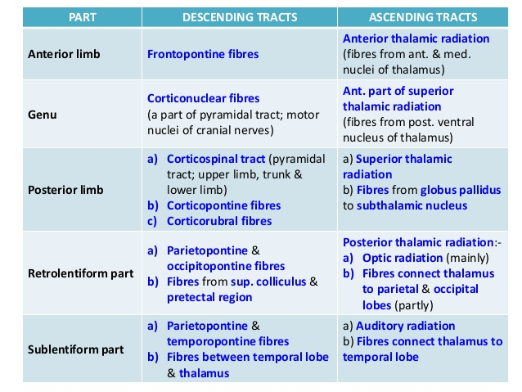

Slide 19
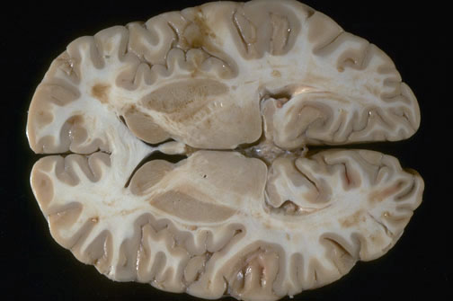

Slide 20
BLOOD SUPPLY INTERNAL CAPSULE
MEDIAL STRIATE
ANTERIOR LIMB
LATERAL STRIATE
GENU
INTERNAL CAROTID ARTERY
POSTERIOR LIMB
POSTERIOR
COMMUNICATING
ANTERIOR CHOROIDAL
SUB LENTIFORM
POSTERIOR
CEREBRAL
RETRO LENTIFORM

Slide 21
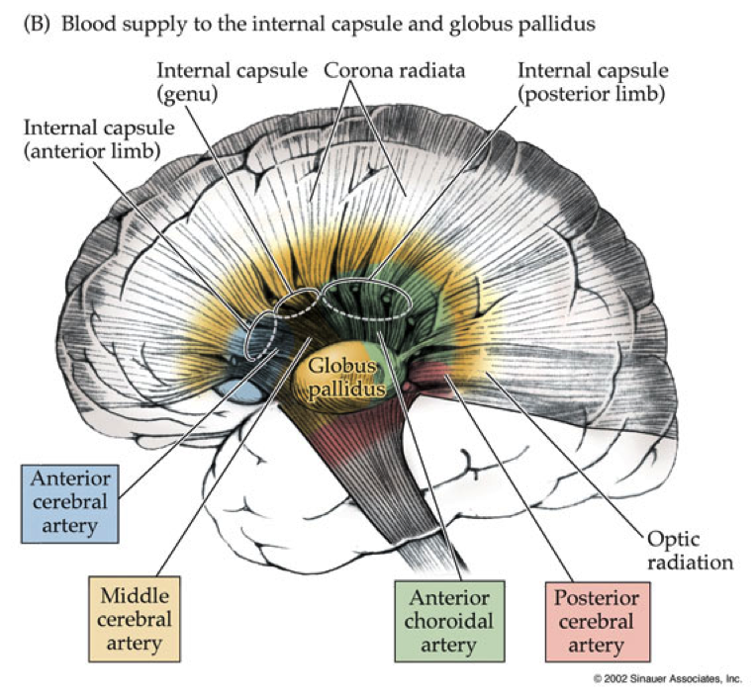

Slide 22
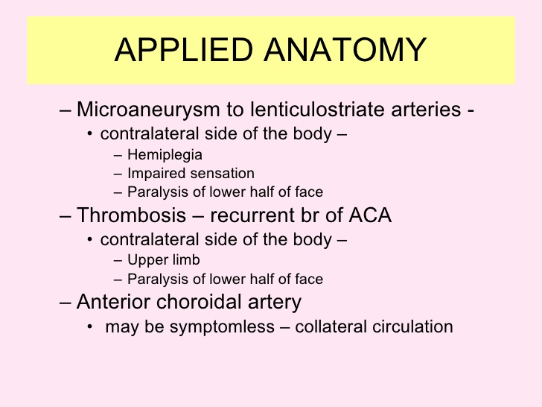

Slide 23
TITLE | AUTHOR / JOURNAL | MATERIAL | RESULT | CONCLUSION
Axonal Injury or Loss in the Internal Capsule and Motor Impairment in Multiple Sclerosis | Martin A. Lee, Andrew M. Blamire, Sarah Pendlebury, Arch Neurol. 2000;57(1):65-70. doi:10.1001/archneur.57.1.65 | performed magnetic resonance spectroscopy and T2-weighted imaging of the internal capsule, calculated central motor conduction times, and related these results to measures of motor function asymmetry in 12 patients with multiple sclerosis MS. | Levels of NAA from normal-appearing white matter of the internal capsule in patients with MS were significantly lower than those in control subjects (P = .05). Side-to-side differences in NAA levels were also significantly greater in patients with MS than in controls (P = .01). There was a correlation between asymmetry in motor function for the left and right limbs and asymmetry of internal capsule NAA concentrations (r = 0.60; P = .04) | demonstration of a graded association between NAA concentrations within primarily normal-appearing white matter of a specific tract and functional impairments referable to that tract suggests that axonal pathology distant from macroscopic lesions might be an important determinant of disability in MS.

Slide 24
MCQ
Q. 1 The motor fibres for head and neck run in ____ part of
internal capsule
Anterior limb
Posterior limb
Genu
Sub lentiform

Slide 25
MCQ
Q. 2 Retro lentiform part of internal capsule carries ____ fibres
Auditory
Motor
Visual
Nuclear

Slide 26
MCQ
Q. 3 Which structure is not related to anterior limb of
internal capsule
Caudate nucleus
Putamen
Globus pallidus
Thalamus

Slide 27
MCQ
Q. 4 Projection fibres are
Contralateral
Both ipsilateral and contralateral
Ipsilateral
None of the above

Slide 28
MCQ
Q. 5 The internal capsule continues as
Corona radiata
Crus cerebri
Cortico-thalamic radiation
Thalamo-cortical radiation

Slide 29
MCQ ANSWERS
Q. 1 c
Q. 2 c
Q. 3 d
Q. 4 c
Q. 5 b

