Slide 1
Muscles Of Mastication,Temporomandibular Joint, Pterygoid Venus Plexus
Dr. Arun
Professor
Department of anatomy
S.B.K.S.M.I. & R.C.

Slide 2
COMPETENCY
1.AN33.2 Describe & demonstrate attachments, direction of fibres, nerve supply and actions of muscles of mastication
2.AN33.3 Describe & demonstrate articulating surface, type & movements of temporomandibular joint
3.AN33.4 Explain the clinical significance of pterygoid venous plexus.
4.AN33.5 Describe the features of dislocation of temporomandibular joint

Slide 3
S L O
At the end of session phase 1 MBBS students should be able to
Describe the T-M joint a)type & articular surfacess.
b)Ligaments
c)Relations
d)Movements & muscles producing them.
e)Applied anatomy.

Slide 4
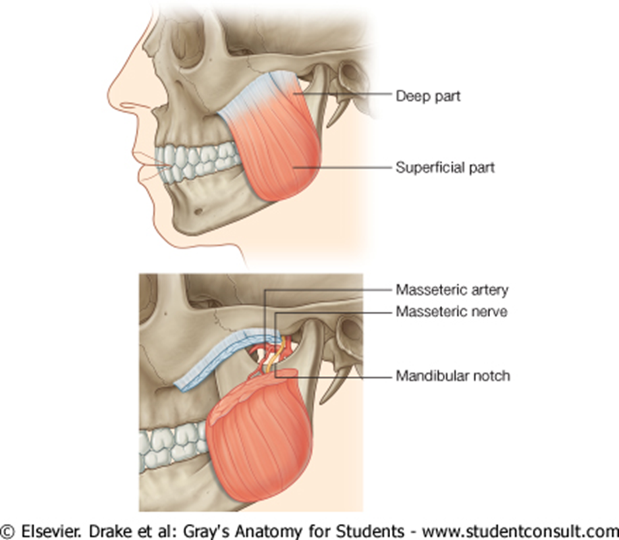
Muscles Of Mastication:1.Masseter

Slide 5
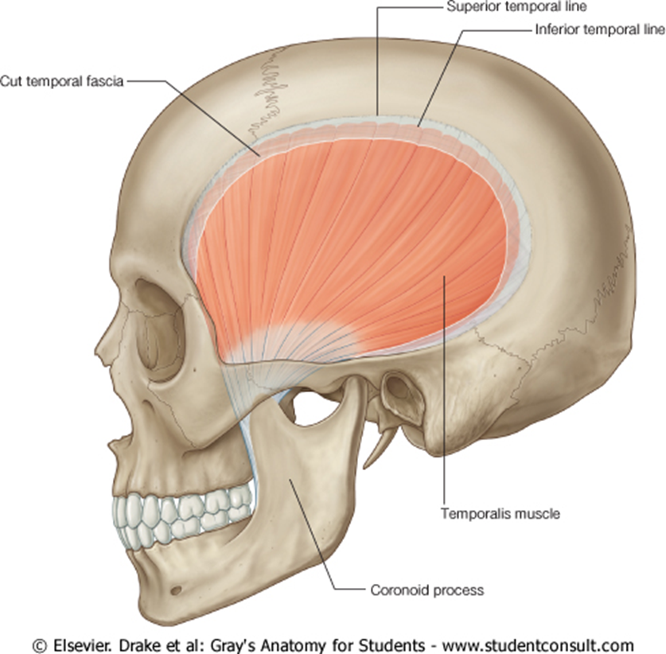
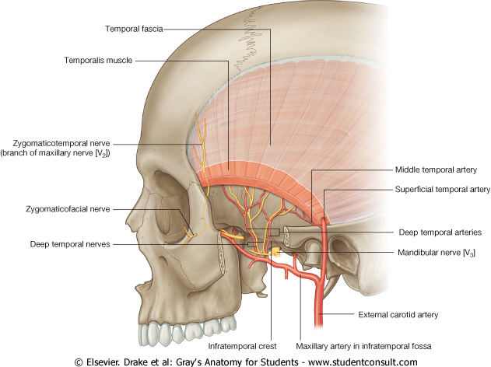
2.Temporalis:fan shaped

Slide 6
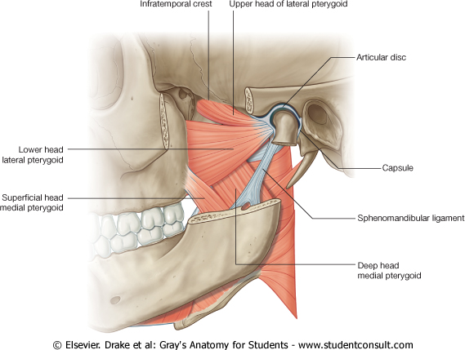
3.Lateral pterygoid & 4. medial perygoid

Slide 7
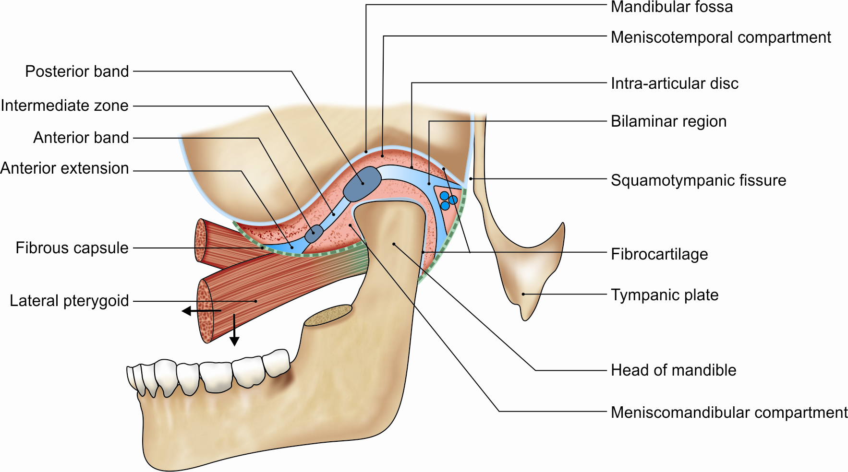
Type of Joint
This is a synovial joint of the condylar variety.

Slide 8
Articular Surfaces
upper articular surface (temporal bone: )
1. Articular tubercle
2. Anterior part of mandibular fossa.
3. Posterior non-articular part formed by the tympanic plate.
inferior articular surface-
the head of the mandible.

Slide 9
The articular surfaces are covered with fibrocartilage.
The joint cavity is divided into upper and lower parts by an intra-articular disc.

Slide 10
Articular surfaces of the left temporomandibular joint

Slide 11
Ligaments
1. The fibrous capsule
2. The lateral or temporomandibular ligament
3. The sphenomandibular ligament
4. The stylomandibular ligament

Slide 12
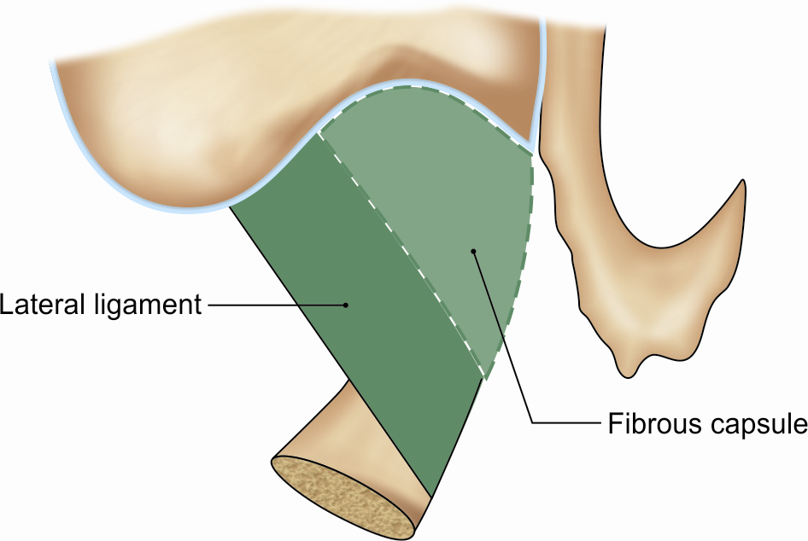
Fibrous capsule and lateral ligament of the temporomandibular joint

Slide 13
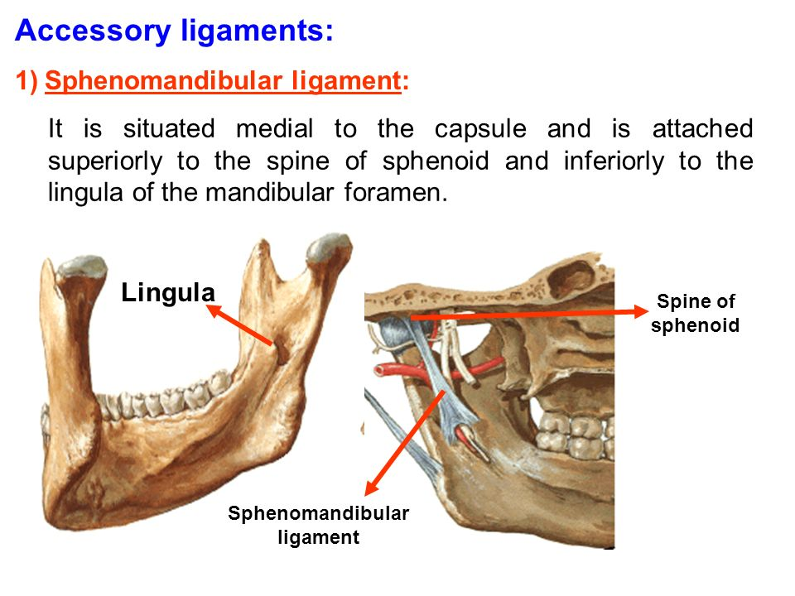

Slide 14
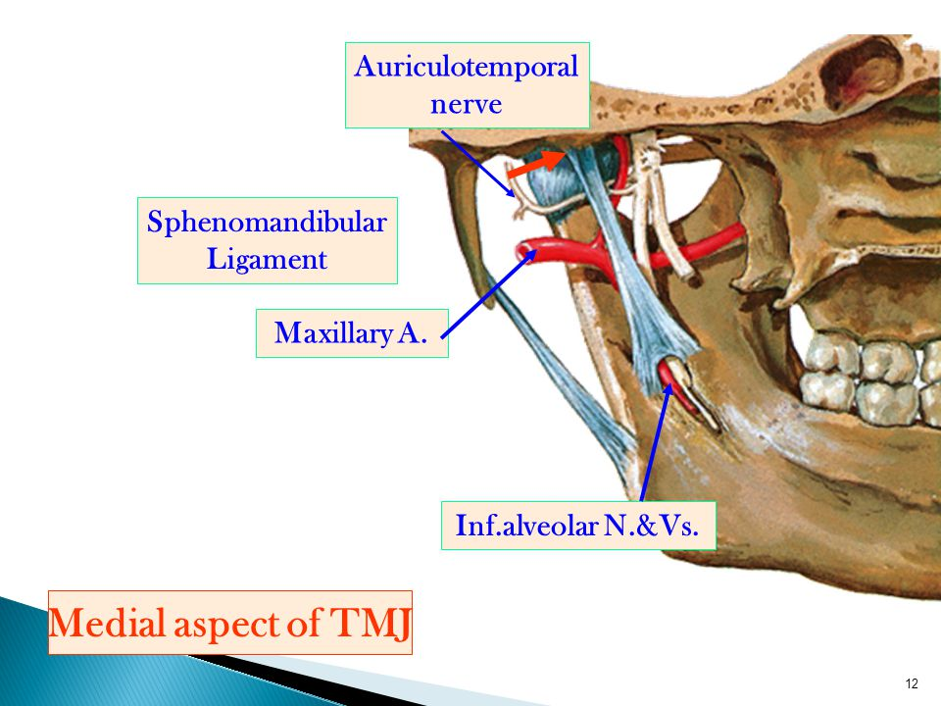
Stylomandibualr ligament

Slide 15
ARTICULAR DISC
• The articular disc is an oval fibrous plate that divides the joint into an upper and a lower compartments. The upper compartment permits gliding movements, and the lower, rotatory as well as gliding movements.
• The disc has a concavo-convex superior surface, and a concave inferior surface
• It acts as a cushion and helps in shock absorption.

Slide 16
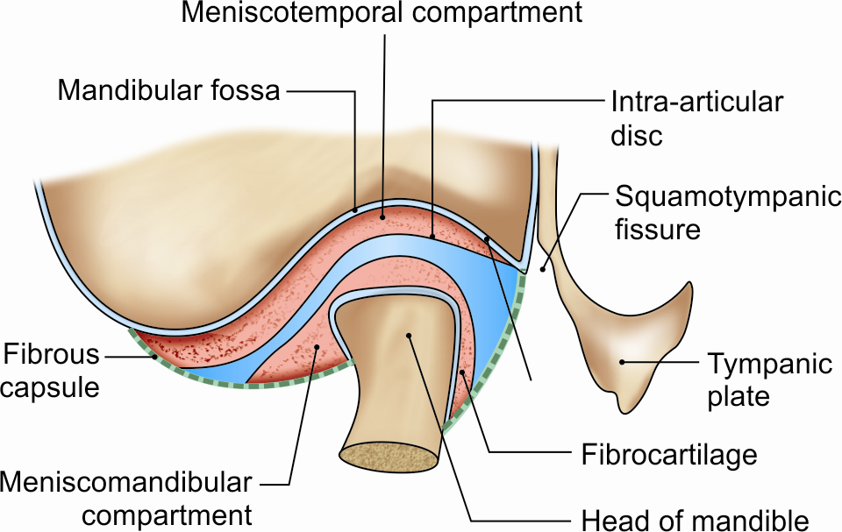
Subdivisions and attachments of the articular disc of TmJ

Slide 18
RELATIONS OF TEMPOROMANDIBULAR JOINT
Lateral
1. Skin and fasciae
2. Parotid gland
3. Temporal branches of the facial nerve.
Medial
1. The tympanic plate
2. Spine of the sphenoid
3. Auriculotemporal and chorda tympani nerves.
4. Middle meningeal artery

Slide 19
Anterior
1. Lateral pterygoid
2. Masseteric nerve and artery
Posterior
1. The parotid gland separates the joint from the external auditory meatus
2. Superficial temporal vessels
3. Auriculotemporal nerve
Superior
1. Middle cranial fossa
2. Middle meningeal vessels.
Inferior
Maxillary artery and vein.

Slide 20
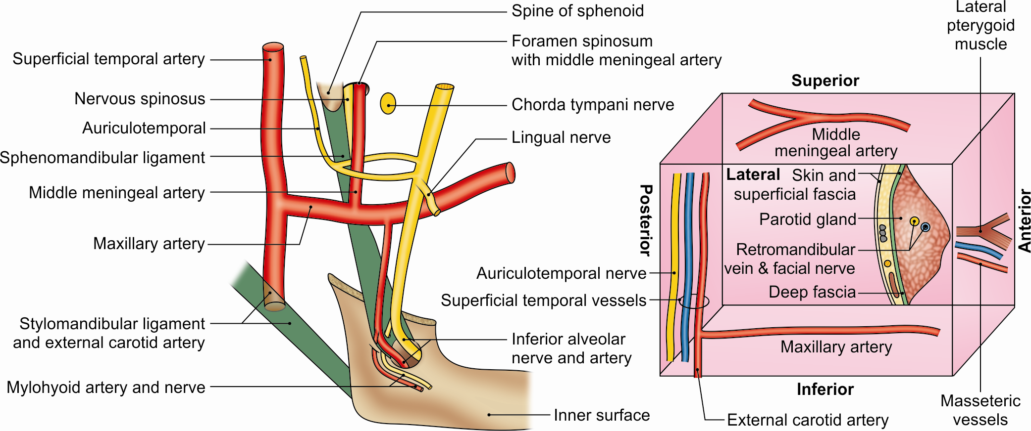
Medial relations of temporomandibular joint seen. Inset shows other relations of the joint

Slide 21
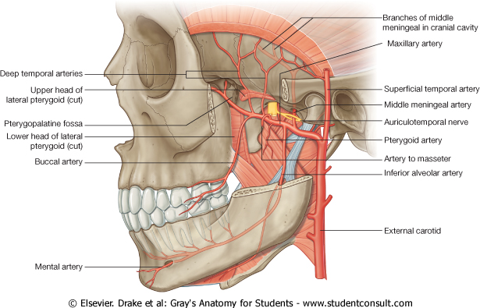
Blood Supply
Branches from superficial temporal and maxillary arteries. Veins follow the arteries.
Nerve Supply
Auriculotemporal nerve and masseteric nerve.

Slide 22
Movements
. Depression (open mouth)
2. Elevation (closed mouth)
3. Protrusion (protraction of chin)
4. Retraction (retraction of chin)
5. Lateral or side to side movements during chewing or grinding.

Slide 23
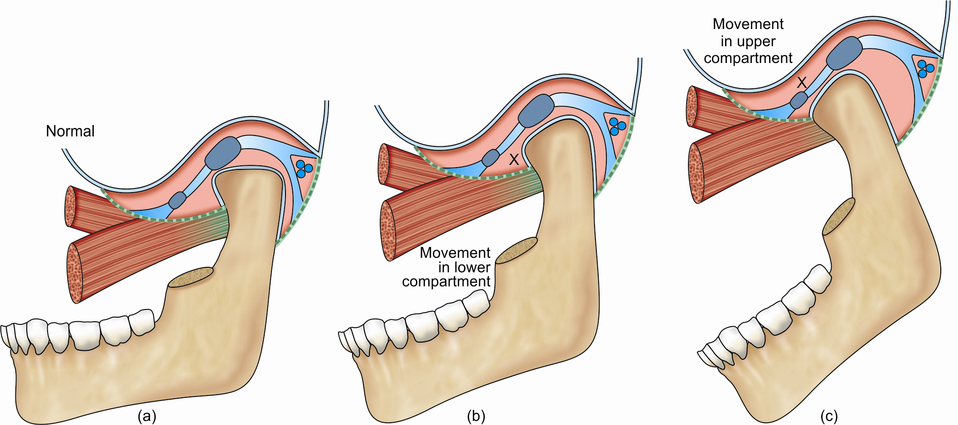
Movements in lower and upper compartments during opening of the mouth

Slide 24
Muscles Producing Movements
1)Depression -lateral pterygoid.
The digastric, geniohyoid and mylohyoid muscles help.
2)Elevation-Masseter, Medial Pterygoid,Temporalis, (MMT).
These are antigravity muscles.

Slide 25
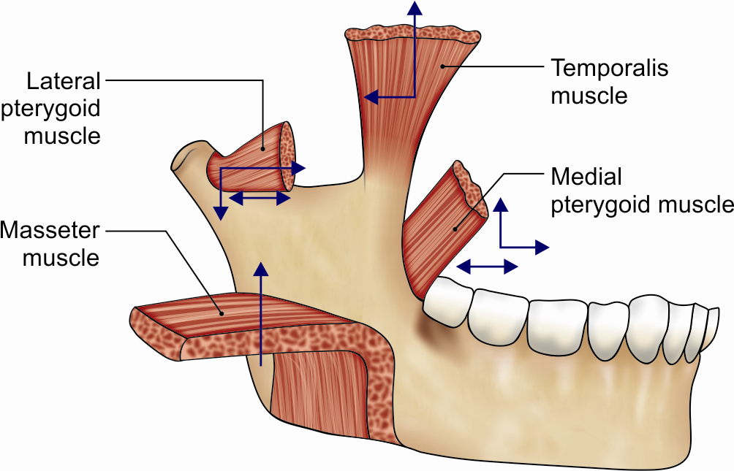
Movements of temporomandibular joint (arrows) by muscles of mastication

Slide 26
← Protrusion
lateral and medial pterygoids and superficial oblique fibres of masseter.
→ Retraction -Temporalis and masseter.
Lateral or side to side movements
Turning chin to left side by right lateral pterygoid , right medial pterygoid vice versa

Slide 27
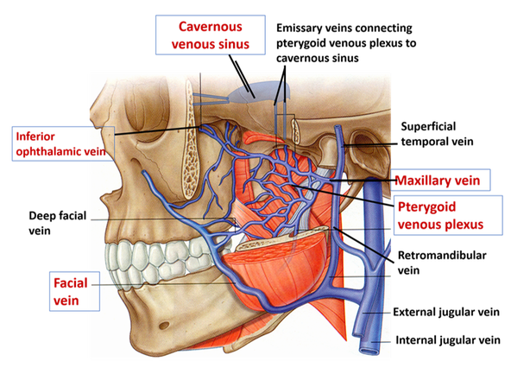
Pterygoid venus plexus: situated between temporalis muscle & lateral pterygoid & partly between two pterygoid muscle.

Slide 28
CLINICAL ANATOMY
• Dislocation of mandible:
• In operations on the temporomandibular joint, the VII nerve and auriculotemporal nerve, branch of mandibular division of V should be preserved with care.
Derangement of articular disc may result in injury like overclosure & gives rise to clicking & pain during movement of jaw.

Slide 29
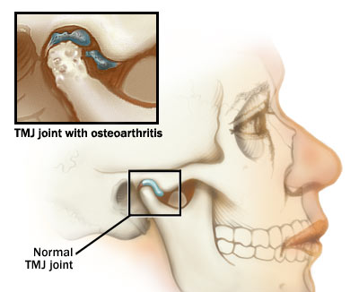

Slide 30
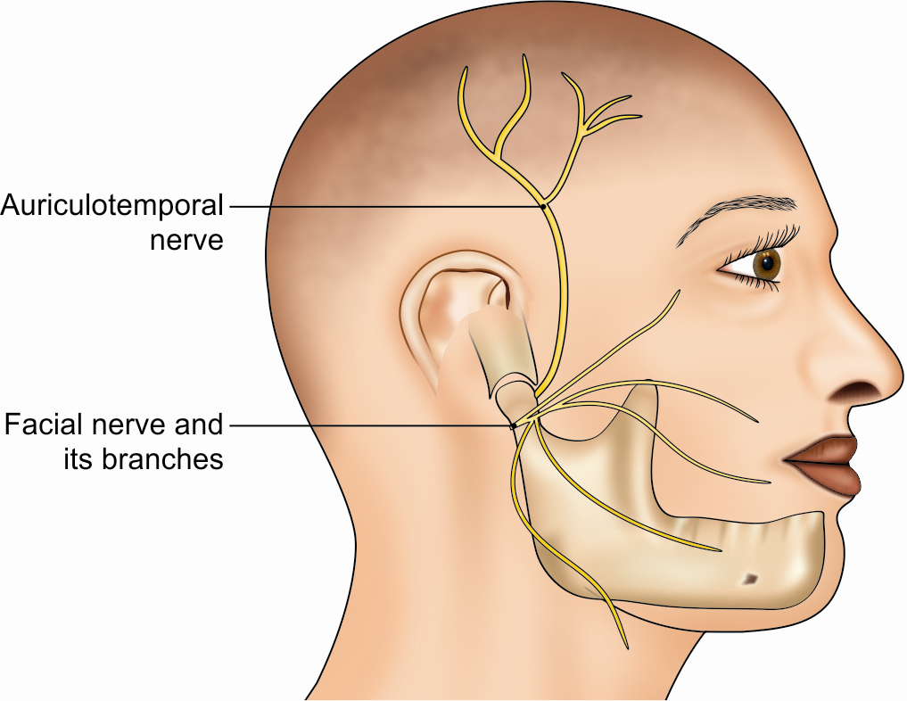
Close relation of the two nerves to the temporomandibular joint

Slide 31
1)All muscles causing elevation of mandible except
Lateral pterygoid
Medial pterygoid
Masseter
Temporalis

Slide 32
2)Nerve supply of temporamandibular joint
Auriculotmeporal nerve
Deep temporal nerve
Buccal nerve
Maxillary nerve

Slide 33
3)Sphenomandibular ligament related laterally to all structure except
Lateral pterygoid muscle
Auriculotemporal nerve
Maxillary artery
Facial artery

Slide 34
4)Fibrous capsule is attached to all structure except
Neck of mandible
Mandibular fossa
Articular tubercle
Base of mandible

Slide 35
5)Which ligament is derived from deep cervical fascia of neck
Sphenomandibular ligament
Stylomandibular ligament
Lateral ligament
Fibrous capsule

Slide 36
Macroscopic and microscopic aspects of the temporomandibular joint related to its clinical implication. Siéssere S1, Vitti M, Semprini M, Regalo SC, Iyomasa MM, Dias FJ, Issa JP, de Sousa LG. Micron. 2008 Oct;39(7):852-8.
Macroscopic and microscopic aspects of the temporomandibular joint related to its clinical implication. | Siéssere S1, Vitti M, Semprini M, Regalo SC, Iyomasa MM, Dias FJ, Issa JP, de Sousa LG. Micron. 2008 Oct;39(7):852-8. | Nine human heads, fixed in formalin (10%) underwent sagittal medial section and were subsequently dissected, evidencing the anatomic components of all surfaces to be analyzed. | Components of the external surface were: skin, subcutaneous tissue, lymphatic ganglia, parotid gland, superficial temporal artery, transverse facial artery, zygomatic-orbital artery, superficial temporal vein, facial and auriculotemporal nerves, masseter muscle, and pre-auricular lymphonodus. The anterior surface comprised the masseter and lateral pterygoid muscles (upper and inferior heads), pterygoid venous plexus, mandibular notch, posterior deep temporal artery, masseteric nerve, and deep posterior temporal branches. Medial surface components were: internal maxillary artery, of which middle meningeal artery was one of the closest branches to the TMJ, anterior tympanic artery, inferior alveolar, lingual, auriculotemporal, and chorda tympani nerves, which belonged to the surface posterior to the anterior wall of the auditory duct; auricolotemporal nerve, parotid gland; and petrotympanic fissure. The cerebral fossa (meninges and encephalon) belonged to the superior surface and the ear belonged to the posterosuperior surface. | It was concluded that the temporomandibular joint is a complex structure and the clinician must have the ability to formulate the diagnosis based on the understanding of morphological aspects of the structures that compose the stomatognatic system.

