Slide 1
Elbow Joint
Mrs. Priyanka Sharma
Assistant Professor
Department of anatomy
S.B.K.S.M.I. & R.C.

Slide 2
COMPETENCY
AN13.3 Identify & describe the type, articular surfaces, capsule, synovial membrane, ligaments, relations, movements, blood and nerve supply of elbow joint.

Slide 3
Objectives
Type of joint
Formation of joint
Ligaments
Blood supply
Nerve supply
Movement of joint
Applied anatomy

Slide 4
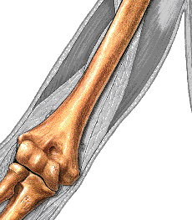
Type of joint
Hinge(ginglymus) type of synovial joint
en.wikiversity.org

Slide 5
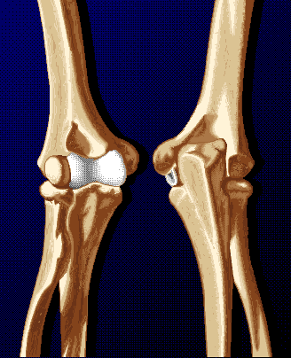
Formation of joint
The ELBOW consists of 2 joints:
  humeroulnar
    Olecranon & coronoid processes of the ulna
    distal aspect of humerus
  radiohumeral
    radial head has small amount of articulation with humerus (capitulum)
40th edition of Gray’s anatomy
en.wikiversity.org

Slide 6
Ligaments
fibrous capsule
Ulnar collateral ligament
Radial collateral ligament

Slide 7
Joint Capsule
en.wikiversity.org

Slide 8
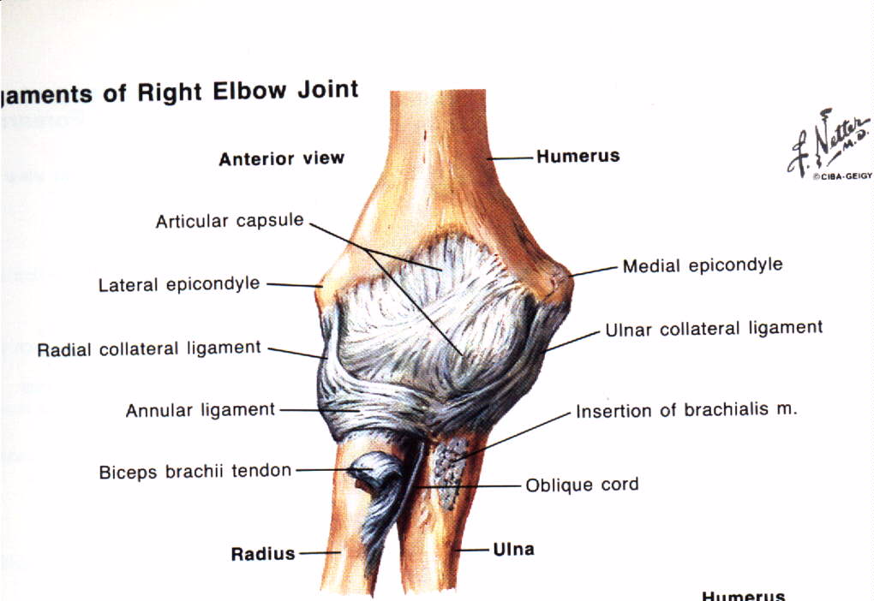
Anterior view of right elbow joint
en.wikiversity.org

Slide 9
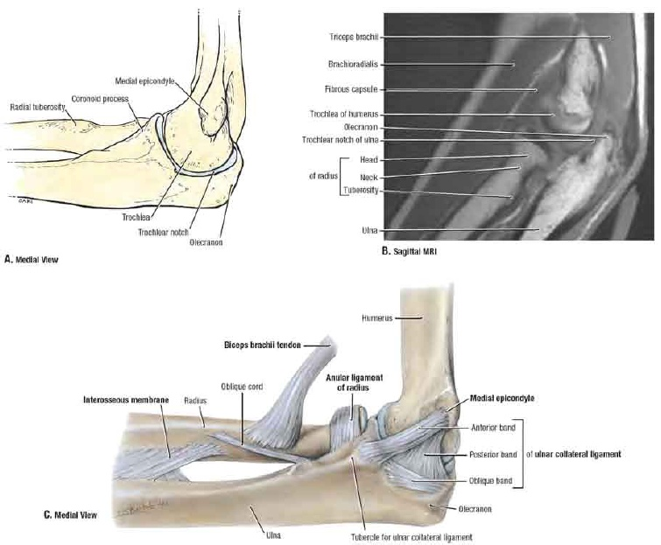
Ulnar Collateral Ligament
healthopedia.com

Slide 10
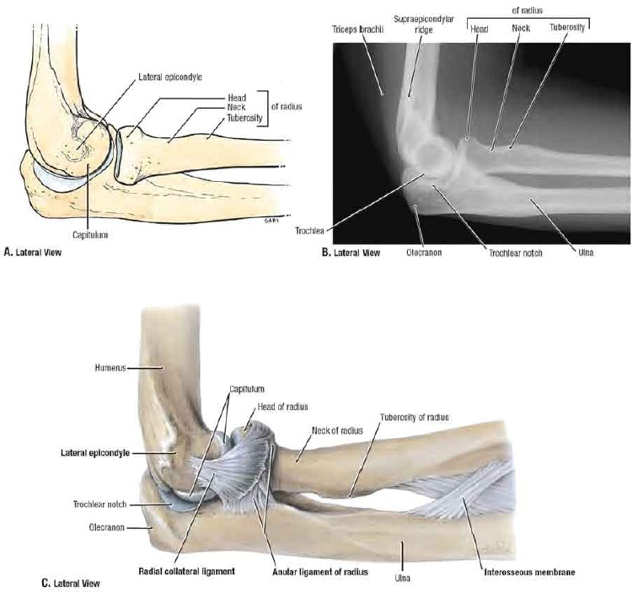
Radial Collateral Ligament
healthopedia.com

Slide 11
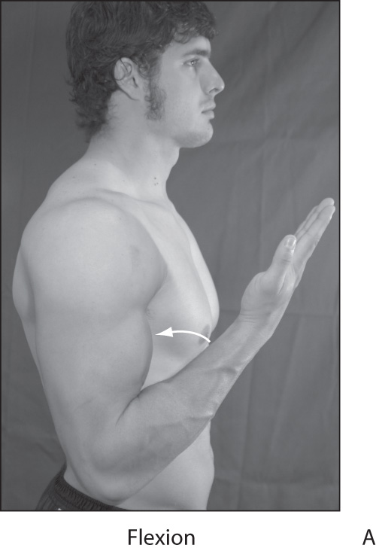
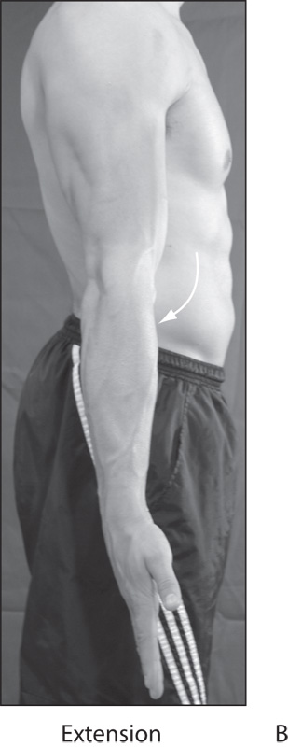
Movements
Flexion
  movement of forearm to shoulder by bending the elbow to decrease its angle
Extension
  movement of forearm away from shoulder by straightening the elbow to increase its angle
40th edition of Gray’s anatomy
assh.org

Slide 12
Muscles
Elbow flexors
  Biceps brachii
  Brachialis
  Brachioradialis
  Weak assistance from Pronator teres
Elbow extensor
  Triceps brachii
  Anconeus provides assistance
40th edition of Gray’s anatomy

Slide 13
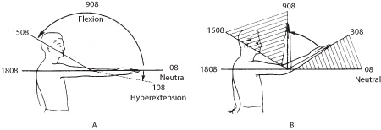
Joints
Elbow moves from 0 degrees of extension to 145 to 150 degrees of flexion
en.wikipedia.org

Slide 14
Nerve Supply:
Median N.
Musculocutaneous N.
Radial N.
Ulnar N.
Blood Supply:
Anastomosis around elbow
40th edition of Gray’s anatomy

Slide 15
Applied Anatomy
Distension of the elbow joint- effusion occurs posteriorly because here the capsule is weak
- Treatment –aspiration on posterior side
40th edition of Gray’s anatomy

Slide 16
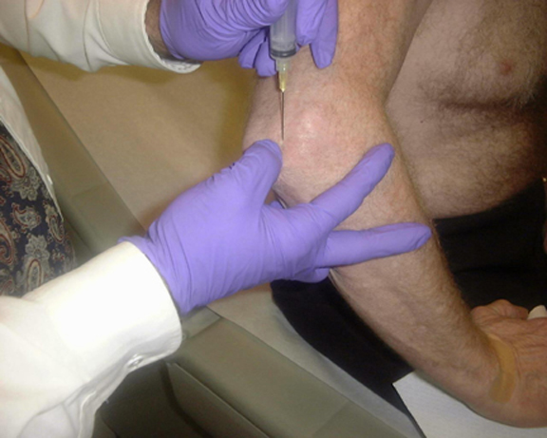
Aspiration or injection
en.wikipedia.org

Slide 17
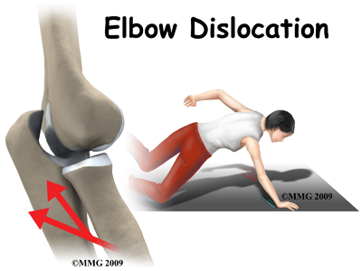
Dislocation: Posterior [more common]
emedx.com

Slide 18
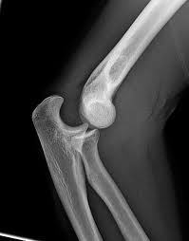
en.wikipedia.org

Slide 19
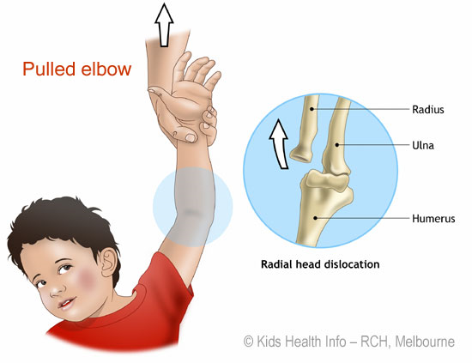
Pulled Elbow
Head of radius slips out of annular ligament
More common in childhood age group
emedx.com

Slide 20

emedx.com

Slide 21
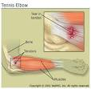
Tennis elbow
Abrupt pronation may lead to pain and tenderness over lateral epicondyle
Due to: - sprain of radial collateral ligament
- tearing of fibers of ext.carpi radialis brevis
medicinenet.com

Slide 22
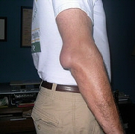
Miner’s(student’s) elbow
Effusion into the bursa over the subcutaneous posterior surface of the olecranon process
orthoinfo.aaos.org

Slide 23
Evidence on the applied anatomy of elbow joint

Slide 24
J. T. Lehtinen, K. Kaarela, E. A. Belt, M. J. Kauppi, E. Skyttä, P. P. Kuusela, H. J. Kautiainen and M. U. K. Lehto, Rheumatology (2001) 40(10): 1141-1145 doi:10.1093/rheumatology/40.10.1141
J. T. Lehtinen, K. Kaarela, E. A. Belt, M. J. Kauppi, E. Skyttä, P. P. Kuusela, H. J. Kautiainen, and M. U. K. Lehto | Radiographic joint space in rheumatoid elbow joints. A 15‐year prospective follow‐up study in 74 patients | An inception cohort of 74 patients with RA were followed for 15 yr. At the end‐point, 148 elbows were radiographed by a standard method. The HU and HR joint spaces were examined from the anteroposterior radiographs by measuring the shortest tangential distance in the middle of the joints. Destruction of the elbow joints, assessed with the Larsen method on a scale of 0–5, was studied in relation to the joint‐space measurements. | The monotonic narrowing was significantly increasing from unaffected (Larsen 0, 1), slightly (2), moderately (3) to severely (4, 5) affected joints (P<0.001). A step in this process occurred between Larsen grades 3 and 4, when the mean joint space diminished from 1.4 and 1.5 respectively to 0 mm. | Joint‐space narrowing is a frequent consequence of rheumatoid affection of the elbow joint. HR joint space decreases together with HU joint space; however, the HR joint space is already slightly narrower at the start. The narrowing is a rather late phenomenon, occurring only after erosive destruction. This should be borne in mind when using the Larsen method to evaluate changes in the elbow joint.

Slide 25
C. P. Little, A. J. Graham and A. J. Carr, J Bone Joint Surg Br April 2005 87-B:437-444.
C. P. Little, A. J. Graham, and A. J. Carr | Total elbow arthroplasty A SYSTEMATIC REVIEW OF THE LITERATURE IN THE ENGLISH LANGUAGE UNTIL THE END OF 2003 | We undertook a hand search of the bibliographies of the papers describing series of prosthetic elbow arthroplasties. | The results reported for TEA are not as good as those for hip and knee replacement, although the published number of studies have tended to be comparatively small.¹ There is little consensus as to the best implant to use in different clinical settings. | This made comparison difficult and makes the pooling of results unreliable. To date, there are very few comparative studies available, and none powered to detect differences in implant performance. This is not surprising given the nature of surgical implant research, but there is a clear demand for such series to throw more light on the performance of implants in selected patient groups in order to clarify the relative roles of the available implants.

Slide 26
THANK YOU !!!!

