Slide 1
DIGESTIVE SYSTEM

Slide 2
Competency
An observable ability of a health professional integrating multiple components such as knowledge , skills , values and attitudes.
Competency PY 4.1 (Core)
Describe the functional anatomy of digestive system

Slide 3
LEARNING OBJECTIVES
In education, learning objectives are brief statements that describe what students will be expected to learn by the end of school year, course, unit, lesson, project, or class period.

Slide 4
LEARNING OBJECTIVES
After studying this topic, the student is able to:
1 Outline the terms Gastro-intestinal Tract (GIT)& Digestive system.
2 Enumerate the structures comprising GI System.
3 Enumerate the functions of digestive system.
4 Describe the organization of structures that make up the wall of GI Tract.
5 Discuss the electrical activity of GI smooth muscle.
6 Explain the Enteric Nervous System with the help of a diagram.
7 Discuss the blood supply to digestive system.
8 Describe the immunology of GI system

Slide 5
GASTRO-INTESTINAL TRACT& DIGESTIVE SYSTEM
GI Tract/Alimentary canal & accessory organs of digestion(Salivary Glands , Liver , Gall Bladder &Exocrine Pancreas)
↓
Digestive system/Gastro-intestinal system

Slide 6
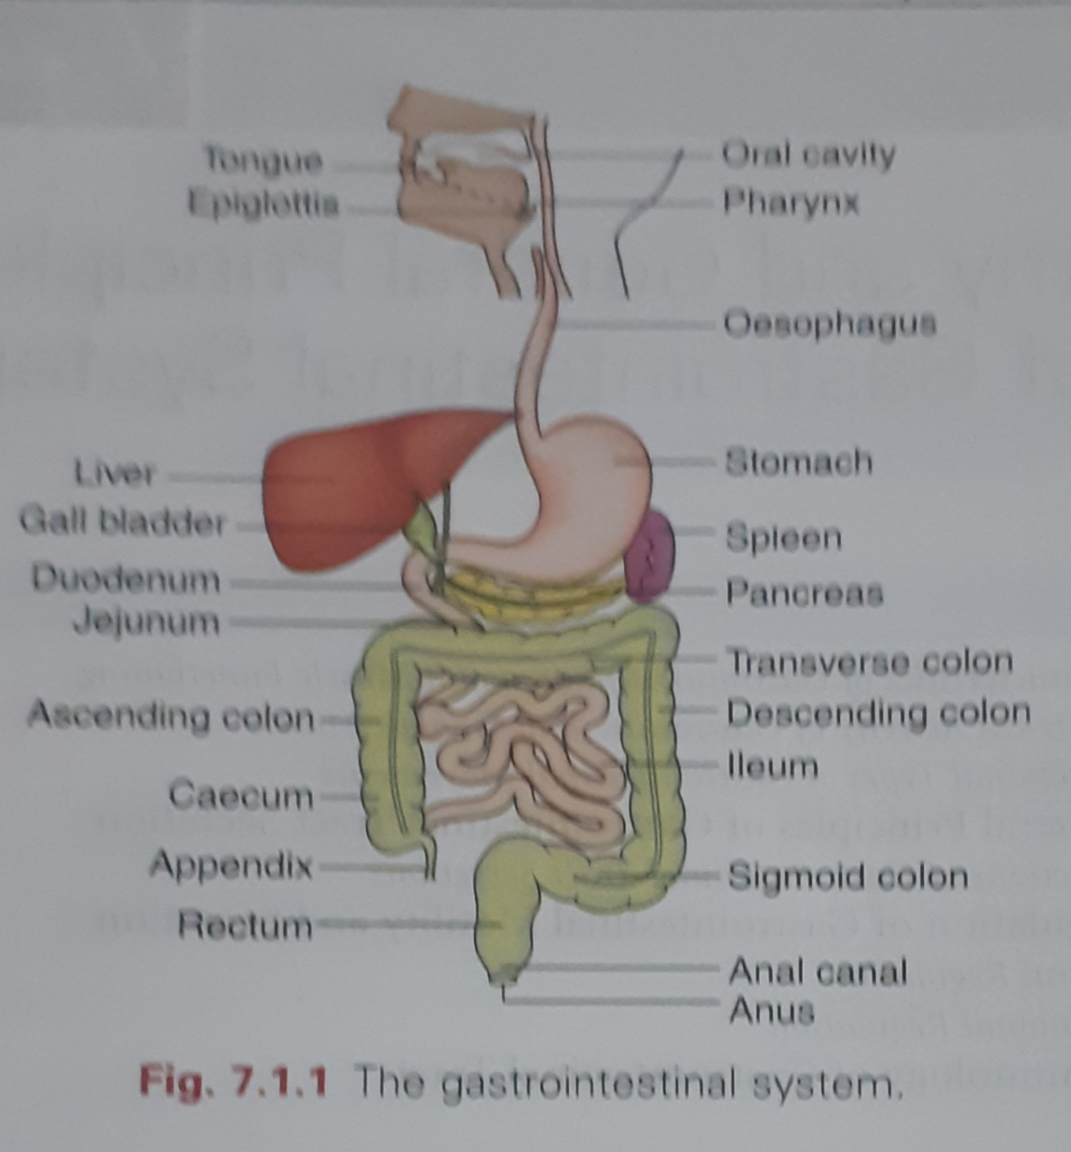

Slide 7
GI TRACT
UPPER GIT LOWER GIT

Slide 8
UPPER GIT
    MOUTH
    PHARYNX
    OESOPHAGUS
    STOMACH
LOWER GIT
    INTESTINES
    ANUS

Slide 9
INTESTINES:
SMALL INTESTINE
DUODENUM (10”)
JEJUNUM
ILEUM (20feet/6m)
LARGE INTESTINE
CAECUM (appendix is attached)(2.5”)
COLON (ascending(5”), transverse(15”) , descending colon(10”) & sigmoid (10-15”)
RECTUM(5”)& ANAL CANAL(1.5”)

Slide 10
FUNCTIONS OF DIGESTIVE SYSTEM
1Ingestion : involves
Placing the food into the mouth
Chewing the food in smaller pieces (mastication)
Moistening the food with salivary secretions.
Swallowing the food (deglutition)
2 Digestion: The process of breaking down complex food molecules into their basic constituent molecules/ component molecules.

Slide 11
FUNCTIONS OF DIGESTIVE SYSTEM
3 Absorption: The simple molecules resulting from digestion is transported from GIT to the circulation.
4 Egestion: The undigested food ,along with various secretions ,sloughed-off epithelial cells from GIT pass into rectum &constitute the feces is eliminated through anus (defecation)
5 Immune Function
6 Blood reservoir function of splanchnic circulation

Slide 12
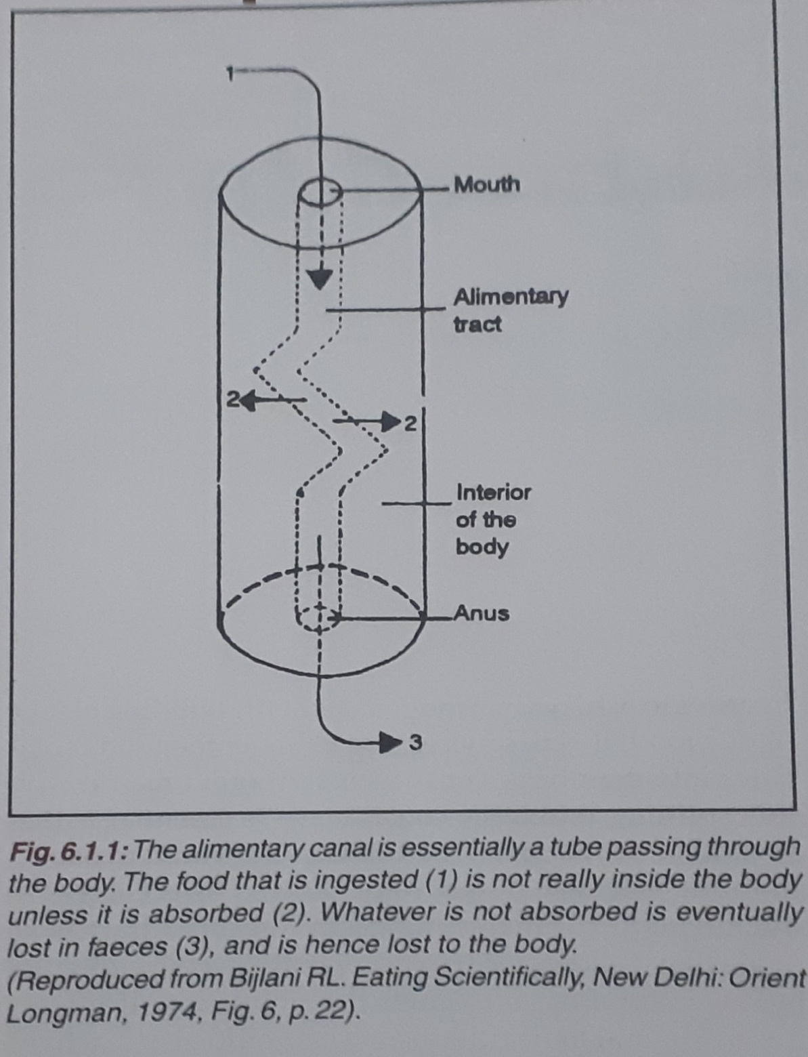

Slide 13
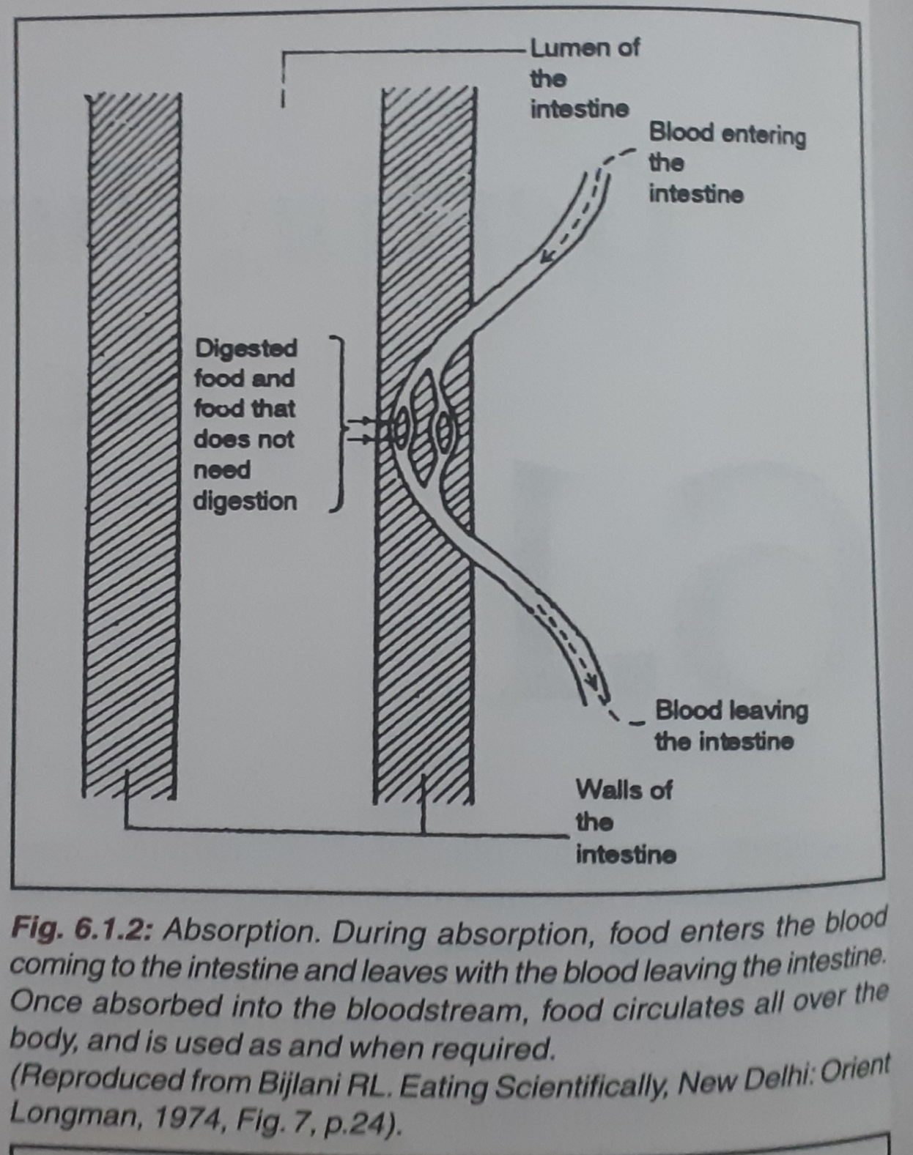

Slide 14
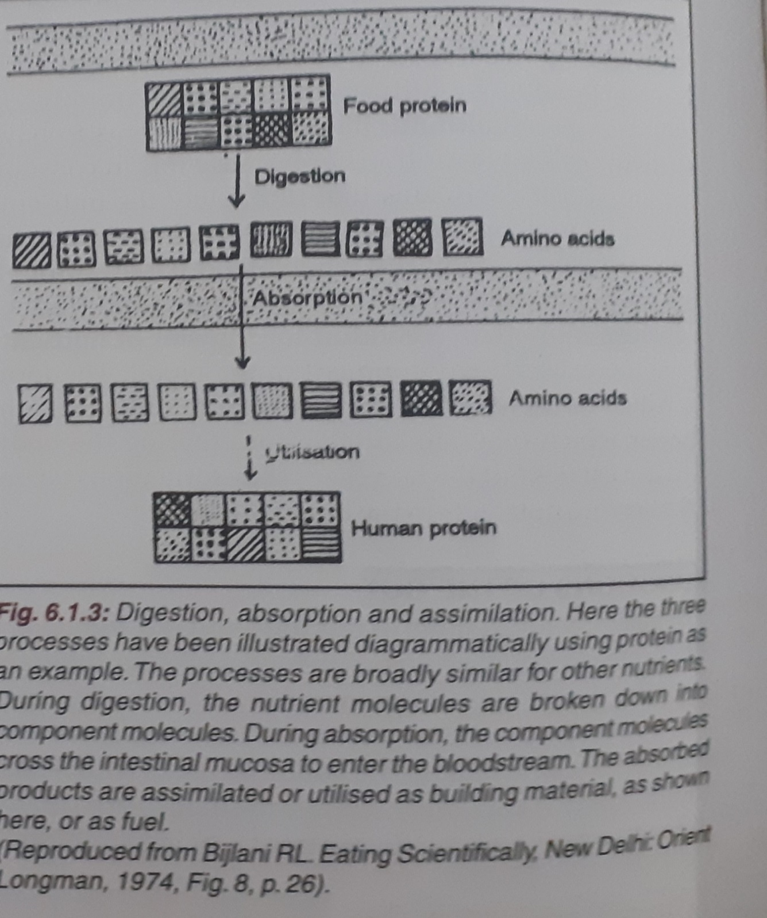

Slide 15
ORGANIZATION OF STRUCTURE OF GIT
The general organization of GIT consist of following layers from outside inwards:
1 Serous layer /Serosa: consist of thin layer of connective tissue covered with layer of squamous epithelial cells.
2 The longitudinal smooth muscle layer: contraction leads to ↓ in length of segment of GIT.

Slide 16
ORGANIZATION OF STRUCTURE OF GIT
3 The circular smooth muscle layer:
contraction leads to ↓ in diameter of lumen of that segment of GIT.
Both muscle layer→ mixing& forward propulsion of contents of GIT.
4 The sub mucous layer : consist of loose connective tissue , nerves , blood vessels & lymphatic.
Muscularis mucosae : thin layer of smooth muscle

Slide 17
ORGANIZATION OF STRUCTURE OF GIT
5 The mucous layer: lined by epithelium. Stroma contains:
Glands
Lamina propria: layer of connective tissue

Slide 18
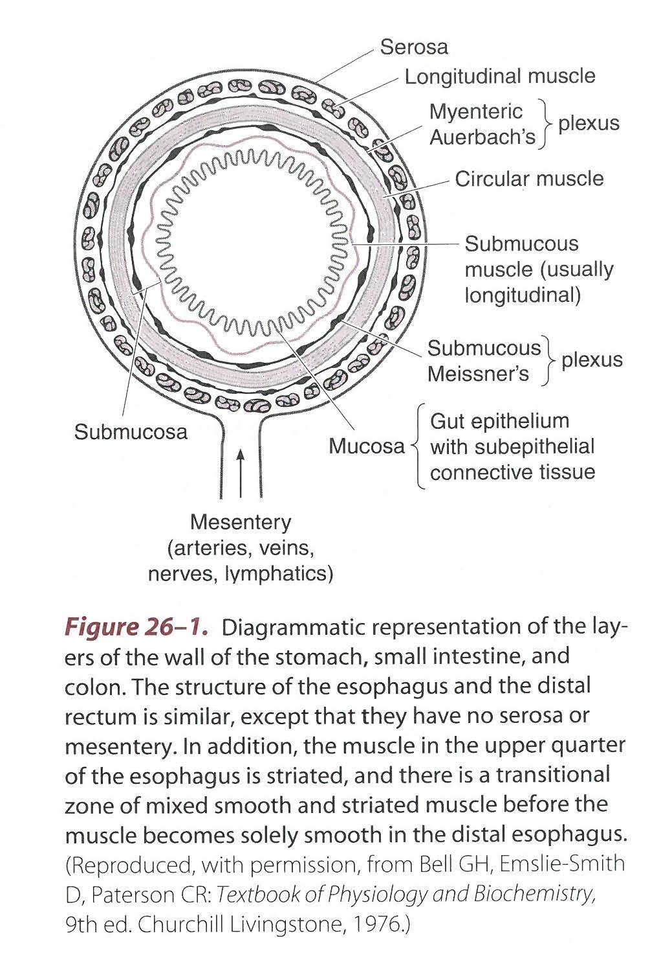

Slide 19
ELECTRICAL ACTIVITY OF GI SMOOTH MUSCLE
Basic Electrical Rhythm- Spontaneous rhythmic fluctuations in resting membrane potential between -65 and -45mv. Also called as ‘slow waves’
Location- Smooth muscle of GI tract except in esophagus and proximal portion of stomach.
Initiated by- Interstitial Cells of Cajal – stellate pacemaker cells
Frequency- 3to 12/minute;4 in body of stomach,12 in duodenum , 8/9 in terminal ileum,2 in cecum ,6 in sigmoid colon.
Function – determines the rhythm of smooth muscle contraction.

Slide 20
ELECTRICAL ACTIVITY OF GI SMOOTH MUSCLE
Spike Potential :
True action potentials
Occur spontaneously when RMP is more positive then -45mv.
Duration-10 to 20 milliseconds.
Genesis-Depolarization due to calcium-sodium channels.
Function- Responsible for contraction of smooth muscle

Slide 21
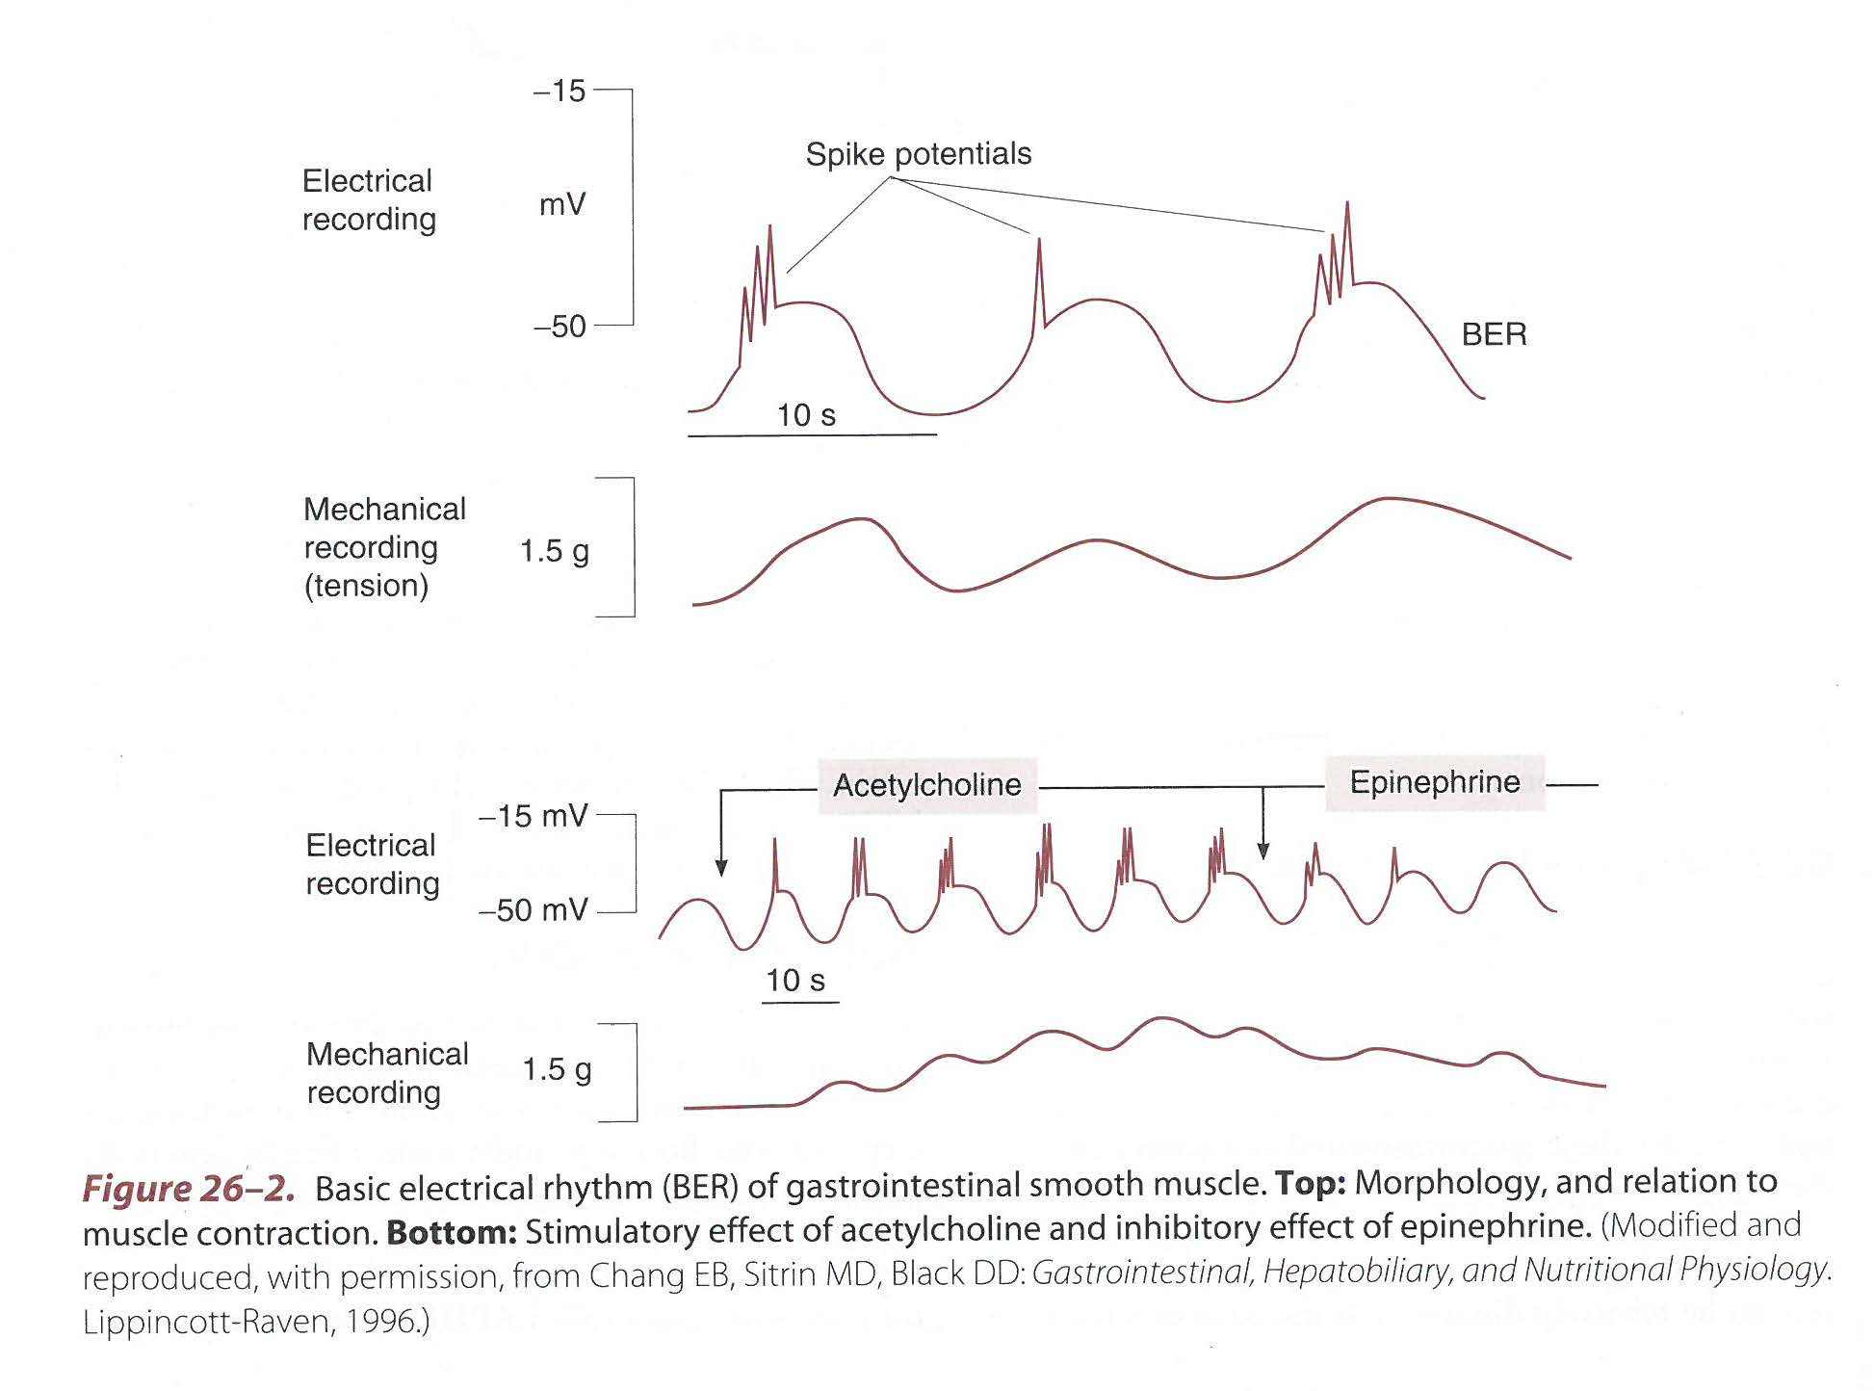
Factors : depolarization ,hyperpolarization

Slide 22
ELECTRICAL ACTIVITY OF GI SMOOTH MUSCLE
Factors responsible for
Depolarization:
Stretch of the muscle
Acetylcholine
Parasympathetic stimulation
GI hormones
Hyperpolarization:
Norepinephrine
Sympathetic stimulation

Slide 23
MIGRATING MOTOR COMPLEX(MMC)
MMC- modified electrical & motor activity in GI smooth muscle during fasting ,between periods of digestion.
Marked by Three phases:
Phase I –Quiescent phase. No spike potential ,No contractions
Phase II-Irregular electrical & motor activity. Irregular spike potential & Irregular contractions
Phase III – Regular spike potentials& Regular contractions

Slide 24
MIGRATING MOTOR COMPLEX(MMC)
Rate& Frequency-Migrate aborally at a rate of 5cm/minute. Intervals of 90-100 minutes
Function:
↑ Gastric, bile & Pancreatic secretions during each MMC.
Clear the stomach& small intestine of luminal contents in preparation of next meal.
Disappear with ingestion of food with return to peristalsis, BER & spike potential

Slide 25
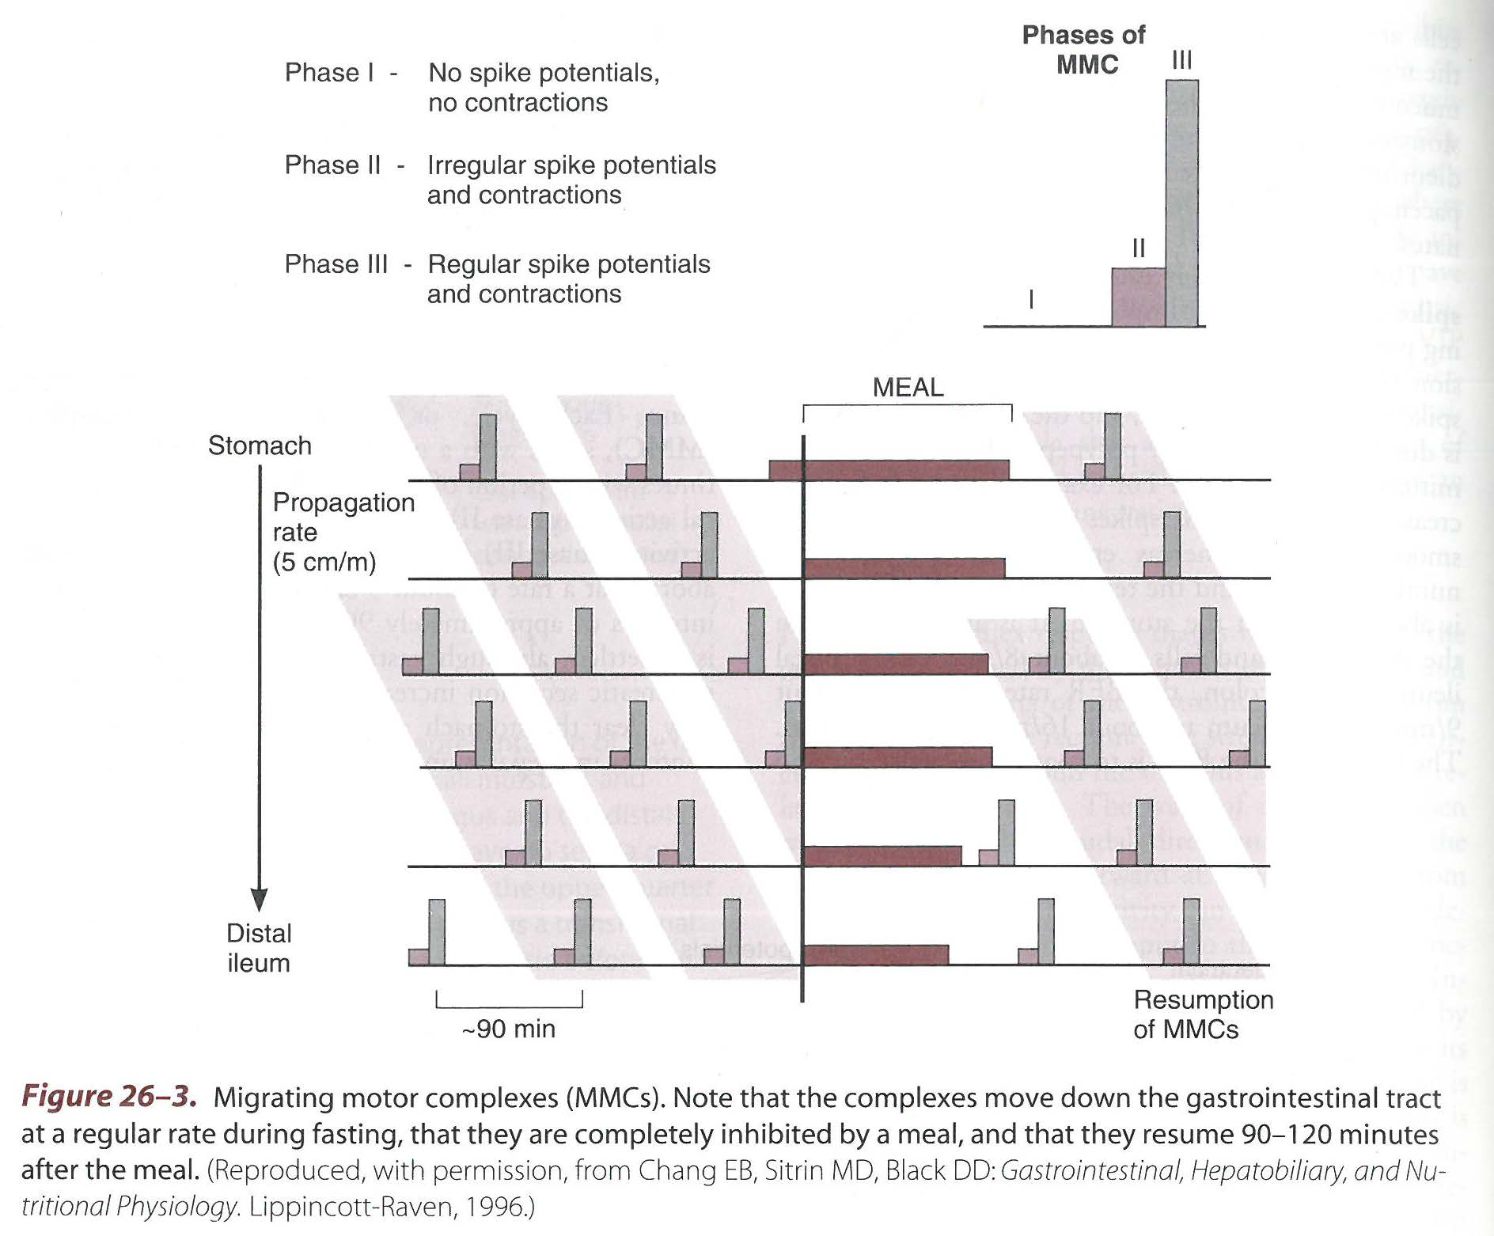

Slide 26
ENTERIC NERVOUS SYSTEM
The nervous system of GI tract.
Begins in esophagus & ends in rectum.
Made up of 100 million neurons .
Consist of two plexuses:
1Outer plexus-Myenteric plexus/ Auerbach plexus
Located between longitudinal and circular muscle layer
Innervates the longitudinal & circular smooth muscle and is concerned with motor control

Slide 27
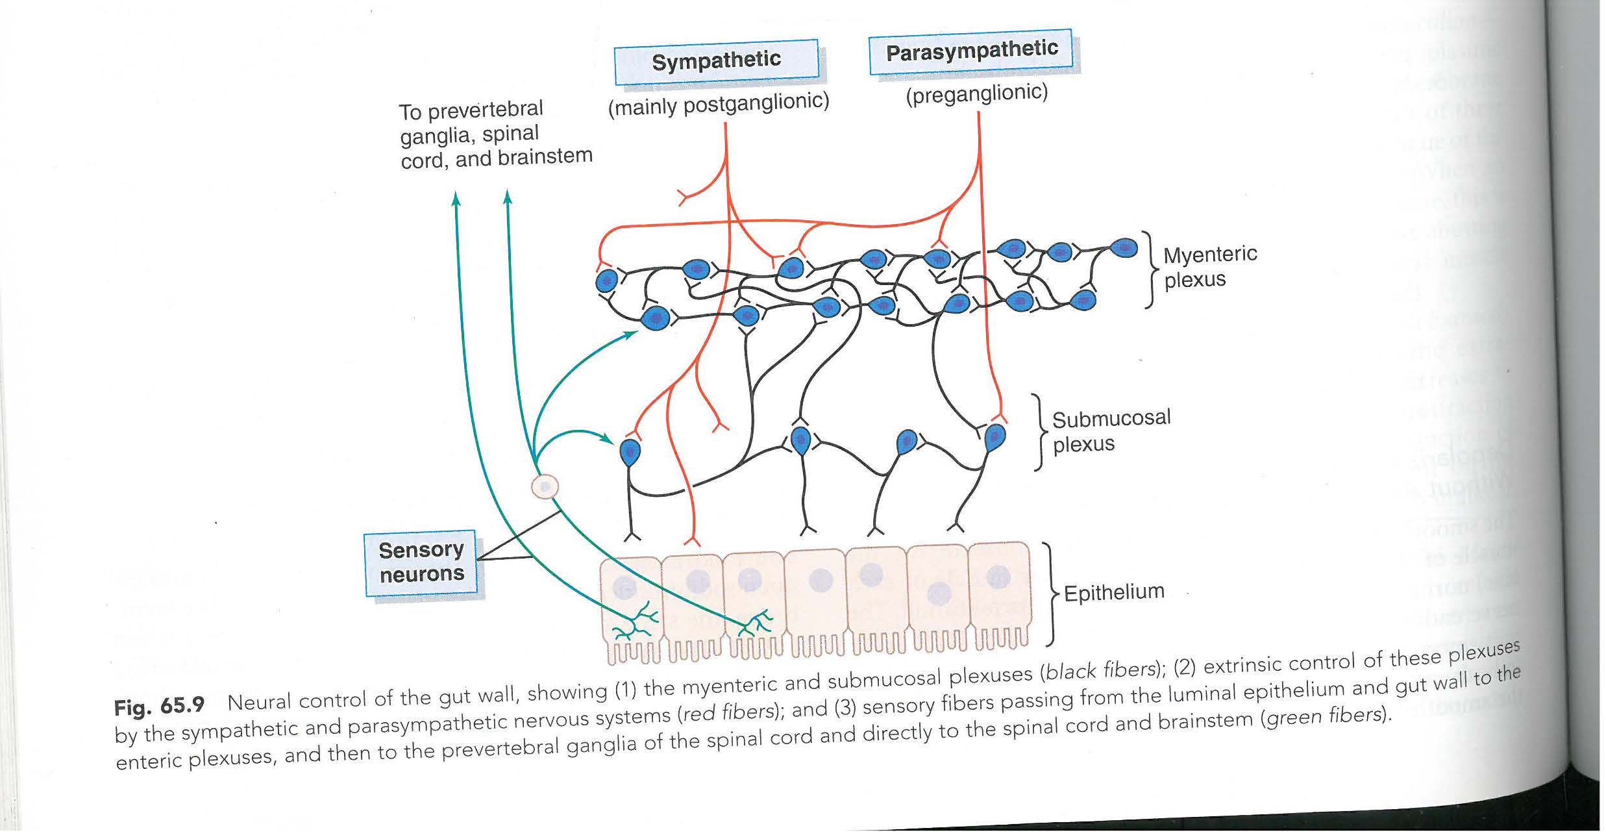

Slide 29
ENTERIC NERVOUS SYSTEM
2 Inner Plexus- Meissner Plexus/ sub mucosal Plexus
Located in sub mucosa
Functions-Innervates the glandular epithelium ,
intestinal endocrine cells and sub mucosal blood vessels and thus controls intestinal secretions.
Sensory fibers from GI gut wall go to:
Both plexuses , prevertebral ganglia of SNS , spinal cord , in Vagus nerve to brain stem.

Slide 30
ENTERIC NERVOUS SYSTEM
Neurotransmitter secreted :
Acetylcholine
Norepinephrine
Serotonin
Dopamine
Substance P
Vasoactive Intestinal Peptide(VIP)
Somatostatin
Bombesin

Slide 31
EXTRINSIC INNERVATION OF ENTERIC NERVOUS SYSTEM
By Autonomic nervous system
Parasympathetic by:
Vagus – Gastric & intestinal glands , smooth muscle of GIT up to junction between proximal 2/3rd & distal 1/3rd of colon.
Pelvic sacral nerves –rest of large intestine.

Slide 32
EXTRINSIC INNERVATION OF ENTERIC NERVOUS SYSTEM
Functions : Stimulates the GIT
↑ in motility & tone
Relaxation of sphincters
↑ Secretions from stomach& intestine.

Slide 33
EXTRINSIC INNERVATION OF ENTERIC NERVOUS SYSTEM
Sympathetic : Inhibits the GIT.
Post ganglionic fibers from T6 to L2/L3
Functions:
↓in motility & tone
Contraction of sphincters
↓Secretions from stomach& intestine.
Vasoconstriction of blood vessels.

Slide 34
The autonomic output to GIT is modulated by higher influences from limbic system& cerebral cortex . Hence GI activity is affected by emotional factors.

Slide 35
GASTROINTESTINAL REFLEXES
Three type of GI reflexes that are essential for GI control:
1 Reflexes that are integrated entirely within the gut wall enteric nervous system. Control GI secretions, peristalsis ,mixing contractions
2 Reflexes from gut to prevertebral sympathetic ganglia & back to the GI tract. e.g
Gastro colic reflex-distension of stomach by food initiates contraction of rectum & desire to defecate.
Enterogastric reflex-distension of intestine leads to inhibition of gastric motility and secretions.
Colono -ileal reflex- Reflexes from colon to inhibit emptying of ileal contents into the colon.

Slide 36
GASTROINTESTINAL REFLEXES
3 Reflexes from GIT to spinal cord or brain stem & back to the GIT. e.g
Reflexes to control gastric motor &secretory activity by way of Vagus
Pain reflexes that cause general inhibition of entire GIT
Defecation reflex.

Slide 37
OTHER AUTONOMIC REFLEX THAT AFFECT BOWEL ACTIVITY
Peritoneal intestinal reflex- irritation of peritoneum( as in peritonitis) inhibits the excitatory enteric nerves causing intestinal paralysis.
Reno-intestinal reflex
Vesico -intestinal reflex
Inhibit intestinal activity as a result of kidney or bladder irritation.

Slide 38
SPLANCHNIC CIRCULATION / HEPATOMESENTERIC CIRCULATION
Blood flow through the gut , spleen, pancreas &liver.
GI System receives blood supply from 3 branches of aorta :
Coeliac axis – send arteries to liver , stomach & spleen.
Superior mesenteric artery- supplies the pancreas , small intestine and part of large intestine.
Inferior mesenteric artery- supplies the remaining part of large intestine.

Slide 39
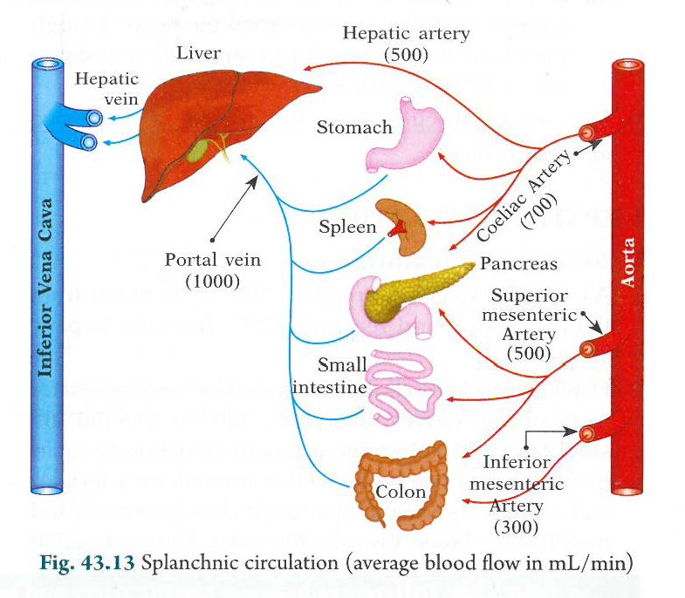

Slide 40
SPLANCHNIC CIRCULATION
All blood that leaves the GI tract ,spleen and pancreas is drained by portal vein which carries it to liver & from liver via hepatic veins to IVC.

Slide 41
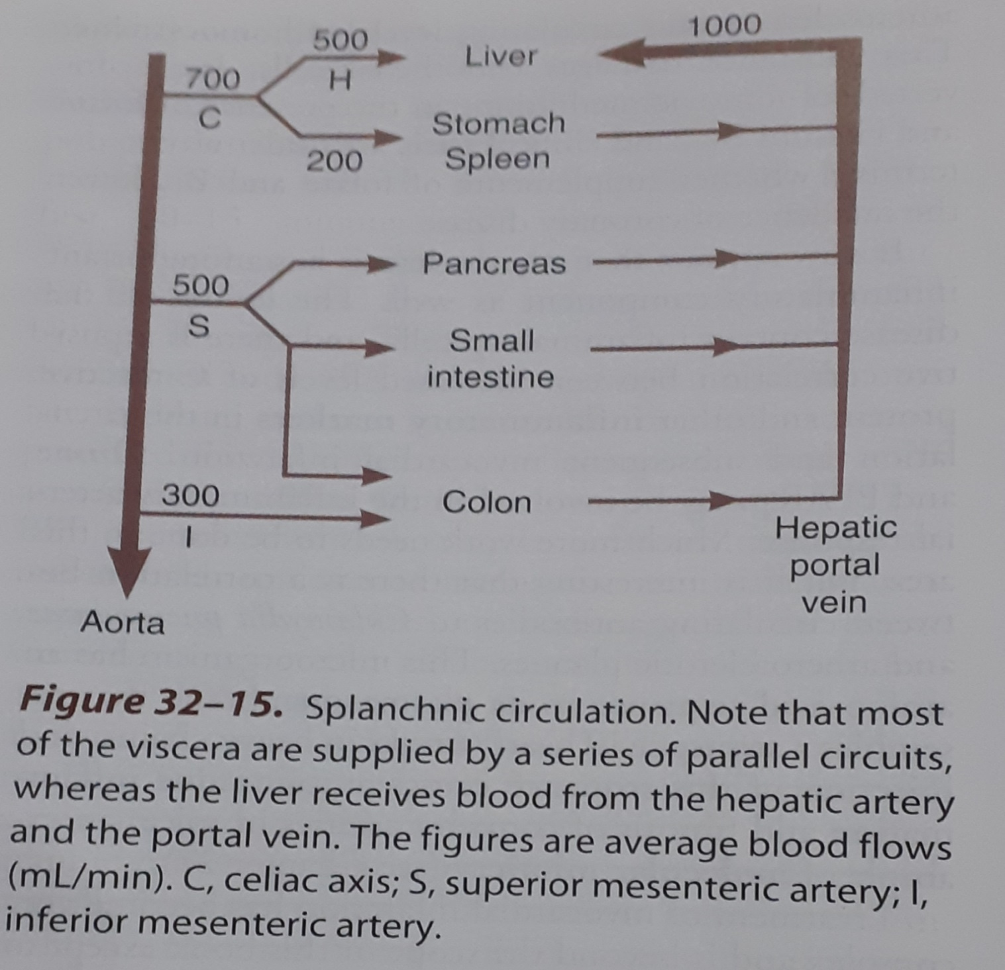

Slide 42
SPLANCHNIC CIRCULATION
Intestinal Circulation:
Supplied by series of parallel circulation via branches of superior and inferior mesenteric arteries.
Presence of Extensive anastomosis.
Blood flow in mucosa greater then that to rest of the intestinal wall .
Capable of extensive auto regulation.

Slide 43
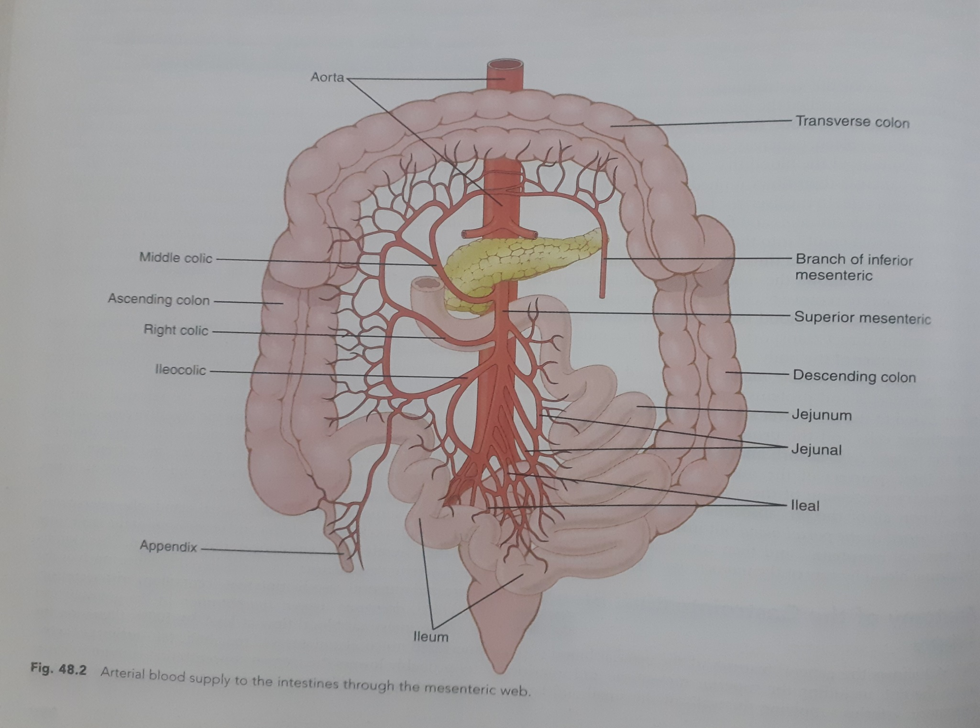

Slide 44
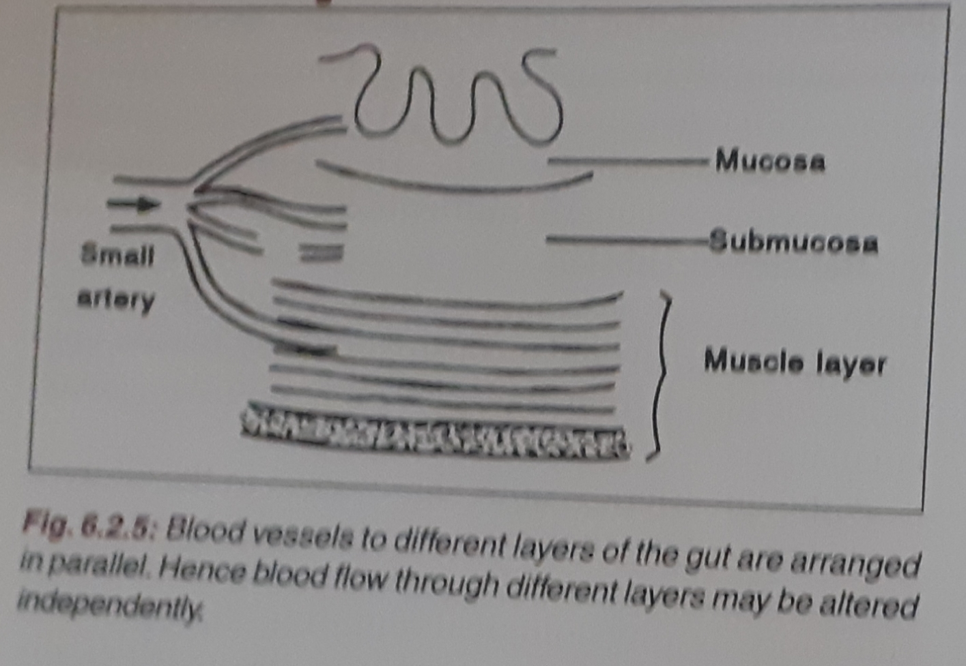
Fig 6.2.5 p352 RLBijlani

Slide 45
SPLANCHNIC CIRCULATION
Intestinal Circulation: Countercurrent blood flow in the Villus
The arterial inflow into villus& outflow of villus in close proximity,
run parallel
in opposite direction.
Due to this :
80% of oxygen diffuses directly from the arteriole to venule without being carried to the tip of the villus

Slide 46
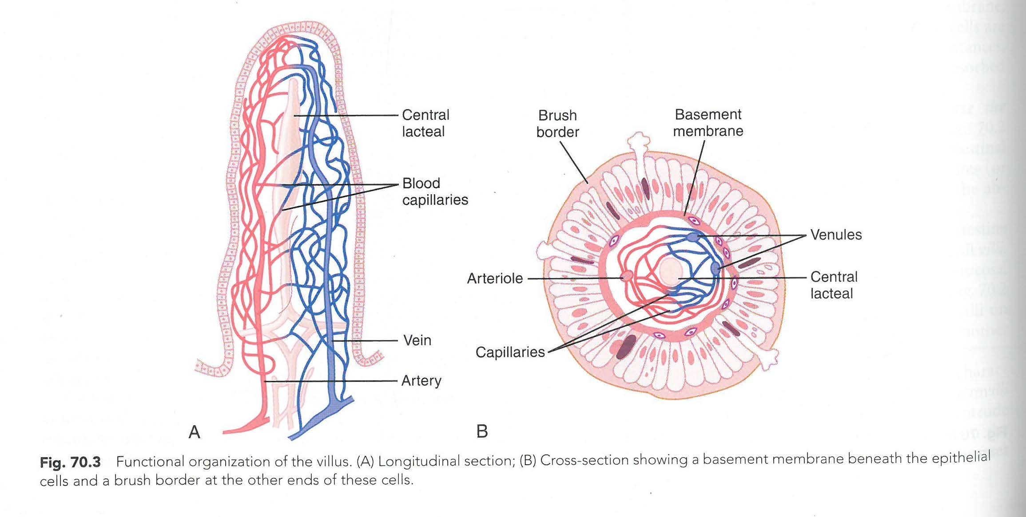

Slide 47
SPLANCHNIC CIRCULATION
Under normal conditions- shunting of oxygen is not harmful
In circulatory shock →↓blood flow to gut ,the oxygen deficit to the tip of villus→ ischemic damage.
Many disease state ,they become blunted →↓ intestinal absorptive capacity.

Slide 48
SPLANCHNIC CIRCULATION
Splenic circulation :
Splenic artery ,branch of coeliac trunk
200 ml of blood/minute
Spleen serves as reservoir of blood
Constriction of splenic venous sinuses by sympathetic stimulation releases blood into circulation

Slide 49
SPLANCHNIC CIRCULATION
Hepatic circulation :
Liver receives dual blood supply:
Hepatic artery (500ml )
Portal vein (1000ml )
Hepatic & Portal blood stream meets in the sinusoids

Slide 51
SPLANCHNIC CIRCULATION
Factors affecting intestinal blood flow:
Nervous control of blood flow:
Sympathetic vasoconstrictor but shows auto regulatory escape
↑ intestinal blood flow
↑ GI activity
GI hormones-CCK ,VIP , Gastrin , secretin
↓O2 concentration in gut wall.

Slide 52
SPLANCHNIC CIRCULATION
Nervous depression of GI blood flow when other parts of body need extra blood- Reservoir function of splanchnic circulation

Slide 53
IMMUNOLOGY OF GIT
1Saliva:
Lysozyme(bactericidal=destructive to bacteria )
Lactoferrin ( bacteriostatic= inhibiting growth of bacteria)
Dilutes the irritant food
Prevents injury to buccal mucosa
2 HCl:
Kills pathogen due to highly acidic p H

Slide 54
IMMUNOLOGY OF GIT
3 Gut & Immune system closely linked:
GALT- Gut associated lymphoid tissue –is a part of
MALT- Mucosal associated lymphoid tissue.
Immunological architecture of gut consist of:
Non hemopoietic cells –Epithelia , Paneth cells , Goblet cells
Hemopoietic cells- macrophages , dendritic cells, T cells, Plasma cells
Intestinal microbiota

Slide 55
IMMUNOLOGY OF GIT
Epithelium- overlying Peyer’s patches have micro fold (M) cells- absorbs antigenic substances
Peyer’s Patches- aggregate of lymphoid tissue (T &B lymphocytes)
Paneth cells –columnar cells located at the base of crypts of Lieberkuhn. Secrete defensins(antimicrobial peptides ,act by binding fungal & bacterial membranes &↑ membrane permeability)in response to bacterial products
Lamina Propria- consist of lymphocytes & Plasma cells

Slide 56
IMMUNOLOGY OF GIT
Plasma cells-secrete IgA antibody
Intestinal microbiota-has protective , metabolic , trophic, immunological functions

Slide 57
IMMUNOLOGY OF GIT
Importance:
Prevents absorption of intestinal derived antigens
IgA check bacterial colonization by preventing adherence of bacteria to mucous membrane.
IgA causes bacteriolysis
IgA neutralizes bacterial toxins
Lymphocytes mount antigen specific cell mediated immunity.

