Slide 1
Properties of skeletal muscle

Slide 2
PROPERTIES OF SKELETAL MUSCLE
Excitability: capacity of muscle to respond to a stimulus
Contractility: ability of a muscle to shorten and generate pulling force
Summation of contraction
All or None phenomenon( for motor unit)
Refractory period
Staircase phenomenon
Extensibility: muscle can be stretched
Elasticity: Ability of muscle to recoil to original resting length after stretched
Tetanisation
Fatigue

Slide 3
Excitability…………
It is the change in potential and the consequence response inherent to the tissue in relation to the stimulus

Slide 4
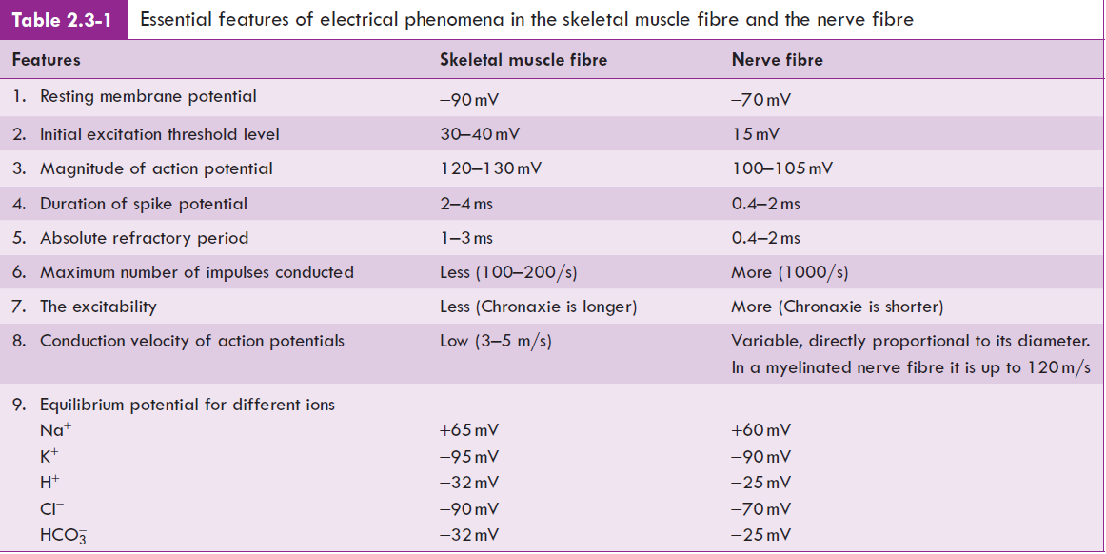

Slide 5
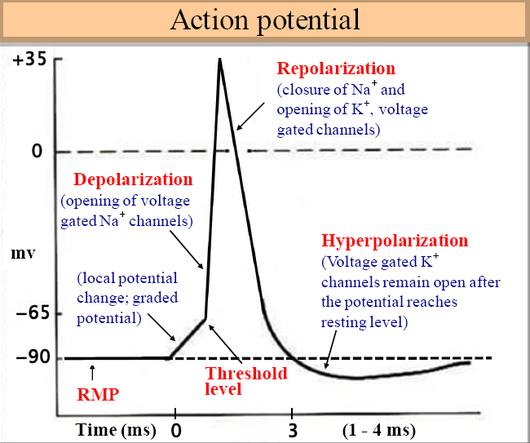

Slide 6
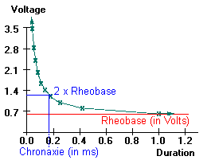
Strength Duration Curve

Slide 7
Rheobase: the minimum strength of the current acting on the muscle for a variable period that can bring about a response.
Utilization time: the minimum duration for which a current of Rheobase strength is applied to excite an excitable tissue
Chronaxie: is defined as the shortest duration of stimulus required to excite a tissue by a current strength equal to twice of Rheobase voltage.

Slide 8
Refractory period……
Refractory period is the period at which the muscle does not show any response to a stimulus.
It is of two types
Absolute RP:
Relative RP:

Slide 9
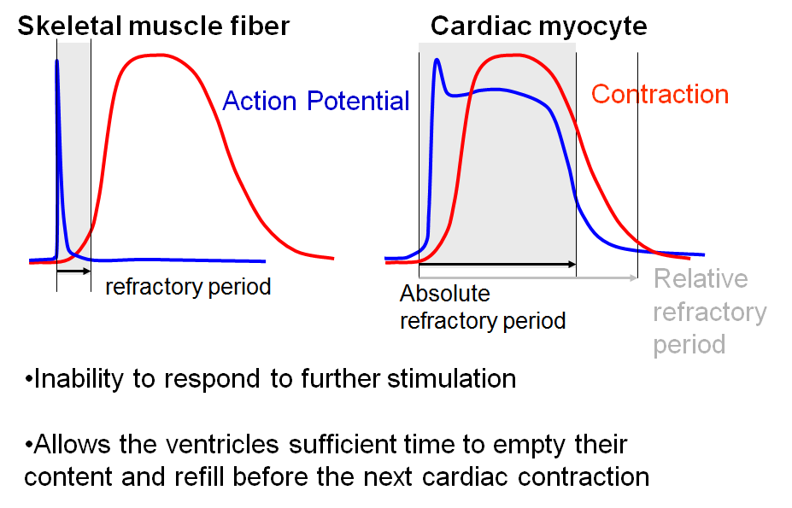

Slide 10
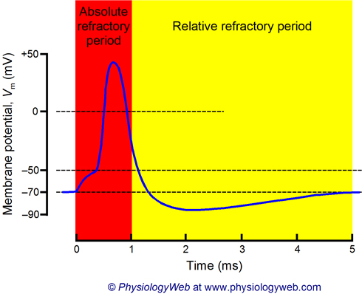

Slide 11
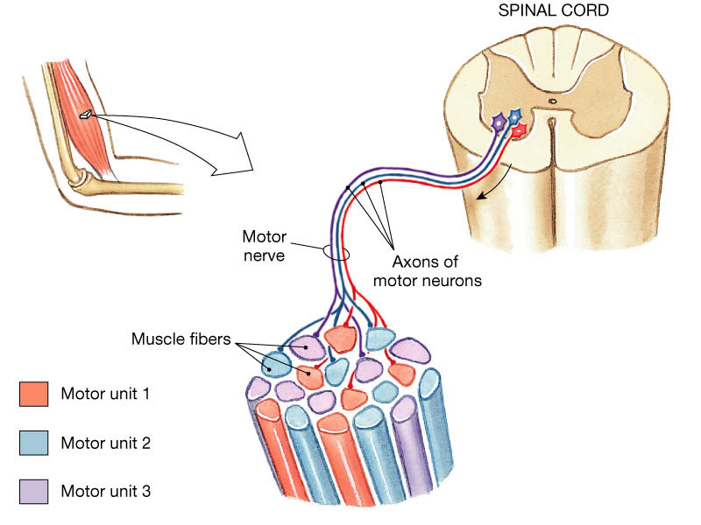
Contractility ……………

Slide 12
Contractility
Def : internal events of the muscle which are manifested by shortening or development of tension or both.
Two primary types
  Isotonic
    Muscle tension remains constant as muscle changes length
  Isometric
    Muscle is prevented from shortening
    Tension develops at constant muscle length

Slide 13
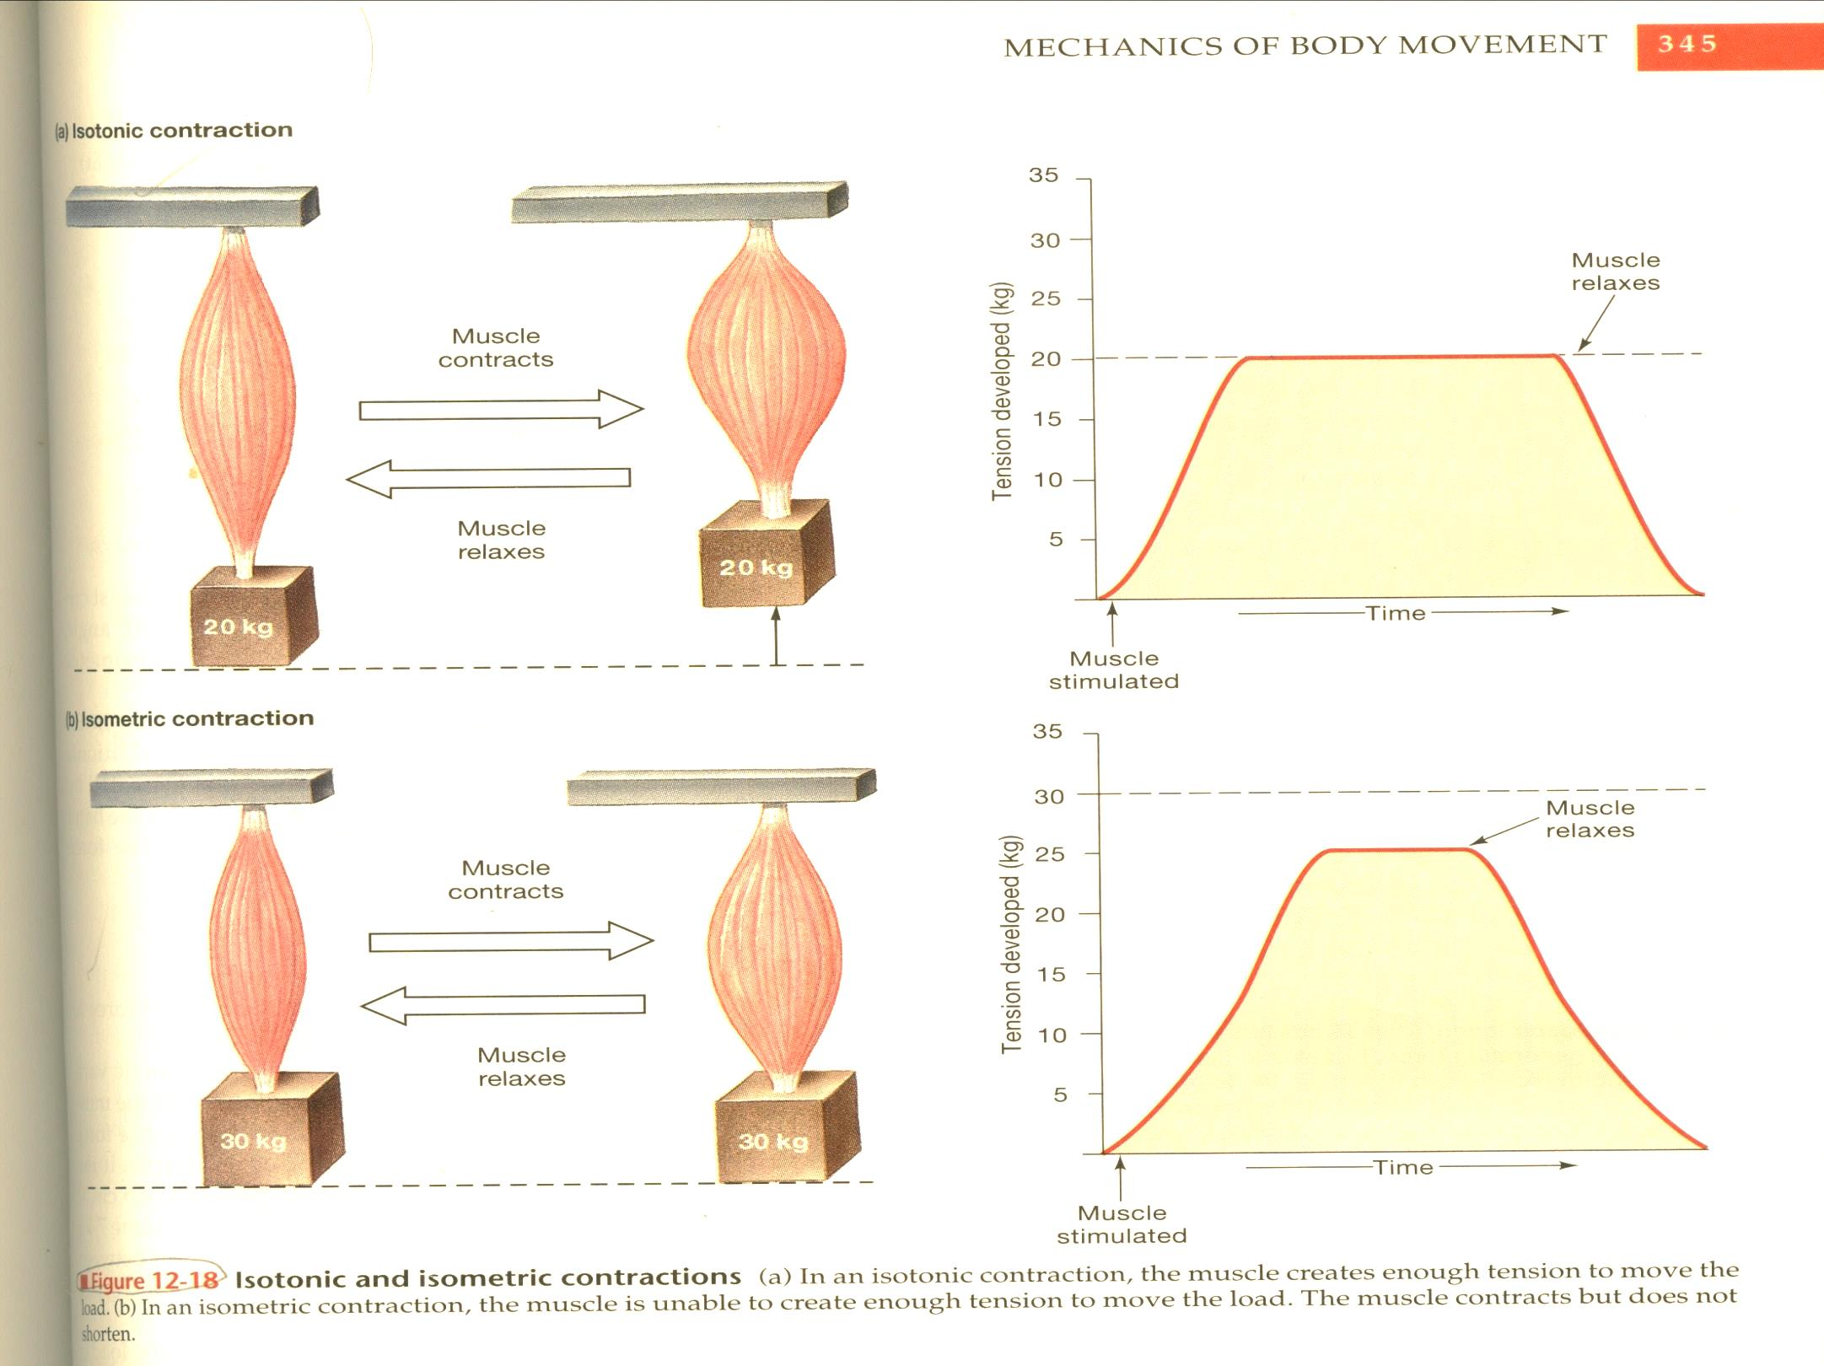
Isotonic
Isometric

Slide 14
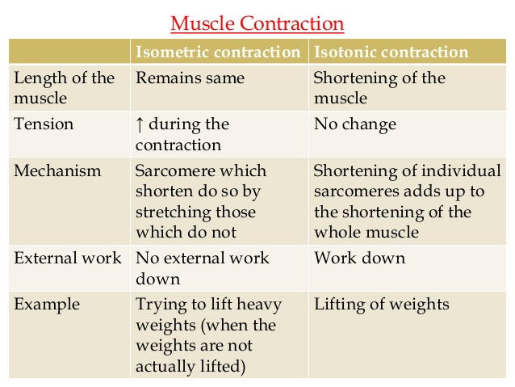

Slide 15
CHARACTERISTICS OF MUSCLE CONTRACTILITY
CONTRACTILITY
Contractile and elastic components of a muscle,

Slide 16
CHARACTERISTICS OF MUSCLE CONTRACTILITY
Consists of three components
Contractile component,
Series elastic component and
Parallel elastic component.

Slide 17
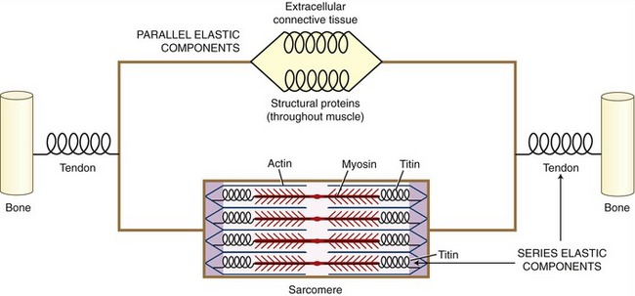

Slide 18
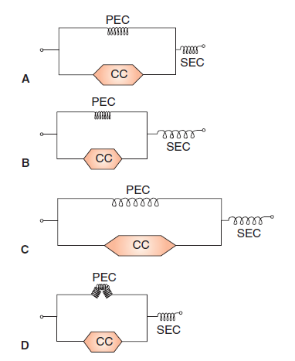
1.The contractile component (CC)
CC represents the thick and thin filaments present in the myofibrils.
It is considered to be viscous in nature, i.e. it offers no resistance to stretch and is unable to return to its original length after it has shortened .
The CC comprises 60% of the total muscle proteins.

Slide 19
2. Series elastic component (SEC)
(SEC) refers to that elastic tissue of the muscle which is present in series with the CC of the muscle.
It consists of the elastic tendon of the muscle.
In resting condition, the SEC offers resistance to passive stretch and explains how muscle is able to contract even when its external length does not change, i.e. isometric contraction
Isometric contraction

Slide 20
3. Parallel elastic component(PEC)
It is attached parallel to the CC.
It is Connective tissue sheaths of the muscle, sarcolemma and filaments.
Role: the muscle regains its original length after it is passively stretched
In isotonic contraction this component gets folded up.
It also offers some resistance to passive stretch.
The SEC and PEC combined
Form 40% (2/5th) of total muscle proteins.

Slide 21
A, when muscle is at normal
length;
B, during isometric contraction
C, when muscle is passively
stretched and
D, in isotonic contraction.
D, in isotonic contraction.

Slide 22
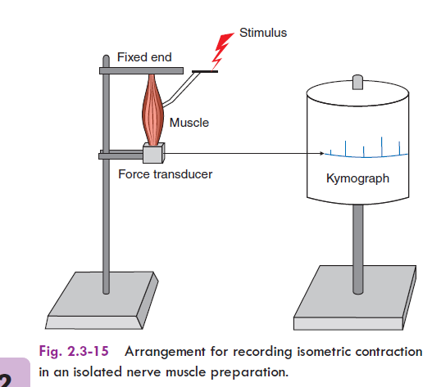
Length-Tension Relationship
Isometric tension developed in a muscle depends on the initial length of the muscle.
For the isometric tension to be recorded in an experimental set up, the ends of muscle are attached to two fixing points so that changing the distance between the fixing points can alter the length of the muscle.

Slide 23
Observations………
When the muscle fiber is stretched , the tension registered by it is known as the passive tension.
It is due to elongation of the elastic Titin filaments, not due to activation of the contractile elements.
If this stretched muscle is stimulated, the tension developed by it is known as the total tension.

Slide 24
At any length, the amount of tension actually generated by the cross-bridge movements is known as the active tension.
-Which is the difference between the two values, that is the total tension minus passive tension.

Slide 25
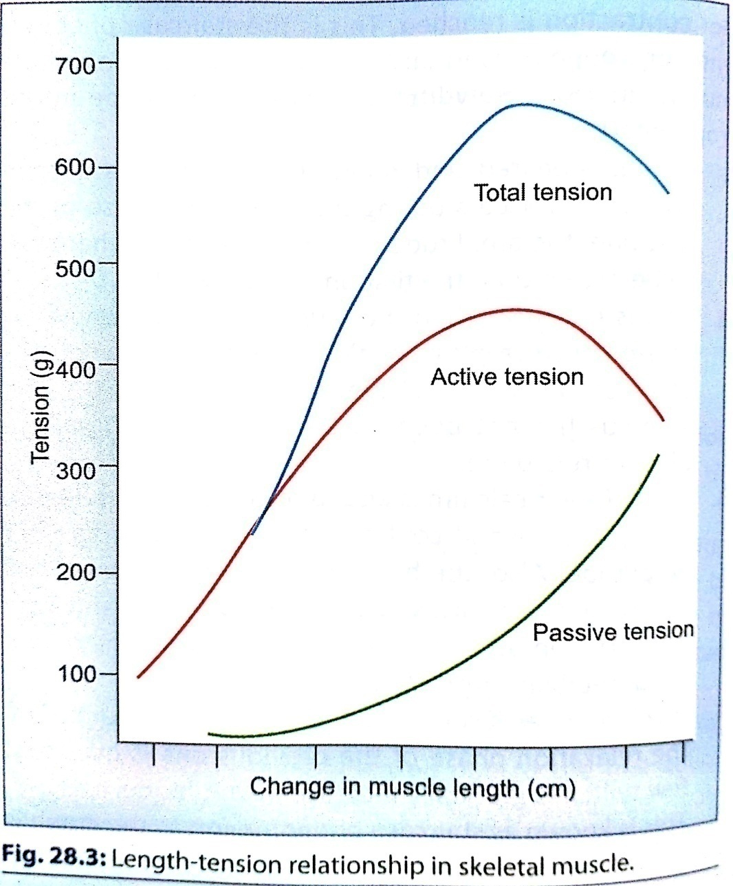
The length-tension relationship graph

Slide 26
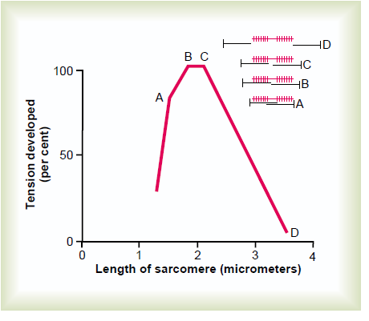
  When a muscle fiber is stretched there is less overlap between the thick and thin filaments and tension is diminished
  When a muscle fiber is shortened the filaments are compressed and fewer myosin heads make contact with thin filaments and tension is diminished

Slide 27
  When a muscle fiber is stretched there is less overlap between the thick and thin filaments and tension is diminished
  When a muscle fiber is shortened the filaments are compressed and fewer myosin heads make contact with thin filaments and tension is diminished

Slide 28
Length–Tension Relationship
  The forcefulness of muscle contraction depends on the length of the sarcomeres
  When a muscle fiber is stretched there is less overlap between the thick and thin filaments and tension (forcefulness) is diminished
  When a muscle fiber is shortened the filaments are compressed and fewer myosin heads make contact with thin filaments and tension is diminished

Slide 29
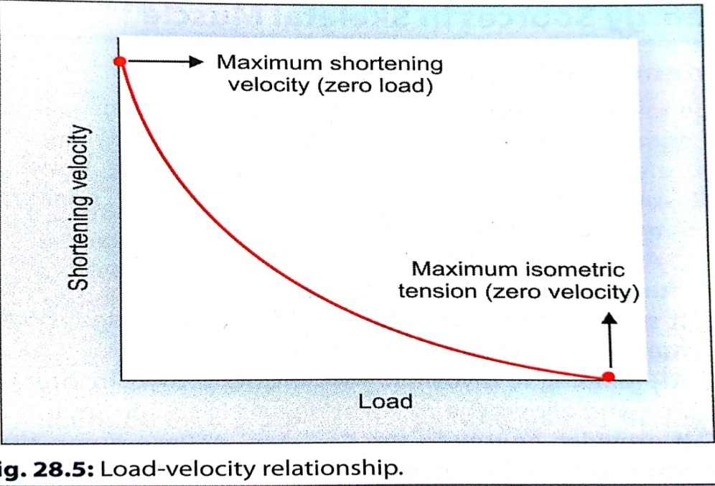
Load -velocity relationship
When a muscle contracts against a load (isotonic-contraction) , the velocity of fiber-shortening is inversely proportional to the degree of load
When there is no load, the muscle contracts with maximum velocity and the velocity decreases with increasing load on muscle.

Slide 30
When the load becomes equal to the maximal isometric tension the muscle can develop, the shortening velocity is zero.
E.g. light object can be lifted faster than heavy objects.

Slide 31
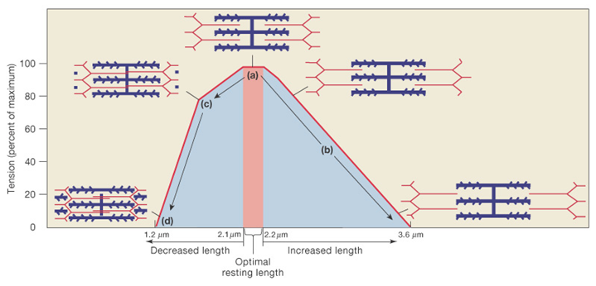
Length-Tension of sarcomere.

Slide 32
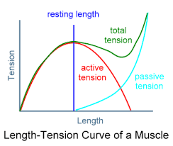

Slide 33
FACTORS AFFECTING CONTRACTION……..
Strength of stimuli- Quantal summation
Number of Stimuli:
1) effect of 2 successive stimuli:
i) Beneficial effect
ii) Summation
2)more than two stimuli:
i) Clonus, Tetanus
ii) Treppe
iii) Fatigue
C. Effect of temperature
D. Load (Preload & Afterload)

Slide 34
Major Types of Muscle Fibers
Classified based on differences in ATP hydrolysis and synthesis
Two major types
  Slow-oxidative (type I) fibers
  Fast-oxidative (type IIa) fibers
  Fast-glycolytic (type IIb) fibers

Slide 35
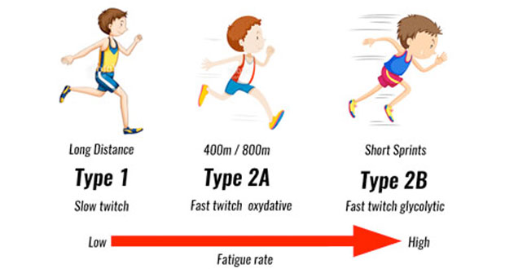

Slide 36
Property Slow Intermediate Fast
Contraction speed Slow Fast Fast
Tension Low Intermediate High
Fatigue resistance High Intermediate Low
Colour Red White White
Myoglobin content High Low Low
Capillary supply Dense Intermediate Scarce
Mitochondria Many Intermediate Few
Glycolytic enzyme Low High High
Substrates used for Lipids, CHO, Primarily CHO CHO
ATP generation (aerobic) (anaerobic) (anaerobic) Alternative names Type I, S (slow), Type IIa, FO Type IIb/x, SO (slow oxidative) FR (fast resistant) FF (Fast fatigue)

Slide 37
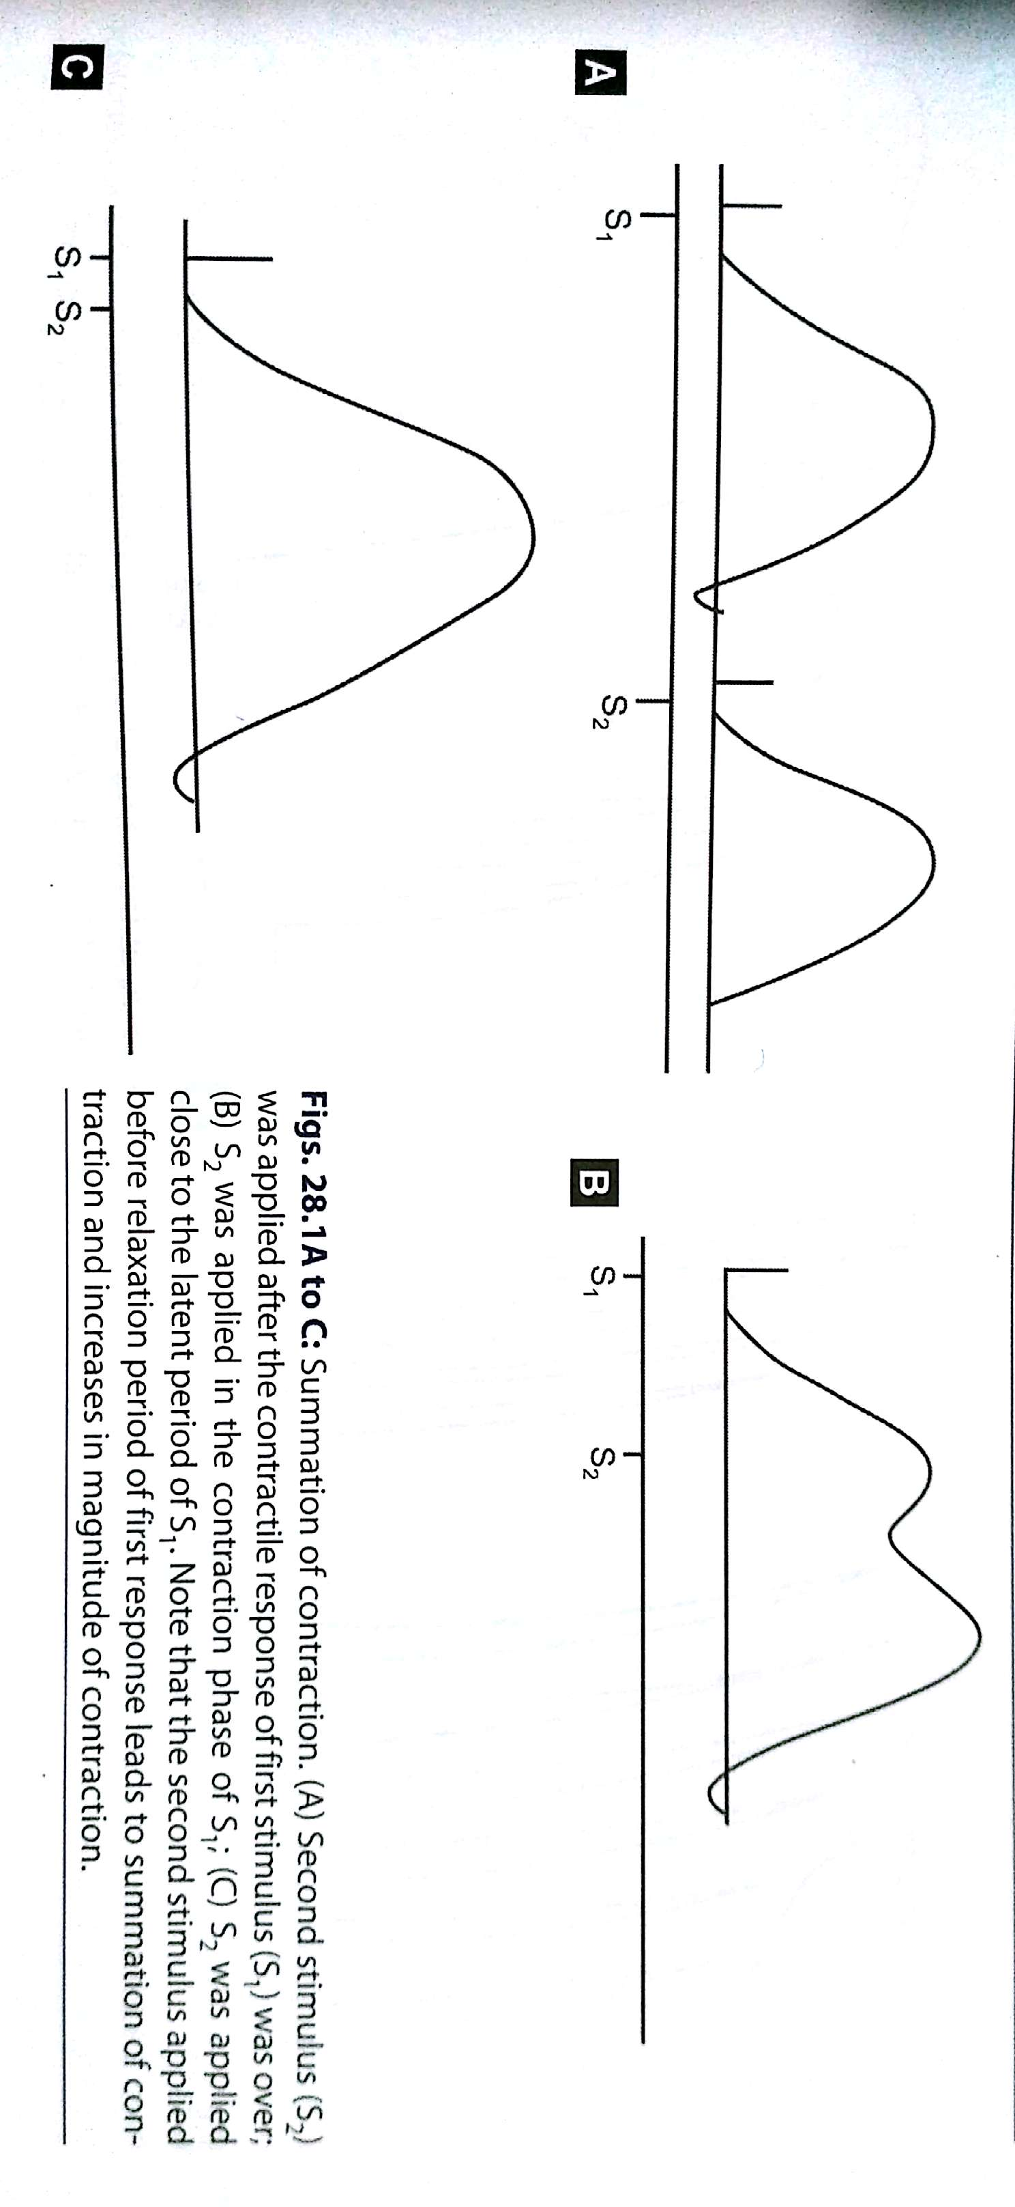
Summation of contraction
Repeated stimulation of the muscle before relaxation has occurred produces a phenomenon known as summation of contraction.

Slide 38
Summation of contraction

Slide 39
All or None response
An individual muscle fiber exhibits contraction of an uniform intensity once their particular threshold has been reached

Slide 40
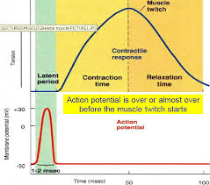
Single muscle twitch
Muscle-twitch (simple muscle curve):
The contraction and relaxation of skeletal muscle in response to a single adequate stimulus

Slide 41
Muscle Fatigue………
Failure of a muscle to maintain tension as a result of previous contractile activity is known as muscle fatigue.
Defense mechanism that protects muscle from reaching point at which it can no longer produce ATP
Underlying causes of muscle fatigue are unclear
It depends upon
1. intensity and duration of exercise
2. Type of muscle fibers.

Slide 42
Causes of muscle fatigue have been classified into central and peripheral
Central - includes CNS, motivation and psychological factors
  restoration of force with external stimulation of muscle -indicates central fatigue
  NH₃, hypoglycemia, reticular formation
Peripheral - PNS to muscle - EC coupling, energy supply and force generation

Slide 43
  Causes of fatigue are:
  Depletion of creatine phosphate
  Insufficient oxygen
  Depletion of glycogen and other nutrients
  Buildup of lactic acid and ADP
  Failure of the motor neuron to release enough acetylcholine

Slide 44
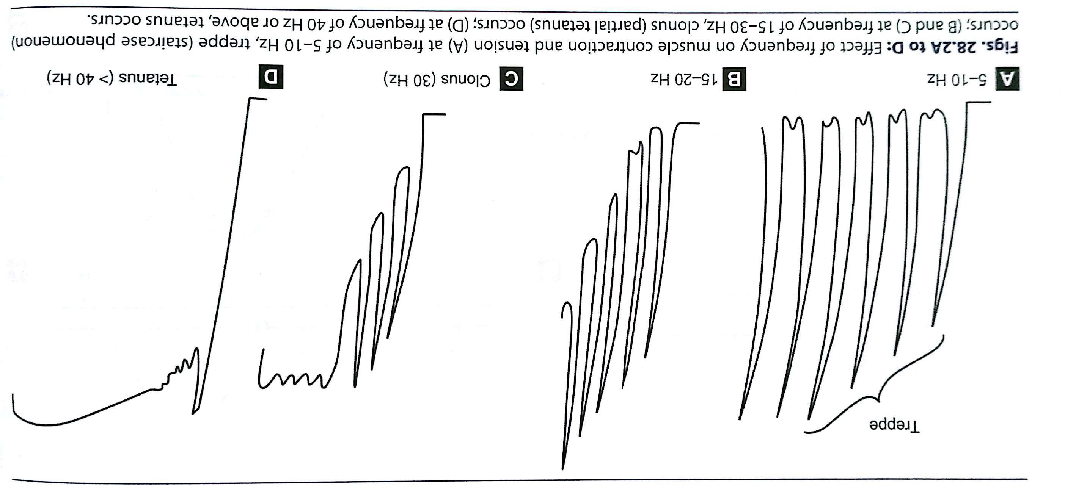
Staircase phenomenon
If a skeletal muscle is stimulated rapidly with a maximal stimulus, there is a progressive increase in the force of contraction for the first few contractions, until a maximum uniform tension per contraction is reached.
This is called staircase phenomenon or Treppe.

Slide 45
Tetanization
If the muscle is stimulated repeatedly at a very high frequency , continuous activation of the contractile mechanism occurs without any relaxation , resulting in sustained contraction known as tetanus
( tetanic contraction).

Slide 46
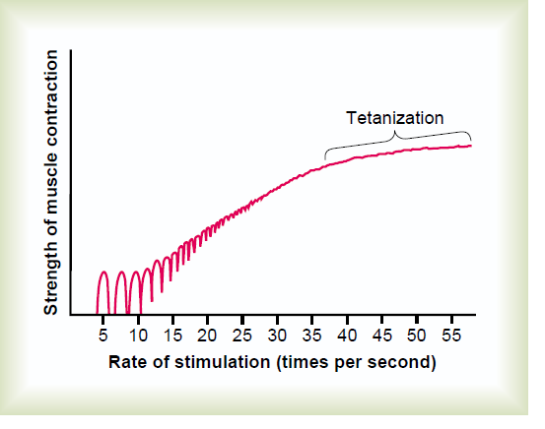
Tetanus

Slide 47
Light load offers less resistance to the sliding of the filaments so that thin filaments move quickly over thick filaments allowing few cross-bridges to form at a time, producing less tension and faster contraction.
Increasing load on a cross-bridge slows its forward movement during a power stroke and reduces the ATP hydrolysis; the slower contraction allows more time for actomyosin interaction and greater tension development.

Slide 48
Energy sources:
ATP: It is the immediate source of energy.
Resynthesis of ATP by
1Phosphorylation of ADP by CREATINE PHOSPHATE(5 sec)
CP+ADP creatine +ATP
2.Glycolysis( for 1min)
3.Oxidative metabolism of fats, carbohydrate and protein(long term contraction)

Slide 49
Other sources:
At rest and during light exercise, muscle utilizes free fatty acids as its energy source.
During moderate to heavy exercise, metabolism of glucose and glycogen has the primary role to generate ATP.
In presence of O2, AEROBIC GYCOLYSIS takes place, the end products being CO2, H2O and 38 molecules of ATP.
If the O2 supply is inadequate , anaerobic glycolysis delivers lactic acid and 2 ATP per molecules of glucose.

Slide 50
Energy Sources for Contraction…
Transfer of high-energy phosphate from creatine phosphate to ADP, First energy storehouse tapped at onset of contractile activity
Oxidative phosphorylation (citric acid cycle and electron transport system). Takes place within muscle mitochondria if sufficient O₂ is present
Glycolysis
  Supports anaerobic or high-intensity exercise

Slide 51
Thermal changes during muscle contraction………
Resting heat: muscle is in rest, not contracting
Initial heat: heat generated in excess of resting heat during muscular contraction
Recovery heat: heat produced in excess of resting heat, following muscle contraction
Relaxation heat: extra heat, in addition to the recovery heat, which is produced during relaxation of the isotonically contracted muscle.

Slide 52
Oxygen Debt
Oxygen Consumption After Exercise
After exercise, heavy breathing continues and oxygen consumption remains above the resting level
Oxygen debt
  The added oxygen that is taken into the body after exercise
  This added oxygen is used to restore muscle cells to the resting level in three ways
    1) to convert lactic acid into glycogen
    2) to synthesize creatine phosphate and ATP
    3) to replace the oxygen removed from myoglobin

Slide 53
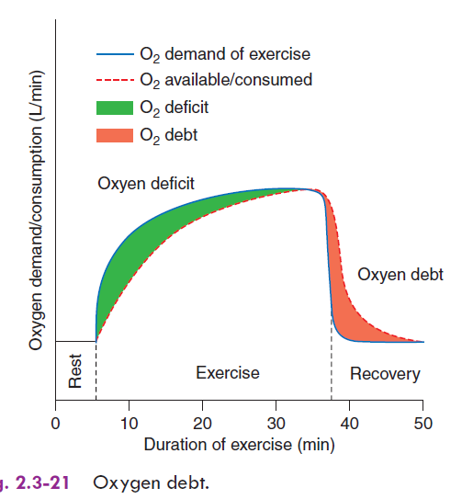

Slide 54
EMG and Disorders of skeletal muscle
The recording of muscle APs is called electromyography. The record is known as an electromyogram
Electomyography is the study of electrical activity of the muscle.
EMG is the graphical representation of electrical activity of muscle.
Useful in diagnosis of neuromuscular diseases and myopathies.

Slide 55
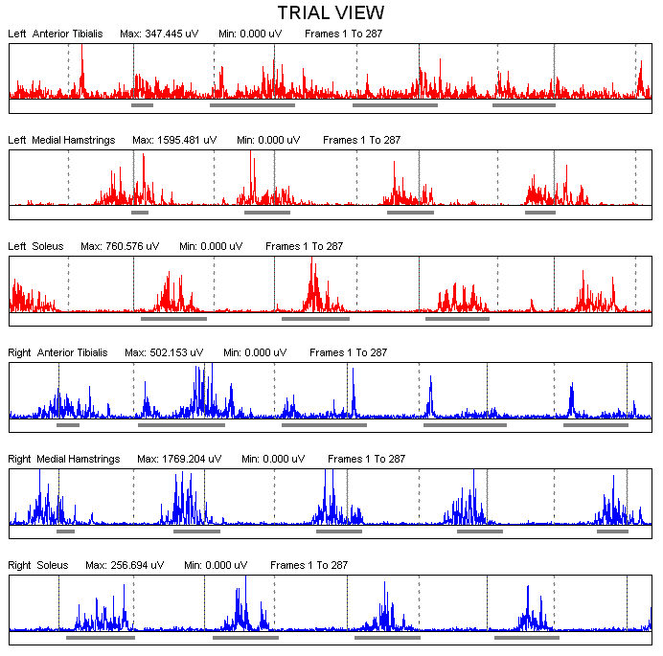
Sweep of AP → similar to a wave
Height of wave and the density of the wave can be recorded

Slide 56
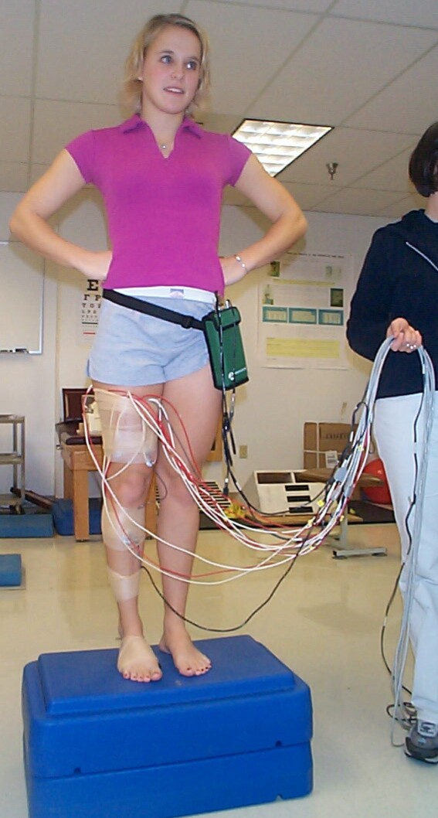
Recording Methodology:
Electrical potential difference measured between two points → bipolar electrode configuration used
Bipolar Electrode Types
    Fine Wire
    Needle
    Surface
Electrode Placement
    Overlying the muscle of interest in the direction of predominant fiber direction
    Subject is GROUNDED by placing an electrode in an inactive region of body
http://www.hhdev.psu.edu/atlab/EMG.jpg

Slide 57
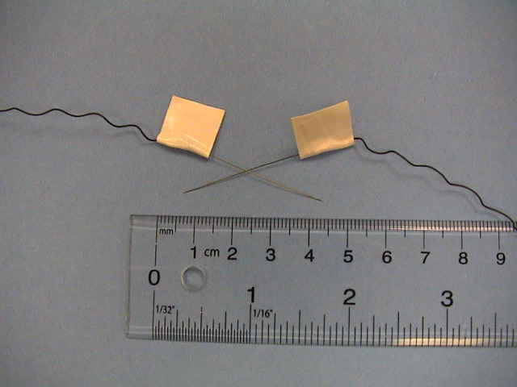
Fine Wire
http://educ.ubc.ca/faculty/sanderson/EMG/Index.htm

Slide 58
DISORDERS OF SKELETAL MUSCLE.
MUSCLE DYSTROPHY- progressive degeneration of muscle fibers without the involvement of nervous system.
1. Duchenne: No formation of dystrophin protein.
2. Becker’s: Altered formation of dystrophin protein.
MUSCLE TONE DISEASES- hyper or hypotonia
DENERVATION HYPERSENSITIVITY AND FIBRILLATION
McARDLE’S DISEASE-Glycogen storage diseases
NEMALINE MYOPATHY-small rod like structures in the muscle fiber.

Slide 59
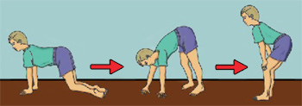
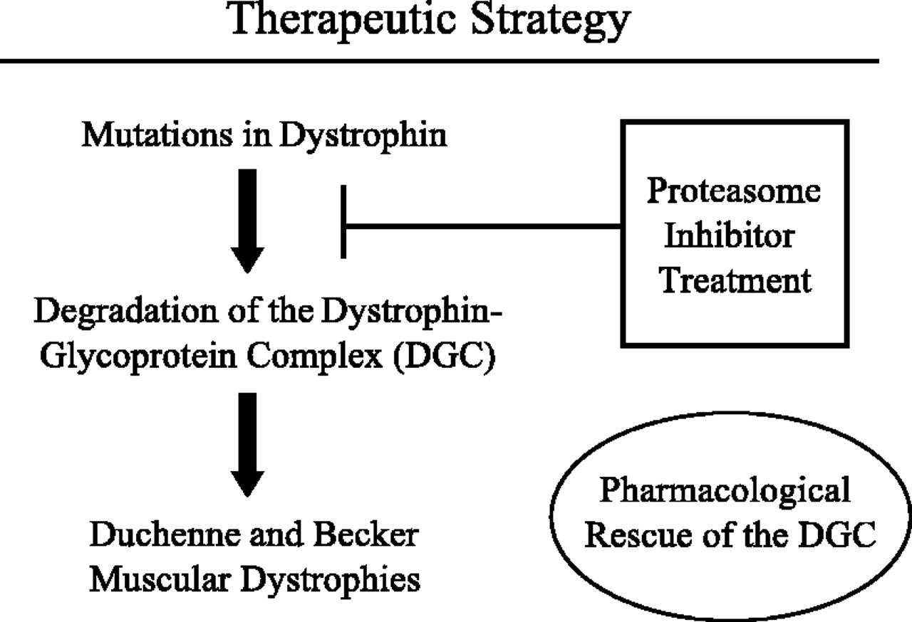
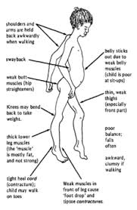
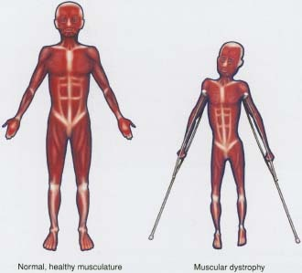

Slide 60
CCES
1.Graphical representation of muscle activity is k/as
EMG
ECG
ETG
ESG

Slide 61
2.Duchenne muscle dystrophy is because of mutation of
Dystrophin
Titin
Myosin
Actin

Slide 62
2. Slow muscle fiber have:
Decreased endoplasmic reticulum
Decreased calcium store
Decreased glycogen
Increased mitochondria

Slide 63
3.The muscle typically exhibit isometric contraction are:
Extraocular
Respirtory
Antigravity
Masticatory

Slide 64
4. The length of sarcomere at the highest tension develop is k/as
Optimal length
Minimum length
Equilibrium length
None

Slide 65
5.Tension developed in muscle due to activation of contractile component is called:
Passive tension
Active tension
Total tension
Resting tension

Slide 66
In human beings the site of fatigue is
Synapse of CNS
NM junction
Sarcomere
None

