Slide 1
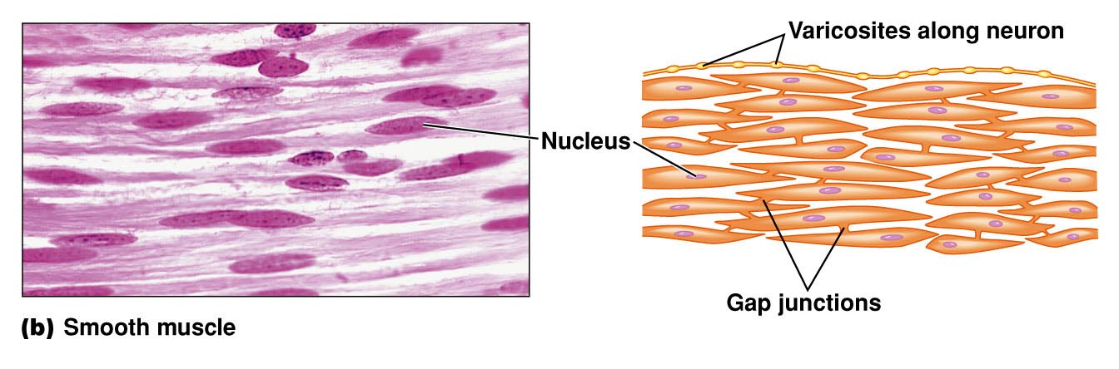
Smooth –muscle physiology

Slide 2
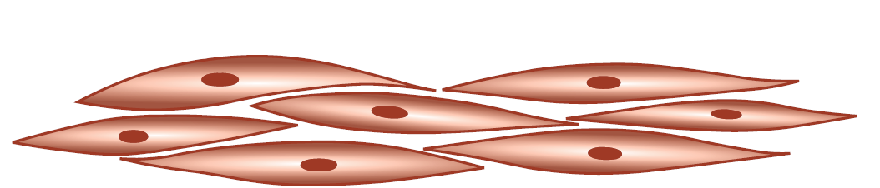
Functional anatomy & organization
Non striated
Involuntary muscle
Long spindle shape cell
Layer of variable thickness
Thick central part overlap thin tapering part
length variable 15 to 500 micrometer

Slide 3
Salient features of structure
Cells communicate through gap junctions.
Nucleus oval or elongated, central
Sarcoplasm is usual
Sarcoplasmic reticulum is not well developed

Slide 4
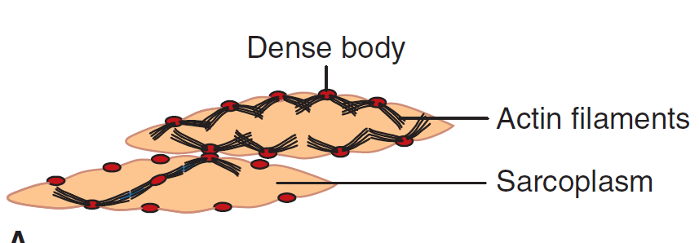
Myofibrils
Made of actin and myosin
No cross striation
Less thick filament and more thin filaments
Myosin is chemically different. It only binds to actin if light chain is phosphorylated
Absence of Troponin
    Dense bodies function is similar to Z disks
Actin attached to dense body

Slide 5
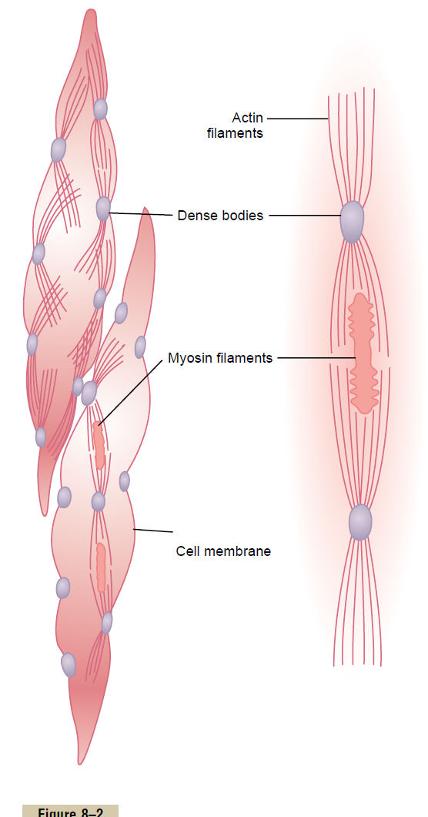
Structure of smooth muscle

Slide 6
Dense bodies attached to cell membrane and scattered all over body of fibre
Actin attached to dense body
In-between actin, myosin filaments
During contraction, dense bodies comes closer
Change in shape from oblongated to oval

Slide 7
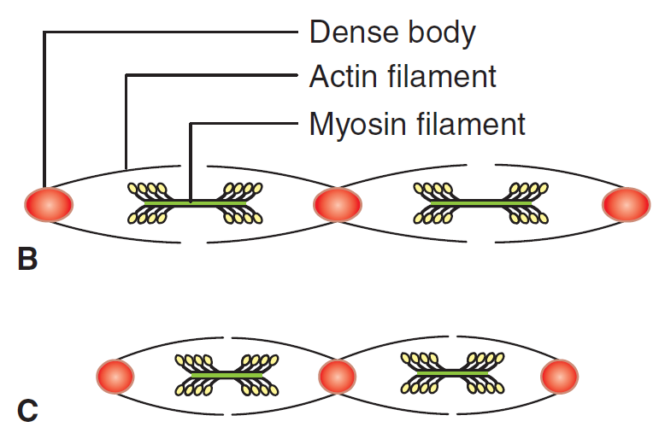

Slide 8
Type of smooth muscle
2 type
Single unit smooth muscle
Multiunit smooth muscle

Slide 9
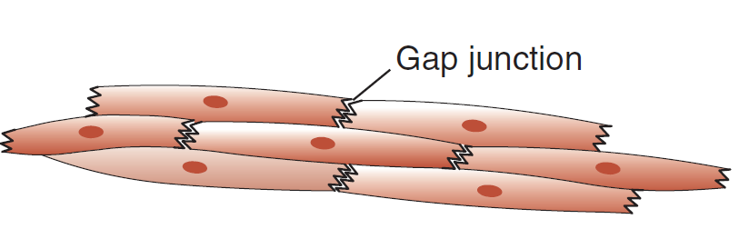
Single unit smooth muscle
Called Visceral smooth muscle
present in the walls of hollow viscera
such as gastrointestinal tract, uterus, ureter, urinary bladder and respiratory tract.

Slide 10
Salient features:
Arranged in Large sheets
having low resistance bridges called Gap Junctions so acts in Syncytial Fashion
Therefore, syncytium contracts as a single unit in many large areas.
Own rhythmical contractility called myogenic tone, independent of nerve supply

Slide 11
Pacemaker determine the rate of contraction
Pacemaker Regions influenced by nerve
Smooth muscle Contraction stimulated by stretching, hormones, temperature, pH
Important in auto regulation in blood vessels(smaller)

Slide 12
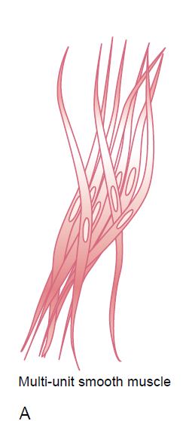
Multiunit smooth muscle
Multiple individual units
Very less gap junctions.
Non syncytial
Located in blood vessels,
Epididymis,
Vas deferens,
Iris,
Ciliary body,
Piloerector muscle

Slide 13
Salient features
Multiple units innervated by single nerve
Muscle fiber has outer glycoprotein membrane helps to insulate an separate from each other
Contraction is neurogenic
Single stimulus cause repeated firing of nerve impulse produces irregular tetanic contractions
No pacemaker activity
Localize excitation due to absence of gap junction
Do not respond to stretch

Slide 14
CLASSIFICATION OF SMOOTH MUSCLES…
UNITARY/ SINGLE UNIT/SYNCYTIAL/VISCERAL
1. Form a sheet or bundles of tissue.
2. Muscles of visceral organs .e.g. GIT, uterus, ureters & some of the smaller blood vessels.
3.Cell membranes show gap junctions that allows AP to pass rapidly from cell to cell.
4.AP spreads rapidly throughout the sheet of cells – cells contract as a single unit. Often autorhythmic
MULTI-UNIT
1. Showing discrete, individual smooth muscle fibers
2. Iris & Ciliary body of the eye, large arteries, Piloerector muscles
3. Smooth muscle cells not electrically linked. Each muscle fiber innervated by a single nerve ending. NT itself can spread and lead to an AP.
4.Selective activation of each muscle fiber that can then contract independently of each other.

Slide 15
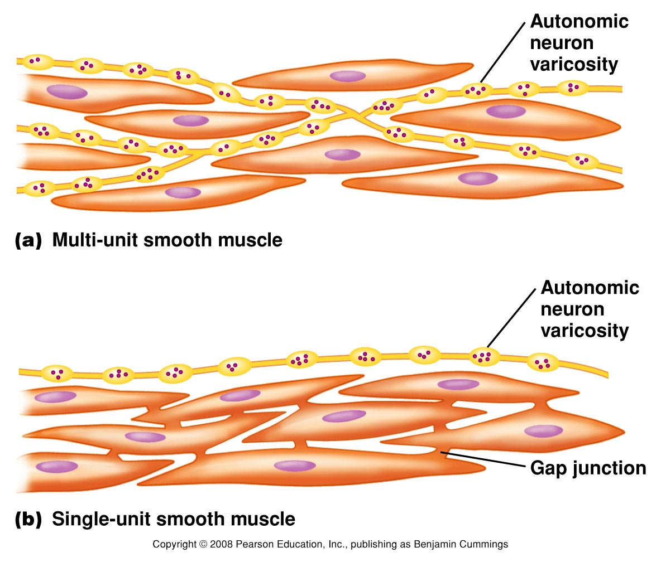
Multi vs. Single-Unit Muscle…..

Slide 16
Nerve supply
Innervated by sympathetic & Parasympathetic.
The two have opposite effects.
In some organs sympathetic stimulation causes contraction and parasympathetic stimulation causes relaxation of smooth muscles.

Slide 17
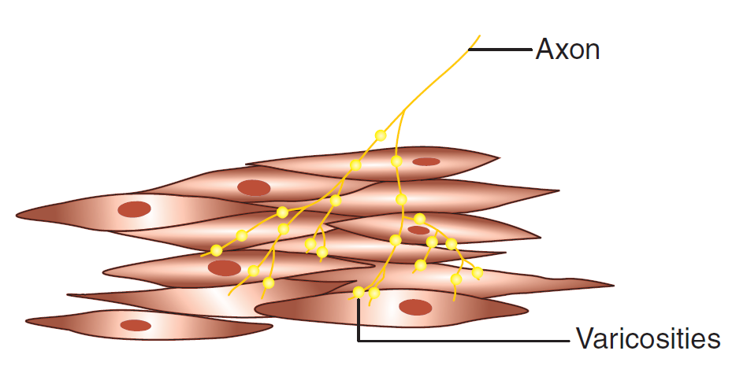
Neuromuscular junction
Varicosities
Do not make direct contact
Release neurotransmitter into interstitial fluid
So it activates up to syncytium
Repeated stimuli needed
In sheet form only upper layer is innervated
Spread of AP in deeper part by gap junction

Slide 18
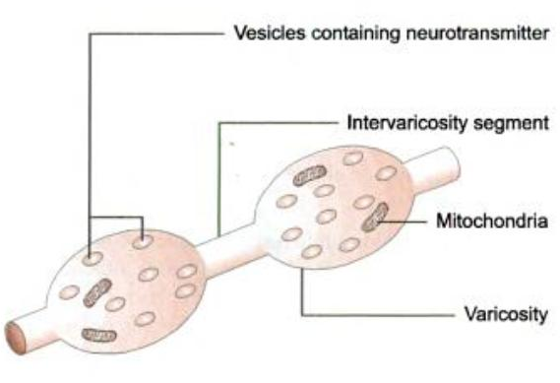

Slide 19
PROCESS OF EXCITABILITY AND CONTRACTILITY
Process of muscle excitation
Process of excitation–contraction coupling
Process of muscle contraction.

Slide 20
Excitation in single unit smooth muscle
Resting membrane potential
-50 mV to -75 mV
As low as -25 mV
Unstability i.e. no true value but oscillating between
-55 to -35 mV
Due to superimposition by pacemaker potential. either due to change in Ca++ channel permeability and/or Na+- K+ pump activity

Slide 21
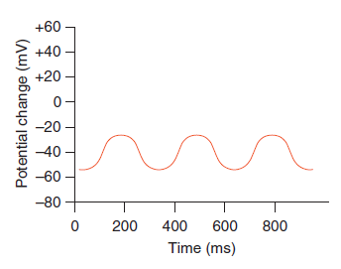

Slide 22
Action potential
When depolarization reaches threshold potential,
an action potential is generated which is transmitted to the adjacent muscle cells through the gap junction.
Three types of AP:
Spike potential
Spike potential superimposed over pacemaker potential
Action potential with plateau.

Slide 23
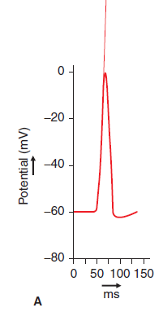
1.Spike potential
Typical spike potential
In Most of single unit muscles
Duration 10 to 50 msec
Very low amplitude
Produce by
  Electrical stimulation
  Hormones
  Neurotransmitters
  Stretch

Slide 24
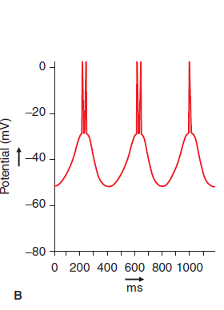
2.Spike potential superimposed over slow wave potential
Slow wave potential is also called pacemaker potential
Seen in muscles of gut
When potential wave rise above
-35 mV it produce action potential which can spread all over
One to two spike superimposed at each peak of slow wave

Slide 25
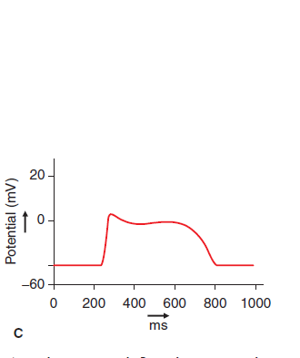
3.Action Potential with Plateau
Seen in ureter & uterus
Rapid depolarization
Repolarization occurs after 100 to 1000 msec
Sustained contraction
Entry of Ca++ from ECF to inside rather than Na
More voltage gated Ca channels
Opens and closes slowly
Ca+ also directly act on contractile mechanism

Slide 26




Slide 27
Electrical activity in multiunit smooth muscle
Respond to nerve stimuli
Neurotransmitter cause depolarization but not generate AP
Excitatory junctional potential (EJP)
EJP can electrotonically spread and produce contraction

Slide 28
Excitation Contraction Coupling
Electro Mechanical Coupling
  muscle is excited through sarcolemmal depolarization.
Pharmaco Mechanical Coupling
  muscle is excited by some chemical agent.
Mechano Mechanical Coupling
  by Stretch

Slide 29
Smooth muscle contraction
Actin and myosin present
Tropomyosin present but function unknwon
Calmodulin but not Troponin
Myosin light chain act as regulator called regulatory chain of myosin
Cross bridge formation

Slide 30
EXCITATION-CONTRACTION COUPLING
in
smooth muscle

Slide 31
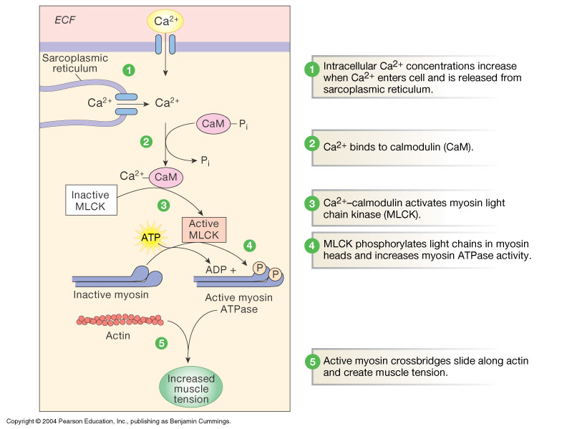
Contraction…
Activation of
Stretch-activated& Chemical-gated
Ca- channels
↓
Increased Influx of Ca(ECF & SR)
↓
Ca binds to Calmodulin
↓
activates Myosin light chain kinase enzyme (MLCK) or Myosin kinase
↓
Activated MLCK uses ATP to phosphorylate myosin regulatory chain
↓
Form cross bridge
↓
Contraction of smooth muscle by Power stroke.

Slide 32
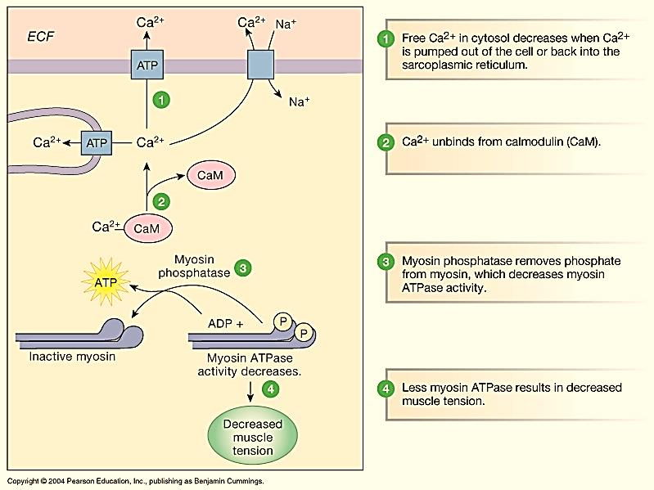
SMOOTH MUSCLE RELAXATION
1.Decreased ca++ by Ca pump,
2.De-phosphorylation of Myosin regulatory chain by myosin phosphatase
↓
After this the cross-bridge cycling stops and the contraction ceases
↓
Relaxation of muscle

Slide 33
Steps of cross-bridge cycling
1. Activation of the enzyme myosin light chain kinase (MLCK). The enzyme MLCK is activated by the Ca2+– calmodulin complex.
2. Phosphorylation of the myosin regulatory chain.
The activated enzyme MLCK uses ATP to phosphorylate the
myosin regulatory chain.
3. Cross-bridging.
When the myosin regulatory chain is phosphorylated, the head of myosin filament acquires the capability to bind with actin filament to form the cross bridge

Slide 34
4. Power stroke.
Formation of the actin–myosin ADP-Pi complex triggers a conformational change in the myosin head causing it to flex towards the arm of the cross-bridge.
The flexion of the myosin head generates mechanical force

Slide 35
5. Relaxation of smooth muscle
Ca++ pump which pump ca++ from ICF to ECF lead to Decreased ca++ and
when the enzyme myosin phosphatase causes dephosphorylation of the myosin regulatory chain.
After this the cross-bridge cycling stops and the contraction ceases

Slide 36
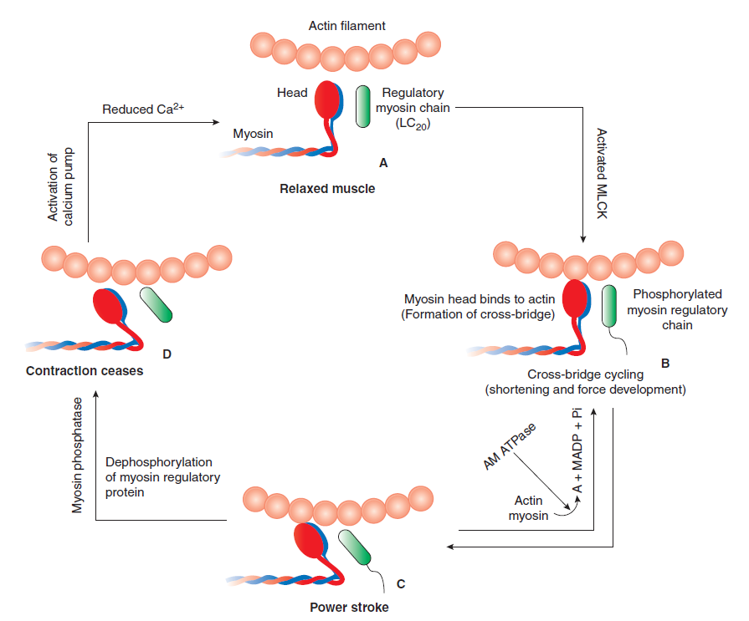

Slide 37
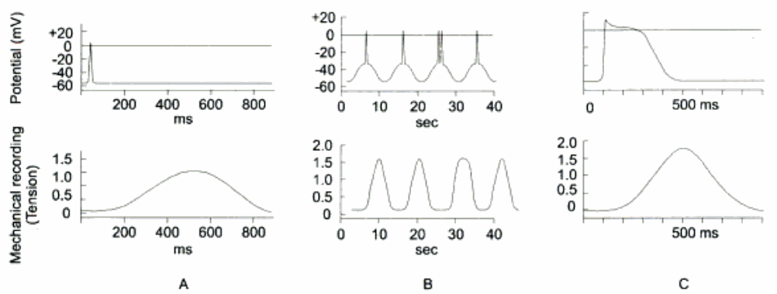
Characteristics of smooth muscle excitation and contraction
1.Slow Excitation Contraction Coupling

Slide 38
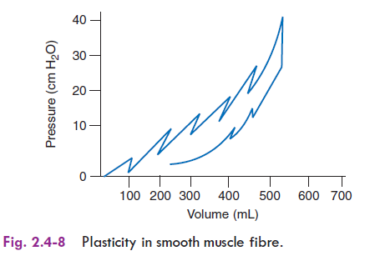
2.Plasticity
Plasticity. (also called “stress relaxation”)
  Slow stretch --> lengthening
  e.g. bladder capacity w/o pressure increase
Readjust its resting length
Defies length tension relationship
When stretch, initially increase tension which gradually reduce to prestretch level
Graph shows jagged lines

Slide 39
3.Latch Phenomenon
Maintain high tension without actively contracting
Long term maintenance of tone in organ
Cannot generate active tension but resist passive stretching
Mostly found in hollow viscera
Due to decrease activity of enzyme causes myosin heads to remain attached
4.Marked Shortening during contraction
5.Less energy require to sustain contraction

Slide 40
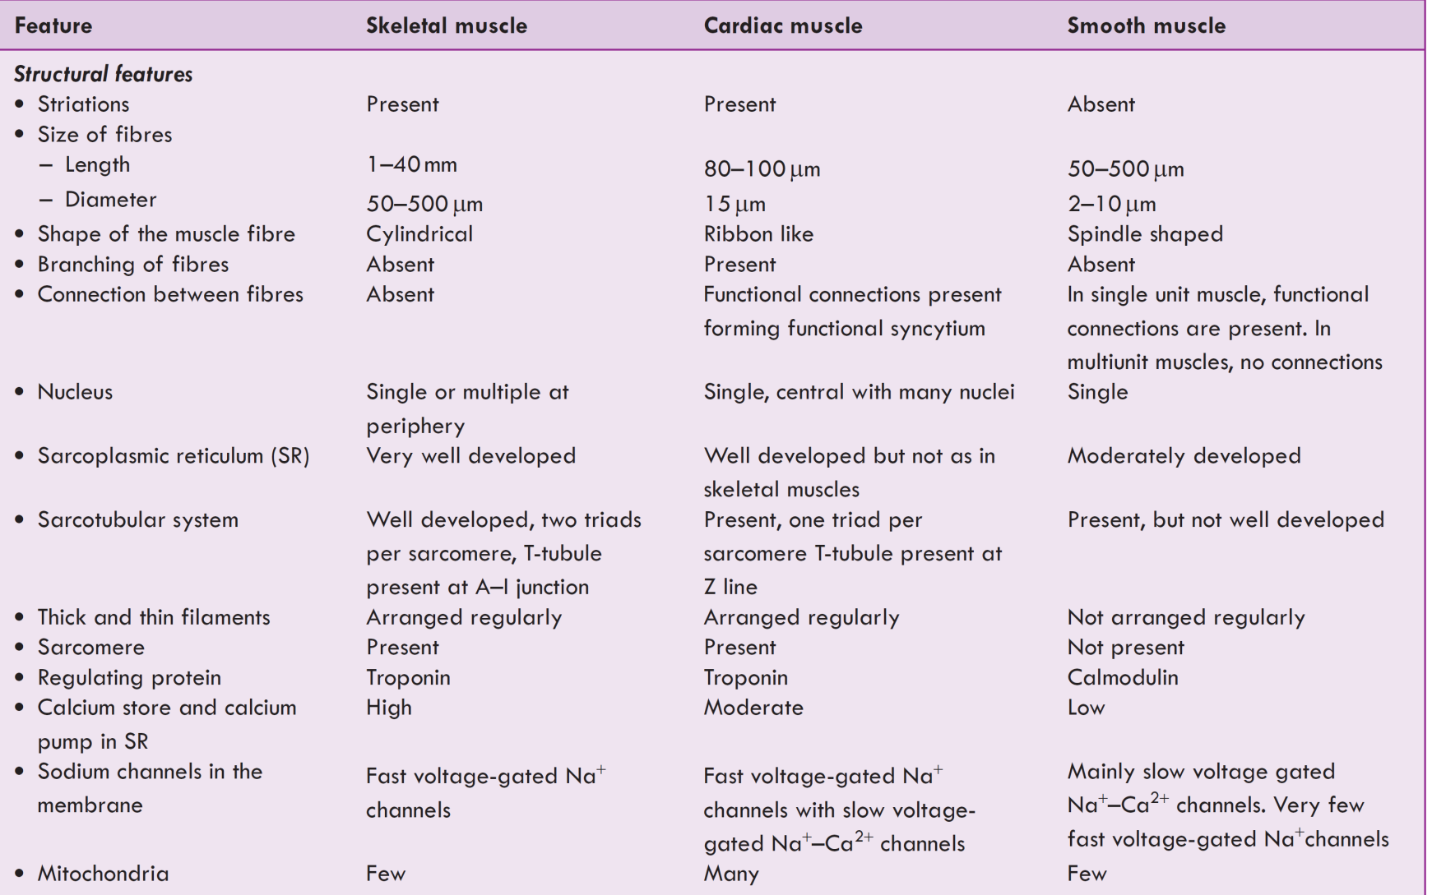

Slide 41
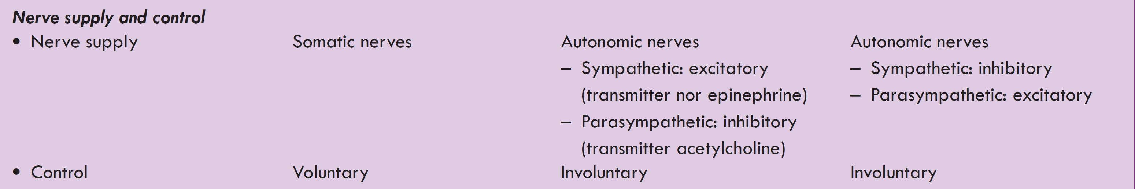
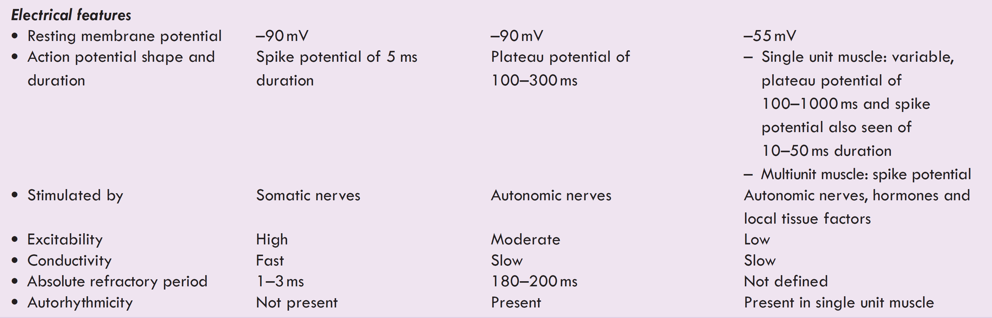

Slide 42
1. Smooth muscle does not contain
a. Actin b. Myosin
c. Tropomyosin d.Troponin
2. Single unit muscles are present in
a. GIT b. Uterus
c. Ureters d. all of the above

Slide 43
3 In smooth muscle the NM junction is present in the form of
a. Varicosities b. terminal buttons
c. vacuoles d. terminal pads
4.Multi unit smooth muscle is present in
a. GIT b. uterus
c. ureters d. ciliary muscle

Slide 44
5. The excitation contraction coupling in smooth muscle :
Depend on troponin
shows sustained contraction with high calcium conc.
require phosphorylation of actin
require cellular calcium

Slide 45
5. unique characteristic of smooth muscle is that:
It can sustain a contraction for prolong period
Calcium is not required for contraction
Repetitive contractions are not possible
Myosin filaments are not required

