Slide 1
EYE PY(10.17)
Dr. Diksha Yadav
07/03/24
SBKSMIRC,
Vadodara

Slide 2
OVERVIEW
Physiological anatomy
Aqueous humour
Accommodation
Error of refraction
Structure of retina
Photochemistry of vision
Receptors of vision
Colour vision
Dark / Light adaptation
Squint
Visual Reflexes

Slide 3
INTRODUCTION
Eyes are one of the most essential sense organs gifted by the nature to the living species.
In human beings, eyes are not only a means to behold the beauty of the creation, but it helps in recognizing faces of the loved ones that strengthens the emotional and social bond. Vision is possible in presence of light. Accordingly, the eye has two major parts:
An optical system that helps to focus and form an image on the receptor cells when light rays being reflected from an object fall on the eye.
ii. A neural system that transmits the optical signal in the form of action potentials along the optic nerve to the visual cortex to be perceived as visual sensation.

Slide 4
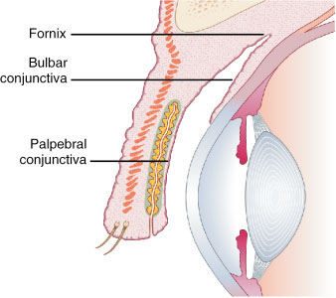
Physiological Anatomy
Appendages of eye ball:-
  Eyebrows
  Eyelids:- having eyelashes
  Conjunctiva

Slide 5
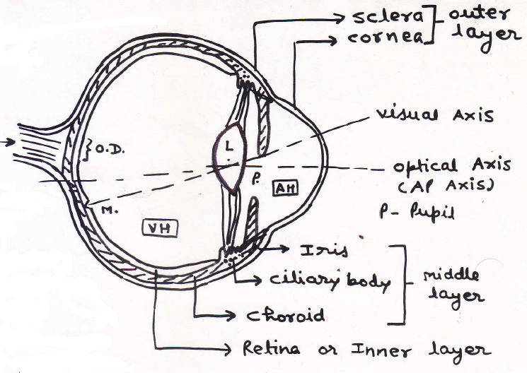
Physiological Anatomy
Notes:
O.D = Optic Disc
(No rods or cones)

Slide 6
EYEBALL
Outer layer / Fibrous coat ( Protection )
    Sclera
    Cornea
Middle Layer/ vascular coat / Uveal tract ( Nutrition )
    Posterior area – Choroid
    Anterior area → Ciliary body
    → Iris
Inner layer – Nervous coat
    Retina

Slide 7
Sclera:-
  It is a fibrous structure. It provides shape and protects the inner parts.
Cornea:-
  It is a transparent structure.
Choroid:-
  It’s a vascular structure, stores and provides vitamin A to rods and cones.
  It also provides blood supply to outer layer of rods and cones.
Ciliary body:-
  It includes ciliary muscle (circular & meridonial fibers for accommodation) and ciliary process (formation of aqueous humour)

Slide 8
Iris:-
  It has sphincter pupillae & dilator pupillae which can constrict or dilate pupil.
  It also decreases spherical and chromatic aberration.
  It absorbs excess light.
  It gives colour to the eye.
Pupil:-
  It is the central aperture in the iris with diameter ranging between 1.5 mm and 8 mm (normal 2.5 mm) needed for light and dark adaptation.

Slide 9
Visual axis:-
  It is an imaginary line joining fixation point & macula.
Optical axis:-
  It is an imaginary line joining anterior & posterior pole of eye.
  (Both axis cross each other at the center of crystalline lens where no refraction takes place)
Zonule:-
  About 70 fibers suspend lens inside eye from ciliary body.

Slide 10
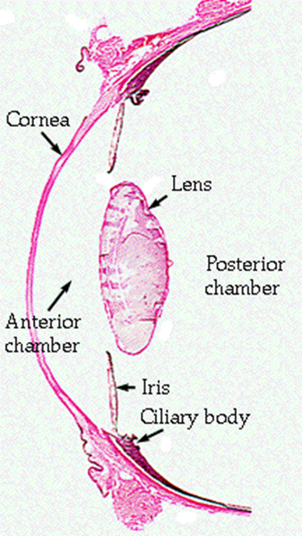
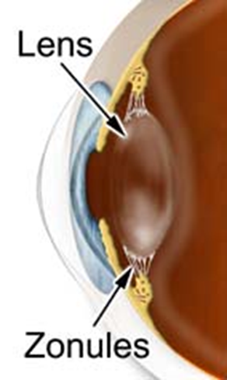

Slide 11
Lens:-
  It is made up of crystalline protein arranged as concentric layers having elastic capsule.
  It has intrinsic elastic property with diopteric power of 20 D which can be increased to 34 D by contraction of ciliary muscle. (accommodation)
Optic disc:-
  It is a structure little medial and posterior to posterior pole of eye where optic nerve fibers leave retina and artery enter into eye.
  It produces blind spot in the field of vision.

Slide 12
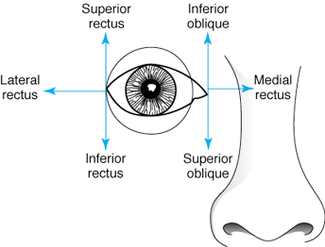
Extra ocular muscles:-
  Controls the movement of eyeball
  (4 recti & 2 oblique muscles)

Slide 14
Aqueous humour
  Formation:-
    it is clear, watery and free flowing fluid filling anterior and posterior chamber of the eye.
    It is formed by blood vessels of the ciliary processes.
    It has the same composition as blood plasma.
    It is continuously secreted with a rate of 2-3 microlitre/hour.

Slide 15
Circulation:-
  Ciliary processes → through suspensory ligaments and surface of lens in posterior chamber → flows through pupil into anterior chamber → at sclero-cornal junction absorbed through trabeculae into canal of Schlemm (intra-ocular veins).
  Absorption through trabeculae at sclero-cornal junction is the main site of regulation.
  It is cleaned by macrophages especially at trabeculae.

Slide 16
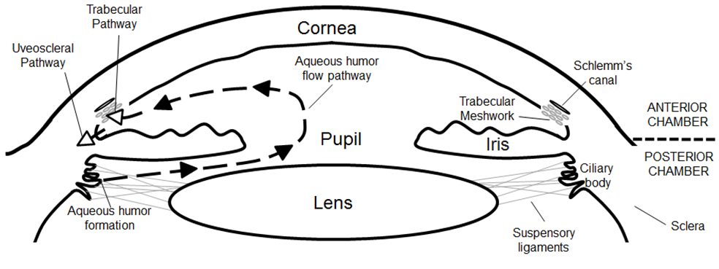

Slide 17
Functions:-
  Supply nutrients (especially glucose) as well as oxygen to the lens and cornea and collect waste products and CO₂ from these structures. (Both are avascular structures).
  It maintains IOP (normal intra-ocular pressure) at 10-20 mm of Hg and shape of the eye. IOP can be measured by tonometry.
  Its refractory index is 1.33, which help in formation of image.

Slide 18
Clinical –
  Glaucoma:-
      Intraocular pressure is increased.
    Causes
      Advancing age, ocular infections, diabetes, high myopia, surgery, congenital etc.
      It is commonest cause of blindness after the age of 50 years.
      Above 65 years of age, 30% people suffer from glaucoma worldwide.
      Direct mechanical pressure or ischemia of optic nerve results blindness.

Slide 19
Types-
  Glaucoma can be closed angle (often acute) or open angle (chronic).
  Closed angle is due to ballooning of iris obliterating filtration angle (angle between iris and cornea) at trabeculae.
  Open angle is due to decreased permeability of aqueous humour into trabeculae.
Clinical features-
  Patient complains of tubular vision and decreased visual acuity.
  It may be symptomless especially initially.

Slide 20
Diagnosis-
  Done by ophthalmoscopy, which shows cupping of optic disc.
Treatment-
  It is medical or surgical.
  Medical treatment is done by drugs which decrease secretion of aqueous humour (ex.- beta adrenergic blockers, cabonic anhydrase inhibitors etc.) or by drugs which increase outflow of aqueous humour by contraction of ciliary muscles (ex.- cholinergic drugs, prostaglandins etc.)

Slide 21
Maintenance of clear refractive media of the eye.
Major factor responsible for transparency of ocular media is their avascularity.
The structures forming refractive media of the eye from anterior to posterior are:-
  Tear film
  Cornea
  Aqueous humour
  Crystalline lens
  Vitreous humour

Slide 22
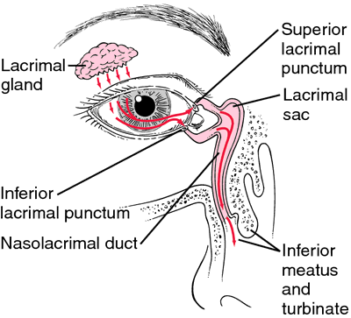
Physiology of tears
Lacrimal apparatus:-
  Tear formation:- by lacrimal gland
  Drainage of tears:- by lacrimal sac & NLD.

Slide 23
Tear film
Fluid covering cornea & Conjunctiva
Composed – 98% Water & 1.5 % Nacl
- Antibacterial substance ,
lysozyme , betalysin & lactoferrin
Consists of three layers, from posterior to anterior are:-
  Mucous layer
  Aqueous layer
  Lipid layer

Slide 24
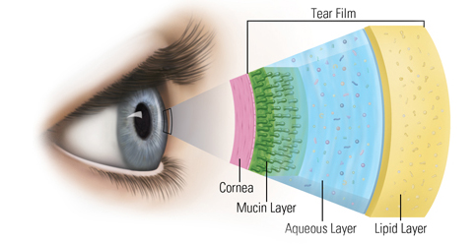

Slide 25
Functions of tear film:-
  Keeps the cornea & conjunctiva moist.
  Provides oxygen to the corneal epithelium.
  Washes away debris & noxious irritants.
  Prevents infection due to presence of antibacterial substances.
  Facilitates the movements of the lids over the globe.

Slide 26
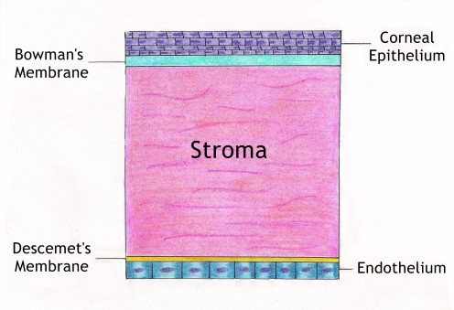
Cornea

Slide 27
The main physiological function of the cornea is to act as a major refracting medium, so that a clear retinal image is formed.
Cornea is an avascular structure which receives its nutrition by aqueous humour.
Oxygen is derived directly from air through the tear film.

Slide 28
Physiology of lens
It is a transparent, biconvex, crystalline structure
Consists of three layers:-
  Lens capsule
  Anterior epithelium
  Lens fibers:-
    Nucleus- central part containing the oldest fibers.
    Cortex – peripheral part comprises of youngest fibers.
Cataract:- any opacity in the lens or its capsule is called cataract.

Slide 29
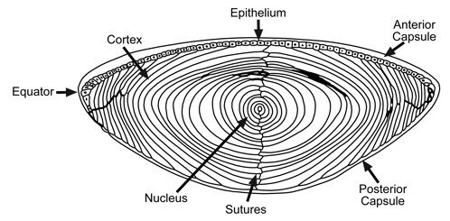

Slide 30
Vitreous Humour
clear gelatinous material which fill space b/w lenses & Retina
high viscosity
Gel like substance – highly hygroscopic protein analogues to gelatin .
Function – shape of eyeball
- Refract light

Slide 31
Thank You

