Slide 1
Peripheral Angioplasty
Dr Cinosh Mathew
MD, DM, FACC, IAFESC, MSCAI
Professor & Interventional Cardiologist
SBKS Medical Instiute
Sumandeep Vidyapeeth

Slide 2
Case 1
Mr D S presented with bilateral limb claudication and left toe gangrene and severe pain in rt foot.
CT angiography suggestive of critical lesions in LT SFA and Rt Tibioperoneal trunk
Treatment options of Surgical Grafting with high risk due to age and comorbidities vs percutaneous approach discussed by Cardiologist , CTVS Surgeon with patient and relatives
Opted for peripheral angioplasty

Slide 3
Peripheral angio suggestive of PVD with critical Left Sup Femoral Artery lesion and Rt Tibio peroneal artery lesion

Slide 4
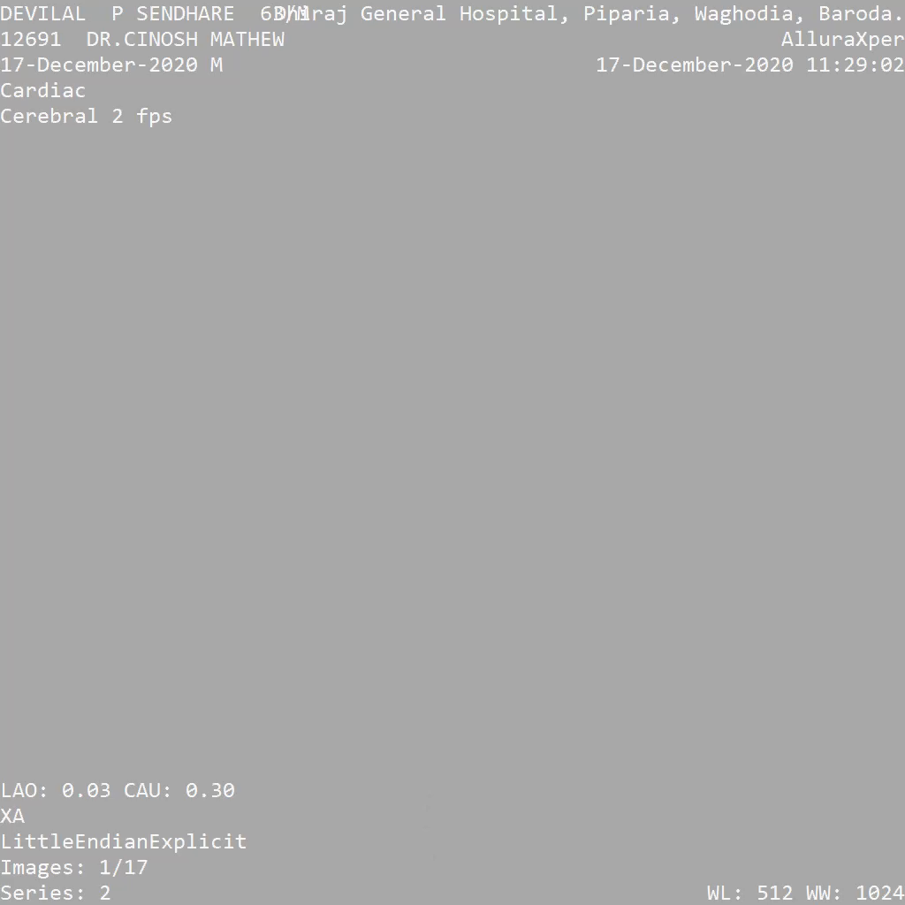
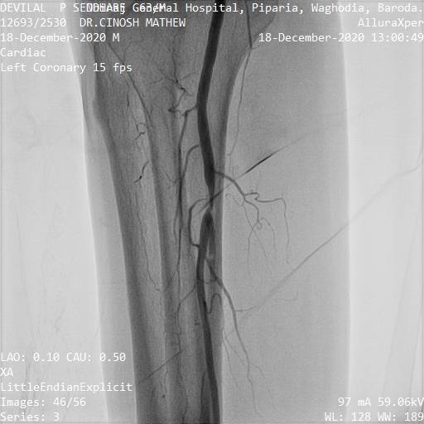
RT LEG

Slide 5
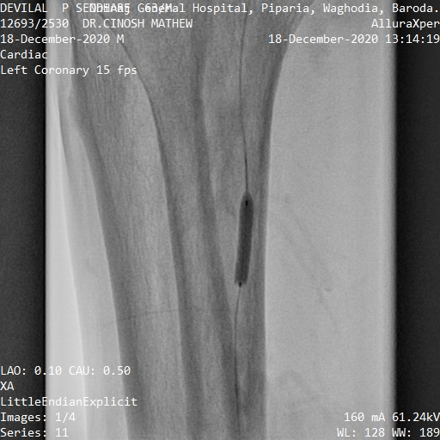
RT LEG

Slide 6
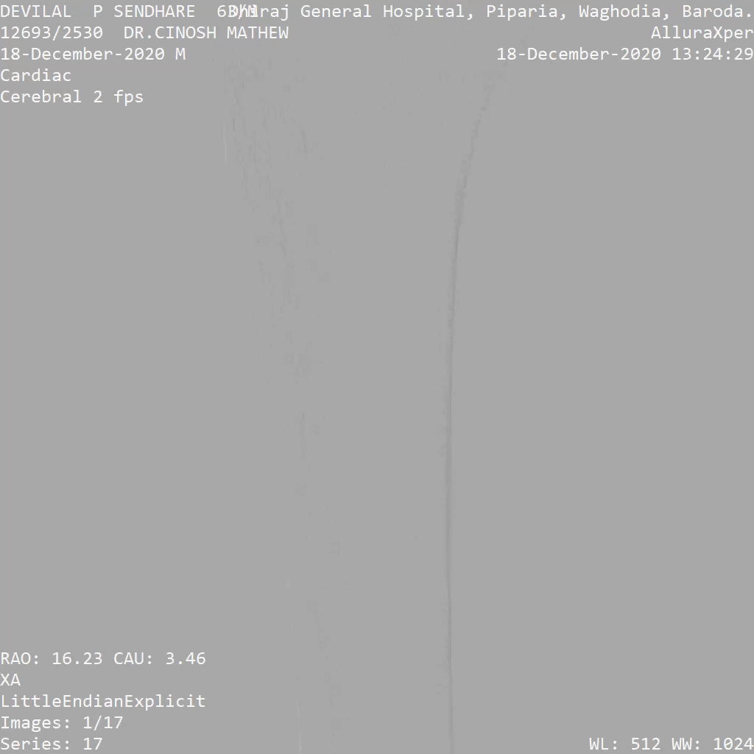
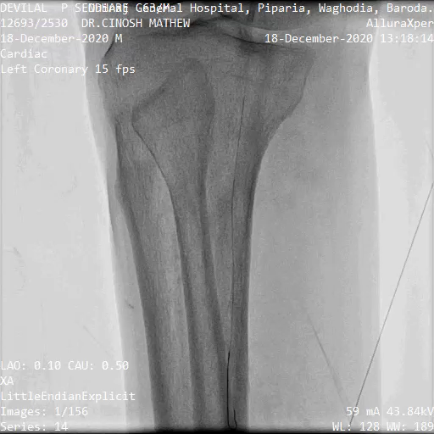
RT LEG

Slide 7
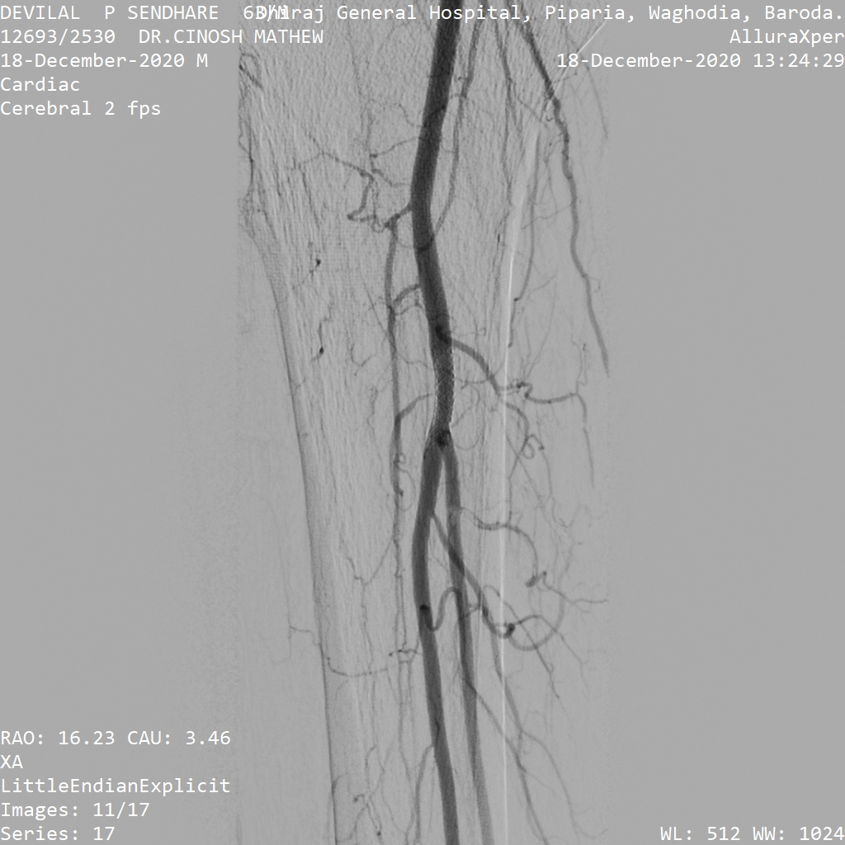
RT LEG
Pre procedure
Post Procedure

Slide 8
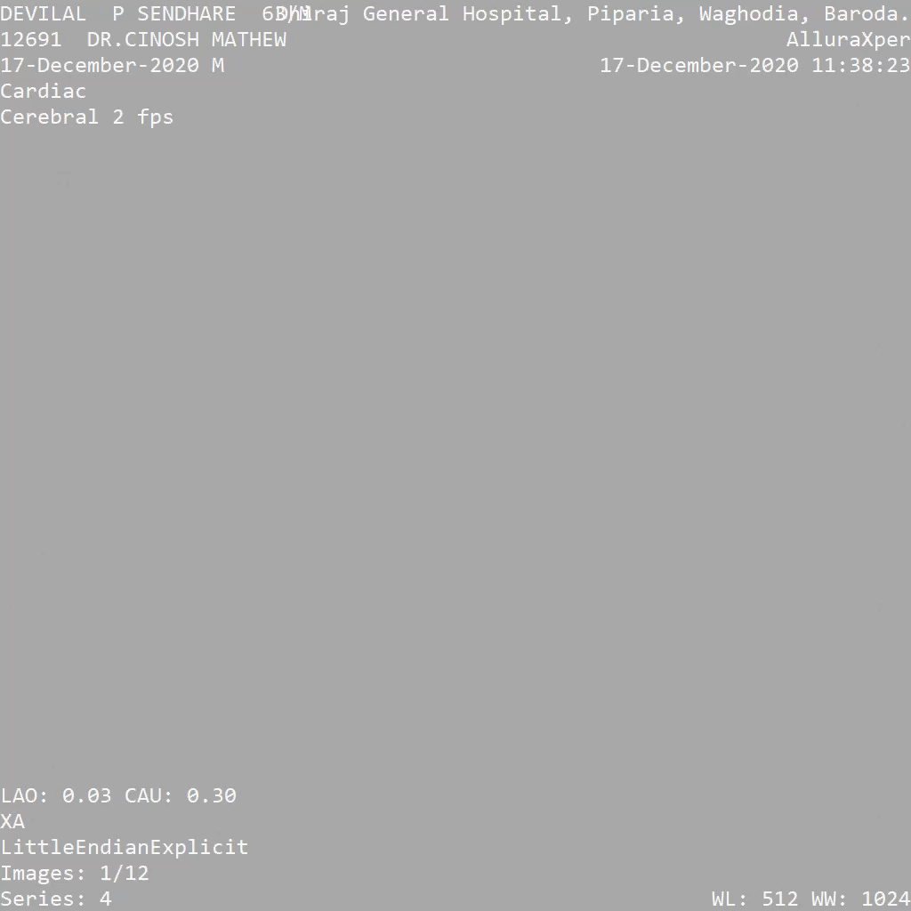
LEFT THIGH SFA

Slide 9
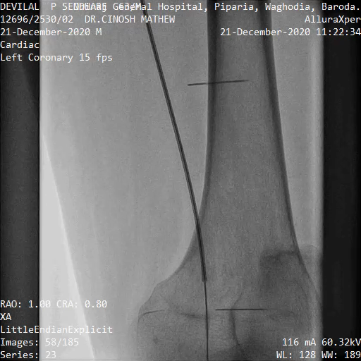
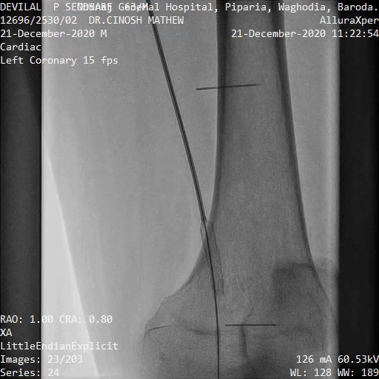
Left Thigh SFA Stent Placement

Slide 10
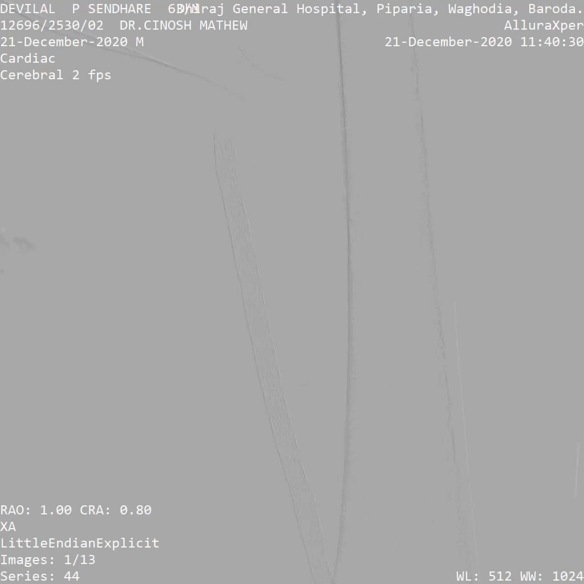
Left Thigh SFA

Slide 11
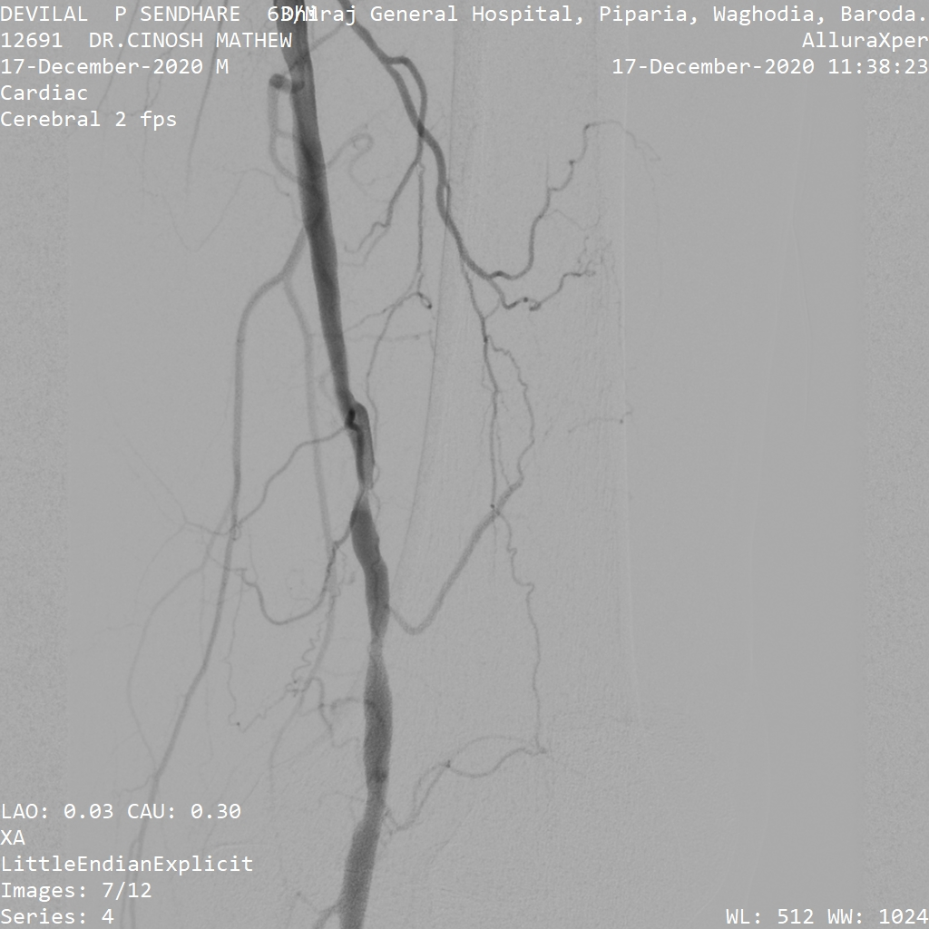
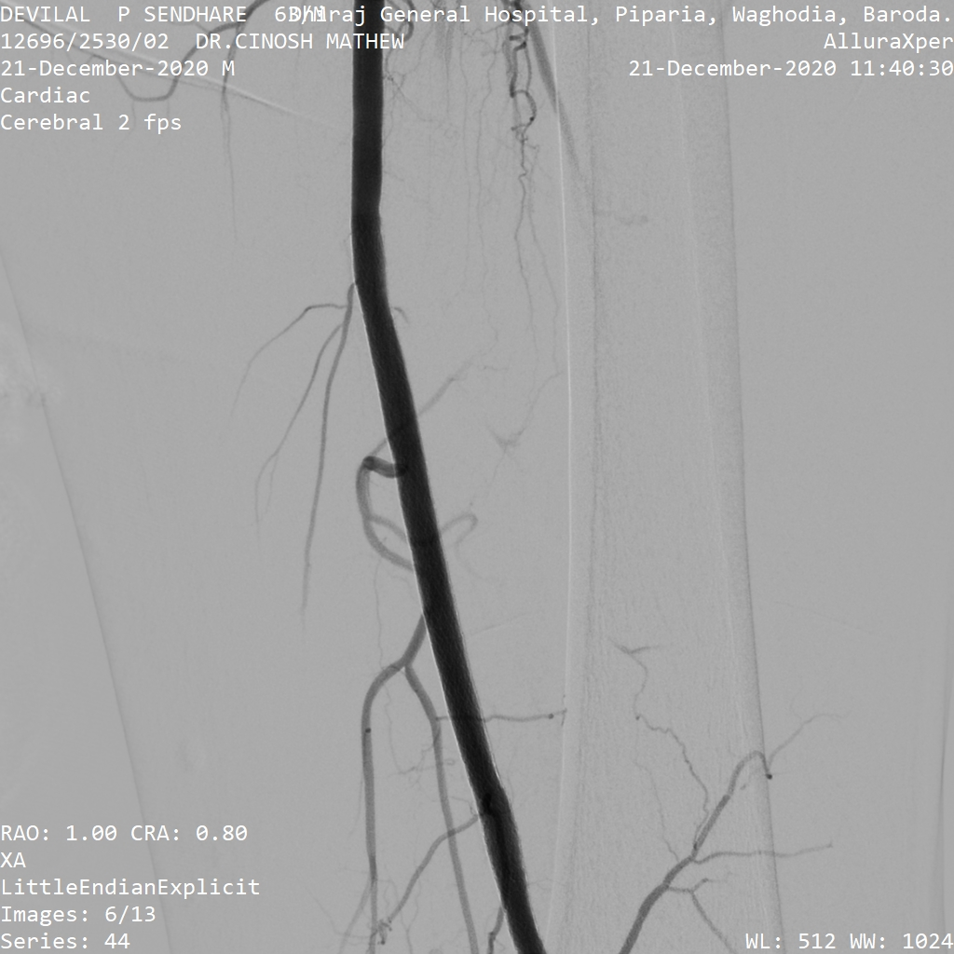
Left Thigh SFA
Pre procedure
Post procedure

Slide 12
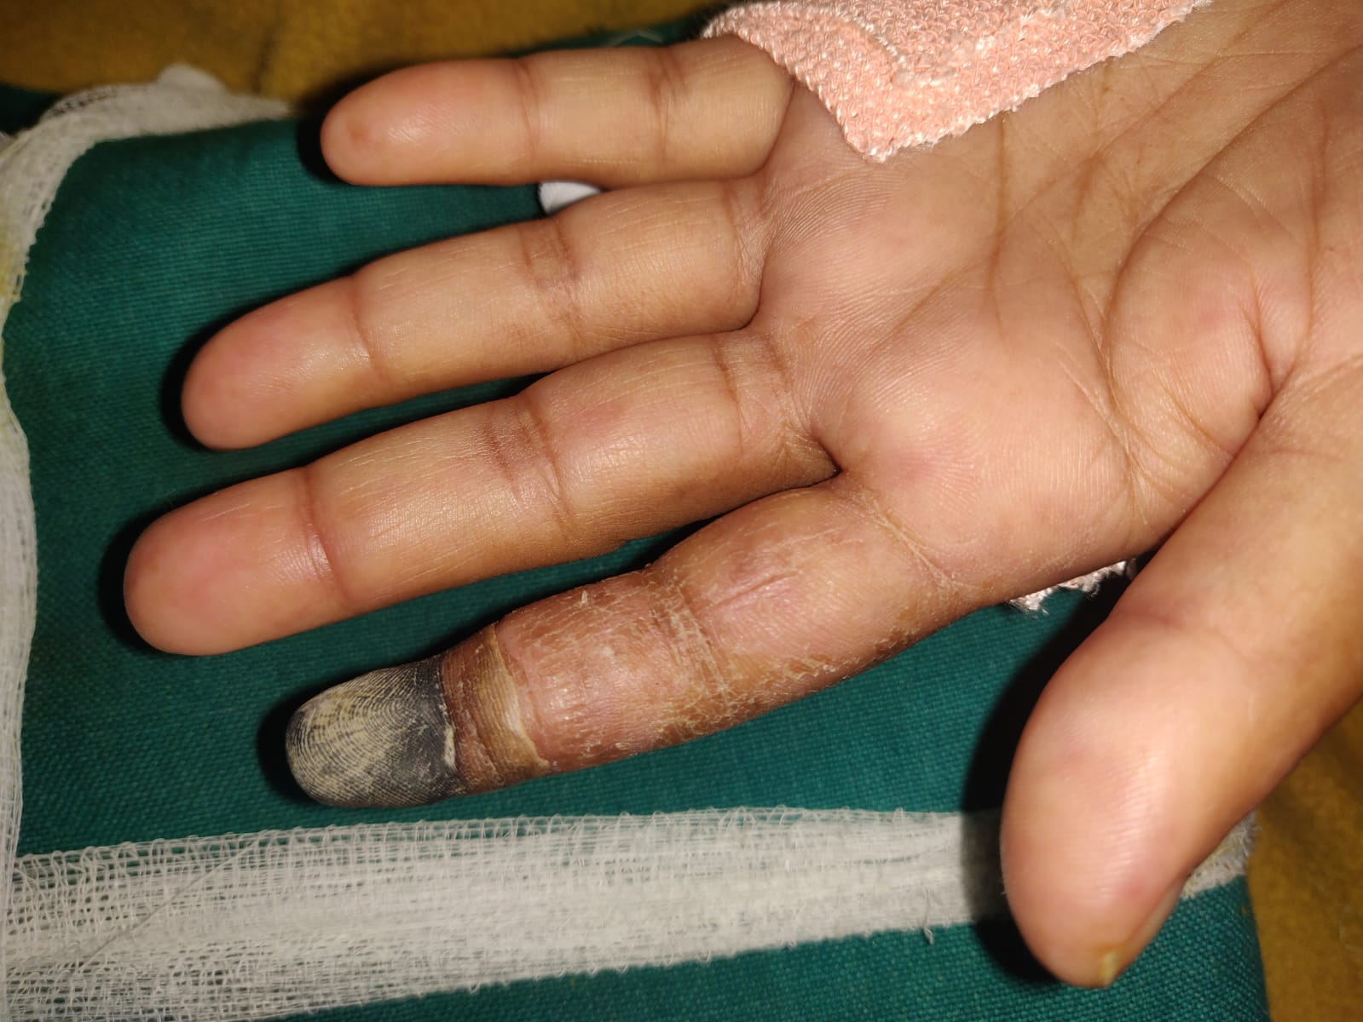
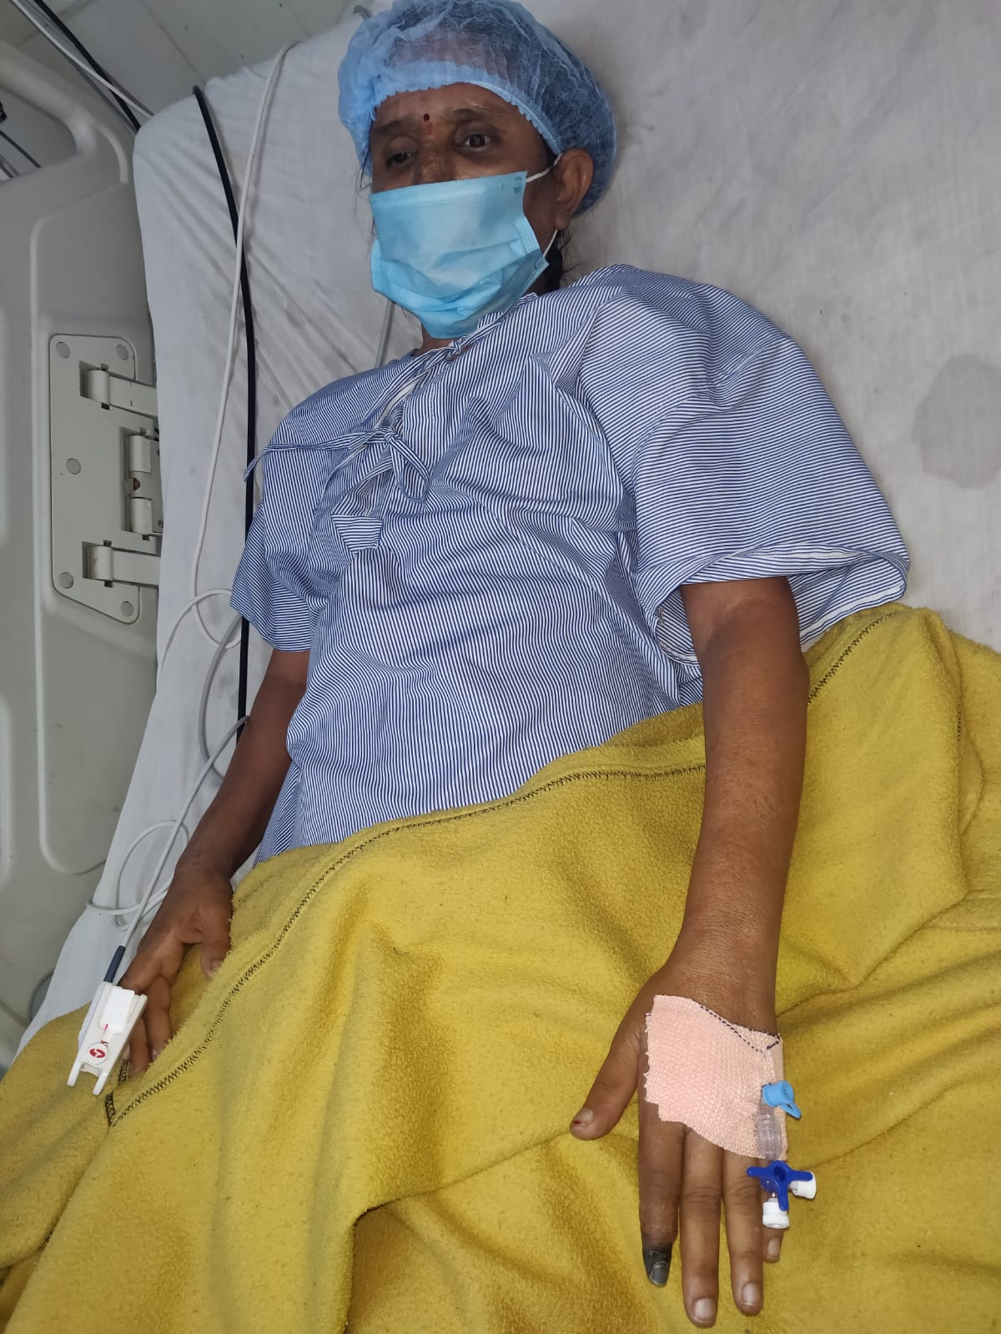
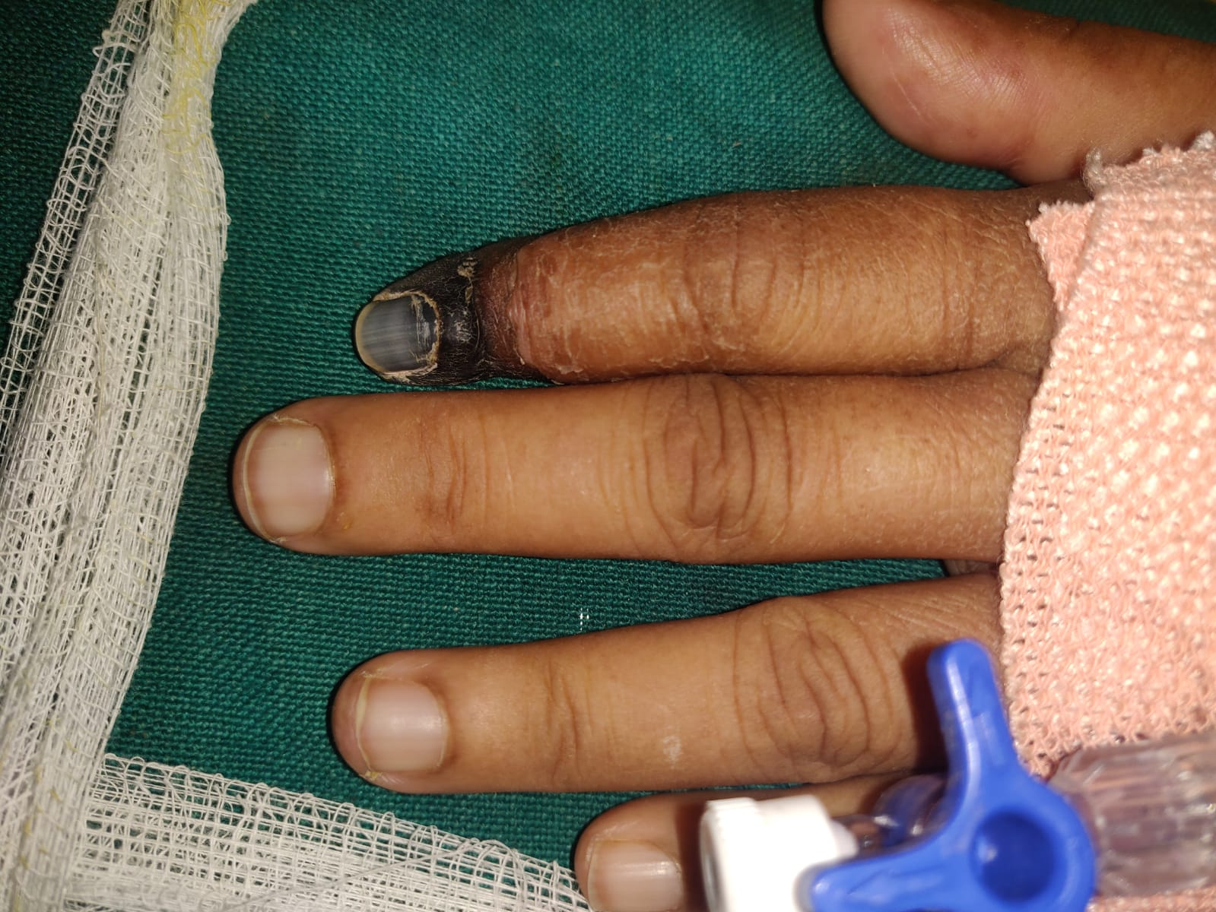
Case 2 Lt Subclavian artery stenting
39 yr female, Y S presented with lt upper limb pain and gangrene of fingers

Slide 13
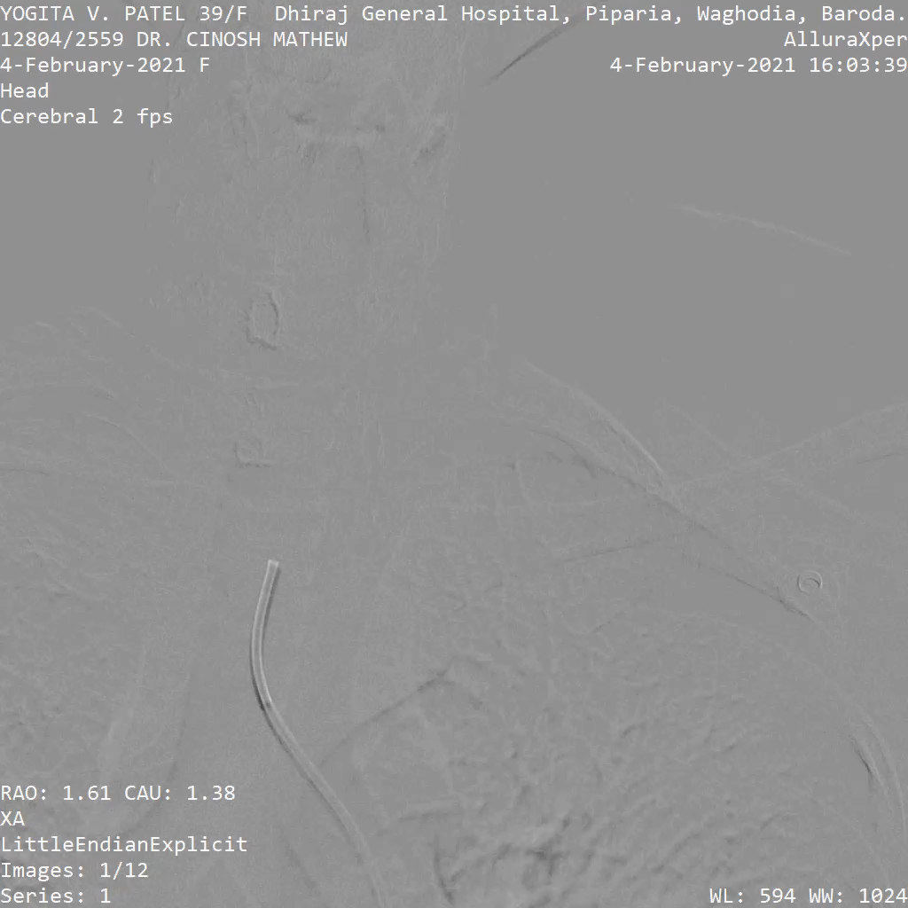
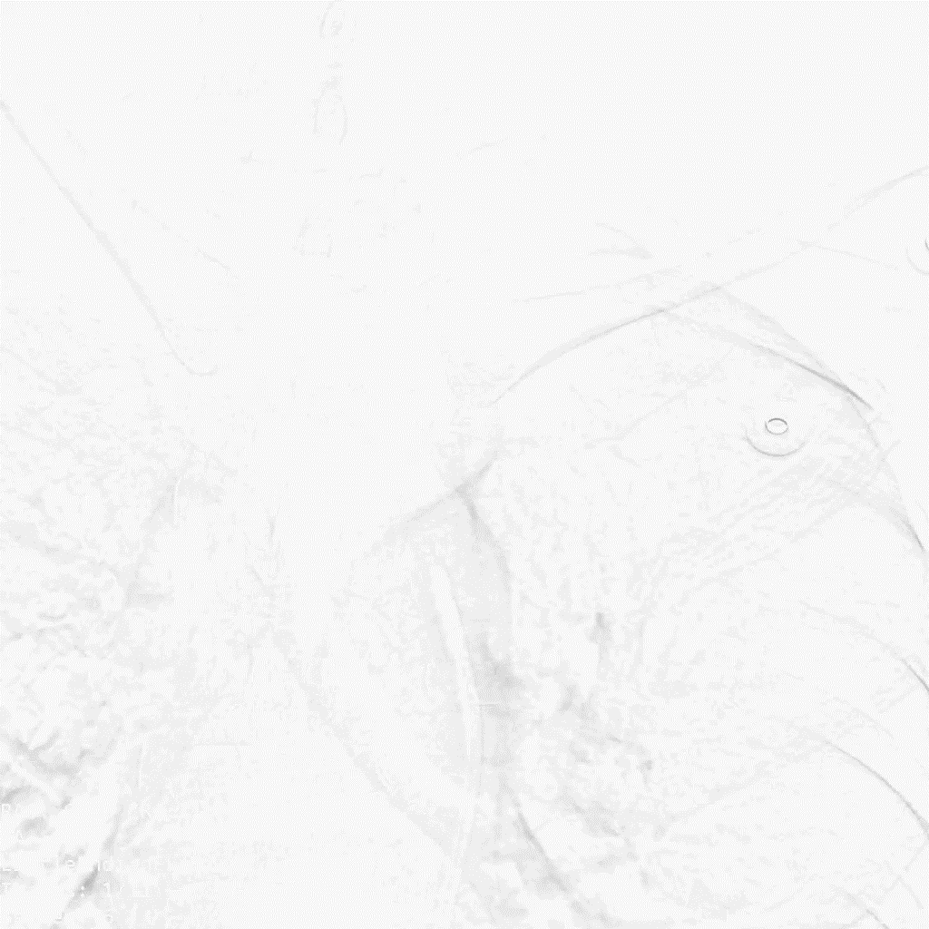
Peripheral angiogram suggestive of Lt Subclavain occlusion
Right side normal
Left subclavian occluded

Slide 14
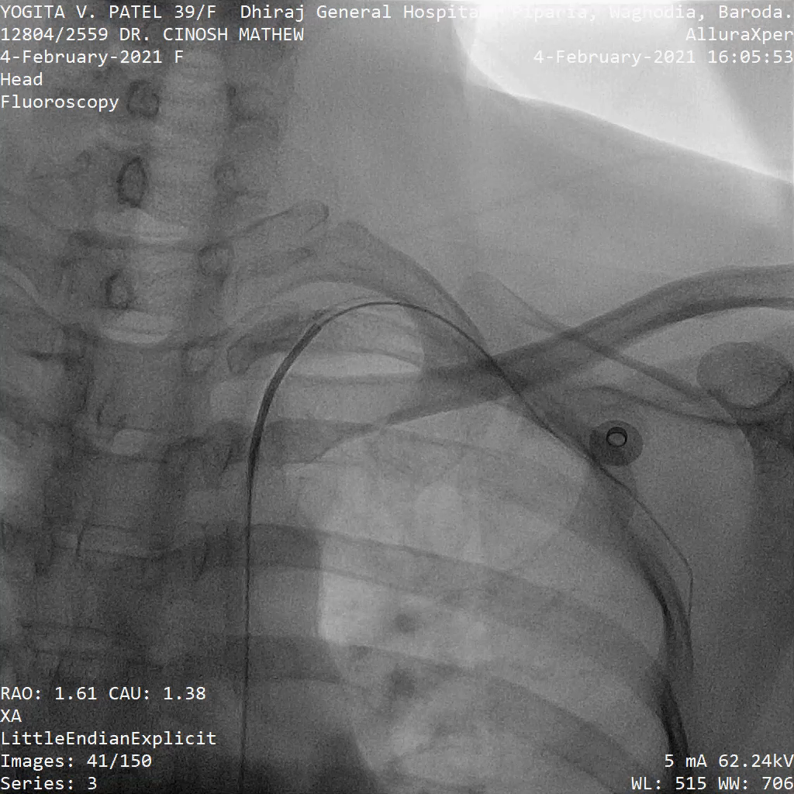
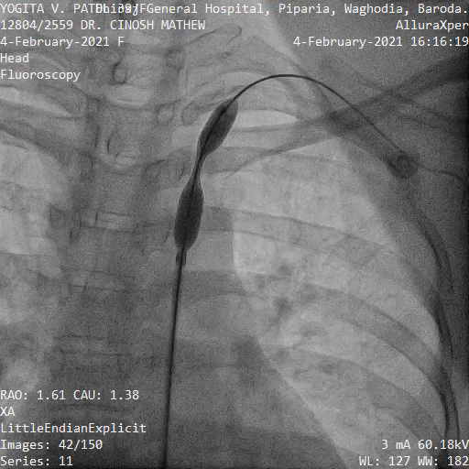
Stent placement
Stent deployment

Slide 15
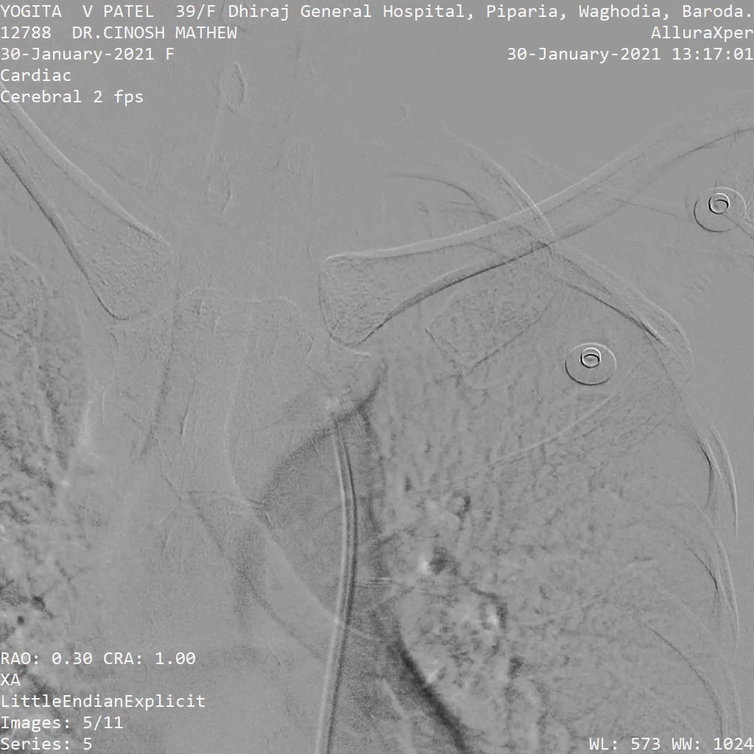
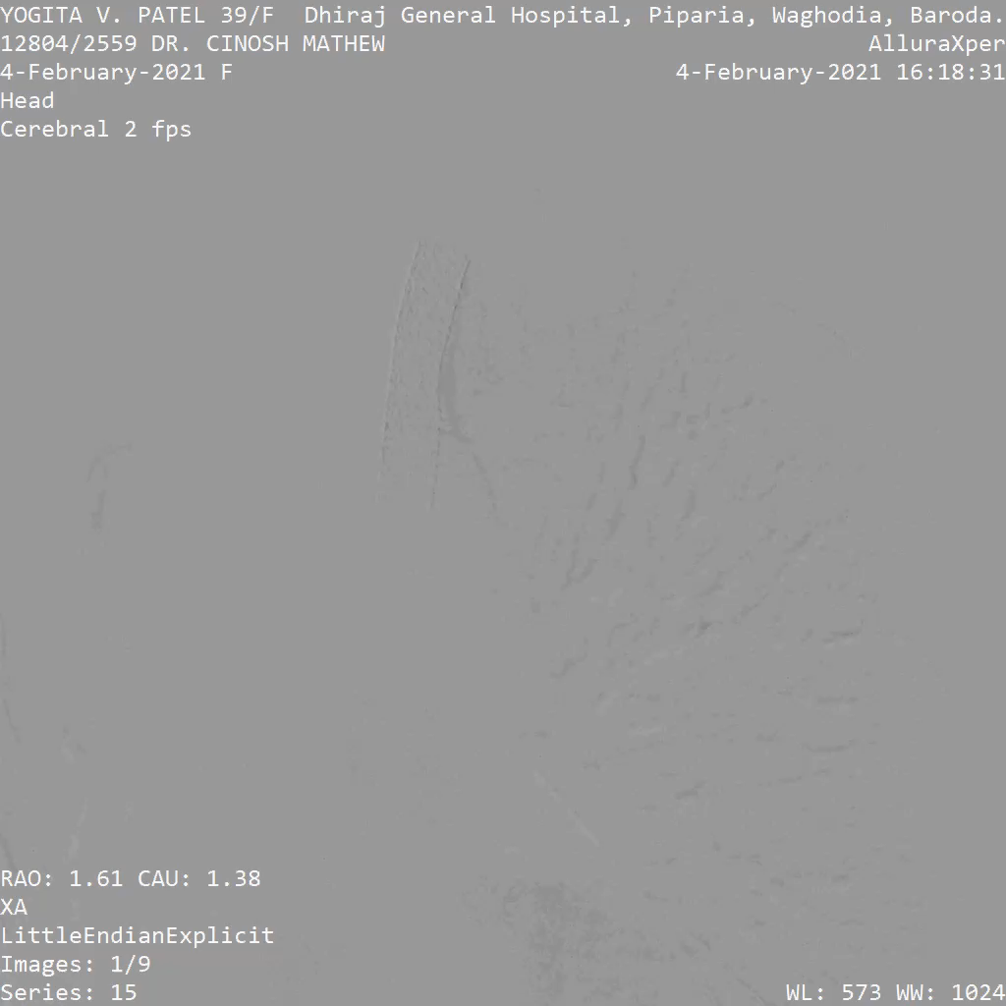
Pre procedure
Post procedure

Slide 16
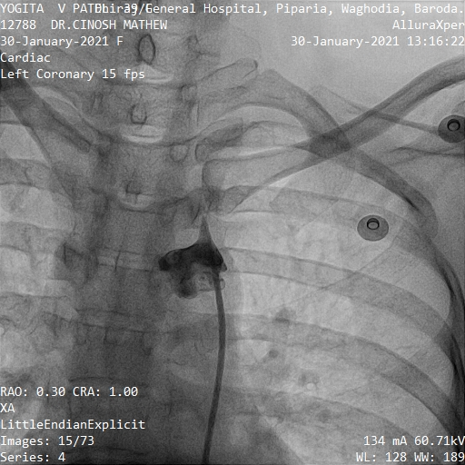
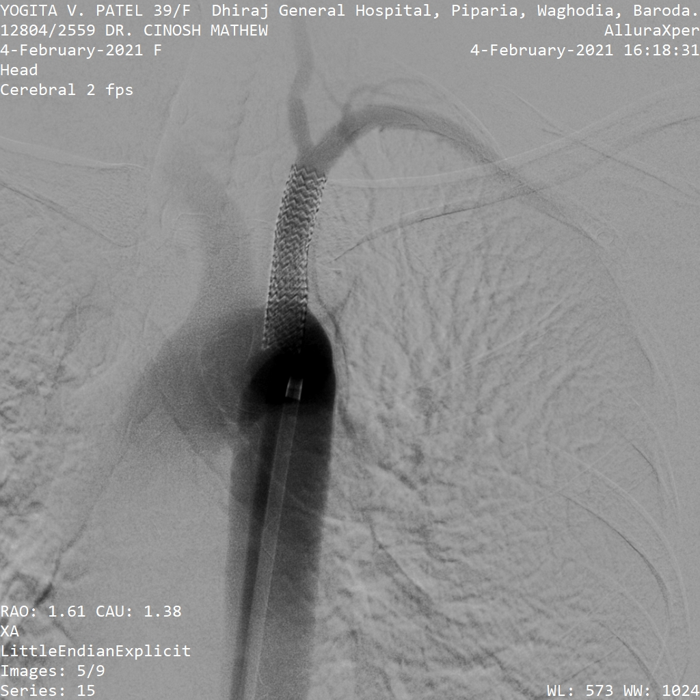
Pre procedure
Post procedure

Slide 17
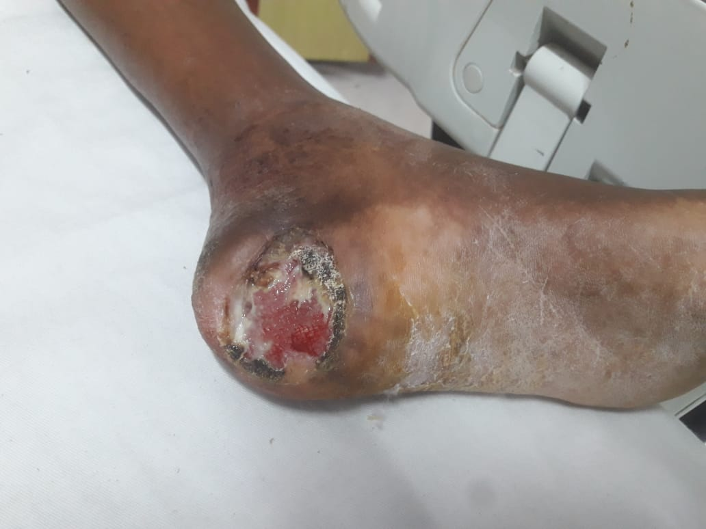
Case 3- left SFA Stenting and PTA of post tibial and peroneal
64yr gentleman, Mr S presented with claudication pain since 6 months and non healing ulcer since 2 months.
Doppler revealed severe PVD.
Peripheral angiogram showed critical Lt SFA disease and chronic Total occlusion of post tibial and peroneal arteries with collaterals

Slide 18
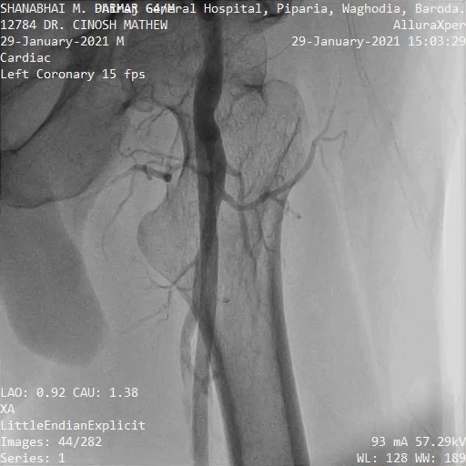

Slide 19
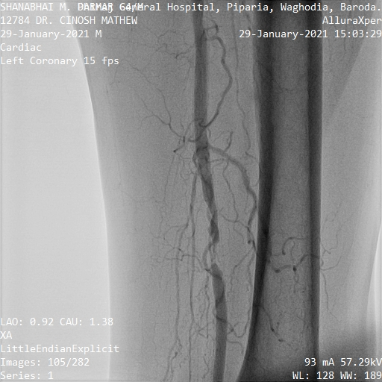
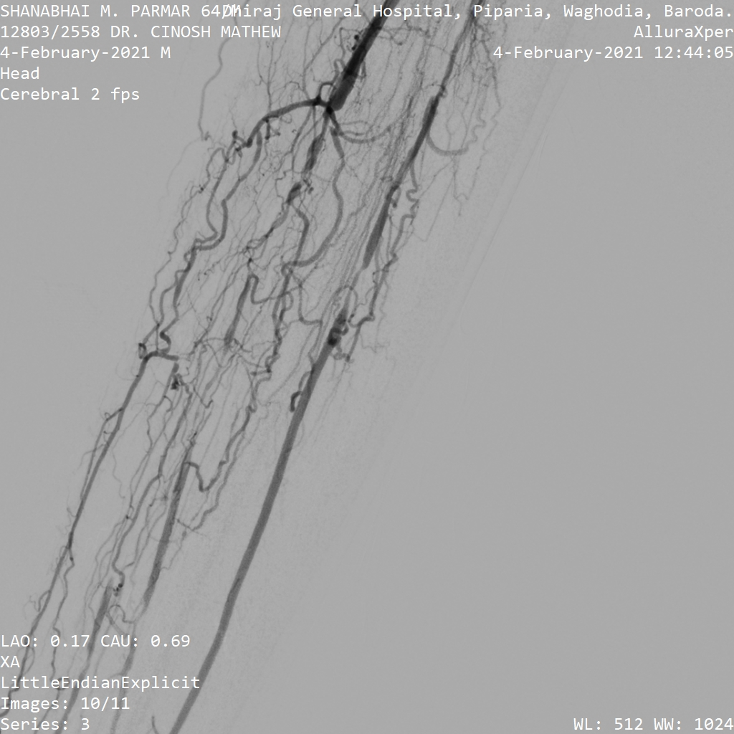

Slide 20
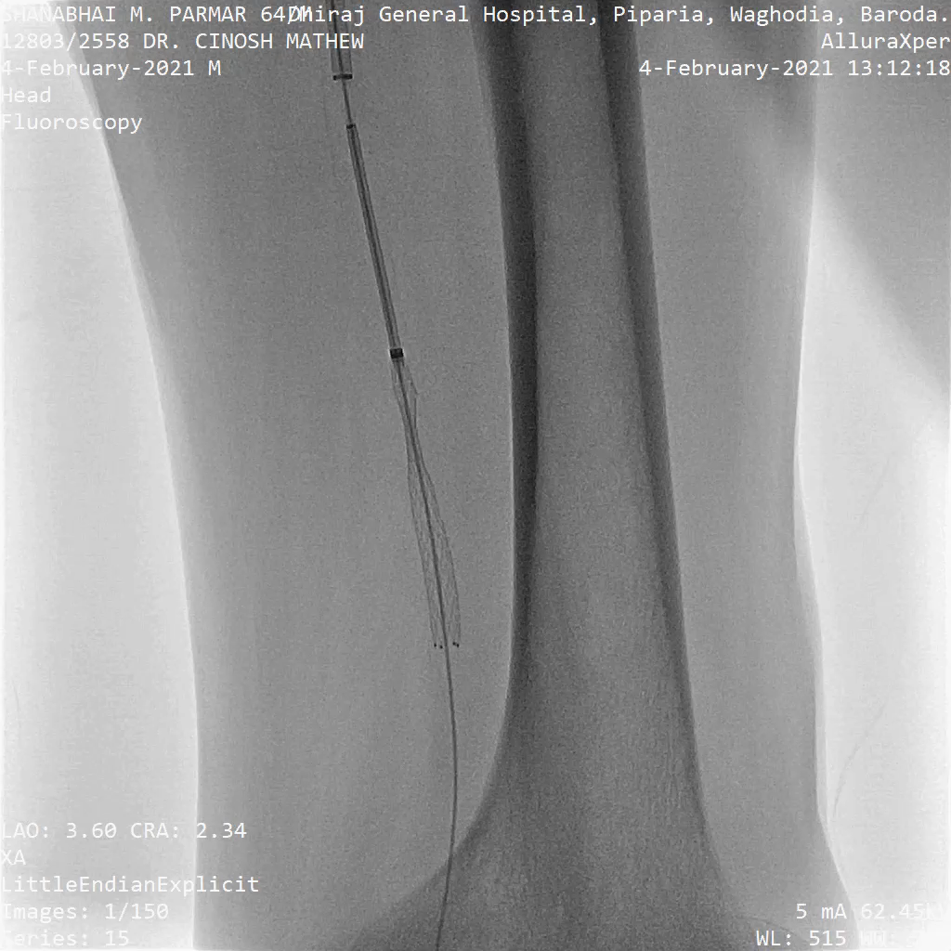
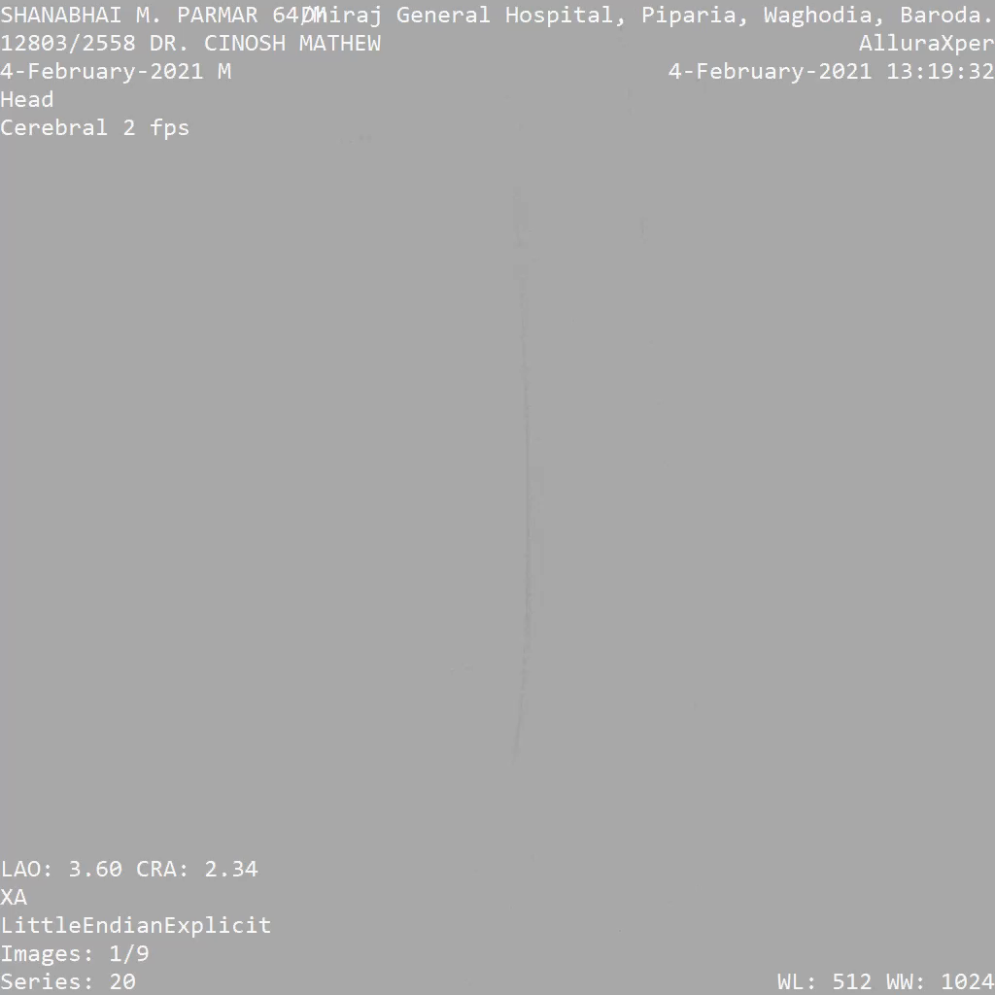

Slide 21
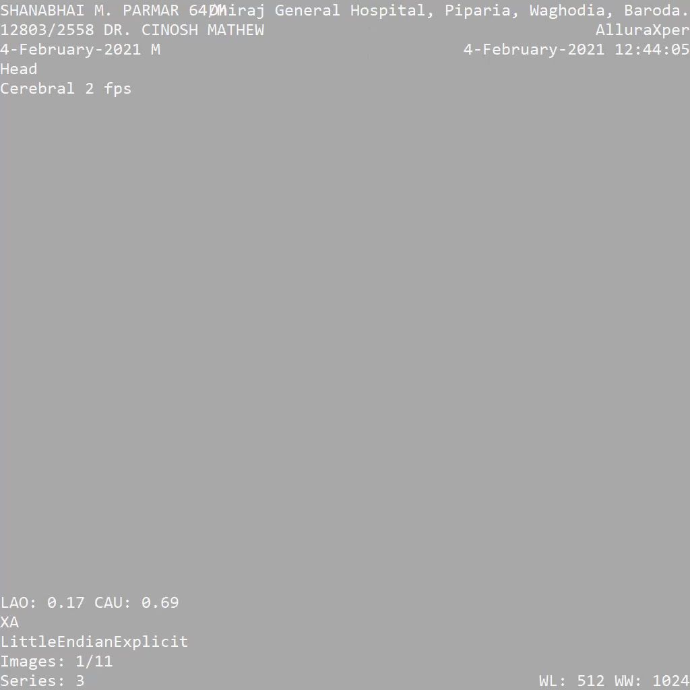

Slide 22
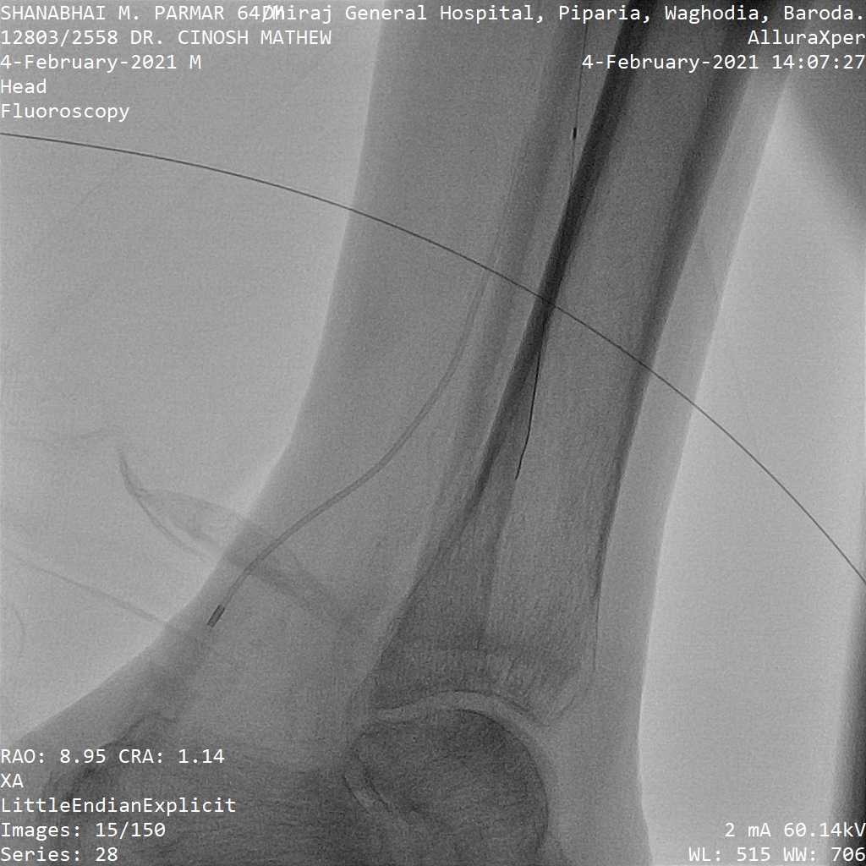
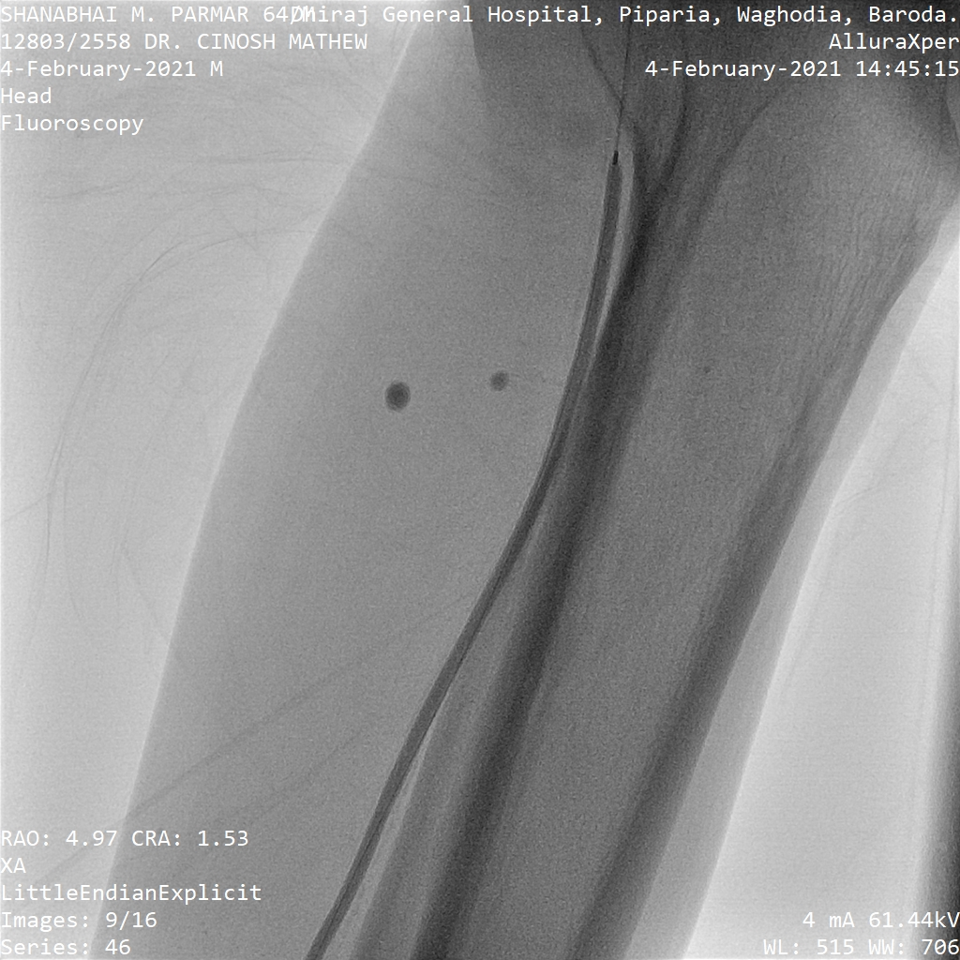

Slide 23
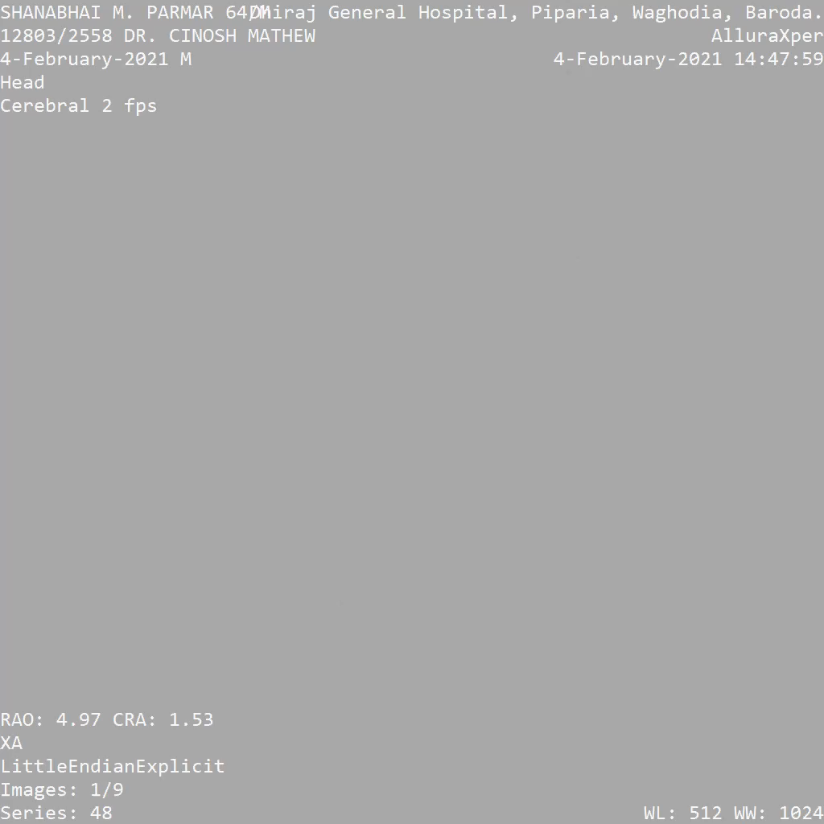

Slide 24
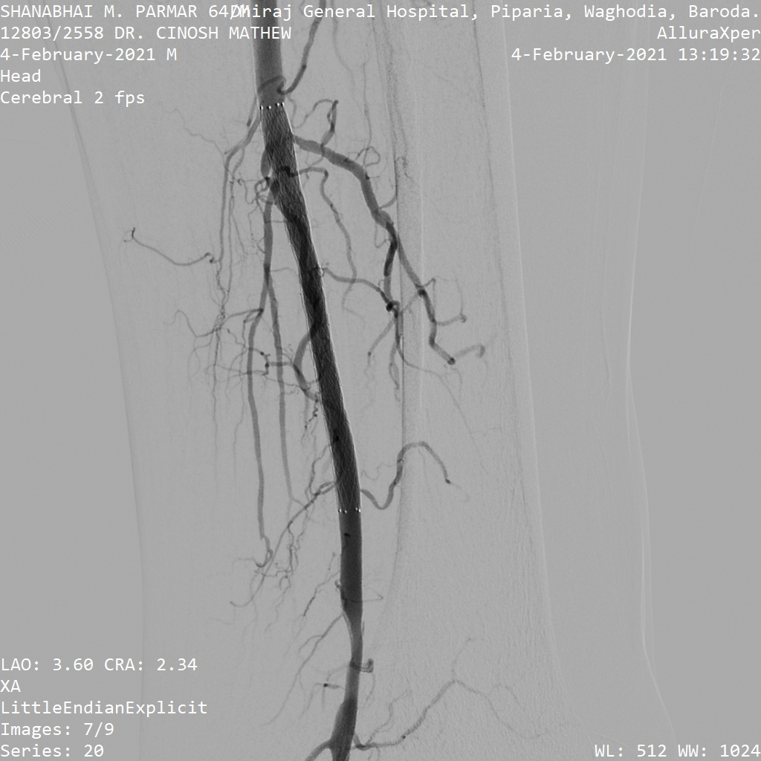

Slide 25
All procedures done under local anaesthesia with no complications
Linear probe for vascular puncture helps in visualing the small arteries and veins and helps in selective and safe punctures.
Small Radial artery, tibial arteries which cant be palpated can be visualized and punctured. Femoral artery can be punctured safely,
For IJV puncture USG guidance is a medico legal requirement.
For pediatric procedures axillary, femoral artery punctures can be done safely and successfully

Slide 26
