Slide 1

EYE- II
Dr. Diksha Yadav
SMKSMIRC, Vadodara

Slide 2
OVERVIEW
Physiological anatomy
Aqueous humour
Accommodation
Error of refraction
Structure of retina
Photochemistry of vision
Receptors of vision
Colour vision
Dark / Light adaptation
Squint
Visual Reflexes

Slide 3
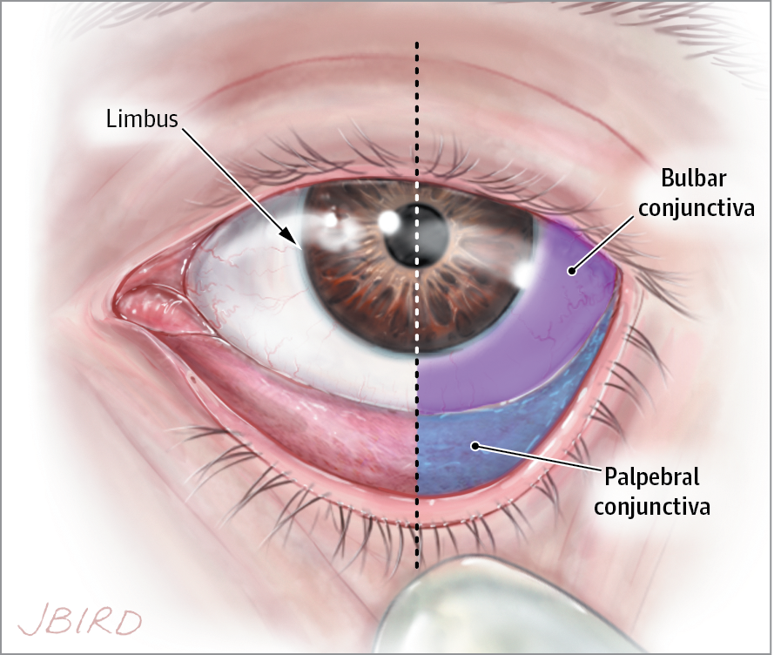
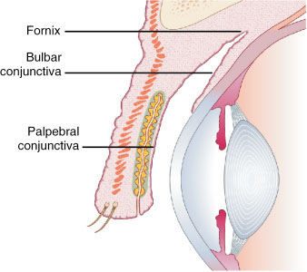
Physiological Anatomy
Appendages of eye ball:-
  Eyebrows
  Eyelids:- having eyelashes
  Conjunctiva

Slide 4
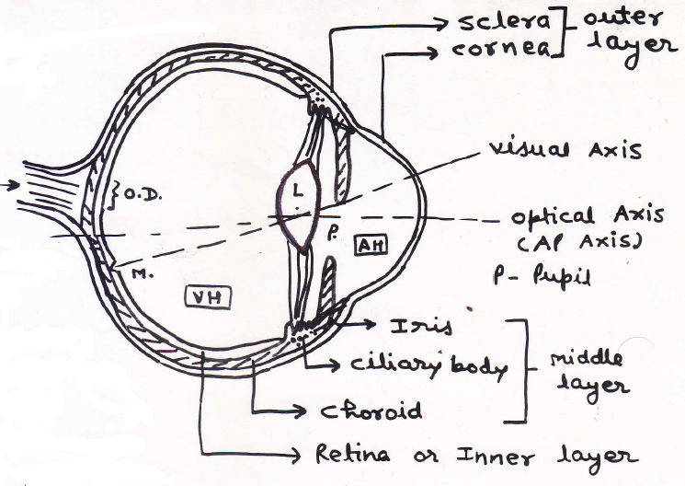
Physiological Anatomy
Notes:
O.D = Optic Disc
(No rods or cones)

Slide 5
EYEBALL
Outer layer / Fibrous coat ( Protection )
    Sclera
    Cornea
Middle Layer/ vascular coat / Uveal tract ( Nutrition )
    Posterior area – Choroid
    Anterior area → Ciliary body
    → Iris
Inner layer – Nervous coat
    Retina

Slide 6
Aqueous humour:-
  Formation:-
    it is clear, watery and free flowing fluid filling anterior and posterior chamber of the eye.
    It is formed by blood vessels of the ciliary processes.
    It has the same composition as blood plasma.
    It is continuously secreted with a rate of 2-3 microliter / hour.

Slide 7
Circulation:-
  Ciliary processes → through suspensory ligaments and surface of lens in posterior chamber → flows through pupil into anterior chamber → at sclero-cornal junction absorbed through trabeculae into canal of Schlemn (intra-ocular veins).
  Absorption through trabeculae at sclero-cornal junction is the main site of regulation.
  It is cleaned by macrophages especially at trabeculae.

Slide 8
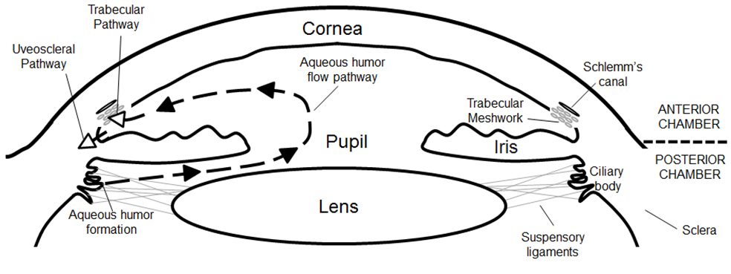

Slide 9
Functions:-
  Supply nutrients (especially glucose) as well as oxygen to the lens and cornea and collect waste products and CO₂ from these structures. (Both are avascular structures).
  It maintains IOP (normal intra-ocular pressure) at 10-20 mm of Hg and shape of the eye. IOP can be measured by tonometry.
  Its refractory index is 1.33, which help in formation of image.

Slide 10
Clinical –
  Glaucoma:-
      Intraocular pressure is increased.
    Causes
      Advancing age, ocular infections, diabetes, high myopia, surgery, congenital etc.
      It is commonest cause of blindness after the age of 50 years.
      Above 65 years of age, 30% people suffer from glaucoma worldwide.
      Direct mechanical pressure or ischemia of optic nerve results blindness.

Slide 11
Types-
  Glaucoma can be closed angle (often acute) or open angle (chronic).
  Closed angle is due to ballooning of iris obliterating filtration angle (angle between iris and cornea) at trabeculae.
  Open angle is due to decreased permeability of aqueous humour into trabeculae.
Clinical features-
  Patient complains of tubular vision and decreased visual acuity.
  It may be symptomless especially initially.

Slide 12
Diagnosis-
  Done by ophthalmoscopy, which shows cupping of optic disc.
Treatment-
  It is medical or surgical.
  Medical treatment is done by drugs which decrease secretion of aqueous humour (ex.- beta adrenergic blockers, cabonic anhydrase inhibitors etc.) or by drugs which increase outflow of aqueous humour by contraction of ciliary muscles (ex.- cholinergic drugs, prostaglandins etc.)

Slide 13
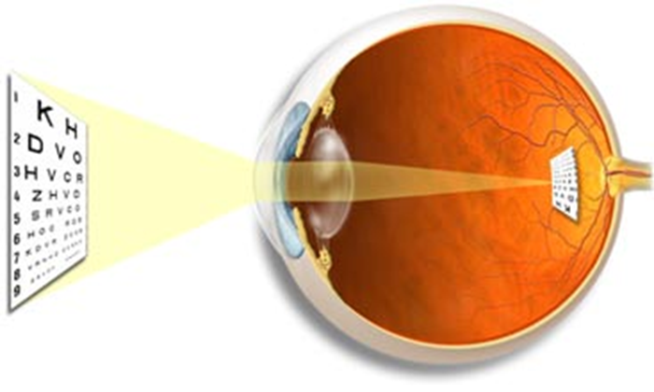
Refractive media
The structures forming refractive media of the eye from anterior to posterior are:-
  Tear film
  Cornea
  Aqueous humour
  Crystalline lens
  Vitreous humour

Slide 14
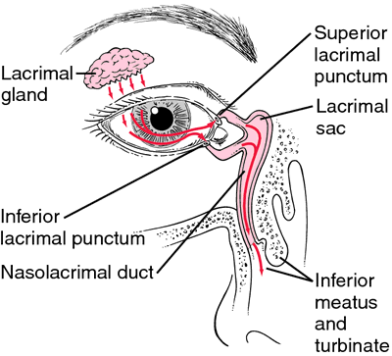
Physiology of tears
Lacrimal apparatus:-
  Tear formation:- by lacrimal gland
  Drainage of tears:- by lacrimal sac & NLD.

Slide 15
1.Tear film
Fluid covering cornea & Conjunctiva
Composed – 98% Water & 1.5 % Nacl
- Antibacterial substance ,
lysozyme , betalysin & lactoferrin
Consists of three layers, from posterior to anterior are:-
  Mucous layer
  Aqueous layer
  Lipid layer

Slide 16
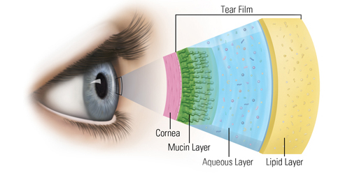

Slide 17
Functions of tear film:-
  Keeps the cornea & conjunctiva moist.
  Provides oxygen to the corneal epithelium.
  Washes away debris & noxious irritants.
  Prevents infection due to presence of antibacterial substances.
  Facilitates the movements of the lids over the globe.

Slide 18
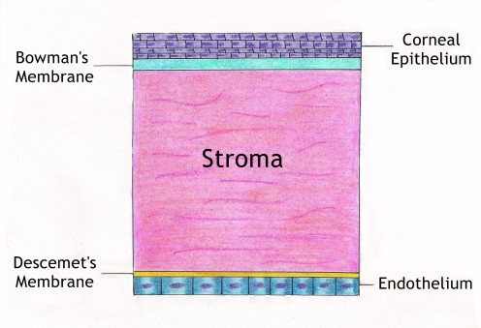
2. Cornea

Slide 19
The main physiological function of the cornea is to act as a major refracting medium, so that a clear retinal image is formed.
Cornea is an avascular structure which receives its nutrition by aqueous humour.
Oxygen is derived directly from air through the tear film.

Slide 20
Physiology of lens
Consists of three layers:-
  Lens capsule
  Anterior epithelium
  Lens fibers:-
    Nucleus- central part containing the oldest fibers.
    Cortex – peripheral part comprises of youngest fibers.
Cataract:-
Any opacity in the lens / its capsule is called cataract.

Slide 21
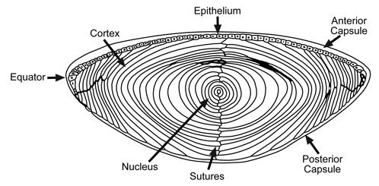

Slide 22
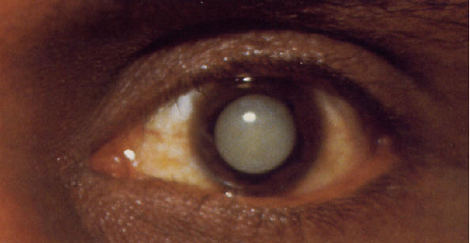

Slide 23
Vitreous Humour
Clear gelatinous material which fill space b/w lenses & Retina
High viscosity
Gel like substance – highly hygroscopic protein analogues to gelatin .
Function – shape of eyeball
- Refract light

Slide 24
OPTICS OF THE EYE
Cardinal points of the eye:-
  Two principle foci
  Two principle points
  Two nodal point
All are situated on principle axis.
Gauss described the optics of eye by using these six cardinal points, this model is known as schematic eye.

Slide 25
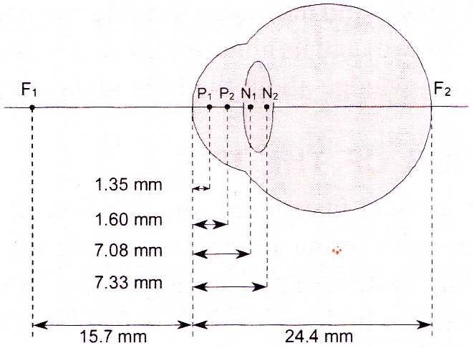

Slide 27
Reflection power unit is diopter (D)
Diopter is inverse to focal length
D α 1/ focal length
If focal length is increased then dioptre is decreased
Diopter = 1mm / focal length eg. (Lens - FL 10)
D = 1/10 =0.1 D
If lens (Convex) have:
Focal length = 1
D = 1/FL
= 1/1
=1D
Focal length = .5 = 1/.5 = 10/5 = 2D
Focal length = .10 = 1/.10 = 100/10 =10D

Slide 28
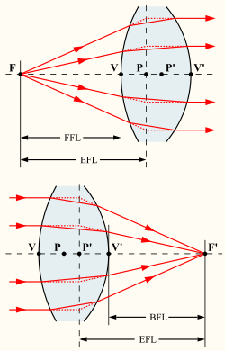
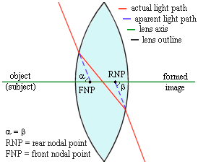

Slide 29
Cardinal data of schematic eye is:-
  Total dioptric power is + 59 D
  Dioptric power of refractory surfaces:
  Anterior surface of cornea = 48
  Posterior surface of cornea = -4,
  Lens = 15
  The principle foci F₁ & F₂ lie 15.7 mm in front of & 24.4 mm behind the cornea respectively.
  The principle point P₁ & P₂ lie in the anterior chamber 1.35 mm & 1.60 mm behind the anterior surface of the cornea respectively.
  The nodal point N₁ & N₂ lie in the posterior part of the lens 7.08 mm & 7.33 mm behind the anterior surface of the cornea respectively.

Slide 30
  The principle foci F₁ & F₂ lie 15.7 mm in front of & 24.4 mm behind the cornea respectively.
  The principle point P₁ & P₂ lie in the anterior chamber 1.35 mm & 1.60 mm behind the anterior surface of the cornea respectively.
  The nodal point N₁ & N₂ lie in the posterior part of the lens 7.08 mm & 7.33 mm behind the anterior surface of the cornea respectively.

Slide 31
The reduced eye:-
  The optics of eye is very complex with schematic eye, so listing has simplified the data by choosing single principle point & single nodal point lying midway between two principle points & two nodal points, this is called listing’s reduced eye.
  The simplified data of this eye are:-
    Power is +60 diopter
    Principle point lies 1.5 mm behind the cornea.
    Nodal point lies 7.2 mm behind the cornea.
    Anterior focal point is 15.7 mm in front of the cornea.
    posterior focal point is 24.4 mm behind the cornea.
    Anterior focal length is 17.2mm & posterior focal length is 22.9 mm.

Slide 32
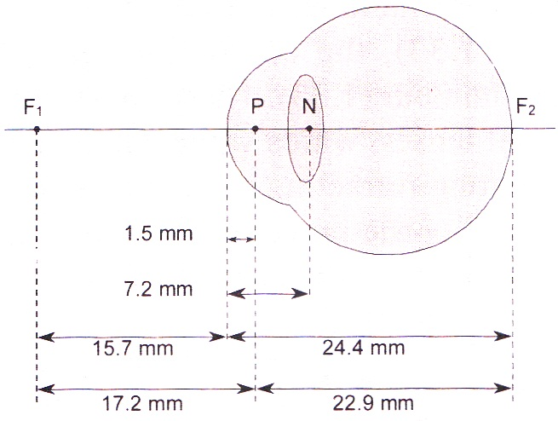

Slide 33
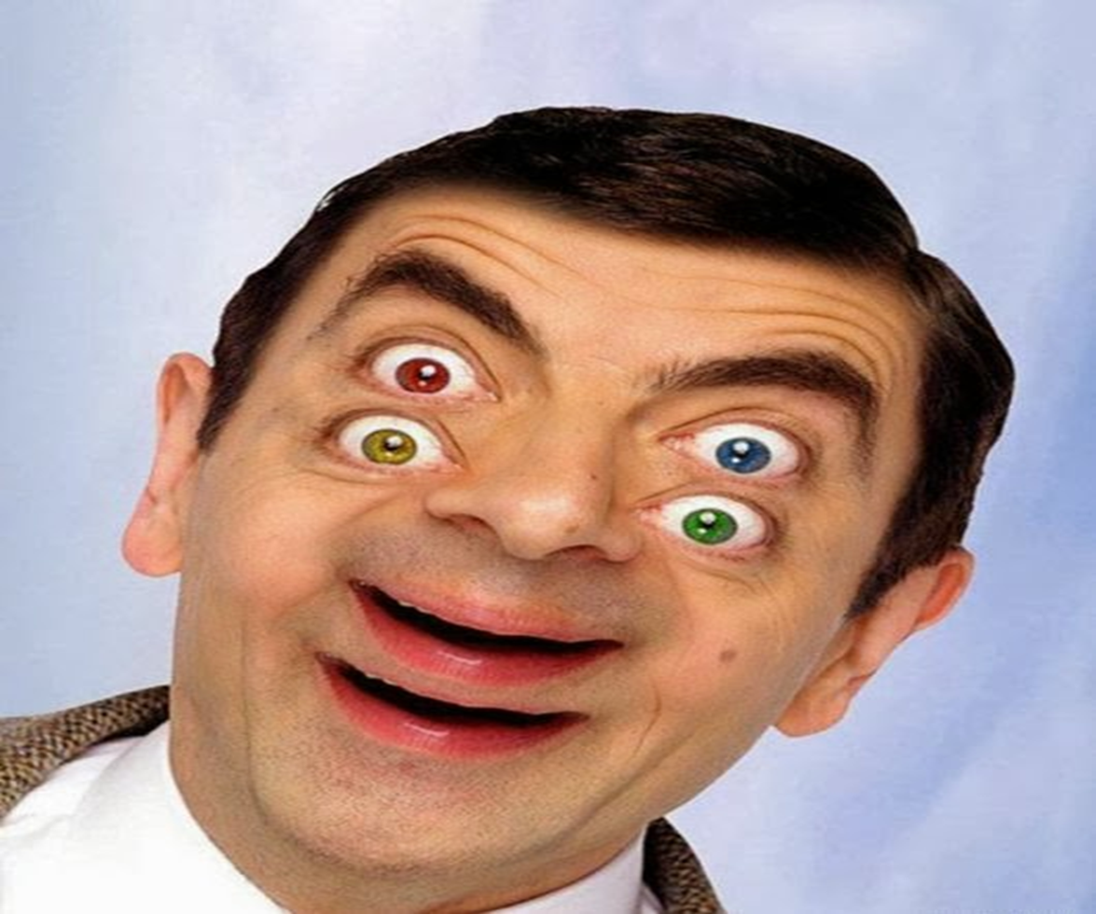
THANK YOU

Slide 34
ACCOMMODATION
Definition:-
  The ability of the eye to see near as well as far objects clearly is called accommodation.

Slide 35
  Mechanism for far point, near point, range & amplitude:-
Far point:-
  It is farthest distance from the eye at which an object is seen clearly (infinity) but for practical purposes, it is considered 6 meter (20 feet).
Near point:-
  Nearest distance from eye at which object can be seen clearly. It is 25 cm (10 inches)

Slide 36
Range of accommodation:-distance b/w far point & near point is known as range of accommodation.
Amplitude of accommodation:- is the difference b/w the diopter power of the lens with ciliary muscle maximally contracted (+29D) & with ciliary muscles completely relaxed (+15 D).
In normal young person amplitude of accommodation is
29 D – 15 D = 14 D
Presbyopia:-Decreased power of accommodation with increasing age is known as presbyopia.
  With increasing age, near point recedes and amplitude and range of accommodation decrease.

Slide 37
Near vision:-
  Light rays coming from the object are divergent
  Therefore, greater refractive power of lens is required to focus them on retina
  Parasympathetic (3rd cranial nerve) stimulation
  This is achieved by Contraction of ciliary muscle.
  Loosening of suspensory ligament & makes the lens more globular.
  The degree of contraction of ciliary muscles depends upon distance b/w object & eye.

Slide 38
  Near vision
  Lesser distance, greater is the contraction.
  Thus any near object’s image is focused on the retina by increasing the refractory power of lens & person is able to see object clearly.
  Constriction of pupil by sphincter pupillae by parasympathetic fibers in 3rd cranial nerve.
  Convergence of visual axis- by medial rectus supplied by 3rd cranial nerve.

Slide 39
Far vision
Object can be seen clearly only when it is focused on the Retina
For looking at the far object
Ciliary muscle – relaxed
Suspensory ligament tensed
lens – minimum refractory power + 15 D
Parallel rays coming far object are focused → retina
Which is place at the focal plane of lens system of eye

Slide 40
Refraction
Refractive Index
Bending of light rays at angulated interface is called refraction
light rays passing from one medium into another
Interface is plane → No change
Interface is angulated → light rays change

Slide 41
ERRORS OF REFRACTION
Physiological:-
  Spherical aberration-
    Parallel light rays passing through the peripheral portions of the eye lens do not exactly focus at the same point where rays passing through central portion of the lens focus.
    This defect is physiological and is called spherical aberration.
    It is minimized especially when pupil constricts because of the iris covering the peripheral portions of the lens.

Slide 42
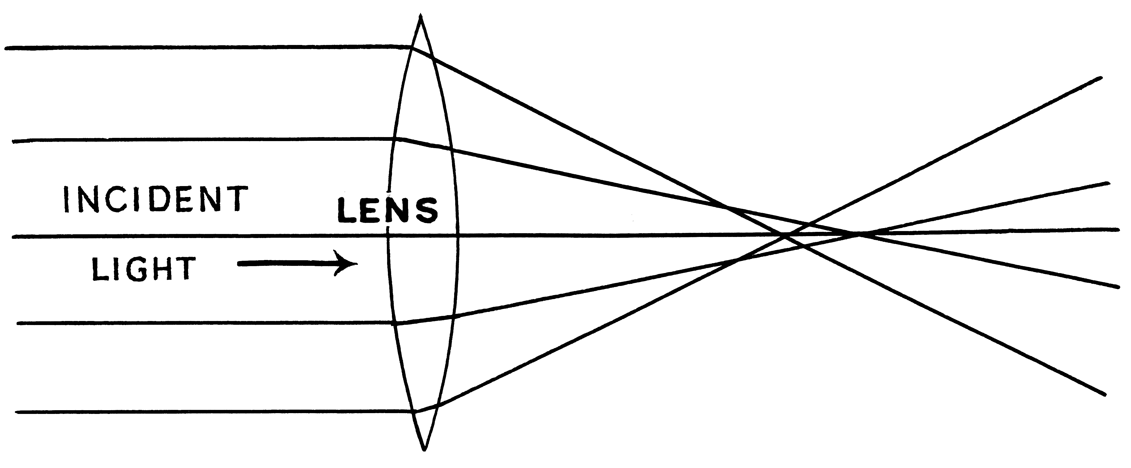

Slide 43
Chromatic aberration:-
  Refractive power of the lens of the eye is different for different colours.
  Therefore the light rays of different colours get focused at different distances behind the lens.
  This error is also physiological and is called chromatic aberration.

Slide 44
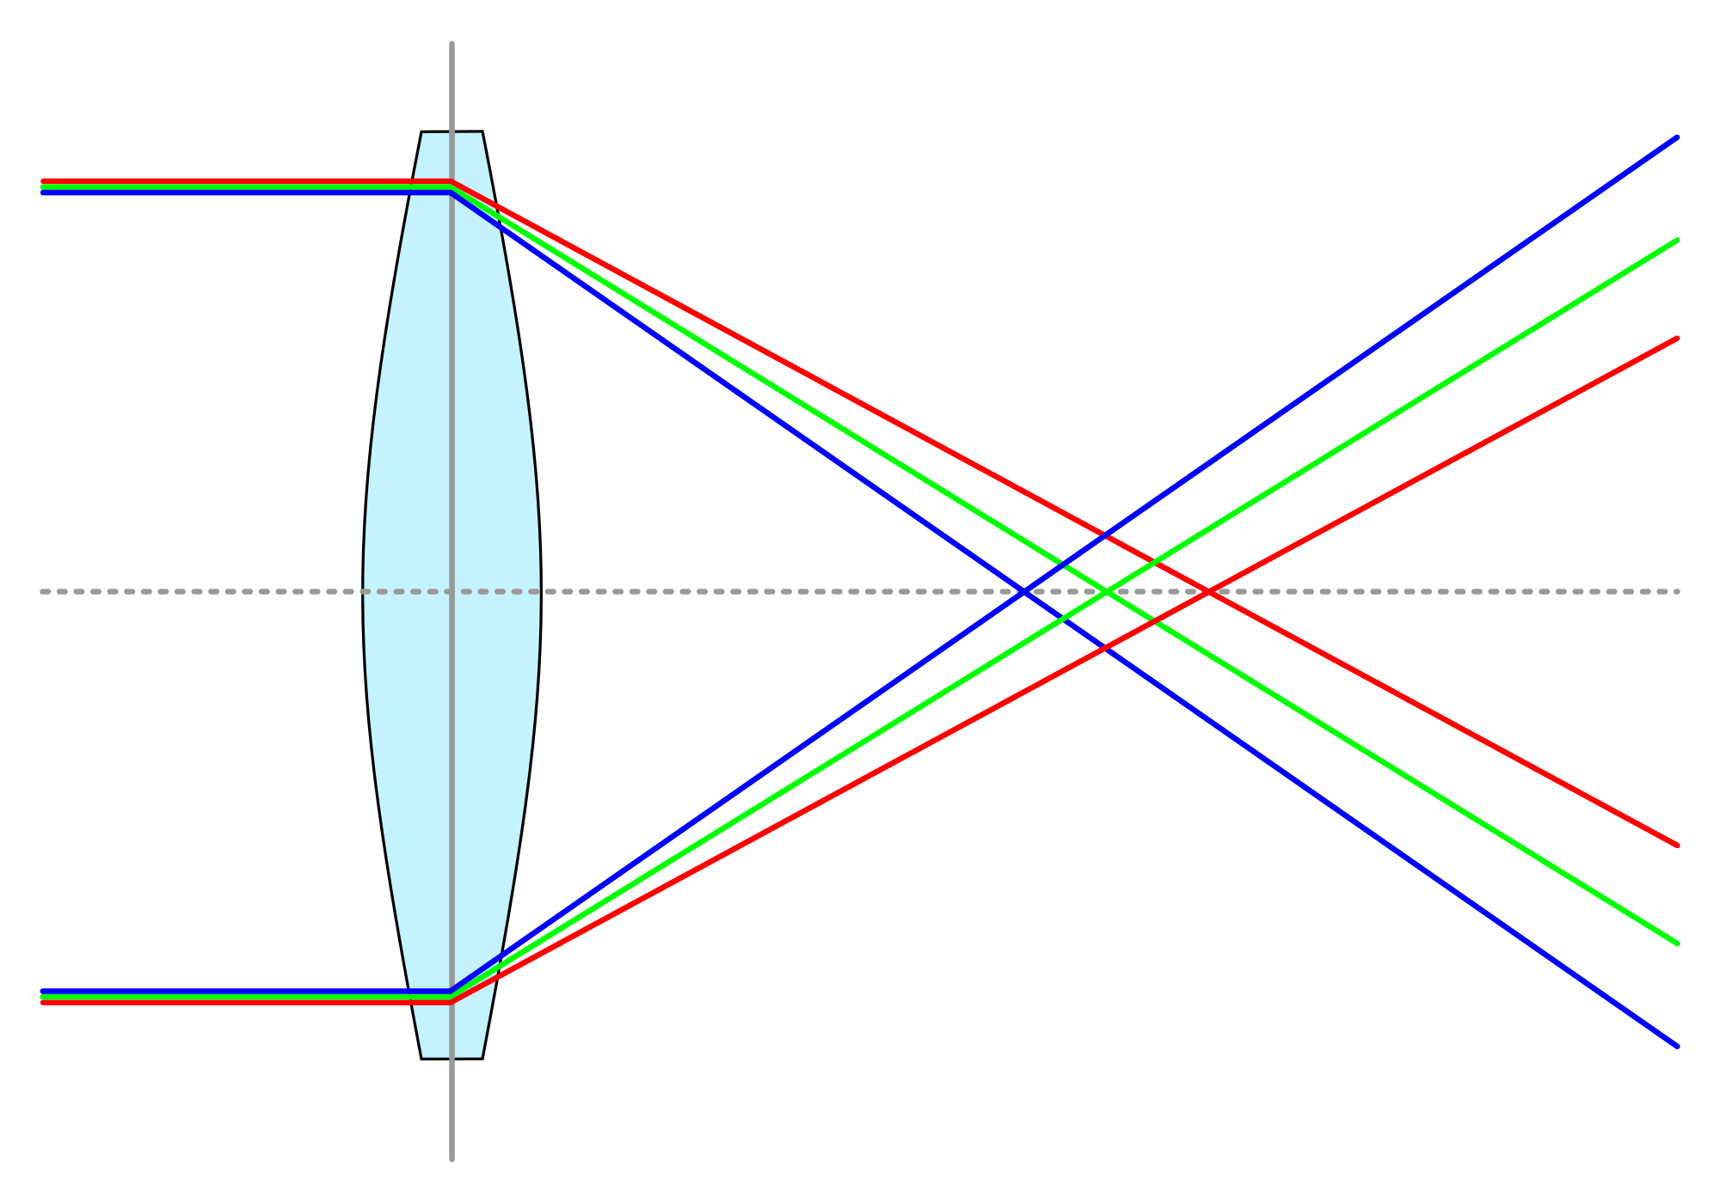

Slide 45
Diffraction:-
  Bending of the light rays as they pass over the sharp borders of the pupil is known as diffraction.
  It interferes with image formation when pupil size is small.
  The ideal size of pupil is 2.5 mm.
Emmetropia:-
  (optically normal eye) parallel rays of light coming from infinity are focused at retina when accommodation being at rest.
Ametropia:-
  (a condition of refractive error) parallel rays of light coming from infinity are focused either in front or behind the retina when accommodation being at rest.
  It includes myopia, hypermetropia & astigmatism.

Slide 46
Pathological:-
  Myopia (near sightedness)
  Hypermetropia / hyperopia (far sightedness)
  Astigmatism
  Presbiopia

Slide 47
Myopia | Hypermetropia
Also known as near sightedness | Also known as far sightedness
Definition: It is the condition in which parallel rays of light coming from infinity focus in front of the retina instead of on the retina, with accommodation being at rest. | Definition: It is the condition in which parallel rays of light coming from infinity focus behind the retina instead of on the retina, with accommodation being at rest.
Causes: - Increased AP diameter of eye - Increased refractive power of the lens or cornea | Causes: - Decreased AP diameter of eye - Decreased refractive power of the lens or cornea

Slide 48
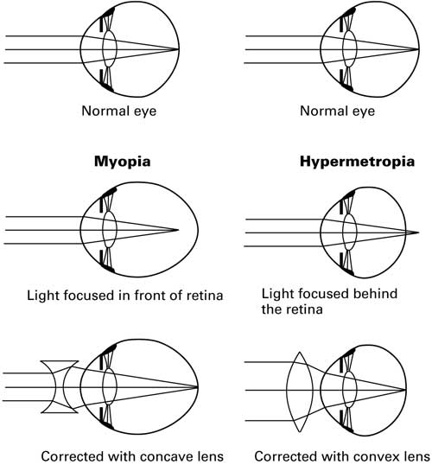

Slide 49
Myopia | Hypermetropia
Pathophysiology: Far point – Near Near point – Nearer | Pathophysiology: Far point – Normal (with accommodation) Near point – Far
Accommodation: used lately, while focusing on object very close to eye. | Accommodation: used even at rest
Clinical features: Near vision – Normal Far vision – Decreased | Clinical features: Near vision – Decreased Far vision – Normal (with accommodation)
Diagnosis: Clinically Snellen’s chart | Diagnosis: Clinically Jaeger’s chart
Correction / treatment: Spherical concave lens Contact lenses LASIC surgery | Correction / treatment: Spherical convex lens

Slide 50
Astigmatism:-
  Definition:-
    It is an ammetropic condition due to difference in curvature of lens or cornea in one or more meridians so that image in that meridian is blurred.
  Correction / treatment:-
    Astigmatism can be corrected with cylindrical lens (concave or convex) in the defected meridian.

Slide 51
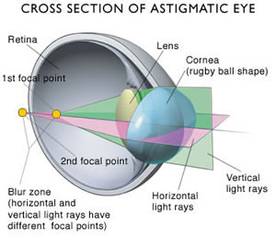

Slide 52
THANK YOU

