Slide 1
MECHANISMS OF RBC DESTRUCTION
Competency :-
PY 2.5 Describe different types of anemias & jaundice

Slide 2
There are two mechanisms of red cell destruction:
Intravascular
Extravascular

Slide 3
INTRAVASCULAR DESTRUCTION
Red cells are destroyed in the circulation, when their cell membrane is breached.
The CAUSES of intravascular destruction are:
The membrane of older red cells becomes rigid and becomes susceptible to rupture during circulation inside the blood vessel.
Defect in the membranes (Membranopathies)- HS,HE
Hemoglobinopathies (Sickle Cell Anemia,Thalassemia)
Enzymopathies (G6PD,Pyruvate Kinase Deficiency)

Slide 4
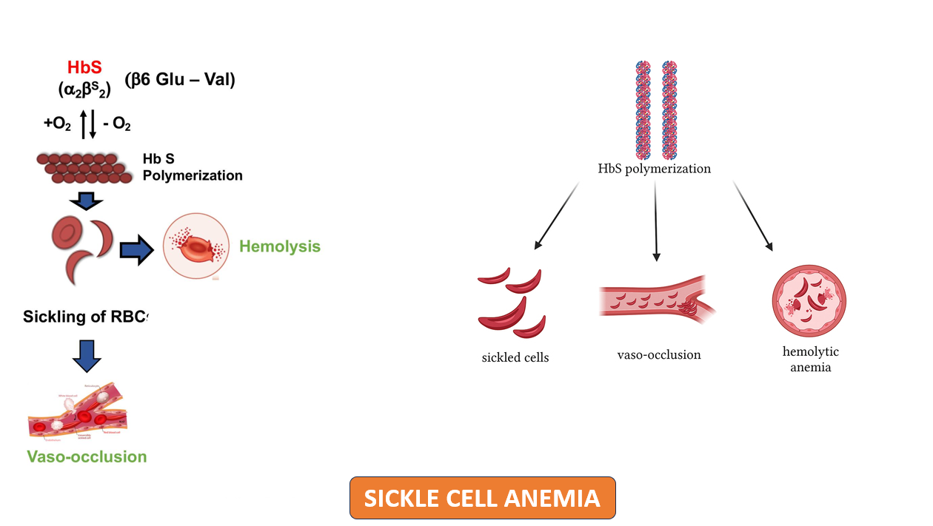

Slide 5
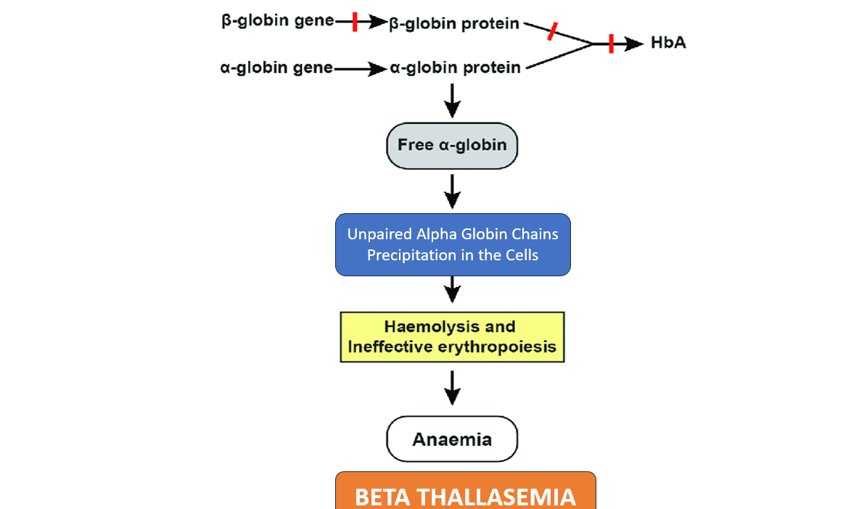

Slide 6
EXTRAVASCULAR DESTRUCTION
Macrophages differentiate young and senescent red cells. They ingest older red cells.
Two important changes occur in senescent red cells that make them vulnerable to phagocytosis by macrophages of RE System/MPS
Decreased deformability
Alteration in surface properties (Abnormal RBCs)

Slide 7
FATE OF DESTROYED RED CELLS
Fate of destroyed red cells depends on whether the cells were destroyed extravascularly or intravascularly.

Slide 8
FATE IN EXTRAVASCULAR DESTRUCTION
In the phagocytic cells such as macrophages, red cells are degraded by lysosomes into Heme and globin.Globin is converted to Amino acids & recycled back
Heme is catabolized to Iron & Porphyrin ring.Iron is recycled back
Porphyrin ring----Biliverdin-----Bilirubin
Bilirubin enters peripheral blood and circulate as Unconjugated bilirubin.

Slide 9
Unconjugated bilirubin is transported to liver, where it gets conjugated and conjugated bilirubin is excreted through bile into the GI tract.
In the intestine, Conjugated bilirubin is converted to urobilinogen by bacterial reduction. Urobilinogen is further converted to stercobilinogen and stercobilin that are excreted in stool.
A small fraction of urobilinogen is absorbed from intestine and excreted through urine as urinary urobilinogen

Slide 10
FATE IN INTRAVASCULAR DESTRUCTION
Destruction of red cells in circulation releases Hb into plasma.
In plasma, Hb binds with haptoglobin and decreases serum haptoglobin level
Hb in the plasma can also bind with haemopexin, a plasma glycoprotein.
When the capacity of haemopexin to bind with Hb is saturated, Hb binds with albumin to form methemalbumin.

Slide 11
The Hb-haptoglobin complex is transported to liver, where the heme of Hb is converted to iron and biliverdin by heme oxygenase.
Biliverdin is further degraded to bilirubin which is Unconjugated

Slide 12
Liver conjugates bilirubin which is excreted through bile into the GI tract.
In the intestine, bilirubin is converted to urobilinogen by bacterial reduction. Urobilinogen is further converted to stercobilinogen and stercobilin that are excreted in stool.
A small fraction of urobilinogen is absorbed from intestine and excreted through urine as urinary urobilinogen

Slide 13
If the intravascular destruction (hemolysis) is more, Hb circulates unbound in the blood and hemoglobinemia occurs.
Hemoglobin enters kidney tubules to be excreted in urine that results in hemoglobinuria
In Severe acute hemolysis, Hemoglobin casts are deposited in kidney tubules and damage the tubules, causing Acute tubular necrosis and Renal failure.

Slide 14
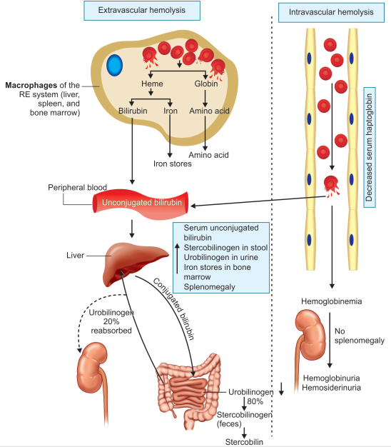
Hb-Haptoglobin Complex
Severe Intravascular Hemolysis

Slide 15
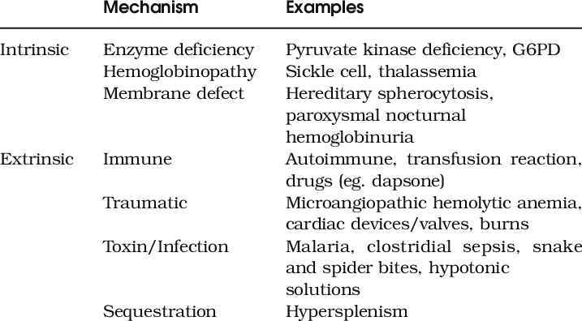
CLASSIFICATION OF HEMOLYTIC ANEMIAS

Slide 16
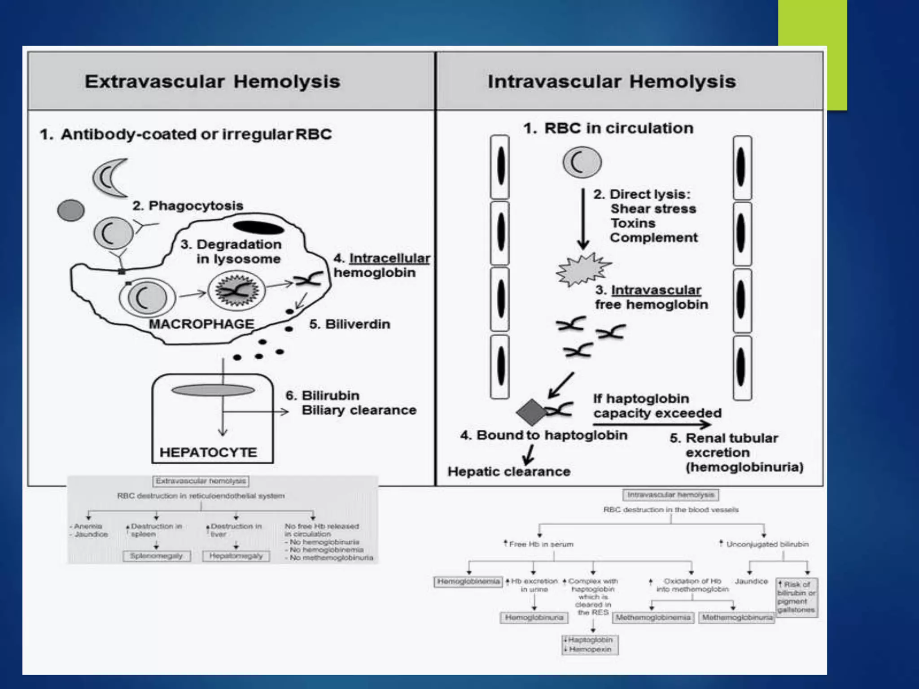

Slide 17
APPLIED ASPECTS

Slide 18
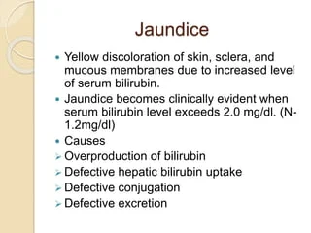

Slide 19
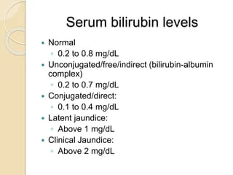
Total Bilirubin
0.2-1.0 mg/dl
0.2-0.8 mg/dl
0.0-0.2 mg/dl

Slide 20
HEMOLYTIC JAUNDICE
Hemolytic jaundice occurs from increased destruction of red cells or their precursors,causing increased bilirubin production.
Jaundice due to hemolysis is usually mild because the healthy liver can excrete a bilirubin load of six times of its normal concentration.
However, this does not happen in newborn. Hence, hemolytic jaundice is common in newborn

Slide 21
Why Hemolytic Jaundice is Common in Newborns ?
In Newborns,Hepatic Enzyme Systems are not Well developed
Due to Which,Bilirubin metabolism is not effective. Hence,Hyperbilirubinemia occurs
Hence,Hemolytic Jaundice is Common in Newborns & may be severe in Premature Deliveries

Slide 22
As Unconjugated bilirubin is mostly bound to Albumin & is not water soluble,Unconjugated bilirubin is not filtered in the glomerulus and therefore, there is no excretion of Unconjugated bilirubin in the urine.
Hence, Hemolytic jaundice is called Acholuric jaundice.
However, urine color may become brown due to excretion of urobilinogen in urine.
Increased quantity of fecal stercobilinogen can cause dark-brown colored stool.
The plasma bilirubin is usually less than 6 mg% and liver function tests are usually normal & Reticulocytosis is seen

Slide 23
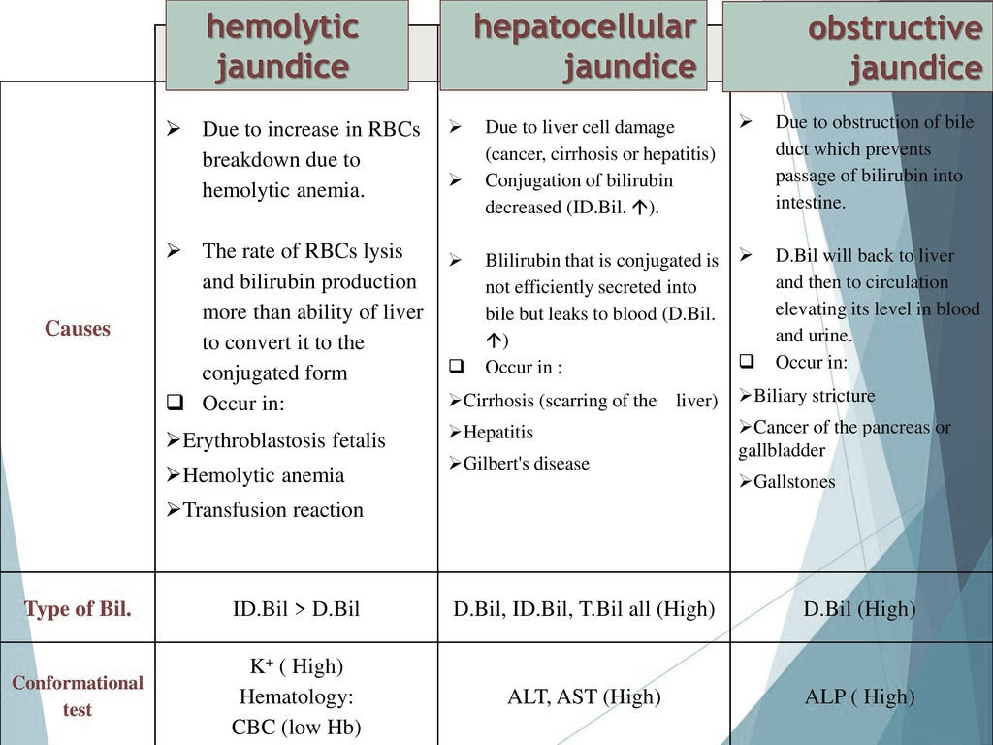

Slide 24
