Slide 1
HEMOGLOBIN
DR SHALINI RANJAN
Competency :-
PY 2.3 Describe & Discuss the Synthesis & functions of hemoglobin & explain its breakdown. Describe variants of hemoglobin

Slide 2
Hemoglobin (Hb) is a Conjugate protein present in Red Cells,Constituting 90% of its Weight & transports Oxygen from the Lungs to the tissues & Carbon dioxide from tissues to the Lungs

Slide 3
Synthesis of Hb

Slide 4
Hb is Synthesized in the Precursors of Red Cells
It appears in the Early Normoblast Stage
Attains Max. Conc. In Late Normoblast Stage

Slide 5
Formation of Hemoglobin requires Heme & Globin
Heme---Formed in Mitochondria
Globin---Formed by Ribosomes
Succinyl-CoA + Glycine α Amino β Ketodipic Acid
(Intermediate Product of TCA Cycle)
α Amino β Ketodipic Acid α Amino δ Levulinic Acid (ALA)
ALA------Porphobilinogen-----Protoporphyrin IX---------Heme--------Hemoglobin
ALA Dehydrogenase
ALA Synthase + Pyridoxal Phosphate
ALA Synthase
Fe²⁺
Globin
Heme Synthase

Slide 6
Structure of Hb

Slide 7
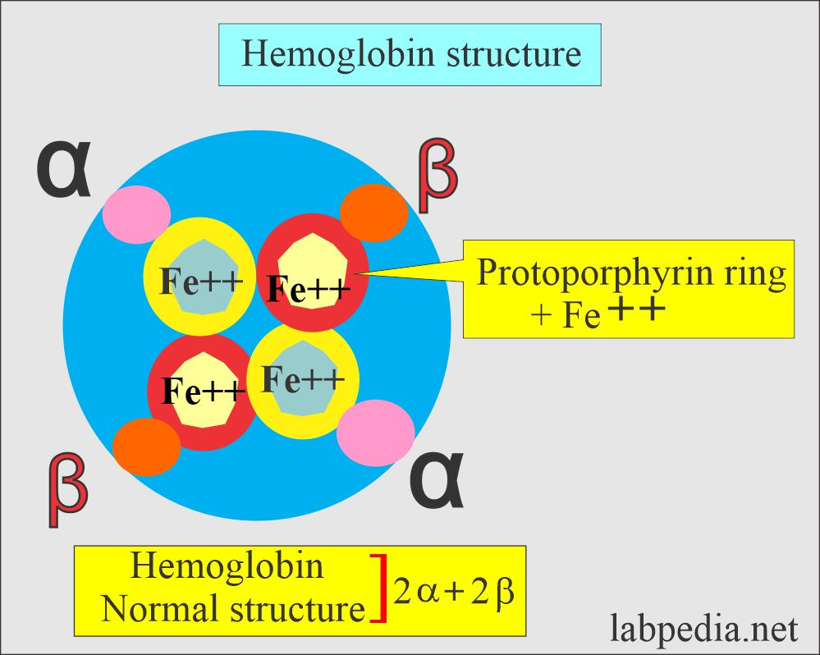
Hemoglobin = Heme + Globin
Heme
Complex Molecule made up of a Series of Tetrapyrrole rings
These Tetrapyrrole rings terminate in Protoporphyrin with a Central Iron Atom
Globin
Protein Consists of 2 pairs of Polypeptide Chains
Each Amino acid chain is attached to Heme to form 1 Hb Molecule

Slide 8
Fate of Hb

Slide 9
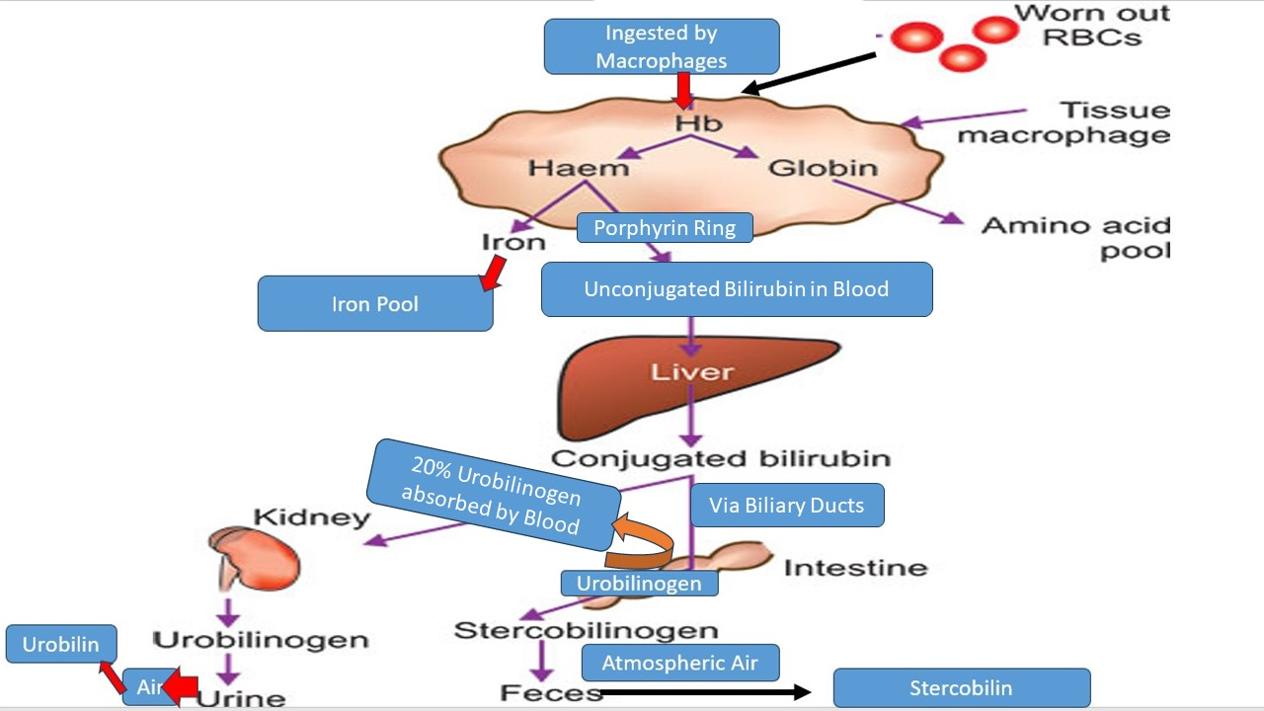

Slide 10
Types of Hb

Slide 11
Normal Hemoglobins :-
Normal Adult Hb
1.Hemoglobin A (Hb A)
  Major Hb in Adults
  Comprises 97% of Hb of Adult Red Cells
  Consists of Two Alpha & Two Beta Chains
  Structural Formula = α₂β₂
  Detected as early as 8th week of IUL
  Replaces HbF by 6 months of Birth

Slide 12
2.Hemoglobin A2 (HbA2)
  Minor Hb in Adults
  Structural Formula = α2δ2
  Present in very small amounts at Birth
  Adult level = 3%
Normal Fetal Hb
1.Fetal Hemoglobin (HbF)
  Major Hb in Fetus
  Structural Formula =α2γ2
2.Hemoglobin Bart’s (Hb Bart’s)
  Minor Hb in Fetal Life
  Structural Formula =γ4

Slide 13
Normal Embryonic Hemoglobins
Confined to very early (Embryonic) stages of Life
1.Gower Hb 1 =2 Zeta & 2 Epsilon chains =Ϛ2ϵ2
2.Hb Gower 2= 2 Alpha & 2 Epsilon Chains =α2ϵ2
3.Hb Portland= 2 Zeta & 2 gamma chains = Ϛ2γ2

Slide 14
Abnormal Hemoglobins :-
1.HbS
Structural Formula = α₂β₂
But in the β Chain,Glutamic Acid (AA) at the 6th position gets Substituted by Valine (Another AA)
HbS results in Sickle Cell Anemia
2.Unstable Hemoglobins
These are Hemoglobin Variants that undergo Denaturation & precipitate in RBCs as Heinz Bodies
3.Other Abnormal Hbs
HbC,HbD & HbE

Slide 15
Normal Values of Hb

Slide 16
Normal Values of Hb
Adult Males=14-18 g/dl of Blood
Adult Females=12-16 g/dl of Blood
Newborns = 16-22 g/dl of Blood

Slide 17
Functions of Hb

Slide 18
1.Transports O2 from Lungs to tissues by forming Oxyhemoglobin & CO2 from tissues to Lungs by forming Carbaminohemoglobin
2.Acts as a Buffer & maintains Blood pH
3.Serves to destroy physiologically important Nitric Oxide Molecule
4.Imparts Red Color to Blood

Slide 19
Variation in Hb Conc.

Slide 20
Conditions that Decrease Hb
Physiological Conditions | Pathological Conditions
Children | Different types of Anemia
Women
Pregnancy
Conditions that Increase Hb
Physiological Conditions | Pathological Conditions
High Altitude | Severe Diarrhoea
Newborns | Excessive Vomiting
Excessive Sweating | Congenital Heart Disease
 | Emphysema
 | Polycythemia Vera

Slide 21
Hb Ligands or complexes

Slide 22
NitrosoHb = Hb + Nitric Oxide
CarbaminoHb =Hb + CO2 (Carbon Dioxide)
CarboxyHb = Hb + CO ( Carbon Monooxide)
MetHb =Hb in which Iron is in Ferric State (Fe3+) instead of Ferrous
(Fe2+)State
CyanmetHb = MetHb + Cyanide Anion
SulfHb = Hb + Sulphur

Slide 23
Glycated Hb = Hb + Glucose
=Enzymatic/Non-enzymatic addition of Glucose to Hb
=Physiological Process
=Normal Value of HbA1c =4-5.6%
=Prediabetes=5.7-6.4%
=Diabetes=≥6.5%
=When Blood Glucose is Chronically Elevated for more than 3 months as in Uncontrolled Diabetes,HbA1c is formed Excessively.So,instead of Fasting Blood Glucose,Estimation of HbA1c is Considered more accurate as it shows the Blood Glucose status of the patient over the past 3-4 months (as RBCs life span=3-4 months).Hence,Glycated Hb is an Index of Chronic Hyperglycemia

Slide 24
BLOOD INDICES

Slide 25
The Values of Hb,PCV & Total RBC Count are used to calculate Red Cell Volume & Red Cell Hemoglobin Content & Concentration,Which are referred to as “Red Blood Indices”
RBC Indices are :-
1.Mean Corpuscular Volume (MCV)
2.Mean Corpuscular Hemoglobin (MCH)
3.Mean Corpuscular Hemoglobin Concentration (MCHC)

Slide 26

1.MCV
Volume of a Single RBC
MCV = Hematocrit or PCV(in%) 10
RBC Count(in million/mm3)
Suppose :- Hct or PCV =40%,RBC Count=5millions/mm3,then
MCV= 40 × 10 =80 fL (80 femtolitre)=80 × 10⁻¹⁵Litres
5
Normal Value of MCV = 78-96 fL
Microcytic RBC =MCV <78 fL
Macrocytic RBC=MCV>96 fL
Normocytic RBC=MCV=Within Normal range=78-96 fL

Slide 27
2.MCH
Avg Weight of Hb in 1 RBC
Expressed in picograms or pg (10⁻¹²gm)
MCH=Hb (in g/dl) х 10
RBC Count (in millions/mm3)
Suppose :- Hb=14g/dl,RBC Count =5millions/mm3,then
MCH=14 х 10 =28pg
5
Normal Value =27-33 pg

Slide 28
3.MCHC
Avg Hb Concentration per unit Volume of RBC
In other words MCHC=How much Volume of RBC is taken by Hb
Expressed as percentage
MCHC= Hb (in g/dl) х 100
PCV (in%)
Suppose Hb=15g/dl,PCV=45% ,then
MCHC=15х 100 =33.3%
45

Slide 29
Normal Value of MCHC =33-37%
Normochromic RBC =MCHC=33-37%
Hypochromic RBC =MCHC<33%
There cant be Hyperchromic RBC as MCHC value = 37% is equal to the upper limit of Hb solubility .It means that beyond this limit Hb cant be held by RBCs.Hence,there cant be any Hyperchromic RBCs

