Slide 1
HEME BIOSYNTHESIS AND REGULATION
Dr. Roshni Sadaria
Professor & Head
Biochemistry Department

Slide 2
HEME
Hemoglobin is a conjugated protein having Heme as a prosthetic group and the protein, Globin.
It is a tetrameric protein with 4 subunits, each subunit having a prosthetic heme group and the globin polypeptide.
The polypeptide chains are usually 2 alpha and 2 beta chains.
Hemoglobin has a Mol. Wt. 67,000 Dalton. Each gram of Hb contains 3.4 mg of iron.

Slide 3
Heme is present in :
Hemoglobin
Myoglobin
Cytochromes
Peroxidase
Catalase
Tryptophan pyrrolase
Nitric oxide synthase
Heme is produced by the combination of iron with a porphyrin ring. Chlorophyll, the photosynthetic green pigment in plants is magnesium-porphyrin complex.

Slide 4
Structure of HEME
Heme is a derivative of Porphyrin.
Porphyrins are cyclic compounds formed by fusion of 4 pyrrole rings linked by methenyl (=CH-) bridges.
Since an atom of iron is present, heme is a ferroprotoporphyrin.
The pyrrole rings are named as I, II, III,IV and the bridges as α,β,γ and δ. The possible areas of substitution are denoted as 1 to 8.

Slide 5
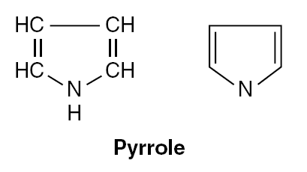

Slide 6
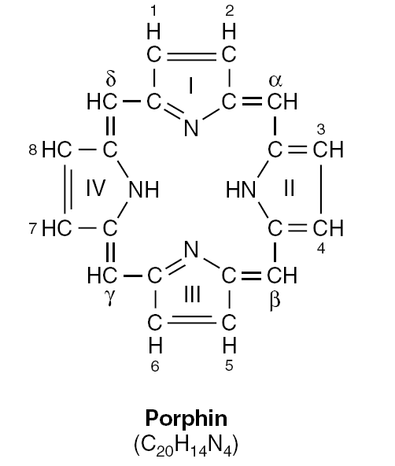

Slide 7
When the substituent groups have a symmetrical arrangement (1,3,5,7 and 2,4,6,8) they are called the I series.
The III series – most predominant- have an asymmetrical distribution of substituent groups (1,3,5,8 and 2,4,6,7).
The usual substitutions are:
1.Propionyl(-CH2-CH2-COOH)group
2. Acetyl(-CH2-COOH) group
3. Methyl(-CH3) group
4. Vinyl (-CH=CH-) group.

Slide 8
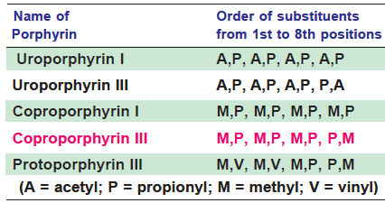

Slide 9
BIOSYNTHESIS OF HEME
Heme can be synthesized by almost all the tissues in the body.
Heme is synthesized in the normoblasts, but not in the matured erythrocytes.
The pathway is partly cytoplasmic and partly mitochondrial.

Slide 10
Step 1: ALA synthesis
The synthesis starts with the condensation of succinyl CoA and glycine in the presence of pyridoxal phosphate to form delta amino levulinic acid (ALA). Hence anemia may be manifested in pyridoxal deficiency.
The enzyme ALA synthase is located in the mitochondria and is the rate-limiting enzyme of the pathway.

Slide 11
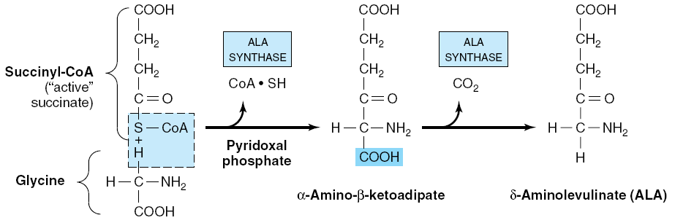

Slide 12
Step 2: Formation of PBG
Next few reactions occur in the cytoplasm.
Two molecules of ALA are condensed to form porphobilinogen(PBG).
The condensation involves removal of 2 molecules of water and the enzyme is ALA dehydratase.
Porphobilinogen is a monopyrrole. The enzyme contains zinc and is inhibited by lead.

Slide 13
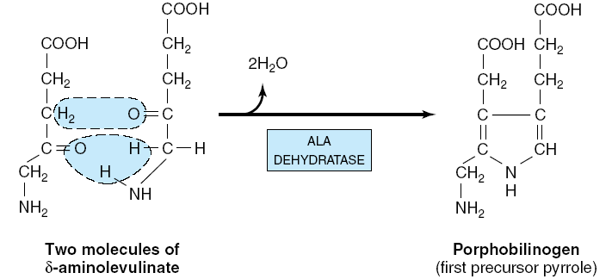

Slide 14
Step 3: Formation of UPG
Condensation of 4 molecules of the PBG, results in the formation of the first porphyrin of the pathway, namely uroporphyrinogen (UPG).
Condensation occurs in a head-to-tail manner, so that a linear tetrapyrrole is produced; this is named as hydroxy methyl bilane (HMB).
The enzyme for this reaction is PBG-deaminase (otherwise called Uroporphyrin I synthase or HMB synthase).

Slide 15
HMB molecule will cyclise spontaneously to form uroporphyrinogen I.
It is converted to uroporphyrinogen III by the enzyme, uroporphyrinogen III synthase.
When the fusion occurs, the III series of isomers are predominantly formed; and only the III series are further utilized.
The pyrrole rings are joined together by methylene bridges (-CH2-), which are derived from the alpha carbon of glycine.

Slide 16
During this deamination reaction 4 molecules of ammonia are removed.
Porphyrinogens are colorless, but are readily oxidized to porphyrins, which are colored compounds.

Slide 17
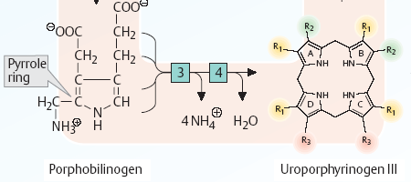
Step 3 : 3 : Porphobilinogen deaminase
4 : Uroporphyrinogen-III- synthase

Slide 18
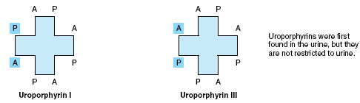

Slide 19
Step 4: Synthesis of CPG
The UPG-III is next converted to coproporphyrinogen (CPG-III) by decarboxylation.
4 molecules of CO2 are eliminated by uroporphyrinogen decarboxylase.
The acetate groups (CH2–COOH) are decarboxylated to methyl (CH3) groups.

Slide 20
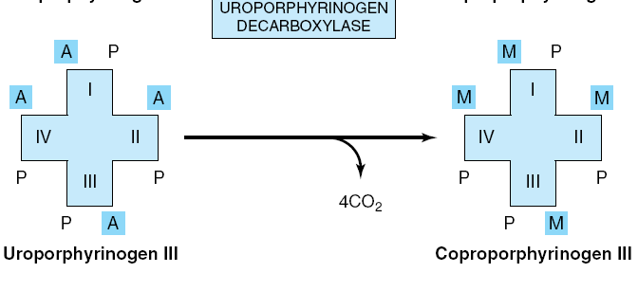

Slide 21
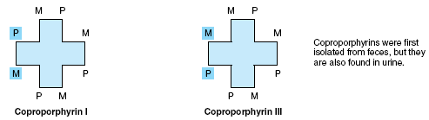

Slide 22
Step 5: Synthesis of PPG
Further metabolism takes place in the mitochondria.
CPG is oxidized to protoporphyrinogen (PPG-III) by coproporphyrinogen oxidase.
Two propionic acid side chains are oxidatively decarboxylated to vinyl groups.

Slide 23
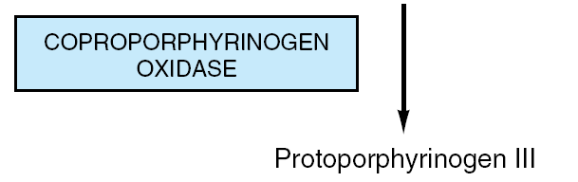
Coproporphyrinogen-III

Slide 24
Step 6: Generation of PP
The Protoporphyrinogen-III is oxidized by the enzyme protoporphyrinogen oxidase to protoporphyrin- III (PP-III) in the mitochondria.
The oxidation requires molecular oxygen.
The methylene bridges (–CH2-) are oxidised to methenyl bridges (–CH=) and colored porphyrins are formed.
Protoporphyrin- 9 is thus formed.

Slide 25
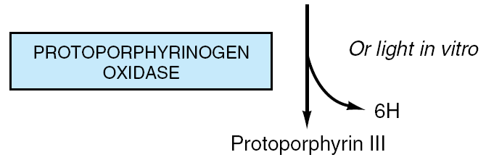
Protoporphyrinogen-III

Slide 26
Step 7: Generation of Heme
The last step in the formation of heme is the attachment of ferrous iron to the protoporphyrin.
The enzyme is heme synthase or ferrochelatase which is also located in mitochondria.

Slide 27
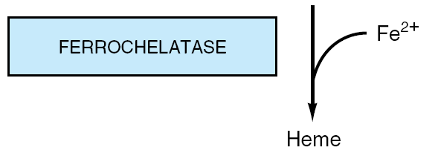
Protoporphyrin-III

Slide 28
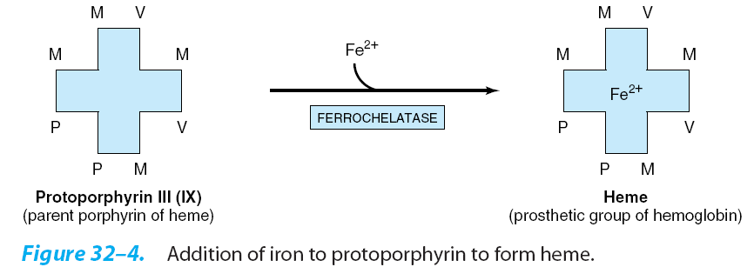

Slide 29
Iron atom is coordinately linked with 5 nitrogen atoms (4 nitrogen of pyrrole rings of protoporphyrin and 1st nitrogen atom of a histidine residue of globin).
The remaining valency of iron atom is satisfied with water or oxygen atom.
When the ferrous iron (Fe++) in heme gets oxidized to ferric (Fe+++) form, hematin is formed, which loses the property of carrying the oxygen.
Heme is red in color, but hematin is dark brown.

Slide 30
In heme molecule, iron atom is co-ordinately linked with nitrogen atom
Pyrrole-N H2O N-pyrrole
Fe
Pyrrole-N N-histidine N-pyrrole
(proximal)

Slide 31
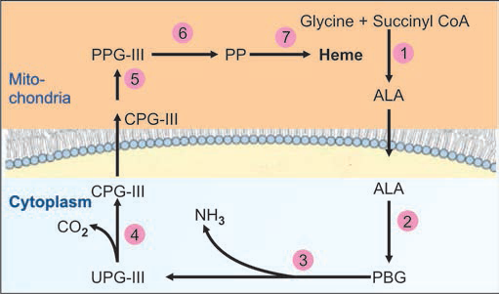

Slide 32
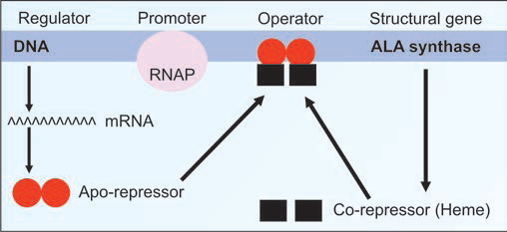
Regulation of Heme Synthesis
1. ALA synthase is regulated by repression mechanism. Heme inhibits the synthesis of ALA synthase by acting as a co-repressor.
Notes:
Repression is the mechanism by which the presence of excess product of a pathway shuts off the synthesis of the key enzyme of that pathway.

Slide 33
2. ALA synthase is also allosterically inhibited by hematin. When there is excess of free heme, the Fe++ is oxidized to Fe+++ (ferric), thus forming hematin.
3. The compartmentalization of the enzymes of heme synthesis makes the regulation easier for the regulation. The rate limiting enzyme is in the mitochondria.

Slide 34
4. Drugs like barbiturates induce heme synthesis. Barbiturates require the heme containing cytochrome p450 for their metabolism. Out of the total heme synthesized, two thirds are used for cytochrome p450 production.
5. The steps catalyzed by ferrochelatase and ALA dehydratase are inhibited by lead.

Slide 35
6. INH (Isonicotinic acid hydrazide) that decreases the availability of pyridoxal phosphate may also affect heme synthesis.
7. High cellular concentration of glucose prevents induction of ALA synthase. This is the basis of administration of glucose to relieve the acute attack of porphyrias.

Slide 36
8. ALA synthase (ALAS) have both erythroid and non-erythroid (hepatic) forms. Erythroid form is called ALAS2; it is not induced by the drugs that affect ALAS1. Erythroid form is not subject to feedback inhibition by heme.

Slide 37
MCQs
1. Porphyrins are cyclic compounds formed by fusion of 4 pyrrole rings linked by which bridges?
A) Methenyl
B) Methyl

Slide 38
2. Site for Heme Biosynthesis is
A) Cytoplasm
B) Mitochondria
C) Both
D) None

Slide 39
3. Rate limiting enzyme for heme biosynthesis
A) heme synthase
B) ALA dehydratase
C) Uroporphyrin I synthase
D) ALA Synthase

Slide 40
4. Hematin can not carry oxygen.
A) True
B) False

Slide 41
5. Heme is a protein present in Hemoglobin.
A) True
B) False

