Slide 1
Structural Organisation of Protein
DR. ROSHNI SADARIA
Professor & Head
Biochemistry Department

Slide 2
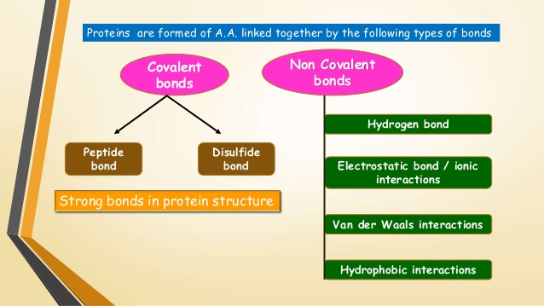

Slide 3
Bonds responsible for protein structure
Two types of bonds
Covalent and non-covalent bonds
Covalent bonds:
The peptide and disulfide bonds are the strong bonds in protein structure.

Slide 4
Disulfide bond:
A disulfide bond (-S-S-) is formed by oxidation of sulfhydryl groups (-SH) of two cysteine residues to produce cystine.
Formed in a single polypeptide chain or between different polypeptides.
Contribute to the structural conformation and stability of protein.

Slide 5
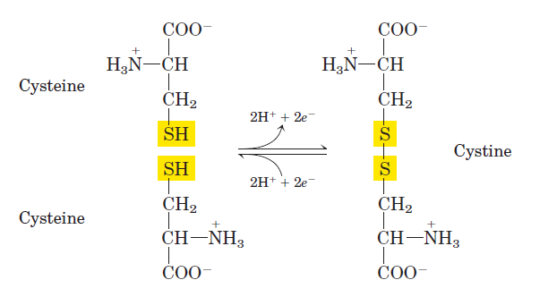

Slide 6
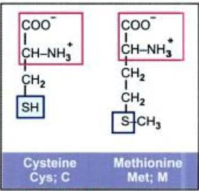

Slide 7
Non-covalent bonds
Hydrogen bonds (H-bonds):
The H-bonds are formed by sharing of H-atoms between the Nitrogen and carbonyl oxygen of different peptide bonds.
Each H-bond is weak but collectively they are strong.
Significantly contribute to the protein structure.

Slide 8
Hydrophobic bonds
Formed by interactions between non-polar hydrophobic side chains of neutral amino acids by eliminating water molecule.
This serves to hold the lipophilic side chains together.

Slide 9
Electrostatic bonds/ Ionic bonds:
These bonds are formed by interactions between negatively charged groups of acidic amino acids with positively charged groups of basic amino acids.

Slide 10
Van der Waals forces:
weak, short-range electrostatic attractive forces between uncharged molecules.
Collectively contribute maximum towards the stability of protein structure.

Slide 11
STRUCTURAL ORGANIZATION
Proteins are made up of one or more polypeptide chains.
STRUCTURAL ORGANISATION OF PROTEINS
Proteins exhibit four different levels of structural organization
1)Primary structure
2)Secondary structure
3)Tertiary structure
4)Quaternary structure

Slide 12
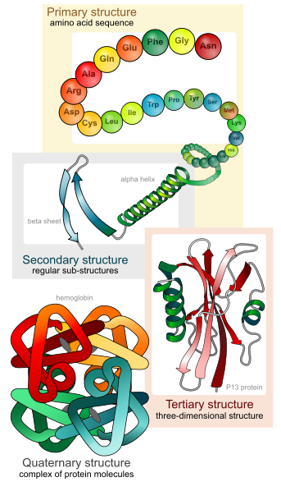

Slide 13
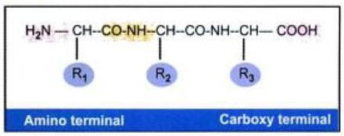
PRIMARY STRUCTURE
Number and sequence of amino acid residues from N-terminal to the C-terminal forms Primary structure.
NH2-Gly-Ala-Val-COOH or
Gly-Ala-Val or GAV -----------Protein A
Gly-Val-Ala : Different sequence ---------Protein B
1st
Notes:
Sequence meaning= Gly-Val-Ala, Naming, numbering

Slide 14
In a tripeptide, there are 3 amino acids, but these 3 can be any of the total 20 amino acids.
Thus 20³ = 8000 different permutations and combinations are possible in a tripeptide.
An ordinary protein having about 100 amino acids, will have 20¹⁰⁰ different possibilities.
By changing the sequence of combination of 20 amino acids, nature produces enormous number of markedly different proteins.

Slide 15
Naming the peptide:
Amino end & carboxyl end.
Therefore, all amino acid sequences are read from the N- to the C-terminal end of the peptide.
When a polypeptide is named, all amino acid residues have their suffixes (-ine, -an, -ic, or -ate) changed to –yl, with the exception of the C-terminal amino acid.
For example, a tripeptide composed of an N-terminal valine, a glycine, and a C-terminal leucine is called valylglycylleucine.

Slide 16
Features:
Peptide bonds maintain and form the backbone of primary structures.
Amino acids are arranged in linear chain linked by peptide bonds.
Primary structure of each protein has a unique amino acid sequence and numbers, decided by genes.
Primary structure is not affected during denaturation.

Slide 17
Peptide Bond:
Rigid, Planar
C-N bond is Partial double bond – no freedom of rotation
The distance is 1.32 Å which is midway between single bond (1.49 Å) and double bond (1.27Å).
Trans configuration
Numbered from the N terminal to the C terminal.
Side chains are free to rotate on either side of peptide bond. The angles of rotation known as Ramachandran angles which determines the spatial orientation of the peptide chain.
Notes:
Single bond- 1.49A; double bond- 1.27A
cis conformation less favorable due to steric interference of side chains.

Slide 18
Proteins
PEPTIDE BOND
1st amino acid
2nd amino acid

Slide 19
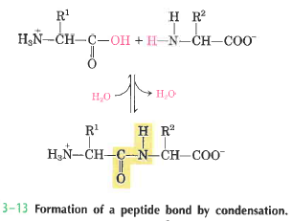

Slide 20
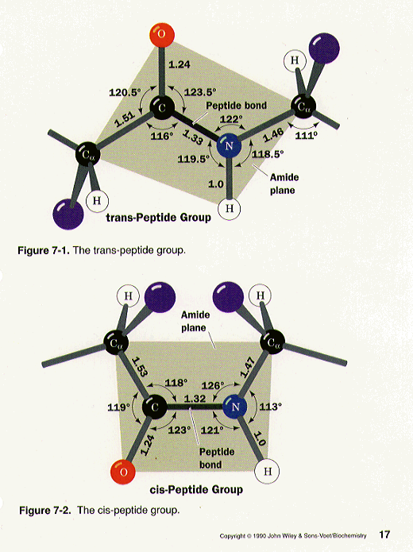
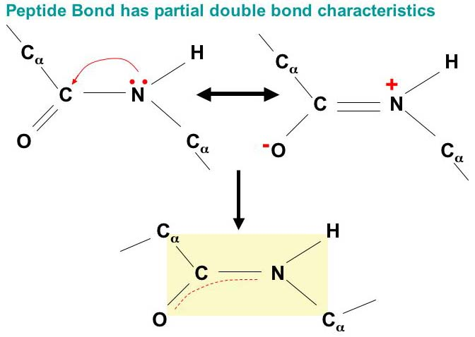
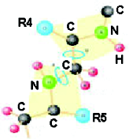
Rigid

Slide 21
Pseudopeptides
Rarely, instead of the alpha COOH group the gamma
carboxyl group of glutamic acid may enter into peptide bond formation, e.g. Glutathione (gamma-glutamyl-cysteinyl-glycine).
The term pseudopeptide (or isopeptide) is used to denote such a peptide bond formed by carboxyl group, other than that present in alpha position.
Notes:
In some proteins peptide bond is formed by COOH group other than α position – gamma carboxyl group of glutamic acid may enter into the peptide bond formation – Glutathione( gamma glutamyl-cysteinyl-glycine).

Slide 22
Polarity of the peptide bond:
Like all amide linkages, the -C= 0 and -N H groups of the peptide bond are uncharged, and neither accept nor release protons over the pH range of 2 to 12.
Thus, the charged groups present in polypeptides consist solely of the N-terminal α-amino group, the C-terminal α-carboxyl group, and any ionized groups present in the side chains of the constituent amino acids.

Slide 23
Branched and Circular proteins:
Generally polypeptide chains are linear.
Branching points in the chains may be produced by interchain disulphide bridges.
Rarely proteins may be in circular form: Gramicidine

Slide 24
Primary structure of Insulin – Branched Protein
Insulin has 2 polypeptide chains. The A(Glycine chain) has 21 amino acids and B(Phenylalanine chain) has 30 amino acids.
They are held together by 2 interchain disulphide bonds. A chain 7th cysteine and B chain 7th cysteine are connected. Similarly A chain 20th cysteine and B chain 19th cysteine are connected.
There is another intrachain disulphide bond between 6th and 11th cysteine residues of A chain.

Slide 25
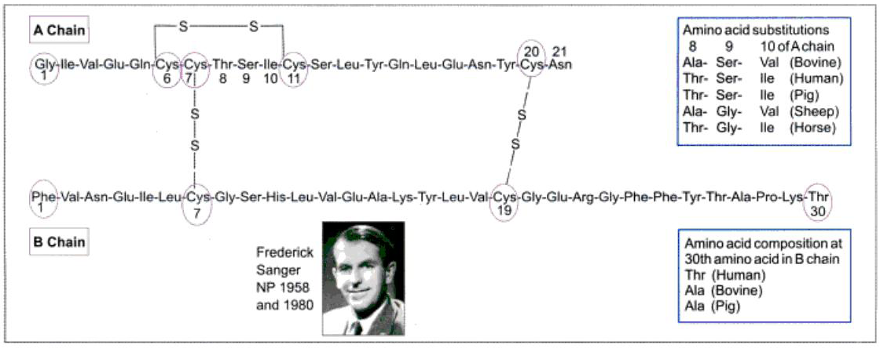
1 Intrachain
2 Interchain

Slide 26
The Porcine insulin and human insulin are structurally similar, except the terminal amino acid in B chain (Thr → Ala).
Bovine Insulin (differ from human insulin by 3 amino acids) may produce antibodies in humans by repeated injections. But de-alaninated porcine Insulin, bearing no antigenic difference from human Insulin will not produce antibodies in diabetic patients even after a long-term use.
Nowadays human Insulin is being produced by recombinant DNA technology.

Slide 27
Pro-insulin
Beta cells of pancreas synthesize insulin as a prohormone.
Proinsulin is a single polypeptide chain with 86 amino acids.
Biologically active insulin (2 chains) is formed by removal of the central portion of the pro-insulin before release.
The C-peptide (connecting peptide) is also released into the circulation.

Slide 28
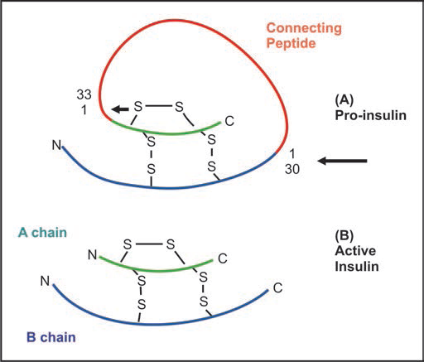

Slide 29
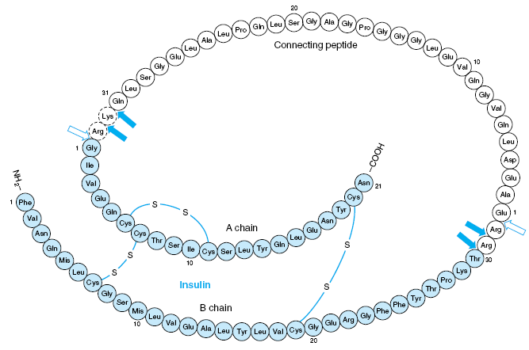

Slide 30
IMPORTANCE OF PRIMARY STRUCTURE
A protein with a specific primary structure will automatically form its natural 3D shape. So the primary structure of proteins determine the higher levels of protein structure. So the biological activities of proteins are dependent on the primary structure.
Understanding the primary structure of proteins is important because many genetic diseases result in proteins with abnormal amino acid sequences, which cause improper folding and loss or impairment of normal function. E.g. Sickle cell anemia.
The primary structures of the normal and the mutated proteins are known, this information may be used to diagnose or study the disease.
Notes:
Beta6 Glu to Val replacement

Slide 31
SECONDARY STRUCTURES
It is the steric relationship of residues which are about 3-4 AA s apart in the linear sequence.
Formed by folding of primary structure into geometrically ordered units.
Stabilized by Noncovalent bonds.
Notes:
Triple helix is a unique secondary structure present in collagen

Slide 32
Types –
α Helix
β Pleated sheet
β Bends
Loop regions
Triple helix

Slide 33
α-Helix
Alpha Helix
Most common and stable conformation; e.g.,
Hemoglobin
Right handed; Spiral structure.
Polypeptide bonds backbone

Slide 34
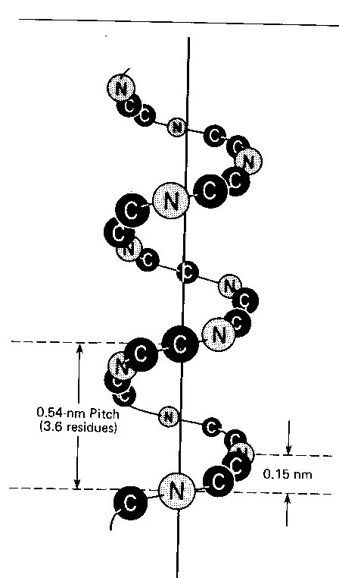
Alpha Helix
3. Structure is stabilized by hydrogen bonds between NH and C=O groups.
Each turn by 3.6 residues;
5. Distance between each residue is 0.15 nm

Slide 35
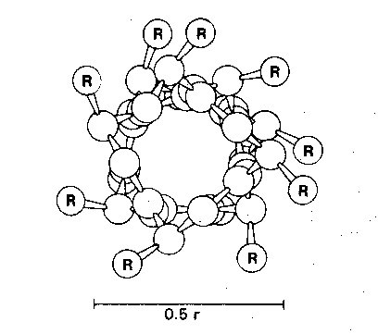
6. Side chains of amino acids extend outward.

Slide 36
Hydrogen bonds are parallel to central axis and R-groups are roughly perpendicular to central axis.
Left handed alpha helix is rare, because amino acids found in proteins are of L-variety, which exclude left-handedness.

Slide 37
Proline form kinks in helix due to absence of α-amino group for hydrogen bonding. Hence these are called helix breakers. Cannot form α-Helix.
Charged amino acids (for example, glutamate, aspartate, histidine, lysine, or arginine) also disrupt the helix by forming ionic bonds, or by electrostatically repelling each other.
Amino acids with bulky side chains, such as tryptophan, or aminoacids, such as valine or isoleucine, that branch at the β-carbon can interfere with formation of the α-helix if they are present in large numbers.

Slide 38
Clinical importance – gives mechanical support by forming strong stiff bundles of fibres.
Example – fibrous proteins – keratin, myosin, tropomyosin, fibrin globular proteins – hemoglobin, myoglobin
Notes:
A very diverse group of proteins contains α-helices. For example, the keratins are a family of closely related, fibrous proteins whose structure is nearly entirely α-helical. They are a major component of tissues such as hair and skin, and their rigidity is determined by the number of disulfide bonds between the constituent polypeptide chains. In contrast to keratin, myoglobin, whose structure is approximately eighty percent α-helical, is a globular, flexible molecule

Slide 39
β Pleated sheet
Almost fully extended structure composed of more than 2 peptide chains.
Distance between amino acid residues is 3.4A

Slide 40
Features:
These are non-helical, extended, zig-zag linear strands held closely by H2 bonds between NH & C=0.
The hydrogen bonds between adjacent strands are perpendicular to long axis of strands
All peptide bonds are involved in ‘H’ bonding

Slide 41
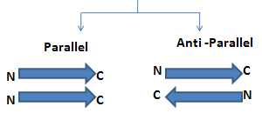
2 types
Eg for parallel – Flavodoxin, carbonic anhydrase
Eg for anti parallel – silk fibroin

Slide 42
Reverse Turns or β-bends
β-Bends reverse the direction of a polypeptide chain, helping it form a compact, globular shape.
β bends play a role in connecting the successive strands of antiparallel β sheets
stabilized by hydrogen and ionic bonds.
Proline and glycine are seen mostly in beta bends.

Slide 43
Loops/ Coils
Approximately one half of globular protein is organized into repetitive structures, such as the α-helix and/or β-sheet.
The remainder of the polypeptide chain is having a loop or coil conformation. These nonrepetitive secondary structures have a less regular structure than those α-helix and/or β-sheet.

Slide 44
TRIPLE HELIX
Collagen forms a triple helix. Collagen is rich in proline and hydroxy proline and cannot form a α-helix or β-Pleated sheet.
Stabilized by both non covalent & covalent bonds.

Slide 45
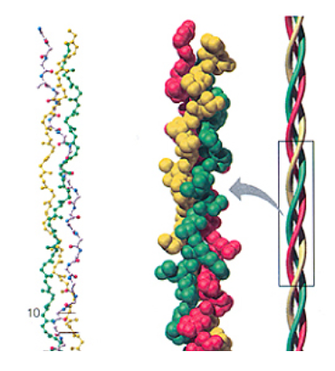
Has 3 polypeptide chains, each called the α chain.
Rich in proline, OHproline, OHlysine and glycine.
Each chain twist as a left handed helix and inturn the 3 chains wrap around each other with a right handed twist.
3 residues per turn

Slide 46
Super secondary structures (Motifs)
Various combinations of secondary structure, called super secondary structure, are commonly found in globular proteins.
Intermediate between secondary and tertiary structures. E.g.
β- α- β unit
Greek key
β-meander

Slide 47
β- α- β unit :
Two parallel β-pleated sheets connected by an intervening strand of α –helix.
Greek key :
A conformation design often found on classical greek pottery.

Slide 48
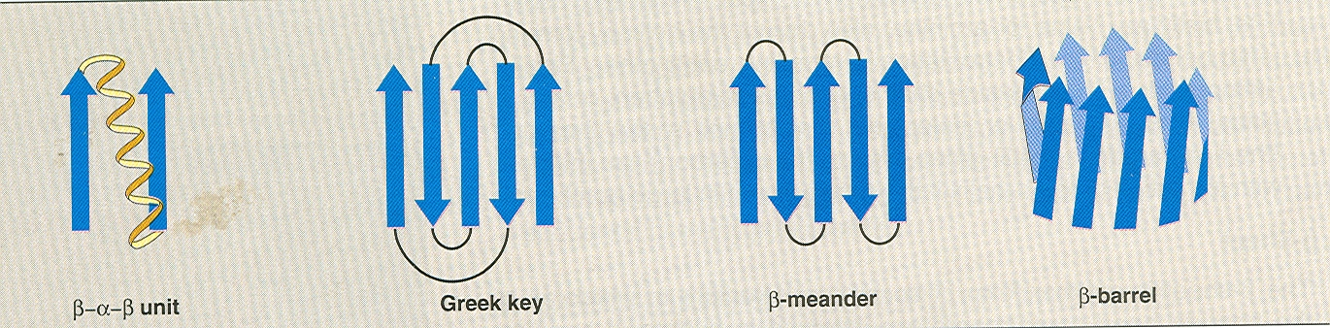
β-meander :
Five β-Pleated sheets connected by reverse turns.
The β-meander contains nearly as many hydrogen bonds as an α-helix and it is very stable.

Slide 49
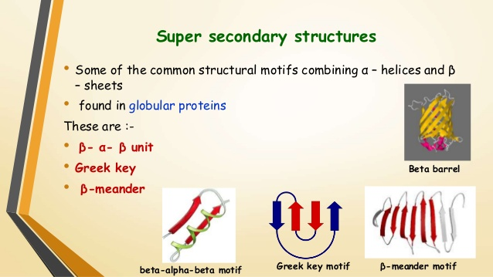

Slide 50
TERTIARY STRUCTURE
It refers to further folding of polypeptide chain of secondary structure giving the compact three dimensional conformation leading to formation of DOMAINS.
It refers to the spatial relationship between the amino acid residues located far apart from each other in their linear structure, but brought closer as a result of folding.
"Tertiary" refers both to the folding of domains and the final arrangement of domains in the polypeptide.

Slide 51
Stabilized primarily by noncovalent interactions.
This type of arrangement ensures thermodynamical stability of the molecule.
A polypeptide with 200 amino acids normally consists of two or more domains.
Phenyl alanine hydroxylase enzyme contains 3 domains, one regulatory, one catalytic and one protein-protein interaction domains.

Slide 52
The core of a domain is built from combinations of super-secondary structural elements (motifs).
Folding of the peptide chain within a domain usually occurs independently of folding in other domains. Therefore, each domain has the characteristics of a small, compact globular protein that is structurally independent of the other domains in the polypeptide chain.

Slide 53
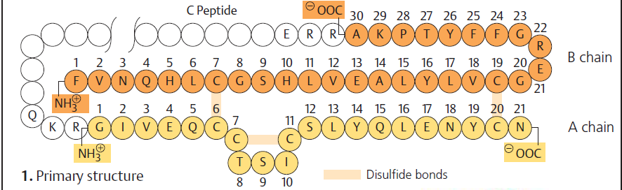
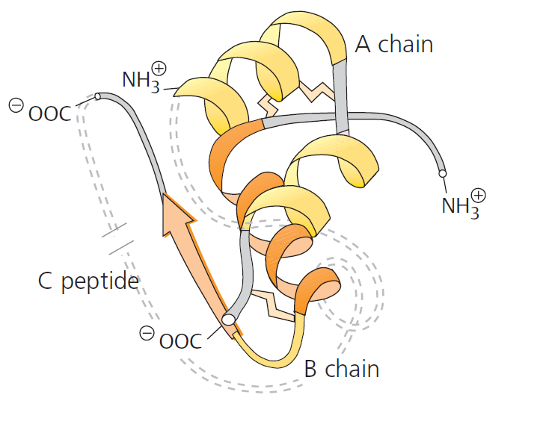
3D structure of insulin

Slide 54
Specific structural motifs in common proteins
Protein | Structural Motifs present
Myoglobin | Alpha helix and beta pleated sheet
Collagen | Triple helix
Keratin | Coiled coil
Elastin | No specific motif
Superoxide Dismutase | Antiparallel beta pleated sheet

Slide 55
QUATERNARY STRUCTURE
Proteins with > 1 polypeptid chains(polymers) – form functional protein.
Proteins will lose its function when subunits are dissociated.
Stabilized by noncovalent bonds.

Slide 56
Such proteins are termed as oligomers.
1 chain – monomer/subunit
2 chains – Dimer
4 chains – tetramer
Homodimer – contains 2 copies of same polypeptide chain
Heterodimer - contains 2 different polypeptide chain

Slide 57
Hb: 2 alpha and 2 beta chains
Immunoglobulin: 2 heavy and 2 light
Creatine kinase (CK) = dimer
Lactate dehydrogenase (LDH) = 4
Aspartate transcarbamoylase = 6

Slide 58
HAEMOGLOBIN
Has 4 polypeptde chains – heteromeric.
α, β, γ, δ, ε
HbA major form in adults→ 2α, 2β chains
-HbA2 minor form in adults→2 α, 2δ
-HbF major form in Fetus→ 2 α, 2γ
Abnormal Hb –
thalassemia – a or b
Hb S – glutamic acid of b6 by valine
Hb C – glutamic acid of b6 by lysine
Notes:
Both α and β chains posess primary, secondary and tertiary structures. However to become functional α and β subunits have to be associated with one another by salt bridges(Quaternary).

Slide 59
Importance of higher structures of proteins
Proteins are biologically active only in their three dimensional conformations. So the biological activities of proteins are attributed to their higher structures.
If a protein loses its three dimensional form(as in denaturation), it loses its biological activity.

Slide 60
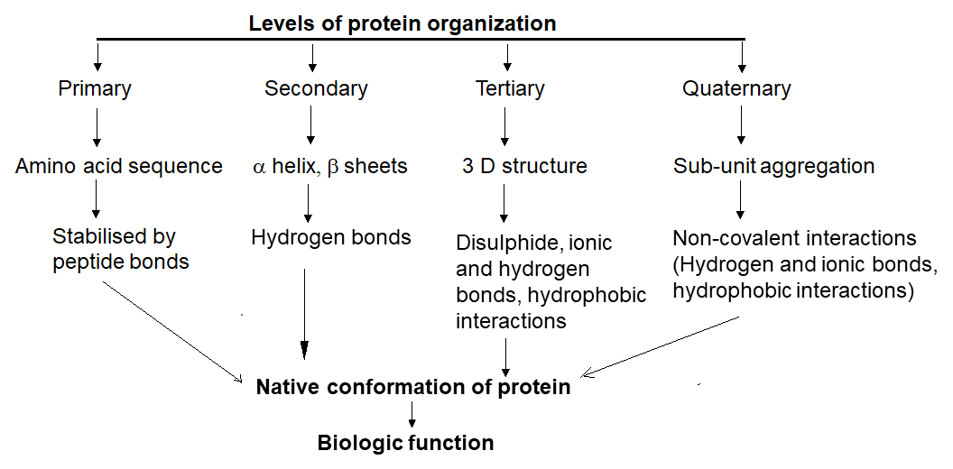

Slide 61
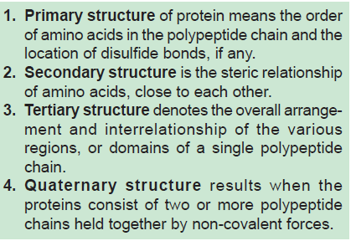

Slide 62
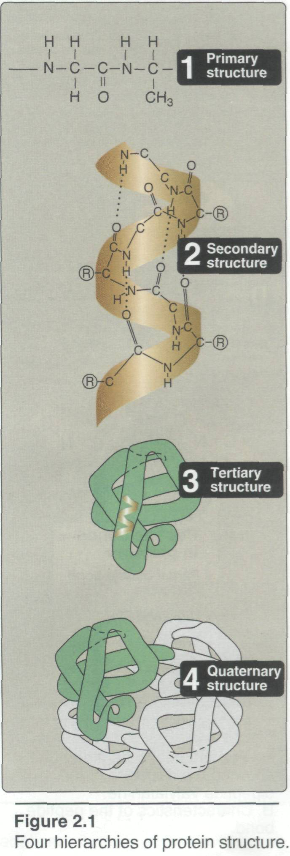

Slide 63
MCQs

Slide 64
Stable Peptide bond occurs in the following isomeric form
cis form
Trans form
Both
None

Slide 65
2. Covalent bond is
Hydrogen bond
Electrostatic bond
Disulphide Bond
Hydrophobic Bond

Slide 66
3. β Pleated sheets are component of
Primary structure
Secondary structure
Tertiary structure
Quaternary structure

Slide 67
4. Triple Helix is found in
Collagen
Elastin
Hemoglobin
Myoglobin

Slide 68
5. Domains are component of
Primary structure
Secondary structure
Tertiary structure
Quaternary structure

