Slide 1
Dr Trushna Shah
Professor
Department of Biochemistry

Slide 2
Fatty acid Oxidation

Slide 3

Cell
Transport from Adipose tissue to Target cells
Adipose tissue
TG
Fatty Acid
From Cytoplasm
to Mitochondria
Blood
Proper
Oxidation in
Mitochondria

Slide 4
Oxidation of Fatty Acids
Fatty acids are an important source of energy
Oxidation is the process where energy is produced by degradation of fatty acids
There are several types of fatty acids oxidation.
β- oxidation of fatty acid
α- oxidation of fatty acids
ω- oxidation of fatty acids

Slide 5
Points
Introduction
Definition
Location
Steps and Pathway
Energetics ( ATP formation)
Regulation
Clinical

Slide 6
BETA OXIDATION OF FATTY ACIDS
This process is known as beta-oxidation, because the oxidation and splitting of two carbon units occur at the beta-carbon atom.
Def: The oxidation of the hydrocarbon chain occurs by a sequential cleavage of two carbon atoms

Slide 7
The beta oxidation of fatty acids involve three stages:
Activation of fatty acids in the cytosol
Transport of activated fatty acids into mitochondria (carnitine shuttle)
Beta oxidation proper in the mitochondrial matrix

Slide 8
Location
Partially cytoplasm and Mitochondrial

Slide 9
Preparative Step 1: Activation of Fatty Acids
Fatty acids are activated to their fatty acyl co A
This activation is taking place in cytoplasm. ATP is hydrolyzed to AMP and Ppi.

Slide 10
The enzyme is a thiokinase or fatty acyl CoA synthetase
Fatty acid Fatty acyl co A
This step occurs in Cytoplasm.
2 ATP are used in this reaction.

Slide 11
Preparative Step 2: Role of Carnitine
Fatty acids are activated in the cytoplasm; but beta oxidation is in mitochondria.
The long chain fatty acyl CoA cannot pass through the inner mitochondrial membrane.
For this Carnitine transporter is required for trnasportation.

Slide 12
Clinical Applications of Carnitine
1. Medium chain and short chain fatty acids do not require carnitine for transport across the inner mitochondrial membrane. So, medium chain and short chain fatty acids are easily oxidized.
2. Carnitine deficiency is reported in preterm infants, in whom impaired fatty acid oxidation is noticed. So more glucose is utilized, resulting in episodes of hypoglycemia.

Slide 13
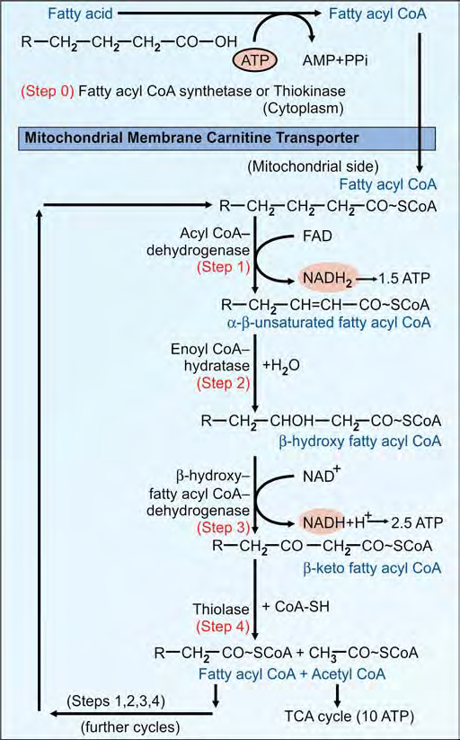

Slide 14
Beta oxidation in Mitochondria
Step 1: FAD Linked Dehydrogenase
The fatty acyl CoA is dehydrogenated to a α, β transenoyl CoA
FAD converted to FADH2
FADH2 when oxidised in electron transport chain will produce 1.5 ATP molecules.

Slide 15
Step 2: Hydration
This is catalyzed by an “hydratase”
step forms a beta-hydroxy fatty acyl CoA.

Slide 16
Step 3: NAD+ Dependent Dehydrogenase
beta-hydroxy fatty acyl CoA
Oxidised
beta-keto fatty acyl CoA.
The NADH when oxidized in electron transport chain will generate 2.5 ATPs.

Slide 17
Step 4: Cleavage
beta-keto fatty acyl CoA
Thiolase
Fatty acyl co A
Acetyl Co A
Cycle Repeated for 7 times

Slide 18
Further Cycles
The newly formed fatty acyl CoA will sequentially undergo further cycles of steps 1, 2, 3 and 4 of beta-oxidation until the fatty acid is completely converted to acetyl CoA.

Slide 19
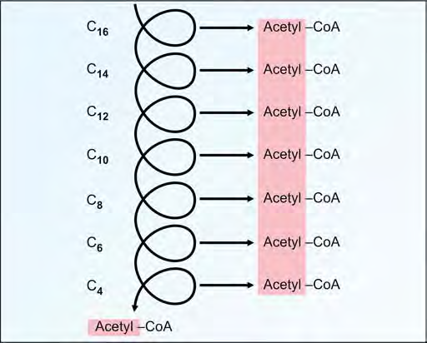

Slide 20
Energetics of Beta Oxidation (ATP Yield)
Palmitic acid (16 C) needs 7 cycles of beta oxidation So, it gives rise to 8 molecules of acetyl CoA .
Every molecule of acetyl CoA when oxidized in the TCA cycle gives 10 molecules of ATP.

