Slide 1
Dr Trushna Shah
Professor
Department of Biochemistry
SBKSMI&RC

Slide 2
DE NOVO SYNTHESIS OF FATTY ACIDS

Slide 3
DE NOVO SYNTHESIS OF FATTY ACIDS
Fatty acids are synthesized mainly by a de novo synthetic pathway operating in the cytoplasm.
So it is referred to a extramitochondrial or cytoplasmic fatty acid synthase system.

Slide 4
The major fatty acid synthesized de novo is palmitic acid, the 16C saturated fatty acid. The process occurs in liver, adipose tissue, kidney, brain, and mammary glands.

Slide 5
Raw material is
Acetyl CoA
NADPH
ATP

Slide 6
Transport of Acetyl CoA to Cytoplasm
The starting material for de novo synthesis is acetyl CoA. It is formed inside the mitochondria from pyruvate.
The inner membrane is not freely permeable to acetyl CoA. Hence the acetyl CoA units are delivered to the cytoplasm as citrate.

Slide 7
Mitochondria
Acetyl co A
OAA AND Acetyl Co A
CITRATE
CITRATE

Slide 8
Citrate is transported from mitochondria by a tricarboxylic acid transporter.
In the cytoplasm, citrate is cleaved to oxaloacetate and acetyl CoA in the cytoplasm. The enzyme is ATP citrate lyase.

Slide 9
Fatty Acid Synthase (FAS) Complex
This system exists as a multi-enzyme complex. The enzymes form a dimer with identical subunits.
Each subunit of the complex is organized into 3 domains with 7 enzymes

Slide 10
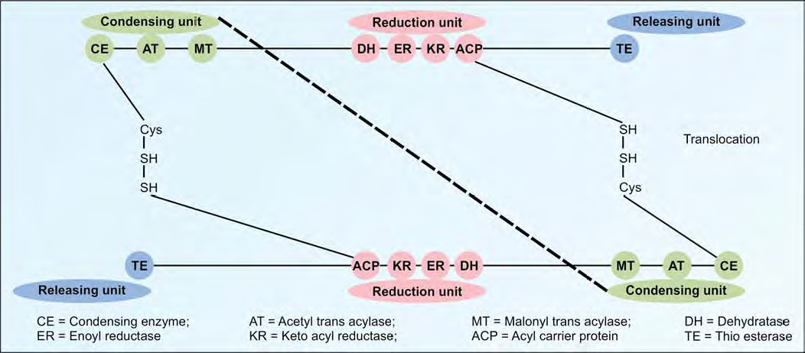

Slide 11
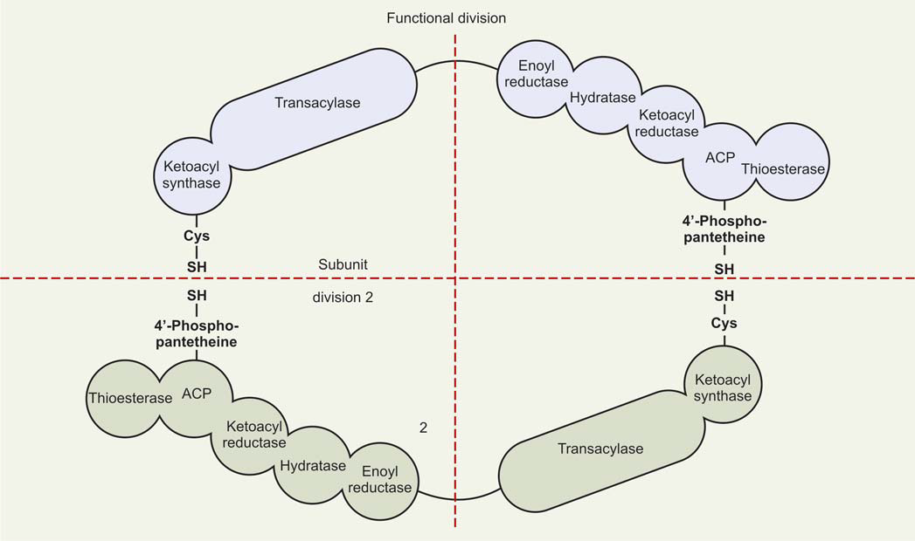

Slide 12
First Domain or Condensing Unit
It is the initial substrate binding site. The enzymes involved are
beta-keto acyl synthase or condensing enzyme (CE);
acetyl transferase (AT)
malonyl trans acylase (MT)

Slide 13
Second Domain or Reduction Unit
Dehydratase (DH)
Enoyl reductase (ER)
beta-keto acyl reductase (KR)
Acyl carrier protein (ACP)

Slide 14
Third Domain or Releasing Unit
It is involved in the release of the palmitate synthesized. It
contains Thio-esterase (TE)

Slide 15
First Step:
The first step in the fatty acid synthesis is the carboxylation of acetyl CoA to form malonyl CoA.
Acetyl CoA carboxylase is not a part of the multi-enzyme complex. But it is the rate-limiting enzyme.
Biotin, a member of B complex vitamins, is necessary for this reaction

Slide 16
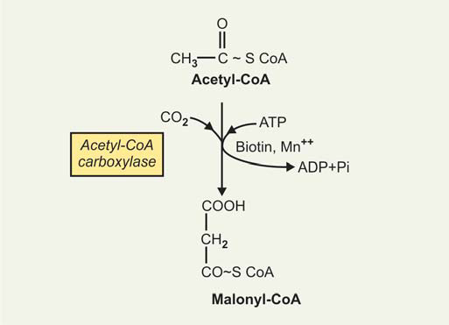

Slide 17
After the conversation of Acetyl Co A to Malonyl Co A, all reactions of fatty acid synthesis are catalysed by a fatty acid synthase complex (FAS Complex)
FAS is a Dimer which run anti parallel to each other.

Slide 18
Step 2: Three C and Two C Units are Added
A. Acetyl transacylase (AT) catalyzes the transfer of the acetyl group (2 carbons) to the SH group of the condensing enzyme (CE) of the other monomer of the fatty acid synthase complex

Slide 20
B. One molecule of acetyl CoA (2 carbon) and one molecule of malonyl CoA (3 carbon) bind to the multienzyme complex.
Malonyl transacylase (MT) transfers the malonyl group to the SH group of the ACP of one monomer of the enzyme

Slide 21
Intermediates
beta-keto acyl ACP
Beta hydroxy fatty acyl ACP
enoyl ACP
butyryl ACP
Palmitic acid

Slide 22
Step 3: Condensation
Acetyl (2C) + malonyl (3C)
condensing enzyme
beta-keto acyl ACP

Slide 23
Step 4: Reduction
beta-keto acyl ACP
NADPH dependent keto acyl reductase(KR)
Beta hydroxy fatty acyl ACP

Slide 24
Step 5: Dehydration
beta hydroxy fatty acyl ACP
dehydratase (DH)
enoyl ACP

Slide 25
Step 6: Second Reduction
Enoyl ACP
2nd molecule of NADPH enoyl reductase (ER)
butyryl ACP

Slide 26
The butyryl group (4C) is now transferred to the SH group of the condensing enzyme(CE) on the other monomer.
The sequence of reactions, namely condensation, reduction, dehydration and reduction (steps 3,4,5,6) are repeated. The cycles are repeated a total of seven times, till the 16-Carbon palmitic acid is formed.

Slide 27
Step 7: Palmitic acid is Released
Thio-esterase (TE) releases palmitate from the multi-enzyme complex.
The end point is Palmitic acid (16 C) in liver and adipose tissue.

Slide 28
Regulation of Fatty Acid Synthesis
Availability of Substrates Fatty acid synthesis occurs when carbohydrate is abundant and the level of fatty acids is low.
The availability of citrate in the cytoplasm is the most important regulatory factor producing a short-term effect.
Acetyl Co A carboxylase is a regulatory enzyme of fatty acid synthesis.

Slide 29
Resent Research
Inhibitors of FAS are associated with suppression of feeding behaviour and anti cancer properties.
Used in treatment of Cancer and obesity

Slide 30
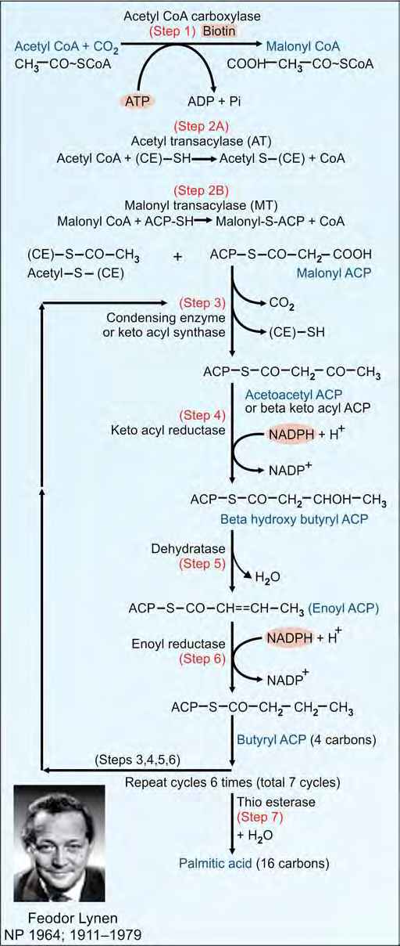

Slide 31
MCQ
1.Regulatory enzyme of fatty acid synthesis is
Acetyl Co A carboxylase
Thioestrase
Enoyl reductase
Ketoacyl synthase

Slide 32
2.Acyl carrier protein (ACP) occurs in a bound state to a derivative of the following vitamin
Biotin
Folic acid
Pantothenate
Pyridoxine

Slide 33
3. The number of cycles requires to synthesise palmitate
9
7
10
12

Slide 34
4. Following electron carriers supply reducing equivalents during synthesis
NADH
FADH
NADPH
ATP

Slide 35
5.Liver can not utilise ketone bodies due the lack of enzyme
Thiolase
Thiophorase
HMG Co A lyase
HMG Co A Synthase

Slide 36
5.All the Following tissues/Organs utilise ketone bodies except
Brain
Liver
Skeletal muscle
Liver

Slide 37
6.Refsum’s Diseases is due to
Beta oxidation
Omega oxidation
Alpha oxidation
None of Above

Slide 38
7. The following biochemical test is used to detect ketone bodies in urine
Benedict's test
Benzidine Test
Rothera’s Test
Hay’s Sulphur test

Slide 39
PLASMA LIPIDS

Slide 40
PLASMA LIPIDS
Total plasma lipid is 400—600 mg/dL.
Out of this, 40% is cholesterol; 30% is phospholipids; 20% is triglycerides.
Since lipids are insoluble in water, they need the help of
carriers in plasma.Therefore, they are complexed with proteins to form lipoproteins.
The protein part of lipoprotein is called apolipoprotein. The lipoproteins are usually abbreviated as Lp.

Slide 41
Classification of Lipoproteins
Depending on the density (by ultra centrifugation) the lipoproteins in plasma are classified into five major types

Slide 42
1. Chylomicrons—contains apoprotein B-48.
2. Very low density lipoproteins (VLDL) or pre-beta lipoproteins. Main apoprotein is B-100.
3 Low density lipoproteins (LDL) -Major apoprotein in LDL is B-100.
4. High density lipoproteins (HDL) -Major apoprotein in HDL is apo-A.
5. Free fatty acids(FFA)

Slide 43
General Characteristics of Lipoproteins.
The lipoprotein molecules have a polar periphery made of proteins, polar heads of phospholipids and cholesterol.
The inner core consists of the hydrophobic TAGs and tails of phospholipids. The apoproteins also increase the solubility of lipids.

Slide 44
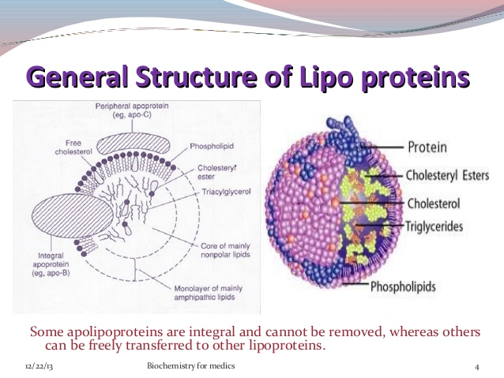

Slide 45
Separation by Ultracentrifugation
The lipoproteins are characterized on the basis of their density. Fat is less dense than water; so fat floats on water.
Lipoproteins with high lipid content will have a low density and so float on centrifugation.
Those with high protein content will sediment easily and have a high density.

Slide 46
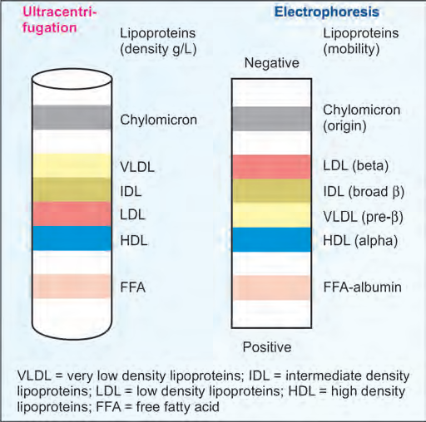

Slide 47
Apo-lipoproteins
The protein part of lipoprotein is called apolipoprotein (apo-Lp) or apoprotein.
All apoproteins are mainly synthesized in liver; but small quantities are produced from almost all organs.

Slide 48
1. Apo-A-I. Activates lecithin-cholesterol acyl trans ferase (LCAT). It is the ligand for HDL receptor. It isanti-atherogenic. It is specific for HDL.
2. Apo-B-100. Only apoprotein component of LDL; it binds to LDL receptor on tissues.
Apo- B-100 is one of the biggest proteins, having 4536 amino acids, with a molecular weight of 550 kDa. It is synthesized in liver.

Slide 49
3. Apo-B-48. Major apoprotein of chylomicrons. It is synthesized only in intestinal cells.
4. Apo-C-II. Activates lipoprotein lipase.
5. Apo-E. Arginine rich protein. It is present in chylomicrons, LDL and VLDL. it is involved in cellular transport of lipids in CNS.

Slide 50
CHYLOMICRONS
Synthesis of Chylomicrons:
Chylomicrons are formed in the intestinal mucosal cells, and secreted into the lacteals of lymphatic system. They are rich in triglyceride
If lipemic serum is kept overnight in the refrigerator, chylomicrons rise as a creamy layer to the top, leaving the upper portion clear.

Slide 51
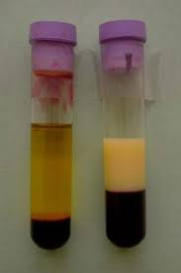

Slide 52
When the chylomicrons are synthesized by the intestinal mucosa, they contain only apo-B-48 and apo-A but apo-C and apo-E are added from HDL in blood during transport

Slide 53
Metabolism of Chylomicrons
i. Main sites of metabolism of chylomicrons are adipose tissue and skeletal muscle.
The half-life of chylomicrons in blood is about 1 hour.
The enzyme lipoprotein lipase (LpL) hydrolyzes triglycerides present in chylomicrons into fatty acids and glycerol.

Slide 54
Function of Chylomicrons
Chylomicrons are the transport form of dietary triglyceride from intestines to the adipose tissue for storage; and to muscle or heart for their energy needs.

Slide 55
LOW DENSITY LIPOPROTEINS(LDL)
Low density lipoproteins (LDL) transports cholesterol from liver to peripheral tissues. The only apoprotein present in LDL is apo B100.
The half-life of LDL in blood is about 2 days.

Slide 56
LDL and Clinical Applications
The LDL concentration in blood has positive correlation with incidence of cardiovascular diseases.
Since LDL-cholesterol is thus deposited in tissues, the LDL (low density lipoprotein) variety is called “bad cholesterol”

Slide 57
Apo-A is a constituent of HDL. This “A” is always written in capital letters. It is seen in all persons. It is anti-atherogenic.
Lp(a) is seen in high levels only in some persons. When present, it is associated with LDL. This “a” is always written in small letters. It is highly atherogenic and connected with heart attacks in younger age group.

Slide 58
In 40% population, there is no detectable level of Lp(a) in serum.
In 20% of population, the Lp(a) concentration in blood is more than 30 mg/dL; and these persons are susceptible for heart attack at a younger age.
Lp(a) is associated with heart attacks at the age of 30 or 40 years. Indians have a higher level of Lp(a) than Western populations

Slide 59
HIGH DENSITY LIPOPROTEIN
High density lipoproteins (HDL) transport cholesterol from peripheral tissues to the liver.
Metabolism of HDL
i. The intestinal cells synthesize components of HDL and release into blood. The free cholesterol derived from peripheral tissue cells are taken up by the HDL

Slide 60
Functions of HDL
i. HDL is the main transport form of cholesterol from peripheral tissue to liver, which is later excreted through bile called as Good Cholesterol.

Slide 61
Clinical Significance of HDL
The level of HDL in serum is inversely related to the incidence of myocardial infarction. As it is “anti-atherogenic” or “protective” in nature, HDL is known as “good cholesterol”

Slide 62
It is convenient to remember that "H" in HDL stands for "Healthy".
HDL level below 35 mg/dL increases the risk, while level above 60 mg/dL protects the person from coronary artery diseases.

Slide 63
VERY LOW DENSITY LIPOPROTEINS
Synthesis of VLDL.
They are synthesized in the liver from glycerol and fatty acids and incorporated into VLDL along with hepatic cholesterol, apo-B-100, C-II and E.

Slide 64
Very low-density lipoproteins transport endogenous triglycerides, phospholipids, cholesterol, and cholesteryl esters. It functions as the body's internal transport mechanism for lipids.
The half-life of VLDL in serum is only 1 to 3 hours.

Slide 65
FREE FATTY ACID (FFA)
i. It is also known as non-esterified fatty acids (NEFA). It is complexed with albumin in plasma.
ii. The FFA is derived from lipolysis of triglyceride stored in adipose tissue by hormone sensitive lipase. Free fatty acids may be either long chain saturated or unsaturated fatty acids.

Slide 66
The FFA molecules are transported to heart, skeletal muscle, liver and other soft tissues.
The free fatty acids are either oxidized to supply energy or incorporated into tissue lipids by esterification.

Slide 67
The half-life of free fatty acids in plasma is very short; only 1–2 minutes. During starvation, about 40–50% energy requirement of the body is met by oxidation of FFA.
Blood level of FFA is very low in the fully fed condition, high in the starved state, and very high in uncontrolled diabetes mellitus.

Slide 68
MCQ
1. Chylomicrons Contain which apoprotein
apoprotein B-48.
apoprotein B-100
apoprotein A
apoprotein B-98

Slide 69
2.Very low density lipoproteins Contain which apoprotein
apoprotein B-48.
apoprotein B-100
apoprotein A
apoprotein B-98

Slide 70
3. High density lipoproteins (HDL) Contain which apoprotein
apoprotein B-48.
apoprotein B-100
apoprotein A
apoprotein B-98

Slide 71
4. Lipoproteins with high lipid content
Chylomicrons
Very low density lipoproteins (VLDL)
Low density lipoproteins (LDL)
High density lipoproteins (HDL)

Slide 72
5. Lipoproteins with high Protein content
Chylomicrons
Very low density lipoproteins (VLDL)
Low density lipoproteins (LDL)
High density lipoproteins (HDL)

Slide 73
SYNTHESIS OF TRIACYLGLYCEROLS

Slide 74
SYNTHESIS OF TRIACYLGLYCEROLS
Liver and adipose tissue are the major sites of triacylglycerol (TAG) synthesis.
The TAG synthesis in adipose tissue is for storage of energy whereas in liver it is mainly secreted as VLDL and is transported.
The TAG is synthesized by esterification of fatty acyl CoA with either glycerol-3-phosphate or dihydroxy acetone phosphate (DHAP)

Slide 75
The glycerol part of the fat is derived from the metabolism of glucose.
In adipose tissue, glycerol kinase is deficient and the major source is DHAP derived from glycolysis.

Slide 76
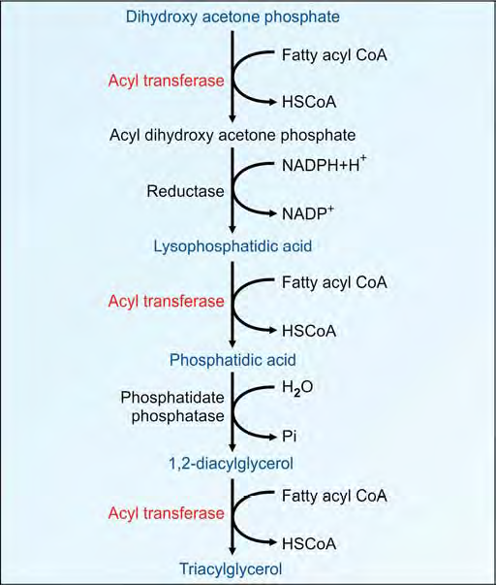

Slide 77
FATTY LIVER AND LIPOTROPIC FACTORS

Slide 78
FATTY LIVER AND LIPOTROPIC FACTORS
Fatty liver refers to the deposition of excess triglycerides in the liver cells.
The balance between the factors causing fat deposition in liver versus factors causing removal of fat from liver, determines the outcome.

Slide 79
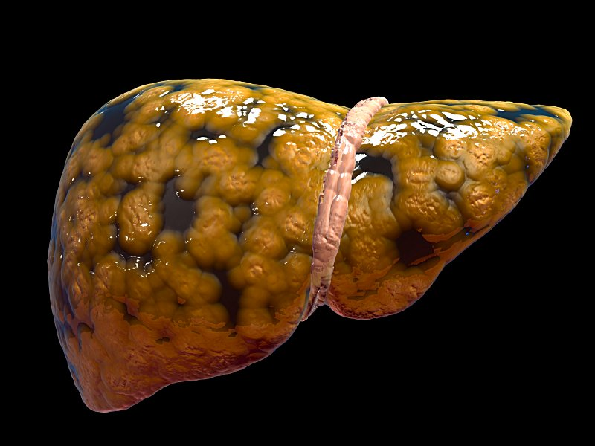

Slide 80
Causes of Fatty Liver
A. Causes of fat deposition in liver
1. Mobilization of FA from adipose tissue.
2. More synthesis of fatty acid from glucose.

Slide 81
B. Reduced removal of fat from liver
3. Toxic injury to liver. Secretion of VLDL needs.
synthesis of apo B-100 and apo C.
4. Decreased oxidation of fat by hepatic cells.
An increase in factors (1) and (2) or a decrease in factors (3) and (4) will cause excessive accumulation, leading to fatty liver.

Slide 82
A. Excessive Mobilization of Fat
The capacity of liver to take up the fatty acids from blood far exceeds its capacity for excretion as VLDL.
So fatty liver can occur in diabetes mellitus and starvation due to increased lipo lysis in adipose tissue

Slide 83
B) Excess Calorie Intake
Excess calories, either in the form of carbohydrates or as fats, are deposited as fat. Hence obesity may be accompanied by fatty liver

Slide 84
Toxic Injury to Liver
i. In toxic injury to the liver due to poisoning by compounds like carbon tetrachloride, arsenic, lead, etc., the capacity to synthesize VLDL is affected leading to fatty infiltration of liver.
In protein calorie malnutrition, amino acids required to synthesise apoproteins may be lacking.

Slide 85
Alcoholism
i. It is the most common cause of fatty liver and cirrhosis in India.
ii. Alcohol is oxidized to acetaldehyde. This reaction produces increased quantities of NADH, which converts oxaloacetate to malate. As the availability of oxaloacetate is reduced, the oxidation of acetyl CoA through citric acid cycle is reduced.
iii. So fatty acid accumulates leading to TAG deposits in liver.

Slide 86
Lipotropic Factors
They are required for the normal mobilization of fat from liver.
Therefore deficiency of these factors may result in fatty liver. They can afford protection against the development of fatty liver.

Slide 87
1. Choline: Feeding of choline has been able to reverse fatty changes in animals.
2. Lecithin and methionine. They help in synthesis of apoprotein and choline formation. The deficiency of methyl groups for carnitine synthesis may also hinder fatty acid oxidation.
3. Vitamin E and selenium give protection due to their antioxidant effect.
4. Omega-3 fatty acids present in marine oils have a protective effect against fatty liver.

Slide 88
CHOLESTEROL

Slide 89
The word cholesterol is derived from Greek words, chole = bile; steros = solid; ol = alcohol.
Almost all nucleated cells (including arterial walls) can synthesize cholesterol. It is widely distributed in the body.

Slide 90
In a 70 kg man, a total of about 140 g of cholesterol is available; which is distributed as about
30 g in brain and nerves,
30 g in muscles, 30 g in adipose tissue,
20 g in skin,
10 g in blood,
10 g in liver and spleen,
5 g in bone marrow,
3 g in alimentary tract, and
2 g in adrenal gland

Slide 91
Normal Range
Total Cholesterol Level Category
Less than 200mg/dL- Desirable
200-239 mg/dL -Borderline high
240mg/dL and above - High

Slide 92
Structure of Cholesterol
All steroids have cyclopentano perhydrophenanthrene ring system .
It is a fused ring system made up of 3 cyclohexane rings designated as A, B and C and a cyclopentane ring D.

Slide 93
1.The six-membered rings are in a phenanthrene arrangement.
2. Total 27 carbon atoms.
3. One hydroxyl group at third position which is characteristic of all sterols. The OH group is betaoriented, projecting above the plane of ring.
4. Double bond between carbon atoms 5 and 6.
5. An eight carbon beta oriented side chain attached to 17th carbon.

Slide 94
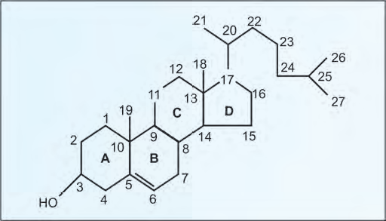

Slide 95
Functions
1.Cell membranes: Cholesterol is a component of membranes
2. Nerve conduction: Cholesterol is used to insulate nerve fibers.
3. Bile acids and bile salts are derived from cholesterol. Bile salts are important for fat absorption.
4. Steroid hormones: Glucocorticoids, androgens and estrogens are from cholesterol.
5. Vitamin D3 is from 7-dehydro-cholesterol.

Slide 96
BIOSYNTHESIS OF CHOLESTEROL

Slide 97
All carbon atoms of cholesterol are derived from acetyl CoA.
The major sites of synthesis of cholesterol are liver, adrenal cortex, testis, ovaries and intestine.
All nucleated cells can synthesize cholesterol, including arterial walls. The enzymes involved in the synthesis of cholesterol are partly located in the endoplasmic reticulum and partly in the cytoplasm.

Slide 98
Intermediate
acetyl CoA
acetoacetyl CoA
beta-hydroxy beta-methyl glutaryl CoA (HMG CoA).
Mevalonate (6 C)
phosphomevalonate, (6 C)
pyrophosphomevalonate, (6 C)
3- phospho-5-pyrophosphomevalonate. (6 C)
isopentenyl pyrophosphate (5 C)
Squalene(30C)
Squalene epoxide (30C)
Lanosterol (27 C)
desmosterol.(27C)
Cholesterol (27 C)

Slide 99
Step 1: Condensation
The acetyl CoA is provided by the ATP-citrate lyase reaction as in the case of fatty acid synthesis.
Two molecules of acetyl CoA condense to form acetoacetyl CoA catalyzed by cytoplasmic “acetoacetyl CoA synthase”

Slide 100
Step 2: Production of HMG CoA
A third molecule of acetyl CoA condenses with acetoacetyl CoA to form beta-hydroxy beta-methyl glutaryl CoA (HMG CoA).
The enzyme is HMG CoA synthase.
HMG CoA is present in both cytosol as well as mitochondria of liver. The mitochondrial pool is used for ketogenesis whereas the cytosolic fraction is utilized for cholesterol synthesis.

Slide 101
Step 3: The Committed Step
HMG CoA
2 NADPH
HMG CoA reductase.
mevalonate

Slide 102
Step 3: The Committed Step
The reduction of HMG CoA to mevalonate is catalyzed by HMG CoA reductase.
It is a microsomal (endoplasmic reticulum) enzyme.
It uses 2 molecules of NADPH
Steps 1 and 2 are shared with ketogenic pathway;
but step 3 is the first reaction that is unique to the cholesterol biosynthetic pathway.
It is the rate-limiting step.

Slide 103
Step 4: Production of 5 Carbon Unit
i. Mevalonate (6 C) is successively phosphorylated to phosphomevalonate (6 C), to pyrophosphomevalonate (6 C), then to
3- phospho-5-pyrophosphomevalonate. (6 C)
This then undergoes decarboxylation to give isopentenyl pyrophosphate, a 5 carbon unit.
Step 4 requires 3 molecules of ATP

Slide 104
Steps 1, 2, 3 and 4 together may be considered as the first phase of the cholesterol synthesis.

Slide 105
Step 5: Condensation of 5-Carbon Units
5A(5 C), 5B(10 C), 5C(15) and 5D Steps condensed to form a 30 carbon compound, Squalene.

Slide 106
Step 6: Cyclization
A. Squalene now undergoes oxidation by epoxidase, using molecular oxygen and NADPH to form squalene epoxide.
A cyclase converts it to 30C lanosterol .
It is the first steroid compound synthesized.

Slide 107
Step 7: Cutting to Size
Lanosterol(30C) converted in to zymosterol(27 C)
zymosterol converted in to desmosterol.
Desmosterol is present in fetal brain.
It is absent in adult brain and re-appears in gliomas (brain tumor).
desmosterol converted in to cholesterol by NADPH

Slide 108
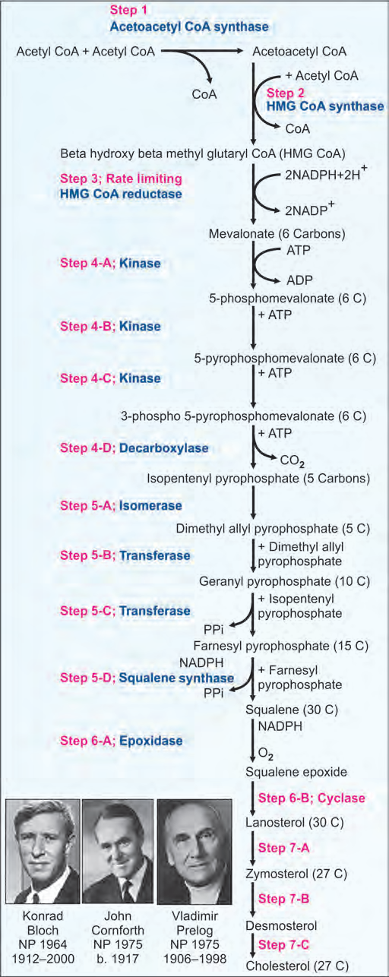

Slide 113
Regulation of Cholesterol Synthesis.
The regulatory enzyme is HMG CoA reductase.
Insulin and thyroxine increase the activity of HMG CoA reductase
Cortisol and glucagon decrease its activity.
Lovastatin and other "statin" group of drugs are competitive inhibitors of HMG CoA reductase. So, they are used in clinical practice to reduce cholesterol level in blood.

Slide 114
Excretion of Cholesterol
Average diet contains about 300 mg of cholesterol per day.
Body synthesize about 700 mg of cholesterol per day.
Out of this total 1000 mg, about 500 mg of cholesterol is excreted through bile.
This cholesterol is partly reabsorbed from intestines.

Slide 115
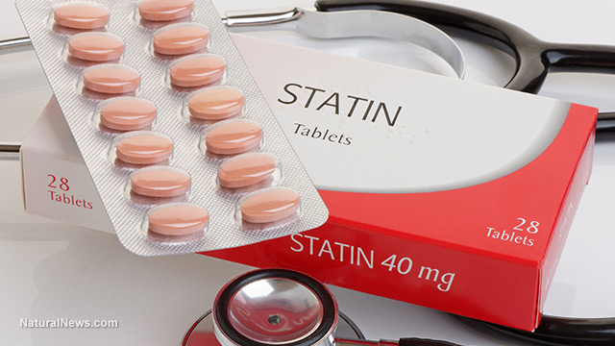

Slide 116
Clinical
Atherosclerosis
Atherosclerosis is a disease in which the inside of an artery narrows due to the build of plaque.
Initially, there are generally no symptoms. When severe, it can result in coronary artery disease, stroke, peripheral artery disease, or kidney problems depending on the arteries which are affected.
Symptoms, if they occur, generally do not begin until middle age.

Slide 117
Risk factors include high blood pressure, diabetes, smoking, obesity, family history, and an unhealthy diet.
Prevention is generally by eating a healthy diet, exercise, not smoking, and maintaining a normal weight

Slide 118
1. Number of carbon present in Cholestrol
23
25
82
27

Slide 119
2.Normal Range of Cholesterol
140-200 mg%
240-400 mg%
70-100 mg%
50-100 mg%

Slide 120
3.Drug used to reduce cholesterol level
Metformin
Aspirin
Statins
None of above

Slide 121
4.Statin inhibit
Hexokinase
HMG Co A Synthase
HMG Co A Reductase
All of above

Slide 122
5. Aspirin inhibit which enzyme
Hexokinase
HMG Co A Synthase
HMG Co A Reductase
Cyclooxygenase

Slide 123


Slide 124
METABOLISM OF KETONE BODIES

Slide 125
Carbohydrates are essential for the metabolism of fat or fat is burned under the fire of carbohydrates. The acetyl CoA formed from fatty acids can enter and get oxidized in TCA cycle only when carbohydrates are available.
During starvation and diabetes mellitus, acetyl CoA takes the alternate route of formation of ketone bodies.

Slide 126
Ketogenesis
Acetoacetate is the primary ketone body while betahydroxy butyrate and acetone are secondary ketone bodies.
They are synthesized exclusively by the liver mitochondria

Slide 127
Step 1: Condensation
Two molecules of acetyl CoA are condensed to form acetoacetyl CoA.

Slide 128
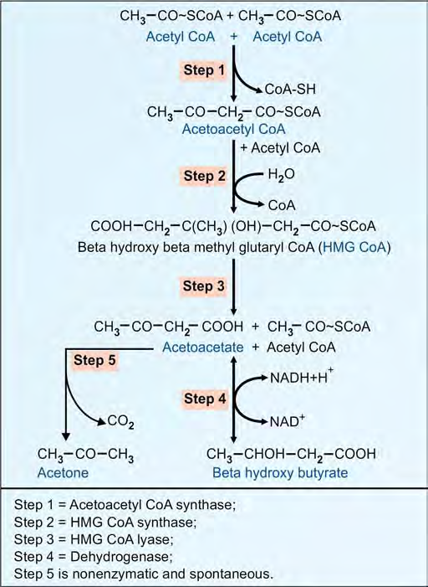

Slide 129
Step 2: Production of HMGCoA
One more acetyl CoA is added to acetoacetyl CoA to form HMG CoA (beta hydroxy beta methyl glutaryl CoA). The enzyme is HMG CoA synthase.
Mitochondrial HMG CoA is used for ketogenesis, while cytosolic fraction is used for cholesterol synthesis.

Slide 130
Step 3: Lysis
Then HMG CoA is lysed to form acetoacetate. Acetoacetate may also be formed by the degradation of carbon skeleton of ketogenic amino acids like leucine, lysine, phenylalanine and tyrosine.
HMG CoA lyase is present only in liver.

Slide 131
Step 4: Reduction
Beta-hydroxy butyrate is formed by reduction of acetoacetate.
Ratio between acetoacetate and beta hydroxy butyrate is decided by the cellular NAD:NADH ratio.

Slide 132
Step 5: Spontaneous Decarboxylation
Acetone is formed

Slide 133
Ketolysis
The ketone bodies are formed in the liver; but they are utilized by extrahepatic tissues.
The heart muscle and renal cortex prefer the ketone bodies to glucose as fuel.

Slide 134
Tissues like skeletal muscle and brain can also utilize the ketone bodies as alternate sources of energy, if glucose is not available.
Acetoacetate is activated to acetoacetyl CoA by thiophorase enzyme.

Slide 135
Almost all tissues and cell types can use ketone bodies as fuel, with the exception of liver and RBC.
The placenta can use ketone body as fuel. Intestinal mucosal cells, brain and adipocytes use ketone bodies. Skeletal muscles, heart, liver, etc. primarily utilize fatty acids during starvation.

Slide 136
Thiophorase
Acetoacetate + Acetoacetyl CoA+
Succinyl CoA + Succinate
Then acetoacetyl CoA enters the beta oxidation
pathway to produce energy.

Slide 137
KETOSIS
Normally the rate of synthesis of ketone bodies by the liver is such that they can be easily metabolized by the extrahepatic tissues. Hence, the blood level of ketone bodies is less than 1 mg/dL and only traces are excreted in urine (not detectable by usual tests).

Slide 138
But when the rate of synthesis increases there will be accumulation of ketone bodies in blood.
This leads to ketonemia, excretion in urine
(ketonuria) and smell of acetone in breath. All thesethree together constitute the condition known as ketosis.

Slide 139
Causes for Ketosis
1. Diabetes mellitus:
Untreated diabetes mellitus is the most common cause for ketosis. Even though glucose is in plenty, the deficiency of insulin causes accelerated lipolysis and more fatty acids are released into circulation.

Slide 140
Oxidation of these fatty acids increases the acetyl CoA pool. Enhanced gluconeogenesis restricts the oxidation of acetyl CoA by TCA cycle since availability of oxaloacetate is less.

Slide 141
Starvation:
In starvation, the dietary supply of glucose is decreased.
The increased rate of lipolysis is to provide alternate source of fuel.
The excess acetyl CoA is converted to ketone bodies. The high glucagon favors ketogenesis. The brain derives 75% of energy from ketone bodies under conditions of fasting.

Slide 142
Explanation for Ketogenesis
During starvation and diabetes mellitus, the blood level of glucagon is increased.
Glucagon inhibits glycolysis, activates gluconeogenesis, activates lipolysis, and stimulates ketogenesis. High glucagon-insulin ratio is potentially ketogenic.

Slide 143
Insulin has the opposite effect; it
favors glycolysis, inhibits gluconeogenesis, depresses lipolysis, and decreases ketogenesis.

