Slide 1
Dr Trushna Shah
Professor
Department of Biochemistry

Slide 2
FATTY LIVER AND LIPOTROPIC FACTORS

Slide 3
FATTY LIVER AND LIPOTROPIC FACTORS
Fatty liver refers to the deposition of excess triglycerides in the liver cells.
The balance between the factors causing fat deposition in liver versus factors causing removal of fat from liver, determines the outcome.

Slide 4
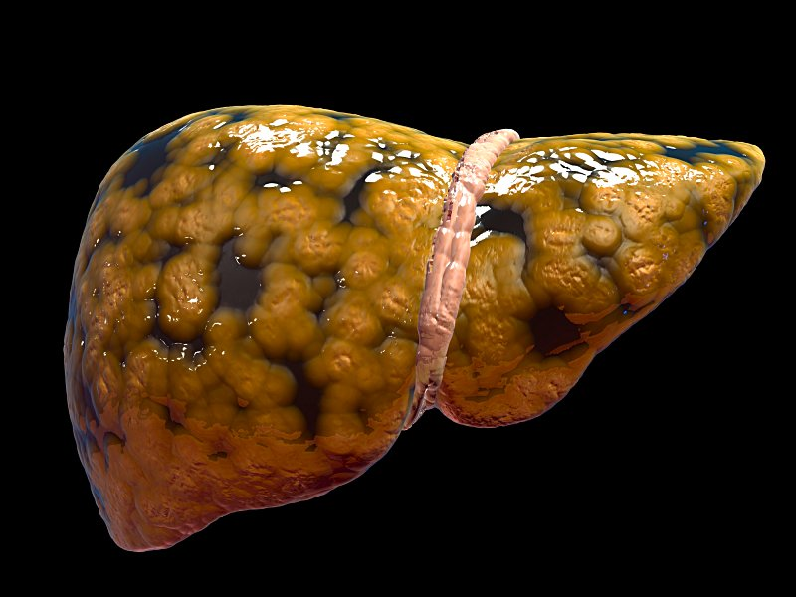

Slide 5
Causes of Fatty Liver
A. Causes of fat deposition in liver
1. Mobilization of FA from adipose tissue.
2. More synthesis of fatty acid from glucose.

Slide 6
B. Reduced removal of fat from liver
3. Toxic injury to liver. Secretion of VLDL needs.
synthesis of apo B-100 and apo C.
4. Decreased oxidation of fat by hepatic cells.
An increase in factors (1) and (2) or a decrease in factors (3) and (4) will cause excessive accumulation, leading to fatty liver.

Slide 7
A. Excessive Mobilization of Fat
The capacity of liver to take up the fatty acids from blood far exceeds its capacity for excretion as VLDL.
So fatty liver can occur in diabetes mellitus and starvation due to increased lipo lysis in adipose tissue

Slide 8
B) Excess Calorie Intake
Excess calories, either in the form of carbohydrates or as fats, are deposited as fat. Hence obesity may be accompanied by fatty liver

Slide 9
Toxic Injury to Liver
i. In toxic injury to the liver due to poisoning by compounds like carbon tetrachloride, arsenic, lead, etc., the capacity to synthesize VLDL is affected leading to fatty infiltration of liver.
In protein calorie malnutrition, amino acids required to synthesise apoproteins may be lacking.

Slide 10
Alcoholism
i. It is the most common cause of fatty liver and cirrhosis in India.
ii. Alcohol is oxidized to acetaldehyde. This reaction produces increased quantities of NADH, which converts oxaloacetate to malate. As the availability of oxaloacetate is reduced, the oxidation of acetyl CoA through citric acid cycle is reduced.
iii. So fatty acid accumulates leading to TAG deposits in liver.

Slide 11
Lipotropic Factors
They are required for the normal mobilization of fat from liver.
Therefore deficiency of these factors may result in fatty liver. They can afford protection against the development of fatty liver.

Slide 12
1. Choline: Feeding of choline has been able to reverse fatty changes in animals.
2. Lecithin and methionine. They help in synthesis of apoprotein and choline formation. The deficiency of methyl groups for carnitine synthesis may also hinder fatty acid oxidation.
3. Vitamin E and selenium give protection due to their antioxidant effect.
4. Omega-3 fatty acids present in marine oils have a protective effect against fatty liver.

Slide 13
CHOLESTEROL

Slide 14
The word cholesterol is derived from Greek words, chole = bile; steros = solid; ol = alcohol.
Almost all nucleated cells (including arterial walls) can synthesize cholesterol. It is widely distributed in the body.

Slide 15
In a 70 kg man, a total of about 140 g of cholesterol is available; which is distributed as about
30 g in brain and nerves,
30 g in muscles, 30 g in adipose tissue,
20 g in skin,
10 g in blood,
10 g in liver and spleen,
5 g in bone marrow,
3 g in alimentary tract, and
2 g in adrenal gland

Slide 16
Normal Range
Total Cholesterol Level Category
Less than 200mg/dL- Desirable
200-239 mg/dL -Borderline high
240mg/dL and above - High

Slide 17
Structure of Cholesterol
All steroids have cyclopentano perhydrophenanthrene ring system .
It is a fused ring system made up of 3 cyclohexane rings designated as A, B and C and a cyclopentane ring D.

Slide 18
1.The six-membered rings are in a phenanthrene arrangement.
2. Total 27 carbon atoms.
3. One hydroxyl group at third position which is characteristic of all sterols. The OH group is betaoriented, projecting above the plane of ring.
4. Double bond between carbon atoms 5 and 6.
5. An eight carbon beta oriented side chain attached to 17th carbon.

Slide 19
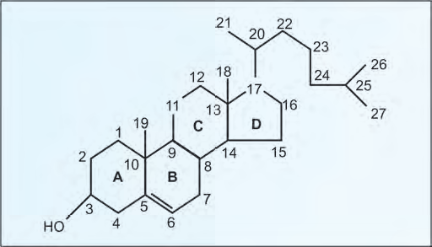

Slide 20
Functions
1.Cell membranes: Cholesterol is a component of membranes
2. Nerve conduction: Cholesterol is used to insulate nerve fibers.
3. Bile acids and bile salts are derived from cholesterol. Bile salts are important for fat absorption.
4. Steroid hormones: Glucocorticoids, androgens and estrogens are from cholesterol.
5. Vitamin D3 is from 7-dehydro-cholesterol.

Slide 21
BIOSYNTHESIS OF CHOLESTEROL

Slide 22
All carbon atoms of cholesterol are derived from acetyl CoA.
The major sites of synthesis of cholesterol are liver, adrenal cortex, testis, ovaries and intestine.
All nucleated cells can synthesize cholesterol, including arterial walls. The enzymes involved in the synthesis of cholesterol are partly located in the endoplasmic reticulum and partly in the cytoplasm.

Slide 23
Intermediate
acetyl CoA
acetoacetyl CoA
beta-hydroxy beta-methyl glutaryl CoA (HMG CoA).
Mevalonate (6 C)
phosphomevalonate, (6 C)
pyrophosphomevalonate, (6 C)
3- phospho-5-pyrophosphomevalonate. (6 C)
isopentenyl pyrophosphate (5 C)
Squalene(30C)
Squalene epoxide (30C)
Lanosterol (27 C)
desmosterol.(27C)
Cholesterol (27 C)

Slide 24
Step 1: Condensation
The acetyl CoA is provided by the ATP-citrate lyase reaction as in the case of fatty acid synthesis.
Two molecules of acetyl CoA condense to form acetoacetyl CoA catalyzed by cytoplasmic “acetoacetyl CoA synthase”

Slide 25
Step 2: Production of HMG CoA
A third molecule of acetyl CoA condenses with acetoacetyl CoA to form beta-hydroxy beta-methyl glutaryl CoA (HMG CoA).
The enzyme is HMG CoA synthase.
HMG CoA is present in both cytosol as well as mitochondria of liver. The mitochondrial pool is used for ketogenesis whereas the cytosolic fraction is utilized for cholesterol synthesis.

Slide 26
Step 3: The Committed Step
HMG CoA
2 NADPH
HMG CoA reductase.
mevalonate

Slide 27
Step 3: The Committed Step
The reduction of HMG CoA to mevalonate is catalyzed by HMG CoA reductase.
It is a microsomal (endoplasmic reticulum) enzyme.
It uses 2 molecules of NADPH
Steps 1 and 2 are shared with ketogenic pathway;
but step 3 is the first reaction that is unique to the cholesterol biosynthetic pathway.
It is the rate-limiting step.

Slide 28
Step 4: Production of 5 Carbon Unit
i. Mevalonate (6 C) is successively phosphorylated to phosphomevalonate (6 C), to pyrophosphomevalonate (6 C), then to
3- phospho-5-pyrophosphomevalonate. (6 C)
This then undergoes decarboxylation to give isopentenyl pyrophosphate, a 5 carbon unit.
Step 4 requires 3 molecules of ATP

Slide 29
Steps 1, 2, 3 and 4 together may be considered as the first phase of the cholesterol synthesis.

Slide 30
Step 5: Condensation of 5-Carbon Units
5A(5 C), 5B(10 C), 5C(15) and 5D Steps condensed to form a 30 carbon compound, Squalene.

Slide 31
Step 6: Cyclization
A. Squalene now undergoes oxidation by epoxidase, using molecular oxygen and NADPH to form squalene epoxide.
A cyclase converts it to 30C lanosterol .
It is the first steroid compound synthesized.

Slide 32
Step 7: Cutting to Size
Lanosterol(30C) converted in to zymosterol(27 C)
zymosterol converted in to desmosterol.
Desmosterol is present in fetal brain.
It is absent in adult brain and re-appears in gliomas (brain tumor).
desmosterol converted in to cholesterol by NADPH

Slide 33
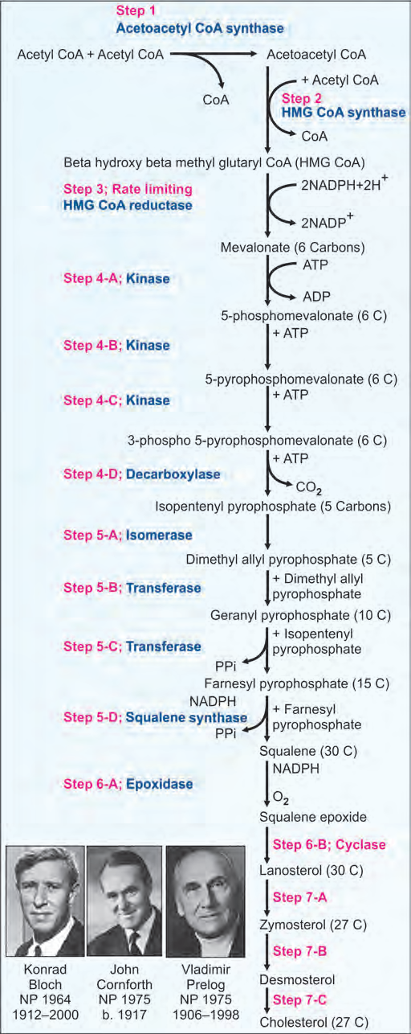

Slide 38
Regulation of Cholesterol Synthesis.
The regulatory enzyme is HMG CoA reductase.
Insulin and thyroxine increase the activity of HMG CoA reductase
Cortisol and glucagon decrease its activity.
Lovastatin and other "statin" group of drugs are competitive inhibitors of HMG CoA reductase. So, they are used in clinical practice to reduce cholesterol level in blood.

Slide 39
Excretion of Cholesterol
Average diet contains about 300 mg of cholesterol per day.
Body synthesize about 700 mg of cholesterol per day.
Out of this total 1000 mg, about 500 mg of cholesterol is excreted through bile.
This cholesterol is partly reabsorbed from intestines.

Slide 40
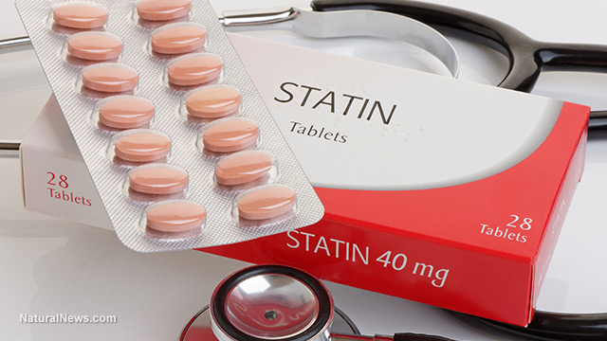

Slide 41
Clinical
Atherosclerosis
Atherosclerosis is a disease in which the inside of an artery narrows due to the build of plaque.
Initially, there are generally no symptoms. When severe, it can result in coronary artery disease, stroke, peripheral artery disease, or kidney problems depending on the arteries which are affected.
Symptoms, if they occur, generally do not begin until middle age.

Slide 42
Risk factors include high blood pressure, diabetes, smoking, obesity, family history, and an unhealthy diet.
Prevention is generally by eating a healthy diet, exercise, not smoking, and maintaining a normal weight

Slide 43
1. Number of carbon present in Cholestrol
23
25
82
27

Slide 44
2.Normal Range of Cholesterol
140-200 mg%
240-400 mg%
70-100 mg%
50-100 mg%

Slide 45
3.Drug used to reduce cholesterol level
Metformin
Aspirin
Statins
None of above

Slide 46
4.Statin inhibit
Hexokinase
HMG Co A Synthase
HMG Co A Reductase
All of above

Slide 47
5. Aspirin inhibit which enzyme
Hexokinase
HMG Co A Synthase
HMG Co A Reductase
Cyclooxygenase

Slide 48


Slide 49
METABOLISM OF KETONE BODIES

Slide 50
Carbohydrates are essential for the metabolism of fat or fat is burned under the fire of carbohydrates. The acetyl CoA formed from fatty acids can enter and get oxidized in TCA cycle only when carbohydrates are available.
During starvation and diabetes mellitus, acetyl CoA takes the alternate route of formation of ketone bodies.

Slide 51
Ketogenesis
Acetoacetate is the primary ketone body while betahydroxy butyrate and acetone are secondary ketone bodies.
They are synthesized exclusively by the liver mitochondria

Slide 52
Step 1: Condensation
Two molecules of acetyl CoA are condensed to form acetoacetyl CoA.

Slide 53
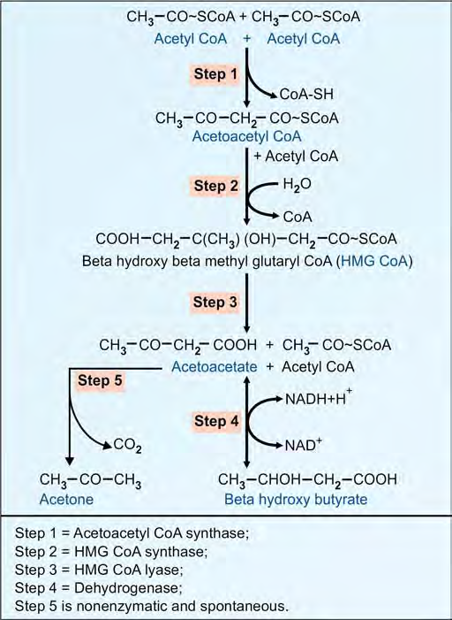

Slide 54
Step 2: Production of HMGCoA
One more acetyl CoA is added to acetoacetyl CoA to form HMG CoA (beta hydroxy beta methyl glutaryl CoA). The enzyme is HMG CoA synthase.
Mitochondrial HMG CoA is used for ketogenesis, while cytosolic fraction is used for cholesterol synthesis.

Slide 55
Step 3: Lysis
Then HMG CoA is lysed to form acetoacetate. Acetoacetate may also be formed by the degradation of carbon skeleton of ketogenic amino acids like leucine, lysine, phenylalanine and tyrosine.
HMG CoA lyase is present only in liver.

Slide 56
Step 4: Reduction
Beta-hydroxy butyrate is formed by reduction of acetoacetate.
Ratio between acetoacetate and beta hydroxy butyrate is decided by the cellular NAD:NADH ratio.

Slide 57
Step 5: Spontaneous Decarboxylation
Acetone is formed

Slide 58
Ketolysis
The ketone bodies are formed in the liver; but they are utilized by extrahepatic tissues.
The heart muscle and renal cortex prefer the ketone bodies to glucose as fuel.

Slide 59
Tissues like skeletal muscle and brain can also utilize the ketone bodies as alternate sources of energy, if glucose is not available.
Acetoacetate is activated to acetoacetyl CoA by thiophorase enzyme.

Slide 60
Almost all tissues and cell types can use ketone bodies as fuel, with the exception of liver and RBC.
The placenta can use ketone body as fuel. Intestinal mucosal cells, brain and adipocytes use ketone bodies. Skeletal muscles, heart, liver, etc. primarily utilize fatty acids during starvation.

Slide 61
Thiophorase
Acetoacetate + Acetoacetyl CoA+
Succinyl CoA + Succinate
Then acetoacetyl CoA enters the beta oxidation
pathway to produce energy.

Slide 62
KETOSIS
Normally the rate of synthesis of ketone bodies by the liver is such that they can be easily metabolized by the extrahepatic tissues. Hence, the blood level of ketone bodies is less than 1 mg/dL and only traces are excreted in urine (not detectable by usual tests).

Slide 63
But when the rate of synthesis increases there will be accumulation of ketone bodies in blood.
This leads to ketonemia, excretion in urine
(ketonuria) and smell of acetone in breath. All thesethree together constitute the condition known as ketosis.

Slide 64
Causes for Ketosis
1. Diabetes mellitus:
Untreated diabetes mellitus is the most common cause for ketosis. Even though glucose is in plenty, the deficiency of insulin causes accelerated lipolysis and more fatty acids are released into circulation.

Slide 65
Oxidation of these fatty acids increases the acetyl CoA pool. Enhanced gluconeogenesis restricts the oxidation of acetyl CoA by TCA cycle since availability of oxaloacetate is less.

Slide 66
Starvation:
In starvation, the dietary supply of glucose is decreased.
The increased rate of lipolysis is to provide alternate source of fuel.
The excess acetyl CoA is converted to ketone bodies. The high glucagon favors ketogenesis. The brain derives 75% of energy from ketone bodies under conditions of fasting.

Slide 67
Explanation for Ketogenesis
During starvation and diabetes mellitus, the blood level of glucagon is increased.
Glucagon inhibits glycolysis, activates gluconeogenesis, activates lipolysis, and stimulates ketogenesis. High glucagon-insulin ratio is potentially ketogenic.

Slide 68
Insulin has the opposite effect; it
favors glycolysis, inhibits gluconeogenesis, depresses lipolysis, and decreases ketogenesis.

