Slide 1
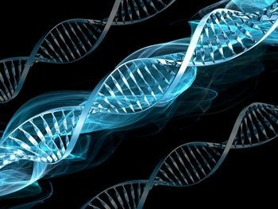
GENE THERAPY
A promising future to disease treatment
By
Dr Mitul Chhatriwala

Slide 2
Objectives
At the end of the lecture students should be able to..
Understand the Basics of Gene Therapy
Describe the Types of Gene Therapy
Explain the Vectors Used in Gene Therapy
Explore Clinical Applications and Challenges

Slide 3
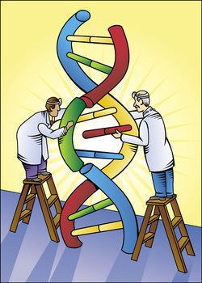
INTRODUCTION
Gene therapy is the introduction of genes into existing cells to prevent or cure a wide range of diseases.
It is a technique for correcting defective genes responsible for disease development.
The first approved gene therapy experiment occurred on September 14, 1990 in US, when Ashanti DeSilva was treated for ADA-SCID.

Slide 4
TYPES OF GENE THERAPY
Somatic CELL gene therapy
Germ line gene therapy
  Therapeutic genes transferred into the somatic cells.
  Will not be inherited later generations.
  At present all researches directed to correct genetic defects in somatic cells.
  Therapeutic genes transferred into the germ cells.
  It is heritable and passed on to later generations.
  For safety, ethical and technical reasons, it is not being attempted at present.

Slide 5
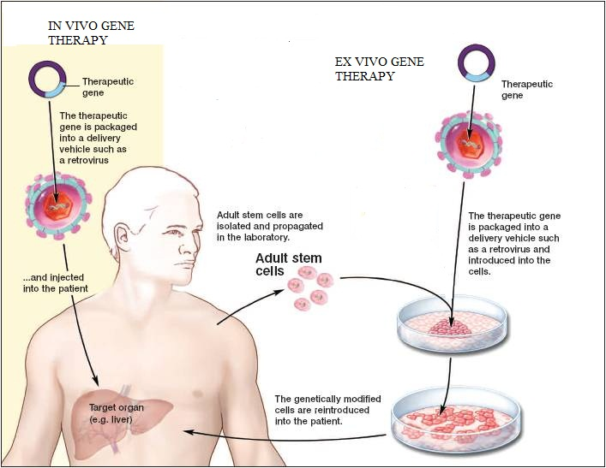
APPROACHES IN GENE THERAPY
In vivo gene therapy:- direct delivery of genes into the cells of a particular tissue in the body
Ex vivo gene therapy:- transfer of genes to cultured cells and reinsertion.

Slide 6
EX VIVO GENE THERAPY
Isolate cells with genetic defect from a patient
Grow the cells in culture
Introduce the therapeutic genes .
Select genetically corrected cells and grow.
Transplant the modified cells to the patient.

Slide 7
EXAMPLE OF EX VIVO GENE THERAPY
1st gene therapy – to correct deficiency of enzyme, Adenosine deaminase (ADA).
Performed on a 4yr old girl Ashanthi DeSilva.
Was suffering from SCID- Severe Combined Immunodeficiency.
Caused due to defect in gene coding for ADA.
Deoxy adenosine accumulate and destroys T lymphocytes.
Disrupts immunity , suffer from infectious diseases and die at young age.

Slide 8
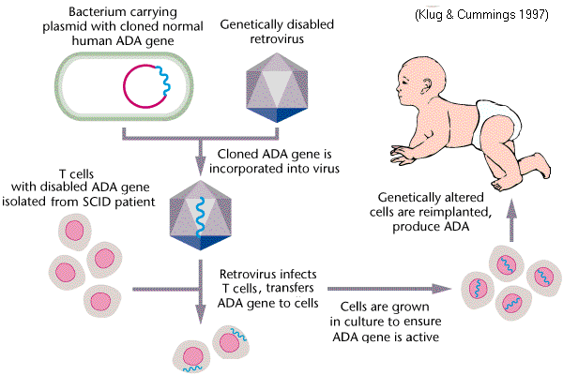

Slide 9
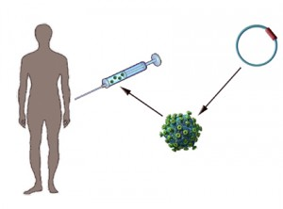
IN VIVO GENE THERAPY
Direct delivery of therapeutic gene into target cell into patients body.
Carried out by viral or non viral vector
systems.
It can be the only possible option in
patients where individual cells
cannot be cultured in vitro in
sufficient numbers.
In vivo gene transfer is necessary when cultured cells cannot be re-implanted in patients effectively.

Slide 10
EXAMPLE OF IN VIVO GENE THERAPY
-Therapy for cystic fibrosis
  In patients with cystic fibrosis, a protein called cystic fibrosis transmembrane regulator (CFTR) is absent due to a gene defect.
  In the absence of CFTR chloride ions concentrate within the cells and it draws water from surrounding.
  This leads to the accumulation of sticky mucous in respiratory tract and lungs.
  Treated by in vivo replacement of defective gene by adenovirus vector .

Slide 11
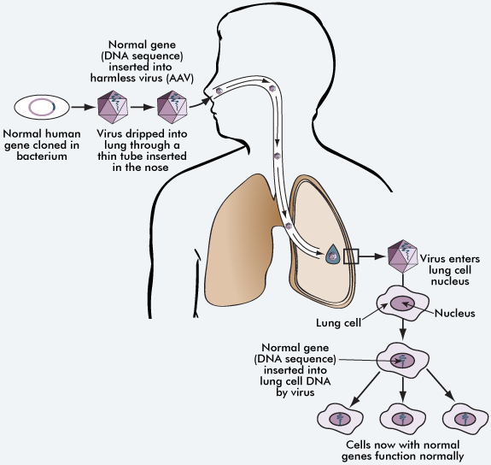

Slide 12
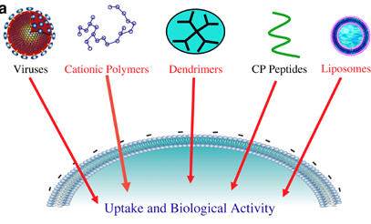
VECTORS IN GENE THERAPY
To transfer the desired
gene into a target cell,
a carrier is required.
Such vehicles of gene
delivery are known
as vectors.
2 main classes
  Viral vectors
  Non viral vectors

Slide 13
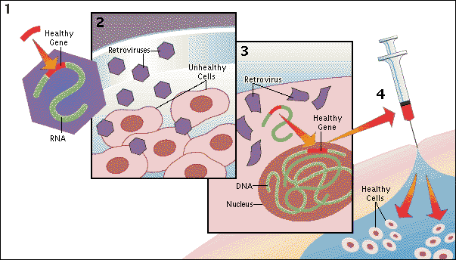
VIRAL VECTORS
1) RETROVIRUS VECTOR SYSTEM
The recombinant retroviruses have the ability to integrate into the host genome in a stable fashion.
Can carry a DNA of
size – less than 3.4kb
Replication defective
virus particles
Target cell - dividing

Slide 14
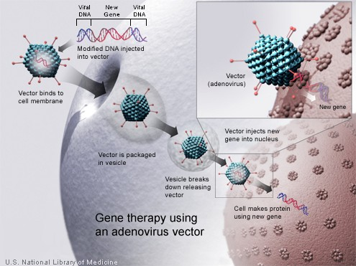
VIRAL VECTORS
ADENO VIRUS VECTOR SYSTEM
Adeno virus with a
DNA genome
– good vectors.
Target- non dividing
human cell.
Eg. Common cold
adenovirus.

Slide 15
VIRAL VECTORS
3) ADENO ASSOCIATED VIRUS VECTOR
It is a human virus that can integrate into chromosome 19.
It is a single stranded, non pathogenic small DNA virus.
AAV enters host cell, becomes double stranded and gets integrated into chromosome.
4) HERPEX SIMPLEX VIRUS VECTOR
Viruses which have natural tendency to infect a particular type of cell.
They infect and persist in nervous cells.

Slide 16
NON VIRAL VECTOR SYSTEM
1. PURE DNA CONSTRUCT
  Direct introduction of pure DNA construct into target tissue .
  Efficiency of DNA uptake by cells and expression rather low.
  Consequently, large quantities of DNA have to be injected periodically.
2. LIPOPLEXES
  Lipid DNA complexes; DNA construct surrounded by artificial lipid layer.
  Most of it gets degraded by lysosomes.

Slide 17
NON VIRAL VECTORS
DNA MOLECULAR CONJUGATES
  Commonly used synthetic conjugate is poly- L- lysine bound to specific target cell receptor.
  Therapeutic DNA is then made to combine with the conjugate to form a complex.
  It avoids lysosomal breakdown of DNA.

Slide 18
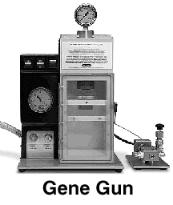
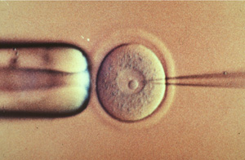
METHODS OF GENE DELIVERY
PHYSICAL METHODS
Gene Gun
Employs a high-pressure delivery system to shoot tissue with gold or tungsten particles that are coated with DNA
Microinjection
Process of using a glass micropipette to insert microscopic substances into a single living cell.
Normally performed under a specialized optical microscope setup called a micromanipulator.

Slide 19
CHEMICAL METHODS
USING DETERGENT MIXTURES
  Certain charged chemical compounds like Calcium phosphates are mixed with functional cDNA of desired function.
  The mixture is introduced near the vicinity of recipient cells.
  The chemicals disturbs the cell membrane, widens the pore size and allows cDNA to pass through the cell.
LIPOFECTION
  It is a technique used to inject genetic materials into a cell by means of liposomes.
  Liposomes are artificial phospholipid vesicles used to deliver a variety of molecules including DNA into the cells.

Slide 20
OTHER TYPES OF GENE THERAPY
GENE AUGMENTATION THERAPY
Most common form of gene therapy
Foreign gene replaces missing or defective gene.
Eg. Replacement of defective p53 gene by a normal one in liver cancer.
GENE INHIBITION THERAPY
Done to block the overproduction of some proteins.
2 types – Antigene and antisense therapy.
  Antigene – blocks transcription using antigene oligonucleotide
  Antisense – blocks transalation using antisense oligonucleotide.

Slide 21
DISADVATAGES
Long lasting therapy is not achieved by gene therapy; Due to rapid dividing of cells benefits of gene therapy is short lived.
Immune response to the transferred gene stimulates a potential risk to gene therapy.
Viruses used as vectors for gene transfer may cause toxicity, immune responses, and inflammatory reactions in the host.
Disorders caused by defects in multiple genes cannot be treated effectively using gene therapy.

Slide 22
ADVANTAGES
Gene therapy has the potential to eliminate and prevent hereditary diseases such as cystic fibrosis, ADA- SCID etc.
It is a possible cure for heart disease, AIDS and cancer.
It gives someone born with a genetic disease a chance to life.
It can be used to eradicate diseases from the future generations.

Slide 23
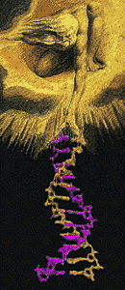
ETHICAL ISSUES
Who will have access to therapy?
Is it interfering with God’s plan?
Should people be allowed to use
gene therapy to enhance basic human
traits such as height, intelligence etc.?
Is it alright to use the therapy in
the prenatal stage of development
in babies?

Slide 24
CONCLUSION
Theoretically, gene therapy is the permanent solution for genetic diseases.
But it has several complexities. At its current stage, it is not accessible to most people due to its huge cost.
A breakthrough may come anytime and a day may come when almost every disease will have a gene therapy
Gene therapy have the potential to revolutionize the practice of medicine.

Slide 25
THANK
YOU

