Slide 1
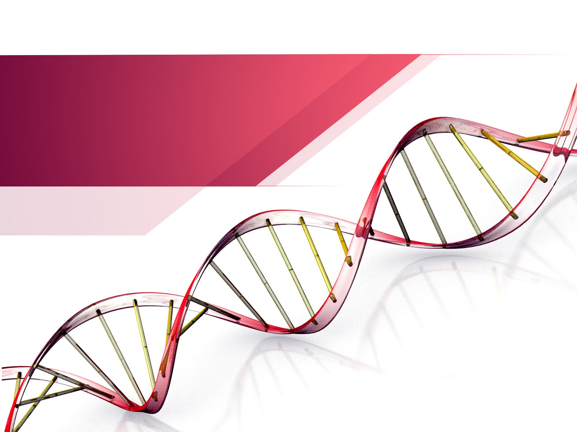
Genetic code

Slide 2
Objectives
At the end of the lecture students should be able to..
Understand the Characteristics of the Genetic Code
Describe the Molecular Basis of Mutations
Relate Mutations to Protein Synthesis
Recognize the Clinical Implications of Mutations

Slide 3

What Is Genetic Code ?
Genetic Code Is The Genetic Information carried by Living cell
Term given By “Goerge Gamow”
Codon :-
It Is Set of 3 Nitrogenous Bases in mRNA , Which Provide Genetic information For Amino acid During synthesis Of Polypeptide Chain

Slide 4
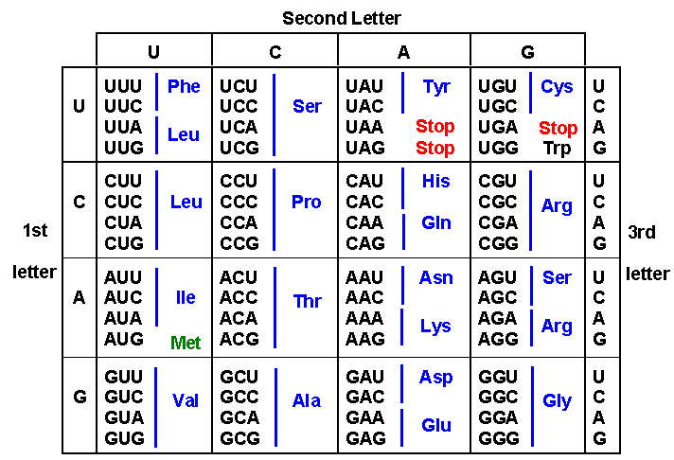
Characteristic Of Genetic Code
Total = 64
61 Code for Amino acid
Remaining 3 are stop Codon
Always triplet In Nature

Slide 5
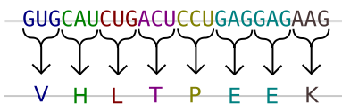
Characteristic Of Genetic Code
Codon are Always Written In Continous Manner , No Comma , No Punctuation held Between Them

Slide 6
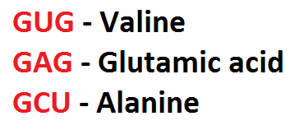
Characteristic Of Genetic Code
Genetic code Is Universal In Nature…
Is same For All Species

Slide 7
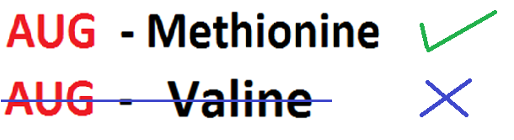
Characteristic Of Genetic Code
Each Codon Represent Only One Amino acid Called Specific or Unambigious

Slide 8
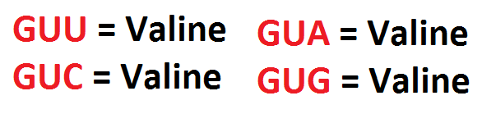
Characteristic Of Genetic Code
Amino acid which Represent By More Than One codon Called Degenerate

Slide 9
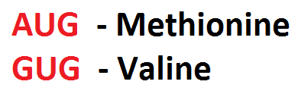
Characteristic Of Genetic Code
Some Codon Initiate Formation Of Polypeptide Chain

Slide 10
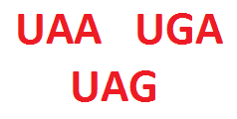
Characteristic Of Genetic Code
Some Codon Stop The Formation Of Polypeptide Chain

Slide 11
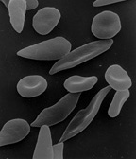
Gene Mutations
Sickle Shaped Red Blood Cells

Slide 12
What is a gene mutation?
Mutations are changes in genetic material – changes in DNA code – thus a change in a gene(s)
In gene mutations, the DNA code will have a base (or more) missing, added, or exchanged in a codon.
Notes:
General introduction (definition) about mutation

Slide 13
How common are mutations?
Mutations occurs at a frequency of about 1 in every 1 billion base pairs
Everybody has about 6 mutations in each cell in their body!
Notes:
A fun fact about how common mutations are. Explain that everyone has mutations, although they are not always seen because the mutation may have occurred in a section of DNA that doesn’t make a protein.

Slide 14
If I have that many mutations, why don’t I look weird?
Mutations are not always seen. The affected gene may still function.
Mutations may be harmful.
Mutations may be beneficial.
Mutations may have no effect on the organism.
Notes:
Explain that everyone has mutations, although they are not always seen because the mutation may have occurred in a section of DNA that doesn’t make a protein or the mutation may cause a cell to die (while not affecting the function of the organ).

Slide 15
How do mutations affect a population?
Mutations are a major source of genetic variation in a population increasing biodiversity.
Some variations may help them to survive better.
Notes:
Clip Art

Slide 16
How are mutations inherited?
Only mutations in gametes (egg & sperm) are passed onto offspring.
Mutations in body cells only affect the organism in which they occur and are not passed onto offspring.

Slide 17
Types of Gene Mutations
Point mutation occurs when the base sequence of a codon is changed. (ex. GCA is changed to GAA)
There are 3 types:
Substitution
Also called frameshift mutations
Deletion
Insertion
Notes:
General information about the three most common types of mutations to transition into the examples

Slide 18
Substitution Mutations
Normal DNA: CGA – TGC – ATC
Alanine – Threonine - stop
Mutated DNA: CGA – TGC – TTC
Alanine – Threonine - Lysine
What will happen to the amino acids?
This is a substitution mutation
The adenine was replaced with thymine
What has happened to the DNA?
Notes:
Ask students if they can figure out what is happening in this mutation.
Answer is on the next slide.

Slide 19
Substitution Mutations
This is a substitution mutation.
A single nitrogen base is substituted for another in a codon.
It may or may not affect the amino acid or protein.
Normal DNA: CGA – TGC – ATC
Alanine – Threonine - stop
Mutated DNA: CGA – TGC – TTC
Alanine – Threonine - Lysine
Notes:
Ask students if they can figure out what is happening in this mutation.
Answer is on the next slide.

Slide 20

TRY THIS!
On your notebook paper write:
The cat ate the rat
Change one letter in the sentence to represent a substitution mutation.
Think-Pair-Share
Notes:
Have students write the sentence on their paper. They will substitute one letter in one word of the sentence. Example: Thg cat ate the rat. Think-Pair-Share. (1 min.) Discuss effect of mutation with students. Changing one letter in the sentence can have little effect on idea of the sentence, but it can also change the entire sentence depending on where the substitution occurs. Example: The hat ate the rat.

Slide 21
Analogy
3 letter words because codons are 3 letters
The cat ate the rat.
SUBSTITUTION
Thc cat ate the rat.
May have little effect. You still have the idea like a typo on a test.
The hat ate the rat.
Changes the thought of the sentence.The effect Depends on where the substitution happens

Slide 22
Insertion Mutations
Normal DNA: CGA – TGC – ATC
Alanine – Threonine – stop
Mutated DNA: CGA – TAG – CAT – C
Alanine – Isoleucine – Valine
This is an insertion mutation, also a type of frameshift mutation.
An adenine was inserted thereby pushing all the other bases over a frame.
What will happen to the amino acids?
What has happened
to the DNA?
Notes:
Ask students if they can figure out what is happening in this mutation.
Answer is on the next slide.

Slide 23
Insertion Mutations
This is an insertion mutation.
A nitrogen base is inserted/added to the sequence.
It causes the triplet “frames” to shift.
It always affects the amino acids and, consequently, the protein.
Normal DNA: CGA – TGC – ATC
Alanine – Threonine - stop
Mutated DNA: CGA – TAG – CAT – C
Alanine – Leucine - Valine
Notes:
Ask students if they can figure out what is happening in this mutation.
Answer is on the next slide.

Slide 24
TRY THIS!
On your notebook paper write:
The cat ate the rat.
Insert a letter into any word above.
Rewrite the sentence . Each word must have only 3 letters to represent the codon.
Discuss the effects on the insertion.
Think-Pair-Share
Notes:
Example: The cat ate the rat. Insert a letter to change the sentence Example: The cca tat eth era t.

Slide 25
Analogy
Insertion
The cat ate the rat.
The cca tat eth era t.
Inserting the c causes a
FRAMESHIFT
THE SENTENCE NO LONGER MAKES SENSE!! Insertions may have huge effects.

Slide 26
Deletion Mutations
Normal DNA: CGA – TGC – ATC
Alanine – Threonine – stop
Mutated DNA: CGA – TCA- TC
Alanine – Serine
A guanine was deleted, thereby pushing all the bases down a frame.
What has happened
to the DNA?
What will happen to the amino acids?
This is called a deletion mutation, also a type of frameshift mutation.
Notes:
Ask students if they can figure out what is happening in this mutation.
Answer is on the next slide.

Slide 27
Deletion Mutations
This is a deletion mutation.
A nitrogen base is deleted/removed from the sequence.
It causes the triplet “frames” to shift.
It always affects the amino acids and, consequently, the protein.
Normal DNA: CGA – TGC – ATC
Alanine – Threonine – stop
Mutated DNA: CGA – TCA- TC
Alanine – Serine
Notes:
Ask students if they can figure out what is happening in this mutation.
Answer is on the next slide.

Slide 28
TRY THIS!
Write the sentence on your paper:
The cat ate the rat.
Delete one letter from any word.
Rewrite the sentence. Remember: each word can only have 3 letters.
Think-Pair-Share

Slide 29
Analogy
DELETION
The cat ate the rat.
Thc ata tet her at
FRAMESHIFT
The sentence no longer makes sense!! Deletions can have huge effects.

Slide 30
Gene Mutations
Which mutation would have the least affect on an organism?
Normal DNA: CGA – TGC – ATC
Alanine – Threonine - stop
Mutated DNA: CGA – TGC – ATT
Alanine – Threonine - stop
Mutated DNA: CGA – TGC – ATG
Alanine – Threonine - Tyrosine
Substitution has the least affect because it changes only one amino acid or it may change no amino acid.
Notes:
The hemoglobin ends up with a differently charged amino acid that caused the RBC to stick to itself. This is the sickle part. This affects the way hemoglobin can carry oxygen.

Slide 31
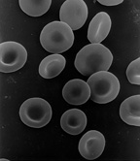
Gene Mutations
An example of a substitution mutation is sickle cell anemia.
Only one amino acid changes in the hemoglobin.
The hemoglobin still functions but it folds differently changing the shape of the rbc.
Normal Red Blood Cells
Sickle Shaped Red Blood Cells
Notes:
The hemoglobin ends up with a differently charged amino acid that caused the RBC to stick to itself. This is the sickle part. This affects the way hemoglobin can carry oxygen.

Slide 32
Gene Mutations
Which mutation would have the most affect on an organism?
Insertion and deletion mutations have the most effect on an organism because they affect many amino acids and consequently the whole protein.
Normal DNA: CGA – TGC – ATC
Alanine – Threonine – stop
Mutated DNA: CGA – TCA- TC
Alanine – Serine
Mutated DNA: CGA – TAG – CAT – C
Alanine – Leucine - Valine

Slide 33
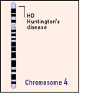
Gene Mutations
Huntington’s Disease is caused by an insertion mutation.
People with this disorder have involuntary movement and loss of motor control. They eventually have memory loss and dementia. The disease is terminal.
Huntington Disease
Located on chromosome 4
First Gene Disease Mapped
Notes:
A genetic marker linked to Huntington disease was found on chromosome 4 in 1983, making Huntington disease, or HD, the first genetic disease mapped using DNA polymorphisms. HD is inherited as an autosomal dominant disease.

Slide 34
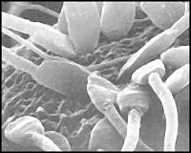
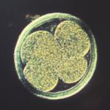
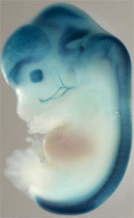
Gene Mutations
When does a gene mutation have the greatest affect on an organism?
Egg being fertilized
When it occurs in the gamete (egg or sperm) or early in embryonic development (in stem cells or first few days).
Four cell Zygote
Embryo
Notes:
Stem cells have the remarkable potential to develop into many different cell types in the body. Serving as a sort of repair system for the body, they can theoretically divide without limit to replenish other cells as long as the person or animal is still alive. When a stem cell divides, each new cell has the potential to either remain a stem cell or become another type of cell with a more specialized function, such as a muscle cell, a red blood cell, or a brain cell.

Slide 35
Mutagens
What causes mutations?
natural errors or an environmental event
What is a mutagen?
something that causes the DNA code to change (mutate) – x-ray, chemicals, UV light, radiation, etc
What happens to a person who has a mutation?
Notes:
Explain that many mutations occur naturally (when your DNA replicates before cell division). Many mutations are caused by mutagens (UV light, exposure to chemicals, radiation, etc.)
What happens? Most of the time the mutation is harmless because there are sections of DNA that do not code for protein (junk DNA) but sometimes the mutations can cause disorders such as Huntington’s disease and sickle cell anemia.

