Slide 1
Vitamin B12
Mr Vanraj Diyora
Assistant Professor
Biochemistry Department
SBKSMI&RC

Slide 2
Vit B12 is known as:
a) extrinsic factor (EF) of castle
b) anti pernicious anemia factor
c) Cobalamin

Slide 3
Chemistry
Vitamin B12 is water soluble, heat stable.
It contains one cobalt atom. Four pyrrole rings co-ordinated with a cobalt atom is called a Corrin ring.
The 5th valency of the cobalt is covalently linked to a substituted benzimidazole ring. This is then called cobalamin.
The 6th valency of the cobalt is satisfied by any of the following groups: cyanide, hydroxyl, adenosyl or methyl.

Slide 4
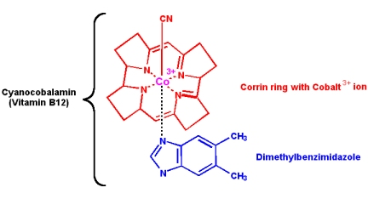
Structure of vitamin B 12

Slide 5
Cyanocobalamin
When cyanide is added at the R position, the molecule is called cyanocobalamin.
During the isolation procedure, cyanide is added to get stable crystals.
Oral preparations are in this form.

Slide 6
Hydroxy cobalamin
When hydroxyl group is attached at the R position, it is called hydroxy cobalamin or vitamin B12a.
Injectable preparations are in this form.
Adenosyl cobalamin (Ado-B12)
When taken up by the cells, these groups are removed and deoxy adenosyl cobalamin or Ado- B12 is formed.
This is the major storage form, seen in liver.

Slide 7
Methyl cobalamin
When the methyl group replaces adenosyl group, it is known as methyl cobalamin.
This is the major form seen in blood circulation as well as in cytoplasm of cells.
The Ado-B12 and methyl B12 are the functional co-enzymes in the body.

Slide 8
Absorption
Absorption of vitamin B12 requires two binding proteins.
1) the intrinsic factor (IF) of Castle.
Intrinsic factor is secreted by the gastric parietal cells.
It is a glycoprotein with a molecular weight of 50,000.

Slide 9
2) Cobalophilin, secreted in the saliva.
Gastric pepsin release the vitamin from the food, and then B12 binds with cobalophilin.
In duodenum, cobalophilin is hydrolyzed by trypsin of pancreatic juice; vitamin is released, and then vitamin binds to intrinsic factor.
In pancreatic insufficiency (absence of trypsin), the vitamin may not be released. Then vitamin-cobalophilin complex is excreted, resulting in vitamin deficiency.

Slide 10
One molecule of IF can combine with 2 molecules of B12.
This IF-B12 complex is attached with specific receptors on mucosal cells.
The whole IF-B12 complex is internalized.
B12 is absorbed from ileum, while folic acid is from jejunum.

Slide 11
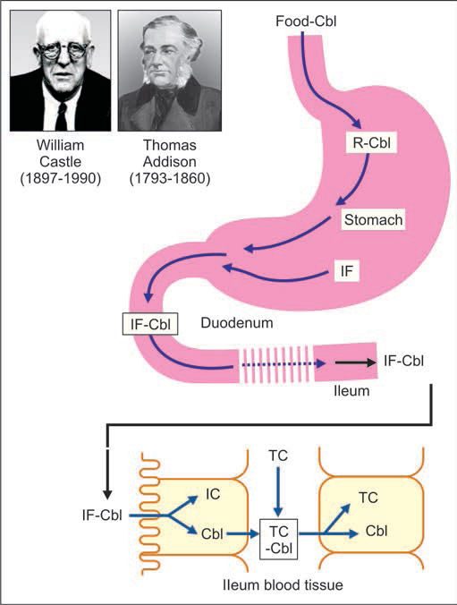
Absorption and storage of vitamin B12.
R = cobalophilin; Cbl = cobalamin; IF = intrinsic factor; TC = trans cobalamin

Slide 12
Transport and Storage
In the blood, methyl B12 form is predominant.
Transcobalamin, a glycoprotein, is the specific carrier.
It is stored in the liver cells, as ado-B12 form, in combination with transcorrin.

Slide 13
Generally, B complex vitamins are not stored in the body, B12 is an exception.
Whole liver contains about 2 mg of B12, which is sufficient for the requirement for 2-3 years. So, B12 deficiency is seen only years after gastrectomy.

Slide 14
Source
It is the only vitamin that cannot be synthesized by plants & animals but by only a few species of bacteria.
liver ( largest store)
kidney, Fish, pork, chicken, meat, egg
milk & cheese are good source.
Curd is a good source because lactobacillus can synthesize B12.

Slide 15
RDA
Normal daily requirement is 1–2 ug/day.
During pregnancy and lactation, this is increased to 2 mg/day.
Those who take folic acid, should also take vitamin B12.

Slide 16
Biochemical role of cobalamin
Many B12 containing enzymes are present in bacteria. But in animal tissue two important enzymes are present.
A) methyl malonyl CoA mutase
B) homocysteine methyl transferase.
Methyl folate trap and folate deficiency.

Slide 17
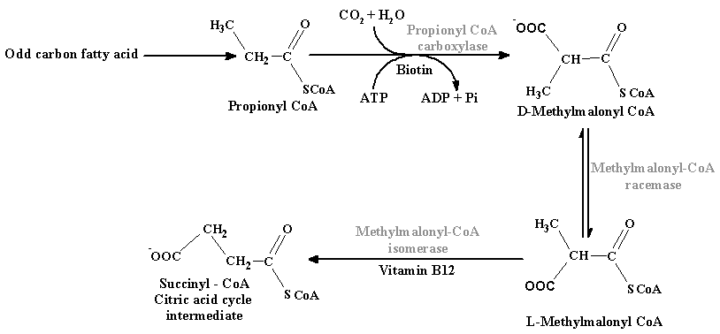
A)methyl malonyl CoA is formed from-

Slide 18
During deficiency of B12 L- methyl malonyl CoA is excreted in urine (methyl malonic aciduria). Odd chain FA deposited is in the myelin sheath and interfere with nerve transmission.
Results in neurological disturbances and breakdown of myelin sheath.

Slide 19
B) Homocysteine methyl transferase
Homocysteine methyl transferase requires B12 and also it require THFA.

Slide 21
“FOLATE TRAP”
The production of N5 methyl THFA is a irreversible reaction therefore the only way to obtain free THFA is to free THFA by transferring methyl group to B12.
If B12 is deficient this reaction will not take place and folic acid deficiency will develop. This is known as methyl folate trap.

Slide 22
If B12 deficiency is there, Homocysteine will be accumulated and blood level will increase which is related to MI. Hence B12 is protective against myocardial infarction.

Slide 23
In B12 deficiency there is a block on the following reaction :S adenosyl methionine is not converted to S adenosyl Homocysteine, due to non availability of active methionine. Hence methylation of phosphatidyl ethanolamine to phosphatidyl choline is not adequate.
This leads to deficient formation of myelin sheath of nerves causing neurological damage.

Slide 24
Causes of B12 Deficiency
1. Nutritional
Nutritional vitamin B12 deficiency is very common in India, especially among vegetarians of low socioeconomic group.
The only source for B12 in vegetarian diet is curd / milk.

Slide 25
2. Decrease in absorption
Absorptive surface is reduced by gastrectomy, resection of ileum and malabsorption syndromes.

Slide 26
3. Addisonian pernicious anemia
It is manifested usually in persons over 40 years.
It is an autoimmune disease with a strong familial background.
Antibodies are generated against IF. So, IF becomes deficient, leading to defective absorption of B12.

Slide 27
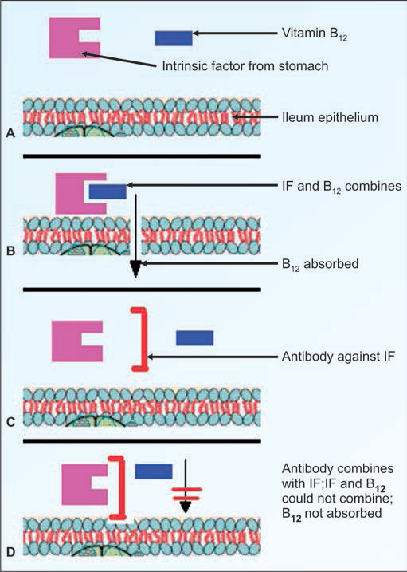

Slide 28
4. Gastric atrophy
Although true Addisonian pernicious anemia is rare, similar atrophy of gastric epithelium leading to deficiency of IF and decreased B12 absorption is common in India.
In chronic iron deficiency anemia, there is generalized mucosal atrophy.

Slide 29
5. Pregnancy
Increased requirement of vitamin in pregnancy is another common cause for vitamin B12 deficiency in India.
6. Fish tapeworm
Not seen in India.
The fish tapeworm, diphillobothrium latum has a special affinity to B12 causing reduction in available vitamin.

Slide 30
Deficiency Manifestations
Folate trap:
Vitamin B12 deficiency causes simultaneous folate deficiency due to the folate trap. Therefore all the manifestations of folate deficiency are also seen.
Megaloblastic anemia:
In the peripheral blood, megaloblasts and immature RBCs are observed.

Slide 31
Abnormal homocysteine level:
In vitamin B12 deficiency, so that homocysteine is accumulated, leading to homocystinuria.
Homocysteine level in blood has a positive correlation with myocardial infarction.
So, B12 and folic acid are protective against ischemic heart disease.

Slide 32
Demyelination:
In vitamin B12 deficiency, the non-availability of active methionine.
Therefore methylation of phosphatidyl ethanolamine to phosphatidyl choline is not adequate.
This leads to deficient formation of myelin sheaths of nerves, demyelination and neurological lesions.

Slide 33
Subacute combined degeneration:
Damage to nervous system is seen in B12 deficiency (but not in folate deficiency).
There is demyelination affecting cerebral cortex, dorsal column and pyramidal tract of spinal cord.
Since sensory and motor tracts are affected, it is named as combined degeneration.
Symmetrical paresthesia of extremities, alterations of tendon and deep senses and reflexes, loss of position sense, unsteadiness in gait, positive Romberg's sign (falling when eyes are closed) and positive Babinski's sign (extensor plantar reflex) are seen.

Slide 34
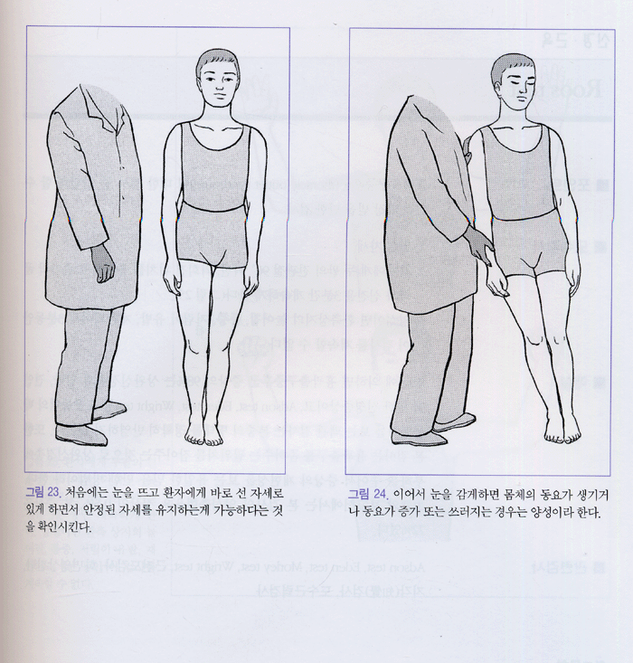
Romberg’s sign positive

Slide 35
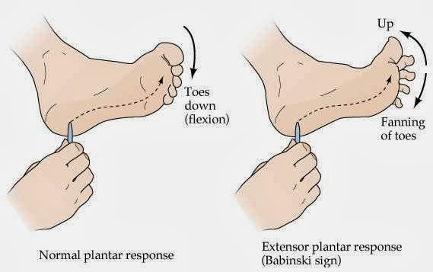
Babinski’s sign positive

Slide 36
Achlorhydria:
Absence of acid in gastric juice is associated with vitamin B12 deficiency.

Slide 37
Laboratory diagnosis
Serum B12:
It is quantitated by radioimmunoassay or by ELISA.

Slide 38
Schilling test:
Radioactive labelled (Cobalt-60) vitamin B12, one microgram is given orally. Simultaneously an intramuscular injection of unlabeled vitamin B12 is given, in order to saturate tissues with normal vitamin B12. So, radioactive vitamin B12 will not bind to body tissues. Therefore, the entire absorbed radioactivity will pass into the urine. The patient’s urine is then collected over the next 24 hours to assess the absorption.

Slide 39
In a normal person, the ingested vitamin B12 will be absorbed into the body. Since the liver receptors for vitamin B12 are saturated by the injection, much of the ingested radioactive vitamin B12 will be excreted in the urine.
In patients with pernicious anemia or with deficiency due to impaired absorption, less than 5% of the radioactivity is detected in urine.

Slide 40
If an abnormality is found, the test is repeated, with radioactive vitamin plus intrinsic factor given orally, and urine is collected for 24 hours.
In pernicious anemia, there is lack of intrinsic factor, so that the first test is abnormal; but the second test is normal.

Slide 41
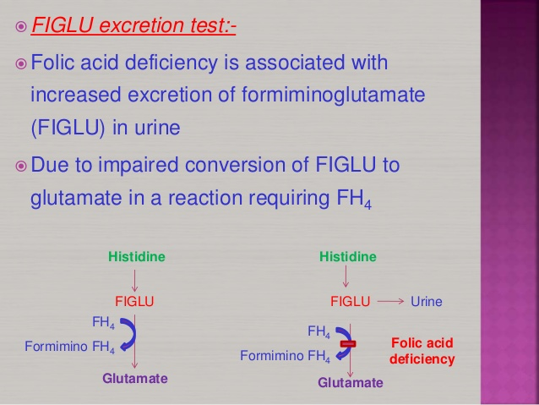
Methyl malonic acid: It is seen in urine.
FIGLU excretion test:

Slide 42
Peripheral smear: megaloblastic anemia
Homocystinuria

Slide 43
Treatment
If megaloblastic anemia is treated with folic acid alone, the anemia may improve but associated nervous lesions are aggravated.
Hence, all macrocytic anemia's are generally treated with folate and vitamin B12.
Therapeutic dose of B12 is 500 to 1000 microgram by intramuscular injections.

Slide 44
MCQS
1) which form of Vitamin B12 is found in the blood circulation?
A) cyanocobalamin
B) methyl cobalamin
C) adenosyl cobalamin
D) Hydroxy cobalamin

Slide 45
2. Vitamin B12 is also known as
A) Extrinsic factor of castle
B) Intrinsic factor of castle
C) Both
D) None

Slide 46
3. Vitamin B12 deficiency leads to folic acid deficiency.
A) True
B) False

Slide 47
4. Deficiency manifestation of Vitamin B12 is
A) Beriberi
B) Subacute combined degeneration of spinal cord
C) Rickets
D) Xerophthalmia

Slide 48
5. Generally, water soluble vitamins are not stored in the body except
A) vitamin B12
B) vitamin B6
C) Biotin
D) vitamin C

