Slide 1
PCI Hardware
Dr. Cinosh Mathew
MD,DM Cardiology
Interventional Cardiologist
Professor& HOD
Department of Cardiology,
SBKS Medical Institute and Research Centre
Sumandeep Vidyapeeth Deemed to be University

Slide 2
Because…
Each Patient is different, each patients coronary artery is different and each lesion behaves differently →no standard single equipment →need to individualize
Being prepared is half the battle won…..
Selection of Guide catheters seems elementary but makes the difference between a successful and failed PCI procedure

Slide 3
Functions of a Guide
Vehicle for contrast injection
Measurement of Pressure
Conduit for wire and device transport
Support for device advancement

Slide 4
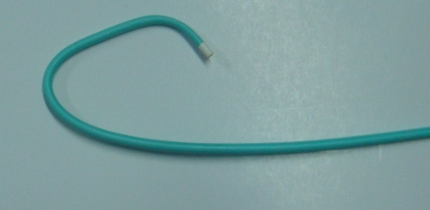
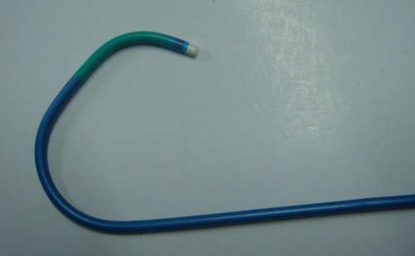
Guiding vs. Diagnostic catheters
A Guide has
  Stiffer shaft
  Re-enforced construction (3 vs. 2 layers)
  Larger internal diameter (ID)
  Shorter & more angulated, non tapering atraumatic tip

Slide 5
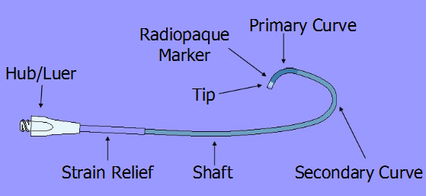
Guide: 3 basic components
Hub or ‘Handle’
Shaft – Braided polyurethane or polyethylene. Softens from proximal to distal tip
Tip – Soft and atraumatic, varying shapes and sizes
Length – usually 100 cms
Many catheters have tertiary curve

Slide 6
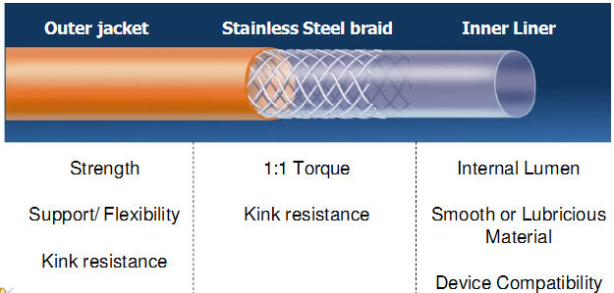
Cross section of catheter
Strength
Support
Flexibility
Curve retention
Kink resistance
Polyurethanene or Polyethylene
1:1 Torque transmission
Kink resistance
Radiopacity
Stainless steel/ Kevlar
Large lumen for Device compatibility
Lubricious material for smooth device delivery
Atraumatic and radiopaque tip
PTFE (Teflon)/Silicone

Slide 7
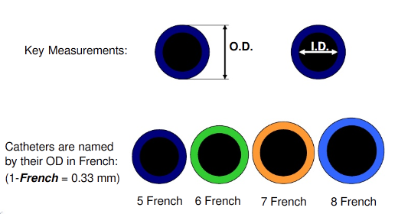
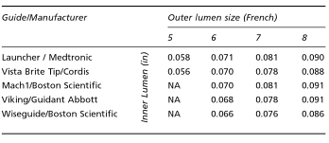
Catheter size
Catheter size in French
For each given size - ID is
either standard, large or giant

Slide 8
Decisions in Guide selection

Slide 9
Guide selection
Size of the ascending aorta
Location and orientation of the ostia to be cannulated
Degree of tortuosity and calcification of the coronary artery segment proximal to the target area

Slide 10
Important features of a guide catheter
Preformed curves & configurations, optimum support
Adequate lumen & device compatibility
Easy to handle, torque control, kink resistance
Atraumatic tip

Slide 11
When selecting a guide catheter, one must consider
  The route of PCI chosen
  use of a native vessel versus a graft vessel
  left versus right coronary artery
  coronary artery anomalies
  tortuosity of the great vessels
  elective or primary PCI
  characteristics of the lesion
  operator preferences

Slide 12
Side hole vs no side hole
Side holes are useful where the pressure gets frequently damped as in RCA interventions, CTO interventions or sole surviving artery or left main interventions
Advantages
  Prevent catheter damping (occlusion of the coronary ostium)
  Allow additional blood flow out of tip, to perfuse the artery.
  Avoid catastrophic dissections in the ostium of the artery
Disadvantages
  False sense of security because now, aortic pressure, and not the coronary pressure is being monitored.
  Suboptimal opacification
  Reduction in back up support provided because of weakness of catheter shaft and the kinking at side holes
Notes:
contrast escapes through side holes

Slide 13
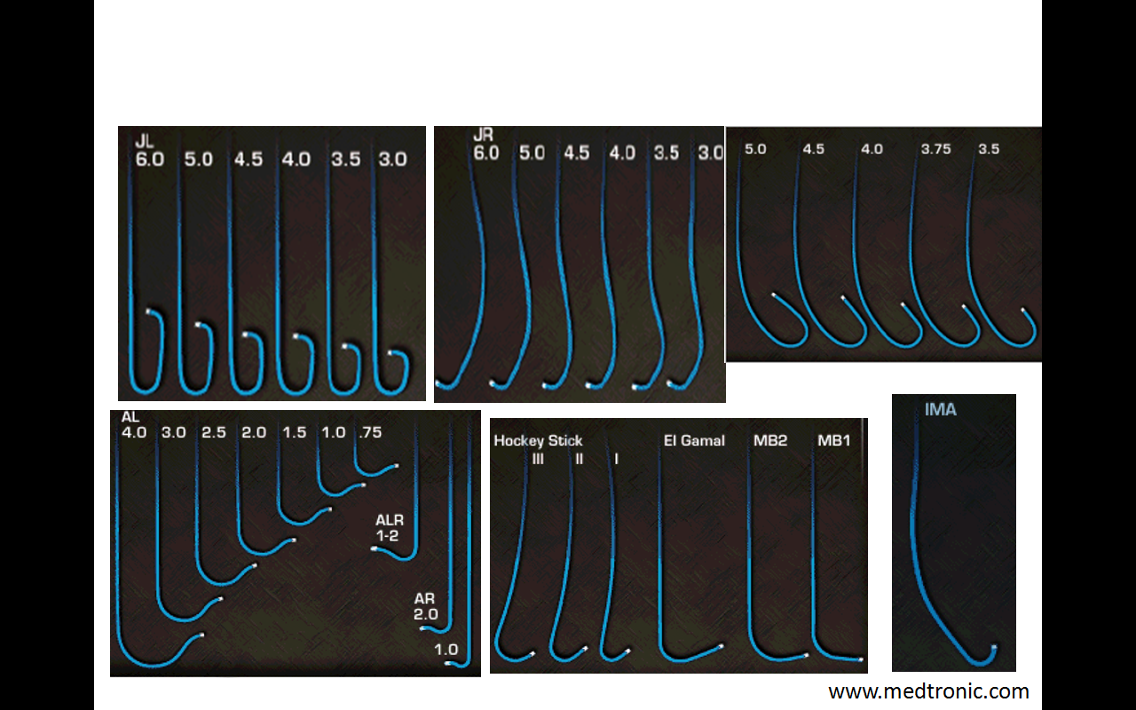
Most commonly used guides
Judkins, Amplatz, and Extra-back-up guides
Others include - Multipurpose for RCA bypass or a high left main (LM) takeoff
LIMA catheter for - right and left coronary bypass graft
Notes:
that have a niche in various situations

Slide 14
The ideal guide catheter should have the following physical properties:
Stiffer body to transmit torque applied from guide hub to distal tip in a 1:1 ratio.
variable softer primary curve
wire braiding for kink resistance in response to guide torque
soft tip to minimize ostial trauma
large lumen (with optional radiopaque marker)
lubricious coating for easy passage of hardware such as stents and balloons.

Slide 15
Factors to consider
Goal | Factors to consider
Co-axial alignment | Coronary or graft anatomy – ostium location; vessel orientation Access site – Femoral/Radial, Left/Right Aortic arch configuration, Aortic root size Body habitus
Support | Lesion – Simple / Complex (Long/calcified/Tortuous/Bifurcation/CTO) Device – type, size, trackeability

Slide 16
Larger Guiding
Higher bleeding risk
but
Greater coronary opacification
Better torque transmission
More passive support
More complex PCI possible
Smaller Guiding
Lower bleeding risk
but
Less coronary opacification
Poorer torque transmission
Less passive support
Less complex PCI possible

Slide 17
Factors determining Support
Catheter size – Larger catheter, more support
Co-axial alignment
Catheter support point
  Maximum support when angle between point of immediate support and proximal coronary artery is 0 degree – directly opposite the ostia
  Larger contact area at support point – more support
Deep Intubation into vessel (‘Active support’)
Physical characteristics of catheter

Slide 18
Guide size and PCI device
Guide size | PCI device (s)
5 Fr (1.42-1.50 mm I.D.) | POBA Drug coated balloon Scoreflex balloon Most coronary stents | Rotablator burr size 1.25 mm Some IVUS catheters Kissing with small profile balloons and .010” wire
6 Fr (1.73-1.80 mm I.D.) | Standard angioplasty and stenting Some bifurcation PCI, Kissing with small profile balloons Flextome Cutting balloon | 6 Fr Thrombuster/Export catheter Rotablator burr size 1.5 mm IVUS catheters
7 Fr (1.98-2.06 mm I.D.) | Simultaneous 2 rapid exchange balloons Simultaneous 2 stent deployment Simultaneous 2 microcatheters | 7 Fr Thrombuster Rotablator burr size 1.75 and 2 mm
8 Fr (2.24-2.30 mm I.D.) | Simultaneous 2 OTW balloons Rotablator burr size 2.25 mm

Slide 19
Passive Support
Active Support
Relies on properties of the shaft and tip to maintain position in the ostium
Support provided by either vascular anatomy or catheter composition/curve shape
Minimal manipulation of the guide is required
Uses aortic root to form desired curve shape and provide backup support
Relies on active manipulation of guiding catheter to
  Obtain stable position
  Seat coaxially
  Deep seating into the vessel: ostia should be disease-free
  Pre-select LAD or LCX

Slide 20
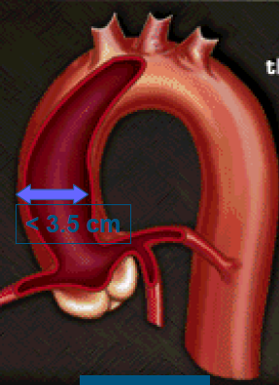
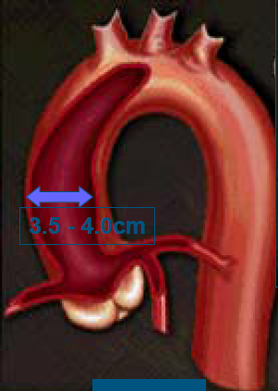
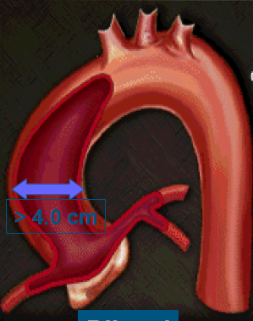



Aortic Width

Slide 21
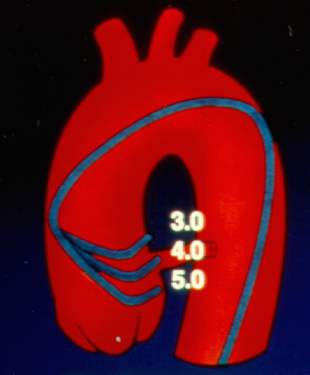
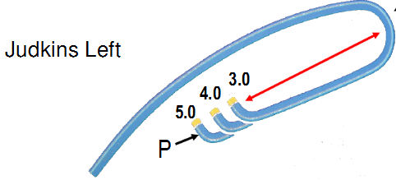
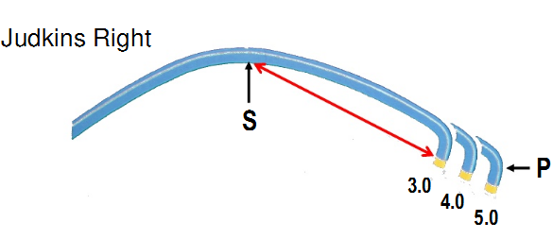
Aortic Width: determines curve length

Slide 22
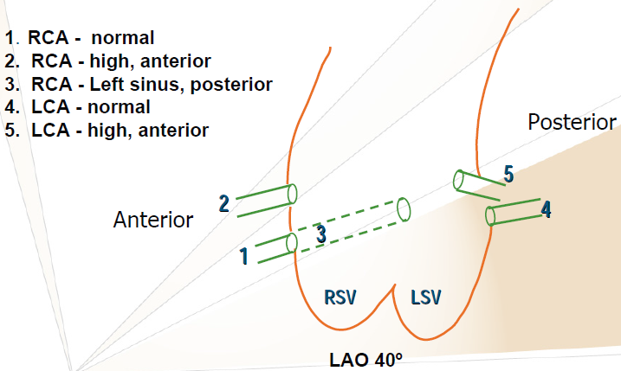
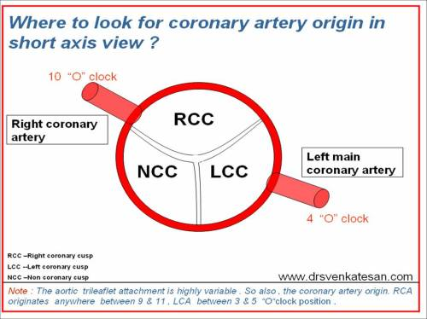
Coronary Anatomy Ostial Origins
Left Main – usually antero-inferior and leftward from LCS
LAD - usually anterio-superior from the left main
LCX – usually postero-inferior from the left main
RCA – usually anterior from RCS
SVGs – usually anterior

Slide 23
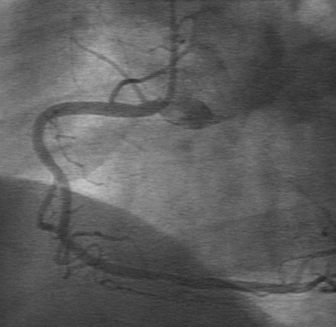
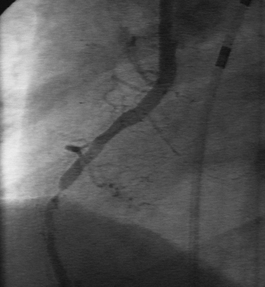
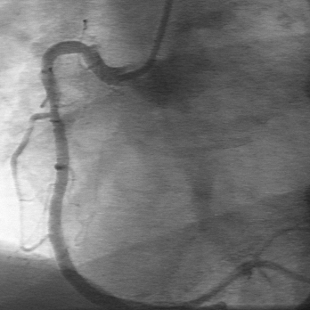
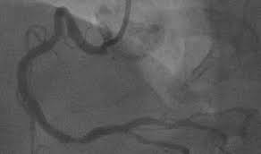
Coronary Anatomy Ostial Variations
Coronary ostial location:
  High
  Low
  Anterior
  Posterior
Coronary ostial orientation:
  Horizontal
  Inferior
  Superior
  Shepherd’s crook (RCA only)

Slide 24
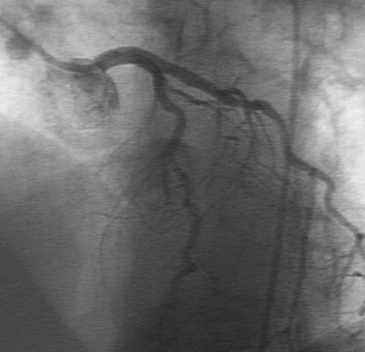
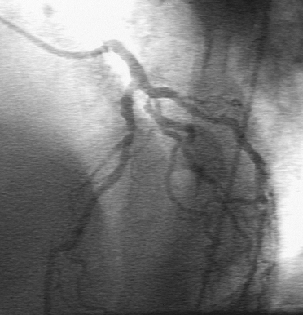
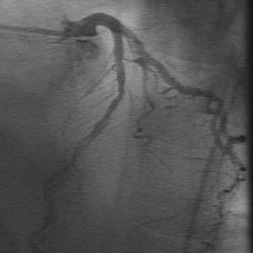
Coronary Anatomy Ostial Variations
Coronary ostial location:
  High
  Low
  Anterior
  Posterior
Coronary ostial orientation:
  Horizontal
  Inferior
  Superior

Slide 25
Guide catheters for transfemoral intervention

Slide 26
  Judkins
  Amplatz
  Extra Backup support – EBU (Medtronic)
  XB (Cordis)
  Voda Qcurve (Boston)
Catheters with niche use
  Multipurpose – RCA graft, High LM takeoff
  IMA cath – LIMA, Superior takeoff RCA or RCA graft
  LCB, RCB cath – SVG

Slide 27
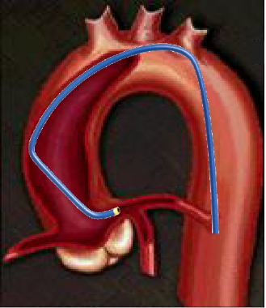
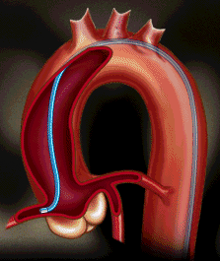
Judkins catheters
35°
JL – primary (35°) Secondary (180°) and tertiary (35°) curve fitting aortic root anatomy – engages LMCA ostium without much manipulation
JR – requires clockwise rotation to engage RCA
180°
35°

Slide 28
Most common used catheters
Judkins
Amplatz
Extra Backup
  EBU (Medtronic)
  XB (Cordis)
  Voda, Q Curve(Boston Scientific)
Catheters with niche use
  Multipurpose – RCA graft, High LM takeoff
  IMA cath – LIMA, Superior takeoff RCA or RCA graft
  LCB, RCB cath – SVG

Slide 29

Judkins catheters
Aortic width and ostial anatomy determines the curve length
 | JL | JR
Normal habitus and aortic root size | 4.0 | 4.0
Small habitus and aortic root size | 3.5, 3.0 | 4.0, 3.5
Large habitus and dilated aortic root | 5.0, 6.0 | 4.0, 4.5, 5.0
Superior takeoff RCA |  | 3.0, 3.5
Separate ostia – LAD, LCX | Smaller JL for LAD, Larger for LCX

Slide 30
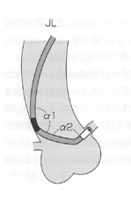
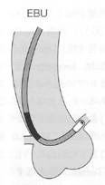
Limitations of Judkins Guide
As 1° curve is fixed - may not be co-axial with the artery
May be difficult to pass balloons - as catheter makes an angle of 90° with ostium
JL - point of contact on ascending aorta - very high & narrow- ↑ chance of prolapse & dislodgement
JR - no point of contact on Asc Aorta - extremely poor support

Slide 31
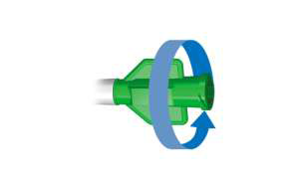
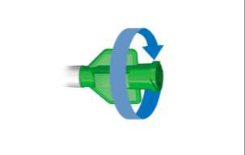
Judkins catheters
Short LM
selective hooking of LAD/LCX
Toward the LAD -
Counter-clockwise rotation
Toward the LCX -
Clockwise rotation

Slide 32
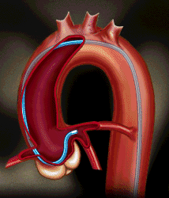
The Amplatz Guide
Secondary curve rest against the noncoronary posterior aortic cusp
Offers firm platform for advancement of device
Best in the case of a short LM, with downgoing left circumflex artery (LCX)
Tip points slightly downward - higher danger of ostial injury causing dissection

Slide 33
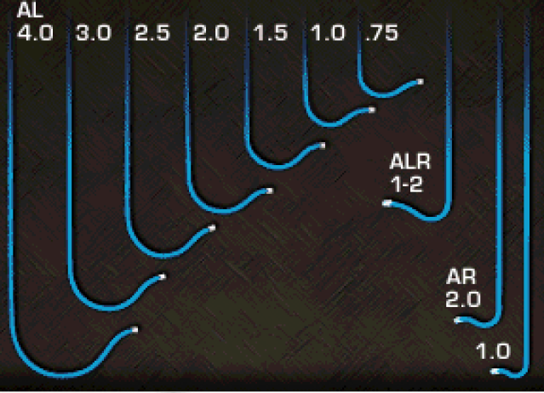
Amplatz Guide
Selection of the proper size for an Amplatz guide is essential
  Size 1 is for the smallest aortic root
  size 2 for normal
  size 3 for large roots
Attempts to force engagement of a preformed Amplatz guide that does not conform to a particular aortic root increase risk of complication

Slide 34
Withdrawal of an Amplatz Guide
Must be carefully disengaged from the coronary artery
A simple withdrawal from the vessel can cause the tip to advance farther into the vessel and cause dissection
To disengage - first advance guide slightly to prolapse the tip out of the ostium
Then rotate the guide so that tip is totally out of the ostium before withdrawing it.
After deflation if baloon is pulled out, the tip of the Amplatz (or any) guide would have the tendency to be sucked in deeper
To avoid this - pull the balloon out while simultaneously pushing the guide in - to prolapse the guide out

Slide 35
If tip does not reach the ostium and keep lying below it - guide is too small
If tip lies above the ostium - guide is too large
When RCA ostium is very high - left Amplatz guide may be used to engage the right ostium
Notes:
Optimal Position
Once the tip of the Amplatz is inside an LM or RCA ostium, the primary and secondary curves should form a closed loop
With the tip coaxial to the ostial segment

Slide 36
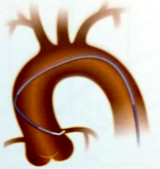
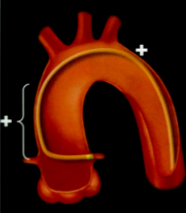
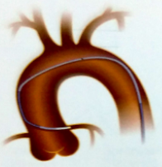
Long tip catheters (Extra Support)
Voda, XB, EBU
Advantages
  coaxial intubation
  better support & stability due to large area of contact between catheter & contralateral aortic wall
  precise control and manipulation
  lack of bends - improve advancement of devices, decrease the loss of supportive forces
  safety
Voda EBU
Notes:
BL

Slide 37
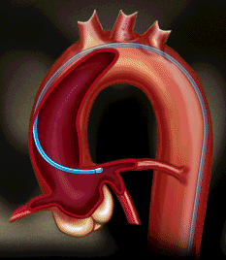
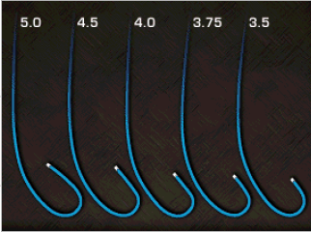
Extra-Back-Up Guide
Long tip forms a fairly straight line with the LM axis or the proximal ostial RCA
Long secondary curve - abut the opposite aortic wall
So tip in the coronary artery is not easily displaced

Slide 38
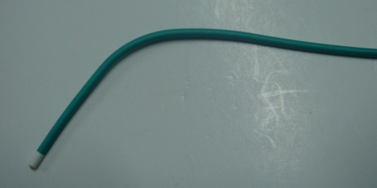
Multipurpose Guide
Straight with a single minor bend at the tip
For RCA bypass graft or a high left main (LM) takeoff

Slide 39
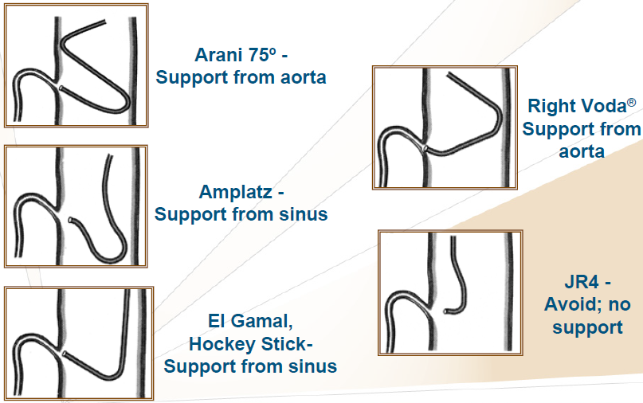
Other catheters
3 DRC - Three dimensional right curve - for tortuous, bent anatomy and posterior or superior take off of RCA
Arani
Double angle 90° curve sits on ascending aorta in S configuration and is therefore useful for RCA with horizontal take-off & shepherd crook RCA
Primary and secondary curve provides two contact points on the opposite side of aorta thus providing tremendous back-up

Slide 40
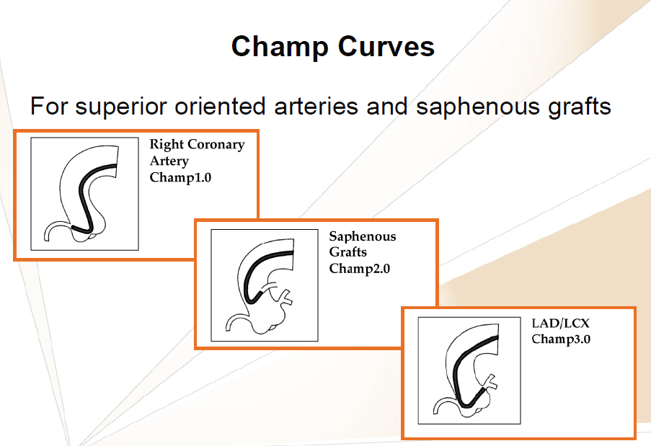

Slide 41
XBR and XBRCA - new catheters developed specifically for the inferior and superior take off of RCA respectively
El Gamal (EGB) - pre-shaped catheter with improved distal end-portion for accessing bypass grafts and more precise access of RCA
LCB - for left coronary venous bypass grafts. Its tip has 90 º bend with 70º secondary bend
RCB - for right coronary venous bypass grafts, its tip and secondary bends approximate 120º - like a JR catheter with a shallower tip bend

Slide 42
Guiding Catheter Selection - LCA
Aortic root
•Normal
•Dilated
•Narrow
•JL4
•JL ≥ 5, AL ≥ 2, VL ≥ 4, , XB ≥ 4, EBU ≥ 4
•JL3.5, VL3.5, XB3.0, EBU3.5
Orientation*
•Normal, Anterior
•Posterior
•Superior
•JL, AL, VL, XB, EBU
•AL, VL, XB, EBU
•JL, VL, XB, EBU

Slide 43
Guiding Catheter Selection - RCA
Aortic root
•Normal
•Dilated
•Narrow
•JR4, AL1, AR1
•JR ≥ 5, AL ≥ 2, AR ≥ 2
•JR 3, AL ≤ 0.75
Orientation*
•Normal
•Anterior, Superior
•Inferior
•Shepherd Crook
•Horizontal
•JR, AL, AR
•AL, , MP
•MP, AR, JR
•AL, VR, VRSC, IMA, Champ
•JR,, AR, VR4

Slide 44
Guiding Catheter Selection - SVG
RCA graft usual location : Primary – MP
Alternate – JR, AL, RCB, HS, EGB
RCA graft anterior location : Primary – AL
Alternate – JR, MP, HS
LCA graft : Primary – JR, HS
Alternate : AL, LCB, MP, EGB (El Gamal)
LCA graft ant location : Primary – AL, HS
Alternate : JR, LCB, MP

Slide 45
Guide catheters for transradial intervention

Slide 46
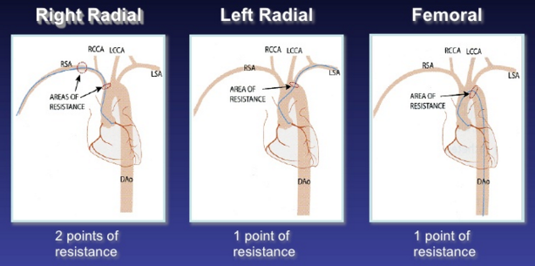
Radial vs Femoral Cath course

Slide 47
Choice of Catheters for TR-PCI
Left coronary artery: down size JL by 0.5
  Judkins left, Amplatz left, Multipurpose, EBU
  Ikari left, El Gamal
Right coronary artery
  Judkins right, Amplatz right, Amplatz left, Multipurpose, EBU-R
  Ikari right, El Gamal
Single catheter strategy
  Ikari left, Kimny, Barbeau, Fadajet

Slide 48
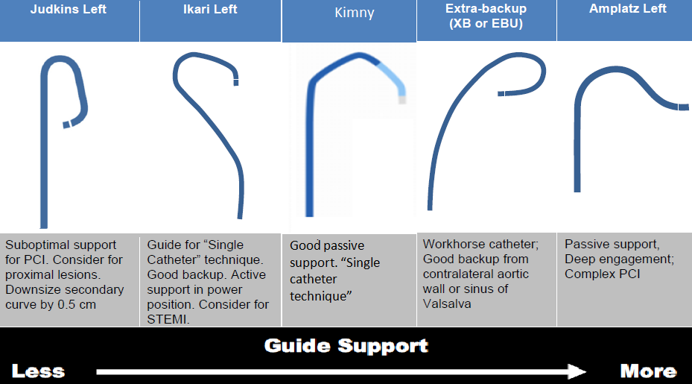
TR-PCI of the left coronary artery

Slide 49
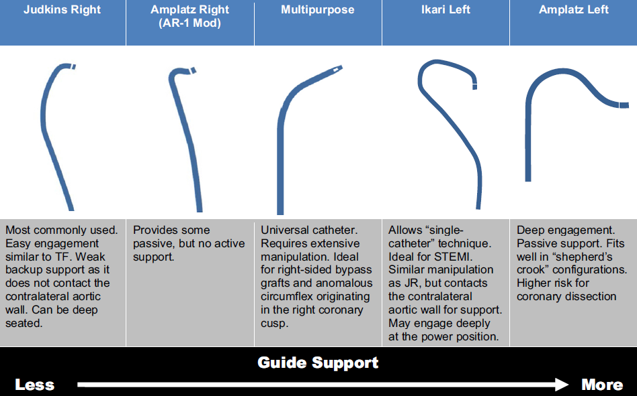
TR-PCI of the right coronary artery

Slide 50
Dampening of Arterial Pressure
Guide can cause
  fall of diastolic pressure - ventricularization
  fall of both systolic and diastolic pressure - dampened pressure
Can be due to
  significant lesion in the ostium
  coronary spasm
  non-coaxial alignment
  mismatch between diameter of the guide and of the arterial lumen

Slide 51
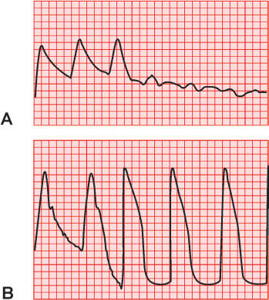
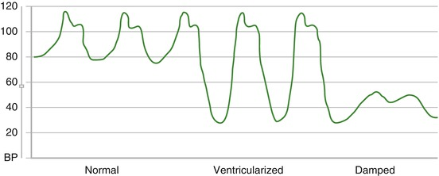
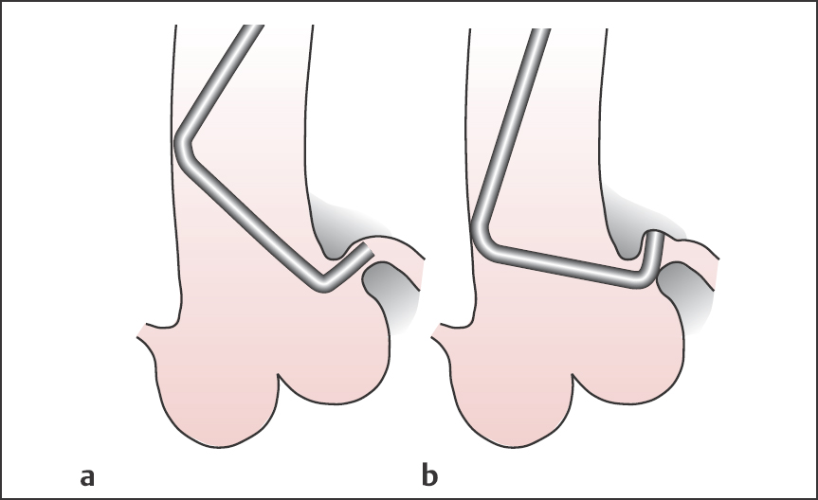
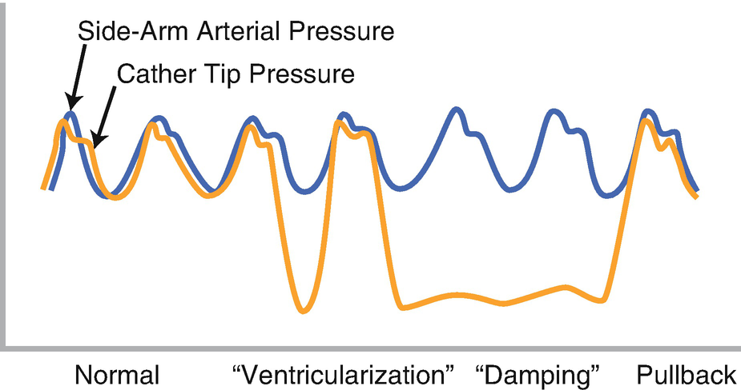

Slide 52
Damping or ventricularization of the pressure wave
. The catheter must always be pulled out of the ostium without delay when damping or ventricularization occurs. Not infrequently, the cause is left main stem stenosis, which has to be confirmed or excluded before the examination is continued.

Slide 53
In addition, incorrect positioning of the catheter, in which the tip impinges on the coronary artery wall, can cause a damping of the pressure curve; this is frequently seen if the selected Judkins curve for the left coronary artery is too small.
Contrast injection should be avoided with this catheter position due to the risk of dissection.
Occasionally this catheter position can be corrected by a slight counterclockwise turn

Slide 54
In most cases a good evaluation of the main stem can be achieved by moving the catheter into close proximity of the ostium without entering it again, and then injecting contrast. After that it can be decided whether a careful new engagement is advisable.
With distal left main stem stenosis, the catheter tip can be kept at an appropriately safe distance from the stenosis, and therefore contrast can be carefully injected if the pressure curve is normal. In general both duration of the catheter dwelling in the ostium and the number of contrast medium injections should be minimized with left main stenosis.

Slide 55
Damping/ventricularization of the pressure curve. In this situation, the first action to take should always be to pull back the catheter. A pressure drop is much more common with engagement of the right coronary artery (RCA) than with the left coronary artery. There are multiple causes for pressure damping with RCA engagement
Higher-grade ostial stenosis
Catheter-induced coronary spasm
Subselective engagement of the conus branch of the RCA
Small RCA
Complete occlusion close to the ostium
Impingement of the catheter tip on the arterial wall

Slide 56
Checking Stability and Potential of Backup Capability
Forward advancement of guide should further intubate the coronary artery rather than prolapse into the aoric root
If tip slips out - guide does not provide sufficient backup Need to be changed for another with better support
Active intubation of the guide may be tried
  if its tip is soft
  if the artery is large enough to accommodate the guide
  no ostial or proximal lesions
Active support position is needed temporarily in order to advance the device across the lesion
Once device is positioned guide is withdrawn to ostium.

Slide 57
Techniques to Stabilize a Guide
1. Second angioplasty wire/ Buddy Wire - advanced parallel to the first one
Straightens tortuous vessel and provides better support for device tracking
2. Second wire in a side branch - useful in anchoring the guide (second wire in LCX when dilating LAD lesion)
Provides for better backup and allows retraction of the guide when necessary, without loss of position
Also prevents the guide from being sucked in beyond the LM when pulling back balloon catheters
Cause unnecessary denudation of endothelium in that vessel

Slide 58
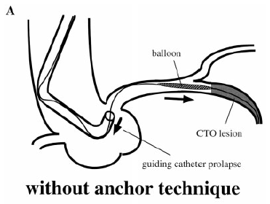
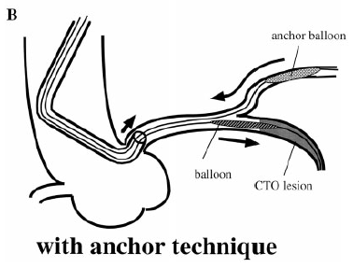
Anchor wire/balloon technique

Slide 59
Techniques to Stabilize a Guide
3.Change to stronger guide
4. Anchoring Balloon
Second small balloon (1.5–2 mm diameter) inserted in a small proximal branch
Inflated at 2 ATM - anchor the guide
5 . Change the current sheath to a very long sheath
6 . Double guide technique
  insert a smaller guide in current guide

Slide 60
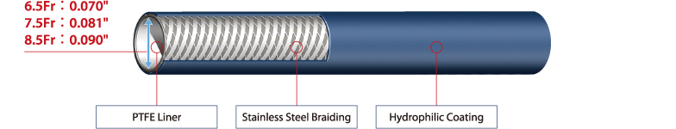
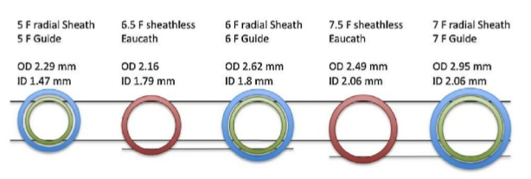
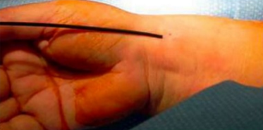
Sheathless TRI
Eaucath GC – Asahi, Japan
Virtual 3F - Medikit,Japan

Slide 61

Deep-Seating
If the guide needs to be deep-seated then it is advanced over an interventional device
Apply clockwise/counter clockwise torque
Once deep-seated device is advanced and positioned
After achieving the position guide is withdrawn with gentle rotation

Slide 62
Shepherd’s crook deformity of RCA
Dramatic upturn with a near 180 degree switch back turn
www.medtronic.com
Notes:
Guides with the tip pointing in cranial direction are necessary
Amplatz left guide
hockey stick
left venous bypass
internal mammary artery guides

Slide 63
Deep-seating
Attempted only if
  Artery is large enough to accommodate the guide
  No ostial or proximal lesion
  Guide tip is soft
Direction of torquing
Toward the LAD -
Counter-clockwise rotation
Toward the LCX and RCA -
Clockwise rotation

Slide 64

Determinants of back up support
Catheter size
Angle theta of the catheter on the reverse side of aorta
Contact area
Role of θ − If θ is larger and close to 90°
the backup force is greater
If Fcosθ ≤ λ (static friction),
the guiding catheter works.
If Fcosθ > λ, system collapses.
λ
λ
Fmax = ――――
cosθ

Slide 65


Slide 66


Slide 67


Slide 68

Guide Extension

Slide 69



Guideliner catheter
(Vascular solutions)
Guidezilla catheter
(Boston scientific)

Slide 70
Standard safety techniques
Basic safety measures should be applied rigorously when manipulating guides
1 . Aspirate the guide vigorously after it is inserted into the ascending aorta for any thrombus or atheromatous debris floating
2 . Insist on generous bleed back to avoid air embolism
3. Flush frequently to avoid stagnation of blood inside the guide
4 .Constantly watch the tip when withdraw interventional device especially with ostial or proximal plaques
5 .Watch the blood pressure curve for dampening to avoid inadvertent deep engagement of the tip
6 .During injection, keep the tip of the syringe pointed down so any air bubbles will float up and are not injected

Slide 71

Internal mammary artery - IMA catheter , LCB
  IMA Catheter is designed for both Rt. And left Internal Mammary arteries
  shaped like a JR catheter but with a steeply angled tip (80 to 85º).

Slide 72

Mother and child
Improve the delivery of coronary stents to complex lesions
Child catheters 4/5 F 120 cm
Mother catheter - 6 F guiding catheter 100cm
Superior trackability of the 4F child catheter
Increased backup support of the mother-child system
4F mother-child system provided > 90% success rate
(Circ Cardiovasc Interv. 2011;4:155-161.)

Slide 73
General Rules for Cardiac Catheter Handling
Before every examination, catheters are checked for integrity, patency of the lumen, and compatibility with the guidewire and sheath.
The catheter is advanced carefully together with the guidewire, which protrudes ~5 to 10 cm from the catheter tip, to the descending thoracic aorta or with the wire to the ascending aorta.
Every manipulation of the catheter or guidewire should be done under fluoroscopy.
Every manipulation has to be done gently and without force.
After removal of the guidewire, blood is aspirated from the catheter to remove air and smaller thrombi. This is done after every catheter exchange and after every disconnection from the manifold. Usually arterial blood flows back from the catheter spontaneously and no force is required for aspiration.

Slide 74
Image and evaluate every finding before continuing the examination. Image especially unexpected, unusual findings, and anomalies. The same is true for complications.
Do not take anything for granted. Every examination is unique. The operator should always check materials prepared by others (e.g., air in pressure or contrast medium tubing).
Always examine carefully and never with force. This is especially true for complex interventions such as valvuloplasties, transseptal procedures, etc.
Pain indicates a problem that must be investigated immediately.
The invasive examination or procedure should only be completed when all questions that can be answered have been answered.

Slide 75
If blood cannot be aspirated, then most likely the catheter tip is impinging on the aortic wall. If no blood aspiration is possible even after correcting the catheter position, reopening the catheter by injecting saline or reintroducing the guidewire should never be attempted. The catheter has to be removed.
After aspiration of blood and flushing, the catheter is connected with the flush solution running to the manifold. From this moment on, arterial pressure is continuously recorded until the catheter is removed.

Slide 76
With every manipulation the torque control of the catheter has to be considered; that is, every rotation of the catheter by the operator has to correspond to a rotation of the catheter in the aorta.
If that is not the case, continuation of the manipulation can lead to kinking of or formation of a knot in the catheter shaft. In most cases the cause is kinking of the iliac arteries and may require the use of a stiffer catheter or even a different access route.
Alternatively, engagement of the coronary ostium can be achieved with the guidewire (0.035 in.) in place. Here the wire still has to be safely inside the catheter (~5 cm proximal to the tip). The end of the wire is being led to the outside via a Y-connector. If the catheter lumen is of sufficient size (≥ 6F), the catheter can be rotated safely with the possibility of intermittent opacification.

Slide 77
Prior to injection of contrast into the coronary arteries a test injection of a small volume of contrast is done in the aorta.
For engagement of the coronary arteries the catheter has to be stably seated in the respective ostium without tension. Further manipulation of the catheter during or between contrast injections should be avoided.

Slide 78
The pressure tracing and the ECG have to be carefully monitored during every manipulation while engaging the coronary arteries.
If engagement of the coronary arteries results in a pressure drop or in a so-called ventricularization of the pressure tracing , then the catheter has to be pulled back into the aorta immediately.
The catheter should be seated safely in the ostium so that the contrast is injected completely into the coronary artery. This provides good opacification and reduces contrast exposure at the same time.

Slide 79
When injecting into the coronary arteries, the syringe content must never be injected completely due to the risk of air embolism. For the same reason, the tip of the syringe should always be pointed down.
Catheter exchange always has to be done over a guidewire. However, due to the risk of thrombus formation, guidewires may remain only briefly in the vasculature.
New operators should familiarize themselves with the geometric and technical properties of a catheter before its introduction. They will thus know prior to catheterization whether a clockwise or counterclockwise rotation of the catheter will lead to an anterior or posterior rotation of the catheter tip.

