Slide 1
Introduction to ANS & cholinergic drugs
Dr.Shruti Brahmbhatt
Dept of Pharmacology

Slide 2
Nervous system
Central Nervous system (Brain + Spinal Cord)
Peripheral Nervous system
Autonomic Nervous system
Somatic nervous system
Sympathetic Nervous system
Parasympathetic System

Slide 3
Somatic nervous system
  It deals with skeletal muscles only
  Voluntary functions
  Locomotion, respiration, posture, deep tendon reflexes

Slide 4
Autonomic- Autos- Self, Nomos- Governing
ANS innervates heart, smooth muscles, glands, viscera and controls the functions of these organs
Autonomics- 2 divisions- SNS and PNS
Most of the viscera have both sympathetic and parasympathetic innervations

Slide 5
These both have opposite effects
Prime function of sympathetic system is to help a person to adjust to stress and prepare the person for fight or flight response

Slide 6
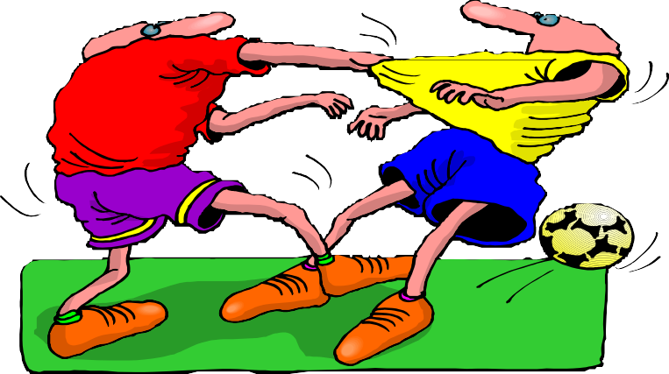
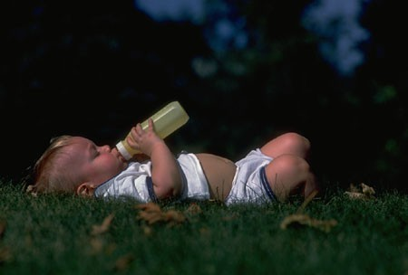
Sympathetic Vs Parasympathetic
SYMPATHETIC
Fight or Flight
Increase BP & HR, glucose, perfusion
to skeletal muscles, Mydriasis, Bronchodilatation
PARASYMPATHETIC
Rest and Digest
Miosis, decreased HR, BP, bronchia secretion, Insulin release, Digestion, excretion

Slide 7
Sites of Cholinergic Transmission - Summary
Parasympathetic Stimulation – Acetylcholine (Ach) release at neuroeffector junction - biological effects
Sympathetic stimulation – Noradrenaline (NA) at neuroeffector junction - biological effects

Slide 8
Cholinergic system (PNS)
Neurotransmitter –Acetyl choline
Site of release- ganglia, post ganglionic parasympathetic nerve ending, sweat glands, skeletal muscle , adrenal medulla, CNS

Slide 9
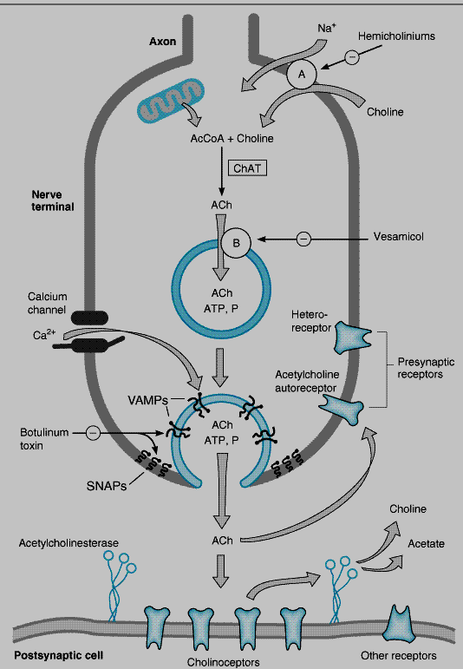
Cholinergic Transmission – Synthesis:

Slide 10
Cholinergic neurons contain large numbers of small membrane-bound vesicles
ACh is synthesized in the cytoplasm from acetyl-CoA and choline by the catalytic action of Choline acetyltransferase (ChAT)
Acetyl-CoA is synthesized in mitochondria, in the nerve ending
Choline is transported from the extracellular fluid into the neuron terminal by a Na+ dependent membrane choline cotransporter
This carrier can be blocked by a
group of drugs called hemicholiniums

Slide 11
Synthesized, ACh is transported from the cytoplasm into the vesicles by an antiporter
This transporter can be blocked by vesamicol
Release is dependent on extracellular Ca²⁺ and occurs when an action potential reaches the terminal and triggers sufficient influx of Ca²⁺ions
The increased Ca²⁺concentration "destabilizes“ the storage vesicles by interacting with special proteins associated with the vesicular membrane Fusion of the vesicular membranes with the terminal membrane results in exocytotic expulsion of ACh into the synaptic cleft

Slide 12
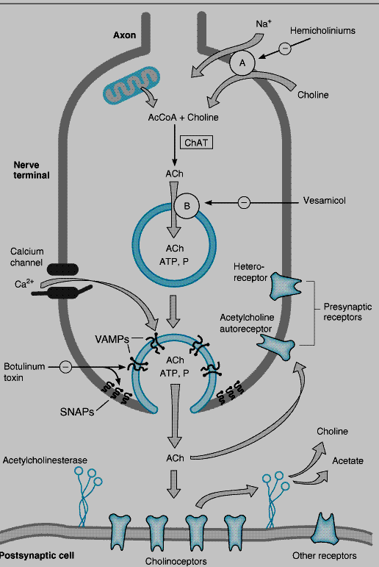
Destruction
After release - ACh molecules may bind to and activate an ACh receptor (cholinoceptor)
Eventually (and usually very rapidly), all of the ACh released will diffuse due to AChE
AChE very efficiently splits ACh into choline and acetate,

Slide 13
Two types of AChE
True- neurons, ganglia and NM junction
Pseudo ChE- plasma, liver and other organs

Slide 14
True Vs Pseudo AChE
True AChE (Typical)
Cholinergic synaptic cleft
All cholinergic sites, RBCs, gray matter
Pseudo AChE (Atypical)
Plasma, liver, Intestine and white matter
Distribution
Action on: Acetycholine Methacholine Function
Very Fast
Slower
Termination of Ach action
Slow
Not hydrolyzed
Hydrolysis of Ingested Esters
More sensitive to Organophosphates
More sensitive to Physostigmine

Slide 15
M1 | M2 | M3
Location-CNS, Autonomic ganglia, Gastric paracrine cells | SA node, AV node, Atria, Ventricles | Exocrine glands, smooth muscles, vascular smooth muscle
Function-Gastric acid secretion, CNS excitation | Decrease rate of impulse generation, decrease velocity of conduction, decrease contraction, decrease HR | Increase exocrine secretion, smooth muscle contraction, relaxation of vascular smooth muscle
Agonist Oxotremorine | Methacholine | Bethanechol
Antagonist- Pirenzepine, Telenzepine | - | -

Slide 16
Cholinergic receptors
Muscarinic
  M1- Autonomic ganglia, gastric glands, CNS (cortex, Hippocampus, Corpus Striatum)
  Mediating Gastric Secretion
  Relaxation of LES (Lower Esophageal Sphicter) caused by Vagal Stimulation
  Intestinal Secretion
  Learning, Memory and Motor Functions

Slide 17
  M2- Heart, nerves, smooth muscles
  Cardiac Muscarinic receptors predominantly are M2
  Mediate Vagal Bradycardia
  Autoreceptors on cholinegric nerve endings are M2
  Decrease rate of impulse generation
  Decrease velocity of conduction
  Decrease contractility
  Decrease Ach Release
  Visceral smooth muscle contraction
  CNS-Tremors & Analgesia

Slide 18
  M3- glands, smooth muscles
  Visceral smooth muscle contraction
  Glandular secretions
  Vasodilatation through release of EDRF
  M4, M5- CNS

Slide 19
Nicotinic
Selectively activated by Nicotine
Blocked by Tubocurarine or Hexamethonium
Activation cause opening of the channel & rapid flow of cations resulting in depolarisation & an action potential

Slide 20
NM | NN
Location – Skeletal muscles Neuromuscular junction | Autonomic ganglia Adrenal medulla
Function- skeletal muscle contraction | Impulse transmission Secretion of NE & E from adrenal medulla
Agonist- ACh, SCh | Nicotine
Antagonist- D-tubocurarine | Ganglion blocker – hexamethonium, thimethaphan

Slide 21
  NM- Neuromuscular junction
  Selectively stimulated by PTMA (Phenyl trimethyl ammonium)
  Blocked by Tubocurarine
  Skeletal Muscle Contraction

Slide 22
  NN- Autonomic ganglia, Adrenal medulla, CNS
  Selectively stimulated by Dimethyl phenyl piperazinium (DMPP)
  Blocked by Hexamethonium
  Constitute primary pathway of transmission in Ganglia

Slide 23
Actions of Ach
Muscarinic actions (MiS DULB DHR)
  Stimulation of muscarinic receptors
Heart- depresses SA node, decrease in Heart rate, even cardiac arrest may occur
Blood vessels- relaxes smooth muscles- dilatation
  Vasodilatation-primarily through release of EDRF (endothelium dependent relaxing factor)-NO

Slide 24
3. Smooth muscles- increases the tone of smooth muscles, increases tone & peristalsis of GI tract, sphincters are relaxed
abdominal cramps- evacuation of bowel
Peristalsis in ureter is increased- contraction of detrusor muscle- relaxation of bladder trigone & sphicter- voiding of bladder
Bronchial muscle-contraction- ashtmatics are highly sensitive-bronchospasm-dyspnoea-precipitation of bronchial asthmatic attack

Slide 25
4. Secretory glands
enhances all the secretion of glands: salivary, lacrimal, nasopharyngeal, tracheobronchial, gastric, intestinal secretions, sweating
5. Eye- constriction of Pupil- contraction of circular muscles
- Contraction of ciliary muscle causing spasm of accommodation, increased aqueous outflow facility, reduction in intraocular tension (glaucoma)

Slide 26
Nicotinic actions
  Neuromuscular junction- skeletal muscle contraction
  Autonomic ganglia (sympatheitc & Parasympathetic)- stimulation occurs at high dose
  CNS- neurotransmitter

Slide 27
Uses
  Ach is destroyed in the gut, when given orally
  On intravenous administration, it is rapidly metabolised by pseudocholinesterases in the plasma and true cholinesterases at the site of action
  Therefore, it is not used therapeutically except occasionally as 1% eyedrops to produce miosis during some eye surgeries.

Slide 28
Esters of choline are effective orally, carbachol and bethanechol are resistant to both cholinesterases and have a longer duration of action.
Their muscarinic actions are prominent with a sustained effect on g.i smooth muscles and urinary bladder.
Methacholine is rarely used.

Slide 29
Carbachol is used in glaucoma.
Bethanechol may be used in hypotonia of bladder and g.i smooth muscles and in some cases of post operative paralytic ileus and urinary retention.
It may also be used in xerostomia as an alternative to pilocarpine.

Slide 30
Adverse effects
  Diarrhoea, flushing, salivation, bradycardia, hypotension, syncope and bronchospasm.

Slide 31
Cholinergic Drugs
Cholinergic drugs act at the same site as Ach
Thereby mimic its actions
So called cholinomimetics

Slide 32
1. Directly acting
Ach
Synthetic choline: Methacholine, Carbachol, Bethanecol
Natural Alkaloids- Muscarine, Nicotine, Pilocarpine

Slide 33
2. Indirectly acting
Anticholinesterase-
  Reversible-
    Carbamates- Neostigmine, Physostigmine, Pyridostigmine,, Rivastigmine
    Non carbamates- Edrophonium, Tacrine, Donepezil, Galantamine
  Irreversible-
    Carbamates- Carbaryl, Propoxur
    Organophosphorus compound- Isofluorophate, Ecothiopate, Parathion, Malathion

Slide 34
Pilocarpine
Chief alkaloid obtained from plant
Tertiary amine
Crosses BBB
Dominant muscarine action
Mild nicotinic action on ganglia
Too toxic for its systemic use- pulmonary edema is major hazard

Slide 35
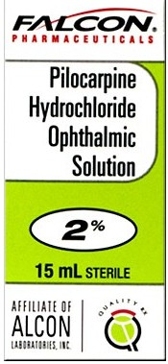
Therapeutic use
  1. Initial treatment of open angle glaucoma
  0.5 to 4 %
  Decrease in IOP
  Duration- 4 to 8 hours
  2. To counteract mydriasis produced by Atropine
  3. To break adhesions between iris and the lens
  4. Stimulation of secretion after laryngeal surgery and in xerostomia after radiotherapy- no oral preparation is available

Slide 36
Muscarine
Alkaloid from mushroom
Only muscarinic actions
No clinical use
Mushroom poisoning due to ingestion of poisonous mushroom- treated by anticholinergic

Slide 37
Indirectly acting (anticholine esterase)
Reversible competitive inhibitors of AChE
  Degradation- Ach binds AChE through electrostatic attraction at two points
    Anionic site
    Esteric site
    Enzyme substrate complex is formed
    Cleavage of ester linkage with regeneration of choline
    Reversible anticholinesterase resemble structurally with Ach
    Temporary inhibition of enzyme

Slide 38
Physostigmine
Tertiary amine, lipid soluble, well absorbed orally and crosses BBB
Hydrolyzed in liver and plasma by esterases
Long lasting action (4-8 hours)
Penetrates cornea readily on local application in eye - Muscarinic action on eye causing miosis and spasm of accommodation on local application
Salivation, lacrimation, sweating and increased tracheobronchial secretions
Increased heart rate & hypotension

Slide 39
Physostigmine - uses
Used as miotic drops to decrease IOP in Glaucoma
To antagonize mydriatic effect of atropine
To break adhesions between iris and cornea alternating with mydriatic drops
Belladonna poisoning, TCAs & Phenothiazine poisoning
Alzheimer’s disease- pre-senile or senile dementia
Atropine is antidote in physostigmine poisoning.
ADRs – CNS stimulation followed by depression

Slide 40
Neostigmine
Synthetic reversible anticholinesterase drug
Quaternary ammonium compound and lipid insoluble
Cannot cross BBB
Hydrolysed by esterases in liver & plasma
Short duration of action (3-5 hours)
Direct action on nicotinic (NM) receptors present in neuromuscular junction (motor)
Antagonises (reverses) skeletal muscle relaxation (paralysis) caused by tubocurarine and other competitive neuromuscular blockers

Slide 41
Neostigmine – Uses and ADRs
Used in the treatment of Myasthenia Gravis to increase muscle strength
Post-operative reversal of neuromuscular blockade
Post-operative complications – gastric atony paralytic ileus, urinary bladder atony
Cobra snake bite
Produces twitchings & fasciculations of muscles leading to weakness
Atropine is the antidote in acute neostigmine poisoning

Slide 42
Other Drugs
Pyridostigmine: Same as Neostigmine - less potent but longer acting
Edrophonium: Same as Neostigmine – shorter duration of action (1- - 30 minutes) – diagnostic use in MG
Rivastigmine, donepezil, galantamine – all used in AD

Slide 43
Uses
Miotic
  Glaucoma- increase the tone of ciliary muscle-facilitates outflow-decreases IOP
  Pilocarpine is preferred- Action rapid & short acting (4-6 hours)
  Diminution of vision especially in dim light, spasm of accomodation, brow pain- frequent side effects
  Higher concentration- systemic side effects- nausea, diarrhoea, sweating, bronchospasm

Slide 44
Physostigmine
  O.1 % only used to supplement Pilocarpine
  Miotics are the third choice, used as add on therapy in advanced cases

Slide 45
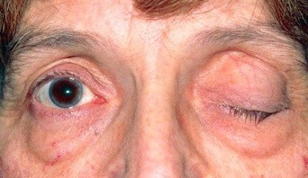
Myasthenia Gravis
Autoimmune disorder affecting 1 in 10,000 population
Development of antibodies directed to the nicotinic receptors at the muscle endplate
Number of Nm receptors may be reduced to 1/3 of normal or less /structural damage to NM junction
Weakness, easy fatigability on repeated activity with recovery at rest
Eyelid, external ocular, facial & pharyngeal muscles are generally involved first

Slide 46
Later, Limb & respiratory muscles get affected
Neostigmine & its congeners are the first line drugs used for this
Improve muscle contraction by allowing Ach released from pre junctional endings to accumulate & act on the receptors over a large area, as well as directly depolarizing the end plate

Slide 47
References
Essentials of Medical Pharmacology -7th edition by KD Tripathi

Slide 48
MCQ

Slide 49
Which of the following receptor is present at NEUROMUSCULAR JUNCTION?
M1
NN
M2
NM

Slide 50
2. All are the actions of Acetyl choline except,
Bradycardia
Mydriasis
Salivation
Lacrimation

Slide 51
3. Which of the following effect occurs on Gastro intestinal tract with Acetyl choline?
Increase in peristalsis
Decrease in peristalsis
Decrease in tone
None of the above

Slide 52
4. Which of the following effect occurs on heart with Ach?
Bradycardia
Tachycardia
Increase in Blood Pressure
all

Slide 53
5. Which of the following cholinergic drug is used for glaucoma?
Neostigmine
Pilocarpine
Muscarine
None of the above

