Slide 1

S. B. K. S. Medical Institute & Research Center
Subject: Pharmacology
TOPIC:
GENERAL PRINCIPAL OF CHEMOTHERAPY : GENERAL CONSIDERATIONS
Date: 20th August, 2024 (12.00 – 1.00 pm)
II MBBS (Aditya Samdadiya Batch 2024)
Faculty: Dr. Ervilla Jagin Parmar
Professor
Department of Pharmacology
S.B.K.S. Med. Inst. & Res. Centre,
Sumandeep Vidyapeeth Deemed University, Vadodara – 391760

Slide 2
COMPETENCY BASED UNDERGRADUATE CURRICULUM FOR THE INDIAN MEDICAL GRADUATE
Board Of Governors - In Supersession Of Medical Council Of India
CODE: PH 1.42 & PH 1.43
COMPETENCY:
PH 1.42 Describe general principal of chemotherapy. – general considerations.
PH 1.43 Describe & discuss the rational use of antimicrobials including antibiotic stewardship program.
SLO:
Define various terminologies related to chemotherapy.
Classification of drugs - general considerations
Mechanism of action - general considerations
Rational Use
Antibiotic Stewardship Program
Integration Teaching: GM, Paedia., Micro.

Slide 3
Introduction to Antimicrobials

Slide 4
Important terms
Chemotherapy: Use of chemical compounds in the treatment of infectious disease and malignancy
Antibacterials: chemical compounds used in treatment of bacterial infections e.g. sulfonamides,quinolones
Antibiotics: Substances generated from one microbe used to destroy other microbes e.g. penicillins, cephalosporins; developed from Penicillium spp Streptomyces spp
Bacteriostatic: substances which inhibit growth of bacteria
Bactericidal: substances which kill bacteria
MIC’S and MBC’S: minimum concentration of antibiotic required to inhibit/kill 50% bacteria

Slide 5
Special terms
Broad spectrum
The agent affect a wide variety of microbial species and are referred to as broad spectrum antibiotics.
For example, tetracyclines and chloramphenicol.
Using broad spectrum antibiotics interfere the nature of the normal bacterial flora and can precipitate a superinfection of an organism.

Slide 6
Bacteriostatic drugs
Bacteriostatic drugs agents arrest the growth or replication of the microorganism, but cannot kill them.
Bactericidal /Lysis drugs
The agents which can kill the microorganisms are called bactericidal drugs. but also can destroy them.
It should be noted that a drug may be bacteriostatic for one organism but bactericidal for another.

Slide 7
Chemotherapy index (CI)
CI is a term used to evaluate the safety of chemotherapeutic drugs, the value is LD50/ED50.
CI= LD50/ED50

Slide 8
Classification of antimicrobial drugs
Antibacterial drugs
Antiviral drugs
Antifungal drugs

Slide 9
MICROBES
Bacteria, viruses, fungi, spirochetes, protozoa
Bacteria: Cocci (round) and Bacilli (rods);
Gm+ve and Gm-ve, Aerobic/anerobic
Gm+ve Cocci - Staphylococcus, Streptococcus
Gm-ve Cocci- Neisseria Gonorrhoea, N.meningitidis,
Gm+ve Bacilli - Clostridium tetani , Anthrax, Diphtheria
Gm-ve Bacilli - largest group - E.Coli, Proteus Klebsiella, Pseudomonas; Salmonella, Shigella; Hemophilus influenzae
Acid fast bacilli -Mycobacterium tuberculosis; M.leprae
Anerobic bacteria - Bacteroides fragilis, Clostridium welchii, Fusobacterium, peptococcus, peptostreptococcus

Slide 10
Bacteria Most Commonly Involved In Different Infections
Oral : Gm+ve cocci, anerobes
Respiratory tract: Upper -
  Commonest infection is pharyngitis
  Streptococcus
  Lower -
  Pneumonia,bronchitis,tuberculosis
  Pneumococcus
  H.influenzae,K.pneumoniae,M.tuberculosis
Urinary tract
  Urethritis, cystitis, pyelonephritis
  E.Coli, Proteus , Klebsiella, Pseudomonas;
GIT - Salmonella, Shigella, E.Coli
Skin and soft tissue
  Streptococcus, staphylococcus, gm-ve bacilli

Slide 11
Evolution of antibacterials/antibiotics
Sulfonamides
Penicillins: Alexander Fleming 1928 - Benzyl penicillin
Ampicillin, Methicillin, Cloxacillin, Piperacillin
Cephalosporins: 1st,2nd,3rd & 4th generation: cephalexin, cefuroxime, cefotaxime
Aminoglycosides: gentamicin, tobramicin
Tetracyclines: doxycyclin
Quinolones: norfloxacin, ciprofloxacin

Slide 12
Mechanism of action
Interference with cell wall synthesis
  Penicillins,cephalosporins,bacitracin
Damage to cytoplasmic membrane
  Polymixin,colistin,detergents
Interference with transcription
  Quinolones, metronidazole,rifampicin
Inhibition of protein synthesis
  Aminoglycosides,tetracyclines,macrolides
Antimetabolite action
  Sulphonamides,trimethoprim,PAS
Binding to enzymes essential for DNA synthesis
  Vidarabine, acyclovir

Slide 13
Bacterial resistance
Needless administration, Insufficient dose, insufficient duration
Mechanisms of resistance:
Natural &
Acquired:
Genetic:
  Mutation
  Resistance (R) factor transmission from one bacteria to other
    Conjugation; Transduction (bacteriophage);
    Transposition (plasmid-transferable, extra chromosomal DNA molecule)
    Transformation (direct gene transfer)
Physiologic effects: Decreased bacterial cell wall permeability: penicillin, chloramphenicol
  Active extrusion of antibiotic from cell: tetracyclines
  Extracellular inactivation of antibiotic:enzyme production-beta lactamase
  Intracellular inactivation:aminoglycosides

Slide 14
Classification of antibiotics
Antibiotics effective against Gram +ve bacteria: Penicillins,Macrolides,Bacitracin(topical)
Antibiotics mainly effective against Gm-ve bacteria: Aminoglycosides
Antibiotics effective against both: Ampicillin,Amoxycillin,Cephalosporins
Antibiotics effective against gm+ve,gm-ve, rickettsiae & chlamydia – tetracyclines & chloramphenicol
Antibiotics effective against acid fast bacilli -streptomycin,rifampicin,kanamycin
6. Antibiotics effective against fungi: nystatin, amphotericin B, griseofulvin
Anticancer antibiotics :mitomycin
Antibacterials:Sulfonamides,quinolones

Slide 15
Antibiotic combinations
To achieve synergistic effect: eg. trimethoprim-sulfamethoxazole
Mixed infections: e.g penicilin+metronidazole aerobic+anerobic like oral infections
To delay development of resistance: tuberculosis - To decrease possibility of toxicity
Severe infection especially in immunocompromised patients
To reduce chances of superinfection

Slide 16
Dangers of unnecessary antibiotic use
Development of allergic and anaphylactic reactions - local use may sensitize e.g penicillin
Selective toxicity: ototoxicity and nephrotoxicity of aminoglycosides,
aplastic anemia with chloramphenicol
Superinfection: broad spectrum, long term, large doses
Development of multi-drug-resistant organisms
Vitamin deficiency
Fetal damage

Slide 17
Reasons of failure of antibiotic therapy
Right antibiotic?
Isolated strain responsible for illness?
Diabetes mellitus
Is the antibiotic reaching the site of infection?
Necessary to look for and drain an abscess?
Deeper focus of infection? e.g. Sub-Acute Bacterial Endocarditis (SABE)
Superinfection
Bacterial resistance

Slide 18
ANTIMICROBIAL THERAPY
Selective toxicity: bacterial infections provide
differences in physiology that can be targeted
for therapy
Cell wall
Protein synthesis: Ribosome
Metabolism: antifolates
DNA synthesis: topoisomerase
RNA synthesis
Membrane

Slide 19
ANTIBACTERIAL AGENT
Antibacterial agent can be defined as substances from microorganisms (bacteria, fungi) or synthesized substance that produce bacteriostatic or bactericidal effects.
Antibiotics can be defined as substances from microorganisms (bacteria, fungi) that produce bacteriostatic or bactericidal effects．

Slide 20
Special terms
Antimicrobial spectrum
Antimicrobial spectrum of a drug means the species of microorganisms that the drug can inhibit or kill.
1.Narrow spectrum
The agents act against a single or limited group of microorganisms, for example, isoniazid is active only against mycobacteria.

Slide 21
Special terms
Minimal inhibitory concentration (MIC)
MIC is the lowest concentration of antimicrobial agents that prevents visible growth in 18-24 hours incubation.

Slide 22
Special terms
Post-antibiotic effect (PAE)
PAE shows the antimicrobial effect after the concentration decreased below MIC.

Slide 23
Mechanism of action
Antimicrobial agents can be classified into five major groups:
(a) inhibitors of cell wall synthesis
(b) inhibitiors of synthesis of cytoplasmic membrane
(c) modification in synthesis or metabolism of nucleic acids
(d) inhibitiors of protein synthesis
(e) modification in energy metabolism

Slide 24
Fig. 2 antimicrobial site of action

Slide 25
Mechanism of antimicrobial agent

Slide 26
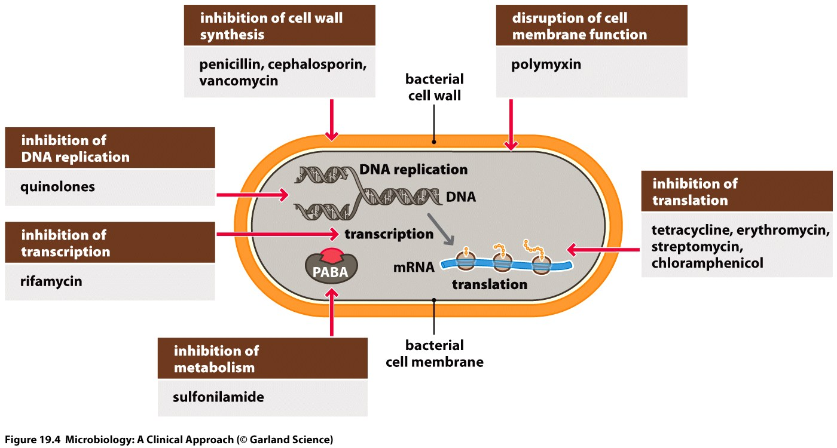
Antibiotic Targets – M/A

Slide 27
Antibacterial drugs have been
classified broadly into:
1. bacteriostatic, i.e. those that act primarily
by arresting bacterial multiplication, such as
tetracyclines, chloramphenicol, macrolides,
lincosamides, sulfonamides, etc.
2. bactericidal, i.e. those which act primarily
by killing bacteria, such as penicillins,
cephalosporins, aminoglycosides, isoniazid,
rifampicin, quinolones, etc.

Slide 28
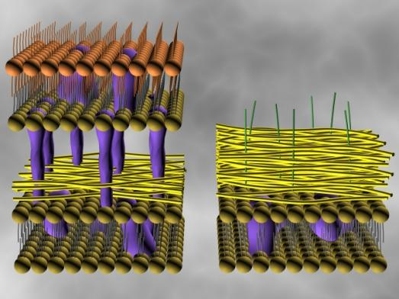
Gram-negative cell
Gram-positive cell
Outer membrane
Peptidoglycan
Peptidoglycan
Penicillin
Binding proteins
(PBPs)
Inner (cytoplasmic) membrane

Slide 29
Penicillin inhibits final crosslinking stage of cell wall synthesis
It reacts with the transpeptidase enzyme to form an irreversible covalent bond.
Penicillins inhibit a bacterial enzyme called the TRANSPEPTIDASE ENZYME which is involved in the synthesis of the bacterial cell wall. Transpeptidation is inhibited by penicillin
Inhibition of transpeptidase leads to a weakened cell wall
Cells swell due to water entering the cell, then burst (lysis)

Slide 30
Inhibition of protein synthesis
Inhibit the protein synthesis.
Tetracyclines and aminoglycosides act on 30s ribosomal subunit.
Chloramphenicol, lincomycin and macrolides act on 50s ribosome subunit.

Slide 31
Interfere the metabolisms of nucleotides
Rifampicin specifically inhibits DNA-dependent RNA-polymerase (DDRP), interfere mRNA synthesis.
Quinolones inhibits DNA gyrase, reducing DNA duplication and mRNA transcription.

Slide 32
Inhibit folic acid metabolisms
Sulphonamides inhibit dihydrofolic acid synthase (DHF).
Trimethoprim inhibit dihydrofolic acid reductase.

Slide 33
Resistance of antimicrobial agent
Type of resistance:
(1) Intrinsic resistance----It is a natural resistance existing on chromosome. Gram-negative bacilli to basic penicillins.
(2) Acquired resistance----It is induced by antimicrobial agents. It is more often plasma-mediated, sometimes chromosome-mediated.

Slide 34
Resistance of antimicrobial agent
1. Enzymatic inactivation
The ability to destroy or inactivate the antimicrobial agents can confer resistance on microorganisms.
For example, β-lactamses destroy many penicillins and cephalosporins.

Slide 35
2. Modification of target sites
The β-lactams can resist to organism by alteration of the target site that is penicillin binding protein(PBP) and mutation of dihydrofolate reductase which is less sensitivity to inhibition in organism resistant to trimothoprim.

Slide 36
3. Decreased accumulation
Antibiotics are unable to gain access to the site of action due to the presence of an efflux system that pumps out the drug.
Another situation is that gram-negative bacteria show a special membrane (lipopolysaccharide layer) and decrease penetrability of antibiotics.

Slide 37
Genetic alterations leading to drug resistance
1. Mutations
Specific genetic mutations are the molecular basis for resistance to streptomycin (ribosomal mutation), to quinolones (DNA gyrase gene mutation) and to rifampin (RNA polymerase gene mutation).
For example, the mutation to rifampin is a single-step mutation: in this case, E. coli or S. aureus’s exposure to rifampin results in highly resistant strains due to a point mutation in the RNA polymerase gene, causing the polymerase protein no longer binds rifampin.

Slide 38
Genetic alterations leading to drug resistance
Transduction
The resistance occurs when a bacteriophage which includes bacterial DNA in its protein coat infects the bacteria.
This bacterial DNA may contain a gene confirming resistance to antibacterial drugs.
For example, Staphylococcus aureus strain resistance development to penicillin may occur by transduction.
Some bacteriophages carry plasmids that code for penicillinase, Other phages can transfer genes which confer resistance to tetracycline, erythromycin and chloramphenicol.

Slide 39
Genetic alterations leading to drug resistance
3. Conjugation
Conjugation is another mechanism for single and multi-drug resistance development.
In conjugation, direct passage of resistance-conferring DNA between bacteria proceeds by way of a bridge.
The genetic material transfer in conjugation requires two elements: an R-determinant plasmid which codes for the resistance and a resistance-transfer factor (RTF) plasmid which contains the genes necessary for the bacterial conjugation process.
For example most resistance of gram-negative bacilli is mediated by conjugation

Slide 40
RATIONAL USE OF ANTIBIOTIC
AND ANTIBIOTIC STEWARDSHIP

Slide 41
Antimicrobial resistance (AMR) is a global public health emergency.
AMR is the ability of a microorganism to survive and resist exposure to antimicrobial drugs, threatening the effectiveness of successful treatment of infection.

Slide 42
The misuse of antimicrobials in human health care is one of the key modifiable factors of the emergence of Antimicrobial Resistance.
Antimicrobial stewardship is a practical guide designed to promote the optimal use of antibiotic agents, which include the decision to use them, drug choice, dosing, route, and duration of administration.

Slide 43
Commonly used Stewardship Interventions interventions
Interventions prior to or at the time of prescription | Interventions after prescription
1. Education of Clinician | 7. Prospective audit and feedback
2. Education of Patient and Public | 8. Self-directed antibiotic reassessments (antibiotics timeouts)
3. Institution-specific guidelines for the management of common infections | 9. Dose optimization
4. Cumulative antibiograms | 10. Duration optimization
5. Prior authorization of restricted antimicrobials
6. De-labeling of spurious antibiotic allergies

Slide 44
Steps in clinical decision-making
Interventions prior to or at
the time of a prescription
Interventions after
a prescription
Subsequent evaluation:
- lab data / report review
- clinical re-assessment
Modify anti-microbials
Initial evaluation - clinical assessment
Diagnostic work-up
Therapeutic decisions
Patient education

Slide 45
Barriers to Antimicrobial Stewardship
Clinician’s knowledge deficits regarding the optimal use of antibiotics
Limited access to reliable clinical diagnostic or microbiologic testing
Limited or unreliable access to quality-assured antimicrobials
Fear that withholding antimicrobials will lead to poor outcomes
Lack of communication between health care providers

Slide 46
Limited infrastructure and/or administrative support for antimicrobial stewardship programmes or interventions
Limited access to data, including antimicrobial prescribing trends, at a facility & of data regarding the prevalence of Antimicrobial resistance in the community / in hospital
Limited public/patient acceptance of antimicrobial stewardship
Public access to antimicrobials, such as antibiotics, without prescriptions in the community

Slide 47
If there is a limited access to microbiologic data (lab facility)
Consider the following interventions:
Education of Clinician
Education of Patient and Public
Institution-specific guidelines for the management of common infections
Duration optimization

Slide 48
Don’ts in antibiotic therapy
Prescribing antibiotics when not indicated
Polytherapy - Using more than one antibiotic when not indicated
Using a “higher” antibiotic for routine community acquired infections
Sub therapeutic doses / insufficient duration
Changing antibiotics too frequently
Using irrational combinations

Slide 49
Preventing Antibiotic Resistance
Encourage rational antibiotic therapy
Use combination therapy selectively
Practice infection control
Promote immunisation

Slide 50
Prophylaxis – Rational Examples
Penicillin prophylaxis for rheumatic fever
Neonate exposed to open TB in the mother
Prophylaxis for infective endocarditis
Perioperative narrow spectrum antibiotics for surgical prophylaxis
Chemoprophylaxis for recurrent UTI
Chemoprophylaxis for malaria in travellers
Chemoprophylaxis for opportunistic infections in HIV

Slide 51
Prophylactic Antibiotic Therapy
Successful only against
- a particular organism
- for a limited period of time
- in a particular setting
E.g.-
- SBE (bacterial endocarditis) prophylaxis in child with CHD (congenital heart disease)

Slide 52
Wrong Notions
Oral antibiotics cannot be a substitute for IV treatment
The oral antimicrobial must be the same medication or from the same medication class as the intravenous agent

Slide 53
Advantages of Parenteral Oral Switch
Patient feels more comfortable. Keeping IV line is uncomfortable.
Infusions-related adverse events including introduction of infections - is prevented.
Reduced cost
Earlier discharge from the hospital

Slide 54
Clinical conditions where parenteral to oral switch is NOT permitted
Neonatal bacteremia / sepsis
Pyogenic meningitis
Infective endocarditis
Neutropenia

Slide 55
Criteria for selection of patients for
IV to PO therapy
Improving clinical status
Intact and functioning GI tract
- No GI bleeding
- No intolerance to oral medications
No adherance / compliance issues

Slide 56
Examples of IV to PO Conversion
IV drug | Oral drug
ampicillin | amoxycillin
ampi-sulbactam | amoxiclav
ceftriaxone | cefixime cefopodoxime
vancomycin | linezolid
cefazolin | cephalexin
cefepime | cipro / levoflox

Slide 57
Antibiotic Escalation
It is changing over from the current antibiotic to another one which is more potent / has a broader spectrum
Applicable when we have started a less potent antibiotic but the patient has not responded

Slide 58
Points to remember
Rational use of antibiotics & antibiotic stewardship is very important to prevent antimicrobial resistance & related consequnces (poor outcome, prolonged hospital stay, higher cost of therapy)
It is reposnsibility of all, especially of health care professionals.

Slide 59
MCQs

Slide 60
Q 1 Antimicrobial agent acting by inhibition of cell wall synthesis is
Erythromycin
Tetracycline
Lomefloxacin
Cefepime

Slide 61
Q. 2 The group of antibiotics that possesses anti Chlamydia action is-
a. Aminoglycosides
b. Polypeptide antibiotics
c. Cephalosporins
d. Macrolides

Slide 62
Q. 3 Tetracyclines inhibit protein synthesis by?
a. Inhibition of initiation and misreading of mRNA
b. Binding to 30 S subunit and inhibiting the binding of aminoacyl-tRNA to A site
c. Inhibiting peptidyltransferase activity
d. Inhibiting translocation

Slide 63
Q. 4 Mechanism of action of fluroquinolones is
a.Inhibits cell wall synthesis
b.Inhibits protein synthesis
c,Inhibits DNA gyrase
d.Interferes with intermediary metabolism

Slide 64
Q. 5 Use of chemical compounds in the treatment of infectious disease and malignancy is known as:
Antibiotics
Chemotherapy
Bacteriostatic
All of the above

Slide 65
Bibliography
Essentials of Medical Pharmacology -7th edition by KD Tripathi
Pharmacology – R S Satoskar
Lippincott's Illustrated Reviews: Pharmacology - 6th edition by Richard A. Harvey
Basic and Clinical pharmacology 11th edition by Bertram G Katzung
Rang & Dale's Pharmacology -7th edition
by Humphrey P. Rang
Clinical Pharmacology 11th edition By Bennett and Brown, Churchill Livingstone
Principles of Pharmacology 2nd edition by HL Sharma and KK Sharma

Slide 66
Thank you

