Slide 1
Drug used in Gout & Rheumatoid arthritis
Dr. Jayant Patharkar

Slide 2
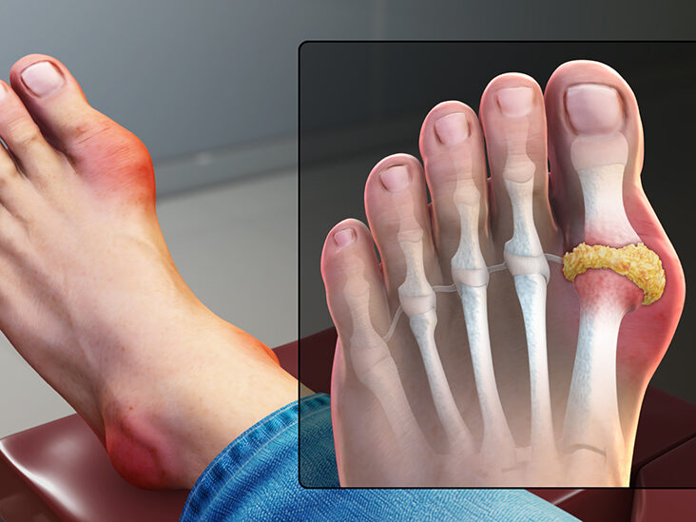
Metabolic disorder – increase in urate level in body –hyperuricemia
Pathophysiology :
Arthritis is due reaction to deposition of monosodium urate (MSU) in the joints
Initially, monoarticular, acute & recurrent involving joint in the lower limbs
commonly metatarso-phalangeal joint of great toe

Slide 3
Tophi: Due to painless deposition of urate crystal in the soft tissues such as cartilage, bursae & tendons leads tophi in subsequent years.
It can be diagnosed radiologically
Diagnosis of Gout:
A characteristic clinical arthritis
Tophi
Urate crystals in the joint & tophi

Slide 4
Normal uric acid levels 2-6 mg/dl
Uric acid – product of purine metabolism
Hyperuricaemia due to increased production of uric acid or reduced uric acid excretion by kidney
Secondary hyperuricaemia occurs due to;
A) enhanced nucleic acid metabolism & uric acid production as in case of leukaemias, lymphomas, polycythaemia when treated with chemotherapy or radiation
B) Drug induced – thiazides, furosemide, pyrazinamide, ethambutol, levodopa : reduce uric acid excretion by kidney.

Slide 5
Drug used in gout:
Drugs used in acute gout:
1) NSAIDs
2) Colchicine
3) Corticosteroids
Drugs used in chronic gout/ hyperuricaemia
A) Uricosuric agents
Probenecid
Sulfinpyrazone
B) Uric acid synthesis inhibitors
Allopurinol
Febuxostat

Slide 6
NSAIDs:
Antiinflammatory action – effective in acute attack
Response slower than colchicine
Though preferred due to better tolerance.
NSAIDs with strong antiinflammatory action like naproxen, piroxicam, diclofenac, indomethacin
Naproxen & piroxicam also inhibit chemotaxis of leucocytes into the inflamed joint.
Used in acute attack continued for 3-4 weeks at lower doses
NSAIDs used instead of colchicine for initiation therapy with allopurinol or uricosurics in chronic gout

Slide 7
Colchicine:
It is an alkaloid colchicum autumnale
It is not analgesic nor antiinflammatory
It specially suppresses gouty inflammation
It dose inhibit synthesis or promote excretion of uric acid.

Slide 8
Mechanism of action:
Precipitation of urate crystal in synovial joint
↓
Release of mediators of inflammation
↓
granulocyte migration into the joint by chemotaxis × colchicine
↓
Granulocyte phagocytose urate crystal
↓
Release of glycoprotein × colchicine
↓
Increased lactic acid production & more precipitation of urate crystal
↓
Release of lysosomal enzymes causing joint destruction

Slide 9
Other actions of colchicine:
Antimitotic: causes metaphase arrest by binding to microtubules of mitotic spindle
2) Increases gut motility through neural mechanisms
Toxicity: high & dose related
Nausea, vomiting, watery or bloody diarrhoea & abdominal cramps
Kidney damage, CNS depression, intestinal bleeding
Aplastic anaemia, agranulocytosis, myopathy & loss of hair
Muscular paralysis & respiratory failure leading to the death

Slide 10
Therapeutic uses of colchicine:
acute attack of gout: 0.5 mg tds maximum 6 mg in total spread over 3-4 days
Control of attack achieved in 4-12 hours
A second course should not be started before 3-7 days
Maintenance dose: 0.5- 1 mg/day for 4-8 weeks when hyperuricaemia controlled by other drugs
Prophylaxis : 0.5- 1 mg/day prevent further attack of gout.
Note: colchicine is used only when NSAIDs are ineffective or cannot be used.

Slide 11
Corticosteroids:
Intraarticular injections of soluble steroids in acute attack
Only used when colchicine/NSAIDs not tolerated or ineffective
These are reserved drugs
Systemic steroids: reserved drugs used only in patients with renal failure or H/O peptic ulcer bleed – NSAIDs contraindicated or not tolerated
Prednisolone : 40- 60 mg in a day tapered over few weeks

Slide 12
Chronic gout:
Persistent pain, joint stiffness in between attacks
Hyperuricaemia
Tophi under skin in pinna, eyelids, nose, around joints
Urate stone in kidney
Hyperuricaemia due to under secretion (excretion by kidney) or over production
It causes progressive disability & permanent deformities
Drug used: A. uricosuric drugs B. uric acid synthesis inhibitor

Slide 13
Uricosuric drugs:
1.Probenecid:
Highly lipid soluble organic acid
Uric acid largely reabsorbed by URAT-1 transporter
Probenecid by blocking this transporter inhibit uric acid reabsorption
Hence, promotes uric acid excretion & lowers its blood level
It inhibit renal tubular secretion of penicillin
It competitively blocks active transport of penicillin by OATP at all sites particularly proximal renal tubule
Hence inhibition of penicillin excretion & sustained blood levels – prolongation of action
Notes:
Urate transporter

Slide 14
Drug interactions:
It inhibits urinary excretion of cephalosporins, sulfonamides, methotrexate & indomethacin
It inhibits biliary excretion of rifampicin.
Pyrazinamide & ethambutol interfere with uricosuric action of probenecid
Salicylates blocks uricosuric action of probenecid
ADR: It is well tolerated
Dyspepsia, rashes, hypersensitivity reactions

Slide 15
Uses of probenecid:
Chronic gout & hyperuricaemia:
It is second line or adjuvant drug to allopurinol
Dose: 0.25 mg bd increased to 0.5 mg bd
It gradually lowers blood urate levels, tophi, arthritis etc required prolonged treatment upto months
Initially, additional treatment started with NSAIDs / colchicine to prevent acute attack
In presence of renal insufficiency , probenecid is ineffective
Probenecid also used for prolongation of penicillin action as required in gonorrhoea, SABE etc

Slide 16
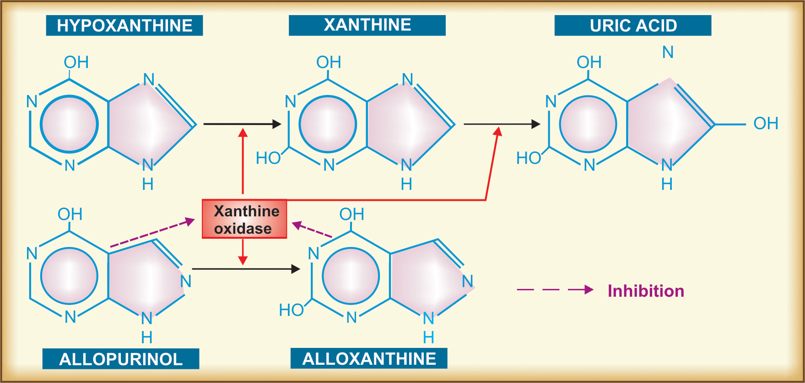
B. Uric acid synthesis inhibitors: Allopurinol

Slide 17
Allopurinol:
It hypoxanthine analogue
It is substrate as well as inhibitor of xanthine oxidase
Xanthine oxidase is an enzyme required in uric acid synthesis
Allopurinol - short acting (t1/2 2 hrs) competitive inhibitor of xanthine oxidase
Its major metabolite, alloxanthine – long acting (t1/2 24 hrs) & noncompetitive inhibitor of xanthine oxidase.
Thus inhibits uric acid synthesis

Slide 18
Drug interactions: Allopurinol inhibits the degradation of
6-mercaptopurine & azathioprine.
Hence there doses are reduced to 1/3rd
Allopurinol potentiate warfarin & theophylline by inhibiting their metabolism

Slide 19
ADR :
hypersensitivity reactions like rashes, fever, malaise, muscle pain are frequent
Gastric irritation, nausea & dizziness infrequent
Stevens-Johnson syndrome rare but serious
Contraindicated in hypersensitive patients, during pregnancy & lactation
Cautiously used in the patients with liver & kidney disease, children & elderly

Slide 20
Uses of Allopurinol:
Chronic gout:
first choice drug
It is indicated in more serious conditions with tophi & nephropathy
Tophi gradually disappear & nephropathy halted with long term therapy
2) Secondary hyperuricaemia due to cancer chemotherapy/radiation/thiazides or other drugs controlled by allopurinol
It can also be used prophylactically in these situations
3) In cancer chemotherapy & immunosuppressant therapy to potentiate 6-mercaptopurine or azathioprine.
Dose: 100 mg od to 300 mg/day maximum 600 mg/day

Slide 21
Febuxostat:
It is nonpurine xanthine oxidase inhibitor
It is equally or more effective than allopurinol in lowering blood uric acid levels
ADR : liver damage, diarrhoea, nausea & headache
Due to inhibition of xanthine oxidase it interact with mercaptopurine, azathioprine & theophylline
It is alternative drug to treat symptomatic gout only in patients intolerant to allopurinol
It is not indicated in malignancy associated hyperuricaemia
Initially addition of colchicine/NSAIDs required for 1-2 months while starting febuxostat therapy
Dose: 40-80 mg od

Slide 22
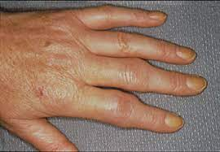
Antirheumatoid drugs
  Dr. Jayant Patharkar

Slide 23
Rheumatoid arthritis (RA) :
Autoimmune disease
Chronic, systemic , inflammatory disease affecting joint & periarticular (synovial) tissues
Synovial proliferation
Destruction of articular cartilage
Chronic progressive disorder with waxing & waning phenomenon
Symptoms like pain, joint swelling, morning stiffness & immobility.

Slide 24
inflammation of small blood vessels
↓
edema of synovium & infiltration with mononuclear cells, macrophages, lymphocytes & plasma cells
↓
production of IgG by plasma cells
↓
activated macrophages, lymphocytes& fibroblast produce cytokines
↓
synovial proliferation & inflammation
↓
activated macrophages produce TNFα
↓
induction of proinflammatory mediators- PGs (PGE2), leukotriene B4,
interleukins (IL-1,IL-6)
↓
cartilage damage & bone destruction

Slide 25
Goal of drug therapy in rheumatoid arthritis:
To reduce pain, swelling & joint stiffness
To prevent articular cartilage damage & bone erosion
To prevent deformity & preserve joint function
Improvement in laboratory indices (ESR, C-reactive
protein)
5) Induction & maintenance of long term clinical & radiological remission after cessation of drug therapy
.

Slide 26
NSAIDs are the first line drugs in RA
They afford symptomatic relief i.e. pain, swelling, morning stiffness are relieved
Disease Modifying Antirheumatoid Drugs (DMARDs) are recommended on diagnosis of RA
More than one DMARD used concurrently

Slide 27
Classification:
I. Antiinflammatory & analgesic drugs:
Aspirin & other NSAIDs
II. Antiinflammatory drugs with indirect analgesic action:
Glucocorticoids: they also have immunomodulatory action
III. Disease modifying antirheumatic (DMARDs) :
A. Nonbiological drugs
1. Immunosuppressants: Methotrexate, Azithioprine, Cyclosporine
2. Sulfasalazine
3. Chloroquine or Hydroxychloroquine
4. Leflunomide
5. gold salts
( Gold and penicillamine are obsolete DMARDs)

Slide 28
B. Biological agents :
1. TNFα inhibitors: Etanercept, Infliximab, Adalimumab
2. IL-1 receptor antagonist: Anakinra
3. IL-6 receptor antagonist: Tocilizumab
4. T cell activation inhibitor : Abatacept
5. Anti-B-lymphocyte antibody : Rituximab
6. Tyrosine kinase inhibitor : Tofacitinib

Slide 29
Antiinflammatory analgesics:
These drugs act symptomatically
Relieve pain, decrease swelling & improve joint movement
Aspirin : 3-5 g daily
Ibuprofen : 200-400 mg thrice daily
Diclofenac : 75-100 mg twice daily
Naproxen : 250 mg twice daily
Ketoprofen : 50 mg thrice daily
Ibuprofen best tolerated NSAIDs
Risk of GI bleed with NSAIDs & glucocorticoids very high, can be minimized by use of PPI

Slide 30
Glucocorticoids:
Potent antiinflammatory action
They act by inhibiting inflammatory mediator synthesis or suppressing their action
Prednisolone: Initial dose : 1 mg/kg/day than tapered gradually to maintenance dose of 7.5 mg/day
They are not used as monotherapy but combined with DMARDs
Low dose 5 mg/day- joint protective effect
Larger dose required for severe systematic manifestations such as pericarditis & vasculitis

Slide 31
Immunosuppressants:
Methotrexate:
It is DMARD of first choice.
Antiproliferative drugs by preventing clonal expansion of T & B lymphocytes.
Folic acid antagonist
Mechanism of action:
Inhibition of cytokine production
Inhibition of chemotaxis
Inhibition of cell-mediated immune reaction

Slide 32
Dose: Initially low oral dose 7.5-15 mg weekly
Clinical response seen in 4-8 weeks
Dose increased by 2.5 mg every other week to a maximum of 15 mg once wkly if no response is seen even after 8 weeks of therapy.
Methotrexate - included in 2 or 3 DMARDs regimen.

Slide 33
Adverse effects:
low-dose regimen- oral ulceration & g.i.upset.
Prolonged therapy- liver damage leading to cirrhosis
To reduce toxicity folic acid 5 mg/day
Contraindications:
Pregnancy, breast- feeding, liver disease, active infection, leucopenia & peptic ulcer

Slide 34
Sulfasalazine:
It is compound of sulfapyridine & 5-amino salicylic acid (5-ASA)
Antiinflammatory action – ulcerative colitis
Mechanism of action:
Inhibition of superoxide radicals & cytokine elaboration by inflammatory cells
Dose: 1-2 g/day
Adverse effects: allergy, nausea, vomiting, headache
Rarely, neutropenia, haemolytic anaemia & thrombocytopenia.

Slide 35
Chloroquine & hydroxychloroquine :
Antimalarial drugs
Low efficacy but advantage due to low toxicity
They do not prevent bony erosions
Remission in upto 50% of RA patients on prolonged treatment of 3-6 months
Mechanism of action:
↓ monocyte IL-I, hence inhibition of B lymphocytes
Antigen processing inhibited
Lysosomal stabilization & inhibition of free radicals

Slide 36
Adverse effects:
accumulates in tissues containing melanin→ toxicity
serious toxic effects – retinal damage & corneal opacity
hydroxychloroquine preferred over chloroquine as former has less ophthalmic toxic effects
Other adverse effects: rashes, graying of hair, irritable bowel syndrome, myopathy & neuropathy.
used in milder nonerosive RA
only when one or few joints are involved
Can be combined with methotrexate/ sulfasalazine
Dose: Chloroquine 150 mg (base) per day
Hydroxychloroquine 400 mg/ day for 4-6 weeks, followed by 200 mg/ day for maintenance

Slide 37
Leflunomide:
Pyrimidine synthesis inhibitor
Immunomodulator – inhibits proliferation of stimulated lymphocytes.
Patients arthritic symptoms are relived within 4 weeks
Efficacy comparable to methotrexate & radiological progression of disease is retarded.
Mechanism of action:
It inhibits dihydroorotate dehydrogenase – mitochondrial enzyme which converts dihydroorotate into orotate.
This step is necessary for biosynthesis of uridine monophosphate
It also inhibits antibody production by B-cells.

Slide 38
Adverse effects:
diarrhoea, nausea, rashes, loss of hair, thrombocytopenia, leucopenia, increased hepatic transaminases – hepatic toxicity
anaphylaxis, Stevens- Johnson syndrome
It is contraindicated in children, lactating & pregnant women.
Dose: Loading dose 100 mg daily for 3 days followed by maintenance dose of 10-20 mg/day

Slide 39
Biological agents:
These are recombinant proteins /monoclonal antibodies.
They inhibits cytokines like TNFα or IL-1
They are expensive & needs to be given parenterally.
They produce prominent adverse effects & hence used only as reserved drugs for severe refractory disease

Slide 40
TNFα inhibitors:
TNFα plays important role in inflammation
It activates membrane bound receptors on (TNFR1& 2) the surface of T-cells, macrophages
TNFα inhibitors neutralize it & suppress macrophage & T-cell function
Thus they decrease inflammatory changes in the joint & new erosions are slowed.
Their action is quick as compared to nonbiologic DMARDs
They can be used as monotherapy but combined with methotrexate.
They increase susceptibility to opportunistic infections - pneumocystitis pneumonia, tuberculosis

Slide 41
Infliximab:
It is anti-TNF antibody
It binds to TNFα with high affinity
Thus inhibits its binding with TNFα receptor & its action.
Dose: 3-5 mg/kg infused i.v. every 4-8 week.
Adalimumab is also recombinant, human anti- TNF monoclonal antibody
It has same mechanism of action as infliximab.

Slide 42
Etanercept:
It is fusion protein dimer consisting of TNF receptor joined to Fc domain of human IgG molecule
It binds to TNFα as well as TNFβ
Dose: 25 mg twice weekly s.c.
IL-1 receptor antagonists:
Anakinra:
It is recombinant human IL-1 receptor antagonists
It is given s.c. in combination with methotrexate.

Slide 43
IL-6 receptor antagonist:
Tocilizumab:
It is anti- IL-6 receptor antagonist
It is indicated in patients not responding to DMARDs or anti-TNF agents
It is given by intravenous route
ADR: neutropenia, ↑ total & LDL- cholesterol.
T- cell activation inhibitor:
Abatacept:
It is fusion protein of cytotoxic T- lymphocyte antigen linked to IgG-1
It inhibits T-cell activation & lowers the serum concentration of inflammatory cytokines in RA

Slide 44
Anti-B-lymphocyte antibody:
Rituximab:
It is monoclonal antibody
It decreases CD 20 B-lymphocytes which causes autoimmune response & chronic synovitis in RA
It is useful in patients resistant to TNF α inhibitors
.
Notes:
an antibody produced by a single clone of cells or cell line and consisting of identical antibody molecules.

Slide 45
Tyrosine kinase inhibitor:
Tofacitinib:
It is first oral janus kinase inhibitor approved for RA patients
Janus kinase is signaling mediator in various immune pathways
Hence it inhibits immune response & inflammatory action leading to joint destruction
ADR:
diarrhoea, nasopharyngitis, hypertension, hypercholesterolaemia, opportunistic infection, neutropenia, lymphopenia, anaemia, increased liver enzymes

Slide 46
Immunosuppressive agents:
Azithioprine, cyclosporine, cyclophosphamide used for remission of RA
They suppress B & T lymphocytes
They are less effective & more toxic

Slide 47
Choice of drug therapy in RA:
It is decided by drug efficacy, safety & affordability
Early use of DMARDs like methotrexate, chloroquine or sulfasalazine in combination
It reduce joint swelling & delay bone damage
NSAIDs - symptomatic relief of pain
Low dose prednisolone (5-10 mg/day) along with DMARD
In severe cases, short term high dose glucocorticoid at the onset & tapered to maintenance dose later

Slide 48
Use of biological agents reserved in DMARD combination resistant patients
Depending on the response quick changes in drug combination along monitoring required
Treatment started immediately if clinical diagnosis made of RA without waiting for lab reports
Weekly methotrexate started – rapid onset of action, long term benefit, acceptable toxicity, low cost.
Methotrexate combined with sulfasalazine & low dose prednisolone.
TNFα inhibitors & other biological agents used only when RA resistant to DMARDs
As they are very expensive & long term safety is not clear though they are highly effective

Slide 49
Local intra-articular injection of a glucocorticoid:
It is indicated in patients when only one or two joints involved that resistant to systemic therapy
When oral NSAIDs are contraindicated & patients with one active joint
Hydrocortisone acetate injection 25-50 mg intra-articular for big joints & 5-10 mg for small joint.
It is to be administered not more than once in three months
Extra-articular injection into the painful ligaments, tendons & inflamed bursae is also beneficial

Slide 50
Supportive therapy:
Rest to the acutely inflamed joint
Proper splinting of the joint
Antianxiety & antidepressant drugs along with analgesic for insomnia & anxiety
In patients with active RA disease bed rest for 4 weeks followed by rehabilitation for 2-6 weeks
Immobilization of the inflamed joint for 4 week followed by active exercises.
Proper exercise & physiotherapy during & after recovery stage is beneficial.
Use of warm baths & hot packs help to loosen joints & relieve stiffness.
In spite of recent advances cure in RA is still elusive.

Slide 51
              MCQs

Slide 52
Q 1. Following is true about rheumatoid arthritis except
chronic inflammatory disease
autoimmune disease
affects joint & periarticular tissue
Injury to the chondrocytes

Slide 53
Q 2. Current pharmacotherapeutic agents used in treatment of RA are except
TNF α inhibitors
methotrexate
prednisolone
penicillamine

Slide 54
Q 3. Following is not DMARD
Sulfasalazine
Chloroquine
Hydroxychloroquine
Ibuprofen

Slide 55
Q 4. Which of the following is used as first choice DMARD
Sulfasalazine
Methotrexate
Chloroquine
leflunomide

Slide 56
Q 5. Following is false about the biological agents used in treatment of RA
highly expensive
highly effective
increased risk of infection
first line drugs

Slide 57
        MCQs

Slide 58
Q.1 Gout is characterized by the following except
hyperuricaemia
tophi
urate crystals in joint, kidney
osteophytes

Slide 59
Q 2. This is the drug of first choice for acute gout
colchicine
NSAID
corticosteroid
allopurinol

Slide 60
Q 3. colchicine acts as
analgesic
antipyretic
inhibition of glycoprotein release
all of the above

Slide 61
Q 4. probenecid inhibits urinary excretion of following except
uric acid
penicillin
cephalosporins
sulfonamides

Slide 62
Q 5. Following is true about allopurinol
xanthine oxidase inhibitor
inhibits synthesis of uric acid
substrate for xanthine oxidase
all of the above

