Slide 1
PACEMAKER BASICS
Dr. Cinosh Mathew
MD,DM Cardiology
Interventional Cardiologist
Professor& HOD
Department of Cardiology,
SBKS Medical Institute and Research Centre
Sumandeep Vidyapeeth Deemed to be University

Slide 2
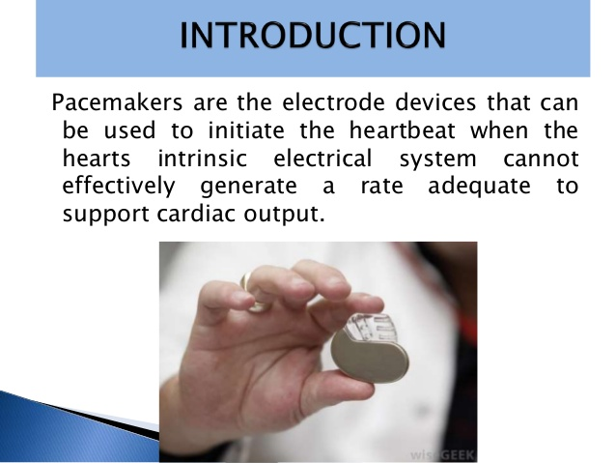

Slide 3
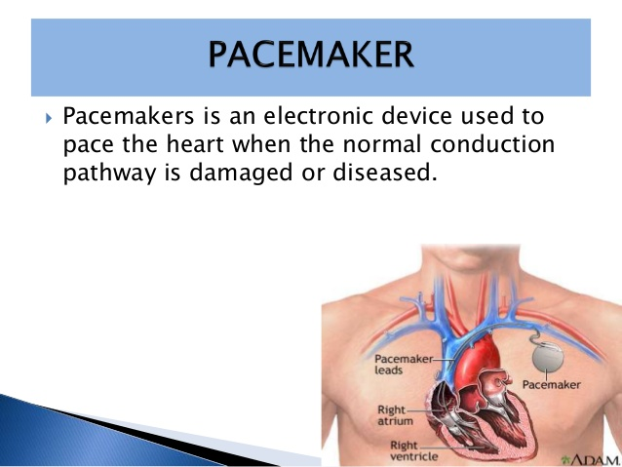

Slide 4
A Pacemaker Must Be Able to Sense and Respond to Cardiac Rhythms
Accurate sensing enables the pacemaker to determine whether or not the heart has created a beat on its own
The pacemaker is usually programmed to respond with a pacing impulse only when the heart fails to produce an intrinsic beat

Slide 5
General indications for pacemaker
Heart rate is slow, causing hemodynamic compromise Sick sinus syndrome
sinus bradycardia or atrial fibrillation with slow heart rate response (generally < 40bpm)
Heart block
3rd degree
2nd degree type 2 (Mobitz)
Malignant Tachyarrhythmia caused by bradycardia

Slide 6
Clinical settings for temporary pacemaker
Syncope
Myocardial infarction
Especially inferior
Shock due to bradycardia
Myocarditis
Lyme disease

Slide 7
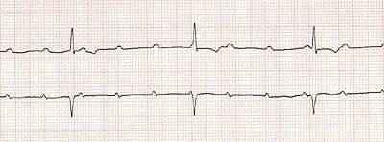
Another 3rd degree heart block

Slide 8
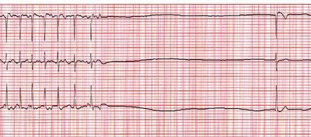
Atrial Fibrillation → Asystole

Slide 9
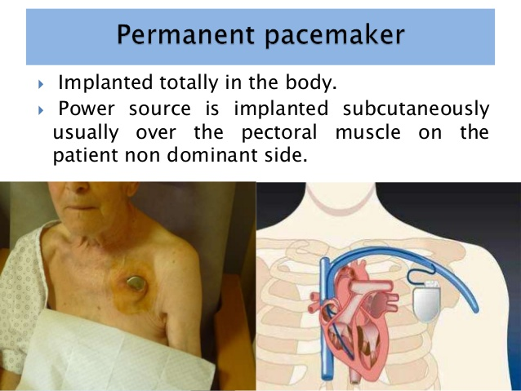

Slide 10
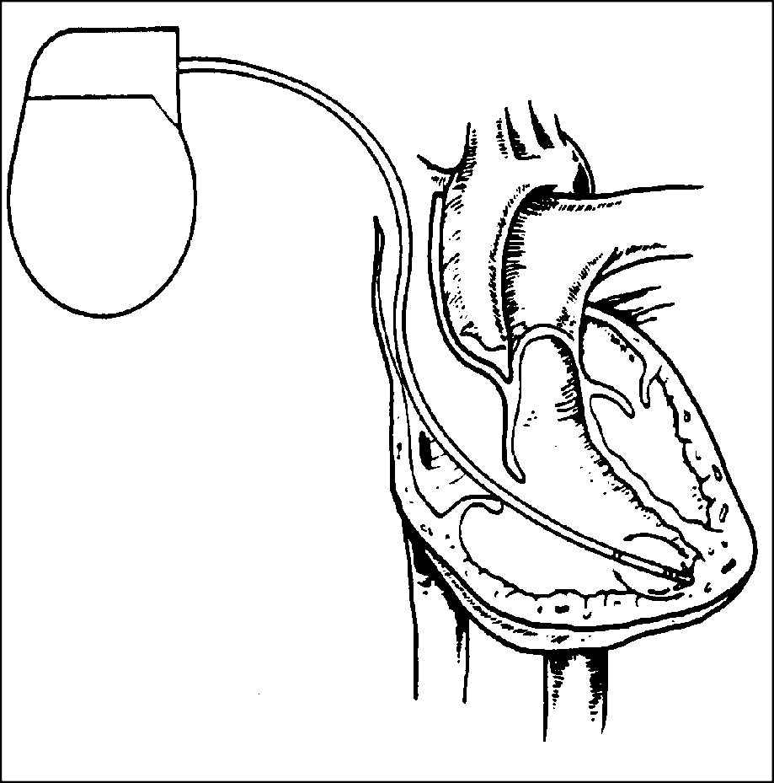
Pacemaker Components Combine with
Body Tissue to Form a Complete Circuit
Pulse generator: power source or battery
Leads or wires
Cathode (negative electrode)
Anode (positive electrode)
Body tissue
Lead
IPG
Anode
Cathode

Slide 11
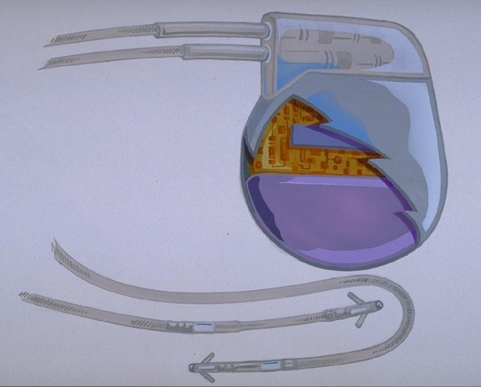
The Pulse Generator:
Contains a battery that provides the energy for sending electrical impulses to the heart
Houses the circuitry that controls pacemaker operations
Circuitry
Battery

Slide 12
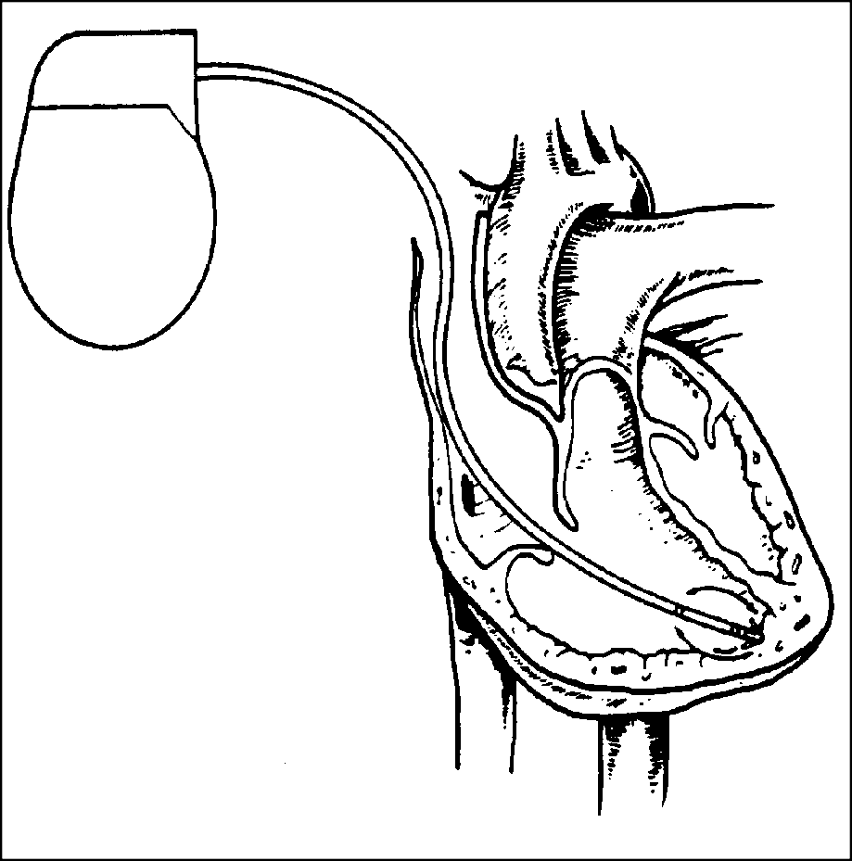
Leads Are Insulated Wires That:
Deliver electrical impulses from the pulse generator to the heart
Sense cardiac depolarization
Lead

Slide 13
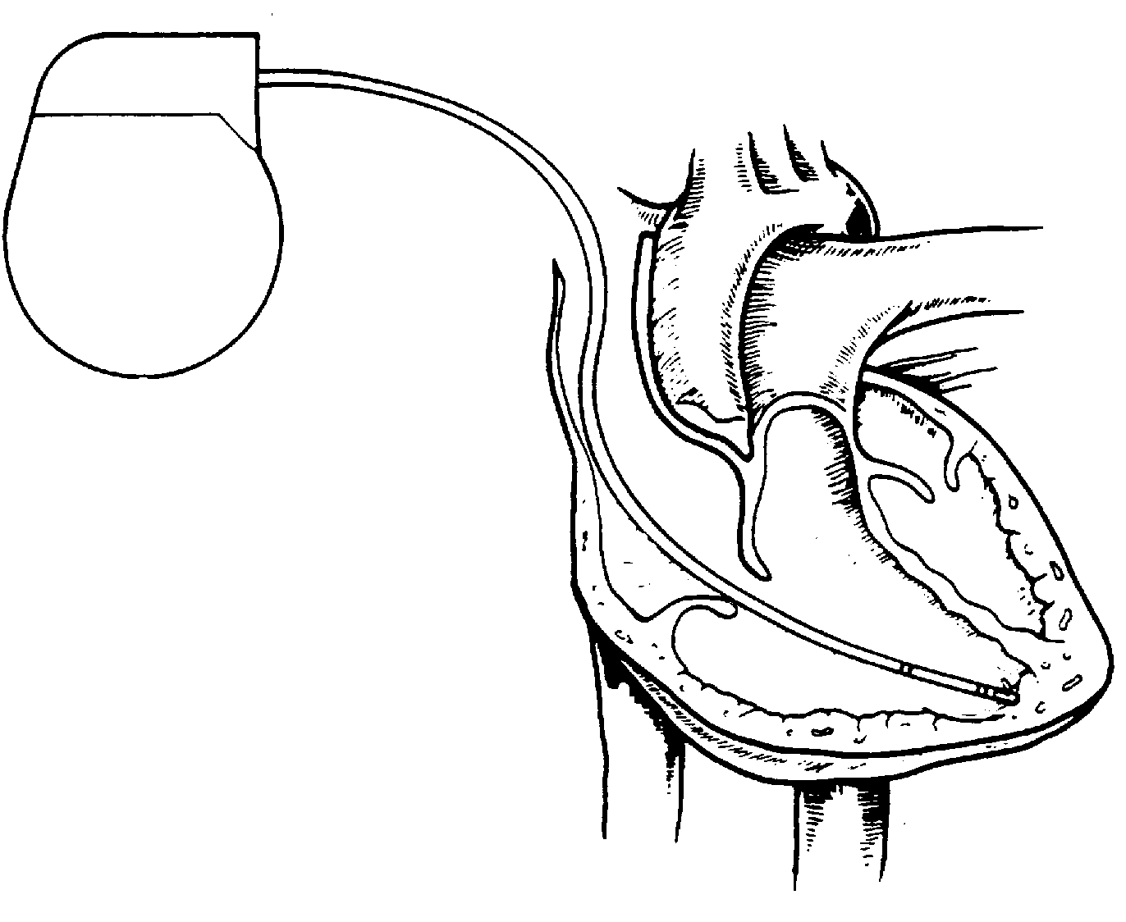
A Unipolar Pacing System Contains a Lead with Only One Electrode Within the Heart; In This System, the Impulse:
Flows through the tip electrode (cathode)
Stimulates the heart
Returns through body fluid and tissue to the IPG (anode)
Anode
-
Cathode

Slide 14
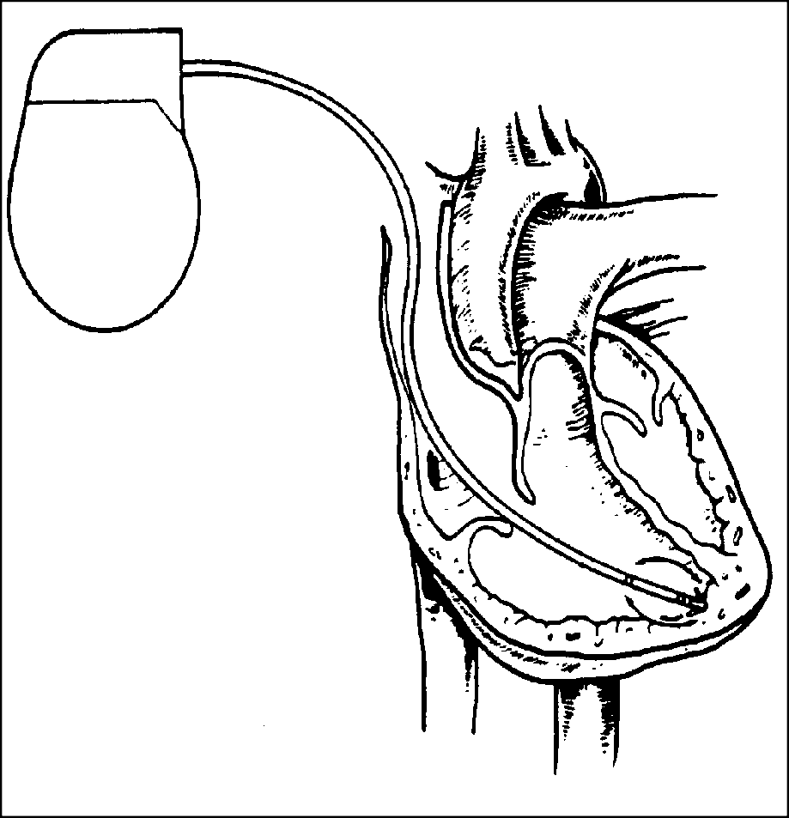
A Bipolar Pacing System Contains a Lead with Two Electrodes Within the Heart. In This System, the Impulse:
Flows through the tip electrode located at the end of the lead wire
Stimulates the heart
Returns to the ring electrode above the lead tip
Anode
Cathode

Slide 15
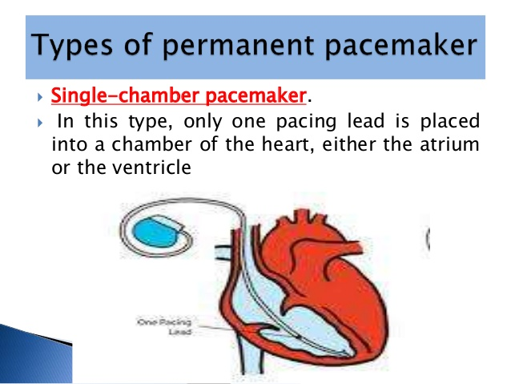

Slide 16
Advantages and Disadvantages of
Single-Chamber Pacing Systems
Advantages
Implantation of a single lead
Disadvantages
Single ventricular lead does not provide AV synchrony
Single atrial lead does not provide ventricular backup if A-to-V conduction is lost

Slide 17
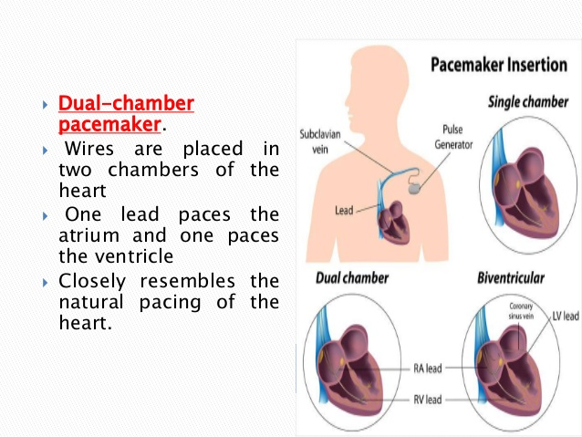

Slide 18
Benefits of Dual Chamber Pacing
Provides AV synchrony
Lower incidence of atrial fibrillation
Lower risk of systemic embolism and stroke Lower incidence of new congestive heart failure Lower mortality and higher survival rates

Slide 19
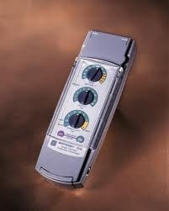
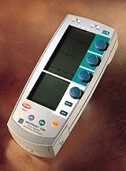
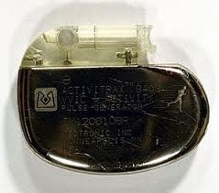
The Can
AKA “Pulse Generator,” “Battery”
Temporary
Single chamber Dual chamber Permanent single chamber

Slide 20
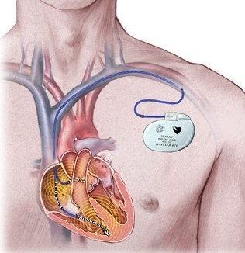
Schematic of pacemaker system

Slide 21
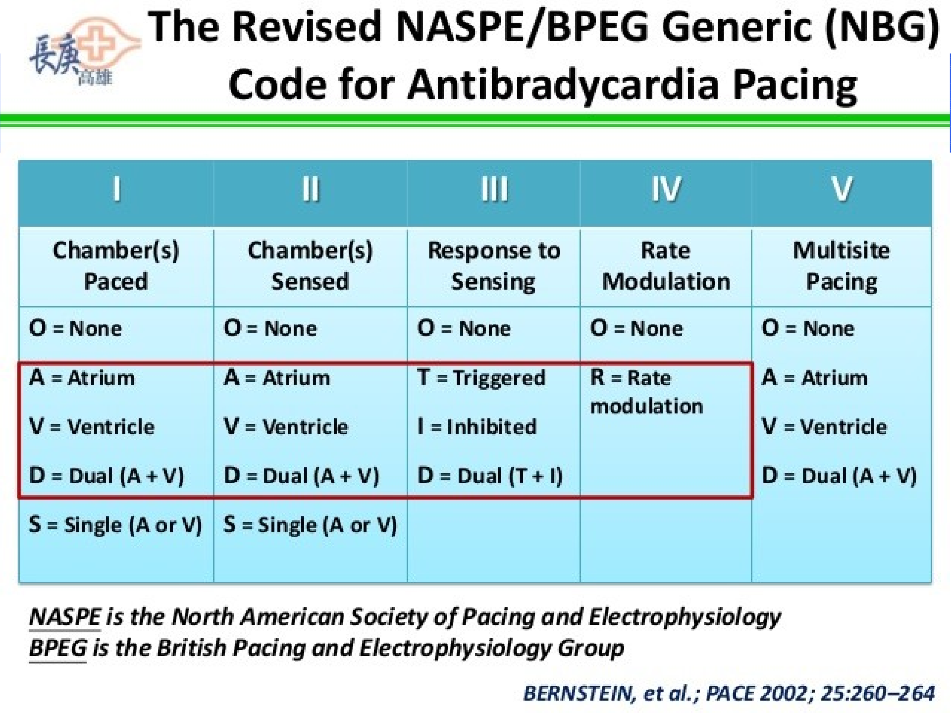


Slide 22

Examples
VVI
V: Ventricle is the paced chamber
V: Ventricle is the sensed chamber
I: Inhibited response to a sensed signal
Thus, a synchronous generator that paces and senses in the ventricle
Inhibited if a sinus or escape beat occurs Called a “demand” pacer
21

Slide 23
Most Pacemakers Perform Four Functions:
Stimulate cardiac depolarization
Sense intrinsic cardiac function
Respond to increased metabolic demand by providing rate responsive pacing
Provide diagnostic information stored by the pacemaker

Slide 24
Capture
Depolarization of atria and/or ventricles in response to a pacing stimulus
10

Slide 25
Sensing
Ability of device to detect intrinsic cardiac activity
Undersensing: failure to sense Oversensing: too sensitive to activity
11

Slide 26
Two Settings Are Used to Ensure Capture:
Amplitude
Pulse width

Slide 27
Amplitude is the Amount of Voltage
Delivered to the Heart By the Pacemaker
Amplitude reflects the strength or height of the impulse:
The amplitude of the impulse must be large enough to cause depolarization ( i.e., to “capture” the heart)

Slide 28
Pulse Width Is the Time (Duration)
of the Pacing Pulse
Pulse width is expressed in milliseconds (ms)
The pulse width is just the length of time each pacing pulse is delivered & must be long enough for depolarization to disperse to the surrounding tissue
5 V
0.5 ms
0.25 ms
1.0 ms

Slide 29
Impedance
The opposition to current flow
In a pacing system, impedance is:
Measured in ohms
Represented by the letter “R” (Ω for numerical values)
The measurement of the sum of all resistance to the flow of current

Slide 30
Impedance Changes Affect Pacemaker Function and Battery Longevity
High impedance reading reduces battery current drain and increases longevity
Low impedance reading increases battery current drain and decreases longevity
Impedance reading values range from 300 to 1,500 Ω
– High impedance leads will show impedance reading values greater than 1,500 ohms

Slide 31
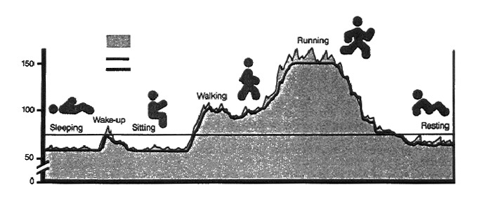
Rate Responsive Pacing
When the need for oxygenated blood increases, the pacemaker ensures that the heart rate increases to provide additional cardiac output
Adjusting Heart Rate to Activity
Normal Heart Rate
Rate Responsive Pacing Fixed-Rate Pacing
Daily Activities

Slide 32
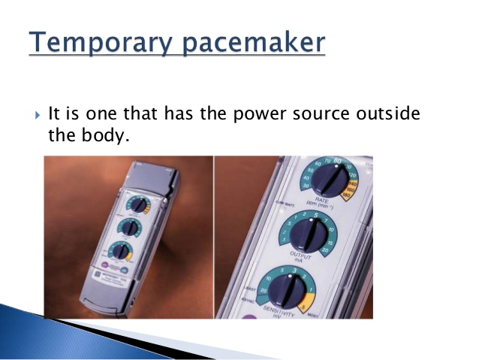

Slide 33
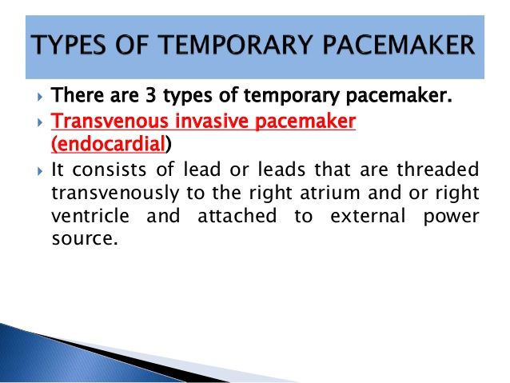

Slide 34
Sites of insertion for a Temporary pacemakers
Right internal jugular
Left subclavian vein
Right subclavian vein
Either femoral vein (Fluoroscopy required)
Left IJ is possible but very difficult

Slide 35
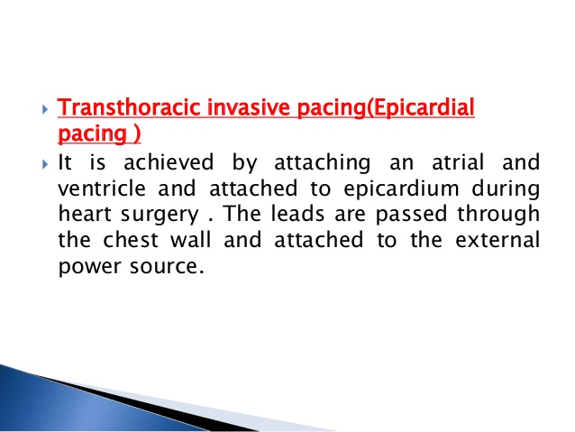

Slide 36
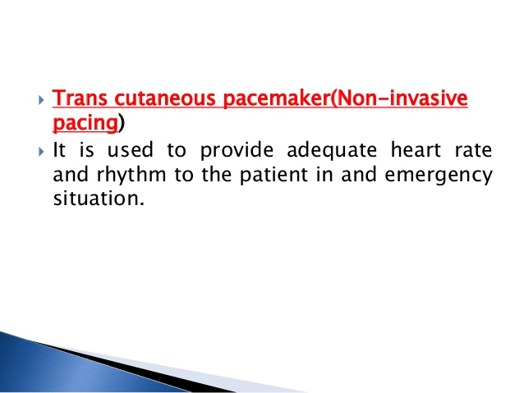

Slide 37
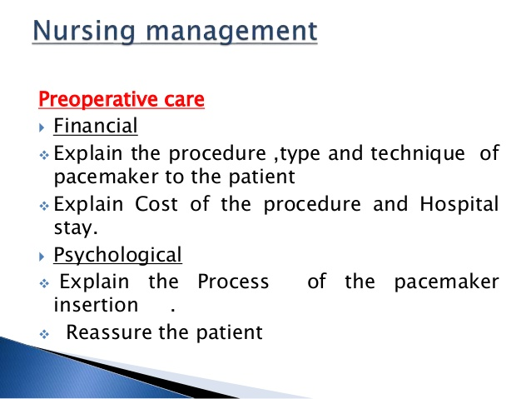

Slide 38
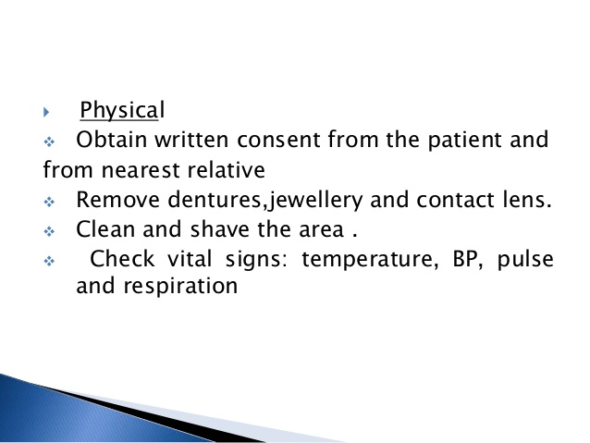

Slide 39
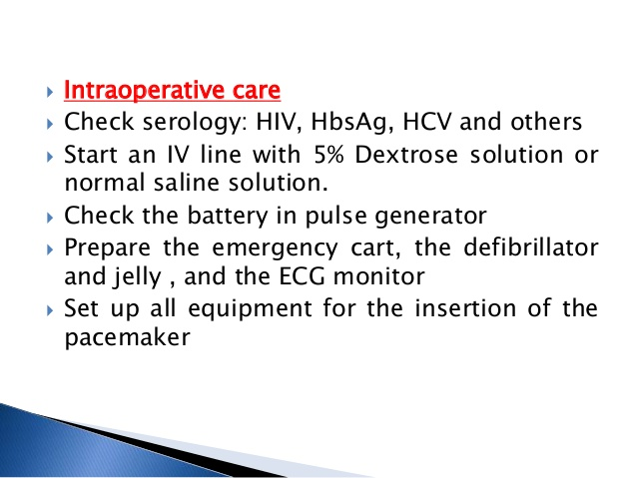

Slide 40
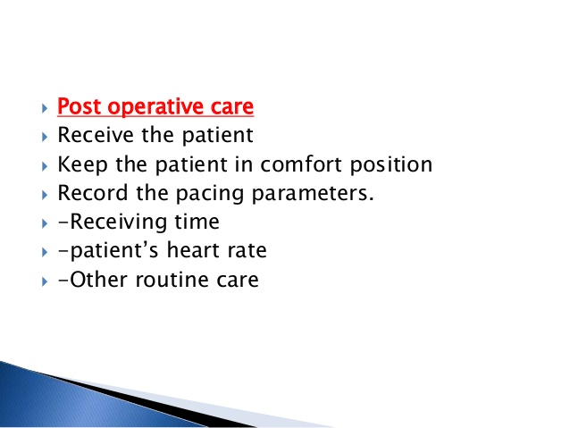

Slide 41
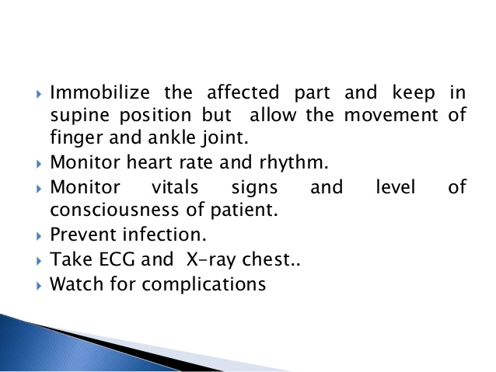

Slide 42
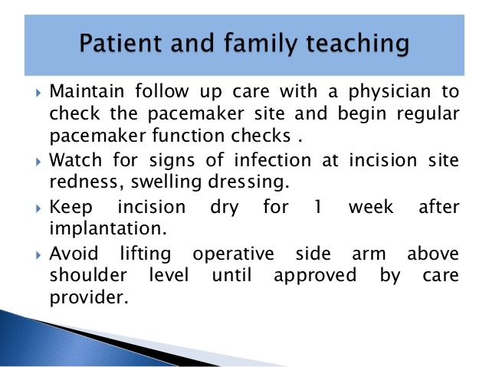

Slide 43
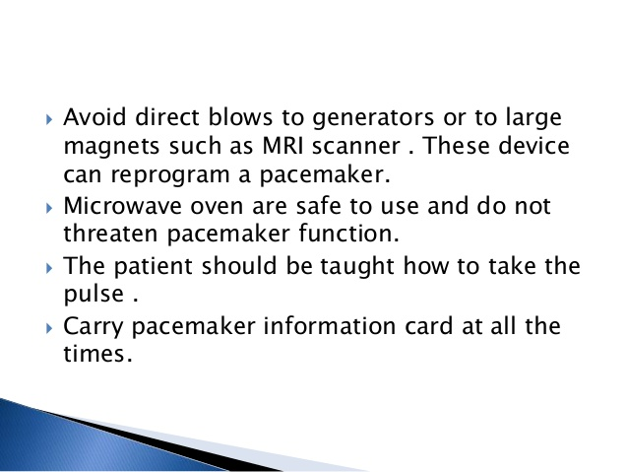

Slide 44
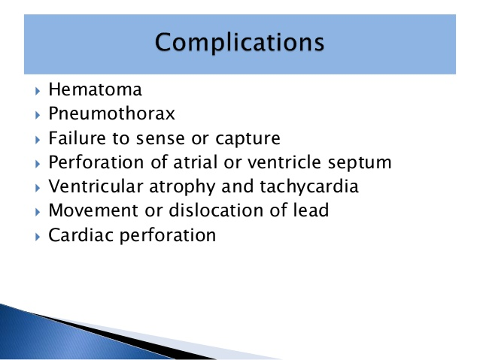

Slide 45
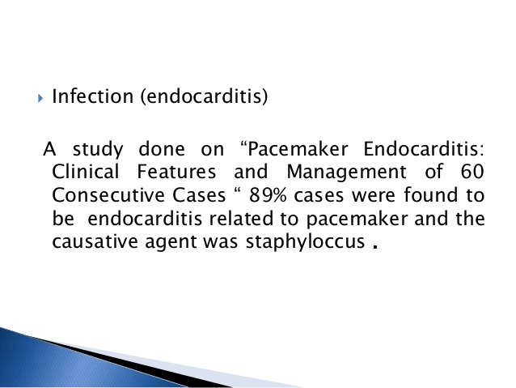

Slide 46
Complication of temporary pacemaker insertion
Blood loss/hematoma
Infection
Arrhythmia (especially during insertion)
PVC’s are common
Heart block
Especially in patients with underlying LBBB
Bundle branch block
Pneumothorax (about 1+% when subclavian access used)
Cardiac perforation → Tamponade

Slide 47
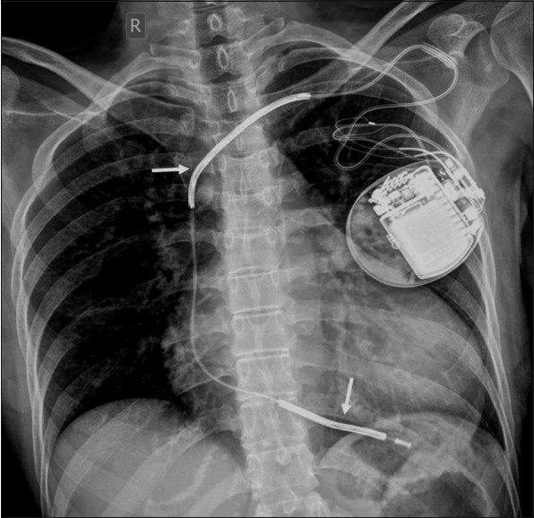
Pneumothorax of Left Lung

Slide 48
The dials on the Temporary pacemaker
Rate
Determines the lower rate limit of the device
Heart rate should not go lower than the set rate
Output
In milliamps, the amount of ‘juice’ the device outputs with each pacer spike

Slide 49
Sensitivity
In millivolts, the amount of energy that has to be
detected in order for the device to ‘sense’ a beat.
• Higher millivolts = less sensitive
More likely for the pacemaker to pace at the lower
rate regardless of what the heart does on its own.
• Lower millivolts = more sensitive
More likely to pick up noise, and ‘sense’ a ventricular
beat even though nothing actually happened

