Slide 1
Dyslipidemia Management- Statins and Beyond
Dr. Cinosh Mathew
MD,DM Cardiology
Interventional Cardiologist
Professor& HOD
Department of Cardiology,
SBKS Medical Institute and Research Centre
Sumandeep Vidyapeeth Deemed to be University

Slide 2


Dyslipidemia prevalence in India
Dyslipidemia prevalence¹
ASCVD²
Associated with pathophysiology of ASCVD
11.8% elevated LDL-C
29.5% hypertriglyceridemia
24% CV deaths (aged 25 to 69 years)
79% atleast one lipid abnormality
<40
years
10% MI (aged <40 years)
72.3% decreased HDL-C
<70
years
>50% CV deaths (aged <70 years)
The prevalence of Dyslipidemia in Indians is very High!!!!!!!!
References: 1. Puri R. et al. The Journal of The Association of Physicians of India. 2020;68(11):8-9. 2. Misra S. et al. Indian Heart J. 2022;74(5):341-350.
ASCVD: atherosclerotic cardiovascular disease; CABG: coronary artery bypass graft; HDL-C: high-density lipoprotein cholesterol; hs-CRP: high sensitivity C-reactive protein; LDL-C: low-density lipoprotein cholesterol; MI: myocardial infarction; RBG: random blood glucose; TG: triglycerides; T2DM: type 2 diabetes mellitus

Slide 3
Cardiovascular risk calculation
Major ASCVD risk factors
Other high-risk features
Moderate risk non-conventional risk factors
Age ≥45 years in males and ≥55 years in females
Family history of premature ASCVD
Current cigarette smoking or tobacco use
High blood pressure
Low HDL-C
Diabetes with 0-1 other major ASCVD risk factors and no evidence of target organ damage
CKD stage 3B or 4
Familial hypercholesterolemia (other than familial
homozygous hypercholesterolemia)
Extreme of a single risk factor
Coronary calcium score >300 HU
Non-stenotic carotid plaque
Lipoprotein (a) ≥50 mg/dL
Coronary calcium score 100-299 HU
Increased carotid IMT
Lp(a) 20-49 mg/dL
FBG 100 to 125 mg/dL*
Increased waist circumference**
Apo B ≥110 mg/dL
hsCRP ≥2 mg/L***
Risk factors/markers
Low risk
Moderate risk
High risk
Very high risk
Extreme risk
0-1 major ASCVD risk factor And Life-time CVD risk <30 %
2 major ASCVD risk factors
Low risk group with ≥1 moderate risk non- conventional risk factor
Life-time CVD risk ≥30%
≥3majorASCVD risk factors
2 major ASCVD risk factors with ≥I moderate risk non- conventional risk factor
≥1 other high-risk features
Pre existing ASCVD
Diabetics with ≥2 other major ASCVD risk factors or evidence of target organ damage
Familial homozygous hypercholesterolemia
Category A
Category B
Risk group
CAD with ≥1 feature of high risk group
CAD with ≥1 feature of very high risk group or recurrent ACS (within one year) despite LDL-C ≤50 mg/dL or polyvascular disease
Clinical judgment to be used if the patient has atherosclerotic PAD instead of CAD; *Confirmed by repeat testing; **If increased waist circumference is the only risk factor, it should again be measured after 6 months after initiating heart healthy lifestyle measures; ***On two occasions at least 2 weeks apart. For reclassifying moderate risk group only.
References: 1. Puri R. et al. The Journal of The Association of Physicians of India. 2020;68(11):21-34.
Apo B: apolipoprotein B;ASCVD: atherosclerotic cardiovascular disease; ACS: acute coronary syndrome; CAD: coronary artery disease; CKD: chronic kidney disease; FBG: fasting blood glucose; HDL-C: high-density lipoprotein cholesterol; hs-CRP: high sensitivity C-reactive protein; IMT: intima-media thickness; LDL-C: low-density lipoprotein cholesterol; Lp(a): lipoprotein(a); PAD: peripheral artery disease; RBG: random blood glucose; TG: triglycerides

Slide 4

LAI recommendations
CV risk may be underestimated by use of LDL-C alone​
An ideal detailed lipid panel for screening, diagnosis should include total cholesterol, HDL-C, triglycerides, apo B, and Lp(a)¹ ​
LAI proposes apo B levels to estimate true risk because it is present on all atherogenic lipoprotein particles^{1​}
LAI strongly recommends measuring Lp(a) levels because of high prevalence of raised Lp(a) in Indian population^{2​}
JBS and FRS risk scores can be used but there is lack of consensus and validation of these estimators in Indian context
References: 1. Puri R. et al. The Journal of The Association of Physicians of India. 2020;68(11):50-53. 2. Ibid. 42-46.
Apo B: apolipoprotein B; ASCVD: atherosclerotic cardiovascular disease; CV: cardiovascular; FRS: Framingham Risk Score; HDL-C: high-density lipoprotein cholesterol; JBS: Joint British Societies; LAI: Lipid Association of India LDL-C: low-density lipoprotein cholesterol; Lp(a): lipoprotein(a); T2DM: type 2 diabetes mellitus

Slide 5
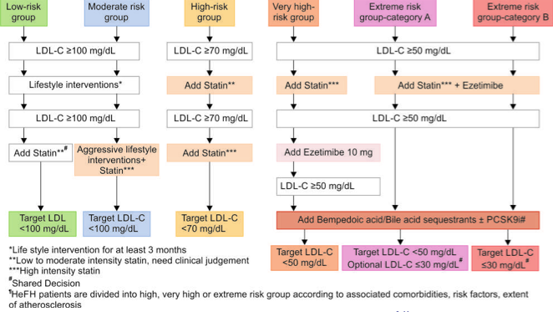
LAI 2022 LDL-C targets and management algorithm
Statin are the first line of treatment for all risk groups
References: 1. Mehta V. et al. The Journal of The Association of Physicians of India. 2022;70(9):67-75.
HeFH: familial hypercholesterolemia;
LAI: Lipid Association of India LDL-C: low-density lipoprotein cholesterol

Slide 6



How should we treat ?
Choice of statin²
Treatment options¹
Prava- statin
20 mg
Simva-statin
20 mg
Atorvstatin
Rosuvastatin
Lifestyle interventions
Fluva- statin
40 mg
10 mg
10 mg
Pitava- statin
2 mg
-25%
  Heart-healthy diet
  Regular physical activity
  Avoid smoking and alcohol
-35%
-40%
Control T2DM and HTN
Maximally tolerated statin therapy
Ezetimibe
PCSK9i
Bempedoic acid
-45%
Each dosage doubling beings an additional LDL-C reduction
-6%
References: 1. Mehta V. et al. The Journal of The Association of Physicians of India. 2022;70(9):67-75. 2. Descamps OS. et al. In Hypercholesterolemia. IntechOpen. 2015.
HTN: hypertension; LDL-C: low-density lipoprotein cholesterol; T2DM: type 2 diabetes mellitus

Slide 7
Guideline recommendations for follow up
LAI recommends the use of one lipid assessment to initiate treatment with statin due to the cost involved and the low probability of patients returning with secondary measurements
Lipid assessment, clinical history, and CV risk evaluation should guide the treatment plan
Guideline recommendation | Monitoring after initiating statin therapy | Further monitoring
ACC/AHA | 4 to 12 weeks | Every 3 to 12 months
ESC/EAS | 1 to 12 weeks 3 to 4 weeks after changing medication | Once a year
NICE | 3 months | Once a year
Panel Question:
LAI does not recommend a timeline for monitoring. What is feasible in the Indian scenario?
References: 1. Misra S. et al. Indian Heart J. 2022;74(5):341-350.
ACC: American College of Cardiology; AHA: American Heart Association; CV: cardiovascular; EAS: European Atherosclerosis Society; ESC: European Society of Cardiology; LAI: Lipid Association of India; NICE: National Institute for Health and Care Excellence

Slide 8
Why is it important to reach LDL-C target?
The adjusted hazard ratios based on achieved LDL-C levels in a meta-analysis of eight major trials
LDL-C (mg/dl) | <50 mg/dl (n=4375) | 50-75 mg/dl (n=10,375) | 75-100 mg/dl (n=10,091) | 100-125 mg/dl (n=8953) | 125-150 mg/dl (n=3128) | 150-175 mg/dl (n=836) | >175 mg/dl (n=375)
Major CV events | 0.44 (0.35-0.55) | 0.51 (0.42-0.62) | 0.56 (0.46-0.67) | 0.58 (0.48-0.69) | 0.64 (0.53-0.79) | 0.71 (0.56-0.89) | 1.00 (ref)
There is a linear correlation between LDL-C lowering and risk of ASCVD
References: 1. Puri R. et al. The Journal of The Association of Physicians of India. 2020;68(11):21-34.
ASCVD: atherosclerotic cardiovascular disease; CV: cardiovascular; LDL-C: low-density lipoprotein cholesterol

Slide 9
What to do if the target is not reached?
Ensure compliance
1
Adapt the statin
2
Reference: 1. Descamps OS. et al. In Hypercholesterolemia. IntechOpen. 2015.
LDL-C: low-density lipoprotein cholesterol

Slide 10
Clinical impact of atorvastatin
Reduced incidence of
  Acute CHD events
  Coronary revascularizations
  Stroke
T2DM
High-dose atorvastatin can halt and, in some cases, reverse atherosclerotic progression
Throughout its dose range, atorvastatin is safe and well tolerated
HTN + ≥3 risk factors
Reduced incidence of
  Non fatal MI
  Fatal CHD
Prior cerebrovascular events
  Reduced risk of recurrent stroke
Mild CKD
  Reduced disease progression
Atorvastatin reduces major CV events in both secondary and primary prevention of CHD and in a broad range of patients and disease conditions
References: 1. Bybee KA. et al. Curr Med Res Opin. 2008;24(4):1217-1229.
CHD: coronary heart disease; CKD: chronic kidney disease; CV: cardiovascular; HTN: hypertension; T2DM: type 2 diabetes mellitus

Slide 11
Atorvastatin versus other statins
For better precision of Atorvastatin³
Dosage | LDL-C reduction
10 mg | 38%
20 mg | 45%
40 mg | 49%
80 mg | 52%
Statins may be generally safe on muscles but there are concerns around adverse muscle events
Meta-analysis of RCTs shows that moderate atorvastatin may be superior to equivalent simvastatin and pravastatin in muscle tolerability¹
Atorvastatin has a BP lowering effect independent of LDL-C levels²
References: 1. Hou Q. et al. Cardiovasc Drugs Ther. 2022. 2. Costa GS. et al. Eur Heart J Cardiovasc Pharmacother. 2022;9(1):100-115. 3. 1. Descamps OS. et al. In Hypercholesterolemia. IntechOpen. 2015.
BP: blood pressure ; LDL-C: low-density lipoprotein cholesterol; RCT: randomized controlled trials

Slide 12

Treatment intensification beyond LDL-C target
1
Under statin therapy, does the patient still have a residual CV risk?
2
Is it necessary to target HDL-C and TG?
3
Would further intervention be beneficial?
Reference: 1. Descamps OS. et al. In Hypercholesterolemia. IntechOpen. 2015.
CV: cardiovascular; HDL-C: high-density lipoprotein cholesterol; LDL-C: low-density lipoprotein cholesterol; TG: triglycerides

Slide 13
LDL-C and Non-HDL goals
Newer treatment goals and statin initiation thresholds based on the risk categories proposed by LAI in 2020
Risk Group | Treatment Goals |  | Consider Drug Therapy
 | LDL-C (mg/dl) | Non-HDL (mg/dl) | LDL-C (mg/dl) | Non-HDL (mg/dl)
Extreme Risk Group Category A | <50 (Optional goal ≤30) | <80 (Optional goal ≤60) | ≥50 | ≥80
Extreme Risk Group Category B | ≤30 | ≤60 | >30 | >60
Very High Risk | <50 | <80 | ≥50 | ≥80
High Risk | <70 | <100 | ≥70 | ≥100
Moderate Risk | <100 | <130 | ≥100 | ≥130
Low Risk | <100 | <130 | ≥130* | ≥160*
*After an adequate non-pharmacological intervention for at least 3 months
LAI recommends non-HDL-C as a co-primary target, as important as LDL-C, for lipid lowering therapy
References: 1. Puri R. et al. The Journal of The Association of Physicians of India. 2020;68(11):21-34.
HDL: high-density lipoprotein; LAI: Lipid Association of India; LDL-C: low-density lipoprotein cholesterol

Slide 14
Further lowering LDL-C levels
Relationship between achieved LDL-C levels, CV events and relative risk reduction in FOURIER Study
Patients | 2669 (10%) | 8003 (31%) | 3444 (13%) | 7471 (29%) | 4395 (17%)
Achieved LDL-C levels at 4 weeks | <20 mg/dL | 20 to 49 mg/dL | 50 to 69 mg/dL | 70 to 99 mg/dL | ≥100 mg/dL
Kaplan Meier event rates | 10.3% | 12.4% | 13.6% | 13.7% | 15.5%
Relative risk reduction | 24% | 15% | 6% | 3% | -
There is evidence to support the benefit of attaining LDL-C levels <50 mg/dL
References: 1. Puri R. et al. The Journal of The Association of Physicians of India. 2020;68(11):21-34.
ASCVD: atherosclerotic cardiovascular disease; CV: cardiovascular; LDL-C: low-density lipoprotein cholesterol

Slide 15
Further lowering LDL-C levels
1
LDL-C levels in neonates = 30 to 70 mg/dL
2
Hunter-gatherer populations have 50 to 75 mg/dL LDL-C and no evidence of atherosclerosis
25 mg/dL LDL-C plasma levels enough to provide nourishment to the body cells.
3
References: 1. Puri R. et al. The Journal of The Association of Physicians of India. 2020;68(11):21-34.
LDL-C: low-density lipoprotein cholesterol

Slide 16

Bempedoic acid can be a promising addition to the therapy
It is a useful adjunct therapy for LDL-C lowering because of:
Lower incidence of new-onset or worsening diabetes
Low frequency of muscle-related side effects
Minimal drug interactions
Significant reduction in high-sensitivity C-reactive protein (hsCRP)
References: 1. Mehta V. et al. The Journal of The Association of Physicians of India. 2022;70(9):67-75.
LDL-C: low-density lipoprotein cholesterol; hsCRP: high sensitivity C-reactive protein

Slide 17
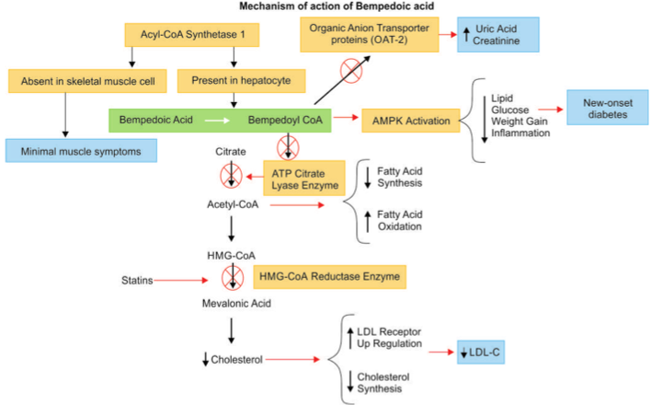
Bempedoic acid: Mechanism of action
Statins and Bempedoic acid act on the same pathway to reduce serum LDL-C levels
References: 1. Mehta V. et al. The Journal of The Association of Physicians of India. 2022;70(9):67-75.
CoA: coenzyme A; LDL-C: low-density lipoprotein cholesterol

Slide 18
CLEAR clinical trials: Investigation on the lipid-lowering effects of bempedoic acid
Patients with hypercholesterolemia and statin intolerance were investigated in CLEAR Serenity and CLEAR Tranquility
Patients with ASCVD or high risk of ASCVD and HeFH were investigated in CLEAR Harmony and CLEAR Wisdom
Study design:
 | CLEAR Serenity | CLEAR Tranquillity | CLEAR Harmony | CLEAR Wisdom
Treatment (compared with placebo) | Bempedoic acid (180 mg /day) (12 weeks) | Bempedoic acid (180 mg) Ezetimibe (10 mg/day) (12 weeks) | Bempedoic acid with ASCVD, HeFH, or both (12 weeks) | Bempedoic acid (180 mg/day) (52 weeks)
Patient’s history | Statin intolerance Receiving low statin doses | Statin intolerance LDL-C ≥100 mg/dL On stable lipid-modifying medications | Receiving maximally tolerated statin LDL-C values ≥70 mg/dL | Receiving maximally tolerated statin
References: 1. Mehta V. et al. The Journal of The Association of Physicians of India. 2022;70(9):67-75.
LDL-C: low-density lipoprotein cholesterol; ASCVD: Atherosclerotic cardiovascular disease; HeFH: Heterozygous familial hypercholesterolemia
27
Notes:
Patients with hypercholesterolemia and statin intolerance were investigated in two clinical trials [CLEAR (Cholesterol Lowering through Bempedoic acid, an ACL-Inhibiting Regimen) Tranquility and CLEAR Serenity]. The effects of bempedoic acid were further investigated in patients with ASCVD or high risk of ASCVD and HeFH in two larger trials, CLEAR Harmony and CLEAR Wisdom.

Slide 19
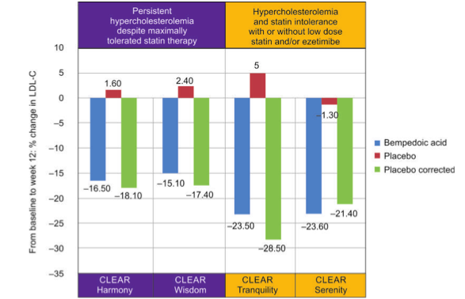
CLEAR clinical trials: Investigation on the lipid-lowering effects of bempedoic acid
Study outcomes:
End points | CLEAR Serenity | CLEAR Tranquillity | CLEAR Harmony | CLEAR Wisdom
Non-HDL-C | -17.9% | –23.6% | –13.3% | –10.8
Total cholesterol | –14.8% | –18.0% | –11.1% | –9.9
Apo B | –15.0% | –19.3% | –11.9% | –9.3
hsCRP | –24.3% | –31.0% | –21.5% | –18.7
HDL-C | - 4.5% | (–7.3 ± 1.2%) | - 5.8% | -6.1%
Bempedoic acid has a reasonable LDL-C lowering efficacy and safety profile!
References: 1. Mehta V. et al. The Journal of The Association of Physicians of India. 2022;70(9):67-75.
28

Slide 20
LAI new recommendations offer a practical ASCVD risk stratification approach
Lower the LDL-C, lower the risk. Aggressive LDL-C lowering approach
Shared decision making for optimal management and adherence
As a high-intensity statin, atorvastatin can be the prescribed for aggressive LDL-C lowering
Bempedoic acid is a non-statin drug suitable for patients hyporesponsive to statins
Key takeaways

